Slide 1
Meeting Students Where They Are
evolving the use of Matlab for students from non-quantitative backgrounds
Michael Wright
Associate Professor
Department of Biological Sciences
California State University, Sacramento

Slide 2
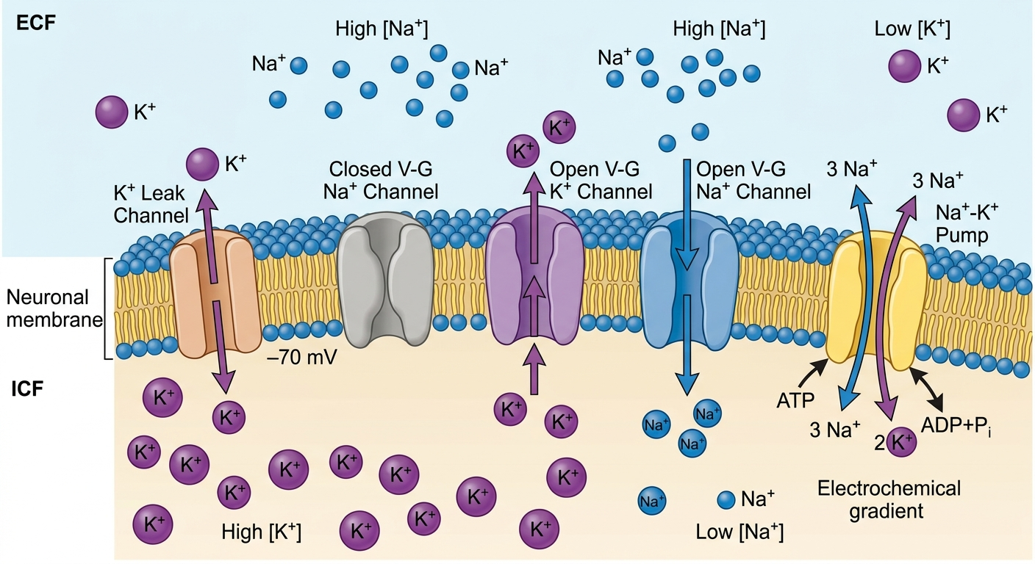
Cellular Neuroscience is inherently interdisciplinary: Biology

Slide 3
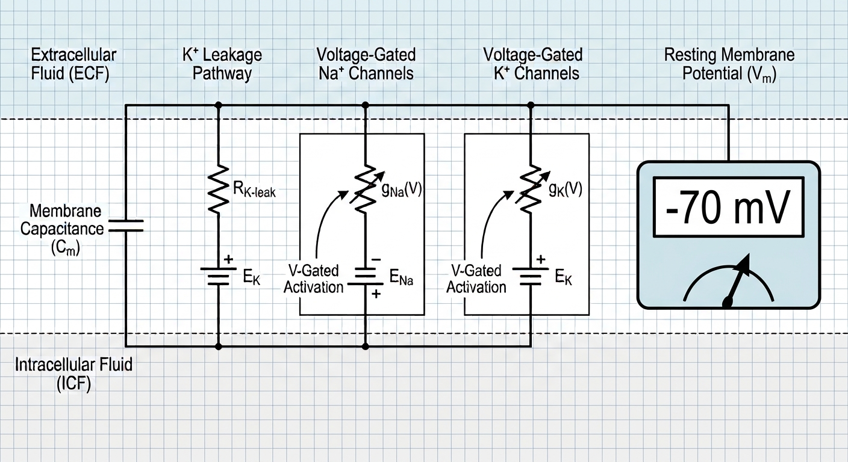
Cellular Neuroscience is inherently interdisciplinary: Physics & Chemistry

Slide 4
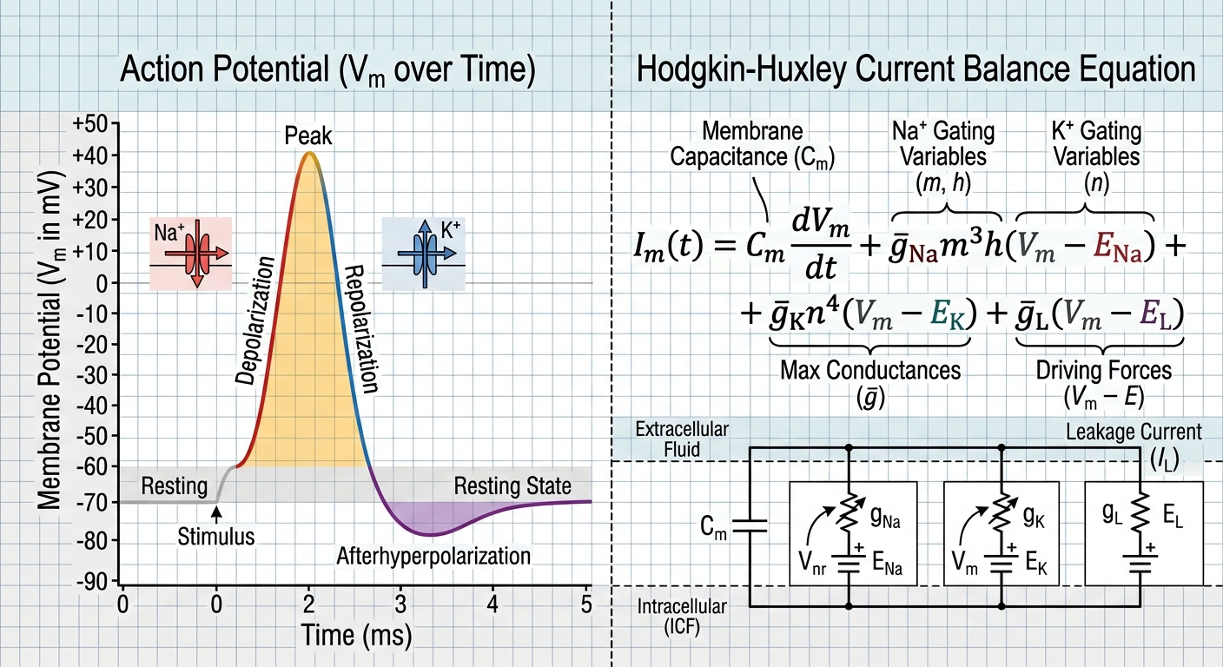
Cellular Neuroscience is inherently interdisciplinary: Mathematics

Slide 5
Non-Physics/Chem/Math Students have differing levels of exposure to these fields
Biology Students
  PHYS/CHEM/CALC required but not mandated when to take it
Psychology Students
  STAT preferred to CALC; CHEM/PHYS not always required
Exercise Science
  PHYS/CHEM/MATH(?) required but not mandated when to take it and may only need a semester
GOAL: generate the same foundational attributes for all students!

Slide 6
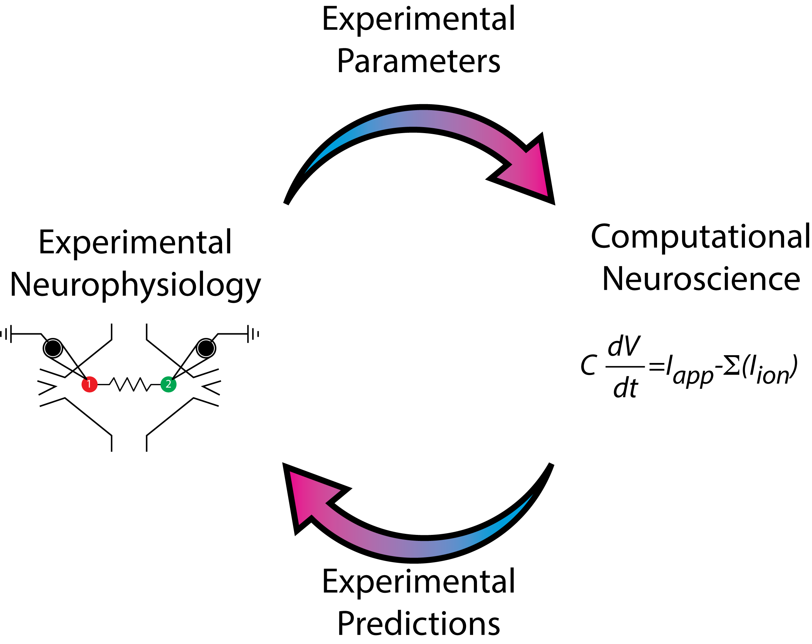
Approach in lecture
Derive the model from first principles (Ohm’s Law, Kirchoff’s Laws, etc.)
Derive the equations and their interpretations
Build the biological intuition
Simulations connect the disciplines
Biology
Modeling

Slide 7
Evolving my Matlab approach
V 1.0 Installation
V 2.0 (Current) Matlab Online
V 3.0 (Future) Live Scripts AND Matlab Online

Slide 8
Thank you!

