Slide 1


Welcome to the 2026 Workshop
Teaching Computation with MATLAB
Notes:
Hello everyone and welcome to the 2023 Teaching Computation with MATLAB workshop. I’m glad you’ve all made it here and hope your travels went well. I’m Maureen Kahn, I am your workshop organizer from the Science Education Resource Center (or SERC) here at Carleton College, after many emails and some virtual meetings I’m thrilled to see everyone finally in person and kick off this year’s workshop.
This workshop is a collaboration between MathWorks, SERC at Carleton College, a convener team of educators, and really all the efforts of our participants. Thank you all for making the journey – from all over, near and far – to be a part of this community and make the event happen. So much of what folks get out of the workshop year after year is from collaborating with colleagues – and what they gain from and sharing teaching challenges and successes.
This is the first year since 2019 that we have been able to run this annual workshop in person, and it’s the first in-person version I’ve gotten the chance to be a part of , and I’m very much looking forward to the next two days of working with you all.

Slide 2
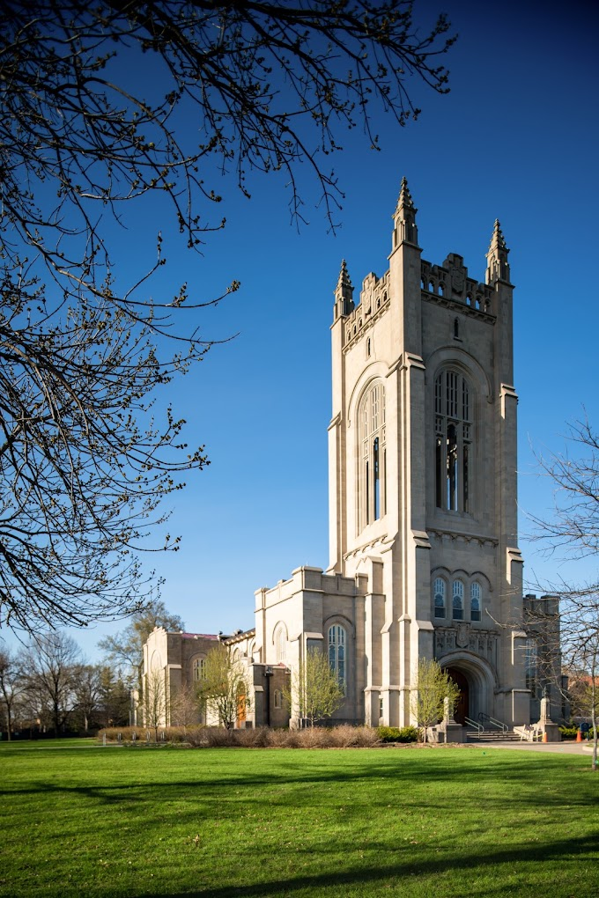
Carleton College
Notes:
1866 – loosely affiliated with the conference of congregational churches (Luthren school across town)
2100 students – all undergraduates
300 acre arboretum

Slide 3
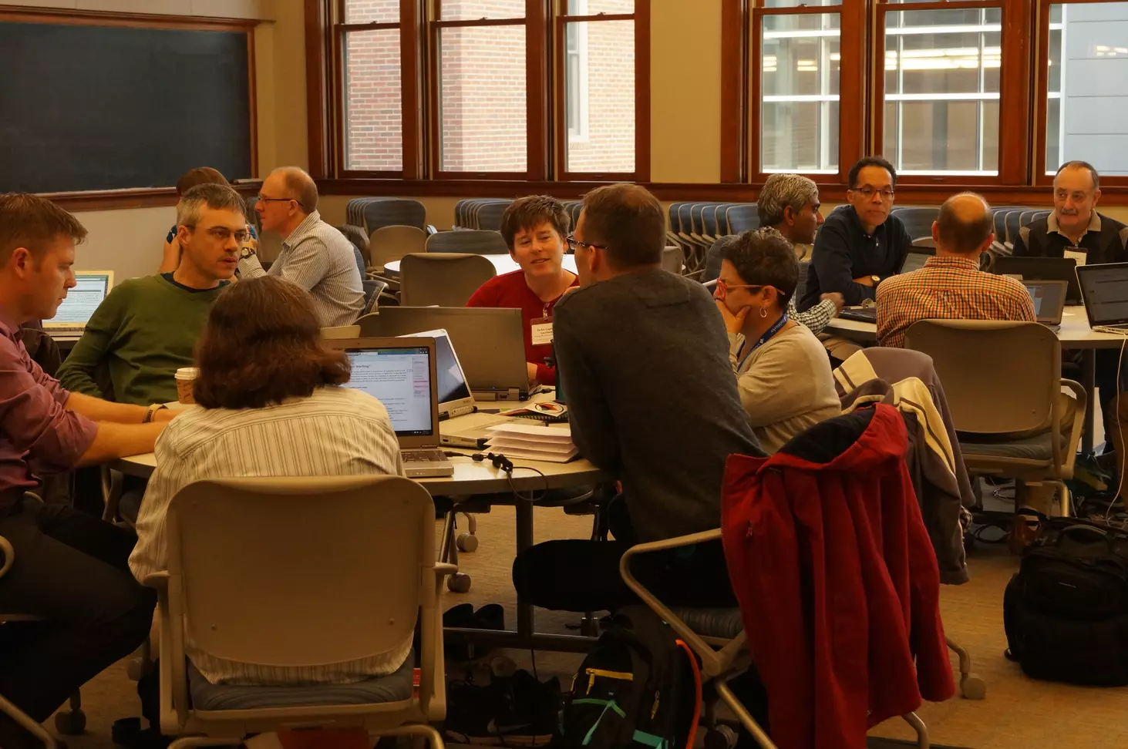
Conveners
Lisa Kempler, Workshop sponsor, MathWorks
Don Baker, McGill University
Benjamin Bratton, Vanderbilt University
Dan Burleson, Review Editor, UT- Dallas
Michele McColgan, Siena College
Kelly Roos, Bradley University
Nirav Acharya, MathWorks
Evan Cosgrove, MathWorks
John McDaris, SERC, Carleton College
Cailin Huyck Orr, SERC, Carleton College
Notes:
I’d like to briefly introduce the convener team, who have been involved in developing the program for the workshop, and whom we’ll hear more from during the panel later this evening.

Slide 4
Conveners
Lisa Kempler, Workshop sponsor, MathWorks
Don Baker, McGill University
Benjamin Bratton, Vanderbilt University
Dan Burleson, Review Editor, UT- Dallas
Michele McColgan, Siena College
Kelly Roos, Bradley University
Nirav Acharya, MathWorks
Evan Cosgrove, MathWorks
John McDaris, SERC, Carleton College
Cailin Huyck Orr, SERC, Carleton College
SERC:
Brianna Douglas
Rebeccah Bradley
Notes:
I’d like to briefly introduce the convener team, who have been involved in developing the program for the workshop, and whom we’ll hear more from during the panel later this evening.

Slide 5
12th annual workshop
First workshop was October 2015.
Annual workshops since with 2020, 2021, 2022 online
  (also workshops for Latin America, Asia Pacific, California institutions and Germany and others run by MathWorks)
Overall >450 individuals, about ¼ have attended more than once
410 teaching activities (including 34 in Spanish language)

Slide 6
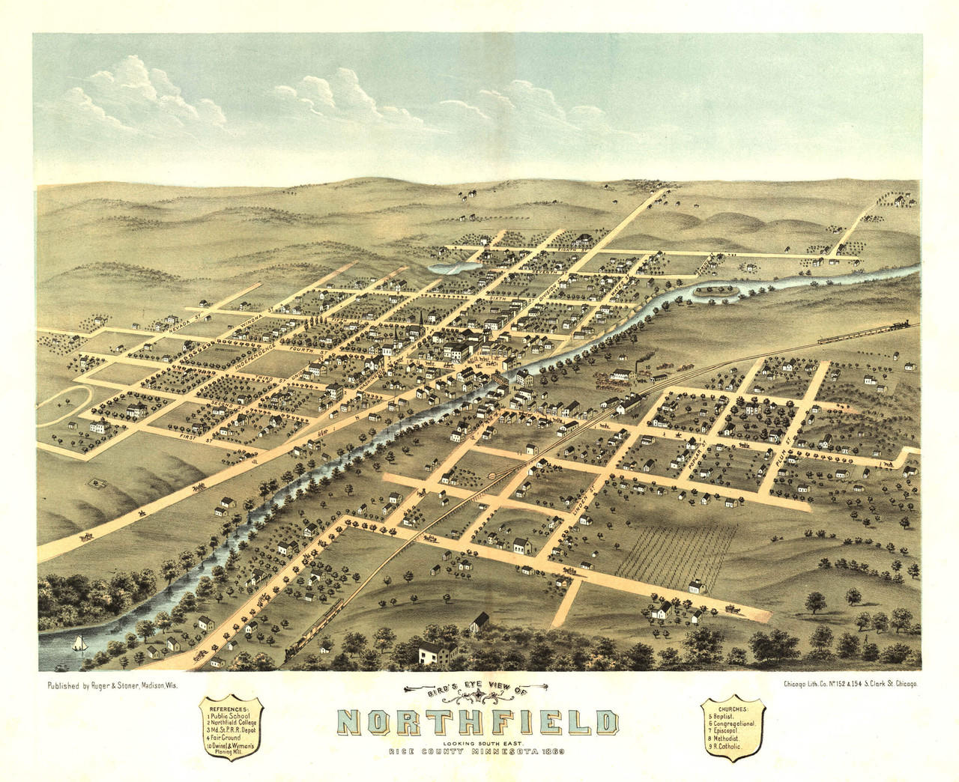
Getting around campus and town
Coffee in town: Goodbye Blue Mondays, Little Joy on Division St.
Networking location Fairfield hotel bar until 11pm
Weitz Center for Creativity
  Café 7:30-4:00
Restrooms and elevators
  All Gender restroom on bottom floor

Slide 7

Code of Conduct
https://serc.carleton.edu/218231
All participants in SERC events are expected to abide by this SERC Code of Conduct.
Treat other participants with respect and consideration.
Be considerate, collegial, and collaborative.
Communicate openly, with civil attitudes, critiquing ideas rather than individuals.
Frame discussions as openly and inclusively as possible and be aware of how language or images may be perceived by others.
Avoid personal attacks and harassment directed toward other participants in attendance.
Alert meeting security personnel, SERC staff, or SERC leadership if they notice someone in distress, or perceive a potentially dangerous situation, or witness a dangerous situation.
The following behavior will not be tolerated:
Harassment, intimidation, or discrimination in any form.
Physical, written, electronic, or verbal abuse of any participant.

Slide 8
Quick overview of the program https://serc.carleton.edu/312861
Sunday: Introductions, Dinner, Convener panel
Monday:
  Presentations by educators
  Learning about MATLAB tools for teaching
  Work time in groups
  Lunch on campus and dinner together at a local restaurant
Tuesday:
  Planning work time
  Individual/group work time
  Presenting your teaching activity progress to your group for feedback
  Workshop synthesis and next steps
  Lunch

Slide 10
Two part instructions:
Group sorts by the criteria provided
Talk to your neighbors using the prompt

Slide 11
Starting Friday, how far did you travel to get to this workshop?
Front of room
Discuss in pairs or trios:
Where you work?
What classes you teach?
Smallest/
nearest
Largest/
Farthest

Slide 12
What year did you start learning MATLAB?
Front of room
What was the
first application you used it for?
1984
2026

Slide 13
What year did you start Teaching MATLAB?
Front of room
What was the
first Course you used it in?
1984
2026

Slide 14
For a course you teach in 2026 – how many students do you have:
Front of room
Up to 15
15-30
What is a classroom management strategy for teaching computation?
60-300 in person
Virtual only or something else
30-60

Slide 15
How much do you use Simulink in courses?
Front of room
A LOT
Some
Collectively: What is a question you have about Simulink?
Adding it this week
Remind me what that is…

Slide 16
How much do you use GenAI in courses?
Front of room
Not used
Students use it, but I don’t tell them how
What works or doesn’t work about this arrangement?
I generally guide students’ use
I provide a clear recipe in my class

