Slide 1

COLLEGE OF ARTS & SCIENCES WORLDWIDE
Designing Virtual Physics Labs using MATLAB
Christina Reynolds, PhD
Assistant Professor of the Practice
Department of Mathematics, Science & Technology
Teaching Computation with MATLAB Workshop
Carleton College
October 26, 2026

Slide 2
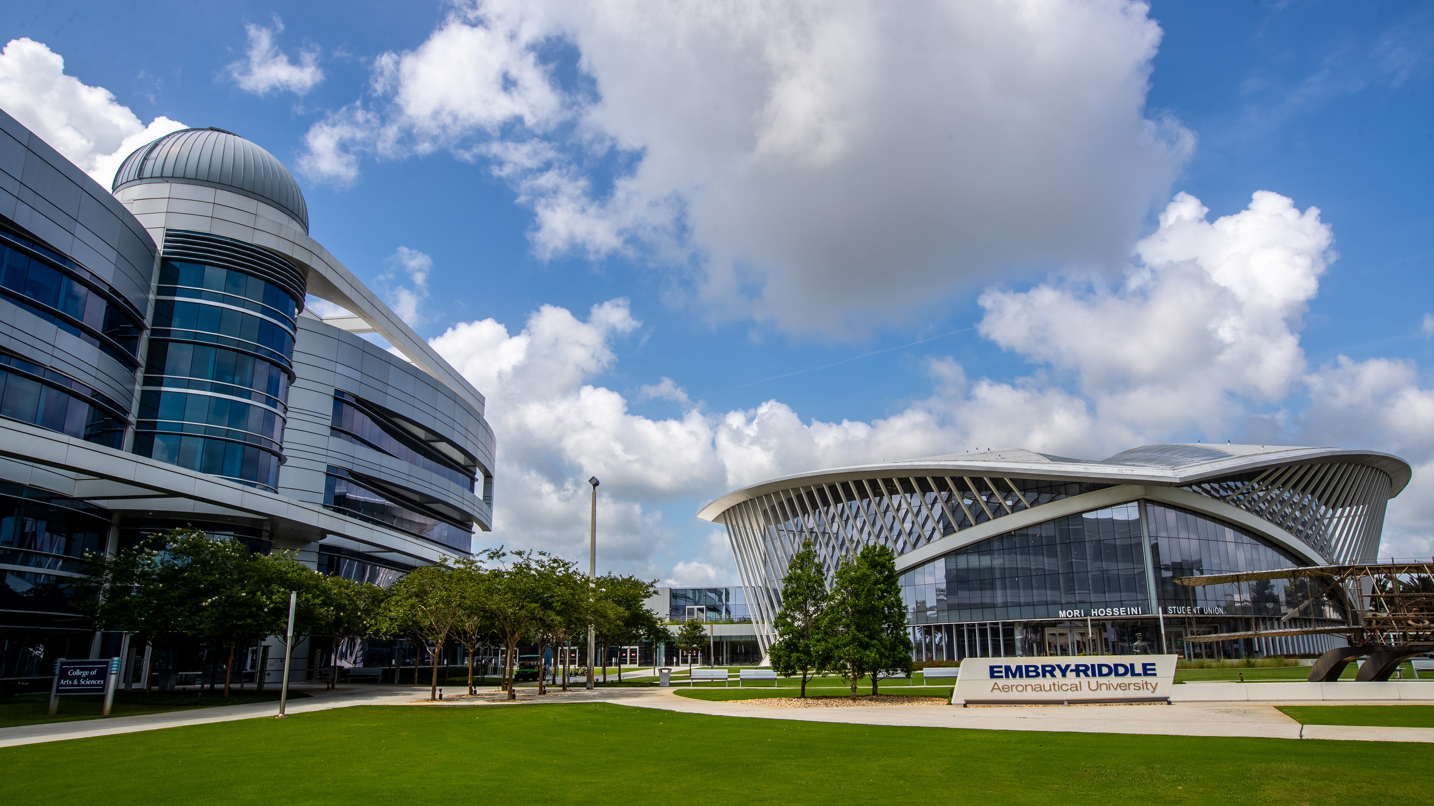

Embry-Riddle Aeronautical University
Leaders in aviation, aerospace and related fields.
Established in 1926, with campuses in Daytona Beach, Florida and Prescott, Arizona.
Notes:
Full text slide

Slide 3
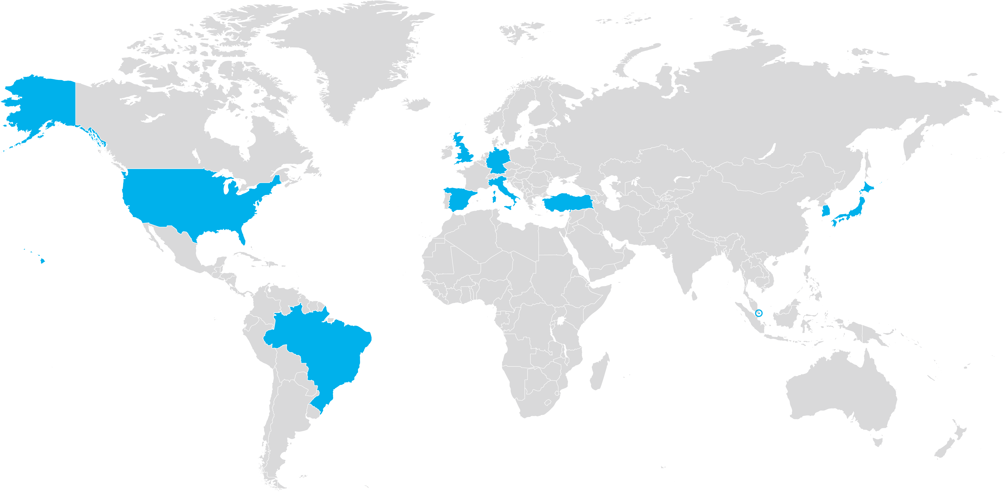
Worldwide Campus
114 LOCATIONS in
10 COUNTRIES
Brazil
Germany
Italy
Japan
Singapore
South Korea
Spain
Turkey
U.K.
U.S.
Notes:
World map slide with text block

Slide 4
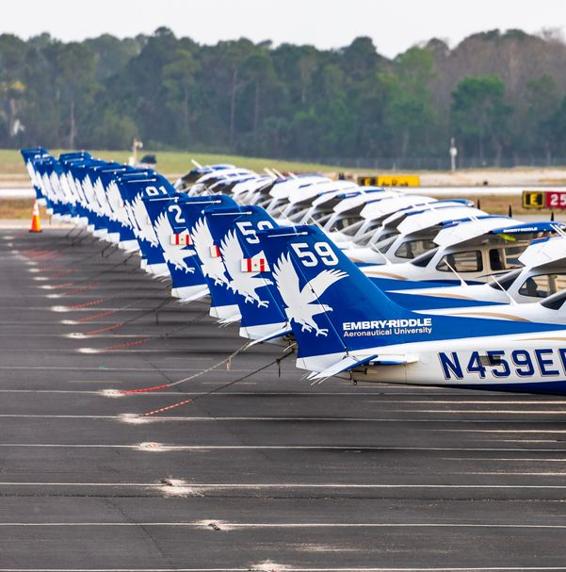
ERAU Worldwide Student Demographics
2025-2026: 20,967 students.
76% of students over age 25.
Strong military relationship
  52% Active military
  28% Veterans
Notes:
Full text slide

Slide 5
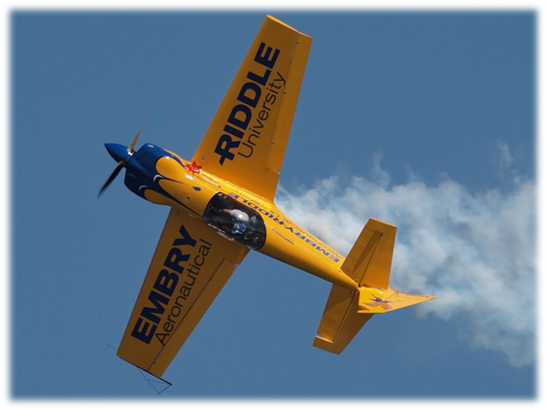
Worldwide Engineering Bachelor of Science Programs
We offer 26 bachelor’s degree programs
Aeronautics: 4,068 (2,308)
Engineering: 760 (318 active-duty military)
Engineering Technology: 174 (61)
Mechanical Engineering: 233 (96)
Engineering Fundamentals (AS): 404 (284)

Slide 6
Online Physics Lab Course Design Goals
Authentic incorporating data collection and analysis and lab kit aligned with ABET accreditation expectations.
Approachable curriculum assuming no programming experience and structured as a two-credit course.
Flexible for our active-duty military and employed students.
Scalable to be taught by multiple instructors without additional training.
Affordable with student cost under $100

Slide 7
Course structure (9 weeks)
Course topics
Data sources
Assessment and Flexibility
Mechanics
Waves and Sound
Thermodynamics
Electricity and Circuits
Magnetism
Light and Optics
Video clips
Audio clips
Published data sets
Interactive simulations
Student-collected sensor data
Follow-up conceptual and quantitative questions as Canvas quizzes
Alternate activities when the Arduino kit is unavailable

Slide 8
24 Lab Activities
Activities in bold incorporate Arduino sensors
Ball on Inclined Plane
Ballistic Trajectories
Gravity on the Moon
Billiard Ball Collisions
Mass on a Spring
Plane Propeller Rotation
Simple Pendulum
Physics of Sound
Vibrations on a String
Altimeter
Black Body Radiation and Stellar Colors
Newton’s Law of Cooling
Coulomb’s Law
Gauss’s Law
Measurement and Control with Arduino
Capacitors in Series and Parallel
Ohm’s Law
Motion Detector
Solar Magnetic Field
Faraday’s Law
World Magnetic Field Model
Snell’s Law
Double-Slit Interference
Photoresistor Light Level Detection

Slide 9
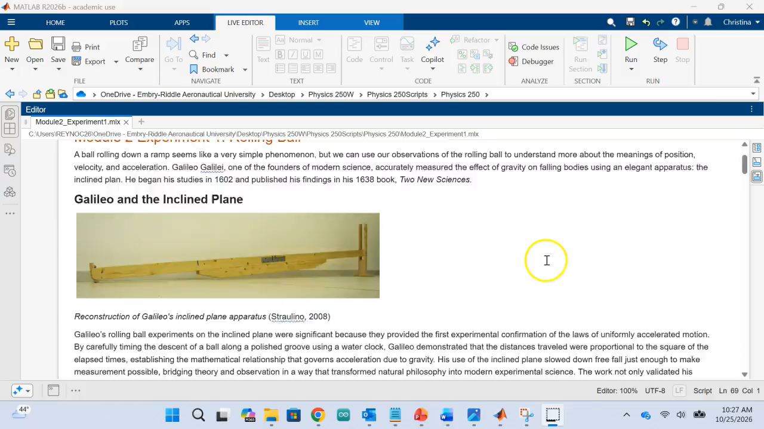

Slide 10
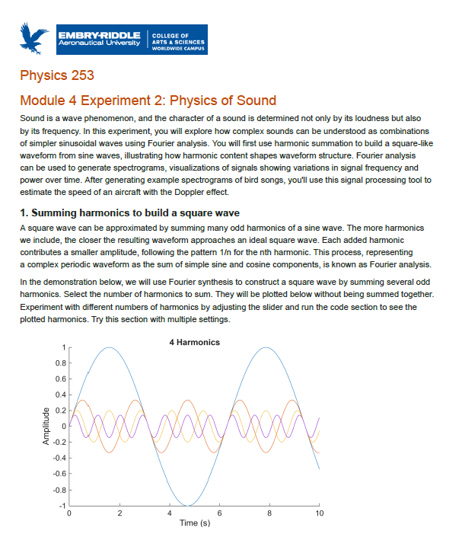
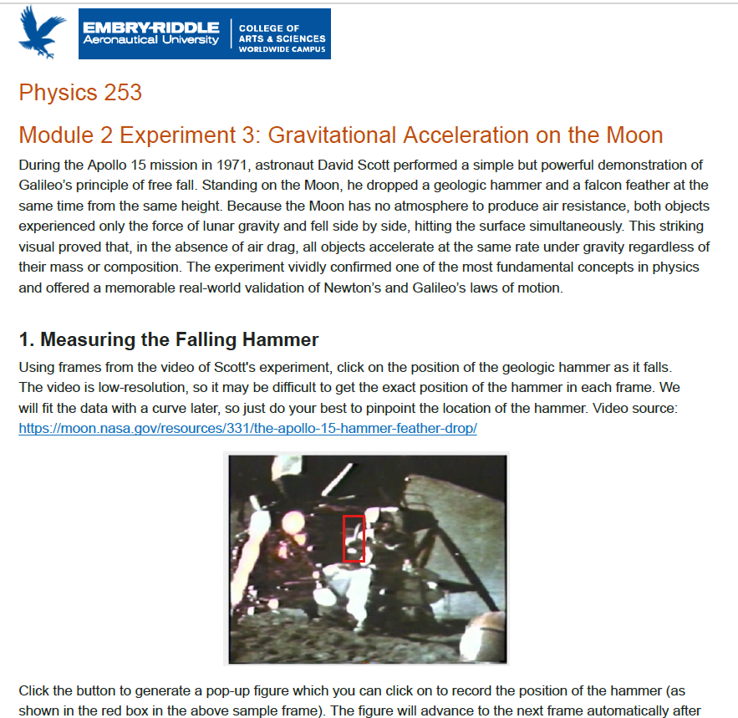

Slide 11
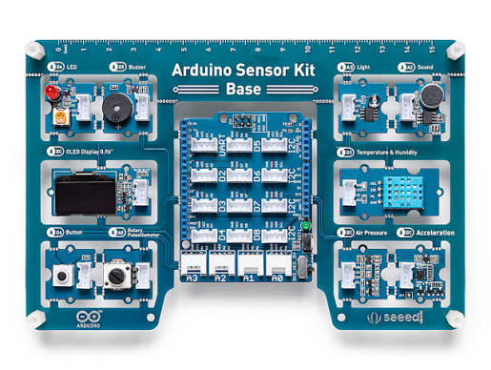
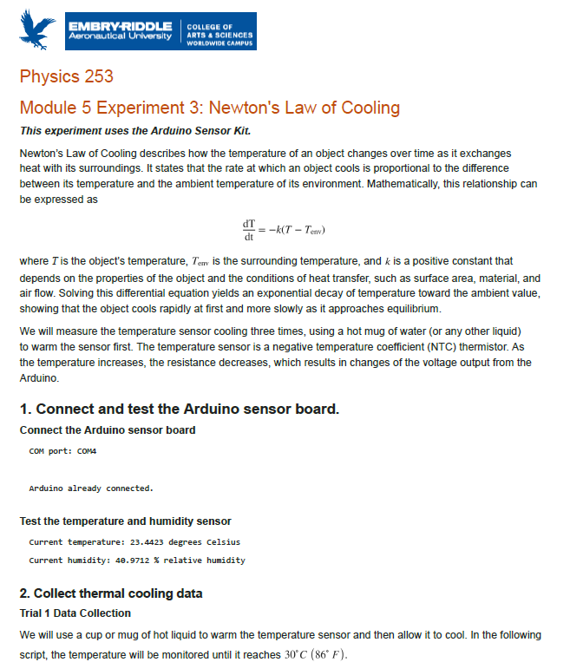
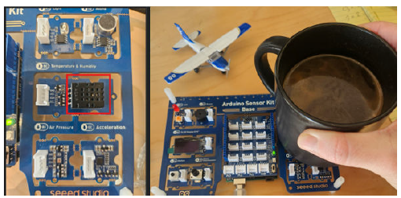

Slide 12
Student Responses (May 2026 term)
52% overall response rate (22/42 students)
4.95/5 for overall teaching effectiveness
4.95/5 for connection to students’ academic or professional goals
21 of 22 respondents selected the highest rating for overall teaching effectiveness
“This course was a very amazing hands-on lab where I felt I was able to see many different physics concepts I have learned be used in real-life applications while being able to apply them myself.”
“Fun and engaging experiments that are applicable to engineering.”
“The MATLAB labs taught me a lot.”
“I liked using the hands-on approach even though I wasn’t in an in-person classroom.”
“The experiments, MATLAB work, and Arduino parts gave me something real to connect the physics to.”

Slide 13
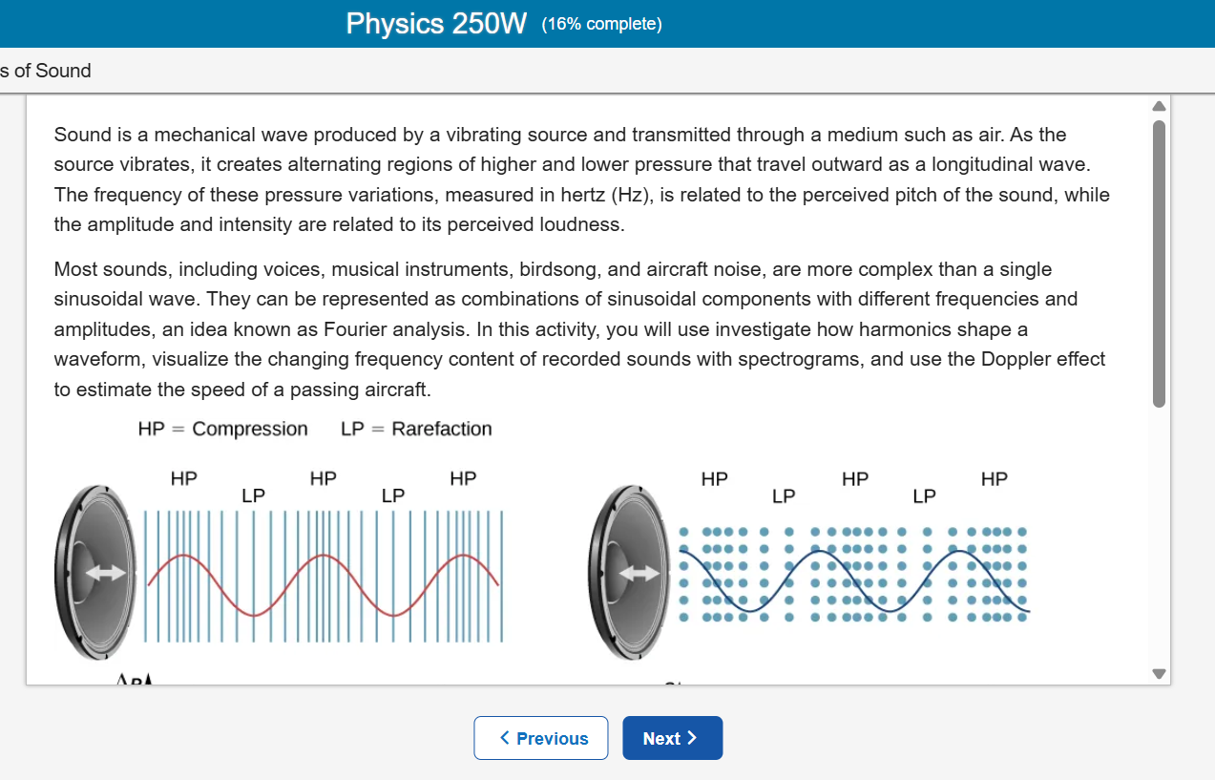
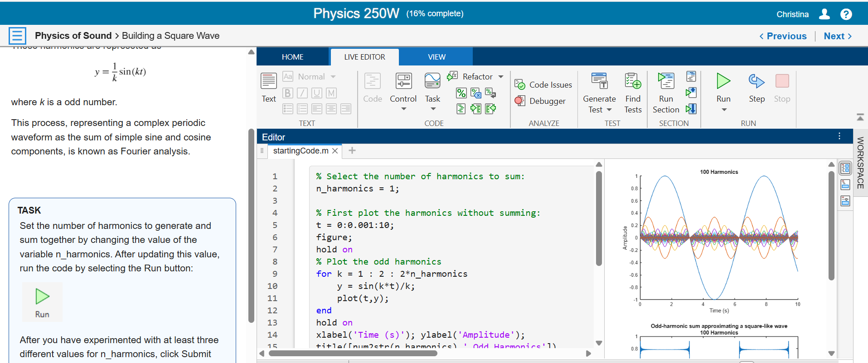
Next step: MATLAB Course Designer
Improved experience for students with transition from script to course format
Canvas-embedded activities reduce potential technical frustration for students
Gradebook integration streamlines the assessment process for instructors

Slide 14
