Slide 1

Enhancing Control Engineering Education with MATLAB Live Scripts
Xiangyu Meng, Louisiana State University
2026 MATLAB Educator Workshop
October 26, 2026 • Northfield, Minnesota

Slide 2







What is control?

Slide 3
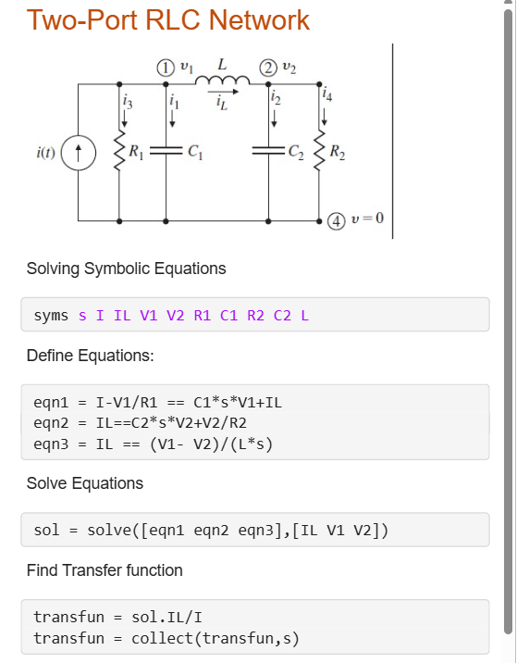
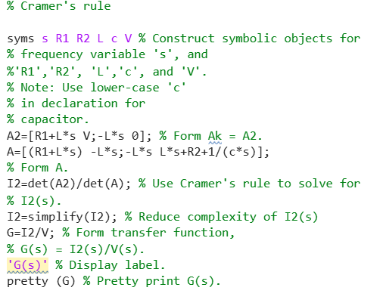
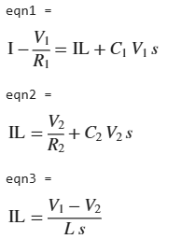

From M files to Live Scripts
Title
Picture

Slide 4


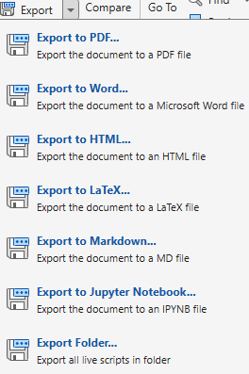

Deep Dive into Live Scripts
Switch between text and code
Section break
Insert
Export

Slide 5
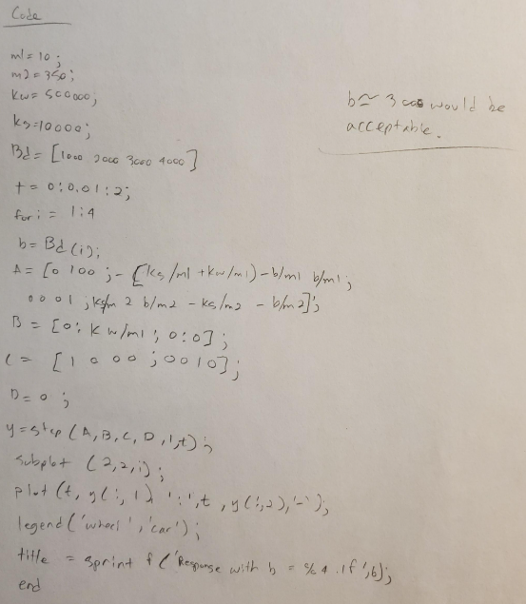
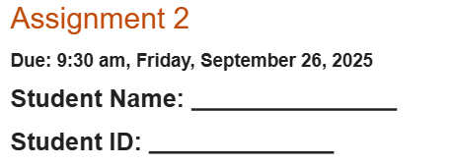

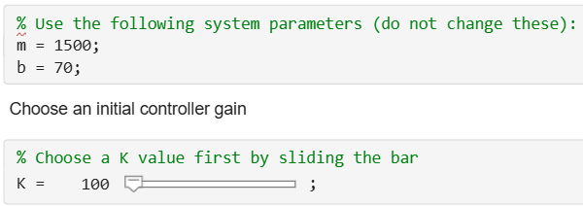
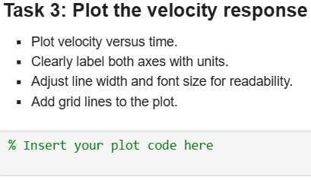
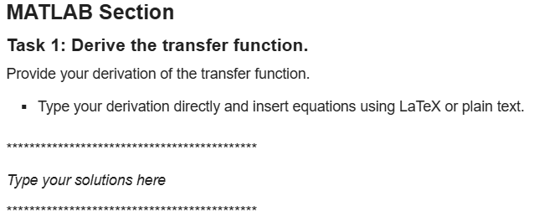
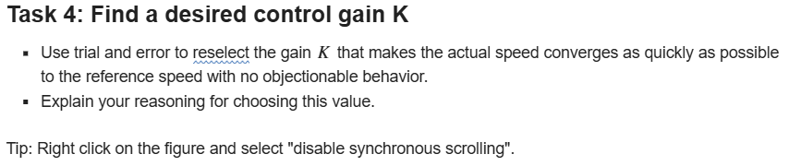
Live Scripts as Assignment Templates

Slide 6
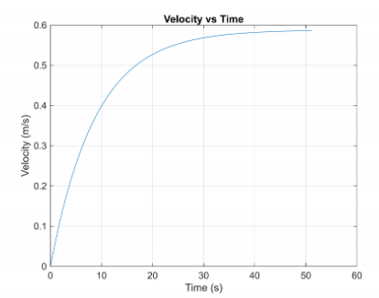

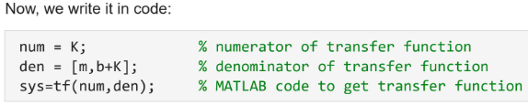
Student’s submission
Is this the best way to train students?

Slide 7
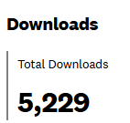
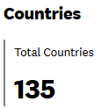
Other Useful Resources
MATLAB Academy Onramp Courses
- MATLAB Onramp (2 hours)
- Simulink Onramp (2 hours)
Symbolic Math Toolbox
- Introduction to Symbolic Math with MATLAB (2 hours)
Control System Toolbox
- Control Design Onramp with Simulink (0.5 hours)
Free textbook: https://louis.oercommons.org/courseware/lesson/1220

