Slide 1
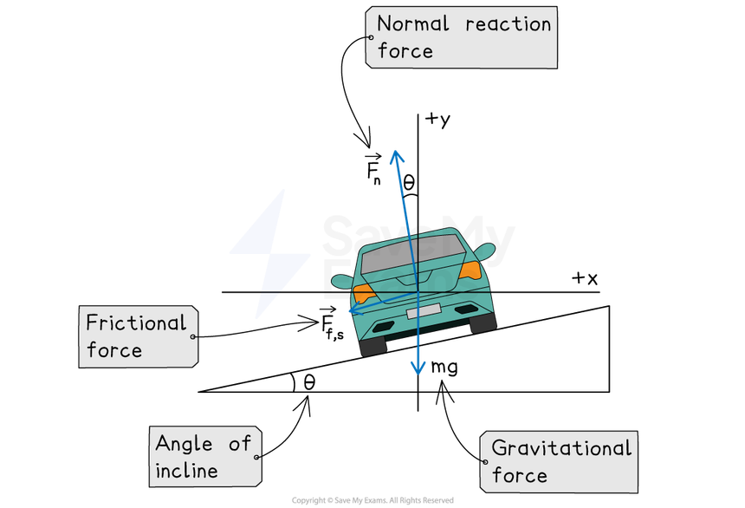
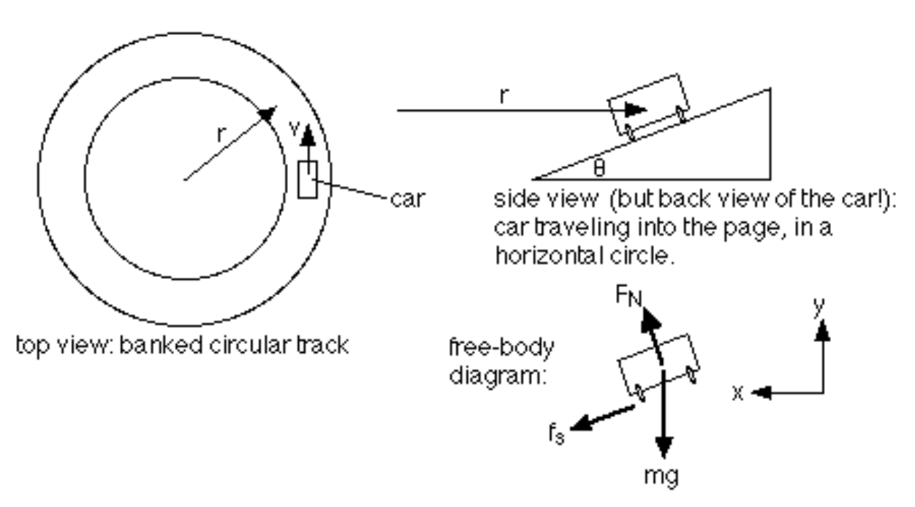

Learning goals, tasks, and assessment
Michele McColgan
Department of Physics & Astronomy
Siena University

Slide 2
Learning Goals, Tasks, Assessments
Develop activities with learning goals and assessments iteratively.
LG
Describe what students will be able to do or know.
T
Describe what the students will use to show their skill or understanding.
A
Describe specifically what in their product you will assess.
Develop activities with learning goals and assessments iteratively
Could a colleague use your criteria to judge the work?
8
Notes:
6:00–7:00 (60 seconds including 20 seconds of reflection)
Take twenty seconds to think about an assignment from your discipline. Choose one concept and one computational skill. Complete these statements for that assignment. Pause for twenty seconds. For the final statement, name what successful work must actually show. For example, specify the relationship and controlled quantities, the numerical check, or the physical justification. Avoid filling that space with shows understanding or appropriate implementation. A colleague should be able to use your description to judge student work. This is the link between learning goals and an assessment plan.
Practice prompts developed from the workshop discussion.

Slide 3
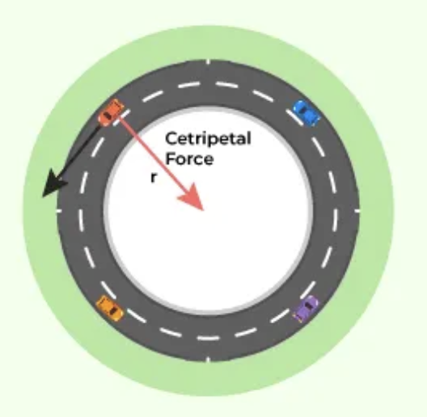

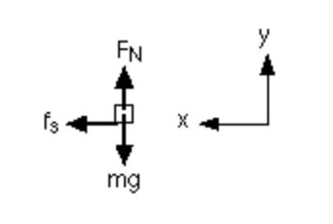
Exploring circular motion in a roundabout with MATLAB
Assignment: How do speed, radius, and road conditions affect a car’s ability to turn?
Flat condition
Banked condition

Slide 4
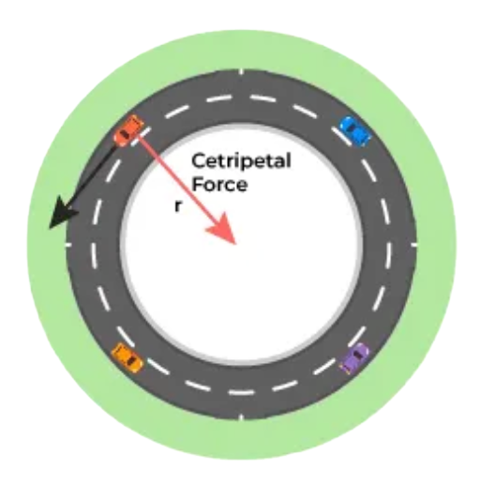
Exploring a roundabout with MATLAB
Assignment: How do speed, radius, and road conditions affect a
car’s ability to turn?
LEARNING GOALS
TASKS
Students will understand:
How the required inward force depends on speed and turning radius for circular motion.
How banking increases the maximum allowable speed for a given radius and decreases the minimum turning radius for a given speed.
How wet and dry road conditions affect available tire–road friction and therefore the allowable speeds and turning radii.
Students will write analytical solutions for flat and banked conditions of circular motion.
In a Live Script, students will create 4 plots
  Force versus speed
  Force versus radius
  Force versus speed with friction limits
  Max speed vs radius for banking in wet/dry conditions
Notes:
Student assignment overview. Vary speed at fixed mass and radius, then radius at fixed mass and speed. Use supplied illustrative wet and dry friction coefficients. At a shared feasible speed on a level road, actual static friction is the same on both surfaces, while the maximum differs. Banking comparisons use the idealized inward-bank model. Assess code, explanations, and plots together. Verification should agree within rounding tolerance. The full assignment instructions should provide parameter values, assumptions, and any required formulas.
Source: Student-facing assignment description developed with the instructor in this conversation.

Slide 5
Exploring a roundabout with MATLAB
Assignment: How do speed, radius, and road conditions affect a
car’s ability to turn?
ASSESSMENT - PHYSICS
ASSESSMENT - CODE
Students are assessed through their analytical solutions, four MATLAB plots, and accompanying explanations. Successful work correctly predicts and quantifies the force relationships, identifies friction-limited motion boundaries, and explains how banking and wet/dry conditions change allowable speeds and radii. MATLAB calculations must agree with independent analytical checks, and plots must identify quantities, units, and road conditions.
Coding is assessed on parameterized functions, correct implementation of the analytical equations, generation of four clearly labeled plots, and verification against independent calculations.
Notes:
Student assignment overview. Vary speed at fixed mass and radius, then radius at fixed mass and speed. Use supplied illustrative wet and dry friction coefficients. At a shared feasible speed on a level road, actual static friction is the same on both surfaces, while the maximum differs. Banking comparisons use the idealized inward-bank model. Assess code, explanations, and plots together. Verification should agree within rounding tolerance. The full assignment instructions should provide parameter values, assumptions, and any required formulas.
Source: Student-facing assignment description developed with the instructor in this conversation.

Slide 6
Student plots of Force vs speed and radius
Double speed: 4× required force
Double radius: ½ required force
Illustrative model: m = 1,000 kg. Only one parameter varies in each plot.
3
Notes:
1:30–2:15 (45 seconds)
Before students run code, ask them to predict both trends. These calculated examples use a mass of 1,000 kilograms. On the left, radius stays at 20 meters. Doubling speed from 5 to 10 meters per second makes force four times larger. On the right, speed stays at 10 meters per second. Doubling radius from 20 to 40 meters halves the required force. Ask students to connect those numerical comparisons to the equation. The plotted force is the required inward net force, not an extra force to add to the free-body diagram.
Physics source: OpenStax, University Physics Volume 1, 6.3 Centripetal Force. https://openstax.org/books/university-physics-volume-1/pages/6-3-centripetal-force
Chart data: ideal-model calculations F=mv²/r, not measurements. Left: v=0 to 15 m/s by 0.5, r=20 m. Right: r=10 to 60 m by 2, v=10 m/s. m=1000 kg.

Slide 7
A sample of a student’s code
CODE EXCERPT
STUDENT REASONING
m = 1000; r = 20;
v = linspace(0,15,100);
F = turnForce(m,v,r);
plot(v,F)
xlabel("Speed (m/s)")
ylabel("Required force (N)")
function F = turnForce(m,v,r)
F = m.*v.^2./r;
end
Before running:
Predict the effect of doubling v.
After plotting:
Compare F at 5 and 10 m/s.
Explain the ratio using F = mv²/r.
Verification by hand:
Check m = 1,000 kg, v=10 m/s,
r = 20 m by hand: F = 5,000 N.
4
Notes:
2:15–3:00 (45 seconds)
This is a short code excerpt rather than a complete Live Script. Students call a parameterized function from the Live Script, then use plot, xlabel, and ylabel to create the figure. Elementwise operators allow the function to work with arrays. In the Live Script, the function belongs after the script statements for this example. A second call varies radius with speed fixed. Before the code, ask for a prediction. After it, ask for a numerical comparison and explanation. The computational and conceptual evidence then appear together. The check case gives 5,000 newtons.
Physics source: OpenStax, University Physics Volume 1, 6.3 Centripetal Force. https://openstax.org/books/university-physics-volume-1/pages/6-3-centripetal-force
MATLAB excerpt uses standard arithmetic, local function syntax, and elementwise array operations.

Slide 8
Student’s plot with the addition of the friction limits for Force vs Speed
ASSUMED FRICTION
Wet: μₛ = 0.40
Dry: μₛ = 0.80
fₛ,max = μₛmg
At v = 8 m/s:
fₛ = 3,200 N on both roads.
Speed limits in this model: wet 8.86 m/s, dry 12.53 m/s.
Below both limits, actual friction is the same. Above a limit, slipping begins.
5
Notes:
3:00–3:55 (55 seconds)
For a level curve, N=mg and static friction supplies mv²/r. At a speed supported by both surfaces, actual friction is the same on wet and dry roads. What changes is the maximum available friction. The assumed coefficients give limits of 3,924 N and 7,848 N for a 1,000 kg car. The rising curve shows required friction, not an actual static force beyond the limit. Above a surface's threshold, the assumed circular motion cannot be maintained without slipping. Do not clamp the curve at the limit and call that circular motion. The coefficients are illustrative inputs, not universal tire-road measurements.
Physics source: OpenStax, University Physics Volume 1, 6.3 Centripetal Force. https://openstax.org/books/university-physics-volume-1/pages/6-3-centripetal-force
Wet-road context: FHWA, Evaluation of Pavement Safety Performance, Chapter 2, https://www.fhwa.dot.gov/publications/research/safety/14065/003.cfm . All numerical curves use the ideal constant-coefficient model.

Slide 9
Student plot of Speed vs radius for banking and road conditions
LEVEL TO 10° BANK
At r = 20 m, maximum speed:
Wet: 8.86 to 11.03 m/s
Dry: 12.53 to 14.93 m/s
At v = 10 m/s, minimum radius:
Wet: 25.48 to 16.44 m
Dry: 12.74 to 8.97 m
vₘₐₓ = √(rgK) rₘᵢₙ = v²/(gK)
K = (sin θ + μₛ cos θ)/(cos θ − μₛ sin θ). Assumed model, g = 9.81 m/s².
6
Notes:
3:55–5:00 (65 seconds)
Banking tilts the normal force inward. At the upper speed limit friction acts down the bank and is at its maximum magnitude. Resolve the forces: N sin θ + f cos θ = mv²/r and N cos θ - f sin θ = mg. Substitute f=μN to obtain K=(sin θ+μ cos θ)/(cos θ-μ sin θ). Then vmax=√(rgK), and at fixed speed rmin=v²/(gK). A positive denominator is required. At 10 degrees, both chosen coefficients exceed tan θ, so there is no additional positive lower-speed limit in this example. In general, strongly banked low-friction curves also impose a minimum speed or an upper radius bound at fixed speed. The graph shows the upper-speed boundary, not every real-world design constraint. Banking is a hypothetical inward-bank comparison, not a claim about actual roundabout construction.
Physics source: OpenStax, University Physics Volume 1, 6.3 Centripetal Force. https://openstax.org/books/university-physics-volume-1/pages/6-3-centripetal-force
Equations derived by resolving normal and friction forces. Illustrative μ values 0.40 and 0.80, g=9.81 m/s². θ=0 or 10 degrees. Data are rounded ideal-model calculations. No braking or acceleration along the path, aerodynamic forces, or rollover model.

Slide 10
Physics rubric
20 points
Criterion | 4 points per criterion
Analytical solutions | Free body diagram. Equations in r- and z- directions. Algebra first. 2 solutions – flat and banked.
Force, speed, and radius | Explains 2v gives 4F and 2r gives F/2.
Wet/dry friction | Calculates friction limits. Explains lower wet speed, larger radius. Identifies speed/radius where friction is the same.
Banking effects | Quantifies speed and radius changes for wet/dry. Explains force components.
Interpretation and assumptions | Identifies feasible motion, assumptions, and limits. Supports conclusions with analytical and plotted results.
4 complete 3 minor gaps 2 partial 1 limited 0 no evidence
Full criterion descriptions and scoring guidance appear in speaker notes.
Notes:
Detailed physics rubric: 20 points, five criteria worth 4 points each. Score 0 for absent work or no relevant evidence.
1. Analytical solutions: identify weight, normal force, and static friction. Flat road: N=mg and mv²/r <= μN. Banked road: resolve normal force and friction horizontally and vertically with consistent direction. Use f=μN only at a slipping boundary. Full credit requires a physically correct approach and solution.
2. Force relationships: doubling speed gives four times the required force at fixed mass and radius. Doubling radius halves the force at fixed mass and speed. Connect both to F=mv²/r and numerical values in the plots.
3. Wet/dry friction: identify intersections of required force and friction limits. Explain lower maximum speed and larger minimum radius for lower available friction. At a shared feasible speed on level roads actual friction is identical.
4. Banking: quantitatively compare flat/banked speeds at fixed radius and minimum radii at fixed speed, for wet and dry. Explain the normal force's inward component and friction direction. At the upper speed boundary friction acts down the bank.
5. Interpretation: distinguish required from available force, identify infeasible motion, state constant-speed/circular-path assumptions and assumed coefficients, support conclusions, and acknowledge lower-speed constraints if parameters require them.
Level anchors: 4 complete and accurate; 3 mostly accurate with minor omission; 2 partial understanding with substantial gaps; 1 limited relevant evidence; 0 absent. Assess explanations independently of code execution.
Source: Instructor-approved rubric developed in this conversation.

Slide 11
Coding rubric
20 points
Criterion | 4 points per criterion
Functions and inputs | Uses relevant inputs consistently. Functions work for new parameter sets.
Equations and arrays | Correct equations, array operations, units, angles, and parameter ranges.
Four plots | Correct variables and controls. Labels, units, limits, and legends clear.
Verification and testing | Checks flat/banked cases independently, tolerance, arrays, and changed inputs.
Reproducibility and clarity | Runs from clean workspace. Clear parameters, sections, names, and function documentation.
4 complete 3 minor gaps 2 partial 1 limited 0 no evidence
Full criterion descriptions and scoring guidance appear in speaker notes.
Notes:
Detailed coding rubric: 20 points, five criteria worth 4 points each. Score 0 for absent work or no relevant evidence.
1. Functions and inputs: accept relevant mass, speed, radius, friction coefficient, and bank-angle inputs. Use inputs consistently and call functions for multiple parameter sets. Changing inputs must update outputs without editing the function equations.
2. Implementation: faithfully translate analytical equations, use elementwise operators as needed, SI units, consistent degree/radian conventions, and check or clearly state valid bank-formula parameter ranges.
3. Plots: generate force versus speed, force versus radius, force versus speed with friction limits, and maximum allowable speed versus radius for flat/banked wet/dry cases. Use correct data pairings and controlled variables. Label quantities and units and distinguish conditions in legends.
4. Verification: document independent analytical checks for at least two parameter sets including flat and banked conditions. State numerical tolerance, establish agreement or resolve discrepancies, test array inputs, and check generalization with changed inputs.
5. Reproducibility: run end to end from a clean workspace, define adjustable parameters before use, organize sections logically, use meaningful variable names, and document function inputs, outputs, units, and assumptions.
Level anchors: 4 complete and accurate; 3 mostly accurate with minor omission; 2 partially functional with substantial gaps; 1 limited relevant evidence; 0 absent.
Scoring guidance: separate physics understanding from implementation. If code faithfully implements the student's incorrect analytical equation, deduct primarily for physics and assess whether the coding translation is correct.
Source: Instructor-approved rubric developed in this conversation.

