Slide 1

An Evolving Approach to Teaching Introductory MATLAB: Programming, Applications, and AI
Richard Blackmon
Elon University
Engineering Department

Slide 2
Pre-2023
1st year course
Completely flipped
All instruction with ZyBook
Bulk of grade from problem sets
Course felt more like programming than Engineering Computing
Students struggled often

Slide 3

Evolution from 2023-2025
Targeting 1st and 2nd year students
Computer science prerequisite
15 minute mini-lecture on ZyBook Reading
Independent work (or group work if everyone is struggling)
Strictly no AI usage allowed
More weight on summative assessments

Slide 4
Feedback from students on evolved course
ZyBook had mixed reviews after adding Pre-req: Useful as an introductory resource and reference, but students questioned its cost, relevance, and effectiveness compared with other learning methods.
Hands-on instruction was highly valued: Students consistently praised in-class coding, lectures, problem sets, and opportunities to ask questions and receive feedback.
Real-world applications increased engagement: Image processing, audio manipulation, and especially the final project were frequently identified as enjoyable and meaningful.
Prior programming experience created opportunities and challenges: Students had differing opinions about how much foundational programming instruction was necessary, suggesting a need to balance review with more advanced applications.

Slide 5
Current Version of Course
Targeting 2nd year students
Computer science prerequisite remains
ZyBook no longer required reading
OnRamps assigned as primary learning tool
Copilot use encouraged
Formative assignments more challenging
Summative assessments are longer
Even more weight on summative assessments

Slide 6
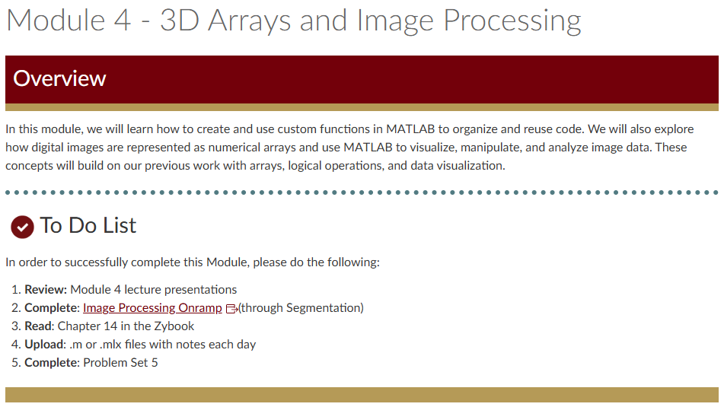
Modular structure
Reorganization of course material through LMS
Resulting in students being better prepared, and fewer late submissions

Slide 7
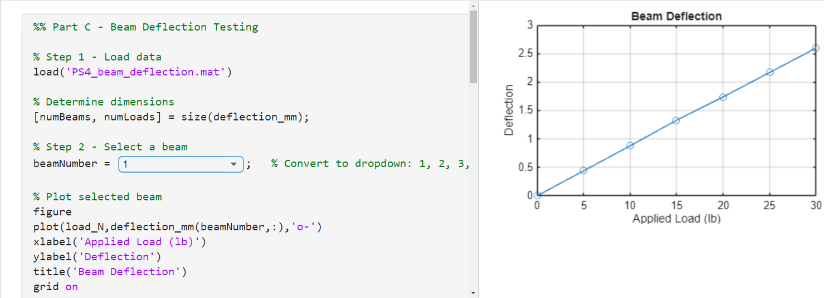

Utilizing Live Scripts
Students analyzing beam deflection data that was generated with GenAI. They could use Copilot to assist with code, but needed to engage the code themselves to draw conclusions from data.

Slide 8
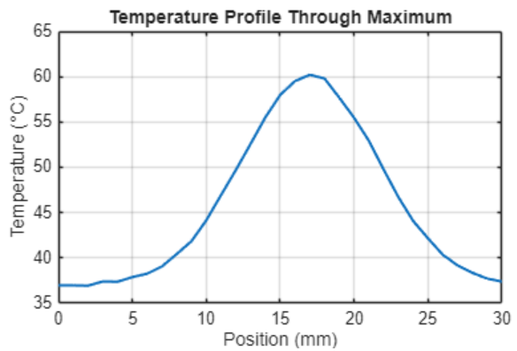
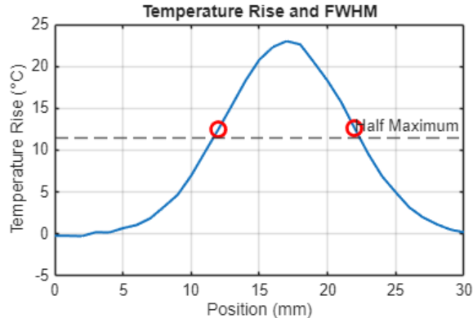
Extracting useful metrics from data
Students were given a dataset, and told to find the full-width, half-max. They used Copilot to help with code, and investigated on their own the significance of FWHW and how it may be used in their discipline

Slide 9
Lessons and Challenges
Prior programming experience ≠ MATLAB proficiency
Less syntax, more engineering applications
Balancing scaffolding with authentic problem solving
AI complicates assessment of student understanding
Redesign is an iterative process

Slide 10
Moving Forward
Generate
Generate customized MATLAB OnRamps
Utilize
Utilize MATLAB Grader for automating feedback
Expand
Continue expanding engineering applications
Assess
Assess the impact of unrestricted use of Copilot and restricted use of other AI tools on student perceptions (end of course survey)
Refine
Continue refining instruction on MATLAB utility for Engineering Computing

