Slide 1
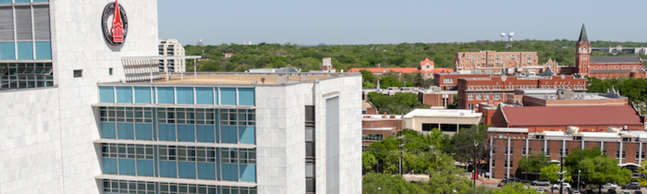

A Year with MATLAB and GenAI: Transforming How Students Learn Engineering Programming
Anita Omo-Okhuasuyi, Ph.D.
Adjunct Professor, University of the Incarnate Word
10/26/2026

Slide 2
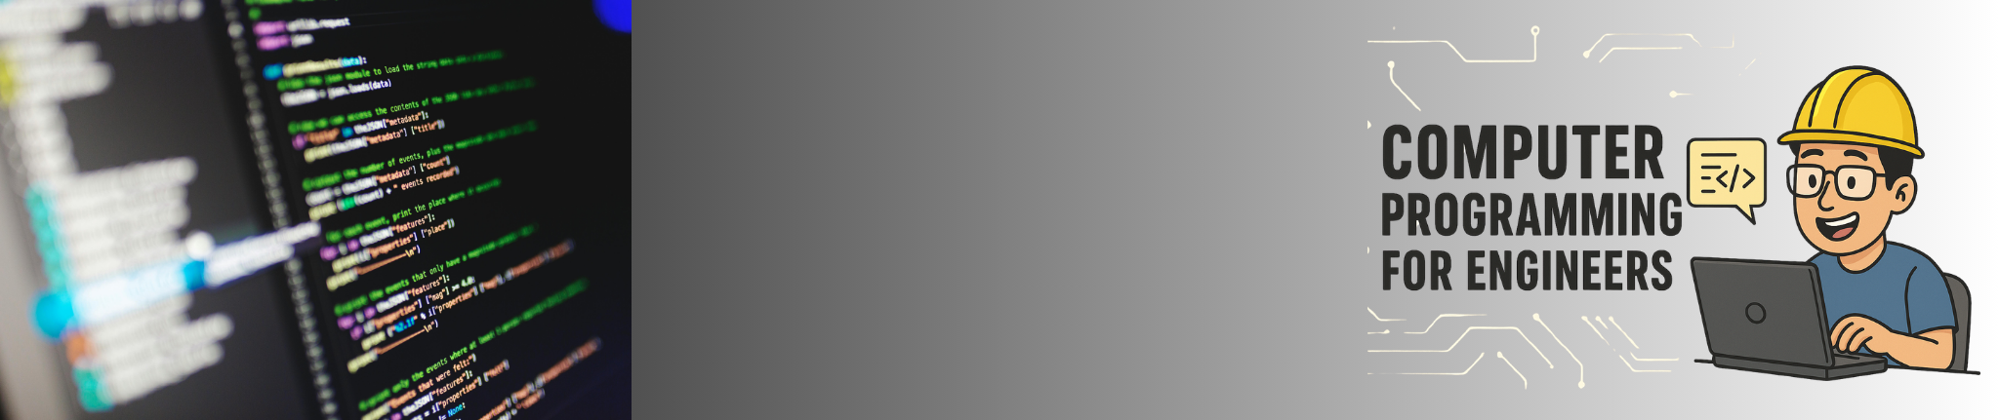
The Course: Computer Programming for Engineers
2nd–3rd year engineering & math majors
Introductory programming course using MATLAB
Main focus on:
  Data types, arrays, indexing
  MATLAB scripting and structured programming
  Branching & loop statements
  User‑defined functions
  Numerical methods
  Advanced data types (cell arrays, structures, function handles, classes)
Prerequisite: MATH 2322 (Linear Algebra)
Required software: MATLAB & Simulink Student Version R2025a
No prior programming experience required

Slide 3
Original approach
Lecture‑driven course with two 75‑minute sessions per week
Heavy emphasis on in‑class programming exercises
Learning reinforced through:
  Short in‑class assignments
  Regular computer programming tasks
  Quizzes
Four major exams forming the backbone of assessment:
Course progression focused on:
  MATLAB scripting fundamentals
  Arrays, indexing, structured programming
  Branching & loops
  Functions
  Numerical methods
  Advanced data types

Slide 4
The Challenge
Head‑to‑Hand Skill Transference
Students could follow examples during class but struggled to independently translate concepts into working code. The gap between “knowing” and “doing” remained wide without authentic practice.
Loss of Programming Knowledge After Class
Because learning was centered on short exercises and exams, students often forgot syntax, logic structures, and debugging strategies once the immediate assessment passed. Retention was low without sustained application.
Inability to Apply Knowledge to Real‑Life Scenarios
Students performed well on predictable, structured problems but could not generalize their skills to open‑ended engineering tasks. They lacked experience integrating multiple concepts into a single solution.
Predictability of Assignments
Repeated use of similar exercises and exam‑style problems made it easy for students to rely on solutions from previous semesters. This reduced originality, discouraged deeper thinking, and weakened assessment integrity.

Slide 5
From MATLAB Exercises to Engineering Problem-Solving
A project-based response to the challenges of teaching programming in the age of GenAI
BEFORE
WHAT I CHANGED
NEW LEARNING EXPERIENCE
Individual MATLAB exercises
Collaborative solar-powered monitoring project
Programming with an engineering purpose
• Commands and syntax
• Standalone scripts
• Instructor-led troubleshooting
• Two complementary teams
• Data simulation + modeling
• Script exchange and integration
• Guided GenAI support
• Applied problem-solving
• Collaboration and verification
• Student ownership of code
THE SHIFT
From writing code that runs → to explaining how code solves an engineering problem

Slide 6
Inside the Project: How It Worked
Group 1
Data & Simulation
Simulated environmental measurements
Organized datasets in MATLAB
Generated visualizations
Shared data and scripts with Group 2
Group 2
Modeling & Analysis
Applied regression techniques
Analyzed environmental trends
Developed predictive logic
Shared models and scripts with Group 1
Shared deliverable: Integrated MATLAB solution and final presentation

Slide 7
How GenAI Supported Our MATLAB Project
01
Concept Clarification
02
Coding & Debugging
Explaining MATLAB syntax, functions, and unfamiliar programming concepts.
Interpreting error messages, troubleshooting scripts, and testing corrections.
03
Data Simulation & Analysis
04
Team Code Integration
Supporting environmental datasets, visualization, regression, and prediction.
Understanding, combining, and troubleshooting scripts from different groups.
05
Independent Learning
Exploring alternatives, checking AI suggestions, and explaining final solutions.
OUR GUIDING PRINCIPLE
AI can support the process; students must understand, verify, and own the work.

Slide 8
Four-Week Pilot: Outcomes and Lessons Learned
Student Accomplishments | Learning Assessment | Teaching Insights
Applied MATLAB concepts to environmental data simulation and analysis. | Evaluated weekly scripts for functionality, readability, and programming logic. | Sustained project work created opportunities to reinforce programming concepts.
Developed regression models, visualizations, and battery-monitoring logic. | Used individual contribution logs to monitor participation and accountability. | GenAI provided an additional resource for explanations and troubleshooting.
Collaborated across project components and integrated MATLAB scripts. | Assessed students' ability to integrate, troubleshoot, and explain code. | Students needed more time for debugging, testing, and system refinement.
Communicated project results, limitations, and proposed improvements. | Evaluated final presentations and technical demonstrations. | The four-week timeline limited opportunities for hardware implementation.
The four-week pilot established a foundation for project-based MATLAB instruction and identified opportunities to deepen the learning experience.

Slide 9
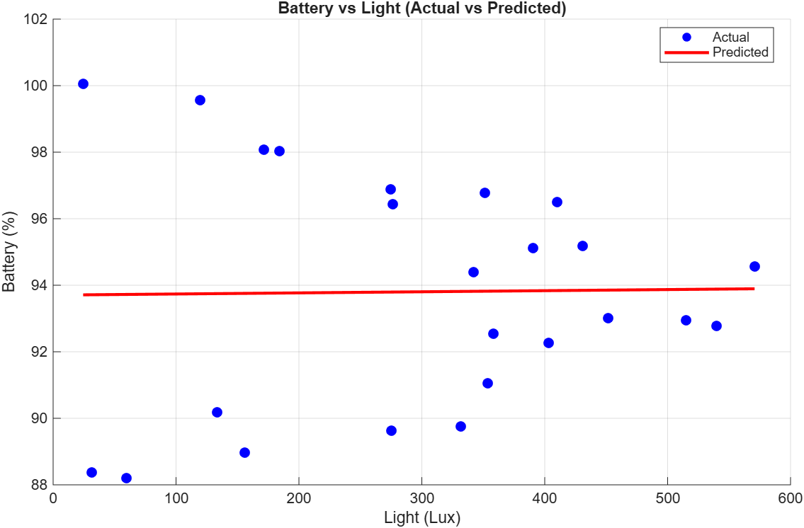
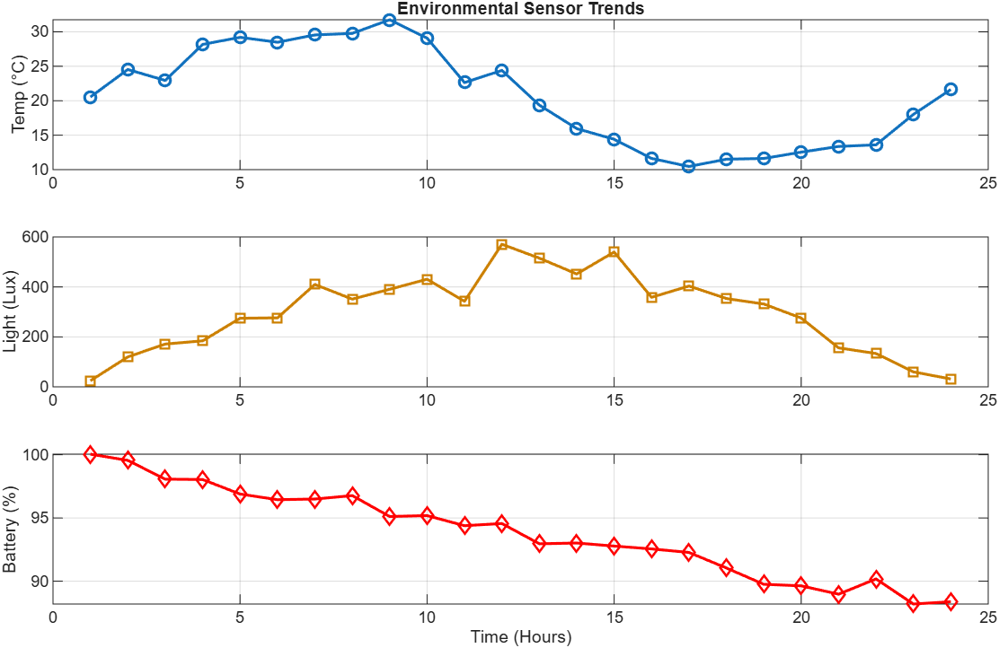
Four-Week Pilot: Student accomplishments:
Programming Application
Simulated environmental datasets, constructed visualizations, and developed a regression-based battery model.
System Integration
Combined simulation, prediction, MSE/RMSE evaluation, and battery-warning thresholds.
Engineering Reflection
Identified limitations of simulated data, model assumptions, and opportunities for improvement.
LEARNING TAKEAWAY Students combined foundational MATLAB concepts into an integrated simulation—and identified limitations of their simplified battery model.

Slide 10
From Four to Eight Weeks — Building on What We Learned
SPRING 2026
4-Week Pilot
Simulation and analysis
FALL 2026
8-Week Expansion
Physical implementation
Why expand?
More time to practice foundational MATLAB programming.
Opportunities to build and test the solar-powered monitoring station.
Transition from simulated data to actual sensor measurements.
Additional opportunities for collaborative debugging and integration.
Continued exploration of GenAI as a learning assistant.

Slide 11
Acknowledgment
Special thanks to MathWorks for supporting this curriculum development initiative through a $4,350 Academic Support Grant, enabling the integration of MATLAB-based, project-driven learning into undergraduate engineering education at the University of the Incarnate Word.
Project: Solar-Powered Internet of Things (IoT) Station for Environmental Monitoring and Data Analysis.

