Slide 1


Welcome to the 2025 Workshop
Teaching Computation with MATLAB
Notes:
Hello everyone and welcome to the 2023 Teaching Computation with MATLAB workshop. I’m glad you’ve all made it here and hope your travels went well. I’m Maureen Kahn, I am your workshop organizer from the Science Education Resource Center (or SERC) here at Carleton College, after many emails and some virtual meetings I’m thrilled to see everyone finally in person and kick off this year’s workshop.
This workshop is a collaboration between MathWorks, SERC at Carleton College, a convener team of educators, and really all the efforts of our participants. Thank you all for making the journey – from all over, near and far – to be a part of this community and make the event happen. So much of what folks get out of the workshop year after year is from collaborating with colleagues – and what they gain from and sharing teaching challenges and successes.
This is the first year since 2019 that we have been able to run this annual workshop in person, and it’s the first in-person version I’ve gotten the chance to be a part of , and I’m very much looking forward to the next two days of working with you all.

Slide 2
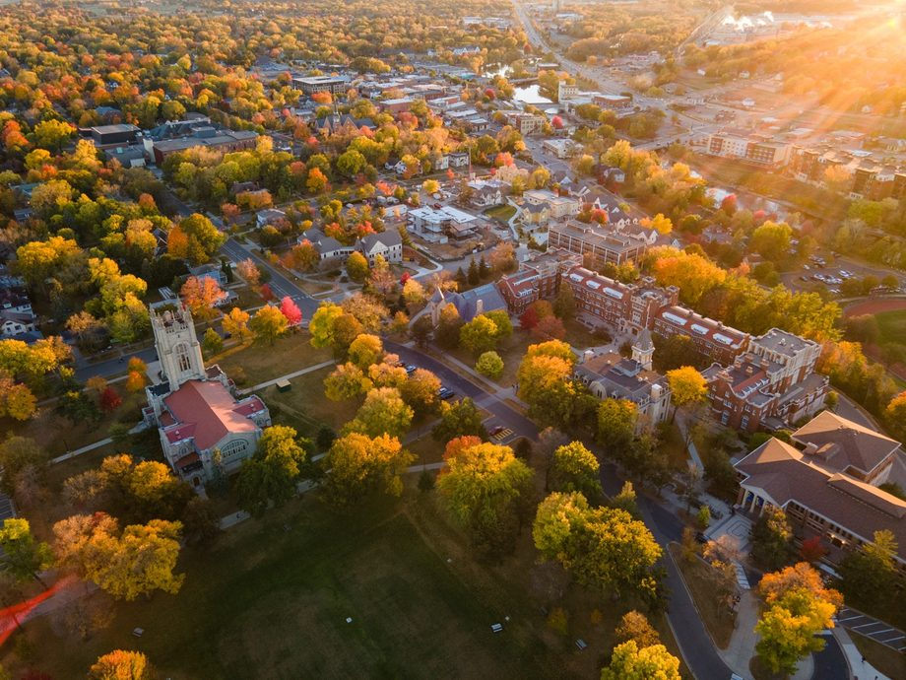
Carleton College
Notes:
1866 – loosely affiliated with the conference of congregational churches (Luthren school across town)
2100 students – all undergraduates
300 acre arboretum

Slide 3
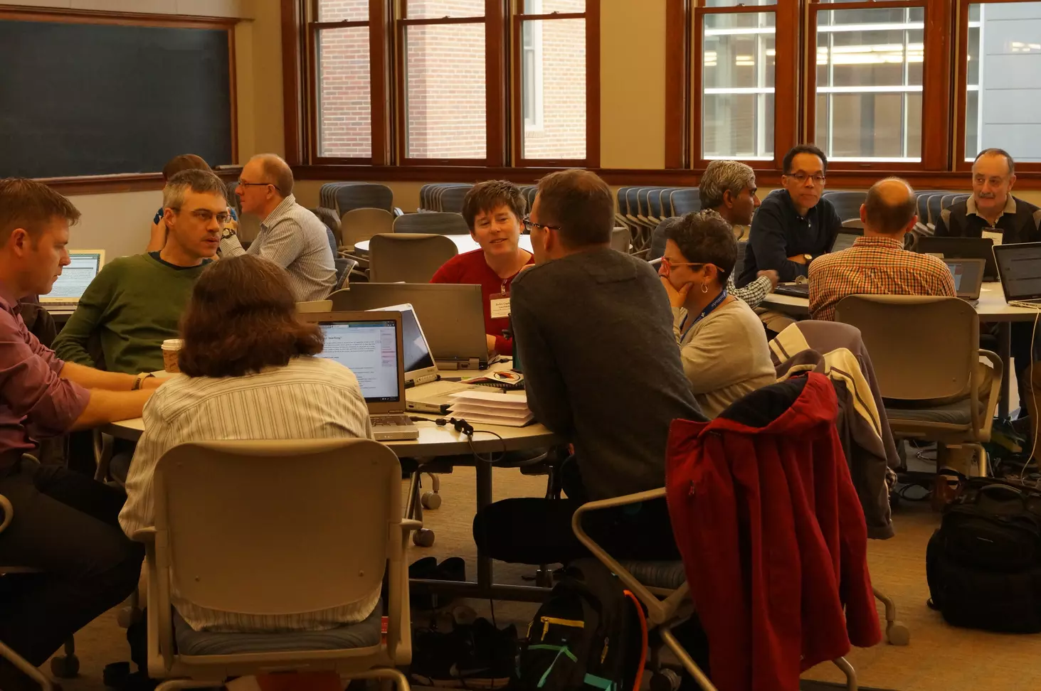
Conveners
Lisa Kempler, Workshop sponsor, MathWorks
Don Baker, McGill University
Benjamin Bratton, Vanderbilt University
Dan Burleson, Review Editor, University of Houston
Michele McColgan, Siena College
Kelly Roos, Bradley University
Laura Keen, MathWorks
Ramnarayan Krishnamurthy, MathWorks
Mitchell Bender-Awalt, SERC, Carleton College
Cailin Huyck Orr, SERC, Carleton College
Notes:
I’d like to briefly introduce the convener team, who have been involved in developing the program for the workshop, and whom we’ll hear more from during the panel later this evening.

Slide 4
Conveners
Lisa Kempler, Workshop sponsor, MathWorks
Benjamin Bratton, Vanderbilt University
Dan Burleson, Review Editor, University of Houston
Michele McColgan, Siena College
Kelly Roos, Bradley University
Evan Cosgrove, MathWorks
Jon Loftin, MathWorks
Holly Kelchner, SERC, Carleton College
Cailin Huyck Orr, SERC, Carleton College
SERC staff:
Rebeccah Bradley
Brianna Douglas
Amy Collette
Notes:
I’d like to briefly introduce the convener team, who have been involved in developing the program for the workshop, and whom we’ll hear more from during the panel later this evening.

Slide 6
11th annual workshop
First workshop was October 2015.
Annual workshops since with 2020,2021, 2022 online
  (also workshops for Latin America, Asia Pacific, California institutions and Germany and others run by MathWorks)
Overall >400 individuals, about ¼ have attended more than once
314 teaching activities (including 34 in Spanish language)

Slide 7
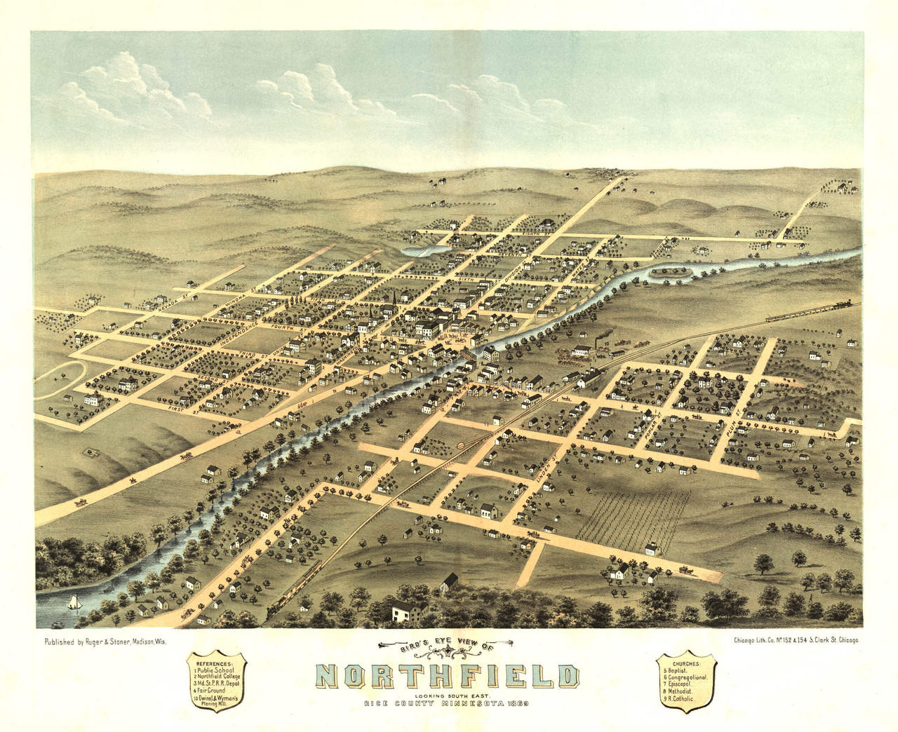
Getting around campus and town
Coffee in town: Goodbye Blue Mondays, Little Joy
Networking locations Sunday, Tanzenvald (9, 8 kitchen), Fairfield hotel bar (11)
Weitz Center for Creativity
  Café 7:30 am -3:00pm
Restrooms and elevators
  All Gender restroom on bottom floor

Slide 8

Code of Conduct
https://serc.carleton.edu/218231
All participants in SERC events are expected to abide by this SERC Code of Conduct.
Treat other participants with respect and consideration.
Be considerate, collegial, and collaborative.
Communicate openly, with civil attitudes, critiquing ideas rather than individuals.
Frame discussions as openly and inclusively as possible and be aware of how language or images may be perceived by others.
Avoid personal attacks and harassment directed toward other participants in attendance.
Alert meeting security personnel, SERC staff, or SERC leadership if they notice someone in distress, or perceive a potentially dangerous situation, or witness a dangerous situation.
The following behavior will not be tolerated:
Harassment, intimidation, or discrimination in any form.
Physical, written, electronic, or verbal abuse of any participant.

Slide 9
Quick overview of the program https://serc.carleton.edu/309408
Sunday: Introductions, Dinner, Convener panel
Monday:
  Presentations by educators
  Learning about MATLAB tools for teaching
  Work time in groups
  Lunch on campus and dinner together at a local restaurant
Tuesday:
  Planning work time
  Individual/group work time
  Presenting your teaching activity progress to your group for feedback
  Workshop synthesis and next steps
  Lunch

Slide 11
Two part instructions:
Group sorts by the criteria provided
Talk to your neighbors using the prompt

Slide 12
Starting Friday, how far did you travel to get to this workshop?
Front of room
Discuss in pairs or trios:
Where you work?
What classes you teach?
Smallest/
nearest
Largest/
Farthest

Slide 13
What is your current discipline or department?
o
Front of room
Discuss in pairs or trios:
Physics,
Education,
Economics
Math
Stats
What do you teach with MATLAB and what are you hoping to learn here?
Engineering
Catch all
Biology, Chemistry
Marine
Environmental
Electrical engineering
Computer science

Slide 14
How many people are in your department?
Front of room
Discuss in pairs or trios:
Up to 5
6-10
Are you using AI in your teaching: Discuss
More than 15
10-15
Something else

