Slide 1
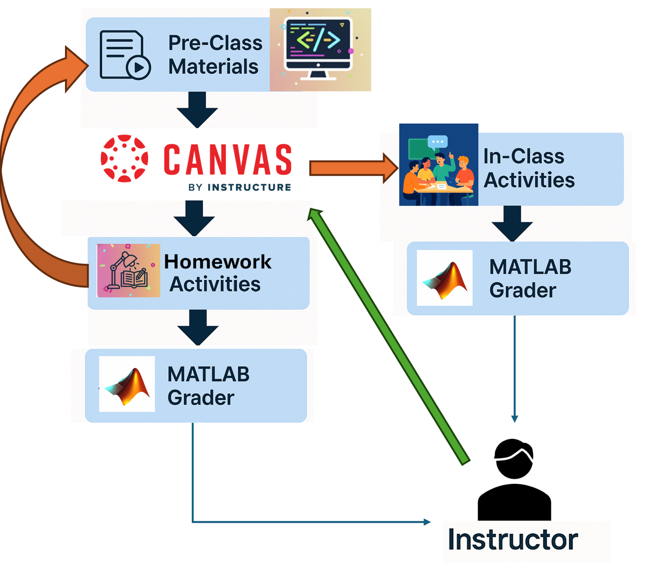
Randomizing Quizzes: The Canvas MATLAB Grader Combo
Edwin Marte Zorrilla, PhD.
Instructional Assistant Professor
University of Florida
2025 Teaching Computation with MATLAB
October 26-28, 2025
Carleton College, Northfield, MN

Slide 2
Agenda
Introduction
Some Context
Failed Attempt
Approach

Slide 3

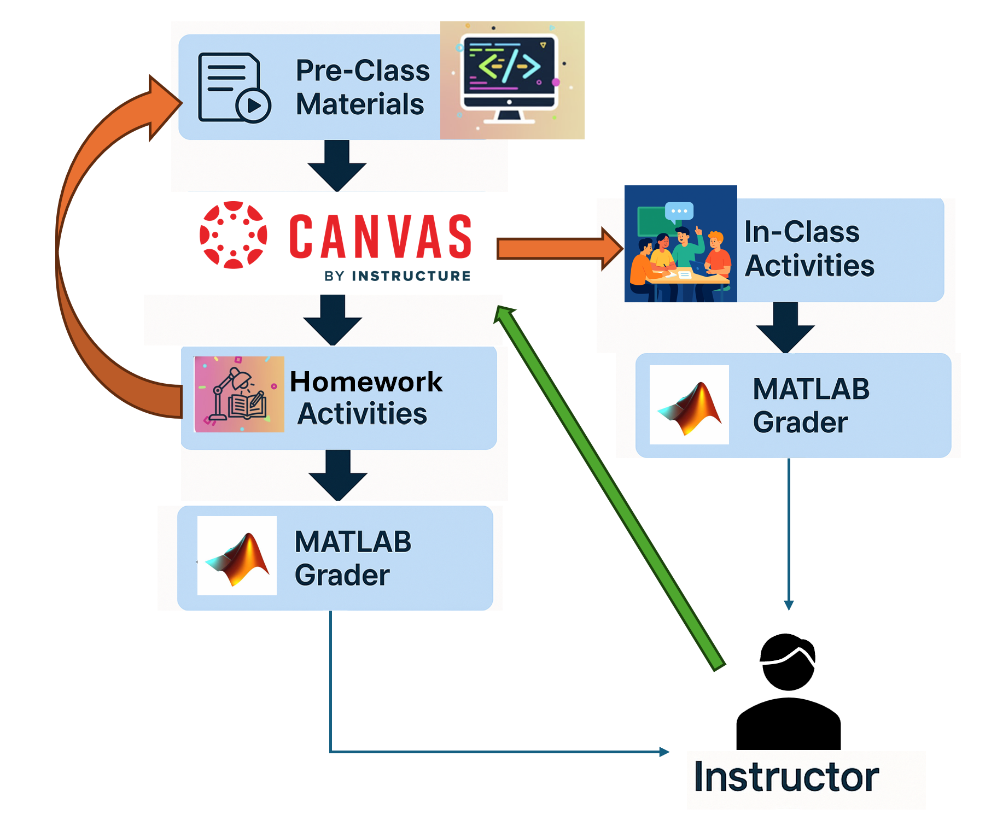
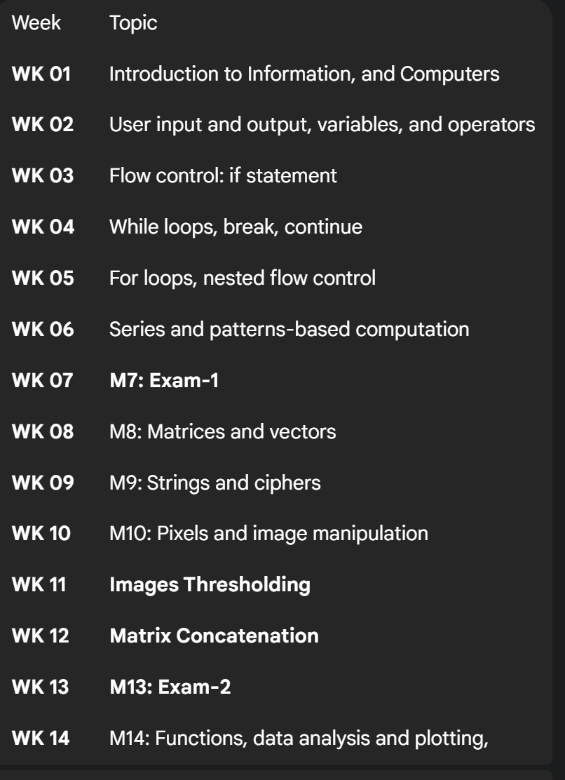
Programming for Engineers in Matlab – COP2271

Slide 4
Programming for Engineers in Matlab – COP2271

Slide 5
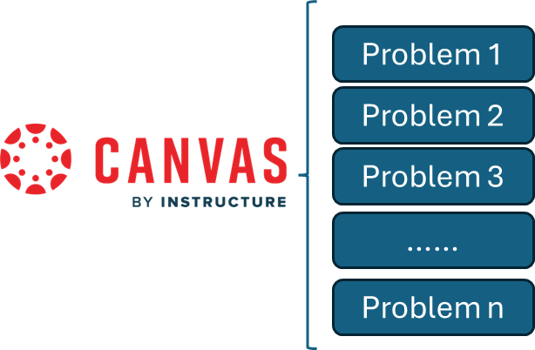
Using the Tools in Exams
Ensure fairness
Reusability
Protect exam integrity
Reduce answer sharing
Unique quizzes for each student

Slide 6


Using the Tools in Exams
Ensure fairness
Reusability
Protect exam integrity
Reduce answer sharing
Unique quizzes for each student

Slide 7
Using the Tools in Exams
Problem 1
Problem 1
Problem 2
Problem 3
……
Problem n
Ensure fairness
Reusability
Protect exam integrity
Reduce answer sharing
Unique quizzes for each student

Slide 8
Using the Tools in Exams
Problem 1
Problem 1
Problem 2
Problem 3
……
Problem n
Ensure fairness
Reusability
Protect exam integrity
Reduce answer sharing
Unique quizzes for each student
Code

Slide 9
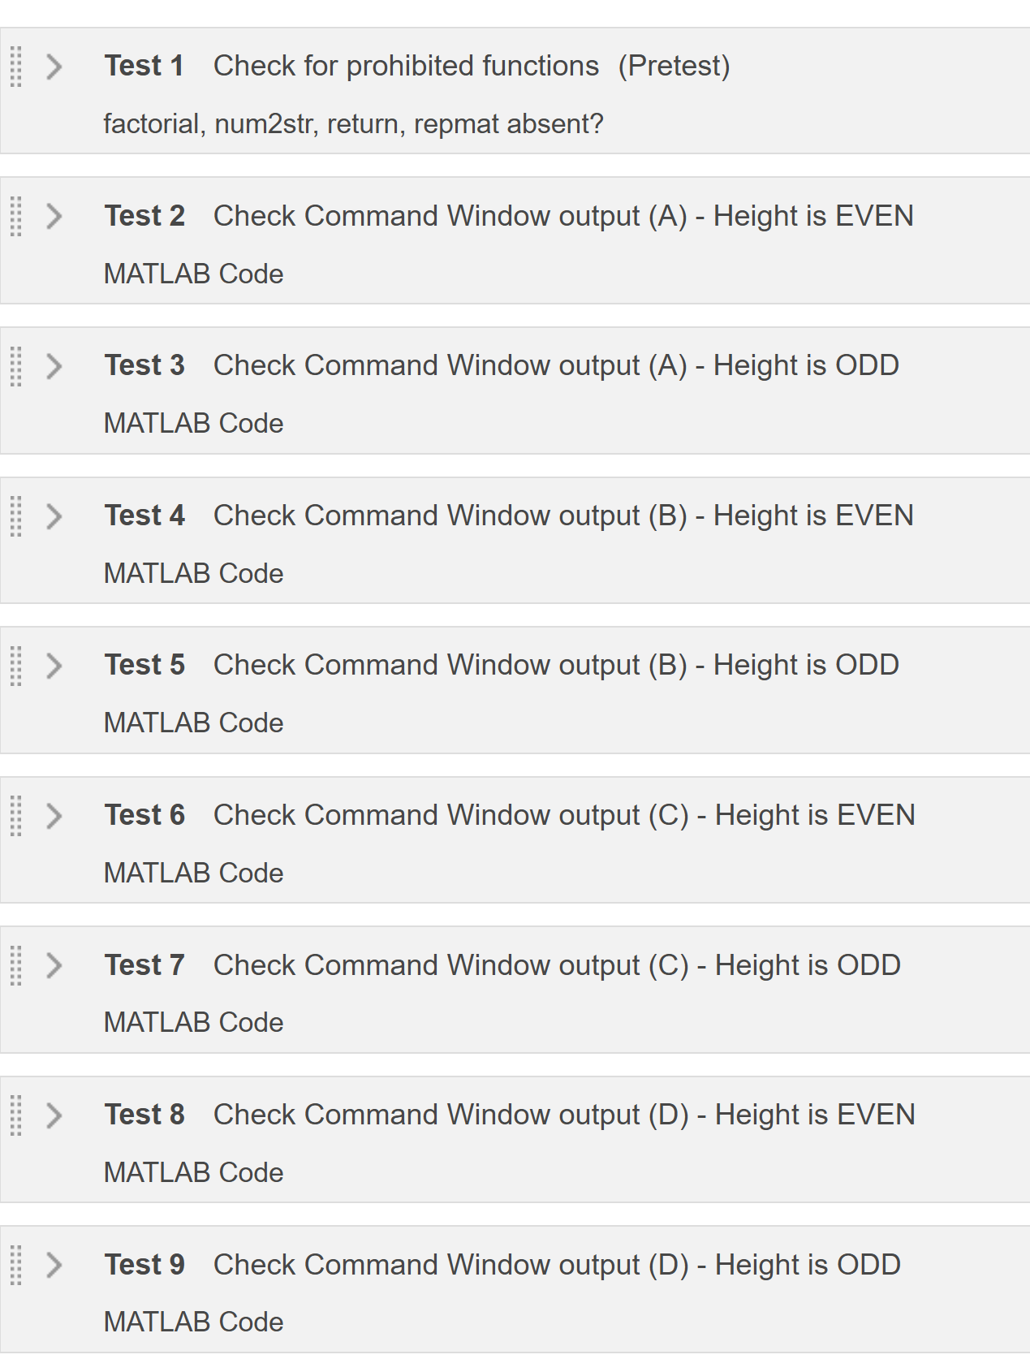
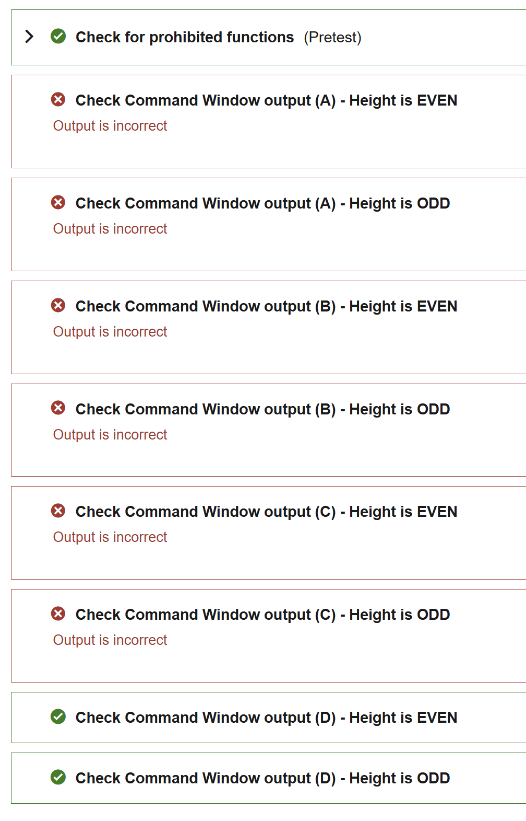
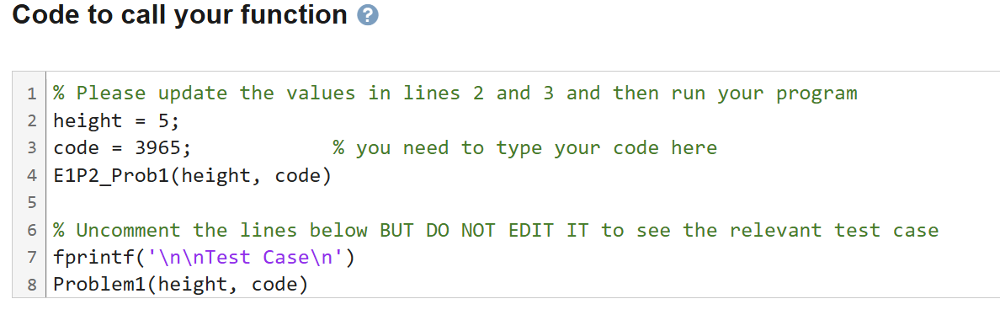
First Failed Attempt

Slide 10
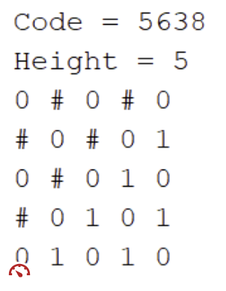
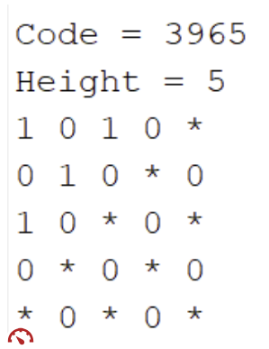
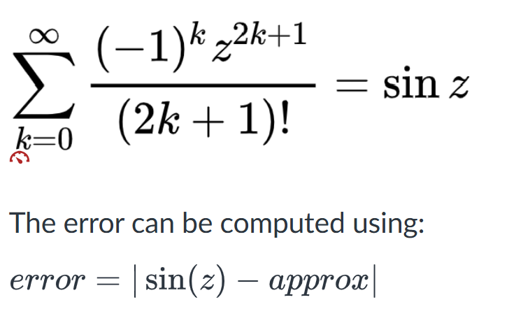
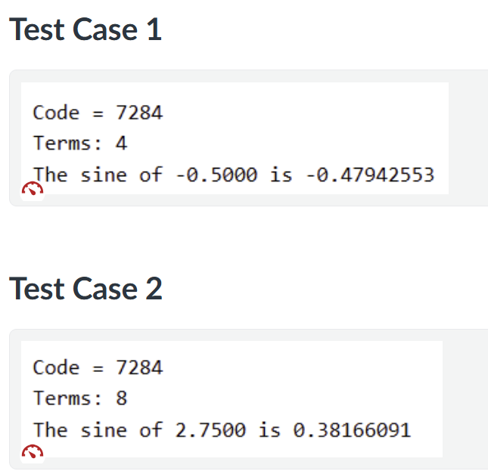
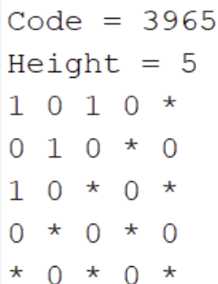
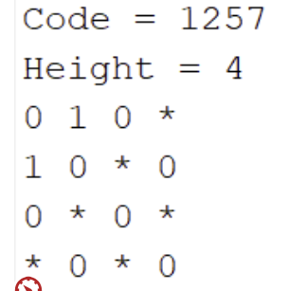
Example Problems
Code 4366 error = 1e-5;
Code7284 error = 1e-6;
Code 8751 error = 1e-7;
Code 1945 error = 1e-8;
Pattern Problem
Approximation Problem

Slide 11


Problem Design Approach in Matlab Grader
Function [code] = reference_function(parameters, code)
Switch code
code 1
solution 1
code 2
solution 1
:
:
code n
solution n
end
parameter = something;
[code]= student_function (parameter)
Call function Box
parameter = something;
[code] = student_function (parameter);
results = strip(evalc(' student_function (parameter)’));
resultsRef = strip(evalc('reference.reference_function(parameter, code)’));
assert(strcmp(results, resultsRef), 'Output is incorrect')
Reference Solution
Function [code] = student_function (parameters)
%TYPE YOUR CODE
code = 2333;
end
Command Window Output Assessment
Student Template

Slide 12
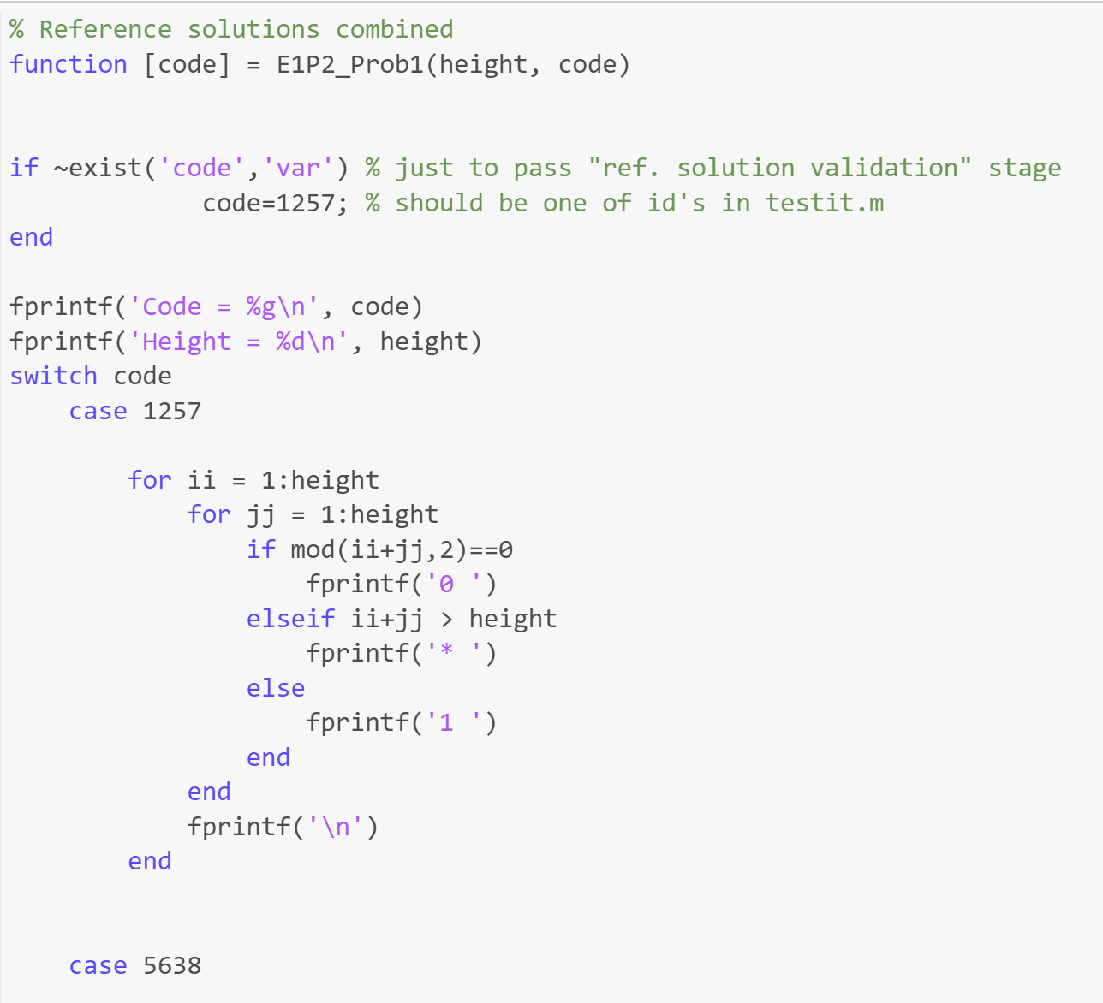
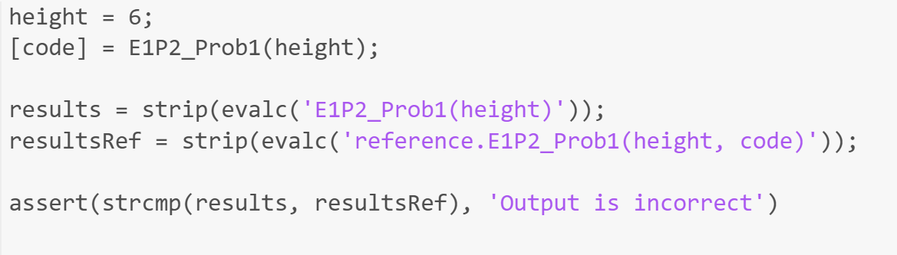
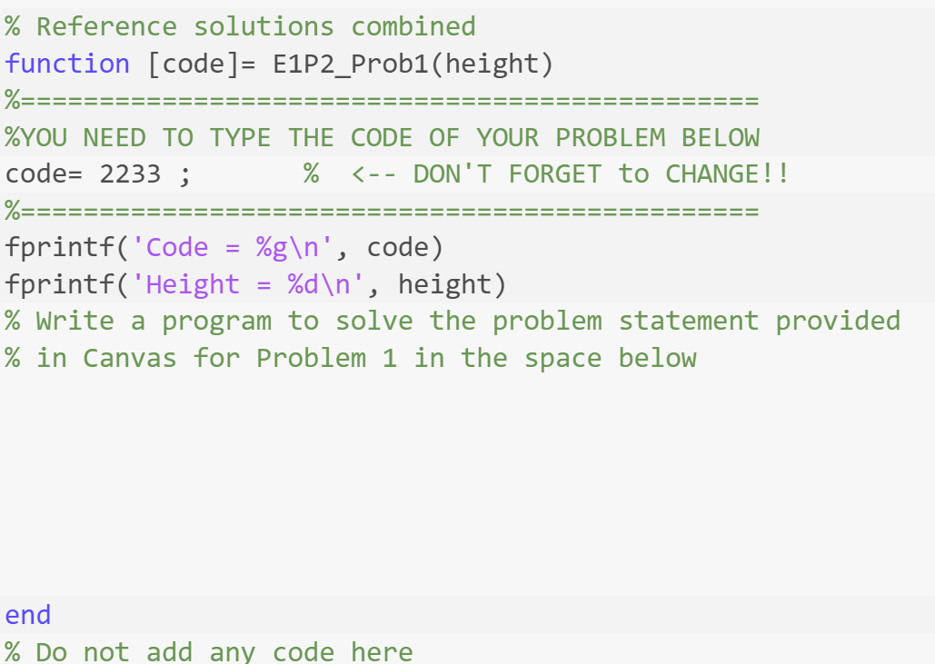
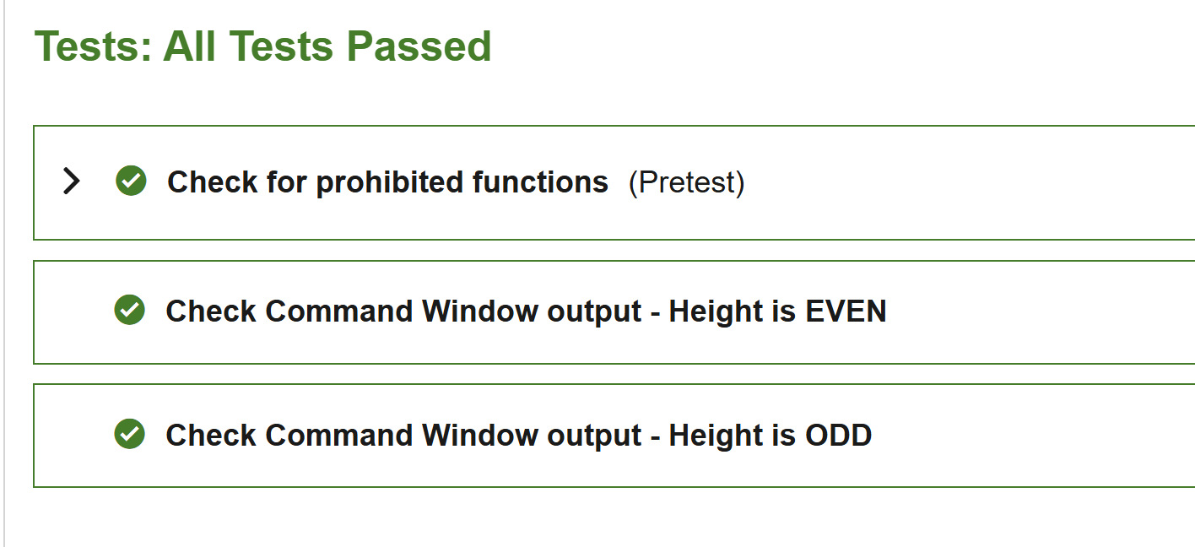
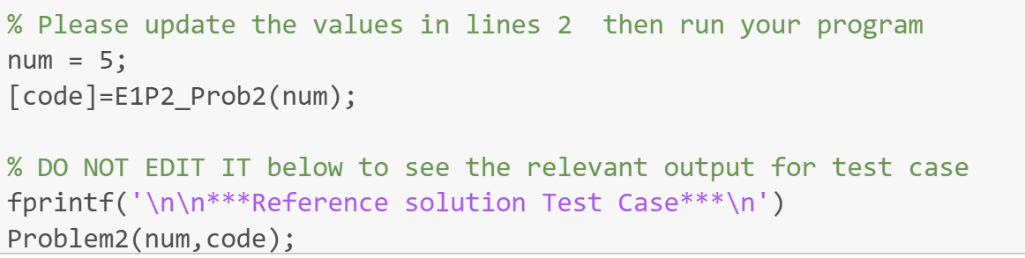
Pattern Problem
Assessment
Student Template
Reference Solution
Call function Box

Slide 13
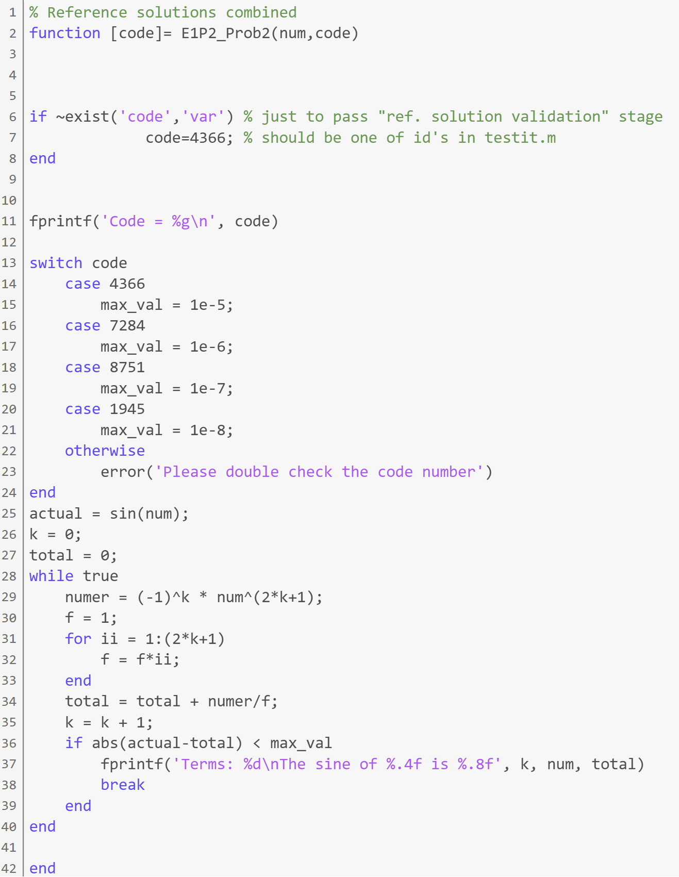
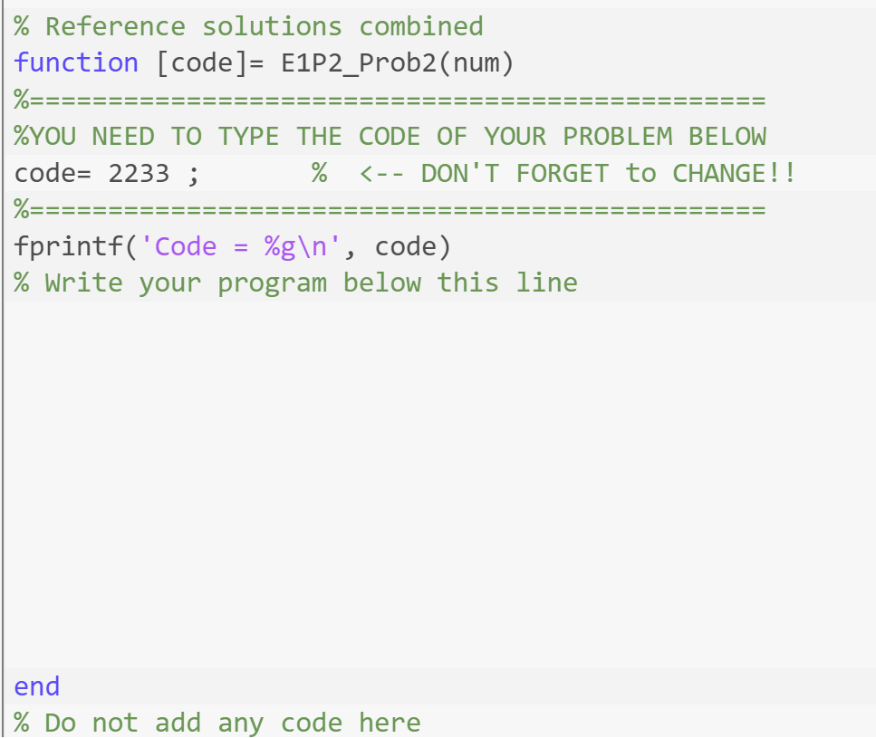
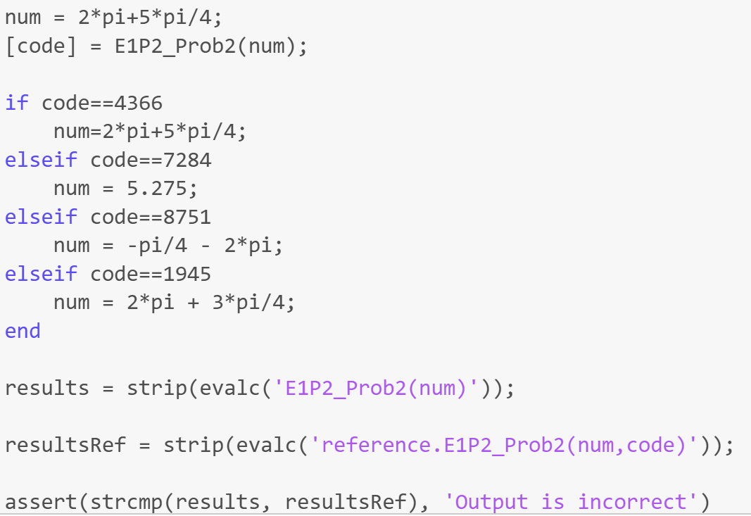
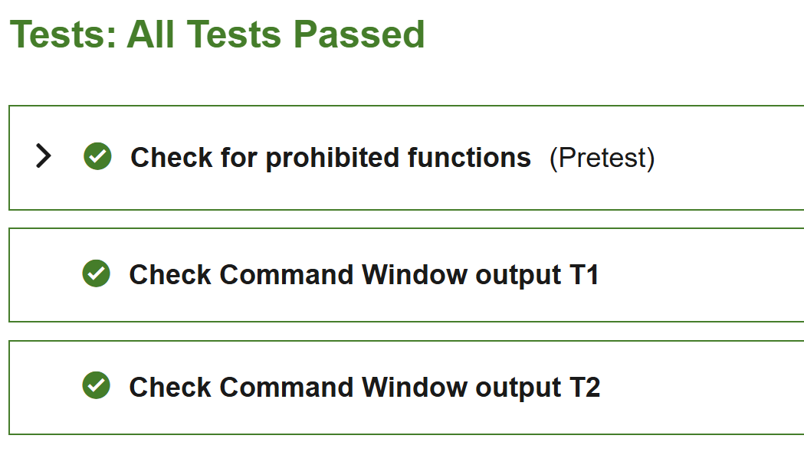
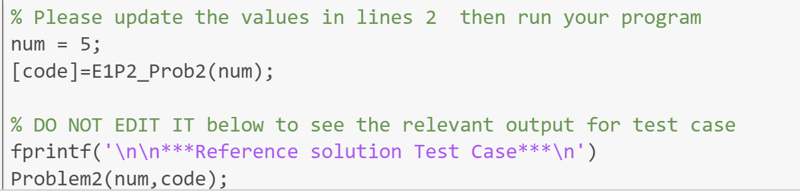
Approximation Problem
Student Template
Assessment
Reference Solution
Call function Box

Slide 14
Results
Integrated randomized MATLAB Grader problems within a single Canvas shell, enabling simultaneous grading of multiple quizzes and exams.
Achieved a significant reduction in grading time for programming-based assessments by automating test case evaluation.
Simplified assessment design process — quizzes and exams can be easily duplicated, randomized, and aligned with learning outcomes.
Improved grading consistency and fairness through standardized rubrics and automated feedback.
Enhanced student learning experience with immediate feedback and multiple randomized practice opportunities.

Slide 15

Thank you
Edwin Marte Zorrilla, Ph.D. Instructional Assistant Professor
University of Florida
Email: emartezorrilla@ufl.edu
Phone: 352-392-0638

