Slide 1
Jacqueline Henderson, PhD Associate Professor, Mechanical Engineering / Biomedical Concentration Bradley University
What A Surprise: Addressing Educational Trials Through Self Paced Matlab Structure

Slide 2
Introduction
Personal Experience
First use of Matlab as researcher (postdoc)
Initially used 3-5 lines when 1 or 2 needed
Limited access to toolboxes
Mastering Matlab was my reference of choice
Teaching Philosophy for Matlab Based Course
Create “community” of learning
Encouraged to talk to each other as they work in class
As they learn they share
Navigate reference materials when coding (pre copilot)
Personal Experience
Teaching Philosophy in Matlab
Notes:
Create an environment where they don’t leave the class hating Matlab,

Slide 3
Introduction
Previous experience with freshman
Students had limited or no true coding experience (student quiz)
Student Impact (Matlab)
Required 3 question quiz
I took a computer programming class prior to taking ME 273
I learned or was exposed to a programming language outside of a classroom setting
What programming languages have you leaning or been exposed to? List all.
Limited experience
Teaching as if students are familiar to coding
Teaching Philosophy when a coding based program is involved
Notes:
ME 273 is Computational Methods in Mechanical Engineering
Pre requisites ( C or better in physics 1 and Cal 3) Co req with Differential Equations
ME 303 Instrumentation and Measurement

Slide 4
Introduction
F 25 (28) |  | Sp 25 (23) |  | F 24 (25) |  | F23 (28)
Q1 (T) - 14 | 50% | Q1 (T) - 9 | 39% | Q1 (T) -7 | 28% | Q1 (T) - 8 | 29%
Q2 (T) - 14 | 47% | Q2 (T) - 8 | 35% | Q2(t) - 10 | 40% | Q2(T) - 15 | 54%
 |  | n/a - 2 | 0.90% | n/a - 1 | 0.40% | N/a - 1 | 0.45%
ECE 227 - 10 | 36%
Question Outcome
(Student Response) Languages learned or exposed to
C++ Matlab Python Raspberry Pi Arduino Java
Visual Basic CSS HTML Google sheets Excel Vex, FLL (robots)
Creo/CAD Block code (scratch, NXT) I don’t remember
Notes:
ME 273 is Computational Methods in Mechanical Engineering
Pre requisites ( C or better in physics 1 and Cal 3) Co req with Differential Equations
ECE 227 – Circuits class with a lab
Location of exposure – Internship, STEM programs ( Girls who code, First ), various classes where it was used as a tool but limited, High School

Slide 5
Class Environment
Create a learning environment for self paced learning
Every lab module due 7 days after assigned (.mlx and pdf)
Module has examples to work through and application
Self - Paced
Notes:
Some assignments they can complete during class time (75 min class) Lecture/explanation no more that 5 min – 15 min. Before this semester students would ask if they could have and extension if they were stuck or it was taking longer then expected.
Show Lec 5

Slide 6
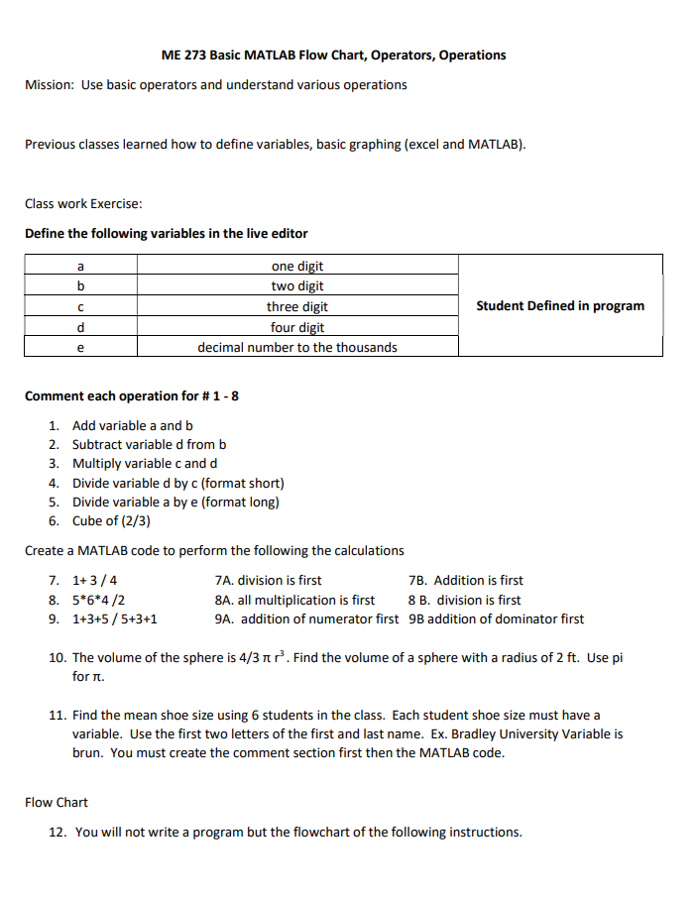
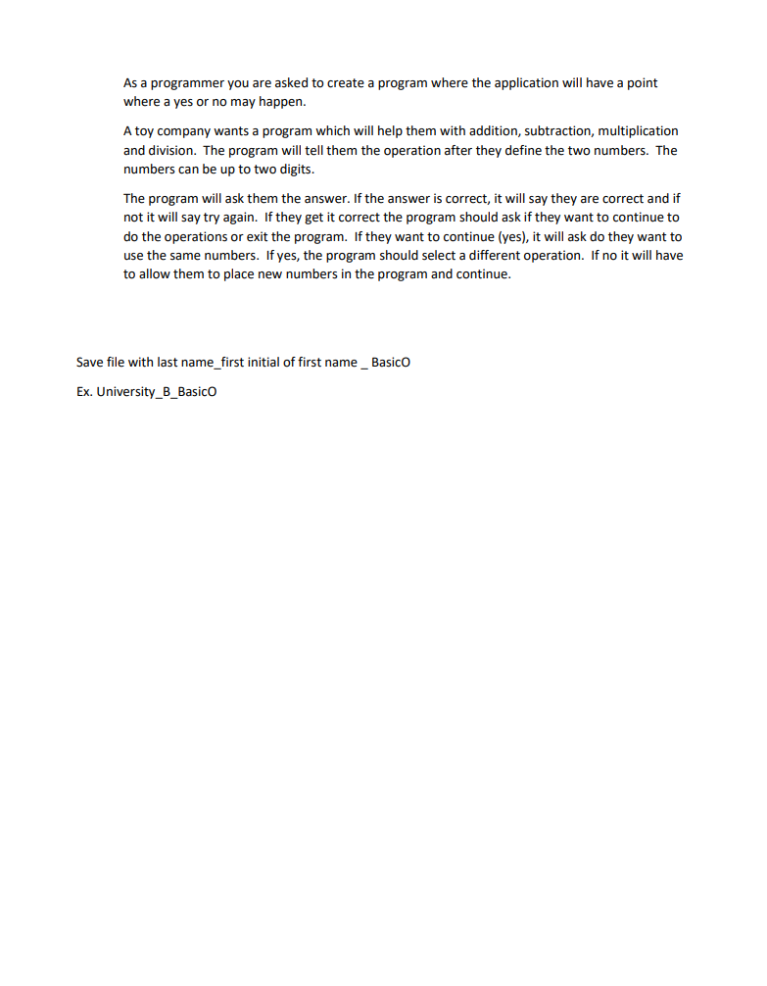
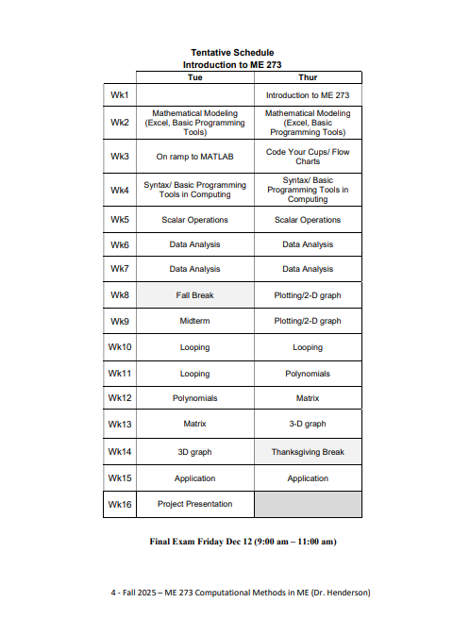
Topics covered
Notes:
This is an example of and initial modules

Slide 7
Conclusion
School purchased full access to Matlab (toolboxes, co pilot)
Great opportunity for students to have access but a program thinking ahead and pushing the code does not allow the student to think about how to find the next step.
Grader has identified more AI copies
I made them go back and redo the assignment properly and discussed with students how they can use but not just cut and paste
Class has been more aware when AI is within code.
The surprise !!!!!!!
Notes:
How class has changed: Students are encouraged to work with each other as they would debug each other codes and share what they learned. There were encouraged to look at help areas of MATLAB. Before they will about for a deadline delay based on working on and assignment, tests in other classes, life. Initially the assignment shown on previous slide put this in AI because they were in a bind. It was caught because certain numbers and comments were the same or similar. None of these students worked together or sat near each other in the room.

Slide 8

If you are always trying to be normal, you will never know how AMAZING you can be.
Maya Angelou – American Poet

