Slide 1
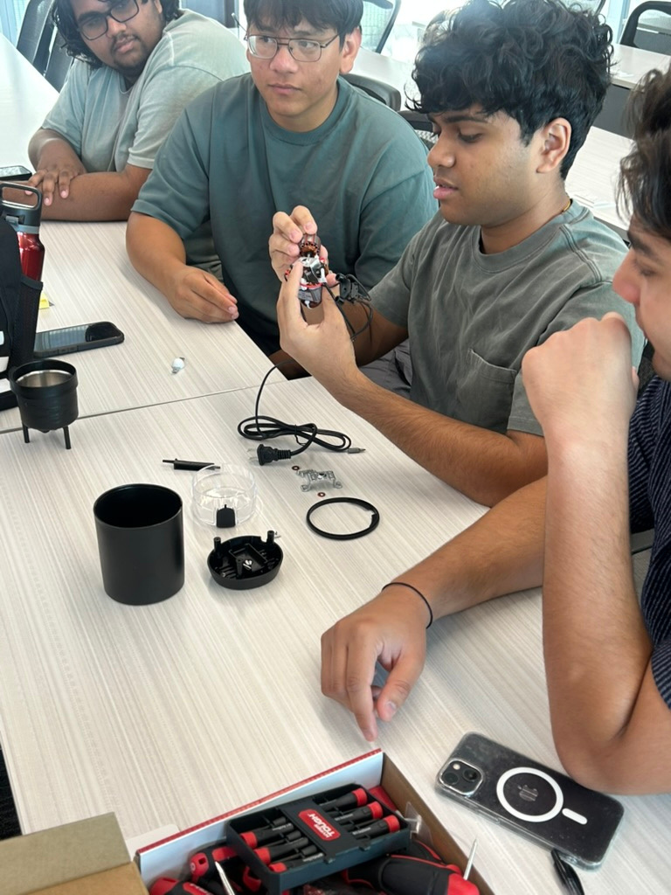
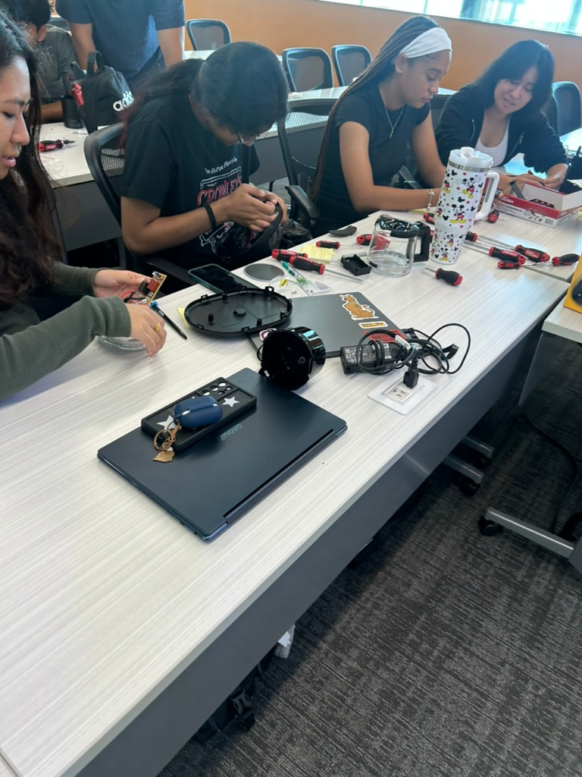

COURSE AND CURRICULAR CHANGE
THROUGH A SHARED UNDERSTANDING OF COMPUTATIONAL THINKING
Dan Burleson, PhD
Director, First Year Program
Professor of Instruction, Mechanical Engineering
daniel.burleson@utdallas.edu

Slide 2
What percent of each is needed for our students to be successful?
MINDSET
SKILLS

Slide 3

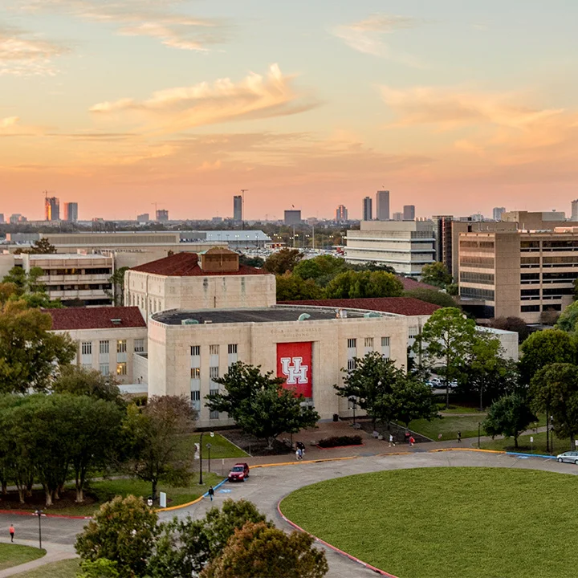
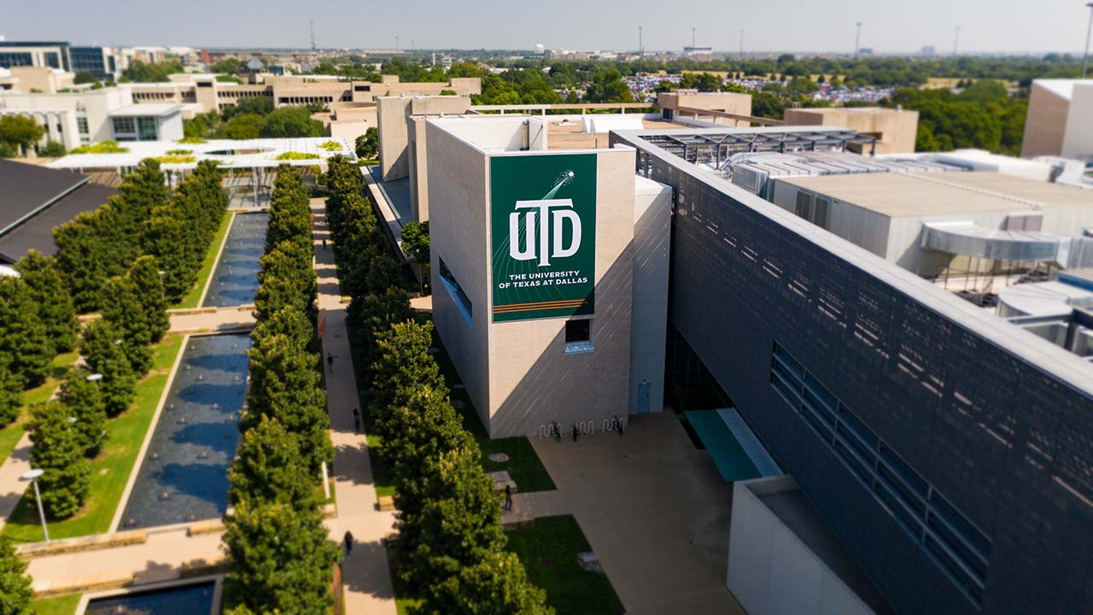
My Persepective
Course and Program Development in First Year Engineering
University of Houston
University of Texas at Dallas
Computing and Problem Solving Course in the First Year Experience
Director for the First Year Program
Focus on curriculum development and course impact
Building a common, foundational first year program that supports and enhances the student experience In both engineering and computer science.

Slide 4
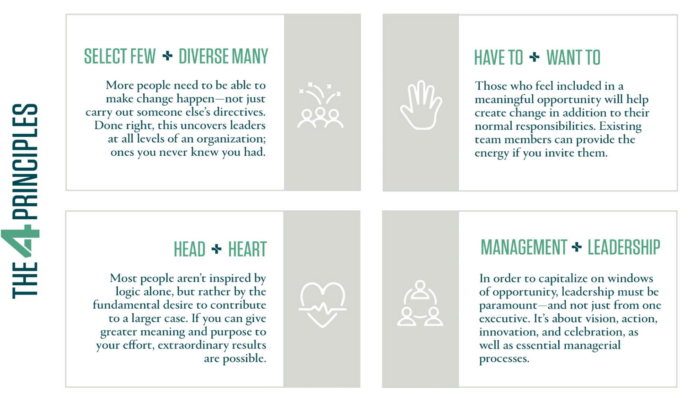
Kotter, Akhtar, and Gupta (2021)

Slide 5

Course Change
Joy?
ENGI 1331: Computing and Problem Solving
University of Houston
Problems
Stakeholders
Students
Next Courses
Teaching Assistants
Other Instructors
Course Detail
80 student sections
2 UTAs per section
Problem solving using MATLAB
GenAI?

Slide 6
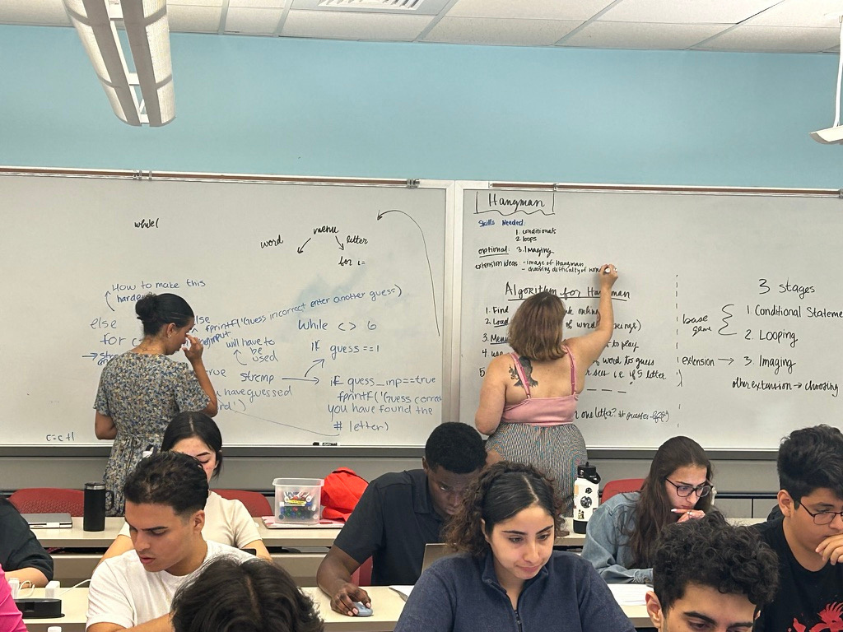
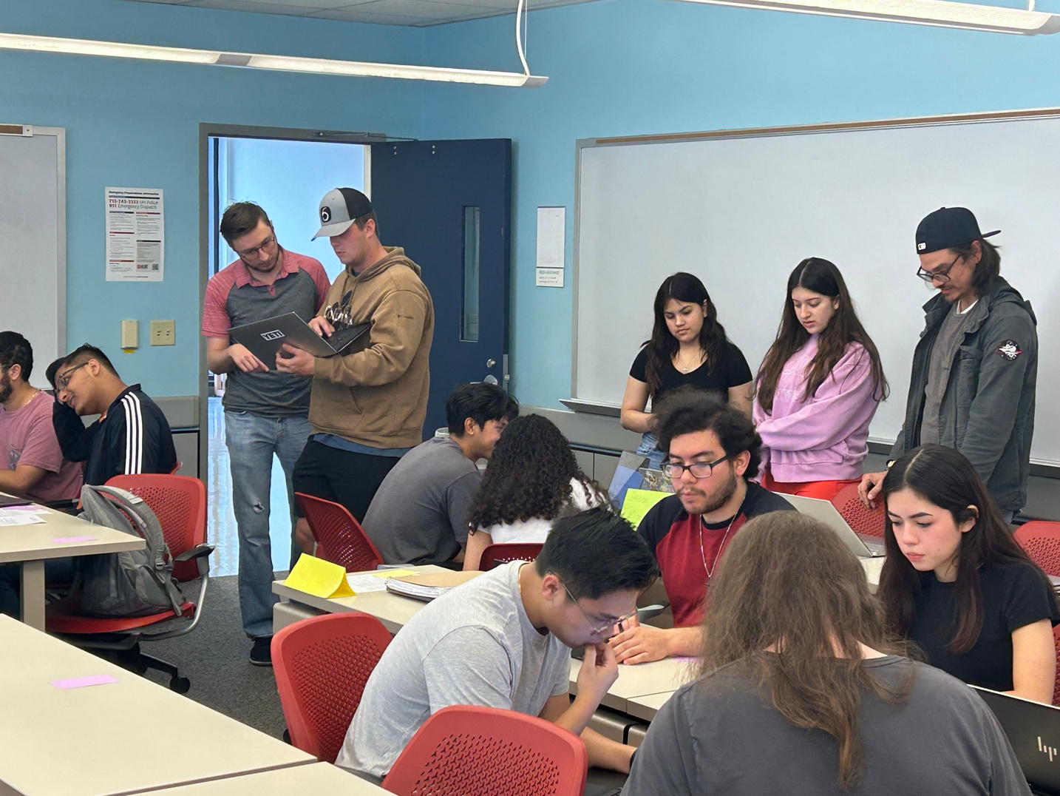
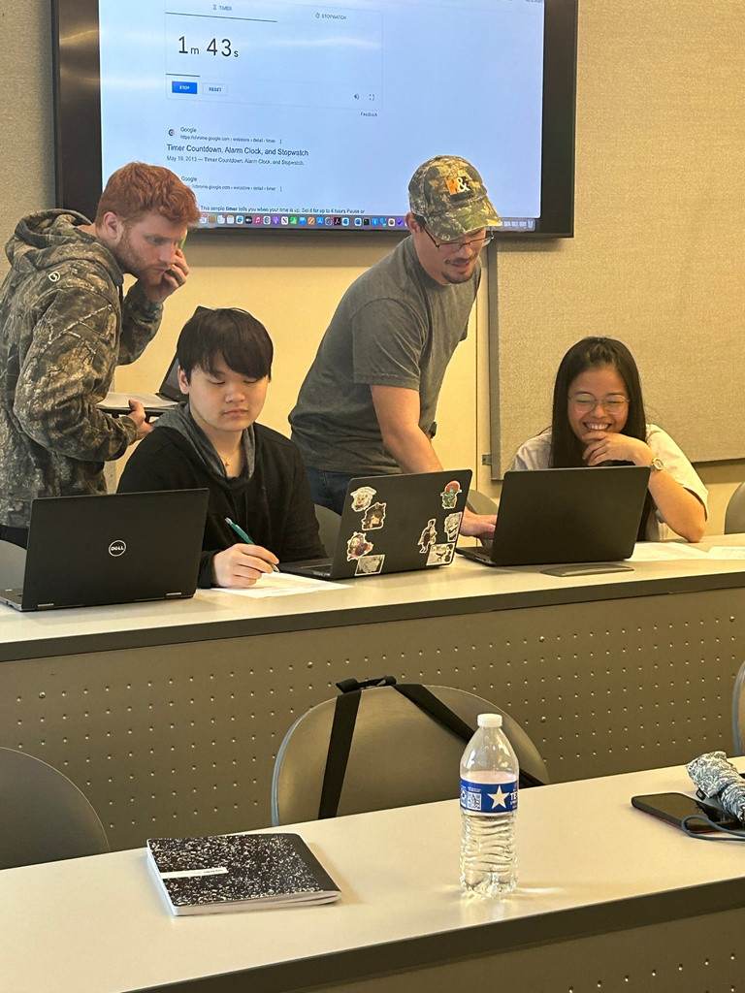
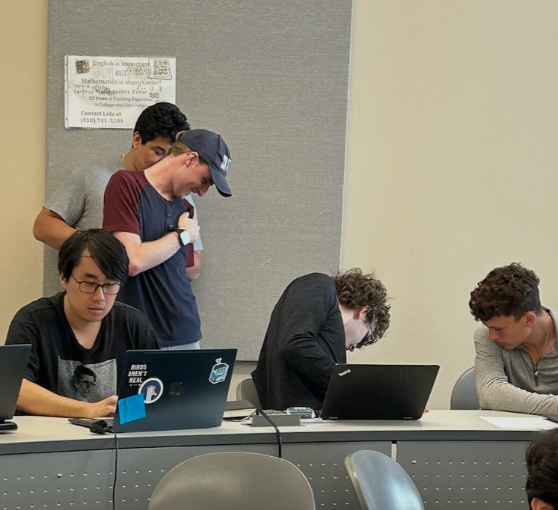
How can we impact mindset In our approach?
What is that mindset?

Slide 7



Introduction to Computing and Problem Solving (First Year Engineering)
Module and Topic
I am a Programmer
I am a Problem Solver
I am a Programmer
I am a Problem Solver
Short Quizzes, Mastery-Based Reading and Coding assignments.
Weekly group checkpoints, individual assignments, technical videos and written document
Final Assessment: Individual Written
Final Assessment:
Code Exam
I am an Engineer
I am a Designer
I am a Gamer
I am a Designer
I am a Gamer
Weekly group checkpoints, individual assignments, technical videos, group expo
Weekly group checkpoints, individual assignments, technical videos, group expo
Final Assessment: Technical Video
Final Assessment: Technical Presentation

Slide 8
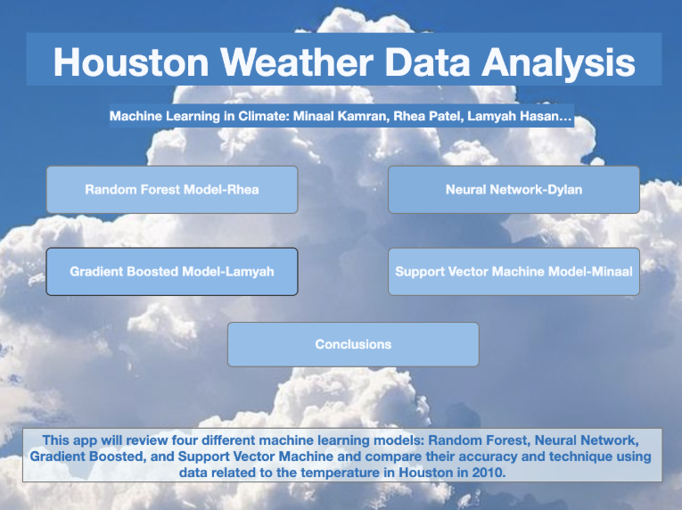
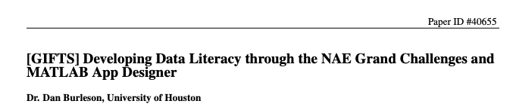
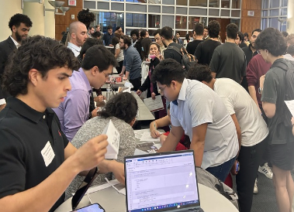
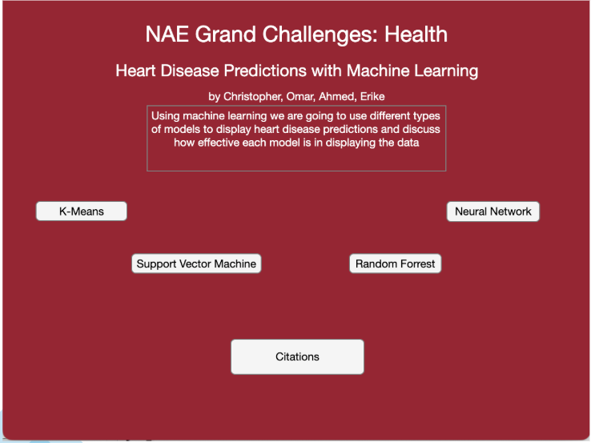

Slide 9
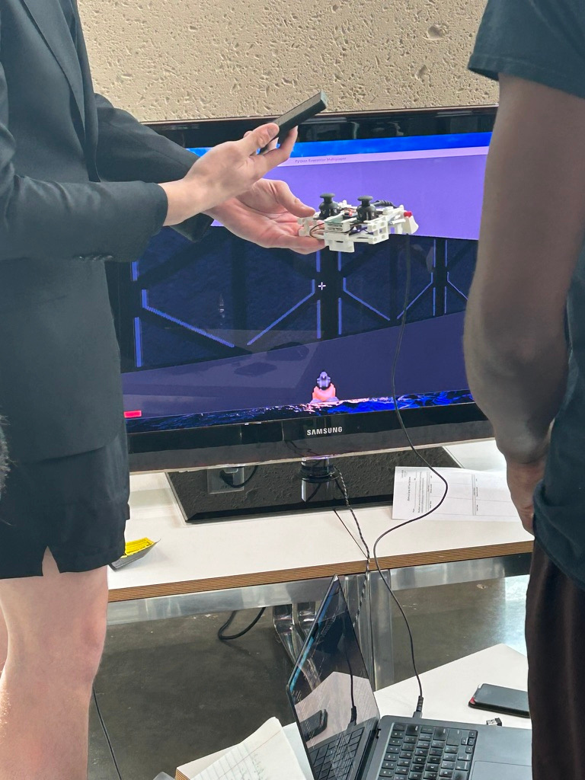
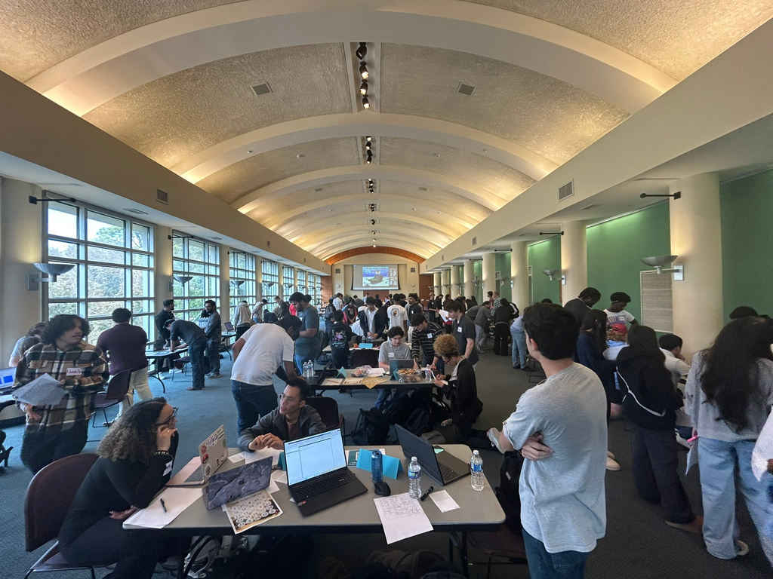
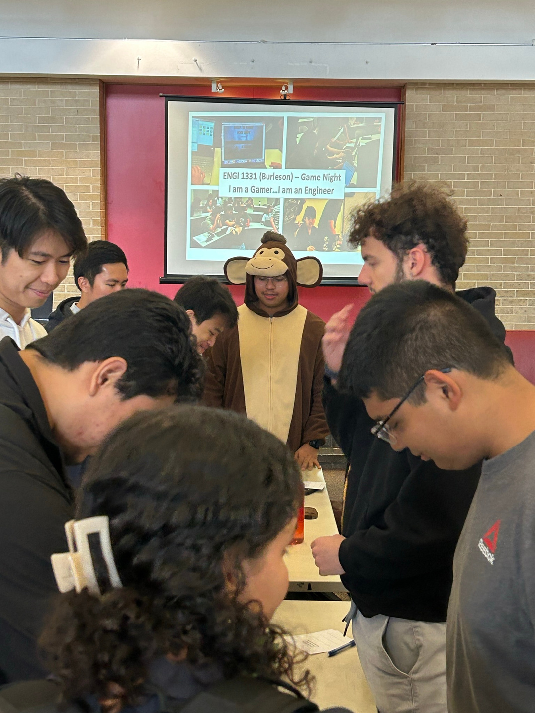
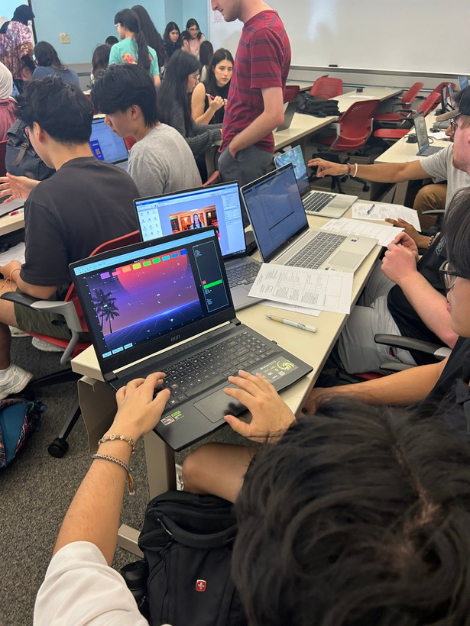
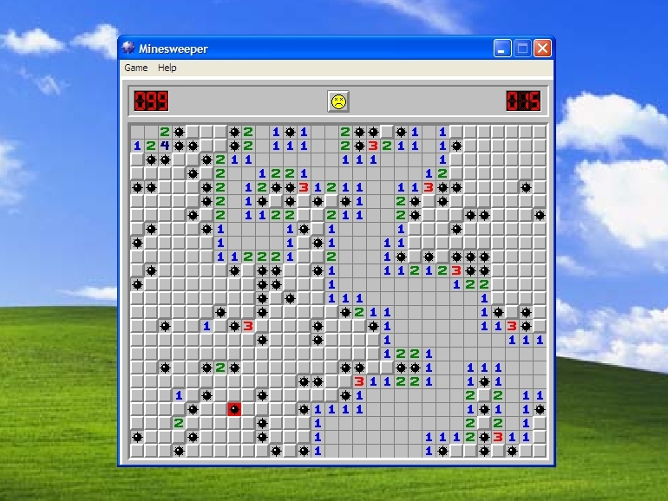
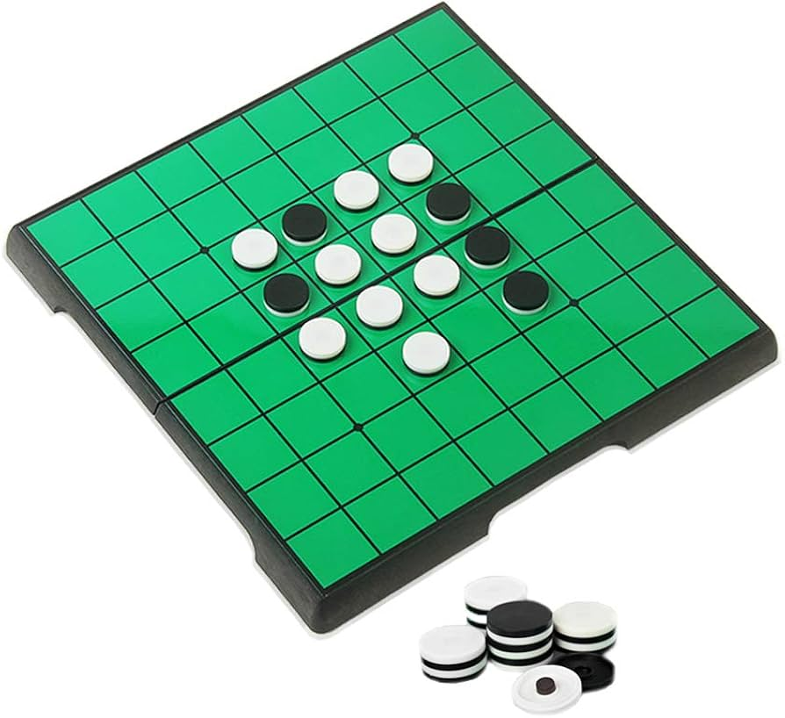

Slide 10
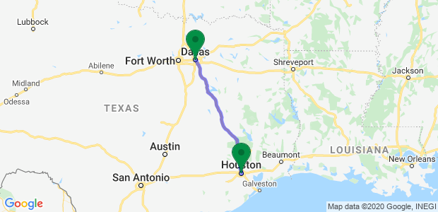
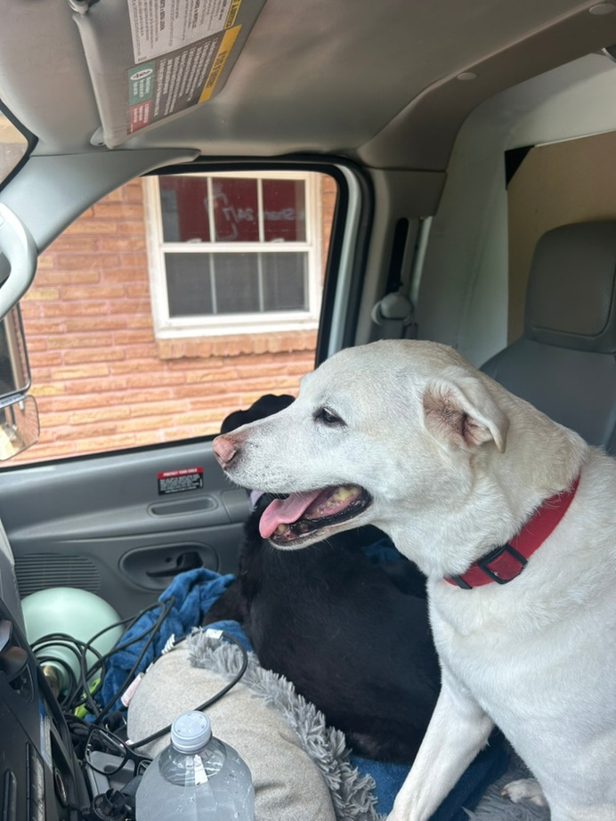

Programmatic Change
Course Change

Slide 11
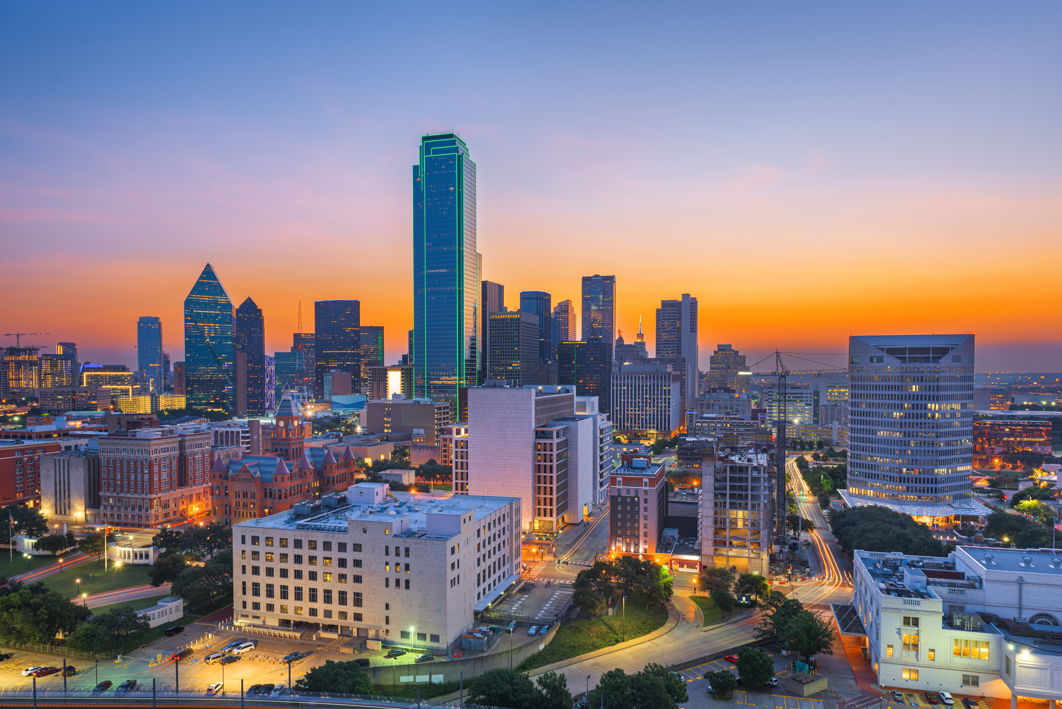
Programmatic Change
Opportunities for a First Year Program in Engineering and Computer Science at UT-Dallas
Enrollment Variability
Building School Community
First Year Retention
Increased variability In enrollment across different majors creating enrollment challenges.
Builds a cohesive school Identity across all disciplines that increases collaboration and school identity.
Address retention In the Jonsson School for first year students with a goal of 85% staying in ECS.

Slide 12
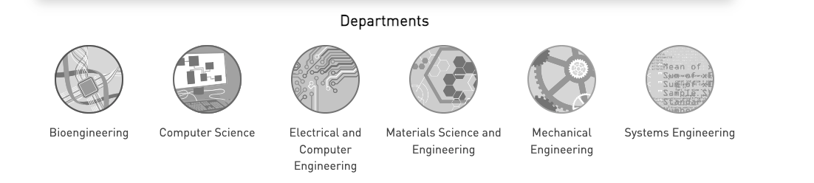
Programmatic Change
Stakeholders
First Year Instructors
Administrators
Students
FIRST YEAR PROGRAM
Recruitment
Advising
Core Math and Science
Career service and Undergrad Research
LLC and Honors

Slide 13
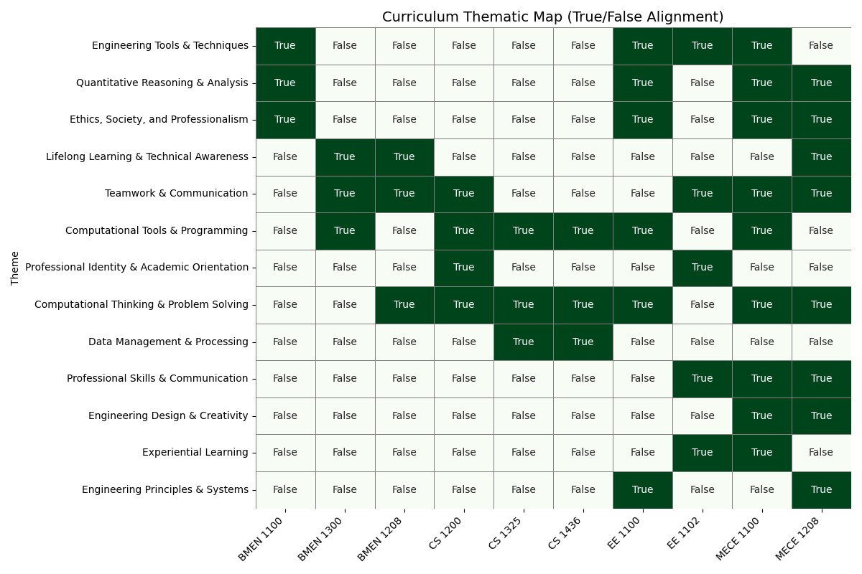

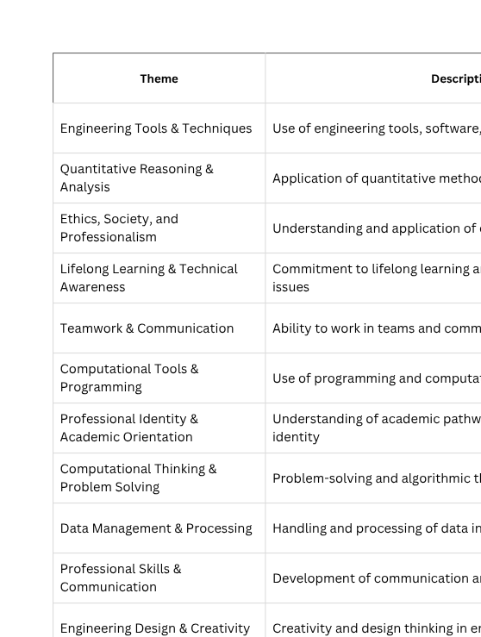
Thematic Analysis for Existing Course Syllabi

Slide 14

Meeting with Stakeholders
Number Fluency
Data Science and Visualization
Computing/Computational Skills
Proofs
Ethics
Teamwork and Collaboration
Spatial Awareness
Problem Solving
Design Thinking
College Readiness and Mentality
Exploration of Majors and Subfields
Excel
Matlab
C/C++
Basic Circuitry and Equipment
AutoCad
SolidWorks
Python
TinkerCAD
Java
Foundational Knowledge
Tools
Hands-on
Flipped Classroom
Active Learning
Undergraduate Teaching Assistants
Collaborative
Role of AI in learning and assessments
Class Size
Facilities
Scalability
Student Flexibility (transfer)
Timeline
Minimize Impact on Degree Plans
Instructional Methods
Implementation
Student Perspective
More Hands-On Opportuntities
Building Connections outside of Major
Build basic skills In other disciplines

Slide 15
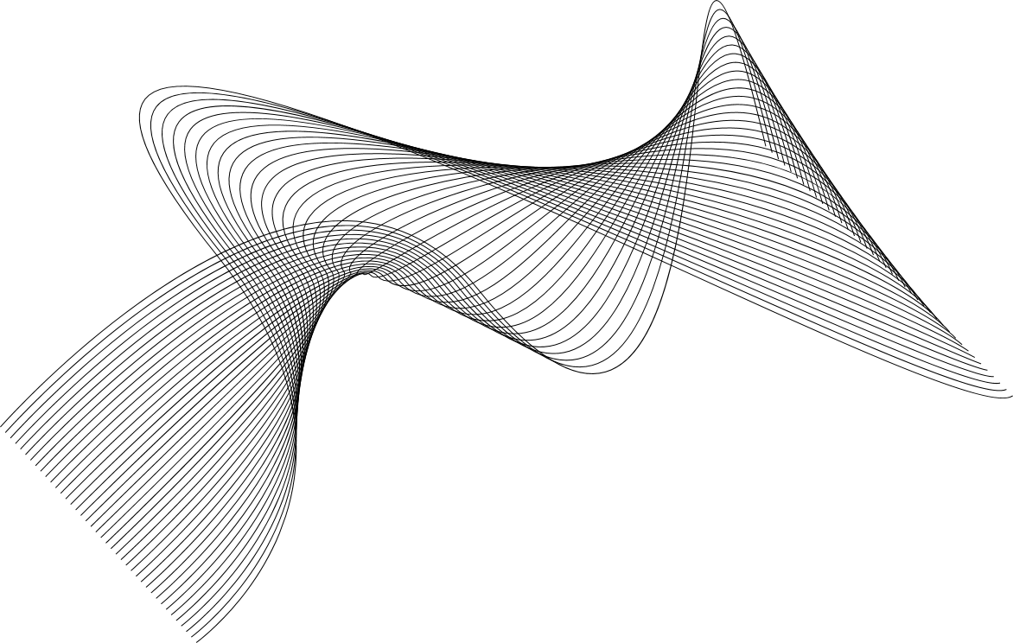
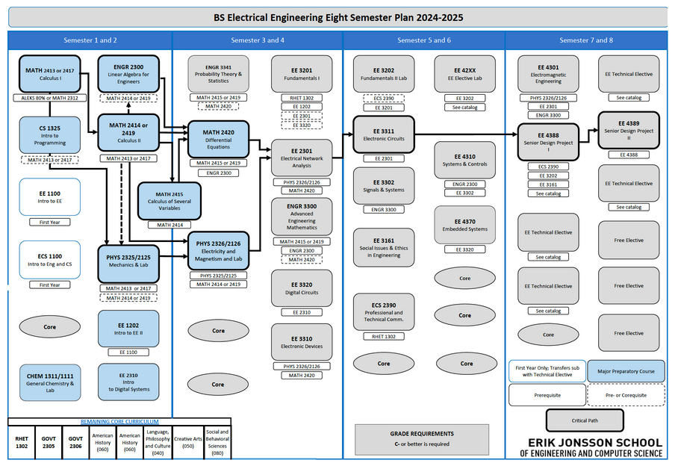
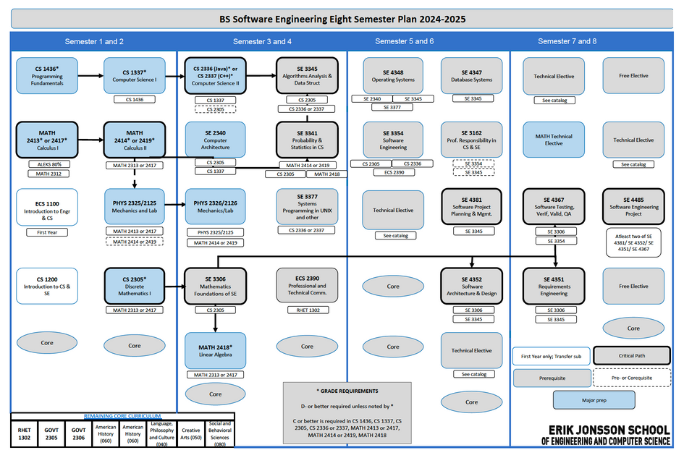
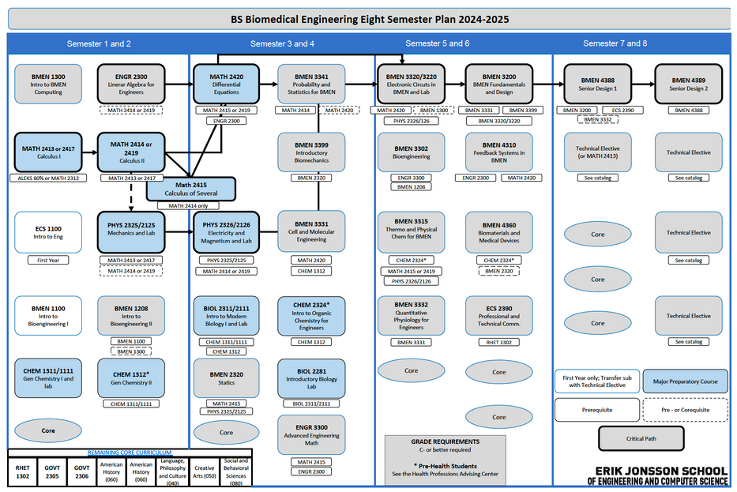



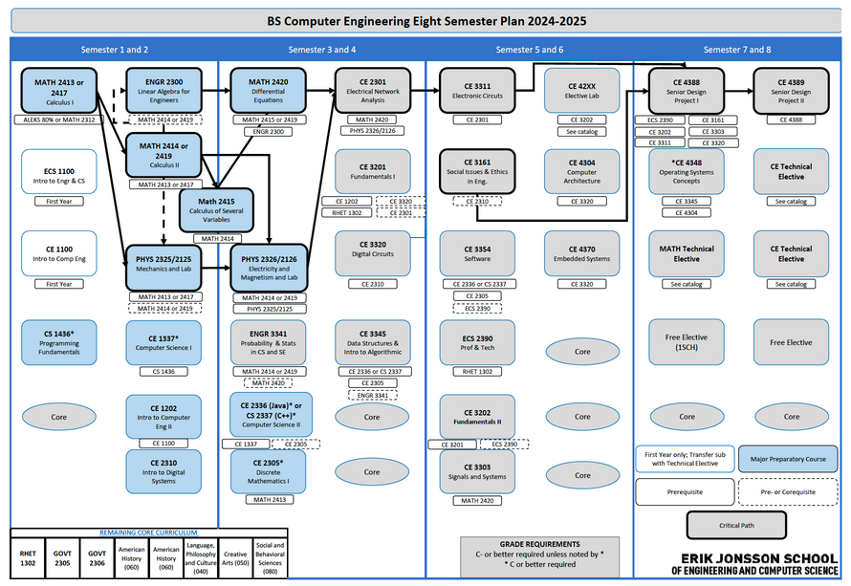
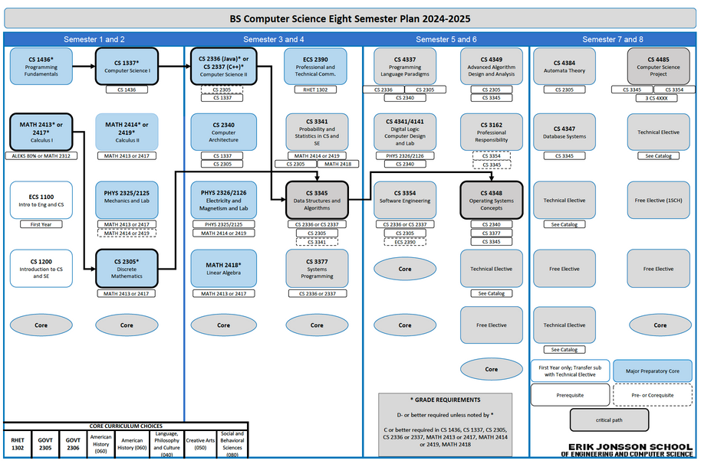
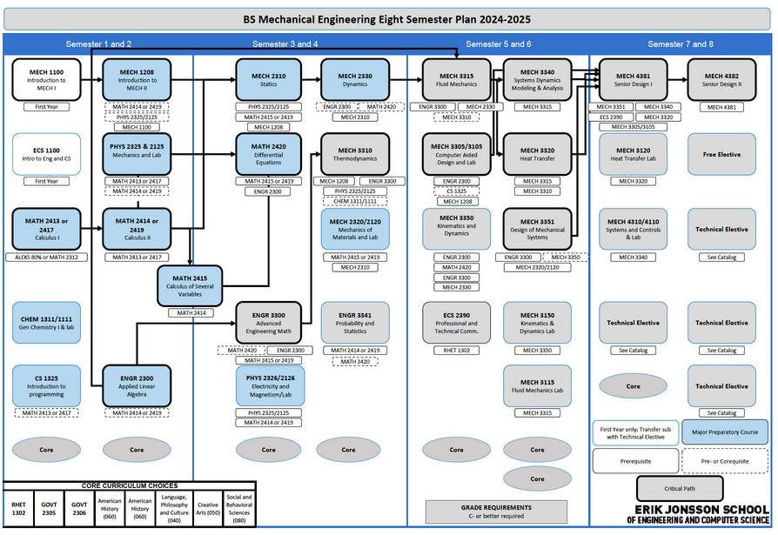
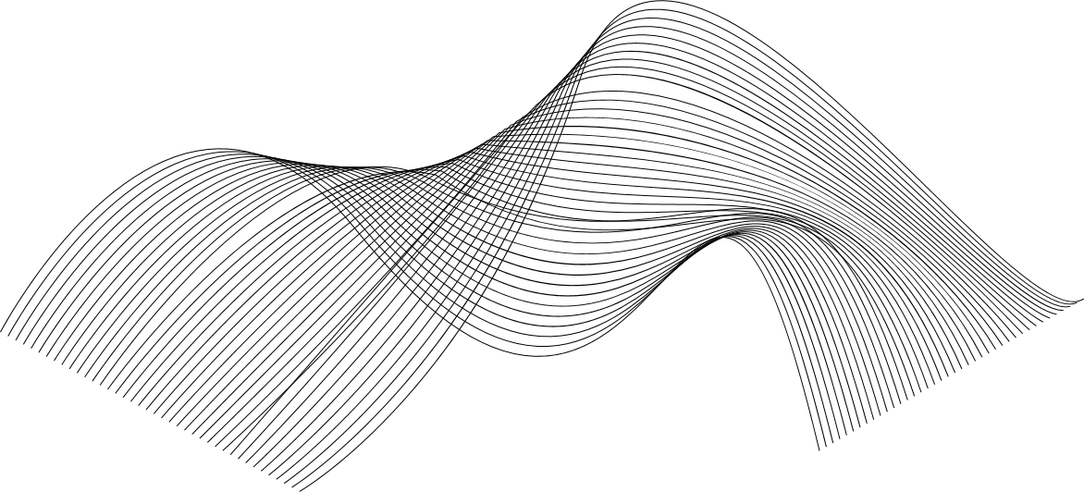
Constraints
Criteria
Full year common course sequence with no impact to overal credit hours for degree
Flexible pathways and offerings for students
01
01
Department contact for Specialized Content
Multiple tools for solving problems
02
02
Program Pathways
Co- & Pre-requisite structure
Articulation Agreements
Resource Management
Major Exploration and Engagement
03
First Year Program Design Requirements at UTD
03
Ethics
Hands-on (Active Learning)
04
04
Design Thinking
Dedicated FYP faculty with engagement in all degree programs
Teamwork and Collaboration
05
05
Problem Solving
06
07
Computational Thinking

Slide 16
Constraints
Criteria
Full year common course sequence with no impact to overal credit hours for degree
Flexible pathways and offerings for students
01
01
Computational Thinking
Department contact for Specialized Content
Main Components (Agreement)
•Abstraction Modeling
•Decomposition
•Algorithmic Thinking
•Representation
•Generalization
•Evaluation and
•Adjustment
•Pattern Recognition
•Data Visualization
Multiple tools for solving problems
02
02
Program Pathways
Co- & Pre-requisite structure
Articulation Agreements
Resource Management
Major Exploration and Engagement
03
First Year Program Design Requirements at UTD
03
Ethics
Hands-on (Active Learning)
04
04
Design Thinking
Dedicated FYP faculty with engagement in all degree programs
Teamwork and Collaboration
05
05
Problem Solving
06
07
Computational Thinking

Slide 17
Constraints
Criteria
Full year common course sequence with no impact to overal credit hours for degree
Flexible pathways and offerings for students
01
01
Computational Thinking
Department contact for Specialized Content
Main Components (Agreement)
•Abstraction Modeling
•Decomposition
•Algorithmic Thinking
•Representation
•Generalization
•Evaluation and
•Adjustment
•Pattern Recognition
•Data Visualization
Multiple tools for solving problems
02
02
But HOW do we do It?
Program Pathways
Co- & Pre-requisite structure
Articulation Agreements
Resource Management
Major Exploration and Engagement
03
First Year Program Design Requirements at UTD
03
Ethics
Hands-on (Active Learning)
04
04
Design Thinking
Dedicated FYP faculty with engagement in all degree programs
Teamwork and Collaboration
05
05
Problem Solving
06
07
Computational Thinking

Slide 18
The First Year Program enhances student success and identity development in the engineering and computer science professions by cultivating problem solving through design, computational, and systems thinking with shared curricular and co-curricular experiences and strategic engagement with departmental specializations.
Design Thinking
Computational Thinking
Key Mindset Development
Systems Thinking
Problem Solving
Notes:
Change this flow
What are the needs of students (

Slide 19

Lessons Learned
Focus on common mindsets and bring examples
MINDSET
Select Few and Diverse Many - Find your people
Mechanisms for engagement and feedback with stakeholders
SKILLS

