Slide 1

A Flipped, Active-Learning Model for Teaching MATLAB in Engineering Computing
Richard Blackmon
Associate Professor, Elon Engineering
10/27/2025

Slide 2

The Course
1st and 2nd year student target
Data Intensive designation
Main focus on arrays and MATLAB-specific functionality
  Avoiding conditionals/loops until late in the semester
Originally no pre-req; now Computer Science I (Python)
Open-ended final project

Slide 3

Original approach
Completely flipped
All instruction using Zybook
Worked problem sets in class
Bulk of grade came from problem sets
This was challenging for 1st-year students

Slide 4
Current approach
Zybook reading before class
Quiz on reading at start of class
15 minute mini-lecture
Pivot to TPS or other collaborative work if class is lost
Summative Assessment
Interactive with multiple choice questions and opportunity to code within the book
~35-40 minutes independent work on Problem Sets
Two exams and one Final Project
Students required to follow along and submit code with comments demonstrating understanding
Incentivizes students to complete reading and done in lieu of grading from ZyBook
Side Note: This course is used to introduce ABET EAC Student Outcome 7: an ability to acquire and apply new knowledge as needed, using appropriate learning strategies.

Slide 5
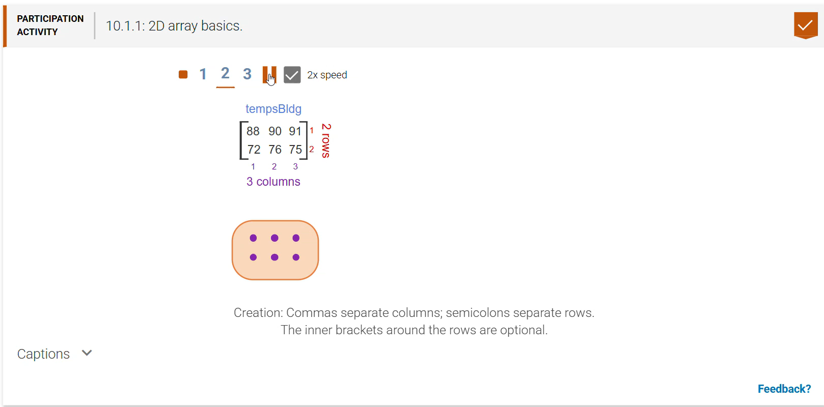
Zybook

Slide 6
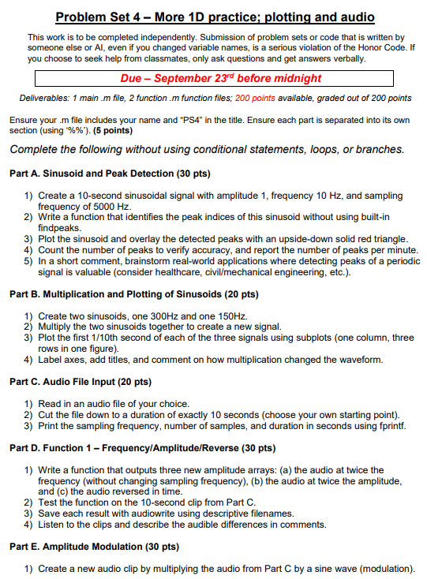
Problem Sets
Directly connected to concepts from reading
Bridge gap from instruction to hands-on/real-world application
Often include sections requiring students to reflect on applications of code or challenges generating code
  Used to continuously improve course

Slide 7
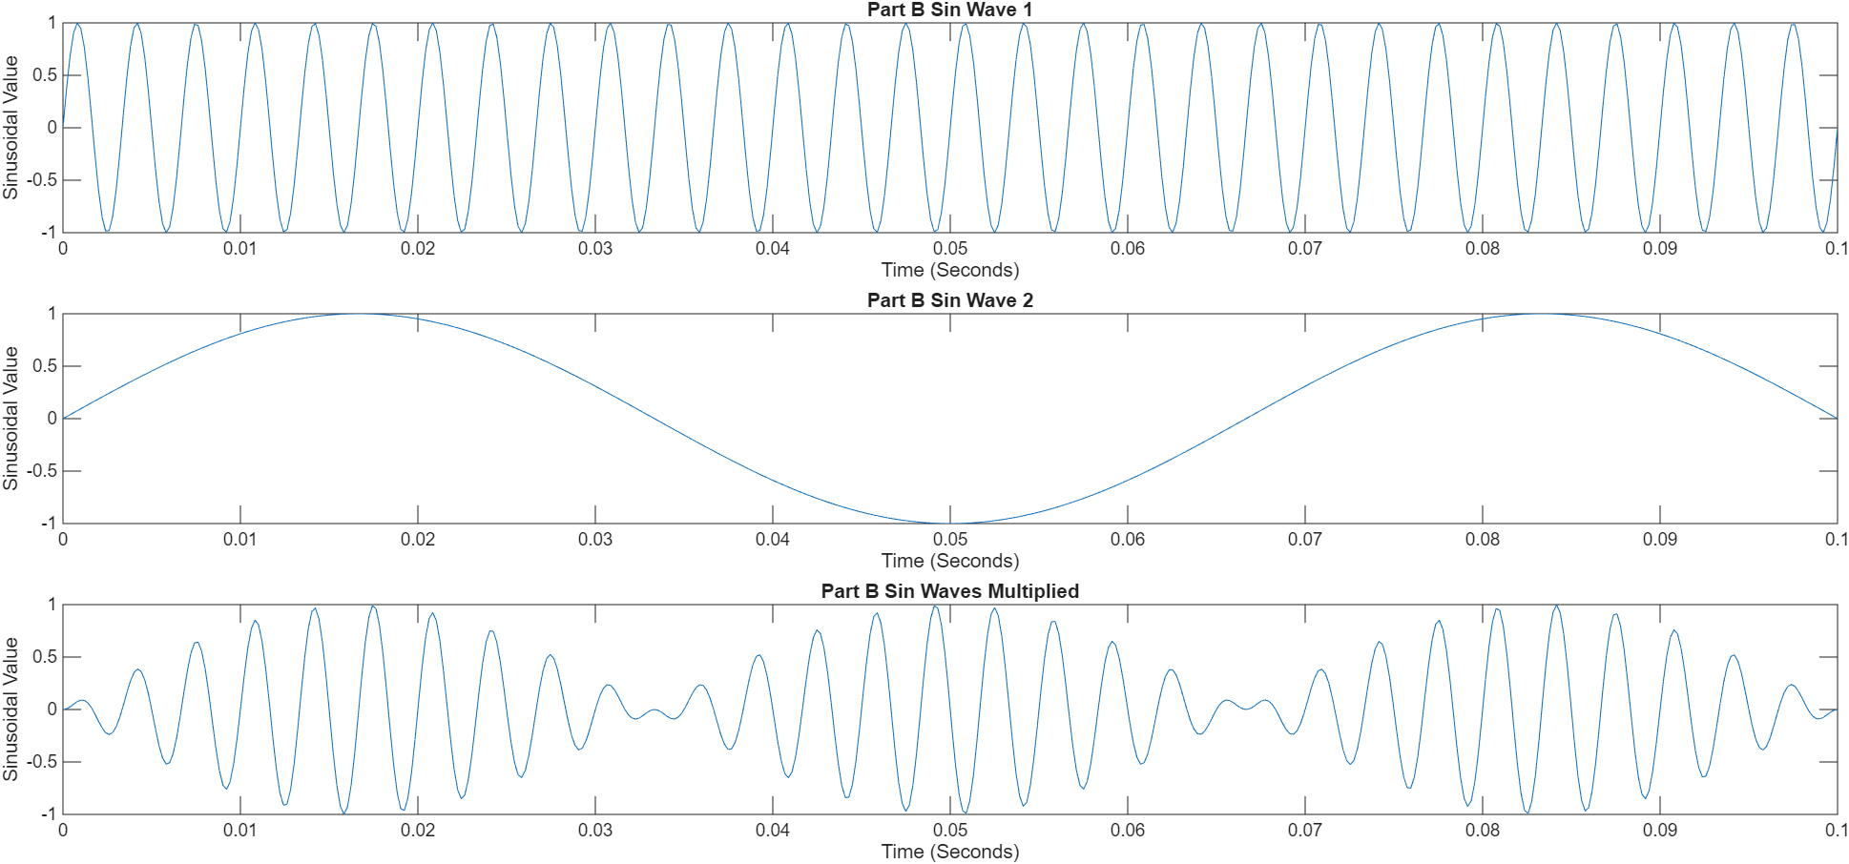
Example Problem – Signal Processing Primer
Created sin waves at varying frequencies
Identified peaks of sin waves and discussed potential applications
Practiced manipulating and plotting sin waves
Listened to waves played at different frequencies
Imported their favorite song to perform similar manipulations (playing backwards, speeding up, etc.)
Practiced: Creating arrays, logic indexing, plotting/subplotting, sampling, signal/audio processing

Slide 8
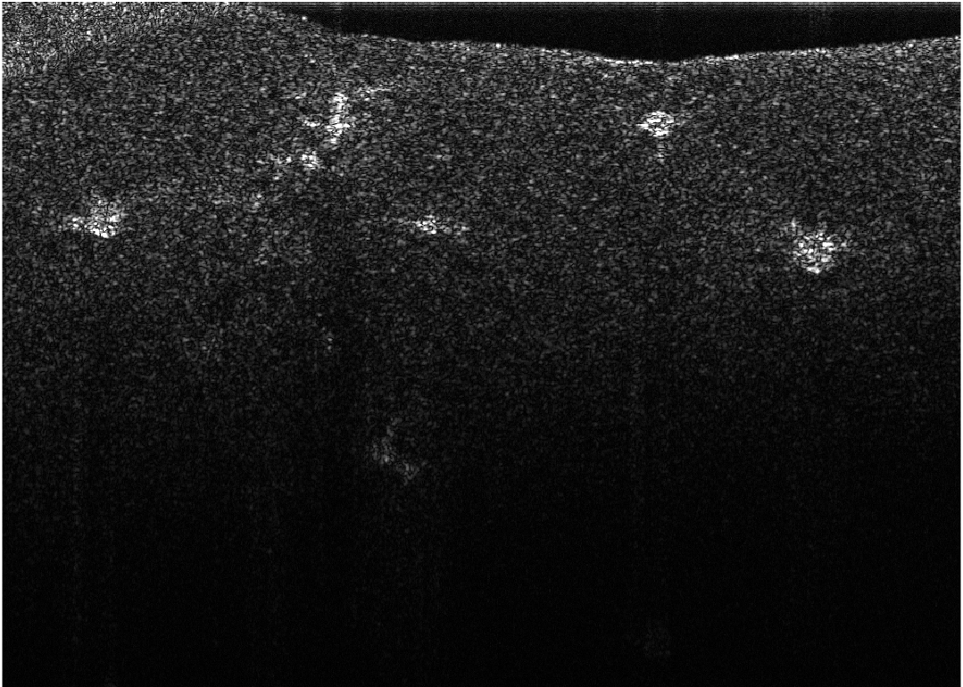
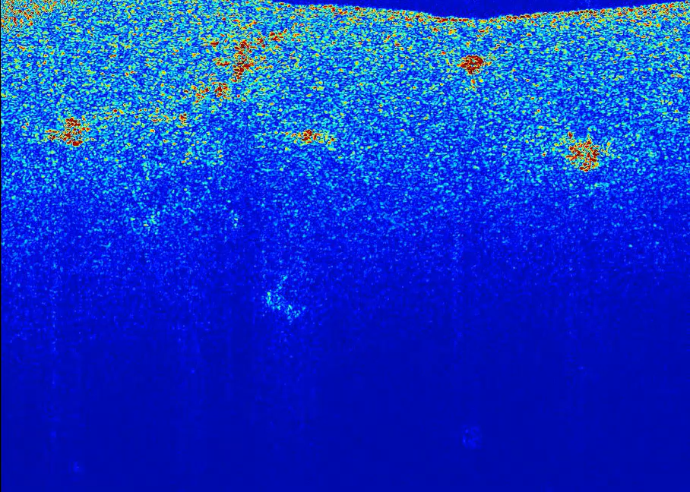
Example Problem – Image Processing for Cancer Study
Students given 300 images of cancer cells imaged with OCT
They process the images to become more visible
They overlay a colormap of their choosing to highlight cells
They create a video of from the images to visualize cellular motility
Practiced: Image processing, loops, data visualization

Slide 9
Final Project
Students submit proposals that must be approved and subject to revision if not within defined scope
They are required to learn a new way to use MATLAB (or demonstrate a significantly increased complex use of class topics)
Final presentation requires students to teach each other the ‘new’ and demonstrate their results

Slide 10
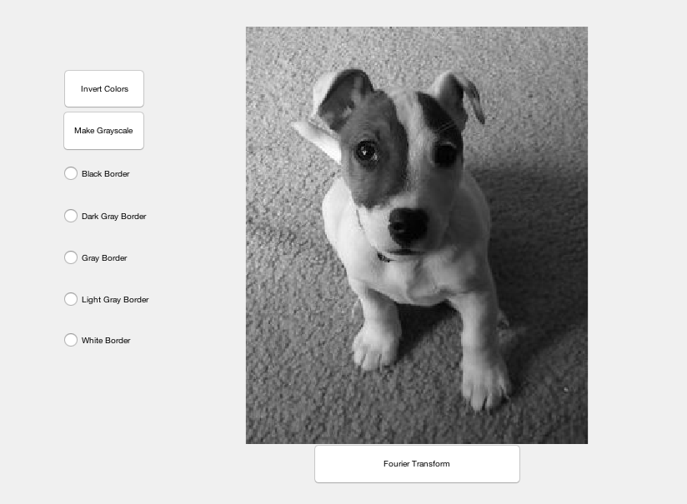
Final Project Examples
Generating .stl file from image to create a lithophane
Creating a working analogue clock
Games
  Black jack
  Poker
  Baccarat
  Custom RPG
ODE Solver
Test for color-blindness
COVID questionnaire
Exploring image processing using Fourier
Rocket Simulator
Simulating a music mixer
Simple image processing GUI

Slide 11
Student Feedback on pivot from fully flipped to quasi-flipped
I thought Zybook was helpful, but I didn't understand a lot of it. I don't love the set up of the learning, but it helped a lot when we went over it in class.
I think the lecture notes helped a lot, showing how we can take functions and new material we've learned and apply them. The typing along that was implement towards the end of the semester was much better then the beginning and it kept me more engaged.
I liked when we had lectures and I could take my own notes to clarify the Zybook. I also liked how we got credit for handing in lectures for attendance. They helped my grade and encouraged me to attend class.
Honestly, I think everything went really well. Especially, when the professor started doing student-followed lectures. Those really helped me in the end, versus having the quizzes.

Slide 12
Student Feedback on Problem Sets and Project
I liked doing the activity about the music and the one with images. Those were my favorite problem sets.
My favorite code that we learned was the user input one. I like to play around with guessing games. I also liked our PS with the pictures.
I enjoyed the final project and doing it on something that I chose.
I really liked using the pets, it made it a little more fun to see what I could do with the image.

Slide 13

Next Steps
Include co-pilot usage in instruction
Redesign problem sets to increase rigor and fold in reflection using chats
Enable students to tackle more problems relevant to their discipline since rigor can increase
Design new processes for assessing student learning

