Slide 1
Teaching Computation in the Laboratory using dq/dt =
J. P. Boyle, Ph.D. Physics
Western Connecticut State University
Outline
0. Teaching Activity: 2023
Course and Laboratory Structure
Examples: dq/dt = physical processes
Goal
Structuring laboratories to merge computation & measurement for understanding
Teaching Computation with MATLAB Workshop 2025

Slide 2
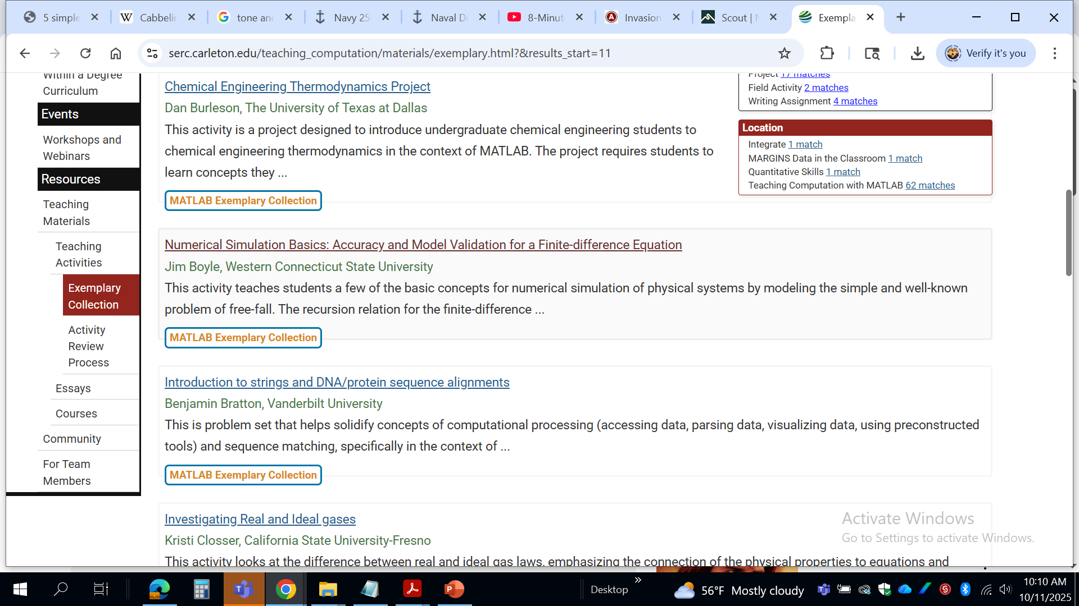
dq/dt = physical processes
2023 Workshop Activity
Application: Free Fall
This motion is governed by Newton's 2nd Law: ∑ F_{z} = ma_{z} = mg;
…
This motion can be simulated numerically by solving the 1st Order Ordinary Differential Equation: dz/dt = gt, as z(t) = f(time only). We need to numerically estimate the 1st derivative….
q unspecified physical quantity (e.g., position, velocity, voltage)
time evolution depends on relevant physical processes

Slide 3
Structure
Department: Physics, Meteorology; coming soon → Climate Science
Laboratory Courses: 2 x 75-minute lecture periods, 1 x 110-minute laboratory
a. Analytical Meteorology (Sophomore) – prerequisite Computer Programming
b. Electronics (Sophomore)
c. Physical Oceanography (Junior)
d. Meteorological Instrumentation (Senior)
e. Physical Meteorology (Senior)
Required Scientific Computing Skills (AMS) :
Experience in a scientific computing environment … recommended
higher-level development environments (e.g., MATLAB, C++, Python)

Slide 4
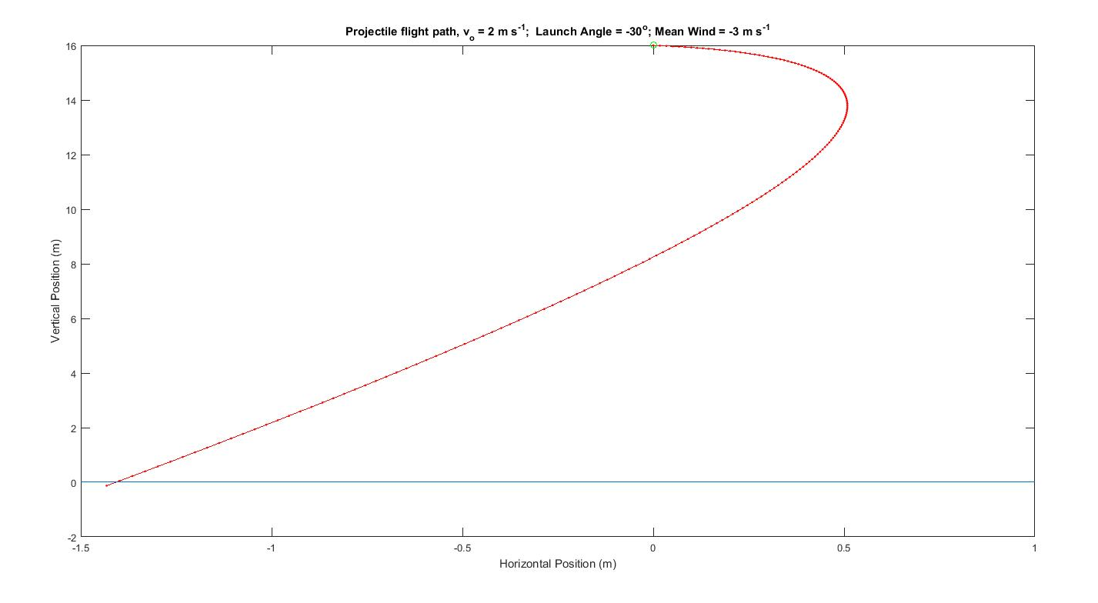
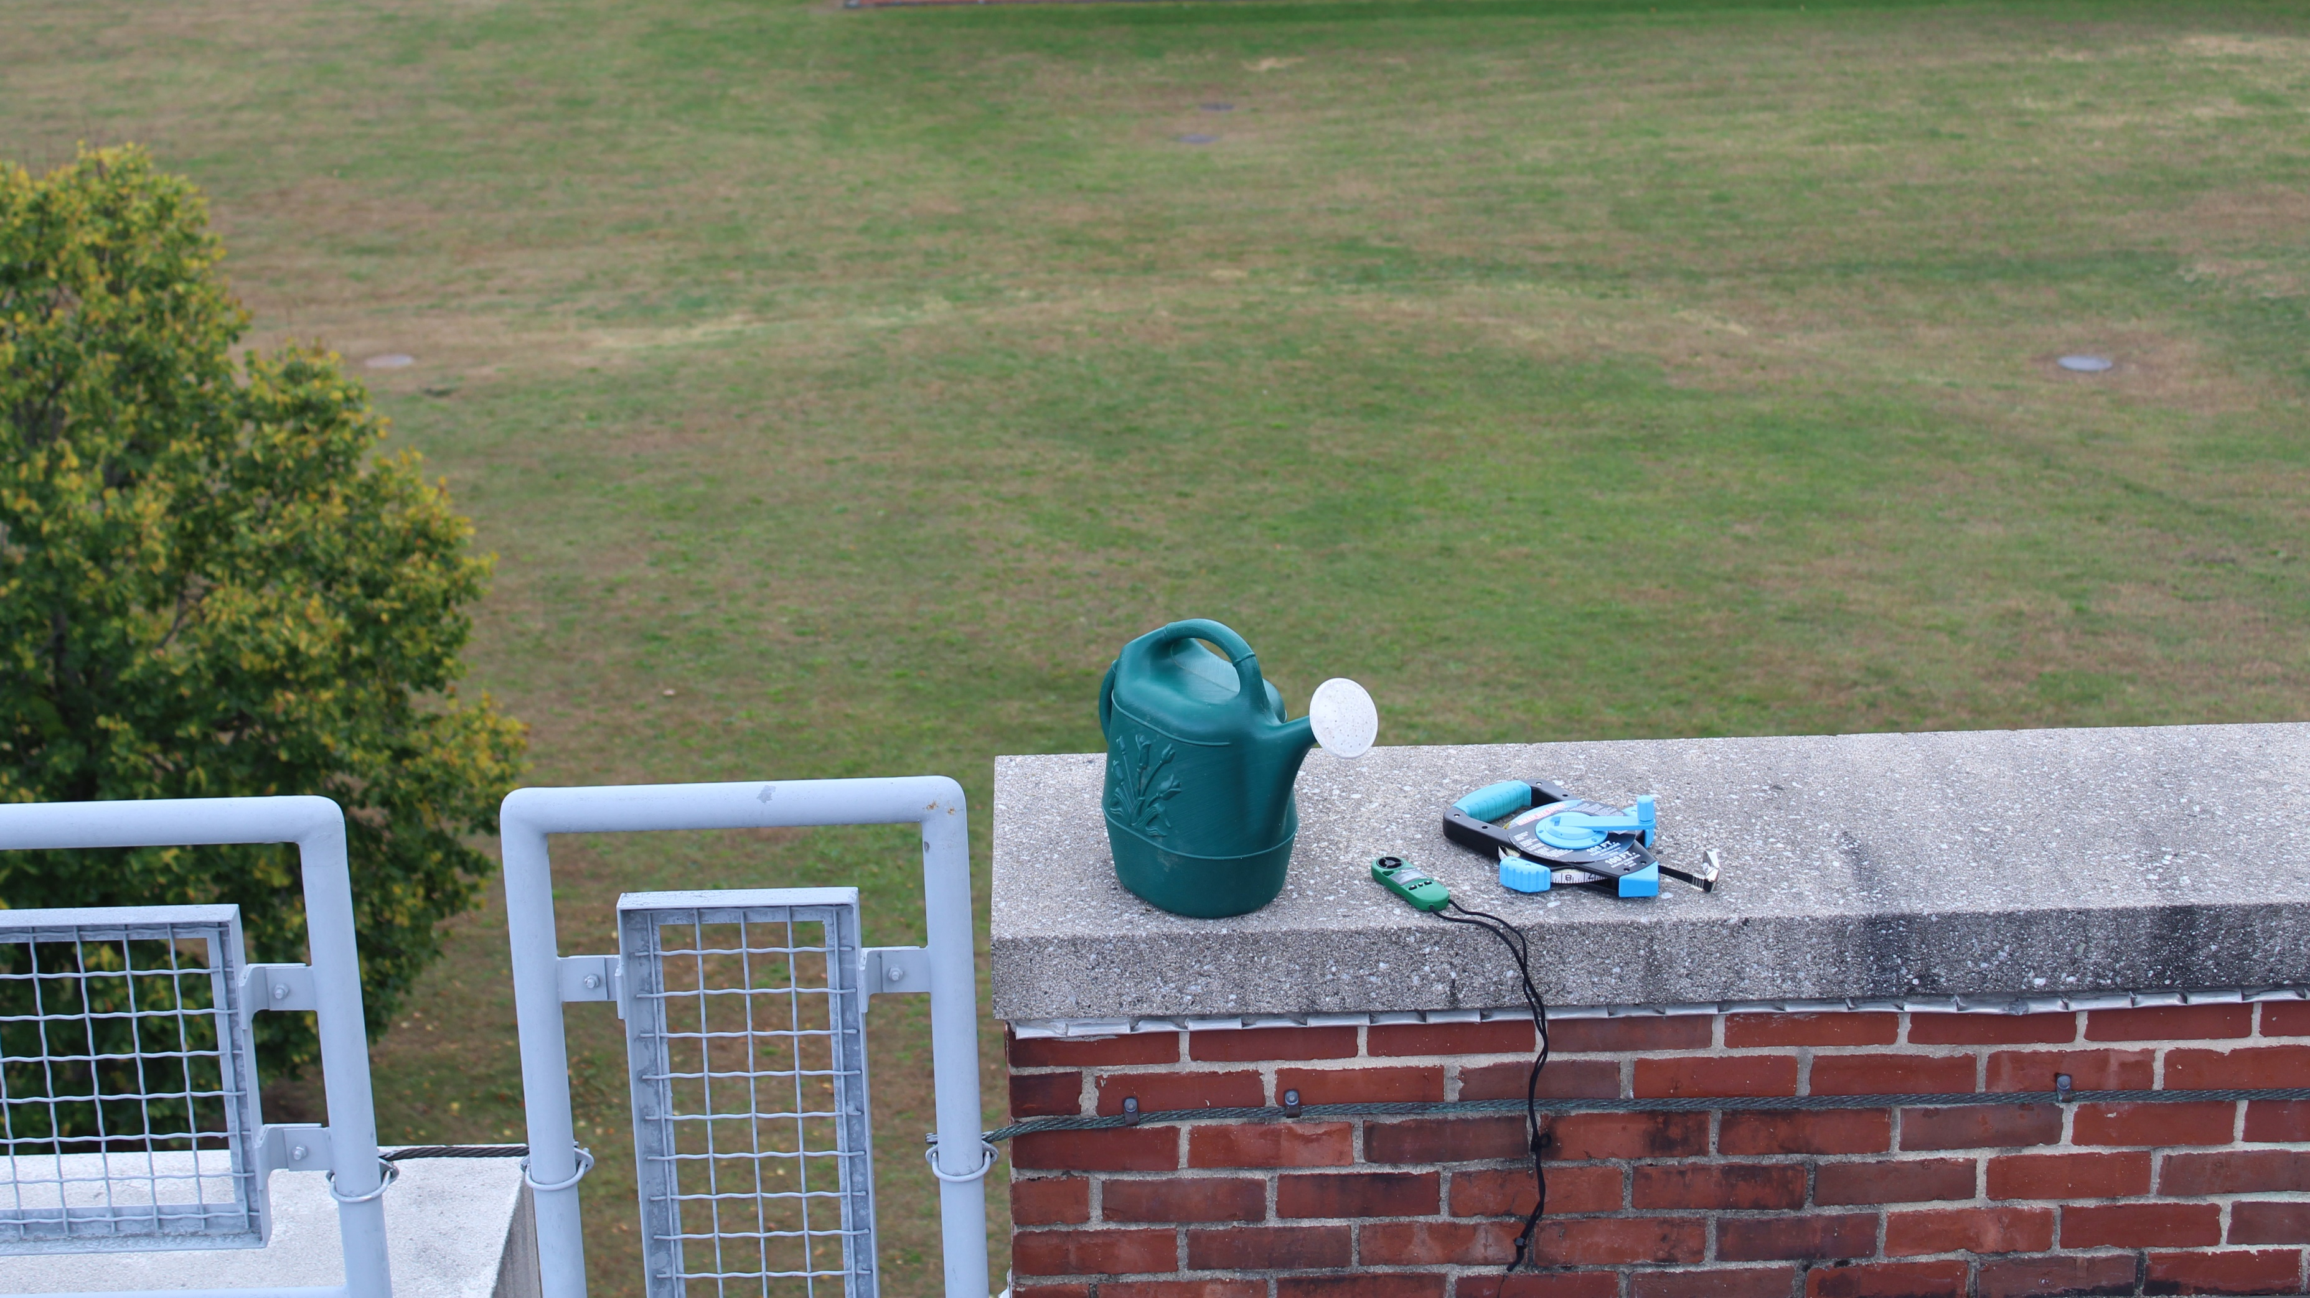
Example: Physical Meteorology → falling raindrop (Senior)
Nucleation & growth → droplet → raindrop → falling (collision, coalescence)
create & validate a single falling raindrop numerical model using closed-form solutions with drag
simulate a distribution of drops falling from a moving cloud → target for polarized Doppler RADAR
rooftop experiment: pathlines & measurements (horizontal displacement & wind, drop size, video)
du/dt = f(v_{DROP}, R_{DROP}, V_{WIND}, ρ_{AIR})
dw/dt = f(v_{DROP}, R_{DROP}, V_{WIND}, ρ_{AIR}) + g
WIND
Figure 2: Equipment for simple rooftop experiment.
Figure 1: Trajectory of a single drop from a two-dimensional simulation.

Slide 5
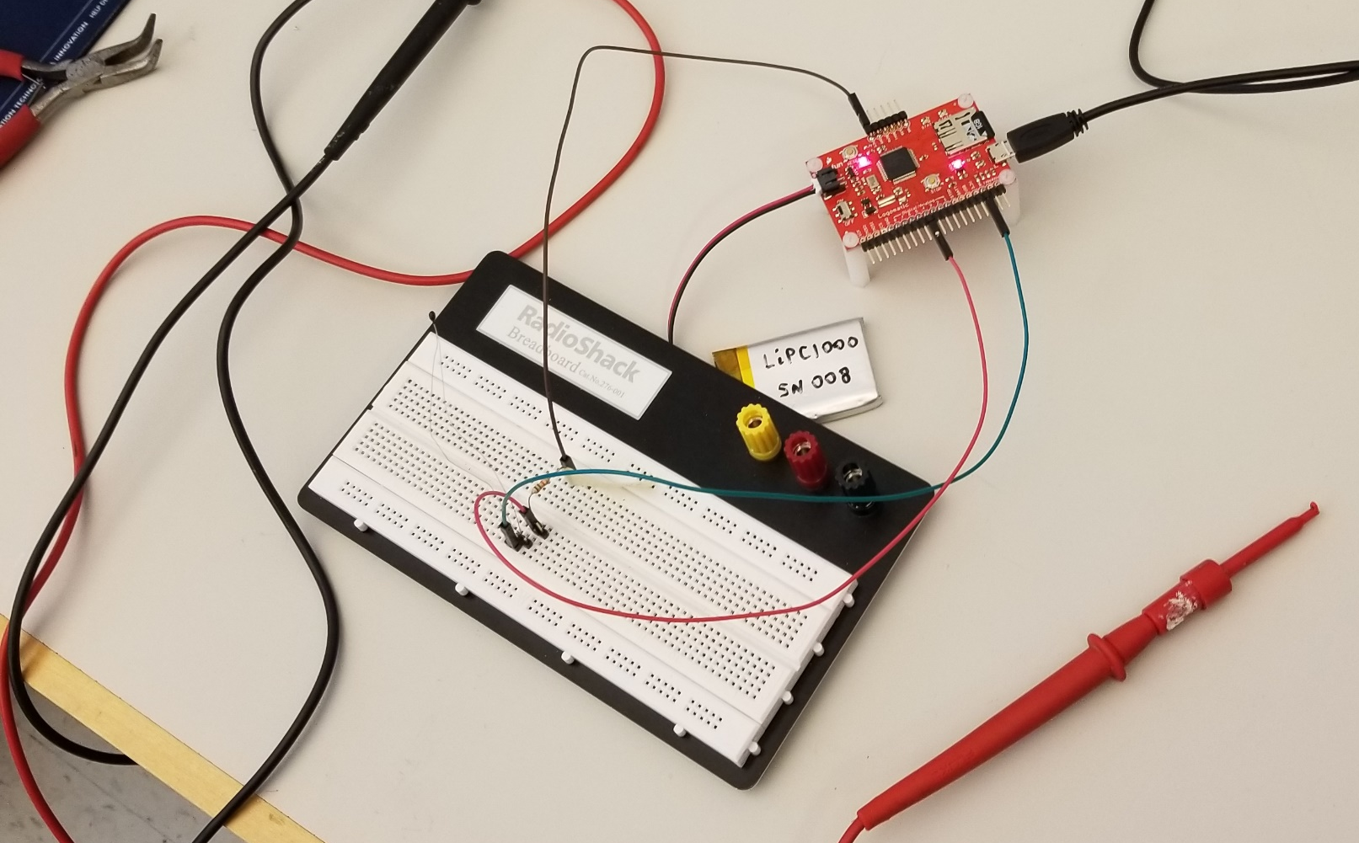
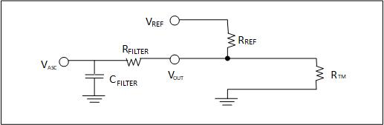
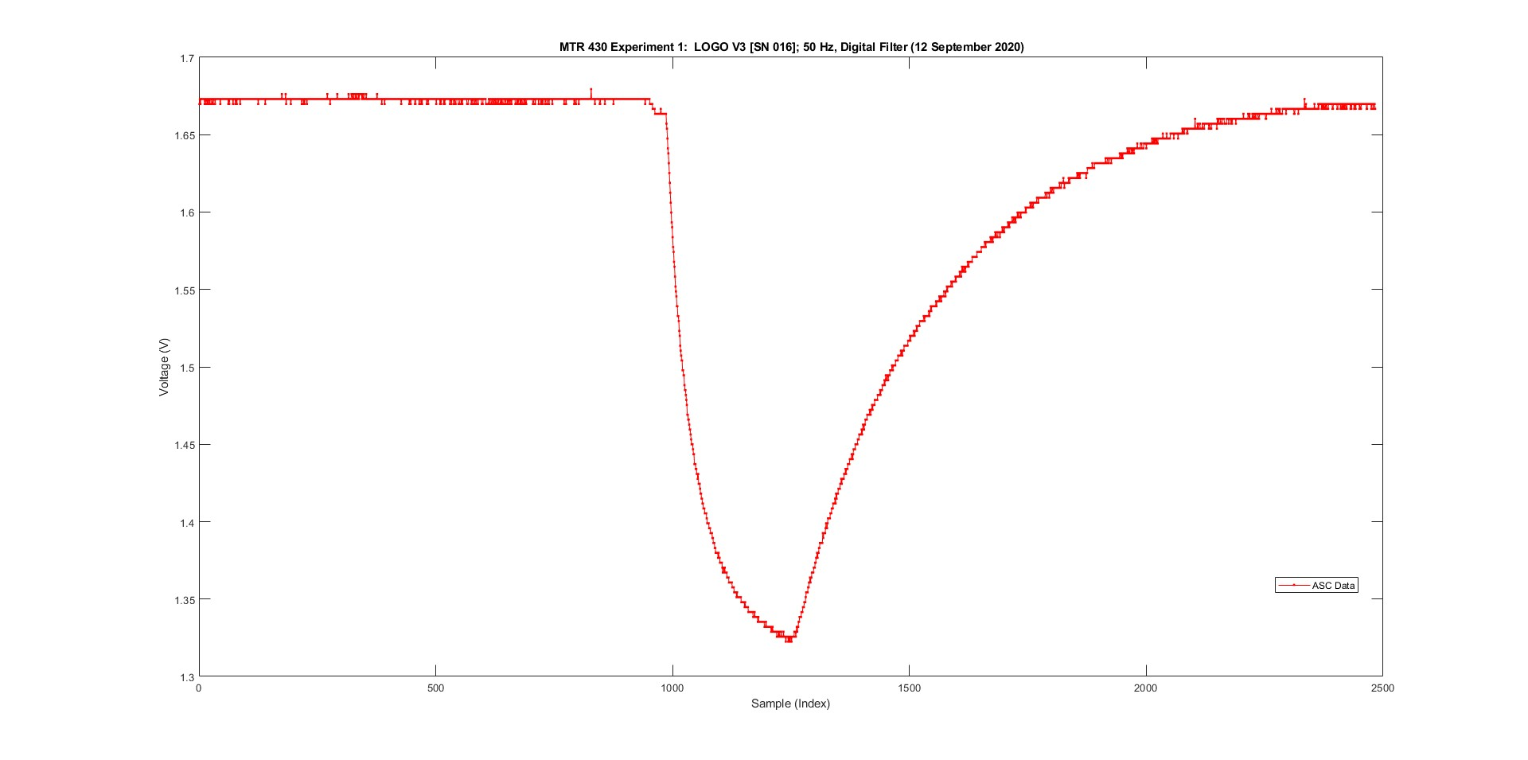
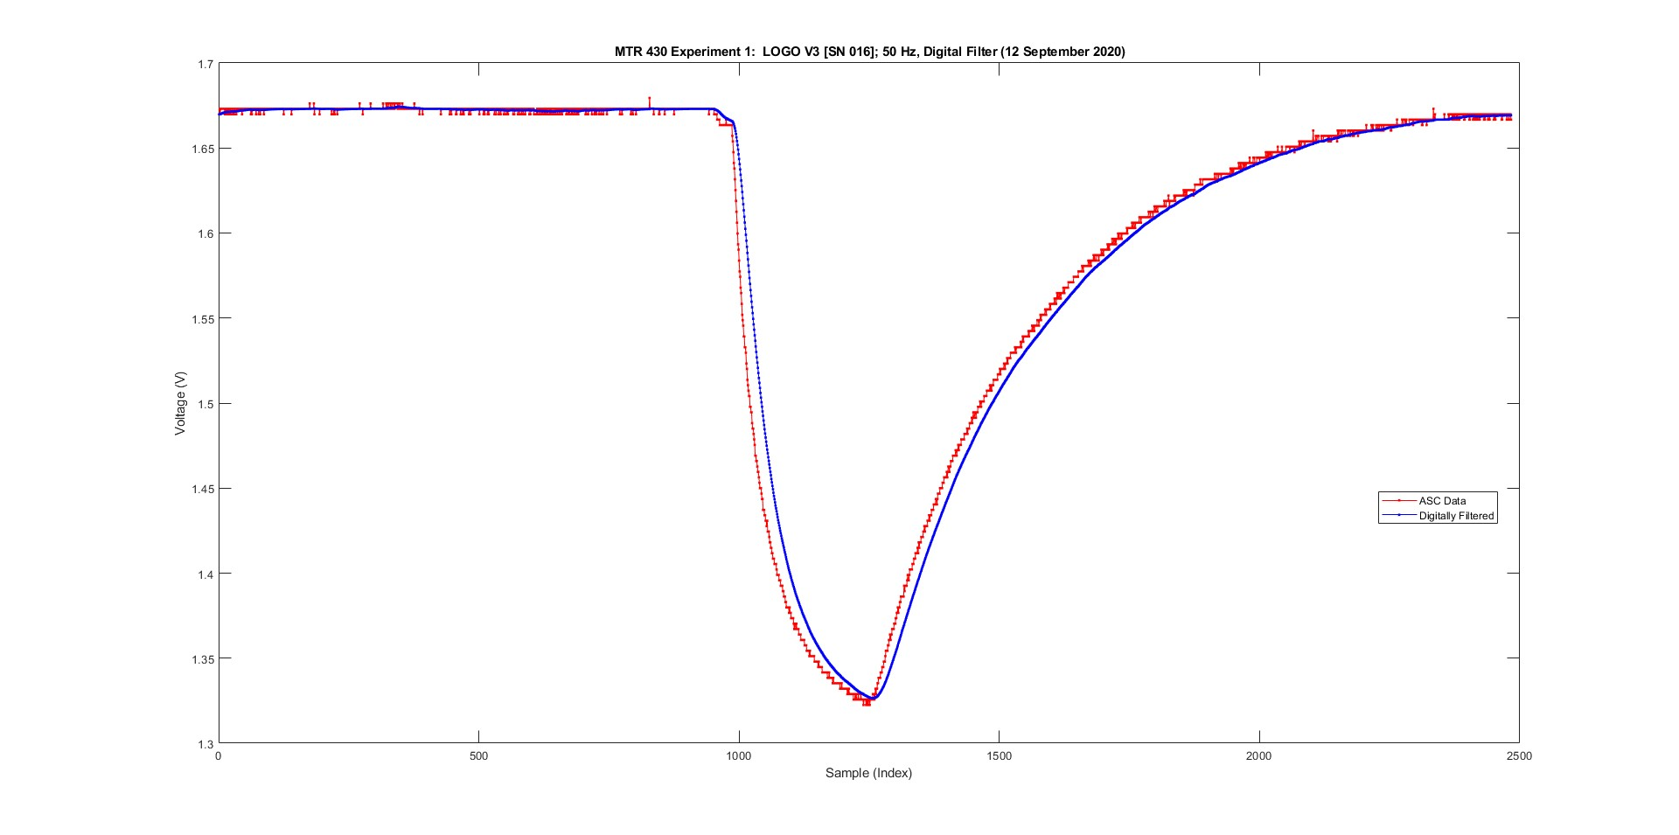
Example: Digital Signal Conditioning (Sophomore)
Measurement → Three-wire Resistor Half Bridge
Figure 2: Circuit Diagram – R_{TM} is a thermistor.
Figure 1: Breadboard, circuit and datalogger.
To derive the discrete filter equation, apply
Kirchhoff’s Loop Rule to a three-wire half bridge:
v_{OUT}(t) – iR – Δv_{C} = 0; here Δv_{C} ≡ v_{ASC}(t)
…
dv_{DSC}(t)/dt = (1/RC){v_{OUT}(t) – v_{DSC}(t)}
Figure 3: Output -- voltage time series plot,
with filtering

Slide 6
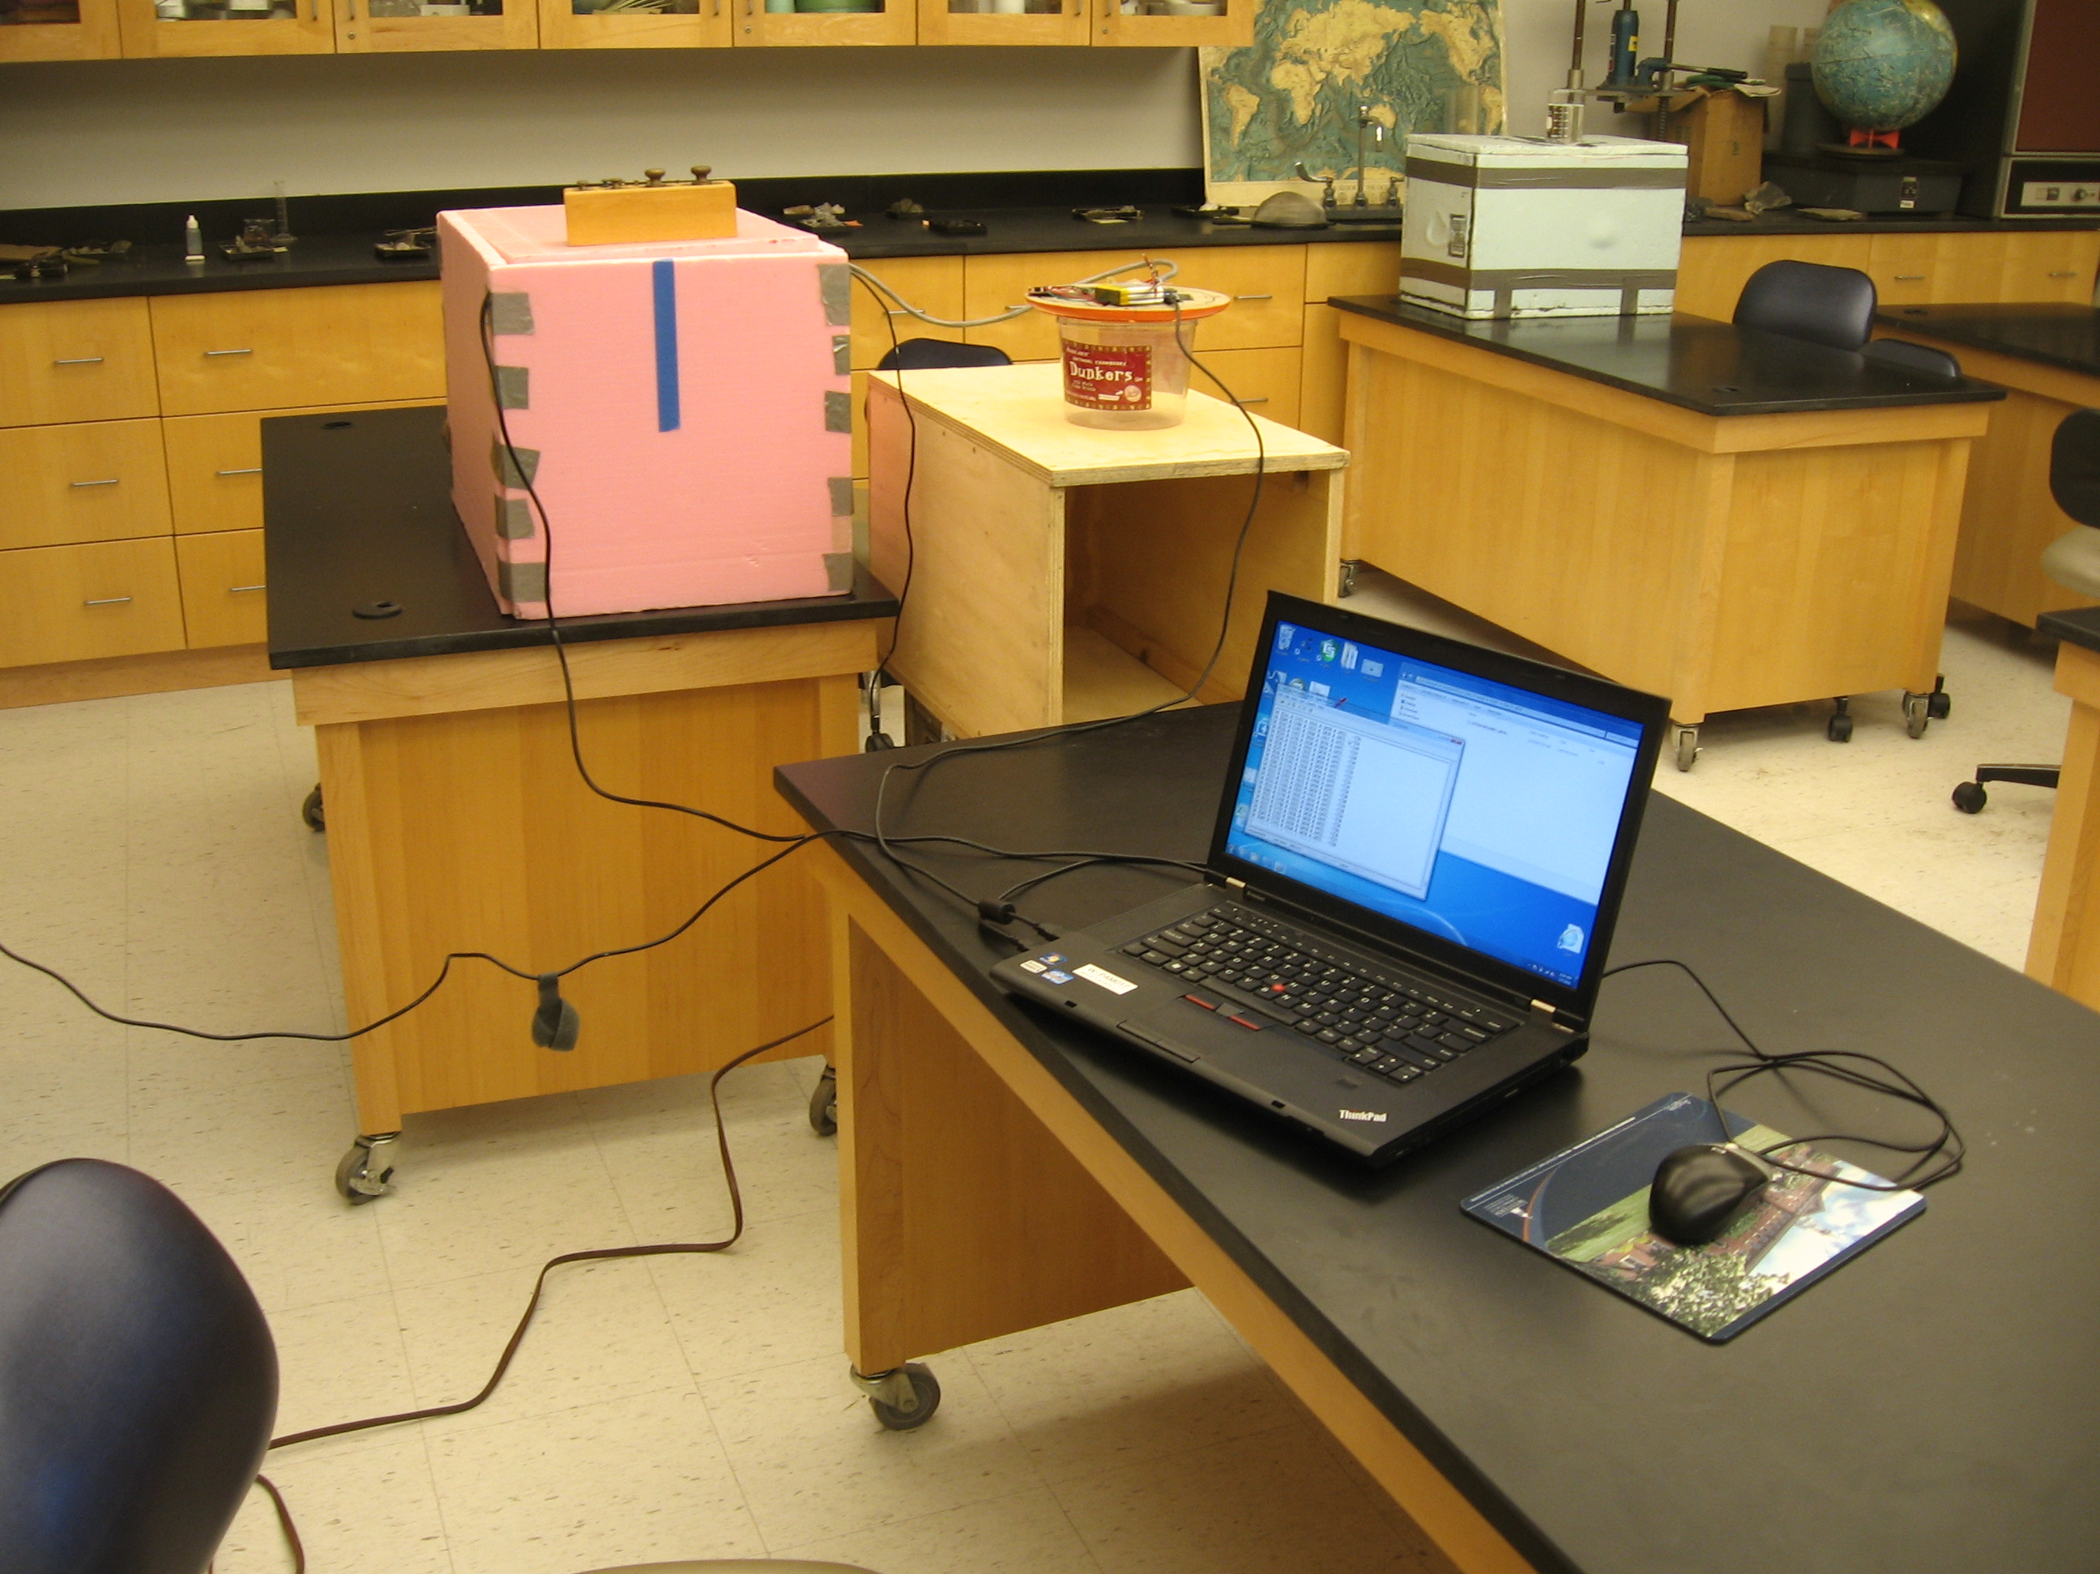
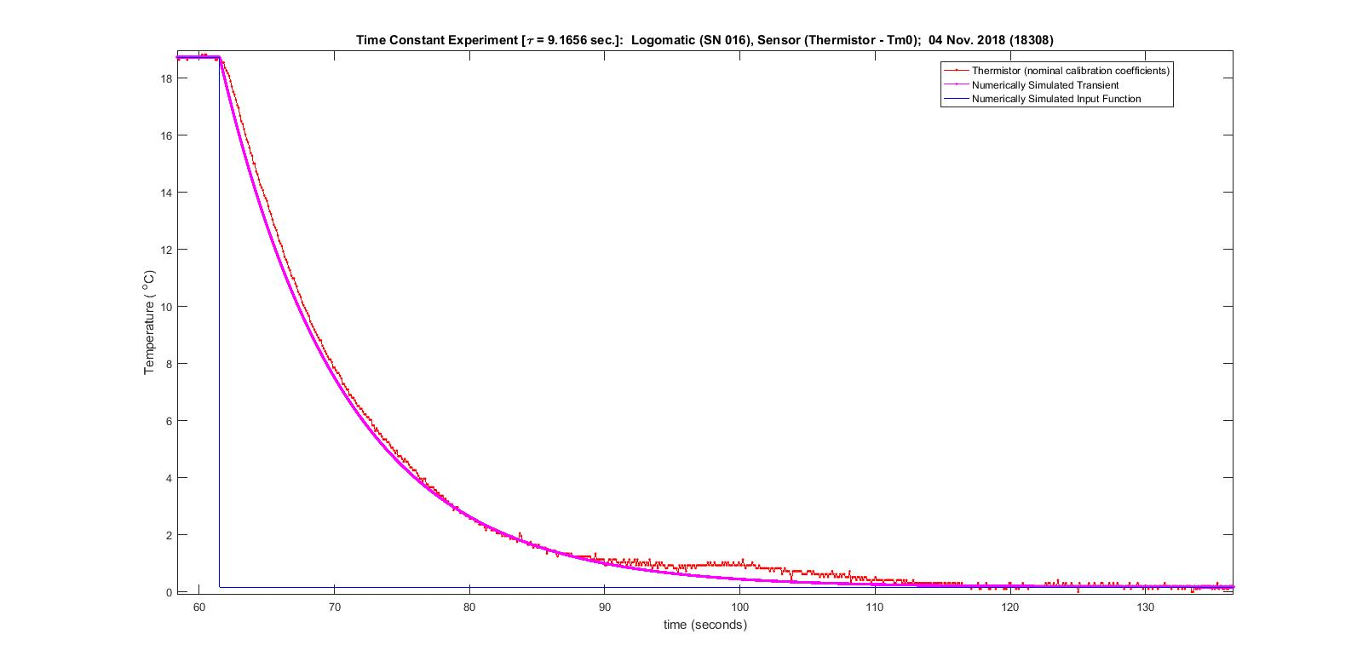
Example: Thermometer Time Constant (Senior)
Each group determines the time constant for their calibrated temperature sensor
dT/dt = heat transfer processes
Figure 1: Experimental Set-up – insulated fish tanks. Students plunge temperature sensor from warm (pink) reservoir into cold, ice-water reservoir (blue).
Figure 2: Student results. Idealized step-function response (blue), actual sensor response (red) – with noise, digitization & irregularities, and numerical simulation response from 1st order ODE (magenta).

Slide 7
Summary
1. Provide concrete reasons for students to become proficient in MATLAB
2. Find ways to establish student ownership with the MATLAB assignment
Include MATLAB applications across multiple laboratory courses
New Programs: BS Climate Science & MS Meteorology:
a. Acquisition, Analysis & Visualization of Atmospheric, Oceanographic & Climate Data (Junior)
b. Remote Sensing and Data Processing (Master’s Degree in Meteorology)
dq/dx_{i} = physical processes

