Slide 1
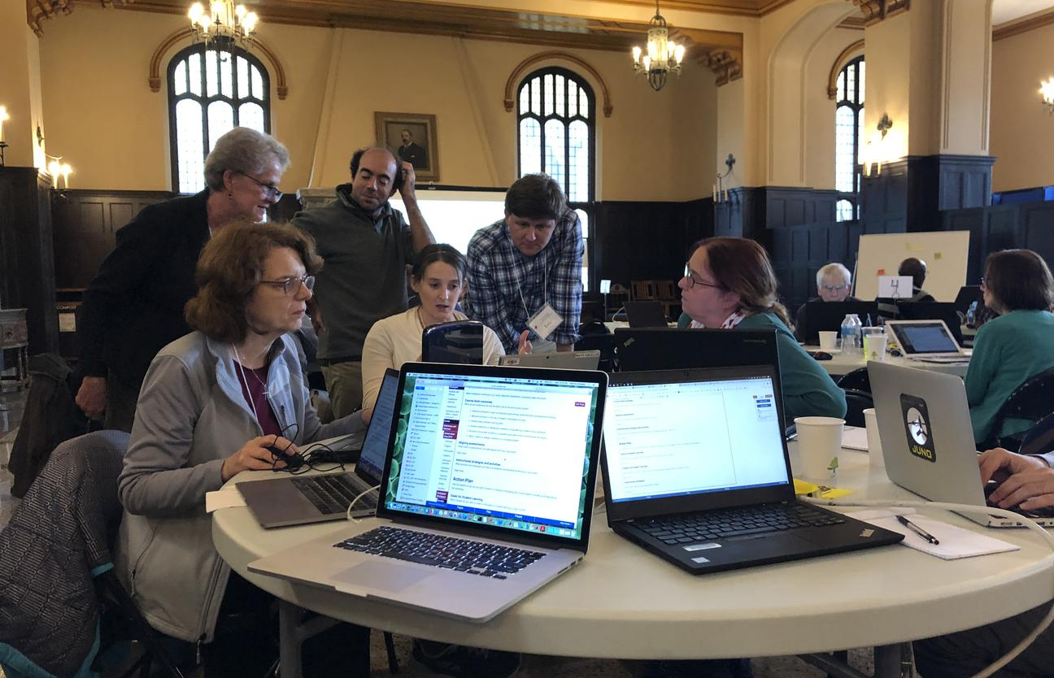
Upgrading Your Teaching
Dan Burleson
Review Editor, Teaching Computation in the Sciences Using MATLAB©
University of Houston

Slide 2

Where are we now?
Excited about new teaching strategies and tools
Thinking about all parts of our courses we can update
Thinking about places to add new activities and computation
But where to begin?

Slide 3


Slide 4
Levels for Upgrading
Curriculum
Specific Course 1
Unit 1
Unit 2
Specific Course 2
Lesson 1
Lesson 2
Activity 1
Activity 2
We are all coming from different levels and have different goals to get from this workshop
Figure out where you want or need to upgrade your teaching and find the lowest level

Slide 5

Post-it #1:
What do you want to work on right now?

Slide 6
Post-it #1 (Back):
Why do you want to work on this?

Slide 7

Add to board

Slide 8
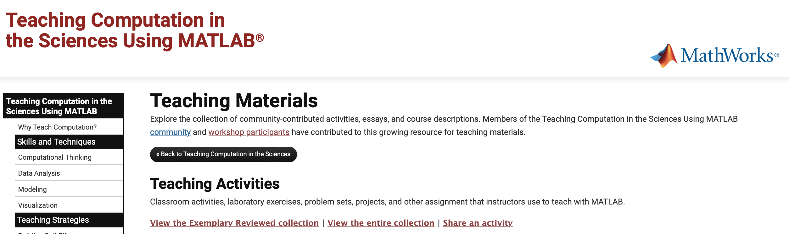
Creating a Repository of Teaching Material
Starting in 2018 – Peer Review Process

Slide 9
Creating a Repository of Teaching Material
Starting in 2018 – Peer Review Process
Action items once you have edited your activity and ready for re-review:
Make/Update Live Page
Reply all to the email notification that your activity is ready for re-review (or initial review)
Revisions by November 9, 2024 for re-review.

Slide 10
Post-it #2:
What is one learning objective for the thing you are work on?

Slide 11
Post-it #2 (Back)
What is an assessment tool you want to check this learning objective?

Slide 12
Add to board

Slide 13
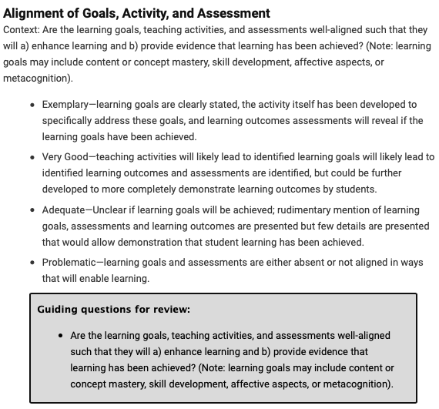
Goals and Assessment
Being specific and aligned
Be specific about learning objectives:
Computational/MATLAB objectives
Scientific/Context objectives
Assessment should address all learning objectives
Rubric
Checks of deliverables that match each objective
MATLAB Grader: connect assessments to learning objectives

Slide 14


Slide 15
Post-it #3:
What is one aspect of your class or curriculum you want to work on during the next hour.

Slide 16
Post-it #3: (BACK)
What is the most important question you with what you want to work on?

Slide 17
Add to board
and…

Slide 18
*ask

Slide 19
2025 MATLAB Activity Review Cycle
Initial Activity Submission
Re-Review Deadline
Final Activity Notification
October 16
November 5
December 1
Activity Review Notification
Oct. 26 - Oct. 28
Action items once you have edited your activity and ready for re-review:
Make updates to the development page of your activity.
Click “Make/Update Live Page” when ready for re-review.
Reply all to the email notification that your activity is ready for re-review.
What if my activity wasn’t live or complete in time for the initial review?

