Slide 1
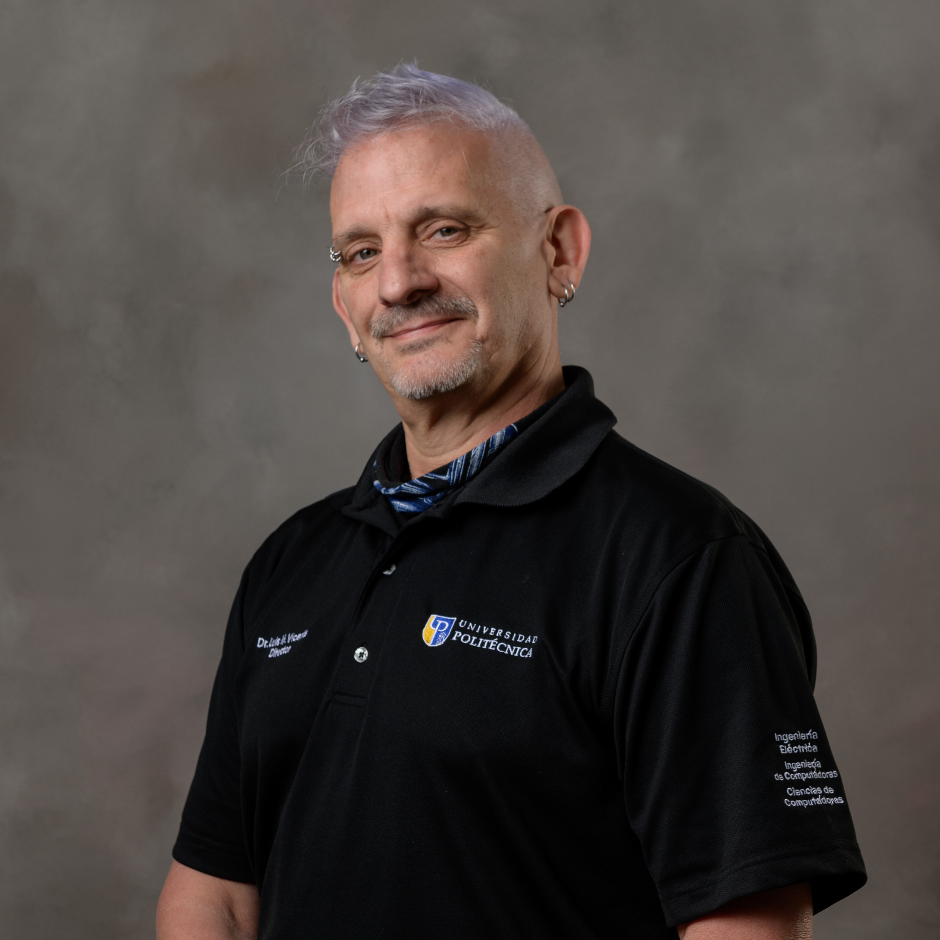
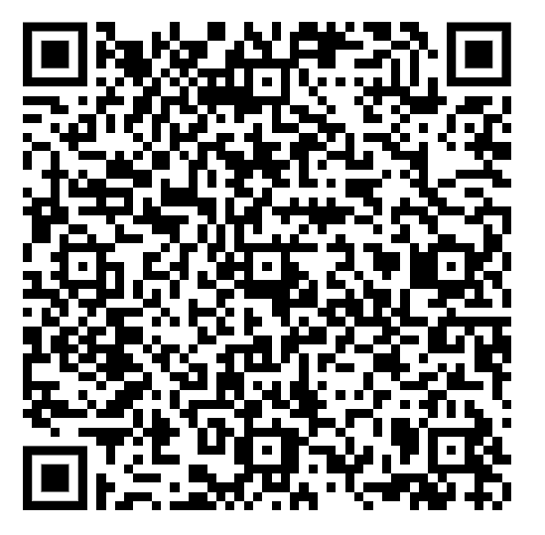

Innovation in Pattern Recognition:
24 Years of MATLAB and the Transition to Live Scripts
Join Dr. Luis M. Vicente as he shares insights from over two decades of teaching pattern recognition using MATLAB at Universidad Politécnica de Puerto Rico. Discover how computational thinking transforms complex algorithms into accessible learning experiences.
Teaching Computational Thinking with MATLAB
24 Years of MATLAB in Pattern Recognition. Transition to Live Scripts
Luis M. Vicente, Ph.D.
Universidad Politécnica de Puerto Rico
lmvicente@pupr.edu
1

Slide 2

Meet Dr. Luis M. Vicente
Associate Professor & Department Director Electrical, Computer & Computer Science Engineering
Universidad Politécnica de Puerto Rico
Dr. Vicente has been a dedicated faculty member since 2003, bringing deep expertise in computational thinking and pattern recognition to graduate education. He earned his Ph.D. in Electrical and Computer Engineering from the University of Missouri-Columbia in May 2009, where he authored or co-authored five publications in his research area before graduation.
In 2020, he was appointed Director of the Department of Electrical Engineering and Computer Science, where he continues to support innovative teaching methodologies using MATLAB to bridge the gap between theoretical concepts and practical applications.
Teaching Computational Thinking with MATLAB
24 Years of MATLAB in Pattern Recognition. Transition to Live Scripts
Luis M. Vicente, Ph.D.
Universidad Politécnica de Puerto Rico
lmvicente@pupr.edu
2

Slide 3
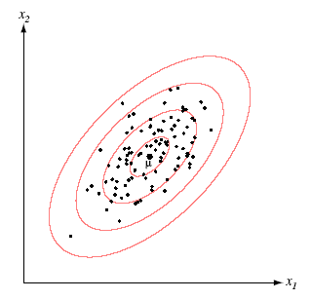
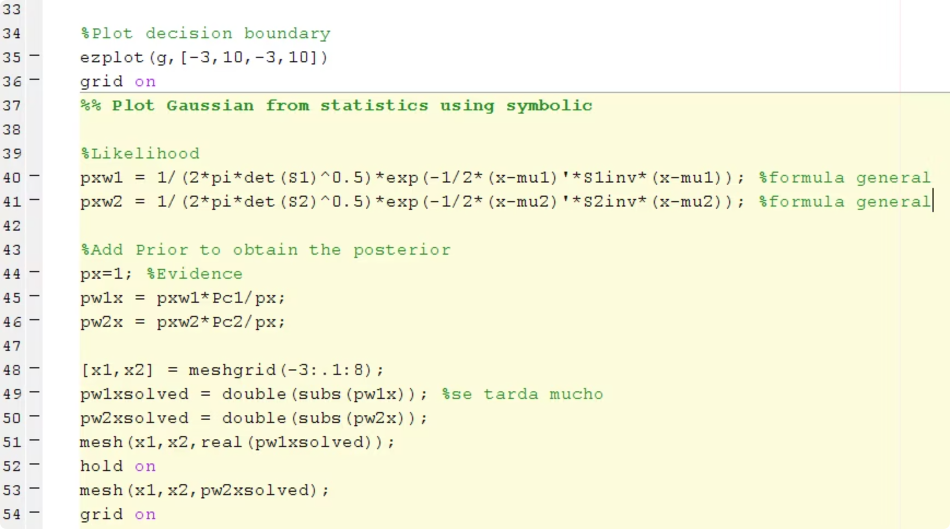
The Challenge: Bridging Diverse Student Backgrounds
The Context
In the graduate course EE 6720: Pattern Recognition, students arrive with vastly different levels of programming experience and mathematical preparation. This creates a significant pedagogical challenge when introducing advanced concepts.
Complex Concepts
Teaching sophisticated concepts like Bayesian classification, PCA, and clustering techniques requires both mathematical rigor and computational proficiency that not all students possess initially.
The Solution
MATLAB provides powerful visualization capabilities that connect abstract theory with concrete applications. By seeing concepts in action, students feel more motivated and comprehend material faster, regardless of their initial skill level. Student feedback and final project outcomes consistently reflect this improvement, though balancing theoretical depth with hands-on demonstrations remains a challenge.
Teaching Approach
My approach emphasizes conceptual understanding before coding. Students first analyze algorithms conceptually, then use MATLAB scripts to see them in action, reinforcing both programming and mathematical reasoning.
3

Slide 4

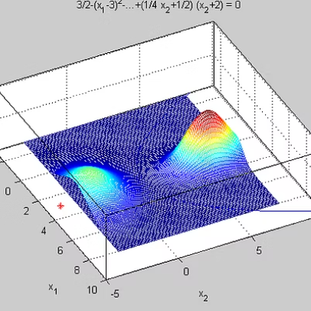
MATLAB as the Teaching Solution
Over 24 years of teaching, MATLAB has evolved from a computational tool into a comprehensive learning environment for pattern recognition.
Use of scripts to explain supervised classification algorithms (Bayes, MLE, k-NN) and unsupervised ones (hierarchical clustering, PCA).
Graphs generated with scripts to visualize discriminant functions, decision boundaries, among others.
Integration of real datasets of signals and images to provide practical context to the exercises (like the famous Wine data)
4

Slide 5
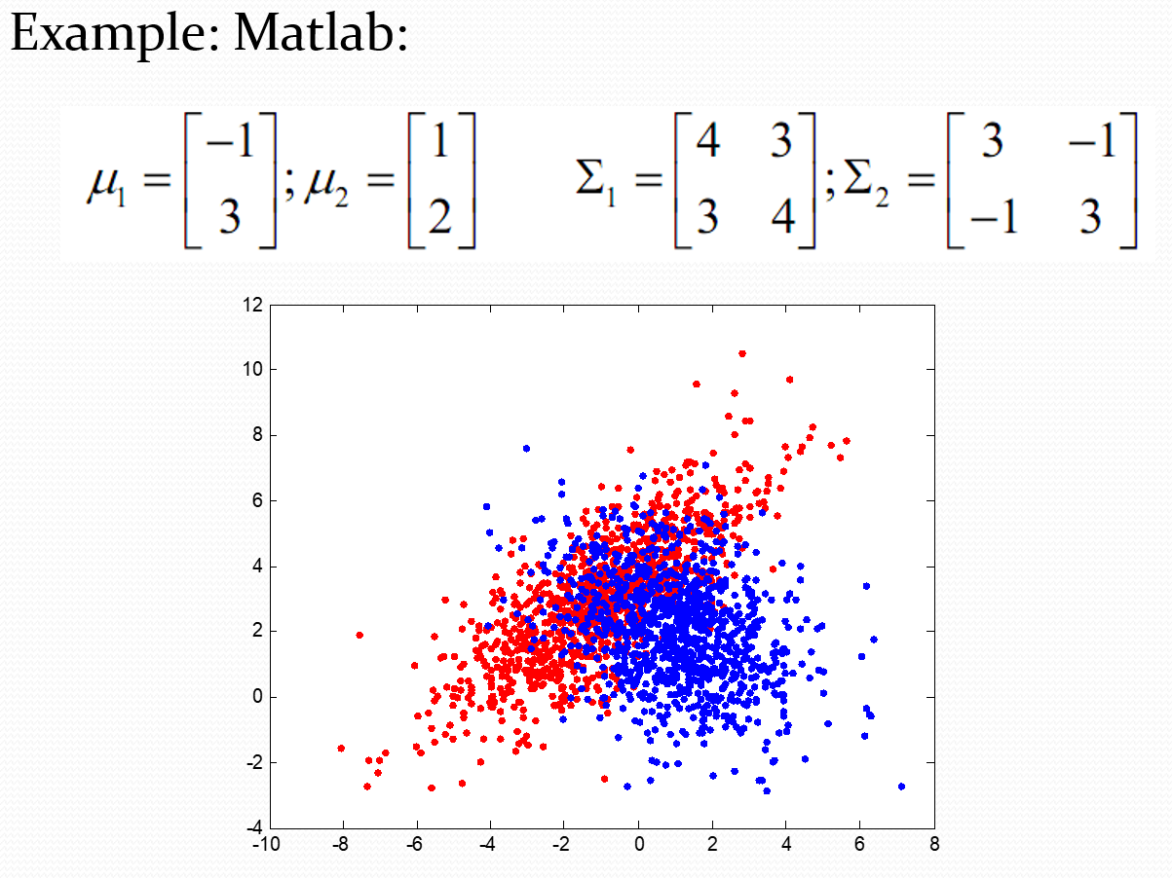

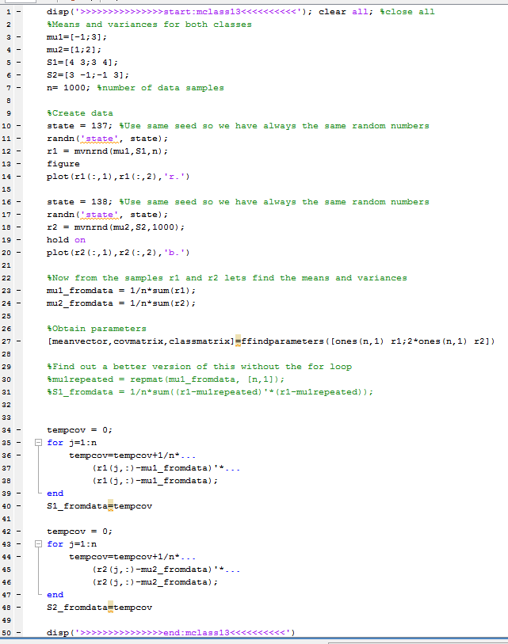
Results
Students achieved a better understanding of complex algorithms such as Bayes, PCA, and clustering by seeing them implemented and visualized in MATLAB.
Manual coding time was reduced thanks to MATLAB’s predefined functions, allowing more time for interpreting results.
Final projects showed greater creativity by using real data (images, signals, multiclass data).
Lessons Learned
Immediate visualization of results helps reduce the gap between theory and practice.
Students with less programming experience can integrate more quickly thanks to MATLAB’s simplicity.
The lack of interactivity in traditional scripts motivates the transition to Live Scripts and Apps to enhance the learning experience.
5

Slide 6
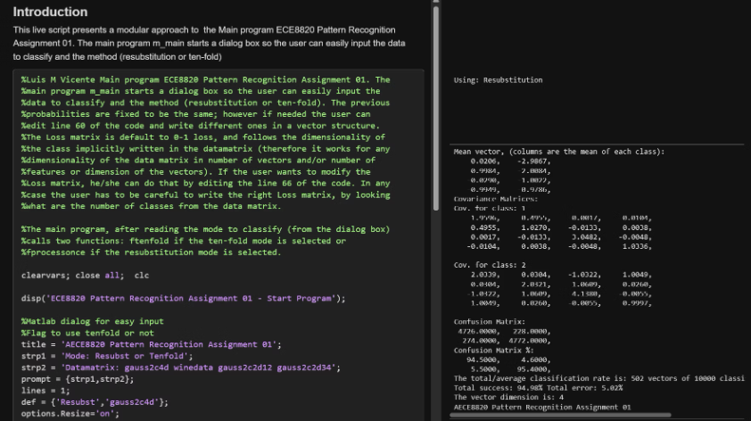




Future Work: Areas for Improvement
Interactive Learning Materials
Progressively integrate Live Scripts and interactive Apps to create more engaging, self-paced learning experiences. These tools allow students to manipulate parameters in real-time and observe immediate effects on algorithms and visualizations.
Self-Explanatory Resources
Develop comprehensive, self-contained materials specifically designed for students with limited programming experience. These resources will include step-by-step tutorials, annotated code examples, and troubleshooting guides.
Remote Assessment Tools
Expand the use of MATLAB Online and MATLAB Grader for assignments and remote evaluations. This infrastructure enables flexible learning and automatic grading while maintaining academic rigor.
Generative AI Integration
Exploring generative AI assistants (e.g., MATLAB Copilot or ChatGPT) to help students debug code and interpret results in real time.
6

Slide 7

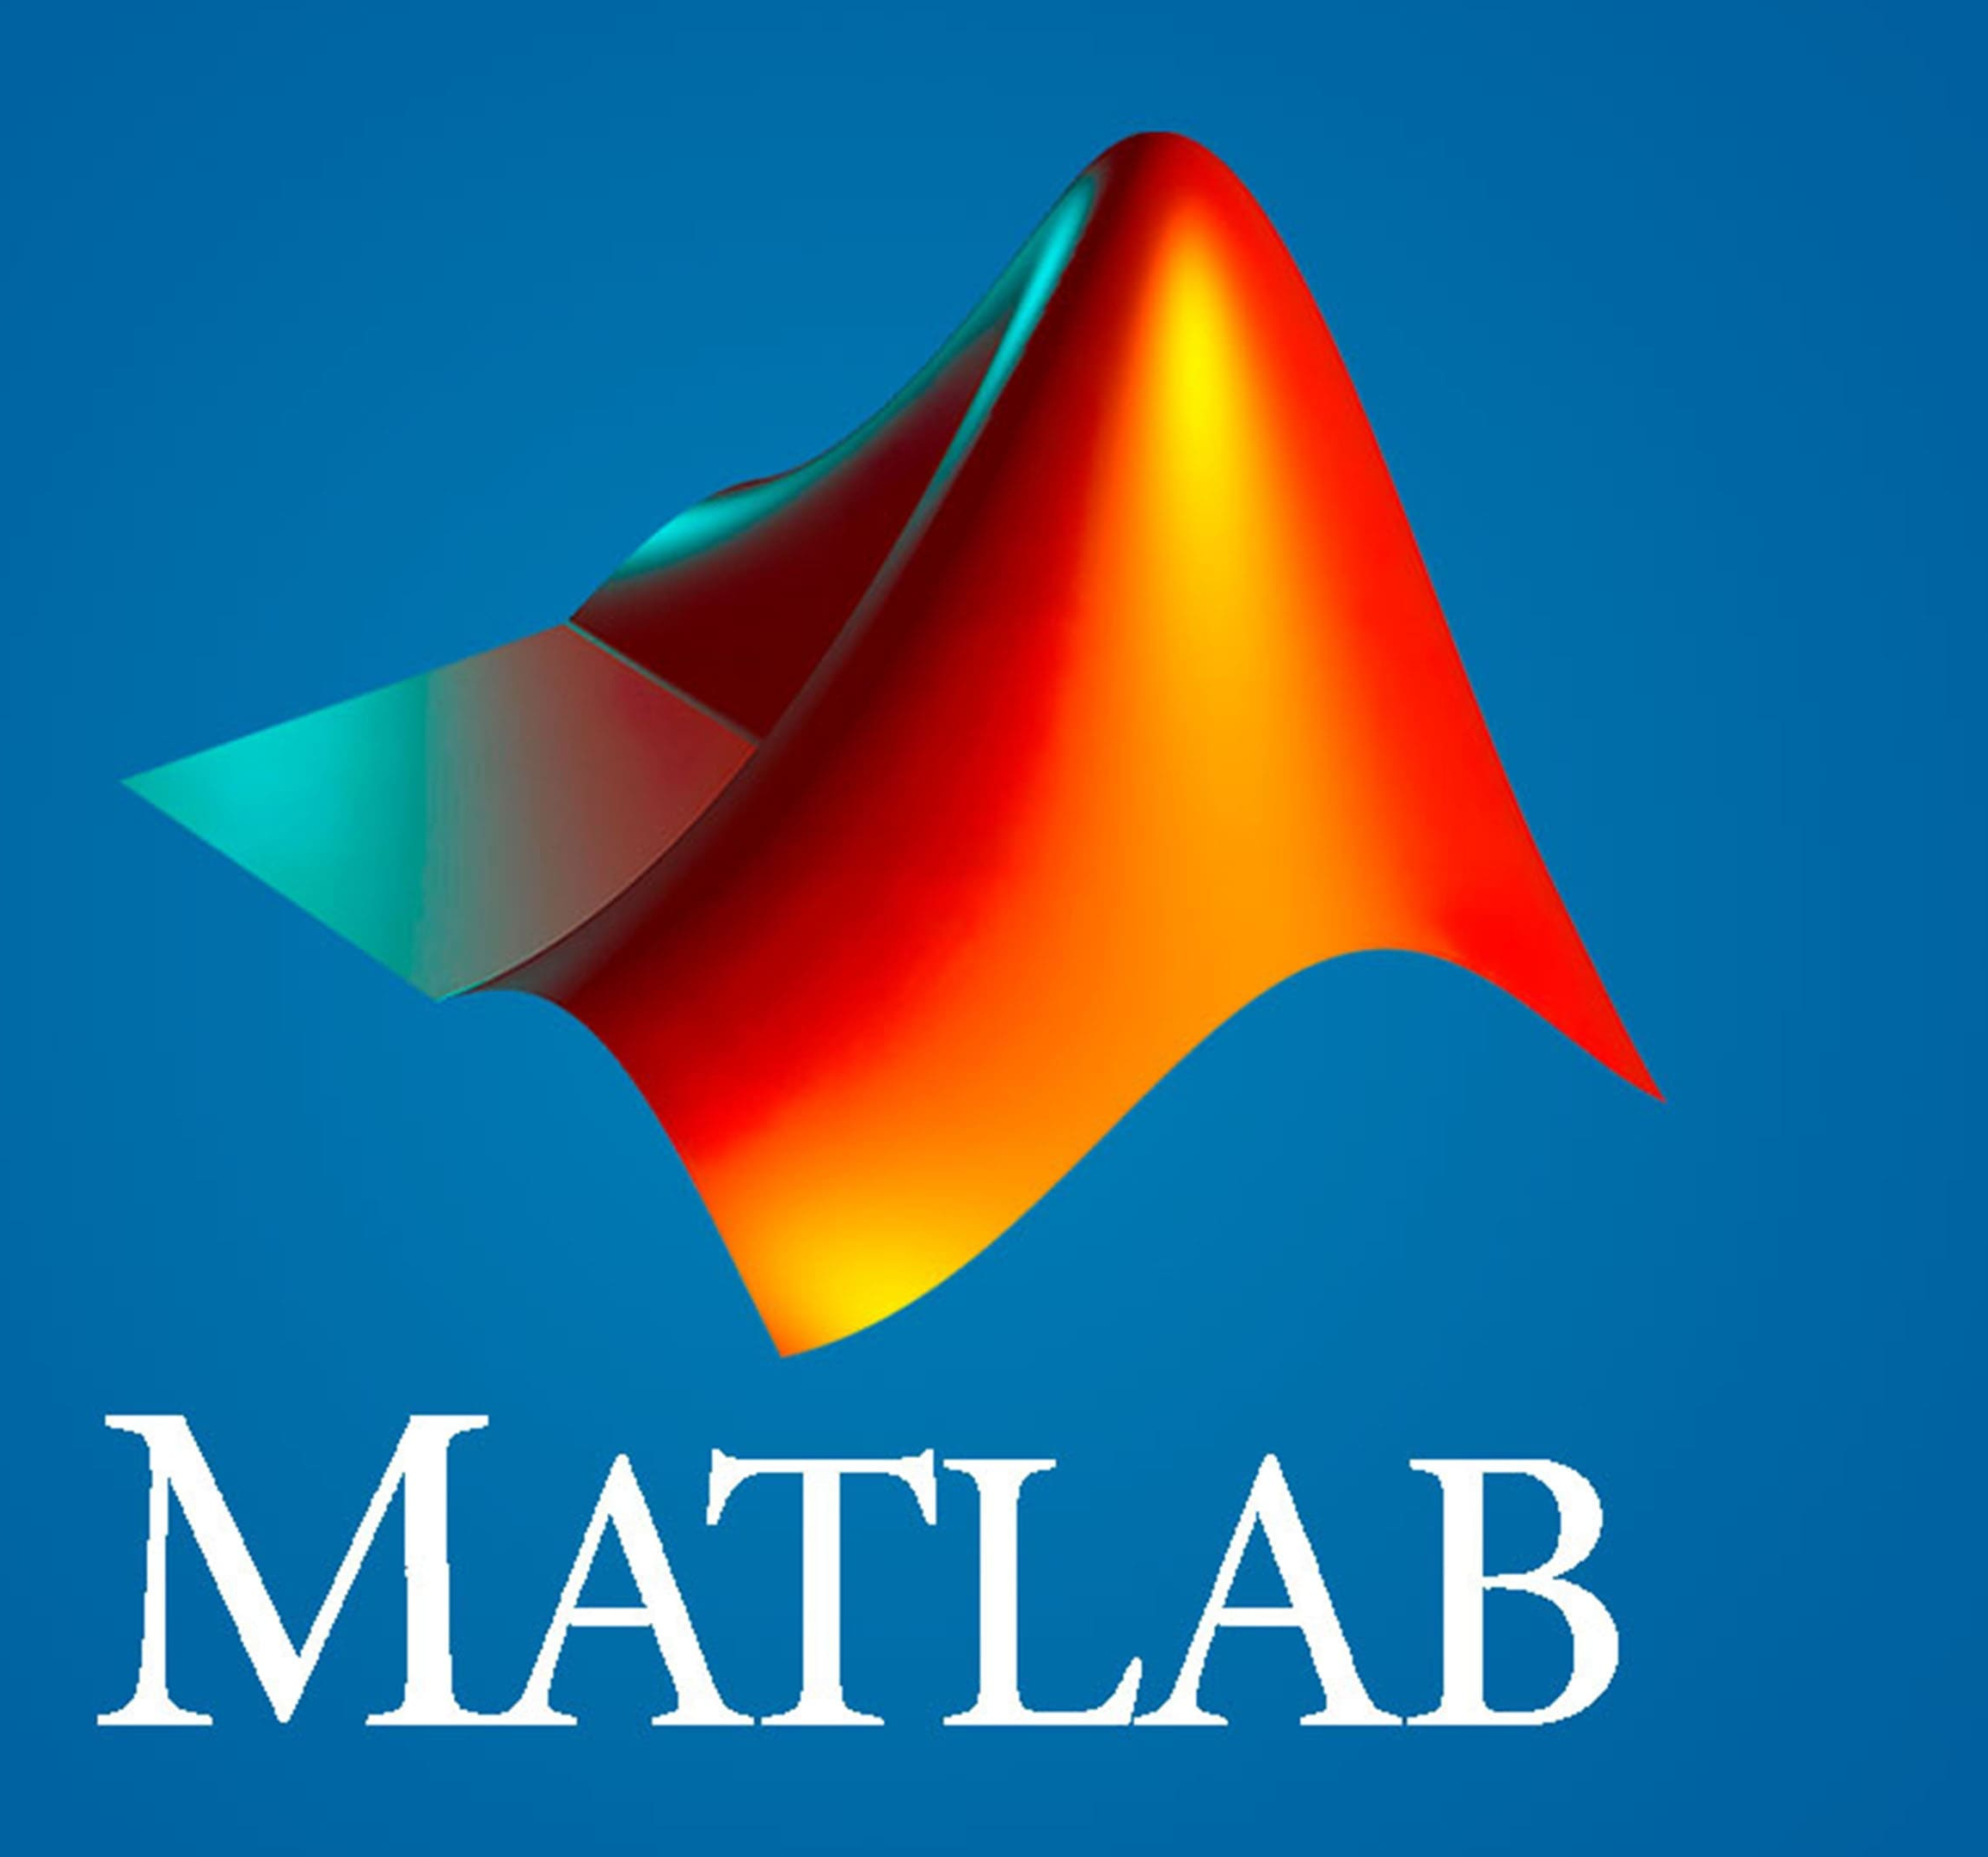
Thank You!
Dr. Luis M. Vicente
lvicente@pupr.edu
8

