Slide 1


Teaching
“AI in Engineering and Science Applications” with MATLAB
Mehrube Mehrubeoglu
Department of Engineering
College of Engineering and Computer Science
2025 Educator Workshop: Teaching Computation with MATLAB (and GenAI)
Carlton College, Northfield, MN
26-28 October 2025

Slide 2
What is the course about?
ENGR 4352 AI in Engineering and Science Apps
Use of AI/ML/DL in engineering and science applications
Survey of existing algorithms for specific problems in ENGR and Sciences
Ethics and representativeness of AI
Hands-on exercises + final project with MATLAB
--
Multidisciplinary - serves as a technical elective
(civil, electrical, industrial, mechanical engineering + mechanical engineering technology)

Slide 3
What We Do in the Class
LEARNING OUTCOMES
By the end of the course, students will be able to:
  Understand the concepts of AI, ML and DL
  Explore basic theory behind AI, ML and DL
  Investigate AI models, methods and applications
  Create an application and solution for an AI problem in engineering or science using a programming tool (MATLAB)
  Analyze ethical concerns in AI solutions and limitations of AI
  Prepare and conduct effective written and oral presentations

Slide 4
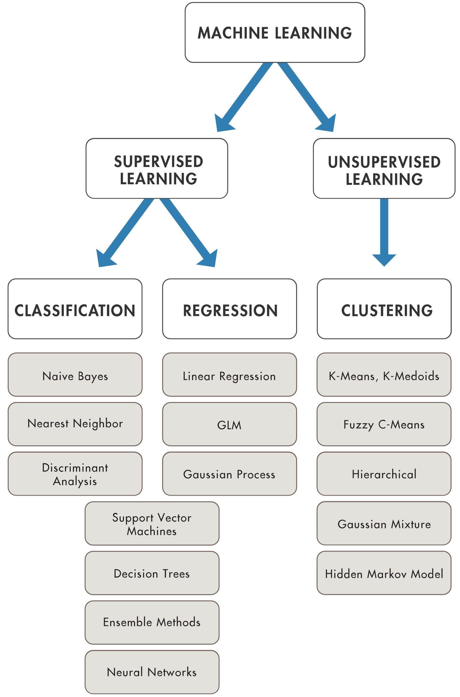
Topics
Brief History + Definitions
AI tools: enterprises, uses, applications
Search Algorithms
Intelligent Agents
Logic Models
Ethics in AI / Limitations of AI
AI Algorithms, with MATLAB
Machine Learning Algorithms, with MATLAB
  Supervised/Unsupervised Learning
  Classification/Regression/Clustering examples
Training and Testing with AI tools in MATLAB
Final Team Project – topic chosen by student
first 5
weeks
next 9
weeks
last 5
Weeks
(overlaps with previous)
https://www.mathworks.com/solutions/machine-learning

Slide 5
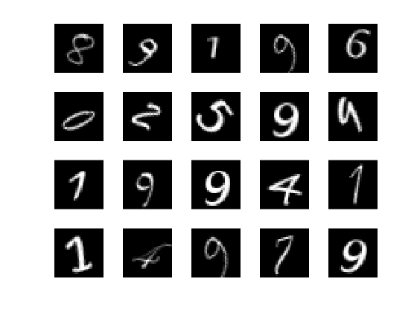
MATLAB AI Exercises Used
Examples from MathWorks
Single Digit Number Identification
Human Motion Classification*
Deep Learning with Transfer Learning
Machine Learning – Unsupervised Learning: K-Means Clustering
YOLO v3 / YOLOx examples for object detection and identification
Regression Analysis*
https://www.mathworks.com/help/deeplearning/ug/create-simple-deep-learning-network-for-classification.html

Slide 6
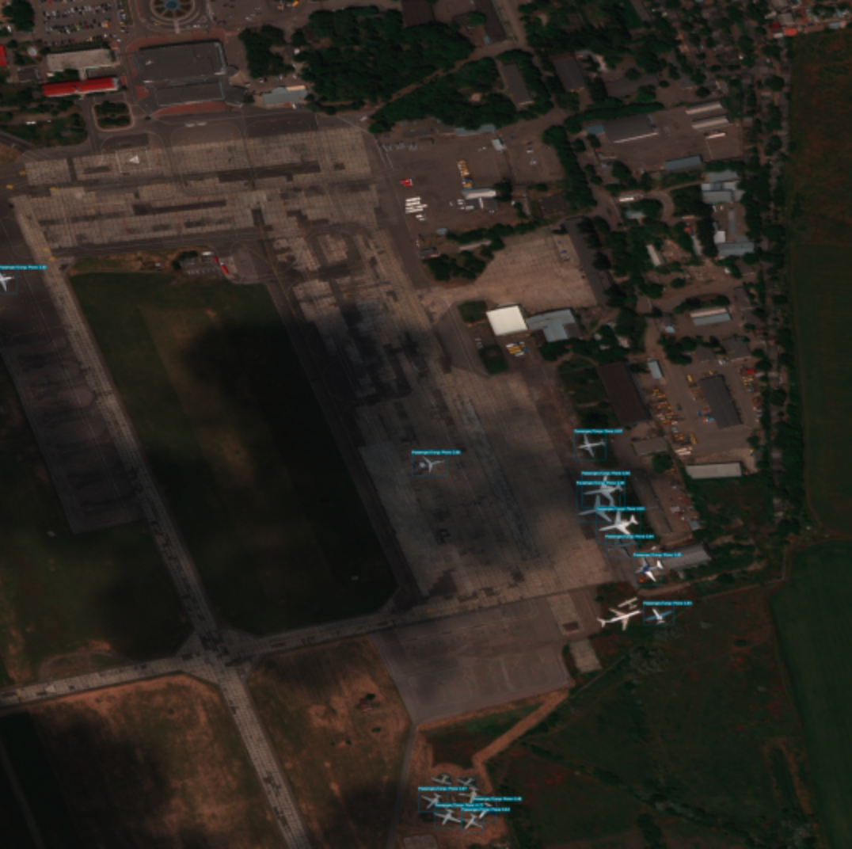
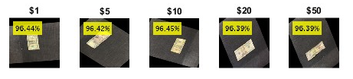
Teaching/Learning Methods
TK, FG “Vehicle Detection in Satellite Images”, Final Project, Fall 2024
Lectures
Critical review of an AI application/implementation (student’s choice)
Webinars
MATLAB videos
In-class MATLAB exercises
Student final projects and presentations – report, oral, demo
KJ, SC “Currency Identification”, Final Project, Fall 2024

Slide 7
Challenges and Learning Goals
Challenges
Finding the datasets to run the MATLAB examples
  availability specific to MATLAB version
Setting up the directories for the code to work
Some of the code do not work with all versions of MATLAB
Learning Goals
The New Features in the Deep Learning Toolbox + Teaching with Copilot
Using and teaching NN/DL/ML model training from scratch
Deploying MATLAB on hardware

Slide 8
Acknowledgment
MathWorks
Workshop and faculty classroom support
Engineering for One Planet – ASEE/Lemelson Foundation
EOP Mini Grant
Texas A&M University-Corpus Christi
OER Program

