Slide 1
2025 MATLAB Workshop:
Post RoadCheck Learning Tips
Lisa Kempler
Tuesday Intro Session, October 28, 2025
2025 Teaching Computation with MATLAB (and GenAI)

Slide 2
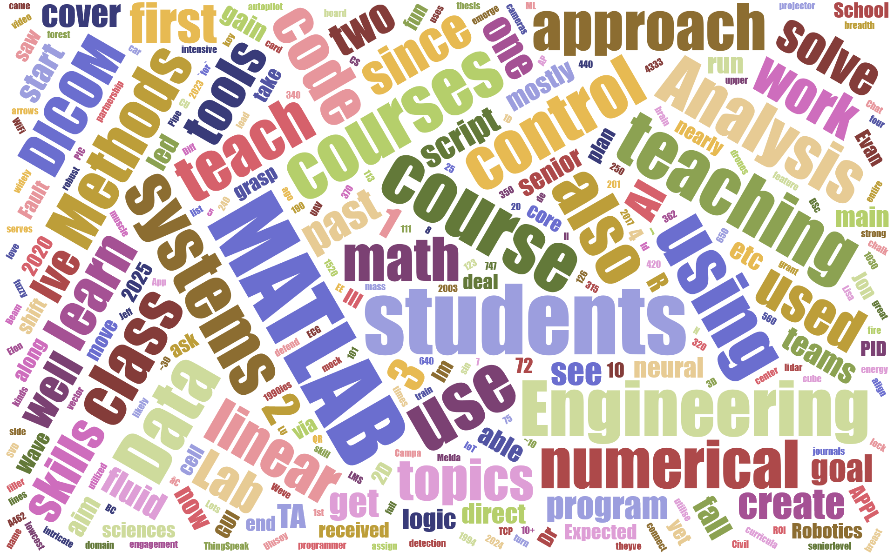
Redo with MATLAB!
Source: 2025 workshop applications via Word Cloud Generator (jasondavies.com)

Slide 3
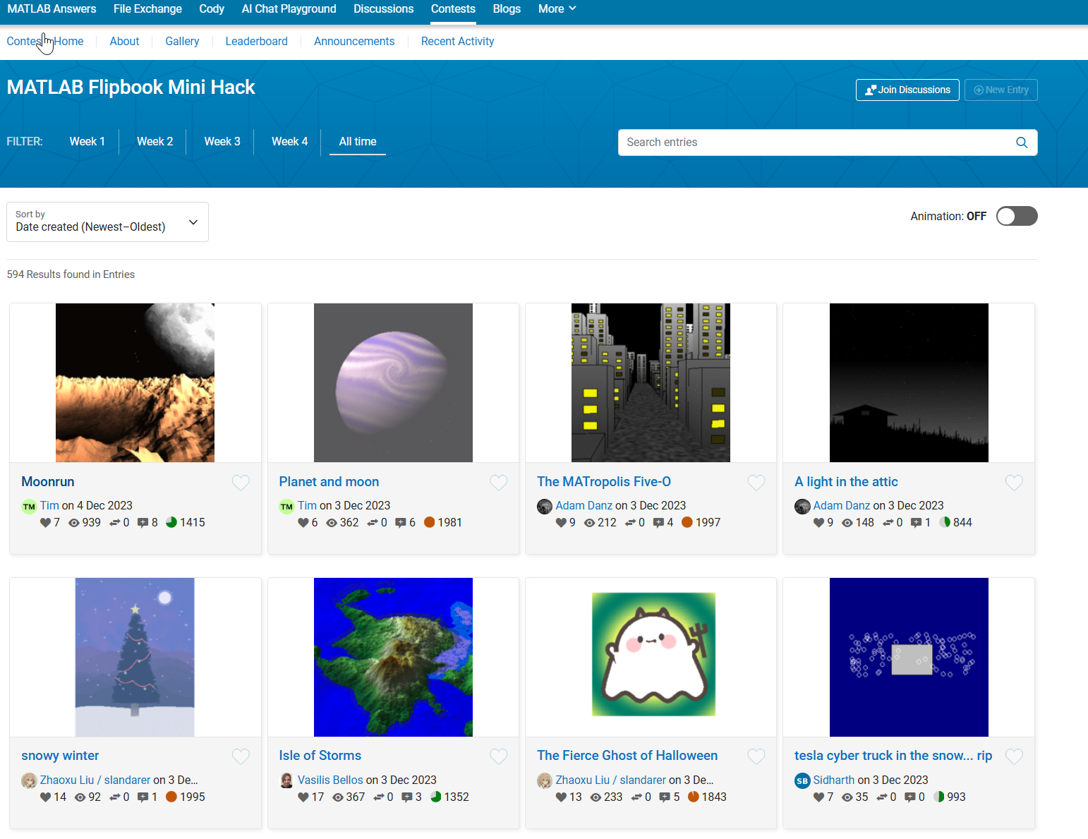
Repo Sources: File Exchange, GitHub, and online Community Hubs Example: Flipbook Contest

Slide 4
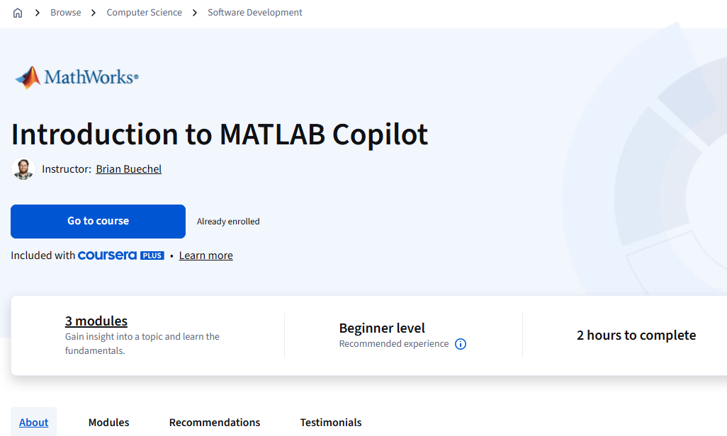
Free Coursera Course: Introduction to MATLA Copilot

Slide 5
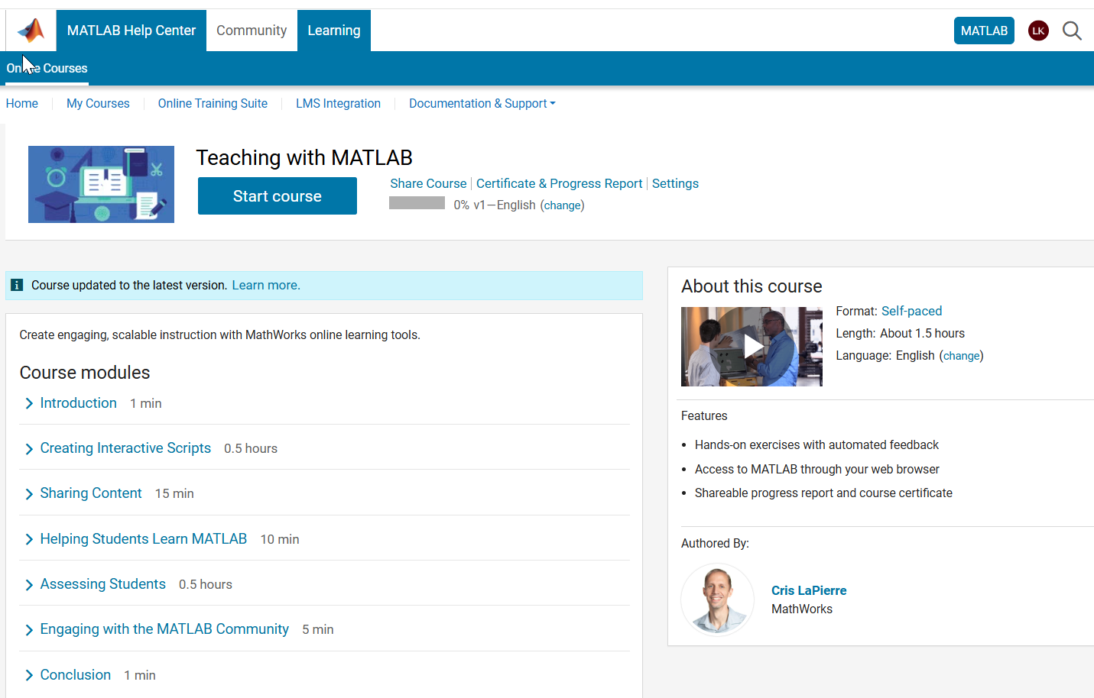
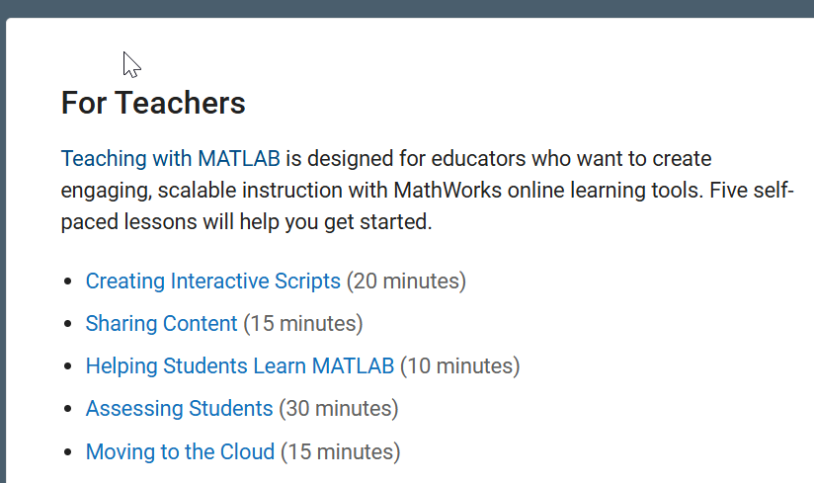
Teaching with MATLAB: Self-paced MATLAB Teaching Tools Training
matlabacademy.mathworks.com/details/teaching-with-matlab/instructoronboard

