Slide 1
Foundational Computation Skills in the Face of Generative AI
instructions
Darren Maczka

Slide 2

Birdseye View
General Engineering Students
Computational skills and tools embedded in a physics + design project environment

Slide 3
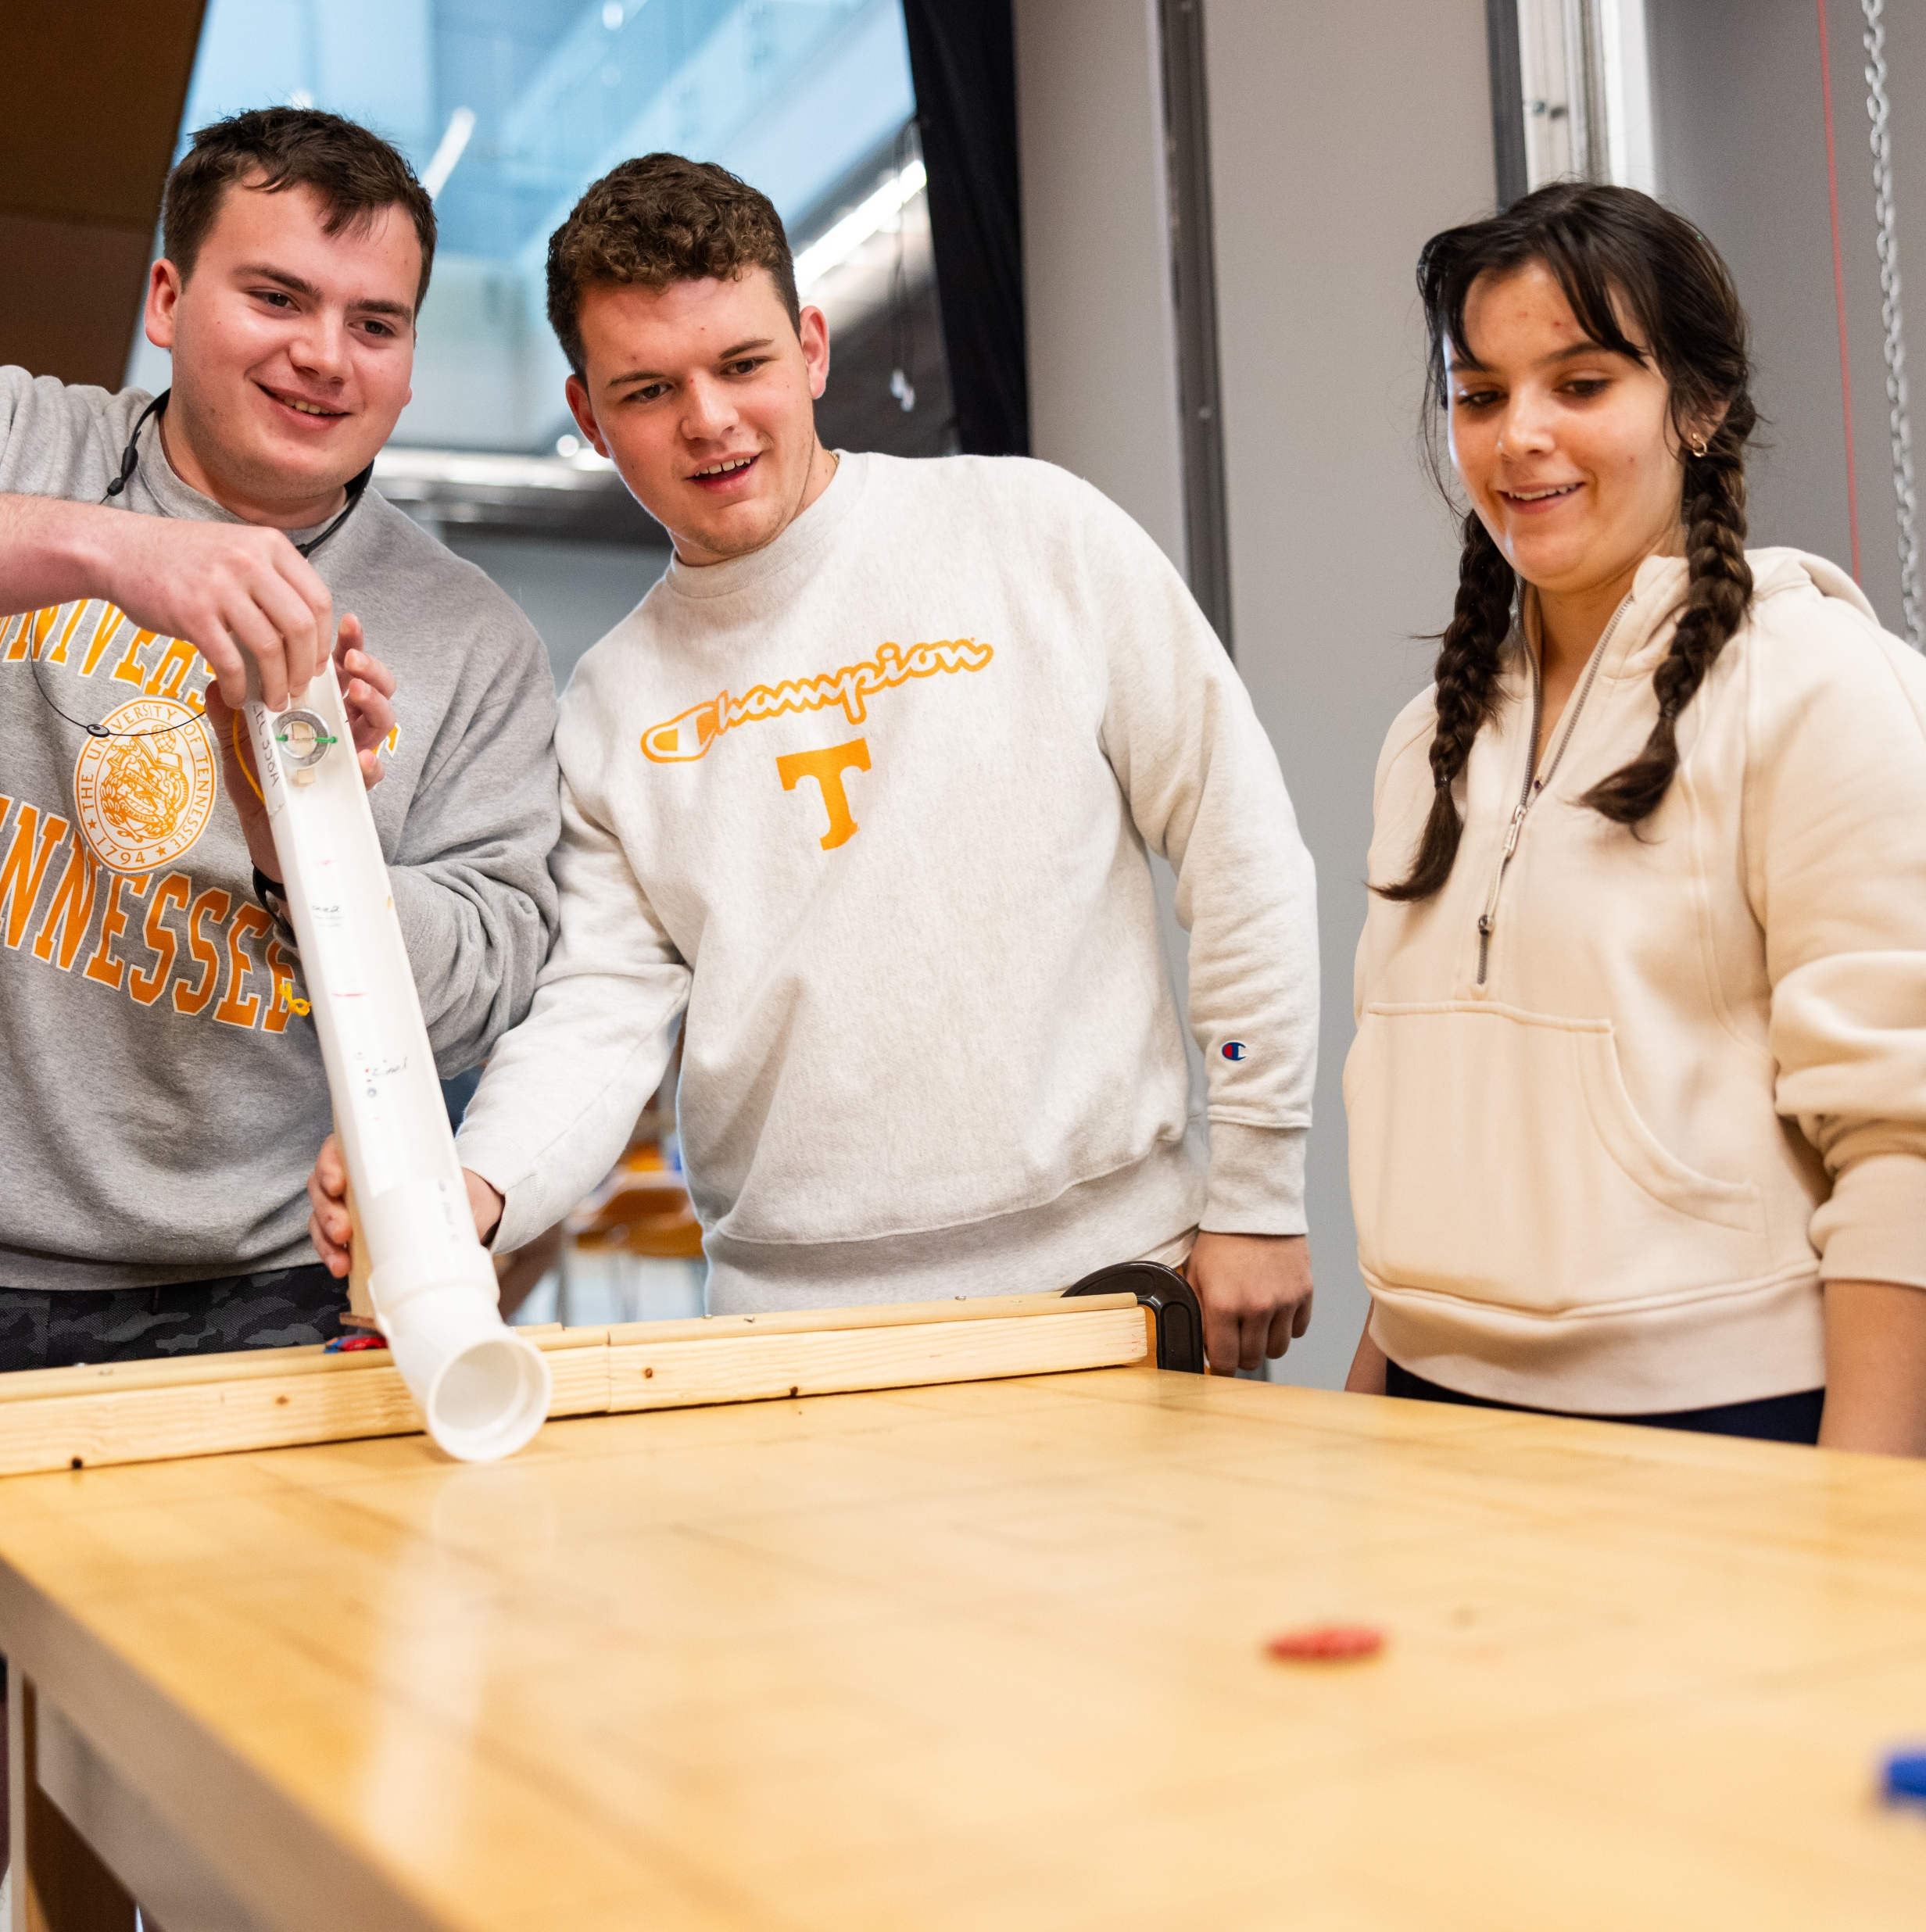
Example: Physics Modeling
Design a device that will launch a puck (poker chip) across a table, with point values associated with different target areas
Write a MATLAB script to support gameplay
Notes:
It will be helpful to have a particular example in mind as we think about curricular change
In my course, we teach MATLAB embedded in a first-year engineering physics curriculum
To help connect physics theory to practice, and practice the engineering design process we include a 1-2 week long design and build project
Let’s assume students have already built a feasible device

Slide 4

Rethinking Intended Learning Outcomes
Notes:
Students (and professionals) now have a tool that will take a natural-language problem statement and generate working code in a formal language (e.g. MATLAB).
That sounds great, (or awful, depending who you are) now anyone has access to the power of computational tools without needing to go through the hassle of learning a formal language, right?

Slide 5
Rethinking Intended Learning Outcomes
Notes:
Wrong!

Slide 6
What Needs to Change?
Learning Outcomes
Teaching & learning activities
Assessment
Adapted from: Biggs, J. (2003). Constructing learning by aligning teaching: Constructive alignment. In Teaching for quality learning at university: What the student does (2nd ed.). McGraw-Hill Education (UK).
Notes:
Constructive alignment: what is learned depends on what the student does, and students choose what to do based on how they will be assessed, therefor, assessments must be designed so that completing successfully will provide evidence of the intended learning outcomes

Slide 7
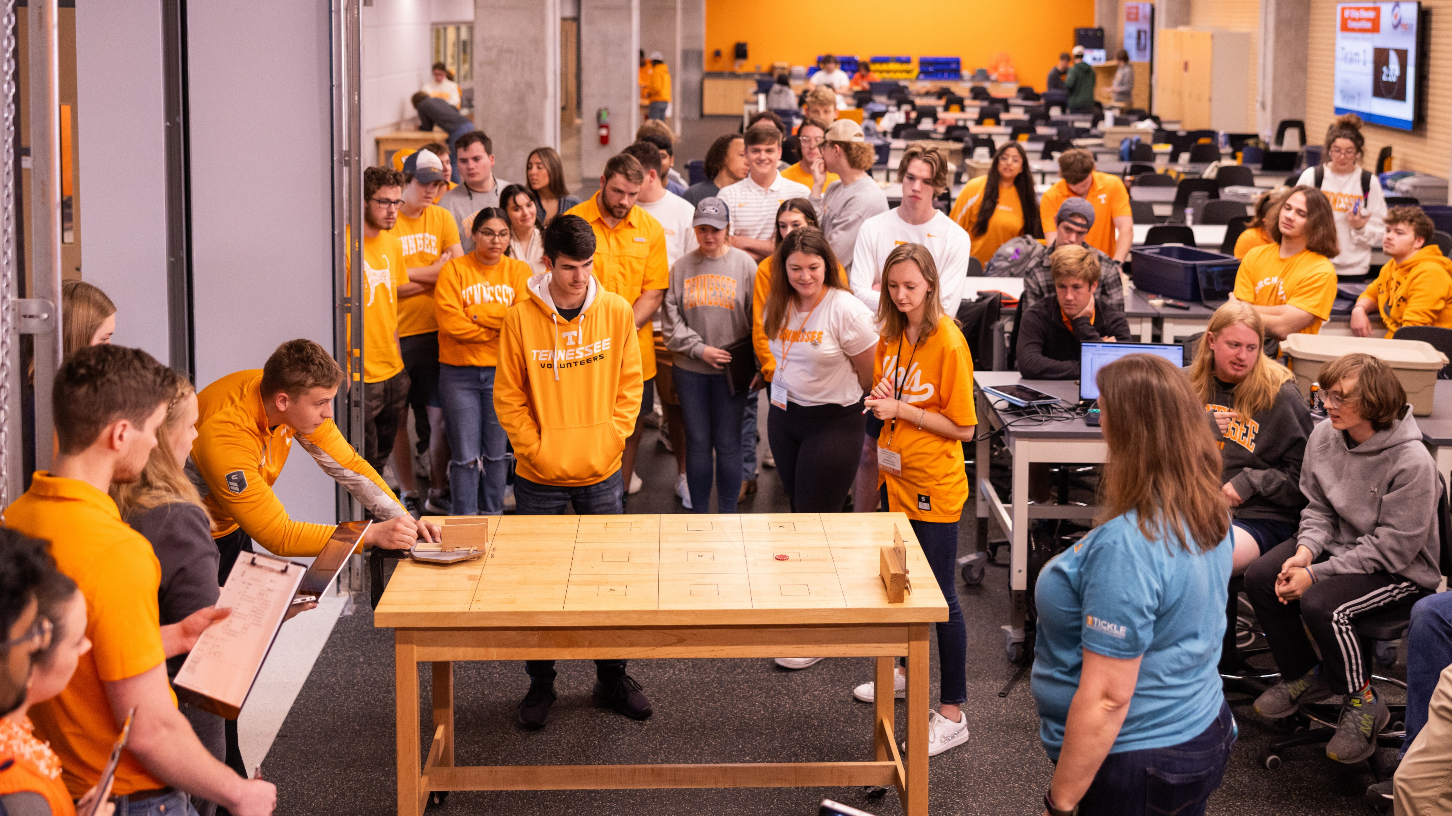
“From our students’ point of view, the assessment always defines the actual curriculum.”
– Ramsden (1992), p.187

Slide 8
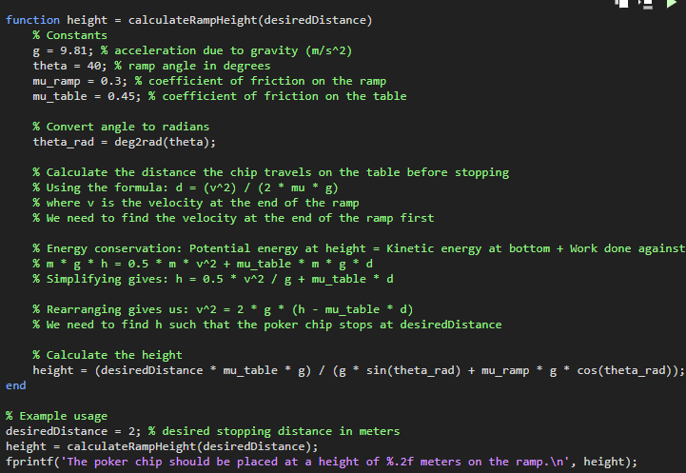
Assessment
This program will aid a user in pointing a device capable of launching a puck across a table so that the puck will come to a stop in a target region.
Is it correct?
If not, make corrections.
Document your process and evidence of conclusions.
Notes:
I’ve already created and ran an initial prompt to generate a program. Doing so requires and understanding of the problem itself, identifying the necessary physics concepts well enough to know what is physically relevant about the system, and what information needs to be included in the prompt
Copy transcript from CoPilot

Slide 9
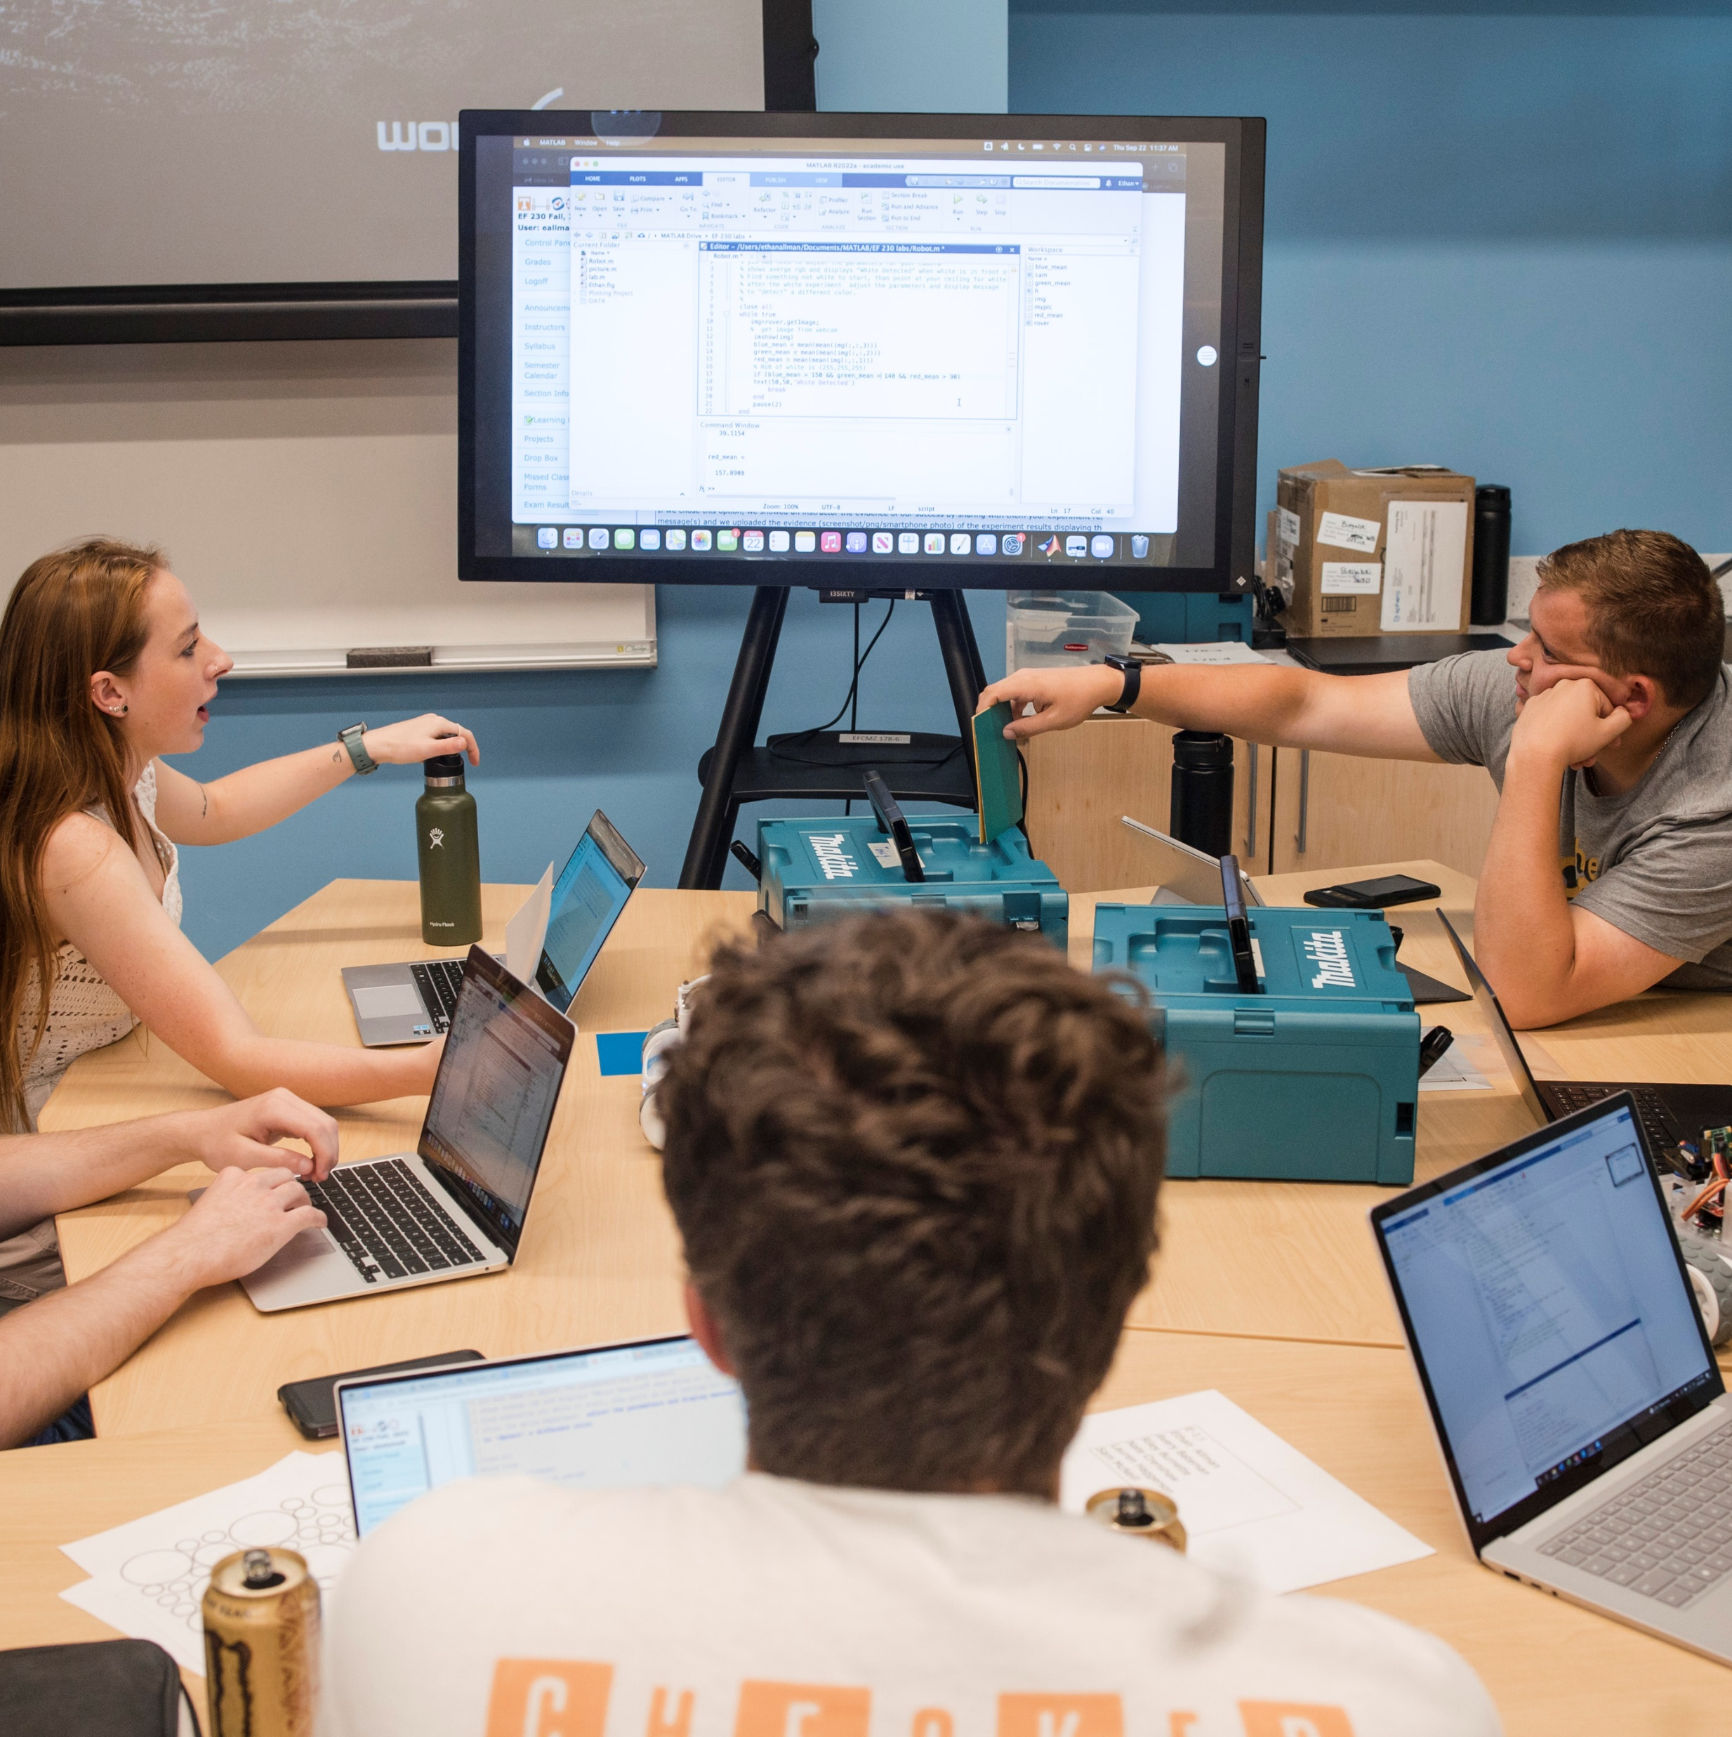
Teaching and Learning Activities
Understand the problem
  Re-state, explain to others
Trace program flow
  Syntax & keywords (e.g. Onramp)
  Paper-based tracing, flowchart matching
Identify problem lines
  “Correct the error” (e.g. Grader)
Identify and assess domain-specific (e.g. physics) code
  Match the equation to the scenario
Notes:
Tracing program flow requires “foundational” knowledge of how a computer executes code, syntax of the language, keywords and functions referenced
Offload syntax learning to async tasks, e.g. MATLAB Grader
Keywords and functions, reading the documentation
Assess the calculations requires enough knowledge of syntax to translate code calculation to mathematical expression
Assessing the physics requires modeling the system, deriving an input/output relationship between puck height and stopping distance, and evaluating whether the derived expression is equivalent to the calculation extracted from the program
In this example, the program logic is fairly simple, but CoPilot used a function to encapsulate the calculation, though this was not specifically requested. In general, CoPilot may generate code that includes constructs that beginning students are not familiar with, increasing the cognitive load required to comprehend. It is, however, a good opportunity to help students use technical documentation as part of their learning.

Slide 10

Foundational skills change with new technology
GenAI provides opportunity for deeper engagement with domain content
Think hard about assessments and learning activities
Take-aways

Slide 11
References
Biggs, J. (1999). What the Student Does: Teaching for enhanced learning. Higher Education Research & Development, 18(1), 57–75. https://doi.org/10.1080/0729436990180105
Park, J. (2025). A systematic literature review of generative artificial intelligence (GenAI) literacy in schools. Computers and Education: Artificial Intelligence, 9, 100487. https://doi.org/10.1016/j.caeai.2025.100487
Ramsden, P. (1992). Learning to teach in higher education. routledge. https://www.taylorfrancis.com/books/mono/10.4324/9780203507711/learning-teach-higher-education-paul-ramsden-paul-ramsden

