Slide 1
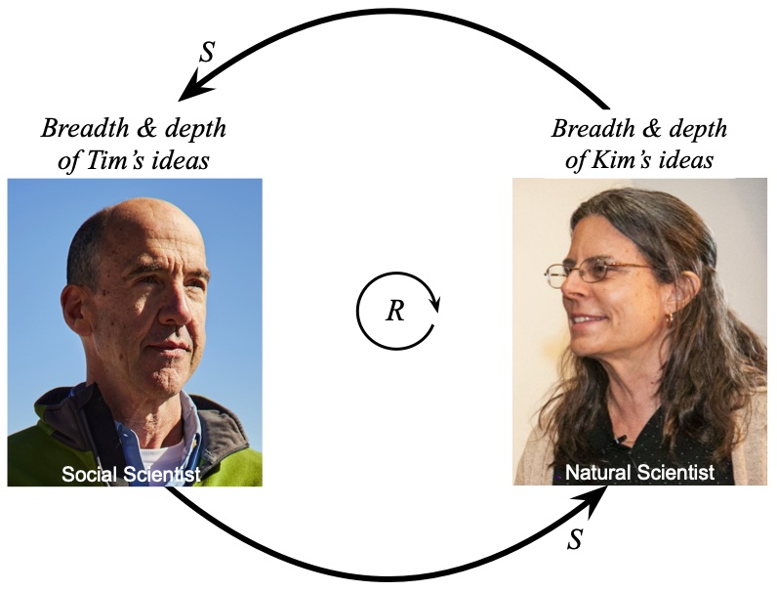
Cognitive Analysis of a Systems Thinking Educational Assignment:
Find & Map the Feedback Loop in Popular Media Articles
Kim Kastens
Lamont-Doherty Earth Observatory
of Columbia University
Thomas F. Shipley
Department of Psychology
Temple University
International Systems Dynamics Conference
Boston, August 4, 2025
National Science Foundation IUSE grants, Supporting Feedback Loop Learning in Natural and Social Science Courses:
Kastens (2141939), Shipley (PI) & Davatzes (2142010), ​and Brenner (2141982).​
Notes:
Session is 13:30 to 14:30 in room 310, chaired by Allyson Beall King. So each talk has 20 minutes including change over.
To see abstracts go to: https://webportal.systemdynamics.org/sched/tentative.html?_gl=1*w60fdr*_gcl_au*Njc4NTQ1MjI2LjE3NTM0MDA0MDQuNzc1NzMyMjkyLjE3NTM3MDQ3NTYuMTc1MzcwNDg1Mg..*_ga*MjA4NTgxMDIwMC4xNzUzNDAwNDA0*_ga_1T2ZJVXKRZ*czE3NTM3MDczNzYkbzQkZzEkdDE3NTM3MDc3NDgkajYwJGwwJGgxMjU5OTE5MzI.

Slide 2
Problem Statement:
Systems thinking draws on complex cognitive processes…
… but many instructors of systems thinking and systems dynamics lack expertise in cognitively-informed pedagogy…
… and thus may be misunderstanding their students’ struggles …
… or missing opportunities to build their students’ strengths.
Cognitive task analysis:
The process of examining how learners process information and build understanding while completing an instructional activity.

Slide 3
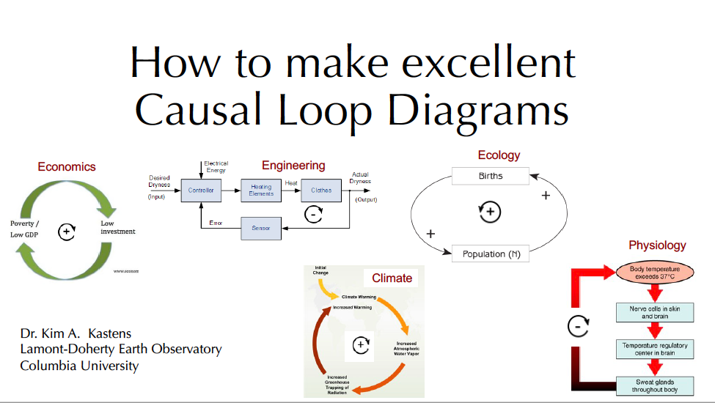
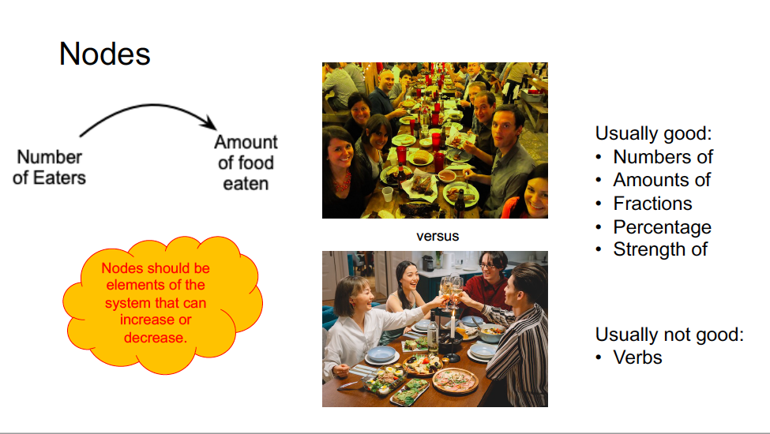
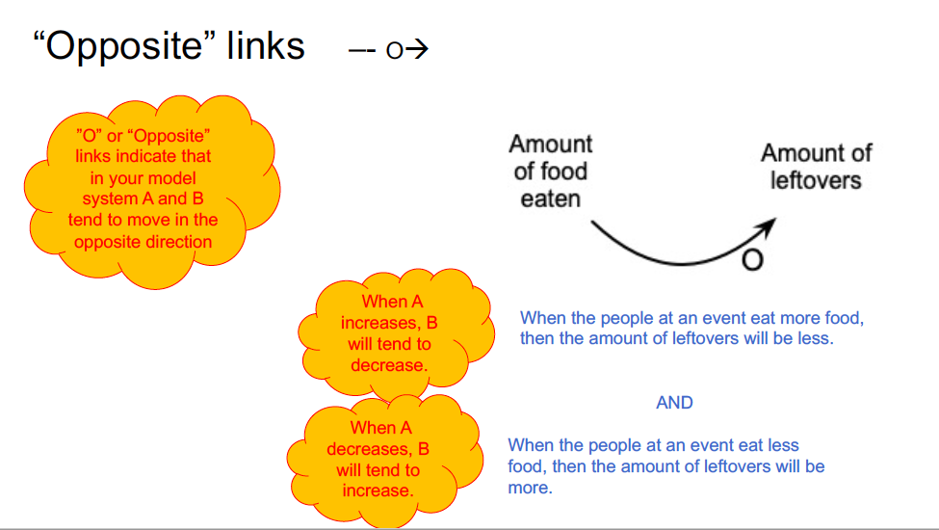
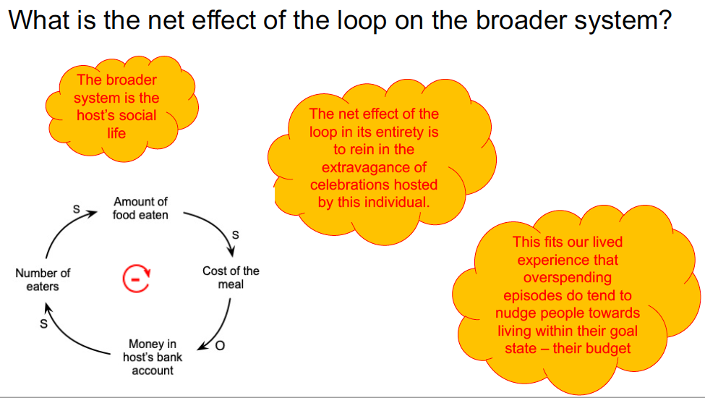
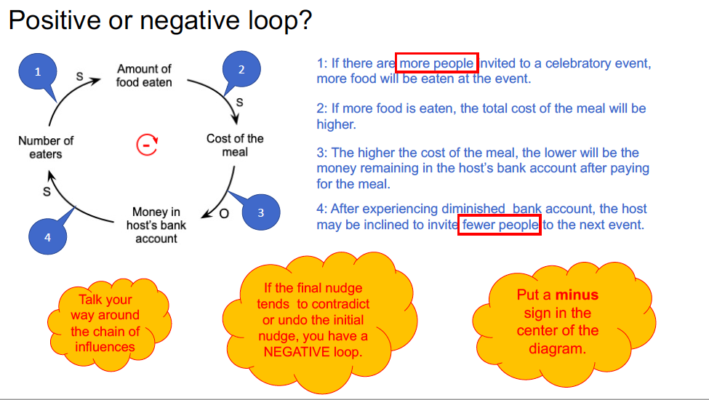
The assignment: Find and map the feedback loop in a popular media article
Students watch an instructional video…

Slide 4
Then read a short reading passage …
… and find the feedback loop
adapted from
Outlive: The Science and Art of Longevity
by Peter Attia and Bill Gifford (2023)
One of the prime hallmarks of aging is that our physical capacity erodes. ... We lose strength and muscle mass with each passing decade, our bones grow fragile and our joints stiffen, and our balance falters, a fact that many men and women discover the hard way, by falling off a ladder or while stepping off a curb.
To paraphrase Hemingway, this process begins in two ways: gradually and then suddenly. The reality of the situation is that old age can be really rough on our bodies. Longitudinal and cross-sectional studies find that [muscle mass] and activity levels remain relatively consistent as people age from their twenties and thirties into middle age. But both physical activity levels and muscle mass decline steeply after about age sixty-five, and then even more steeply after about seventy-five. It's as if people just fall off a cliff sometime in their mid-seventies.
… two more paragraphs

Slide 5
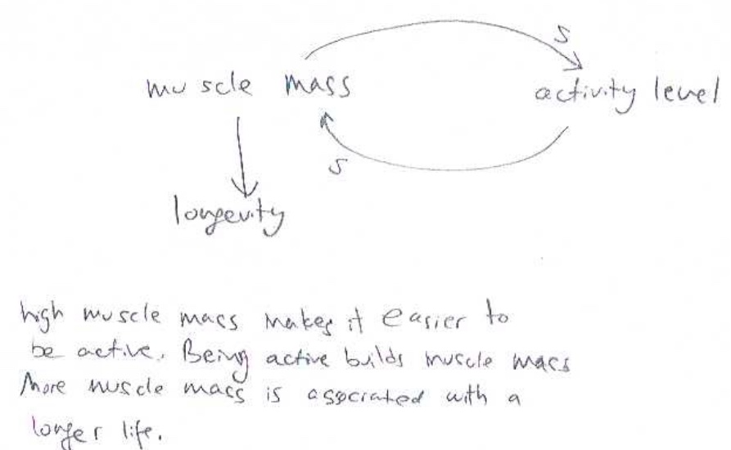
… and draw a CLD and write an accompanying narrative
Mark the place in the article that you think conveys a feedback loop…
Sketch a causal loop diagram (CLD) that depicts the feedback loop…
Write a narrative that describes how the loop works.
Your narrative should start at one node and progress all the way around the loop.
Your narrative should discuss the net effect of the loop taken as a whole on the larger system within which the loop is embedded.

Slide 6
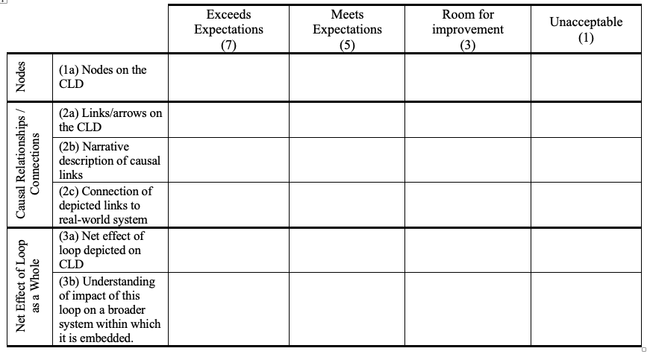
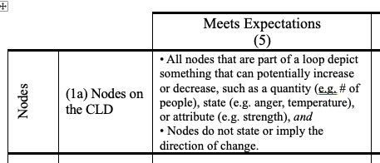
For details, see Kastens, Wakeland & Shipley, 2024 ISDC paper

Slide 7
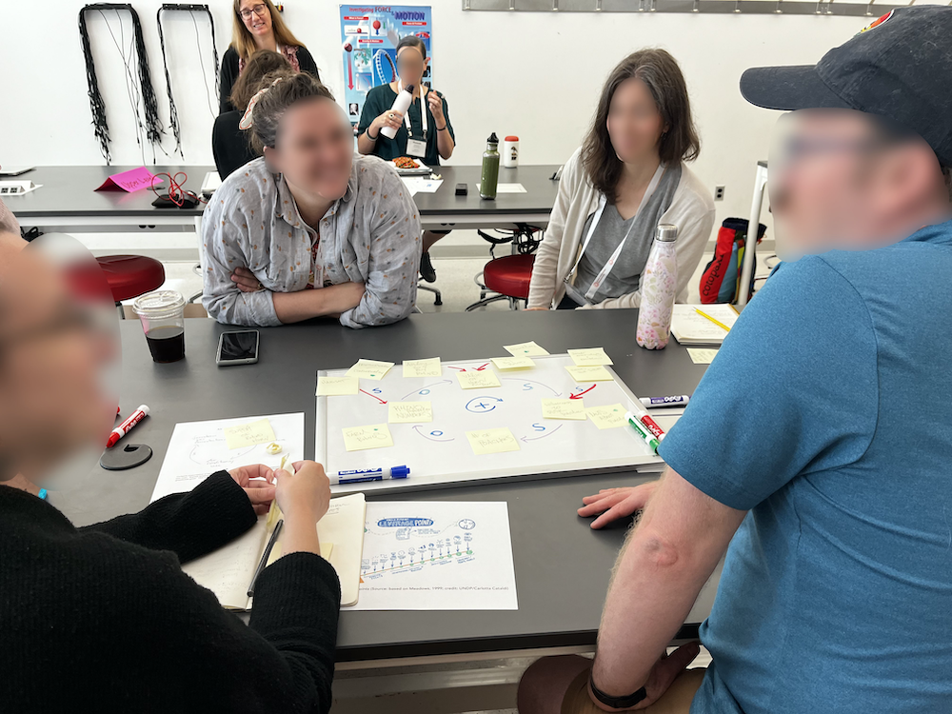
Why we like this assignment
Life-long relevance
Any content domain
Many instructional contexts:
Workshop
Small-group, in class
Homework
Research instrument
Course assessment
Serious cognitive challenges
Photo from Earth Educators’ Rendezvous 2024. Credit: Kim Kastens
Notes:
Blur faces.

Slide 8
Higher order cognitive skills identified:
To find the loop: Analogical reasoning
To make each link: Causal reasoning
Throughout: Distinguishing and integrating parts and wholes
To make the CLD: Semiosis – making meaning with signs

Slide 9
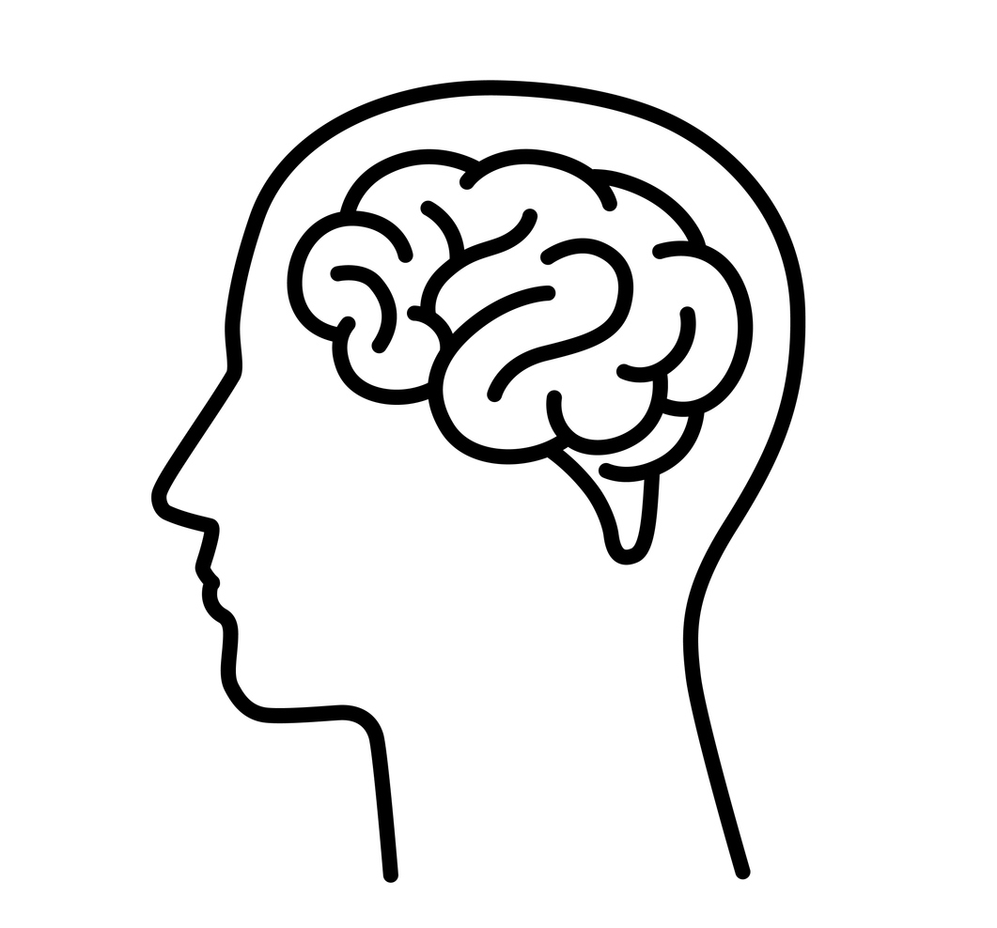
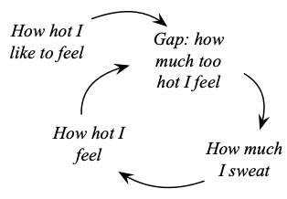
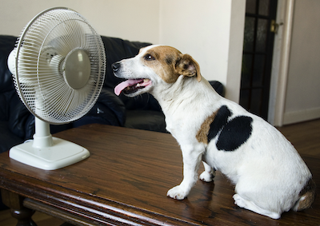
(1) To find the loop: Analogical reasoning
Analogic reasoning: The process by which the human mind can notice important similarities between analogs, and then use those similarities to generate new inferences.
Projective analogy: Use known attributes of familiar “source” analog to better understand unfamiliar “target” analog.
SOURCE ANALOG TARGET ANALOG
NEAR ANALOGY

Slide 10
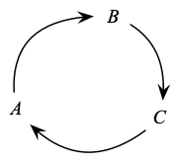
(1) To find the loop: Analogical reasoning
SOURCE ANALOG TARGET ANALOG
FAR ANALOGY

Slide 11
(1) To find the loop: Analogical reasoning
Projective analogy: Use known attributes of familiar “source” analog to better understand unfamiliar “target” analog.
Progressive alignment:
NEAR ANALOGY
Multiple reinforcing feedback loops all driven by the same climate nudge of changing air temperature.
A balancing loop driven by same climatic nudge.
A loop that is in a social system rather than a physical system.
Easier, limited utility
FAR ANALOGY
Harder, broader utility
Notes:
Several reinforcing feedback loops all driven by the same climate nudge of changing air temperature (ice albedo, wildfires, permafrost)
A balancing loop driven by same climatic nudge (cloud cover).
A loop that is in a social system rather than a physical system (economics of supply and demand for EVs).

Slide 12
(2) To create links: Causal reasoning
Under what real-world circumstances are we justified in making a claim that “A” causes or influences “B”?
Ask yourself:
Can I articulate a plausible mechanism by which this ”A” should cause or influence this “B”?
Can I point to empirical evidence that in the real world this “B” does reliably follow this “A”?
Want both; often have to settle for one or the other.
For biases in human causal reasoning, see Kastens & Shipley, 2023 ISDC paper

Slide 13
(2) To create links: Causal reasoning
For each item, indicate the type of causal link that you think connects the two boxed nodes. For each item, there are 4 possibilities:
S
O
S
O
Draw an arrow head to indicate the direction of influence.
Add a “S” to the arrow if you think two nodes change in the Same direction. Add an “O” to the arrow if you think that the two nodes change in the Opposite direction.
(a)
Elapsed time since last meal
S
Hunger
(b)
Ability to buy a car
S
Money in the bank
(c)
Student debt
O
Ability to afford a house after graduation

Slide 14
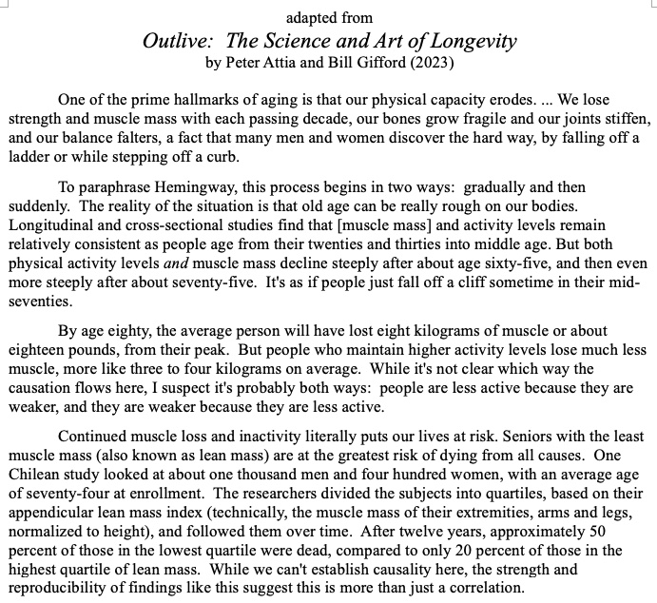
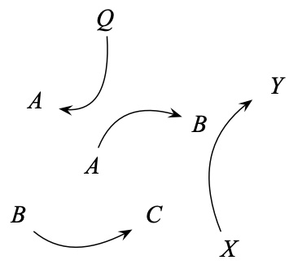
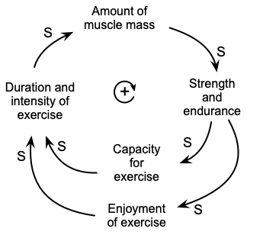
(3) Distinguishing & integrating parts & wholes
WHOLE PART
PART WHOLE
Net effect of the loop on the larger system within which the loop is embedded.
WHOLE PART

Slide 15
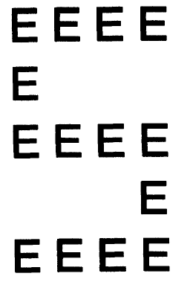
(3) Distinguishing & integrating parts & wholes
Task is harder (slower) when switching from local to global is required
“Navon letter”
• S is global
• E is local
Robertson, L. C. (1996). Attentional persistence for features of hierarchical patterns. Journal of Experimental Psychology: General, 125, 277-249.

Slide 16
(3) Distinguishing & integrating parts & wholes
Task is hardest (slowest) when switching from global to local is required
“Navon letter”
• S is global
• E is local
Robertson, L. C. (1996). Attentional persistence for features of hierarchical patterns. Journal of Experimental Psychology: General, 125, 277-249.

Slide 17
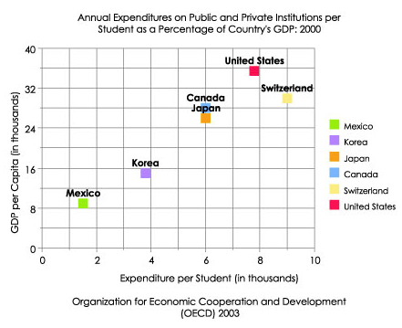
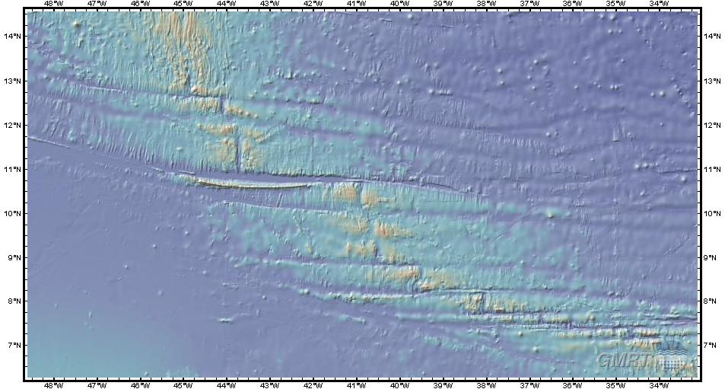
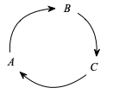
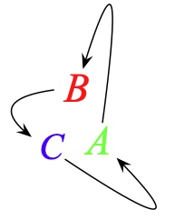
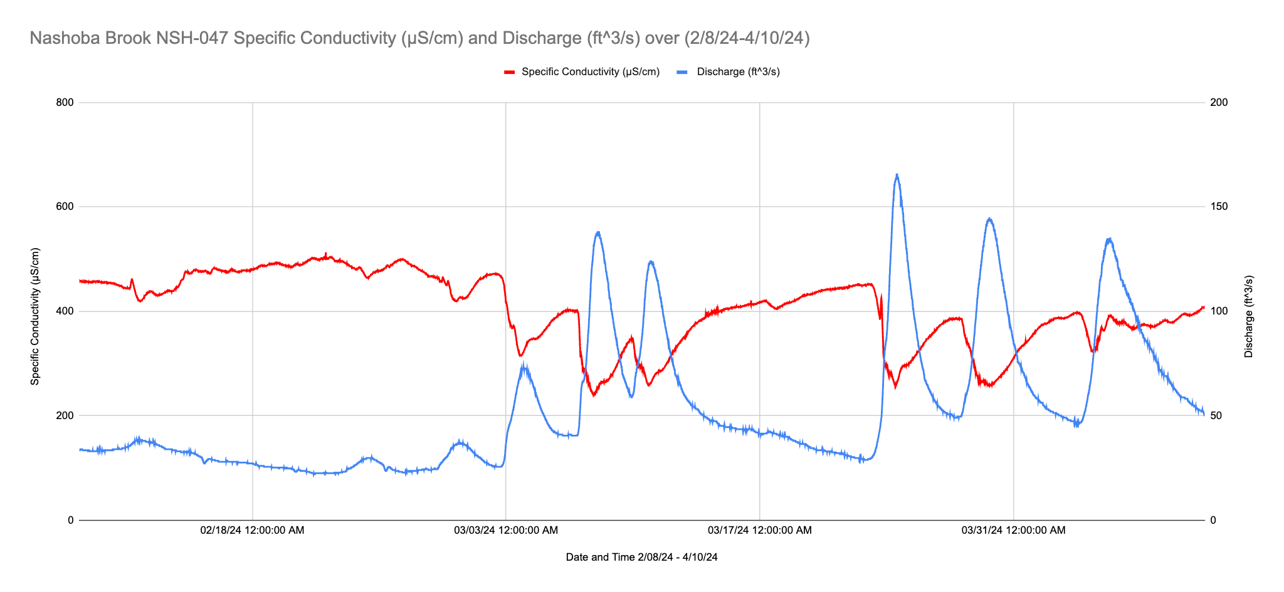
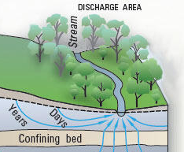
(4) To make the CLD: Making meaning with signs
The use of space on the page or screen is unfamiliar
Position, distance, orientation and size are important signifiers.
Position, distance, orientation, size don’t matter

Slide 18
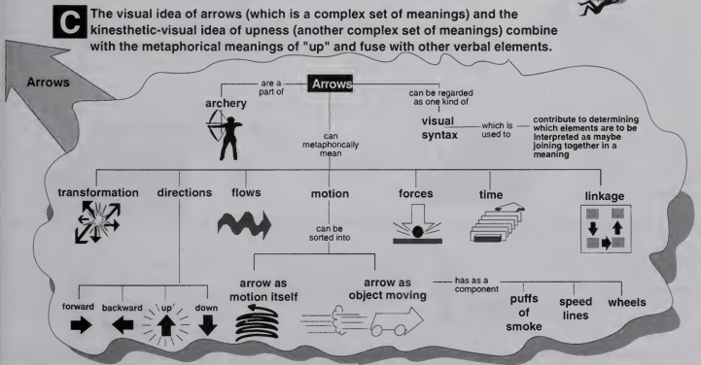
(4) To make the CLD: Making meaning with signs
The graphic language is unfamiliar: what does an arrow mean?
Horn, R.E, 1998, Visual Language. Bambridge Island, WA. MacroVu, Inc.

Slide 19

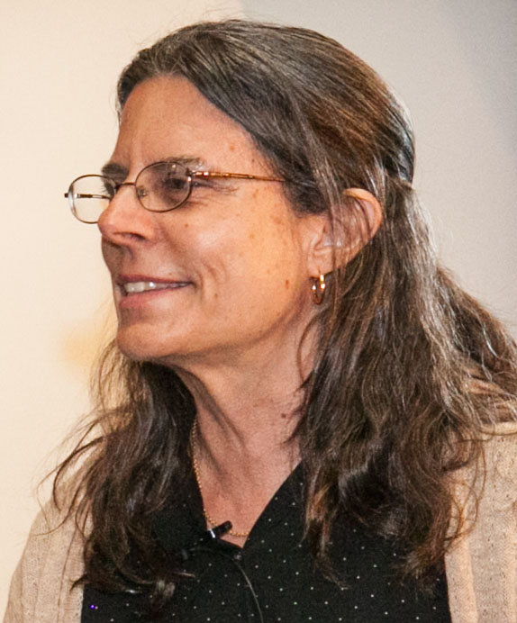

(4) To make the CLD: Making meaning with signs
What does an arrow mean?
… and therefore, and therefore, and therefore…
…and then, and then, and then…

Slide 20
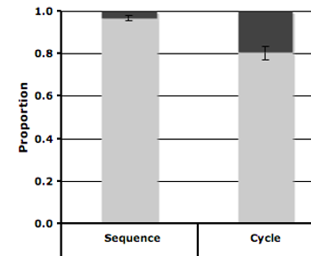
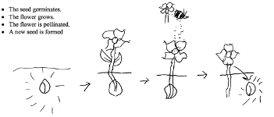
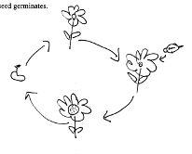

People tend to see temporal cycles as linear chains, not loops
“Please think about the following 4 stages and then construct a simple, schematic diagram conveying them”
The tree grows
The tree dies
The tree decomposes
Fossil fuel is formed
The seed germinates
The flower grows
The flower is pollinated
A new seed is formed
(temporal sequence) (temporal cycle)
Answer coded as “ends”
Answer coded as “repeats”
Work of psychologist Barbara Tversky and students

Slide 21
Higher order cognitive skills identified:
To find the loop: Analogical reasoning
To make each link: Causal reasoning
Throughout: Distinguishing and integrating parts and wholes
To make the CLD: Semiosis – making meaning with signs

Slide 22
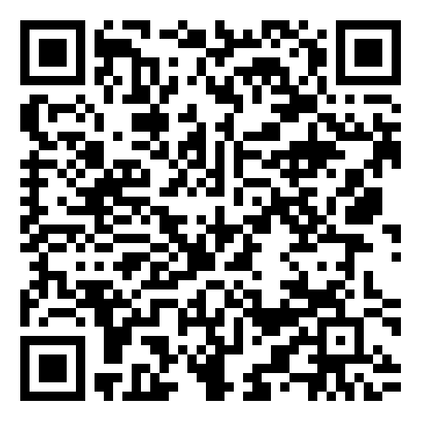
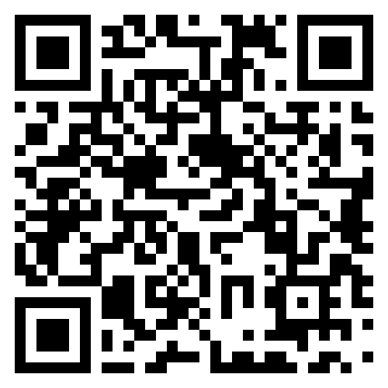
For more of our ideas:
Fostering Feedback Loop Thinking
(Website of educational materials)
Loops Behind the News
(Substack)
https://serc.carleton.edu/teachearth/feedback_loops/index.html
https://loopsbehindnews.substack.com

