Slide 1
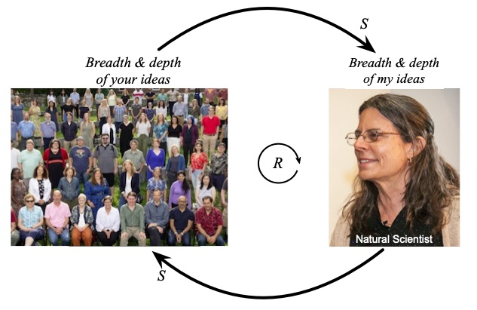
Visualizing invisible causal systems:
Using causal loop diagrams to create, improve, and convey
mental models of feedback loops
Kim Kastens
Lamont-Doherty Earth Observatory
of Columbia University
Gordon Research Conference on
Visualization in Science & Education
Bates College, July 13, 2025
Notes:
8:40 to 9:15 35 minutes

Slide 2
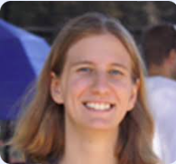

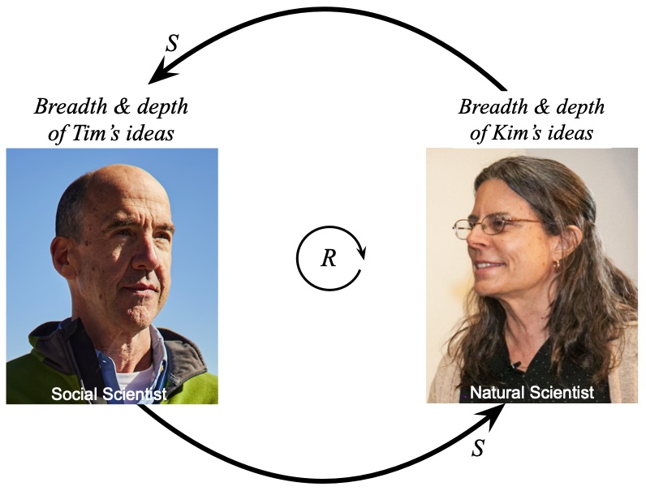

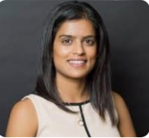

A team effort:
Alix Davatzes
Logan Brenner
Courtney Sheckler
Mansi Shah
Thomas F. Shipley
National Science Foundation IUSE grants, Supporting Feedback Loop Learning in Natural and Social Science Courses: Kastens (2141939), Shipley (PI) & Davatzes (2142010), ​and Brenner (2141982).​
Rebekah Banerjee

Slide 3

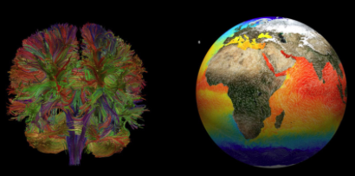
This marvelous conference, in recent years, has mostly been about data visualizations
Notes:
Lace Padilla: https://www.youtube.com/watch?v=zUt94jPttTI
Carter Emmart: https://www.ted.com/talks/carter_emmart_a_3d_atlas_of_the_universe
Mark SubbaRao: https://svs.gsfc.nasa.gov/search/?search=%22mark%20subbarao%22&sort_by_1=date

Slide 4
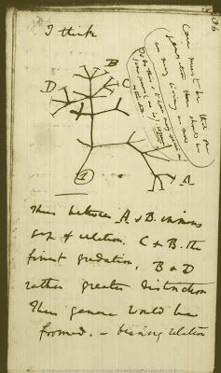
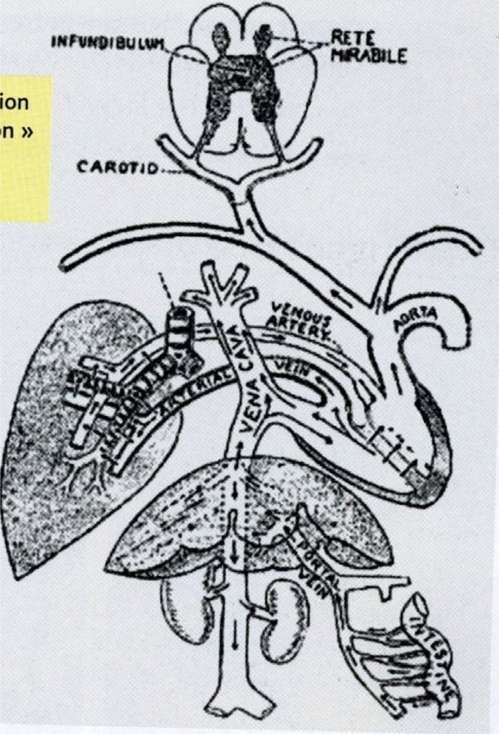
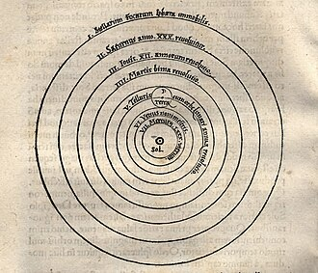
I want to push the boundaries of our conversation this week to embrace concept visualizations
Nicolaus Copernicus
Charles Darwin
William Harvey
Notes:
Darwin’s tree of life: http://phylonetworks.blogspot.com/2012/06/charles-darwins-unpublished-tree.html page 36 of the same Notebook B.
Copernicus https://en.wikipedia.org/wiki/Copernican_heliocentrism Heliocentric model from Nicolaus Copernicus' De revolutionibus orbium coelestium (On the Revolutions of the Heavenly Spheres)
William Harvey’s drawing of the human circulatory system. https://www.researchgate.net/figure/William-Harveys-diagram-showing-circulation-of-blood_fig7_321799094

Slide 5
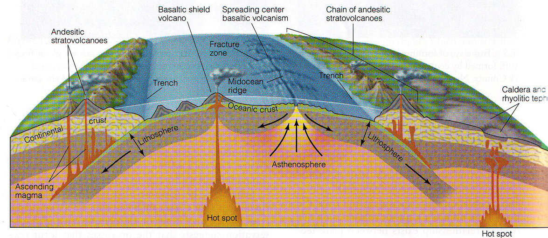
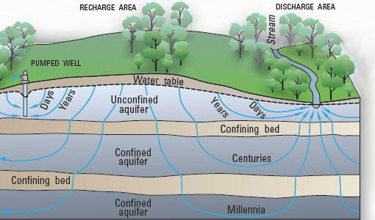
… concept visualizations
Skinner, Porter & Botkin (1995) The Blue Planet
U.S. Geological Survey
Notes:
Plate tectonics: Blue Planet p. 152.
https://www.usgs.gov/media/images/conceptual-groundwater-flow-diagram

Slide 6
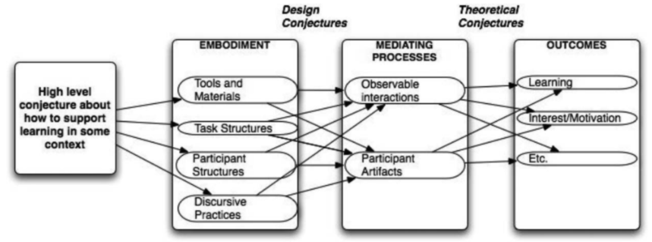
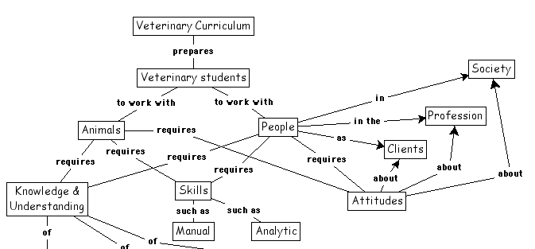
… concept visualizations
Conjecture map
Sandoval (2014)
Concept map
Novak (2008)
Notes:
Conjecture map: https://circls.org/reading-list/reading-list-conjecture-mapping Citation: Sandoval, W.A. (2014). Conjecture mapping: An approach to systematic educational design research. Journal of the Learning Sciences, 23, 18 – 36.

Slide 7
Key attributes of concept visualizations
They [can] combine a lot of information and ideas, of different kinds, into one image.
They [usually] generalize across multiple instances, rather than depicting a single instance.
They are good for depicting relationships: spatial, temporal, causal, hierarchical.
They [often] support “running” a mental model, and thus are good for depicting processes.
They [can be] valuable for “so what?” and “what next?” thinking: brainstorming explanations, predictions, interventions, solutions.
They are tools for thinking, not just communication devices.

Slide 8
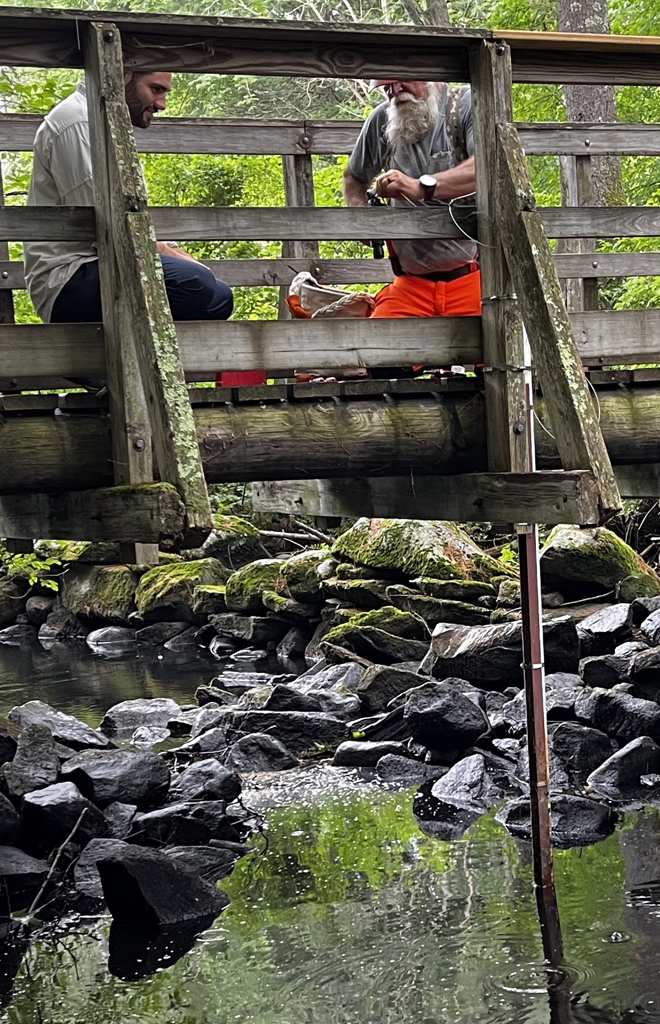
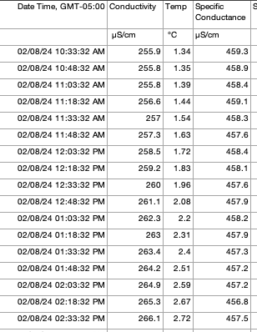
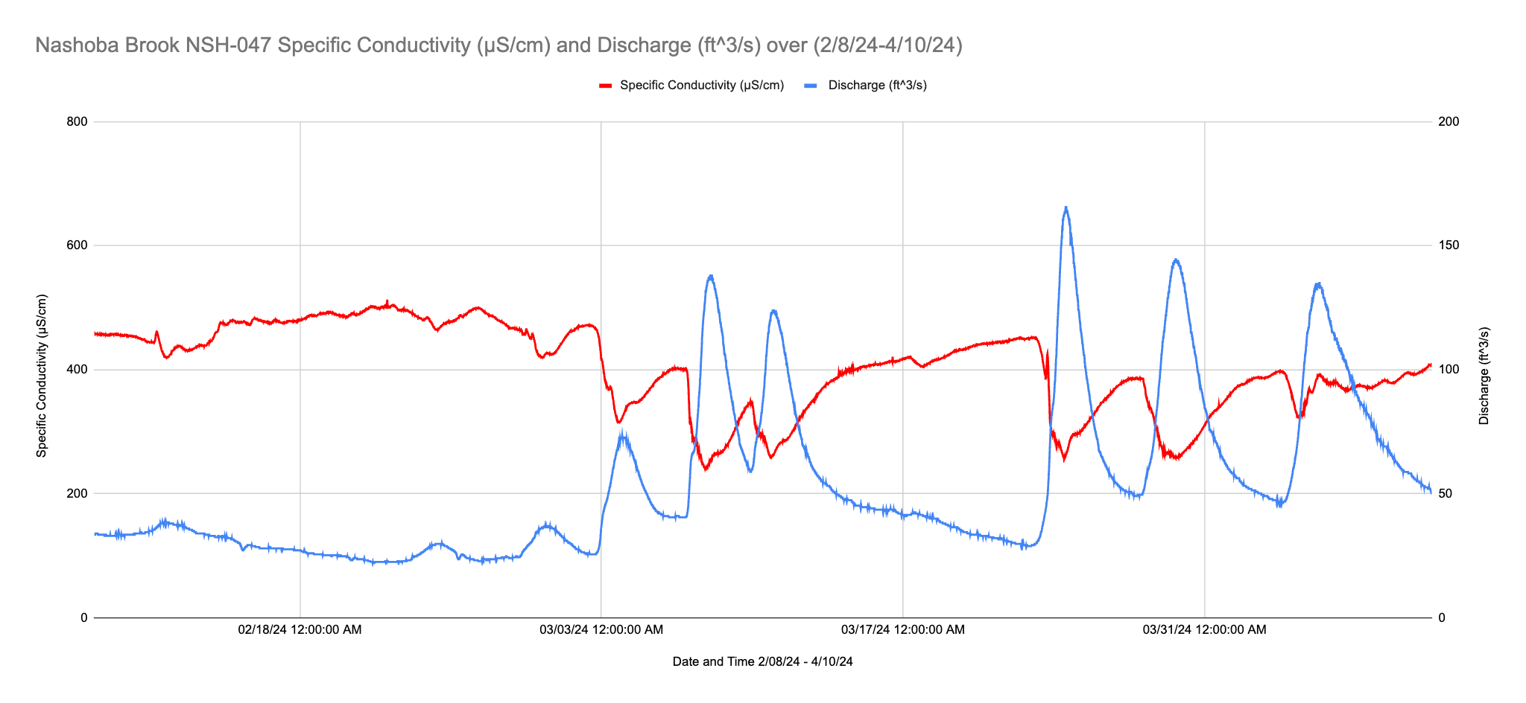

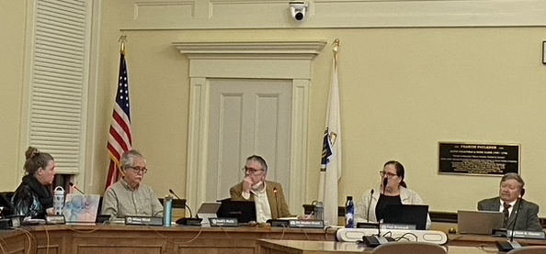
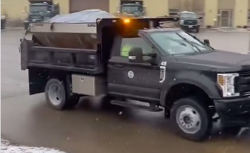
Why should you care about concept visualizations?
Mental model
Data visualization
Sensors deployed in the real world
Quantitative data
Decision
Concept visualization
Action in the real world
Notes:
Sensors deployed: credit Kim Kastens Data visualization: credit Katarina Spasojevic & Brewster Conant, Jr. Mental model: credit https://www.science.org.au/curious/people-medicine/brain Concept visualization: US Geological Survey. T.C. Winter, J.W. Harvey, O.L. Franke, and W.M. Alley – Ground Water And Surface Water A Single Resource. U.S. Geological Survey Circular 1139, Figure 3. Decision: Acton Select Board https://www.actonexchange.org/march-18-2024-select-board-notes-another-year-another-dam/ Photo: Franny Osman Salt truck: credit Acton Department of Public Works

Slide 9
Why should you care about concept visualizations?
Mental model
Data visualization
Sensors deployed in the real world
Quantitative data
Decision
Concept visualization
Action in the real world
Kim Kastens
Notes:
Sensors deployed: credit Kim Kastens Data visualization: credit Katarina Spasojevic & Brewster Conant, Jr. Mental model: credit https://www.science.org.au/curious/people-medicine/brain Concept visualization: US Geological Survey. T.C. Winter, J.W. Harvey, O.L. Franke, and W.M. Alley – Ground Water And Surface Water A Single Resource. U.S. Geological Survey Circular 1139, Figure 3. Decision: Acton Select Board https://www.actonexchange.org/march-18-2024-select-board-notes-another-year-another-dam/ Photo: Franny Osman Salt truck: credit Acton Department of Public Works

Slide 10
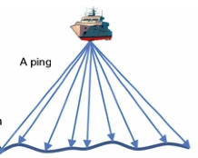
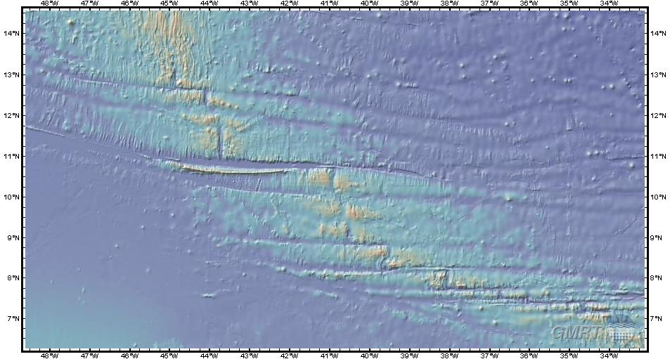
Digression: Is there actually a difference?
“Everything is a model”
Incorporates concepts about:
Sound
Sound velocity
Distance = rate * time
Relationship among sound velocity, water temperature, salinity
Refraction
Latitude & longitude
Geodetic reference frame
Azimuth (of ship)
Includes data from: Kastens, K. A. et al (2000). The Vema Transverse Ridge (Central Atlantic). Marine Geophysical Research, v. 20, p 533-556.

Slide 11
Is there actually a difference? Yes, I think so…
Data visualizations | Concept visualizations
…usually depict a specific instance, a specific place or time or population | …can depict a generalized phenomenon
…purport to convey fact (analogous to the news section of a quality newspaper) | …frankly admit to being a view conceived in a human mind (analogous to the opinion section of the same newspaper)
…usually have a “chain of custody” from the real world to the visualization, following accepted “rules” of the discipline | …sometimes have leaps of inference separating the visualization from the real world
… are well-suited for testing of hypotheses | … are well suited for conveying hypotheses, including multiple working hypotheses
Data Vis
Concept Vis

Slide 12
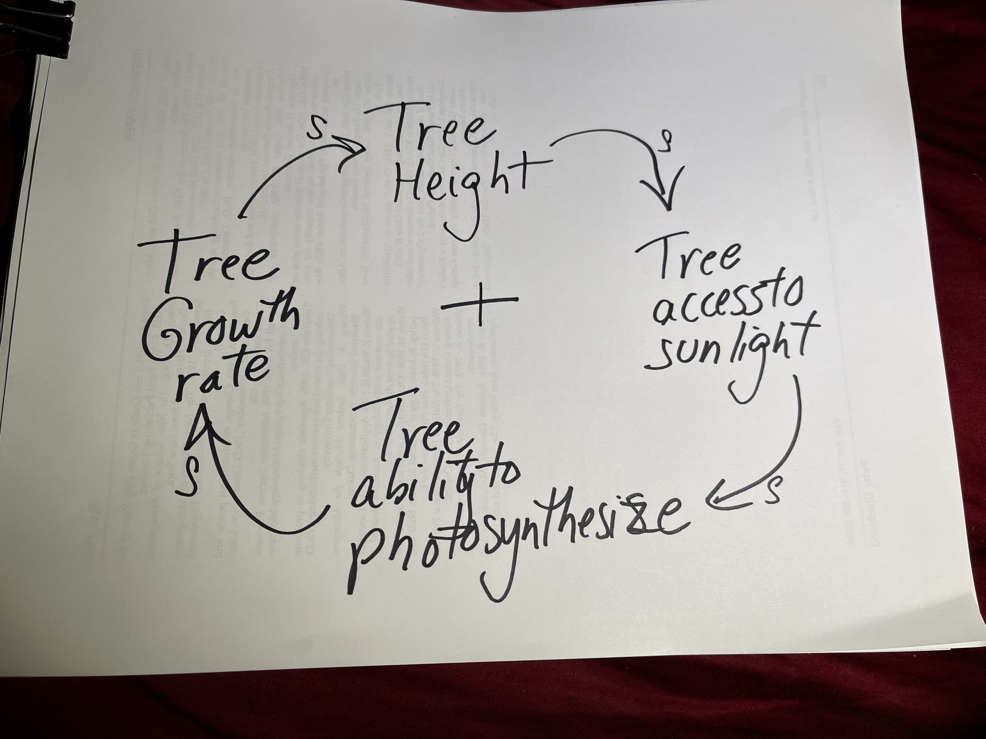
Case study: Causal Loop Diagrams (CLDs)
Economics
Ecology
Engineering
Physiology
S
Climate
Forestry
S
+
S
S

Slide 13
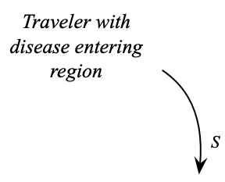
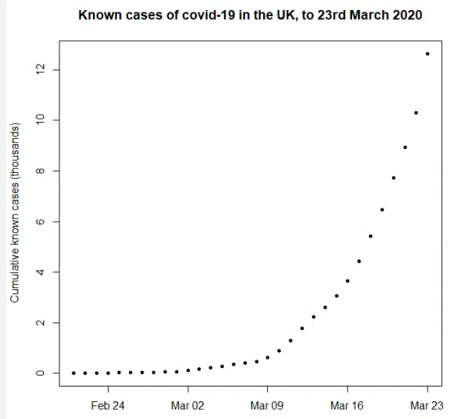
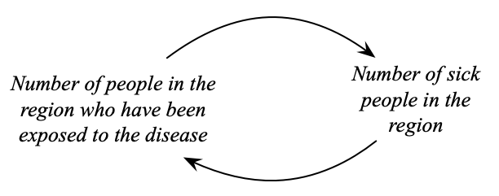


Example of a reinforcing (aka “positive”) feedback loop: Pandemic spread
S
S
(from Stevens, et al, 2021)
Notes:
The graph of Covid growth graph comes from Stevens, R., Perera, R., Heneghan, C., Hobbs, R., & Oke, J. (2021). Exponential growth: what it is, why it matters, and how to spot it. Those authors cite as their data source the UKHSA Data Dashboard.
Reinforcing feedback loops can have bad outcomes, like pandemic spread, but also escalation of hostilities between indivduals, groups, or nations, or addiction, or rich get richer and poor get poorer situations. But reinforcing feedback loops can have good outcomes, such as collaboration, or curiousity-driven learning, or childbirth.

Slide 14
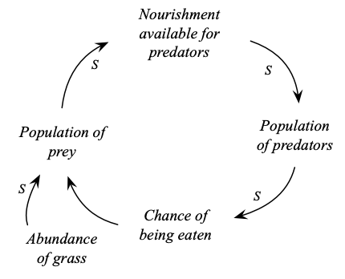
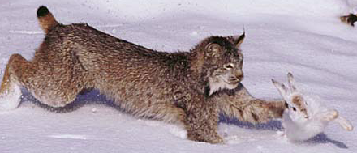
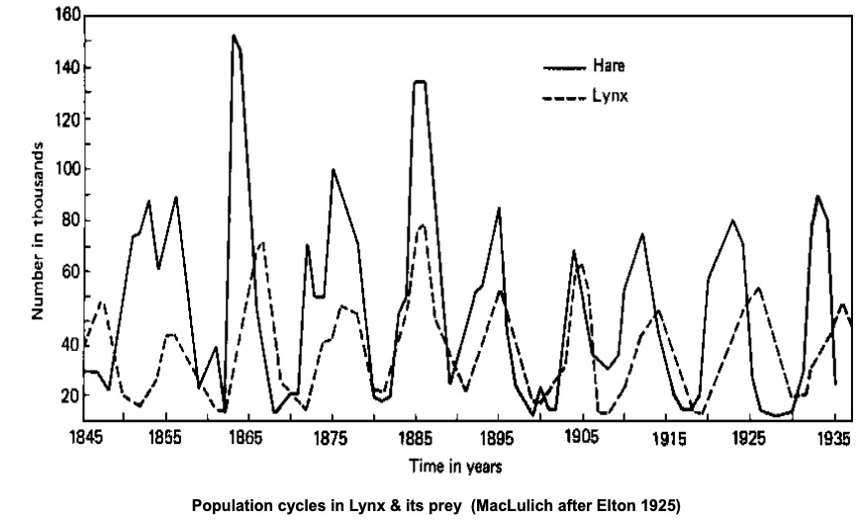


Example of a balancing (aka “negative”) feedback loop: Predator/prey system
Credit: Tom & Pat Leeson
O
Notes:
The original source of the lynx/hare data was Elton, C. S. (1924). 'Fluctuations in the numbers of animals: their causes and effects.' Brit. J. Exp. Biol. 2: 119-63, refined by MacLuich, D. A. (1937). Fluctuations in numbers of the varying hare (Lepus americanus). University of Toronto Biol Series no 43: 1-136. The lynx pelt data was parsed into separate regions by Charles Elton and Mary Nicolson (1942). The ten-year cycle in numbers of the lynx in Canada, Journal of Animal Ecology, vol. 11, no. 2, p.215-244. The data in the graph are archived in the Hudson's Bay Company digital archives.
Balancing feedback loops can have good outcomes, like predator/prey systems in balance, or the thermostat in your home, or the homeostatic systems that keep your body temperature and blood chemistry within life-supporting range. Or they can have bad outcomes, situations that feel like a person or group are stuck in a rut, such as the “cutting down the tall poppy situation, in which any attempt to excel above one’s peers triggers an opposition that pulls them back down into their place.
Photograph from https://jmahaffy.sdsu.edu/courses/f09/math636/lectures/lotka/qualde2.html Math 636 - Mathematical Modeling
© 2000, All Rights Reserved, SDSU & Joseph M. Mahaffy San Diego State University -- This page last updated 06-Oct-10. Photo attribution: this image kindly provided by Tom and Pat Leeson, who retain the copyright

Slide 15
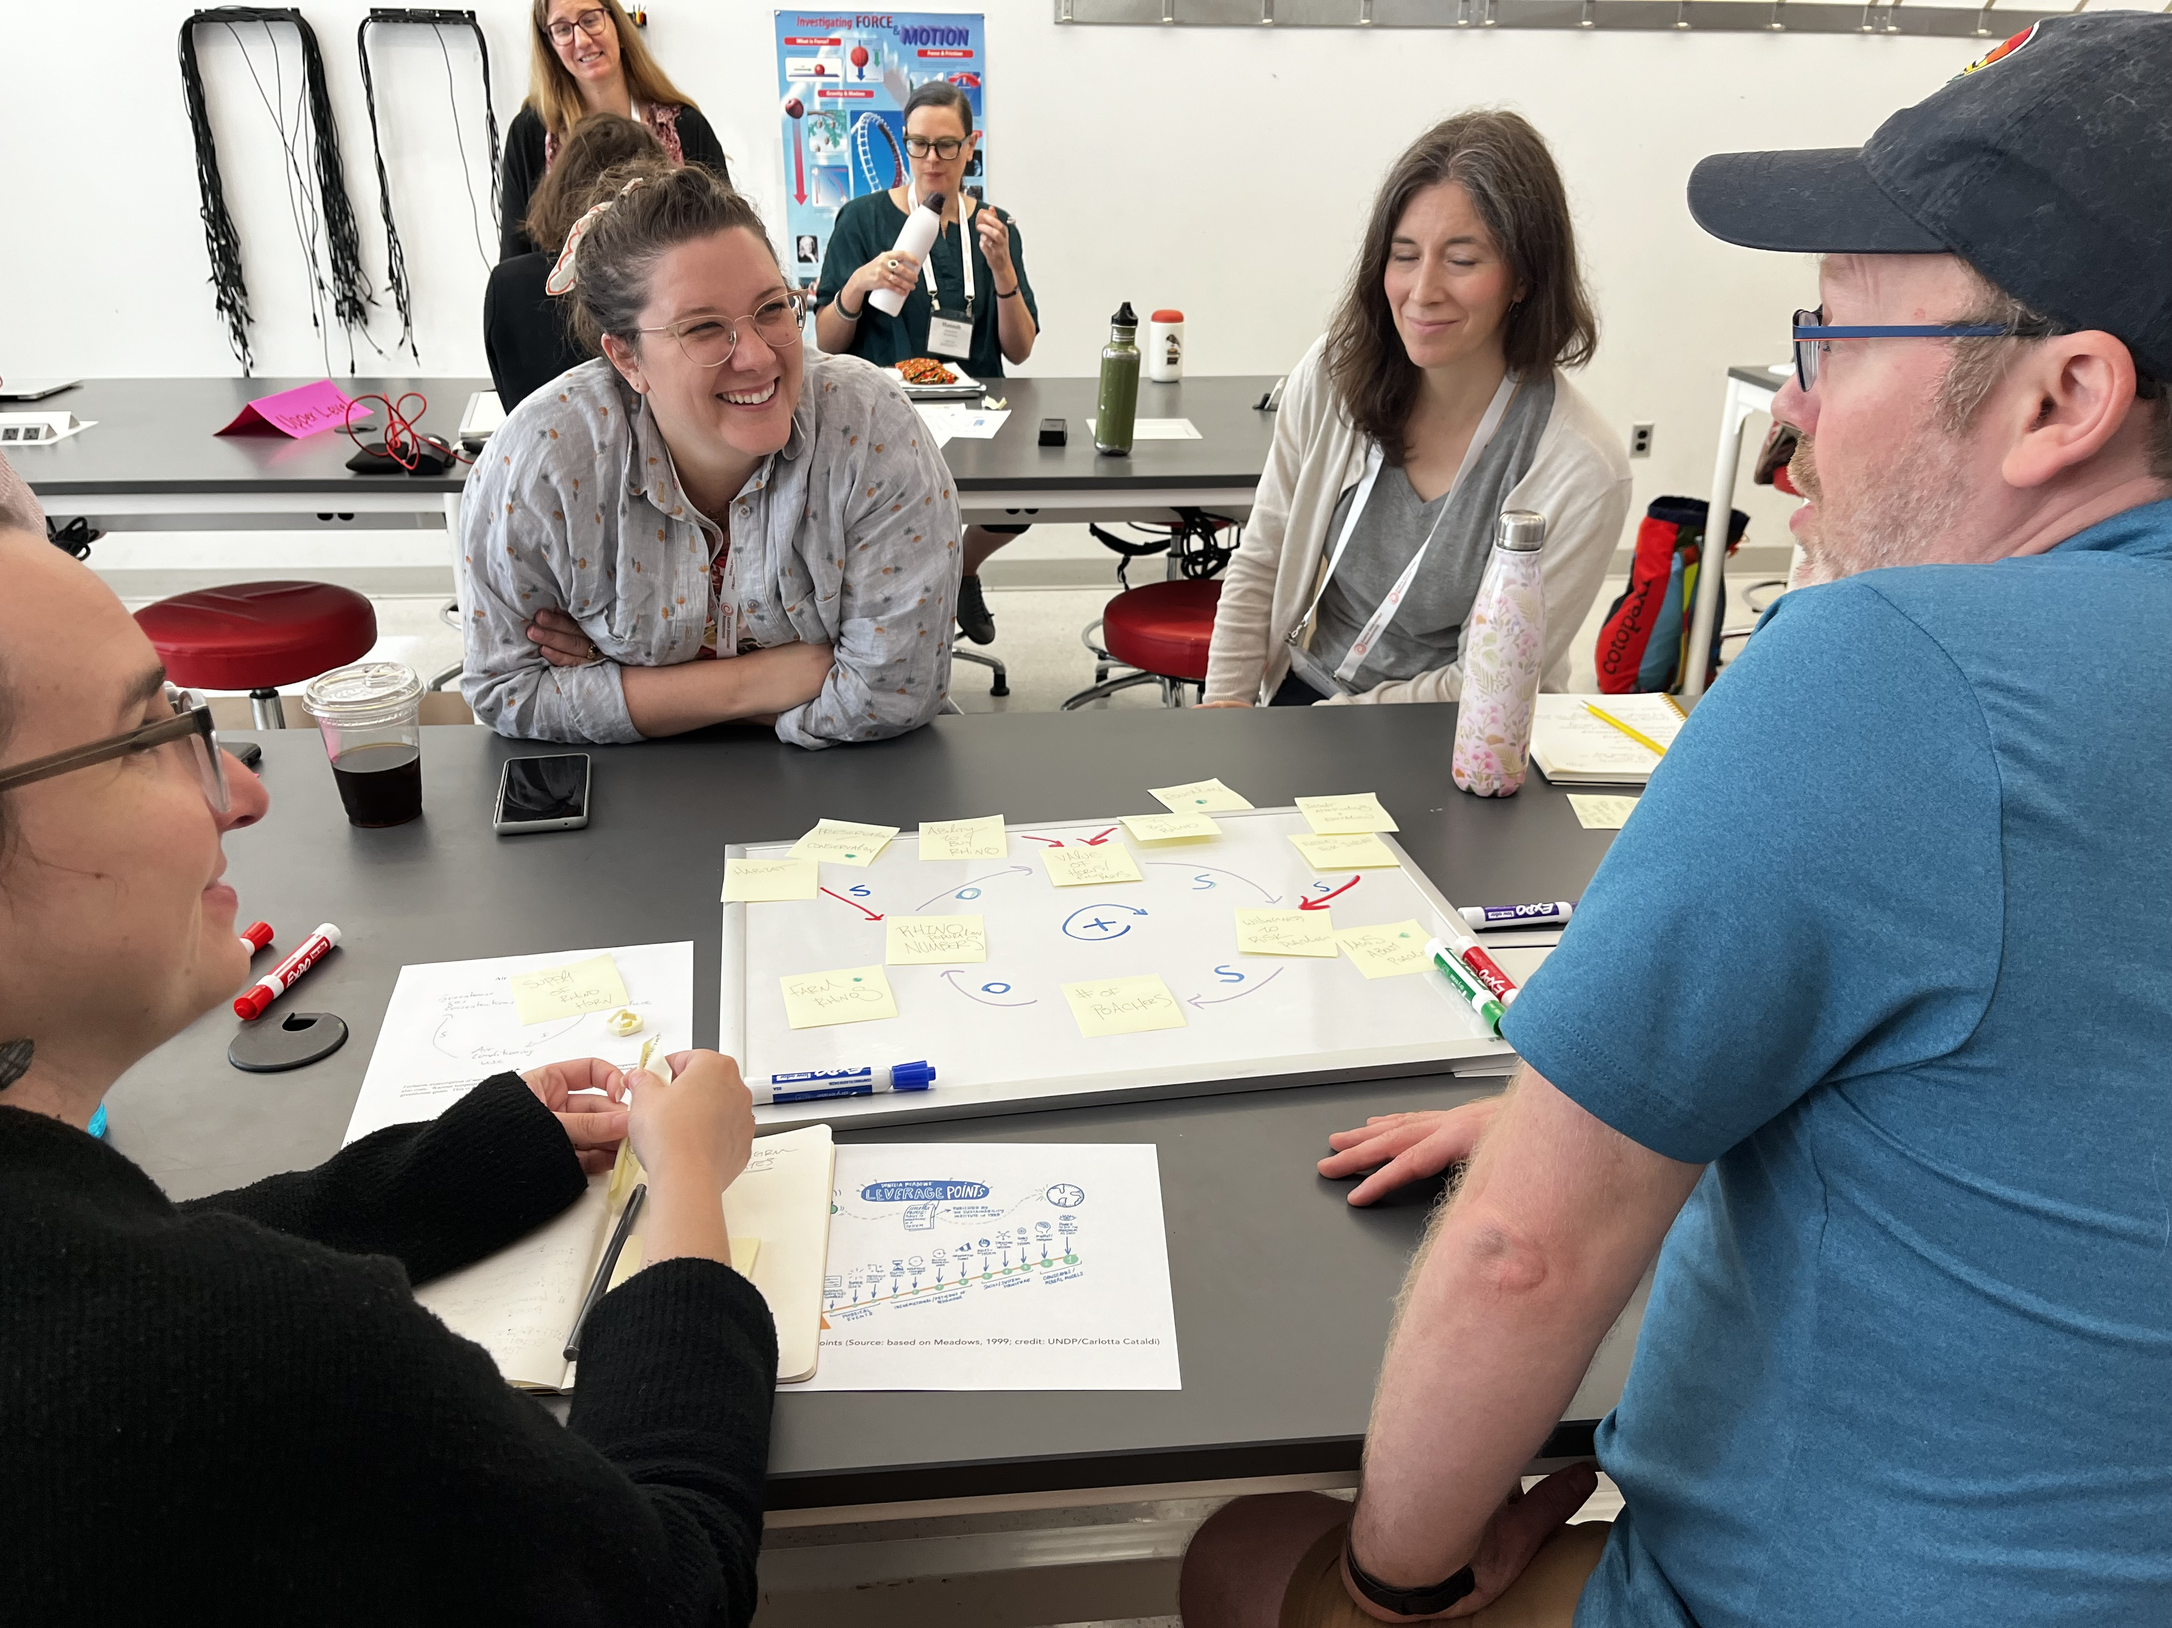
CLD gets mental models out into public where they can be compared, combined, or co-created.
Photo from Earth Educators’ Rendezvous 2024. Credit: Kim Kastens

Slide 16
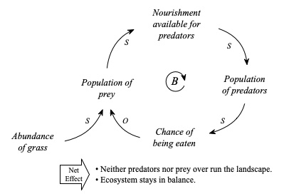
CLD circumvents working memory limitation …
CHUNK
… and conveys relationship between parts & whole

Slide 17
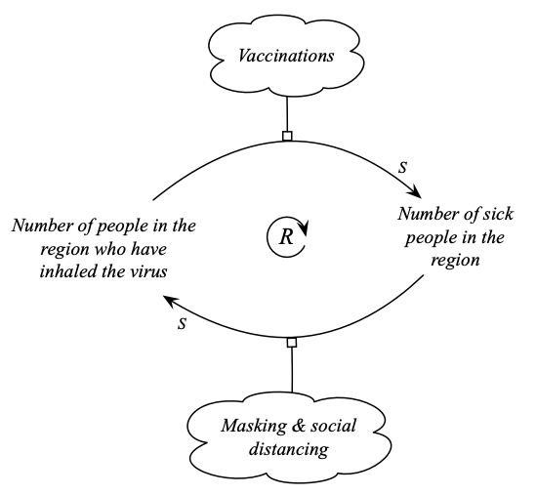
CLD makes it easier to strategize about potential interventions.

Slide 18
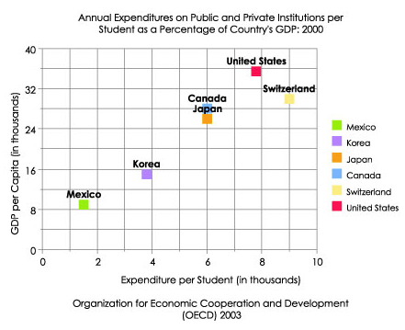


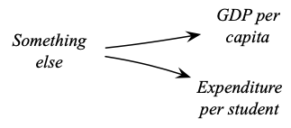
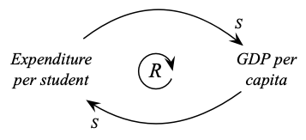
CLD makes it easier to compare competing hypotheses
(from National Center for Educational Statistics,
Kid's Zone, Graphing Tutorial)
Notes:
National Center for Educational Statistics, Kid's Zone, Graphing Tutorial, section on "Examining X-Y (Scatter) Plots," online at https://nces.ed.gov/nceskids/help/user_guide/graph/scatter.asp.

Slide 19
Reprise: how using CLDs strengthens one’s ability to think about feedback loops
CLD gets mental models out into public
CLD circumvents working memory limitations
CLD captures and conveys the relationship between parts and whole,
CLD makes it easier to strategize about potential interventions,
CLD makes it easier to compare competing hypotheses.

Slide 20
How can you research (and thereby improve) use of concept visualizations?
Comprehension/Interpretation methods
Production methods*
* Based on Liben, L. S. (1997). Children's understanding of spatial representations of place: Mapping the methodological landscape. In N. Foreman & R. Gillett (Eds.), A handbook of spatial research paradigms and methodologies. (pp. 41-83). East Sussex, UK: Psychology Press, Taylor & Francis Group.

Slide 21
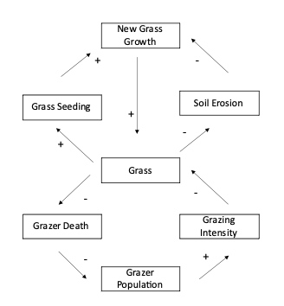
An interpretation task:
What would happen if…
Based on the diagram, which of the following would increase the rate of soil erosion?
( ) Planting more grass
( ) Increasing the grazer population
( ) Introducing a fatal cow disease
( ) Adding fertilizer to enhance grass growth.
…among the best discriminators in
29-item Earth System Concept Inventory.
From Soltis, N. A., & McNeal, K. S. (2022). Development and Validation of a Concept Inventory for Earth System Thinking Skills. Journal for STEM Education Research, 5(1), 28-52. doi:10.1007/s41979-021-00065-z
Notes:
From Nick Soltis by email July 1, 2025: One thing that strikes me about that question is that it had good discrimination between high performers and lower performers. In terms of distribution, the correct answer was the most common, followed by A. Planting more grass. The other two responses weren't as common, with C being the next most common, then D, which was not very common. B is correct.
This was among the best discriminators in a 29 item Earth System Concept Inventory.

Slide 22
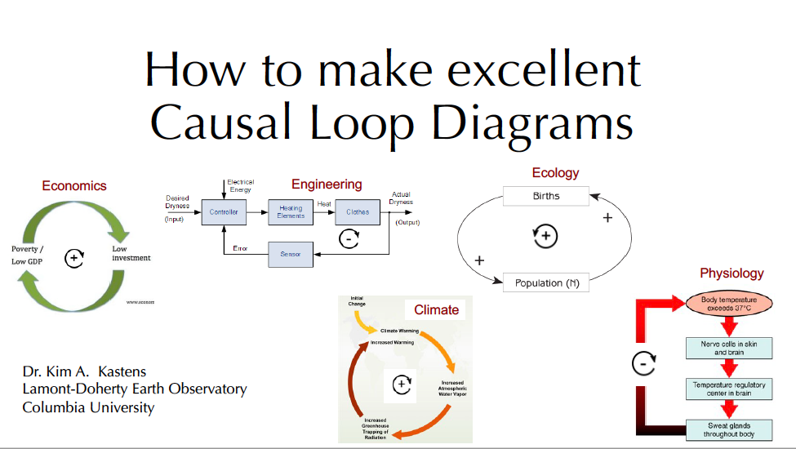
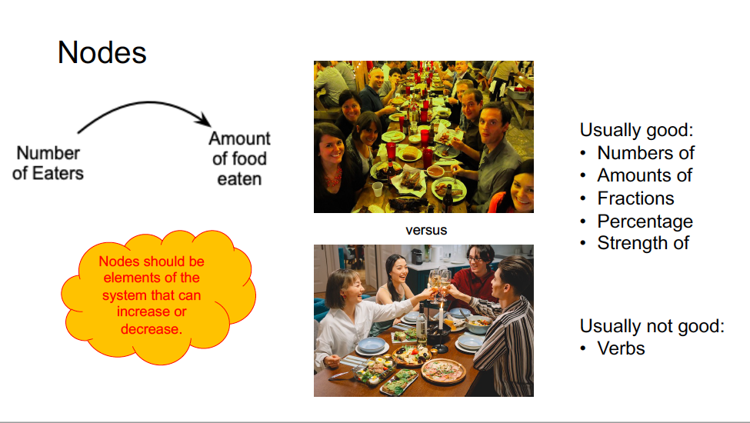
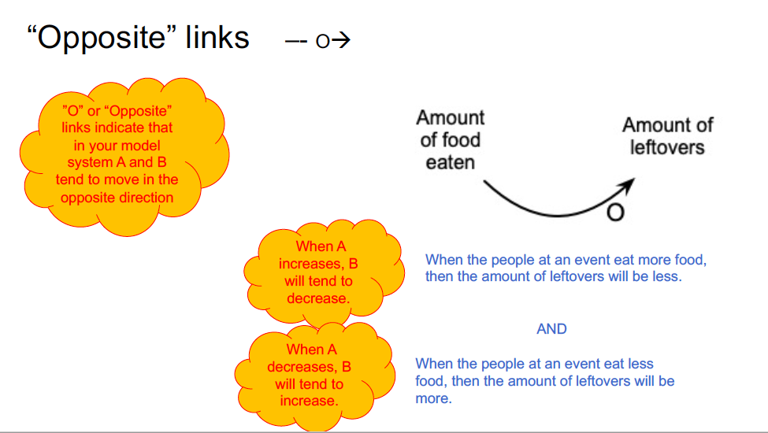
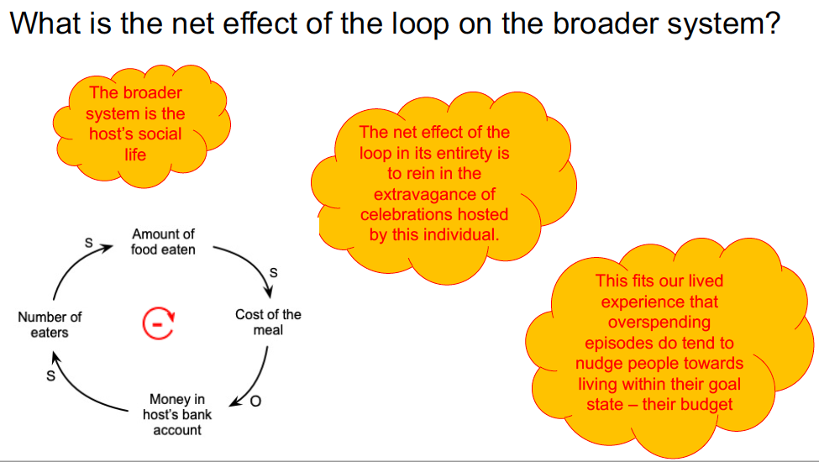
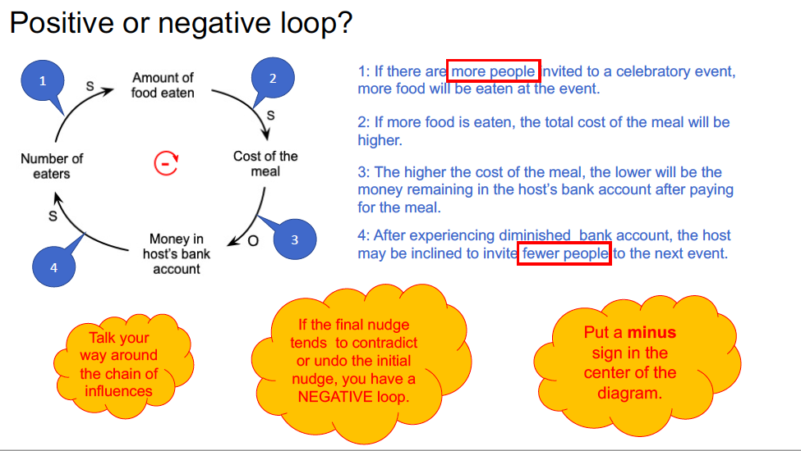
A production task: Find and map the feedback loop in a popular media article
Participants watched an instructional video…

Slide 23
Then read a short reading passage …
excerpt from
Air-conditioning use will surge in a warming world,
by Hiroko Tabuchi. The New York Times, December 5, 2023
Sixty nations committed on Tuesday to improve the efficiency of new air-conditioners by 50 percent and reduce greenhouse gas emissions related to those cooling machines by almost 70 percent, the latest in a flurry of global promises that aim to tackle climate change.
The voluntary pledge made at the U.N. climate talks in Dubai was led by the conference hosts, the United Arab Emirates, and confronts a daunting future facing a warming planet: As global temperatures rise, more people will turn to air-conditioners to ward off the heat.
But additional air-conditioning in buildings and other spaces, which is also driven by rising incomes, population growth and urbanization, means that the world could use more than double the electricity it does now to stay cool, leading to more planet-warming emissions, according to research released by the United Nations on Tuesday.

Slide 24
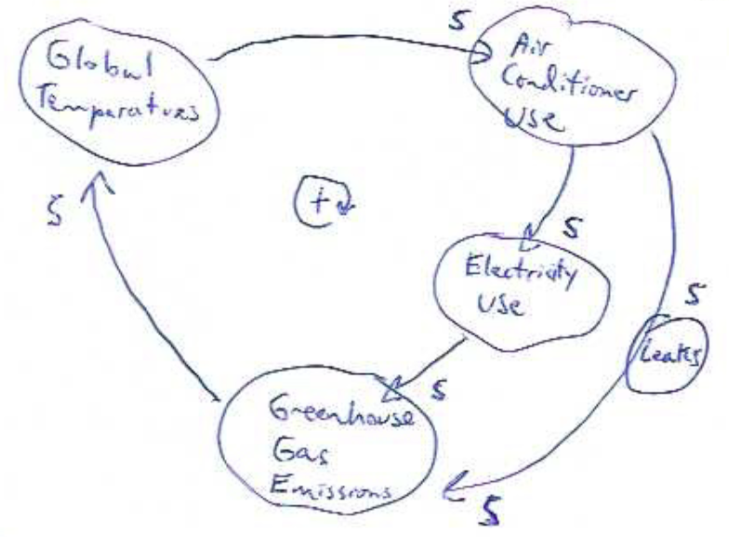
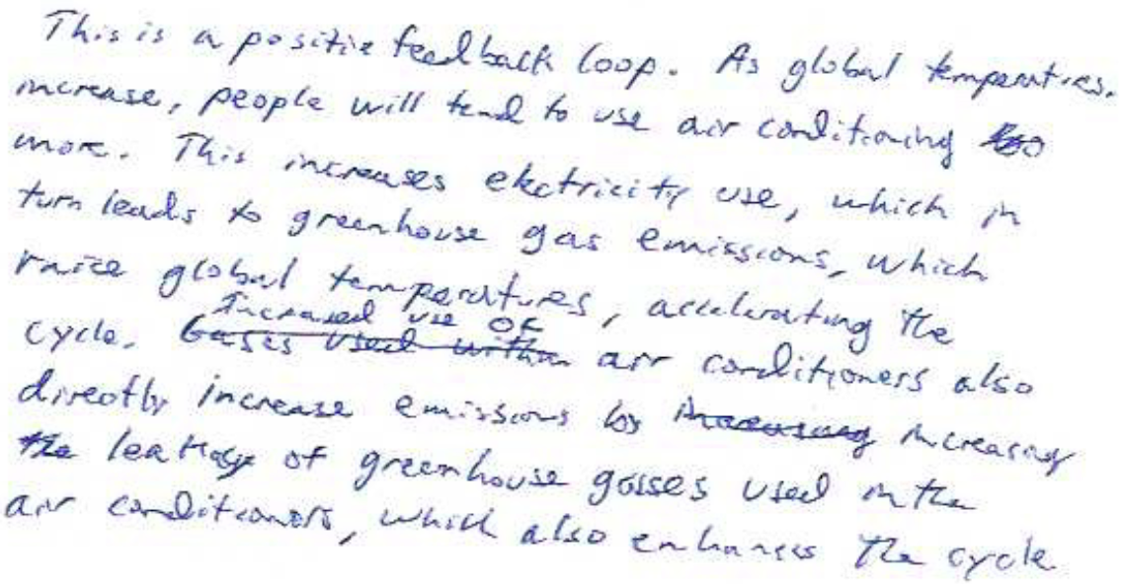
… and drew a CLD and wrote an accompanying narrative

Slide 25
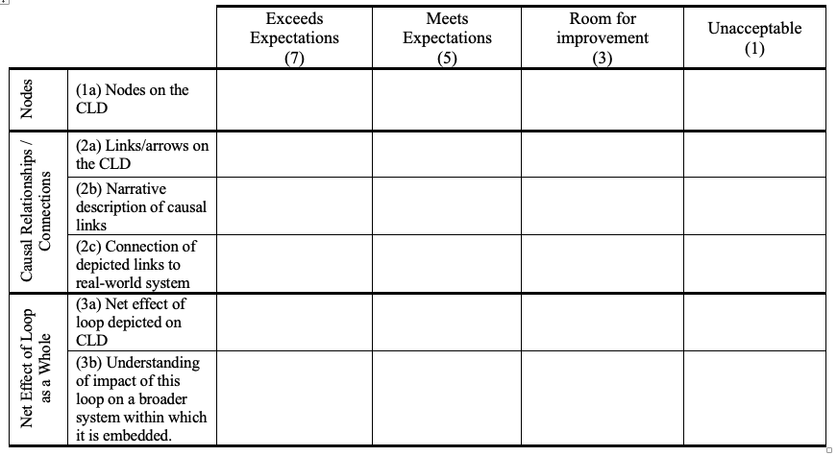
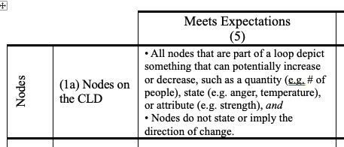

Slide 26
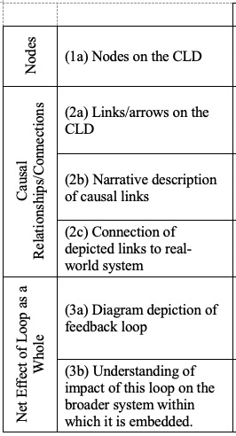
Where undergrads need improvement
Where geoscientists may need improvement

Slide 27
For each item, indicate the type of causal link that you think connects the two boxed nodes. For each item, there are 4 possibilities:
Develop teaching materials
to target
discovered weaknesses
O
S
O
S
Draw an arrow head to indicate the direction of influence.
Add a “S” to the arrow if you think two nodes change in the Same direction. Add an “O” to the arrow if you think that the two nodes change in the Opposite direction.
(a)
Elapsed time since last meal
S
Hunger
(b)
Ability to buy a car
S
Money in the bank
(c)
Student debt
O
Ability to afford a house after graduation

Slide 28
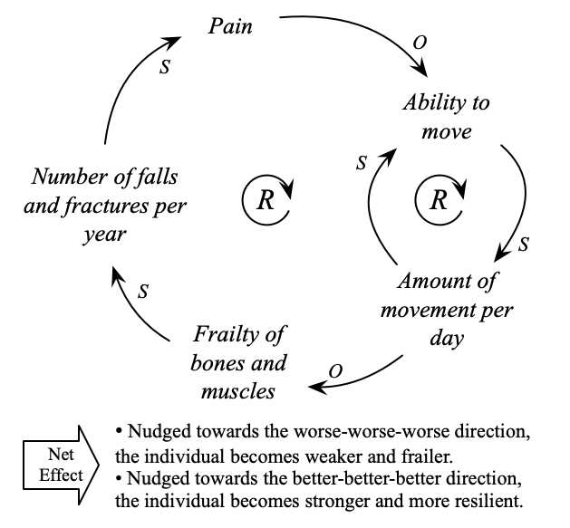
Improve
visualization
to target
discovered
weakness

Slide 29
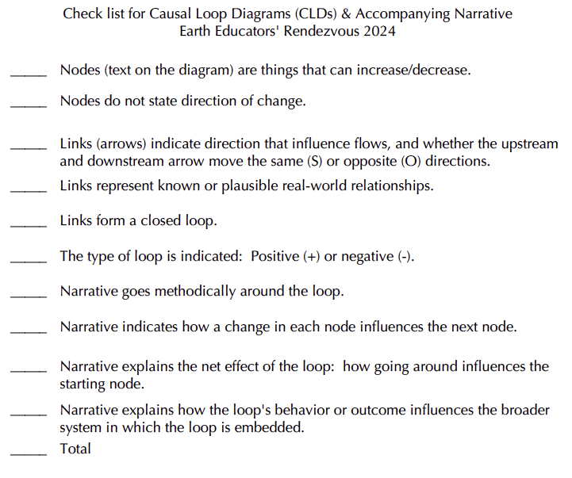
Improve
instructors’ materials

Slide 30
Suggestions about how to research concept visualizations
Design a challenging, holistic task in which participants do something real and important, and engage with the complexity of the world – not a toy problem.
Make a rubric for participant-produced visualizations. This is hard, time-consuming, iterative, but deeply informative.
  Acknowledge that concept visualizations can look different but both be correct.
  Grapple with products that emerge from a mind in the liminal state between understanding and not-understanding the system in question.
Look for common failure modes on the challenging, real world task.
Design targeted, more constrained tasks that test subskills and seek to isolate sources of difficulty.
Tap into practitioners’ wisdom of people who use your type of concept visualization to teach, decide, understand or plan.

Slide 31

What questions or thoughts do you have?

