Slide 1
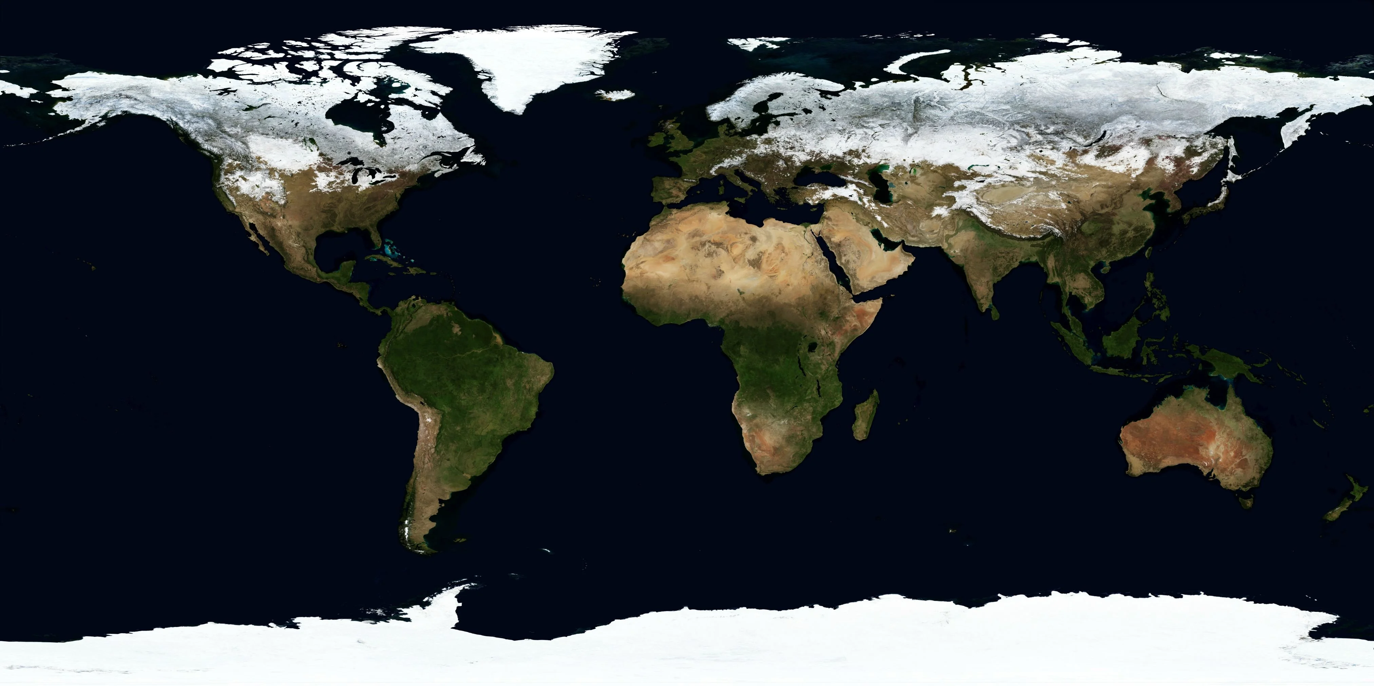
Global water cycle
Notes:
Image: https://visibleearth.nasa.gov/images/73992/march-blue-marble-next-generation/74003l

Slide 2
System
Reservoir – A component of a system in which material is stored
Can be discontinuous (e.g. ocean)
Flux – Process that moves material between reservoirs
Reservoir A
Reservoir B

Slide 3
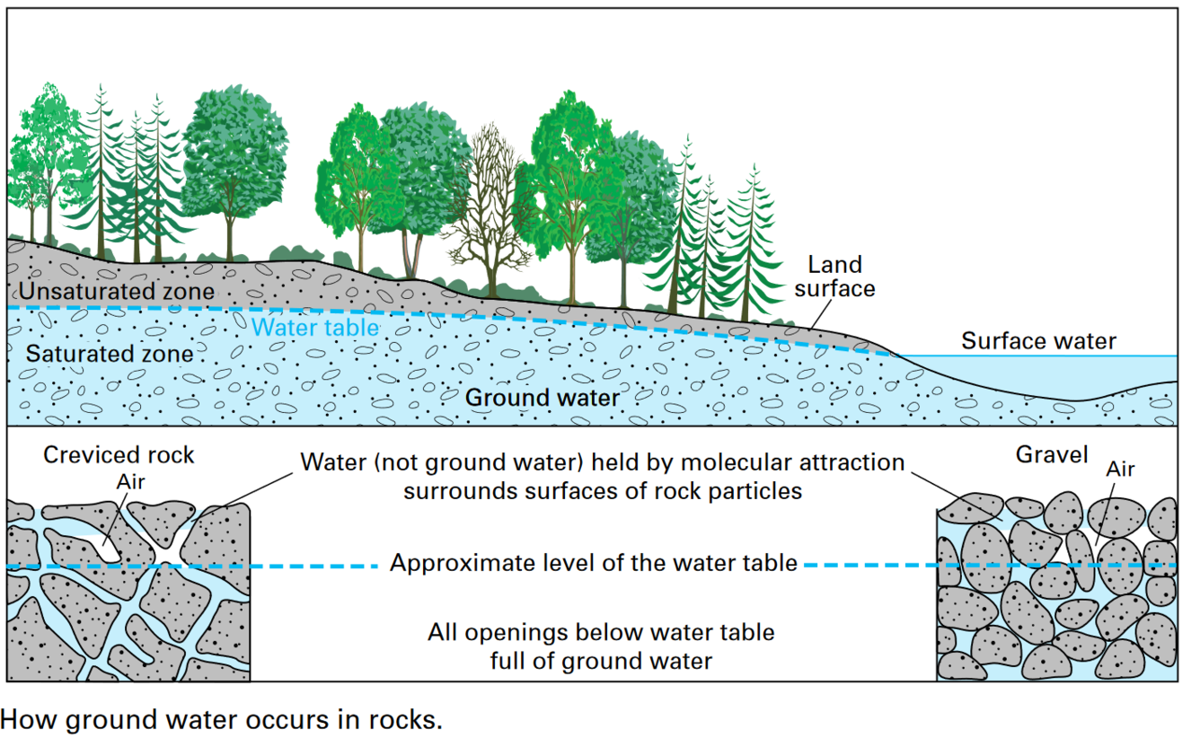
At your table:
List reservoirs where water is found on Earth
List fluxes that move water between the reservoirs
Notes:
Image: https://www.usgs.gov/media/images/groundwater-saturated-zone-soilrock-below-land-surface

Slide 4
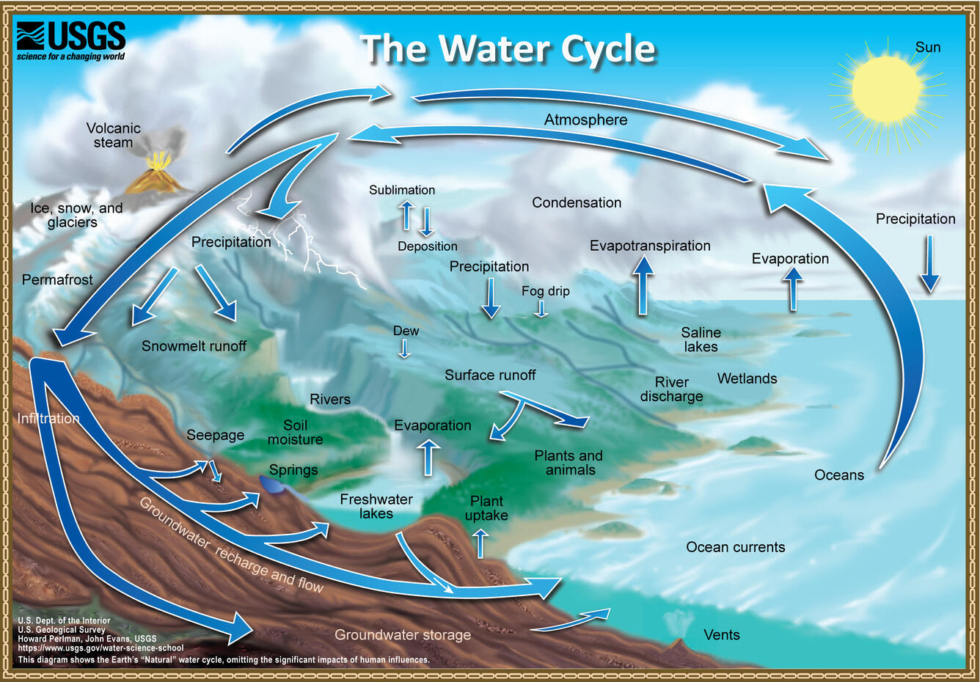
Notes:
Water cycle describes the movement of water between reservoirs on Earth.
Image: https://www.usgs.gov/media/images/natural-water-cycle-jpg

Slide 5
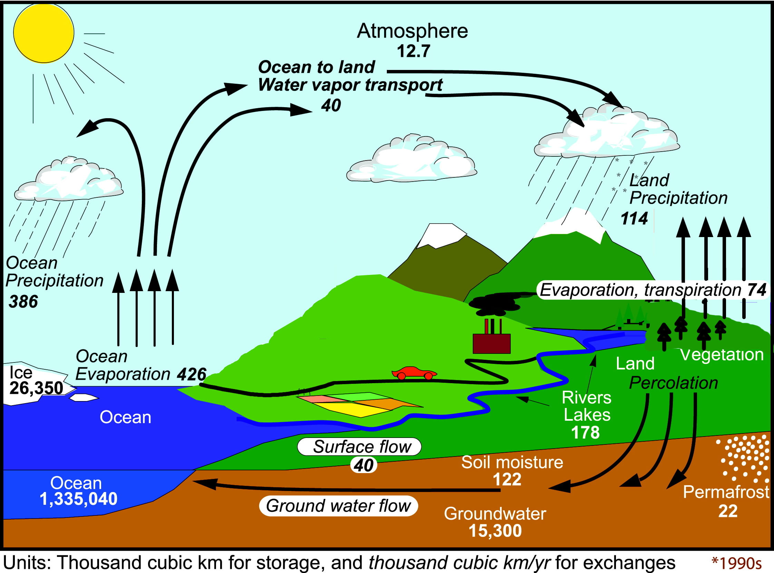
Notes:
Quantify the magnitude of reservoirs and fluxes in the water cycle.
Image: https://www.metlink.org/resource/the-changing-water-cycle/

Slide 6
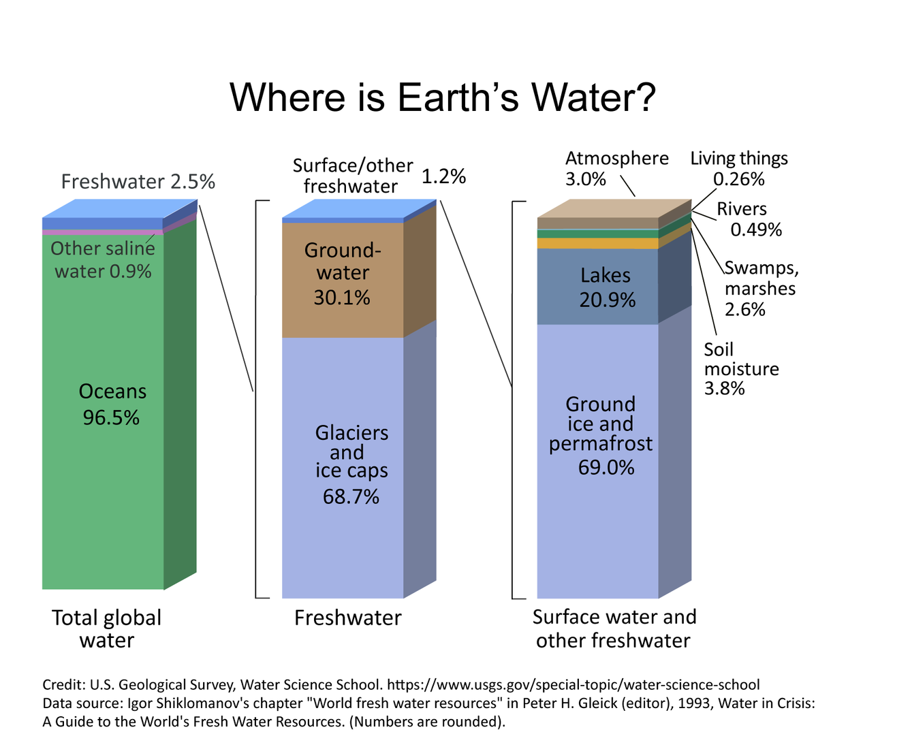
Notes:
Image: https://www.usgs.gov/media/images/distribution-water-and-above-earth

Slide 7
What controls the distribution of water on Earth?
Notes:
Image: https://visibleearth.nasa.gov/images/73992/march-blue-marble-next-generation/74003l

Slide 8
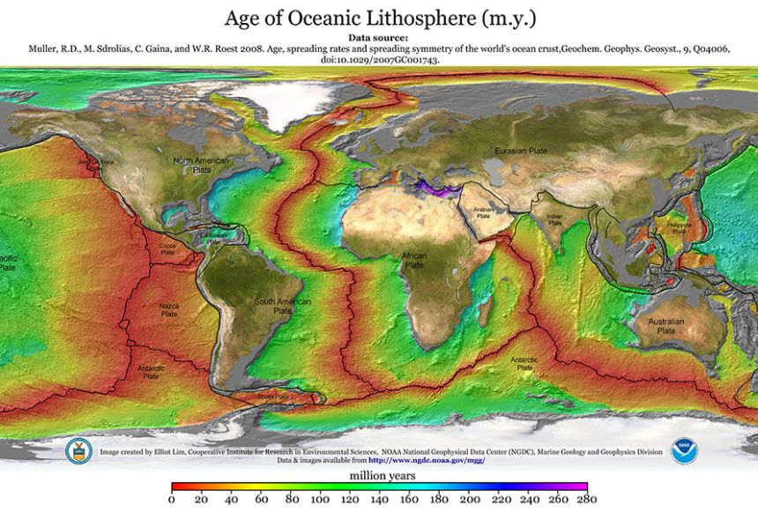
Notes:
Geologic controls include the size and location of oceans.
Image: https://oceanexplorer.noaa.gov/wp-content/uploads/2014/07/mid-ocean-ridge-800.jpg

Slide 9
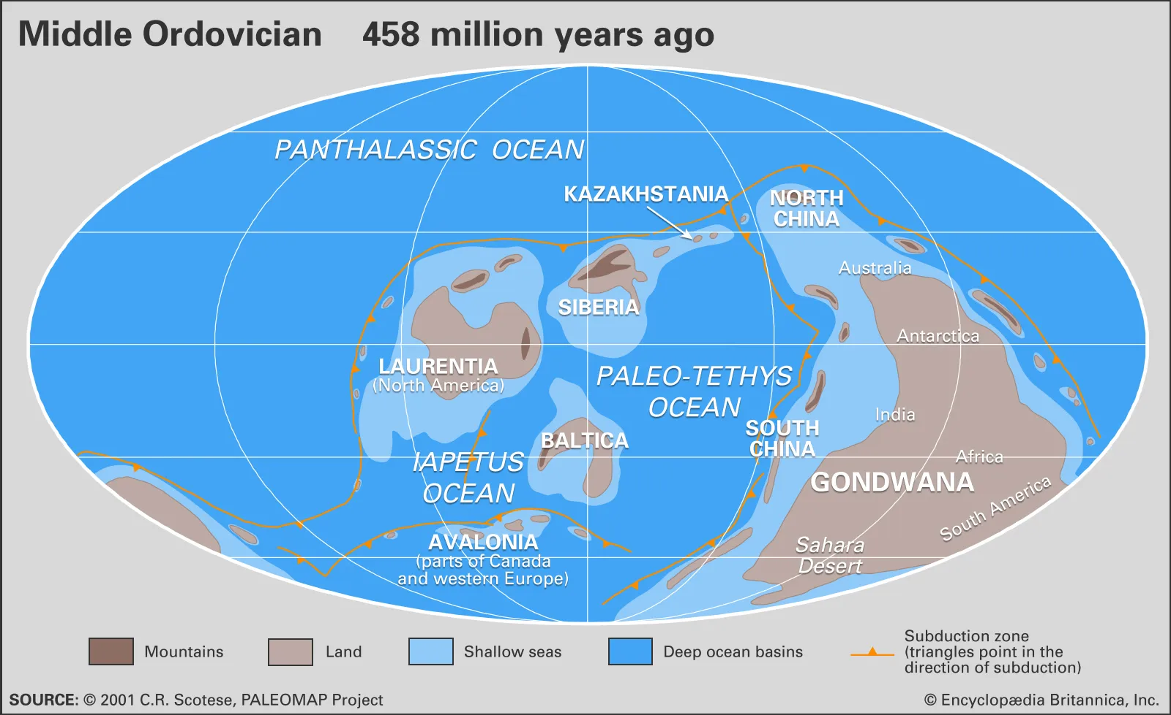
Notes:
Periods in Earth history had different amount and arrangement of continental and oceanic crust.
https://www.britannica.com/science/Ordovician-Period/Oceanography

Slide 10
Fundamentally, water cycle driven by energy
Temperature drives phase changes between solid, liquid, and gas
Potential energy drives rivers and groundwater
Latitudinal gradients in energy drive circulation

Slide 11
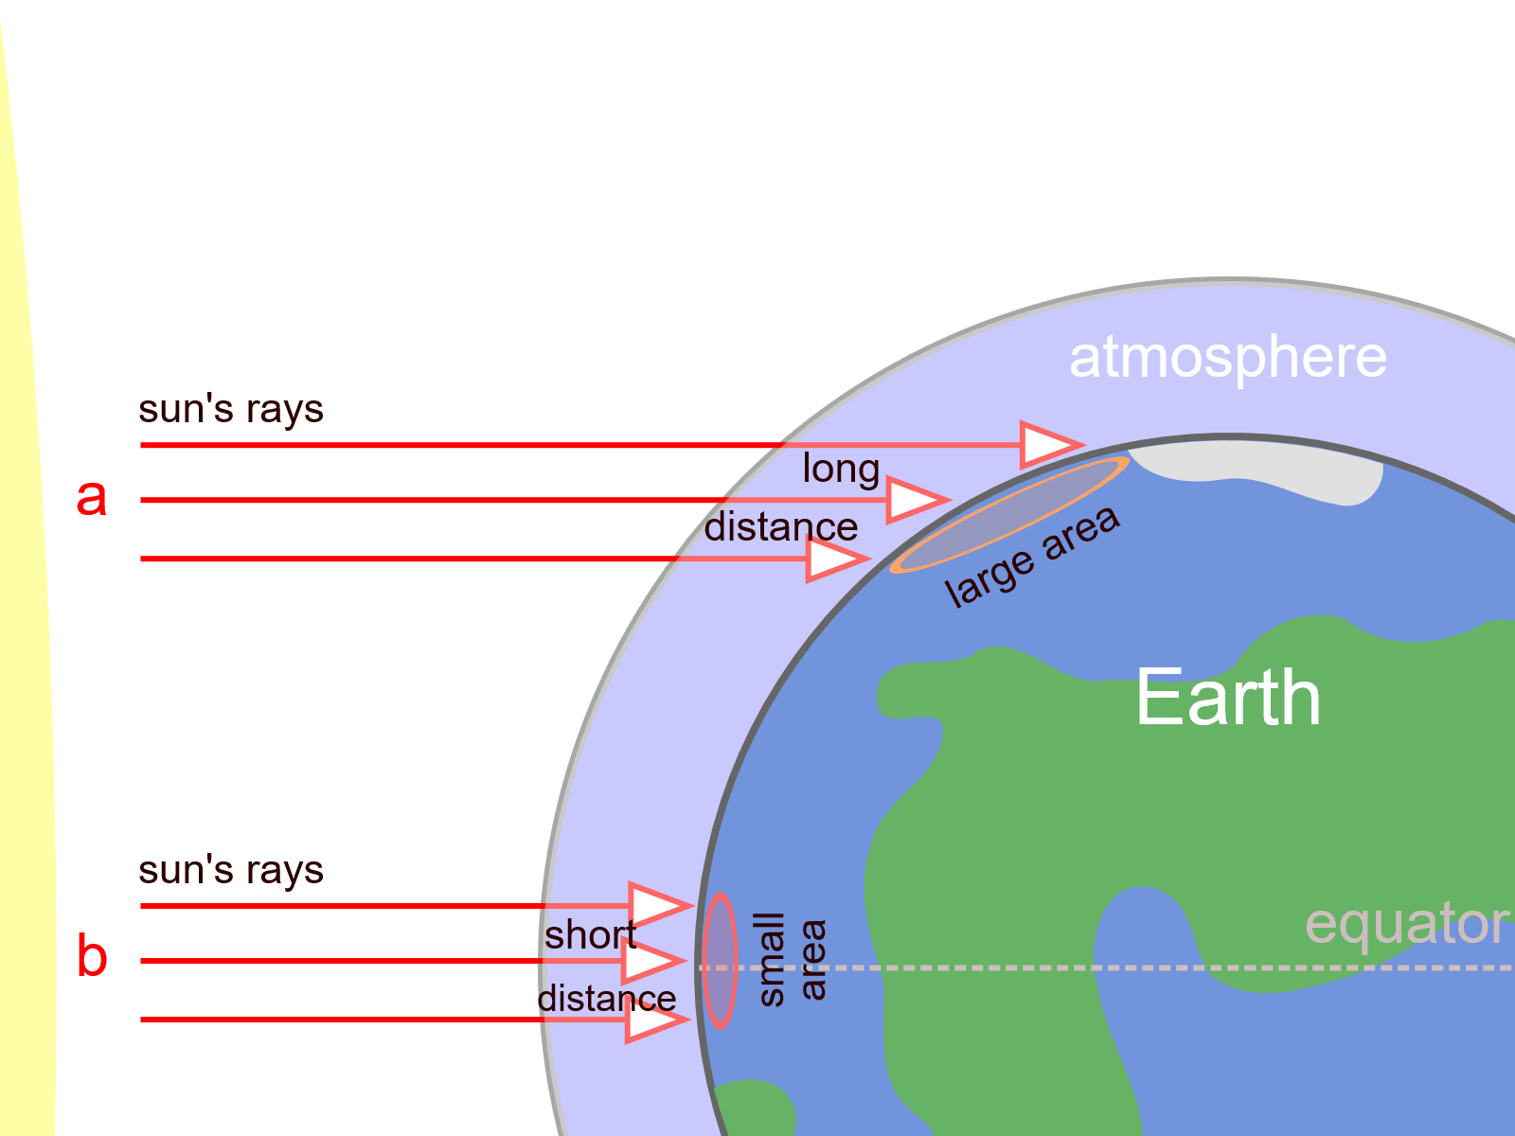
Because the Earth is spherical, incoming radiation is dependent on latitude
At higher latitude, a given amount of energy is spread over a larger area
Notes:
https://commons.wikimedia.org/wiki/File:Oblique_rays_02_Pengo.svg

Slide 12
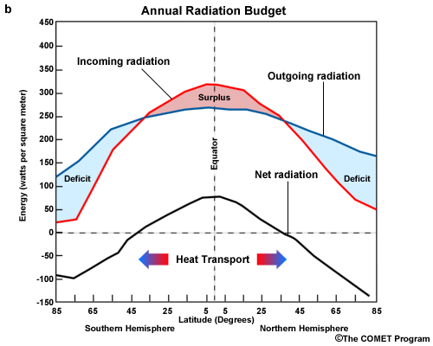
As a result, higher incident radiation at the equator
Outgoing radiation varies much less with latitude
Leads to an energy surplus at the equator and a deficit at the poles
Notes:
Image: https://www.e-education.psu.edu/meteo300/node/649

Slide 13
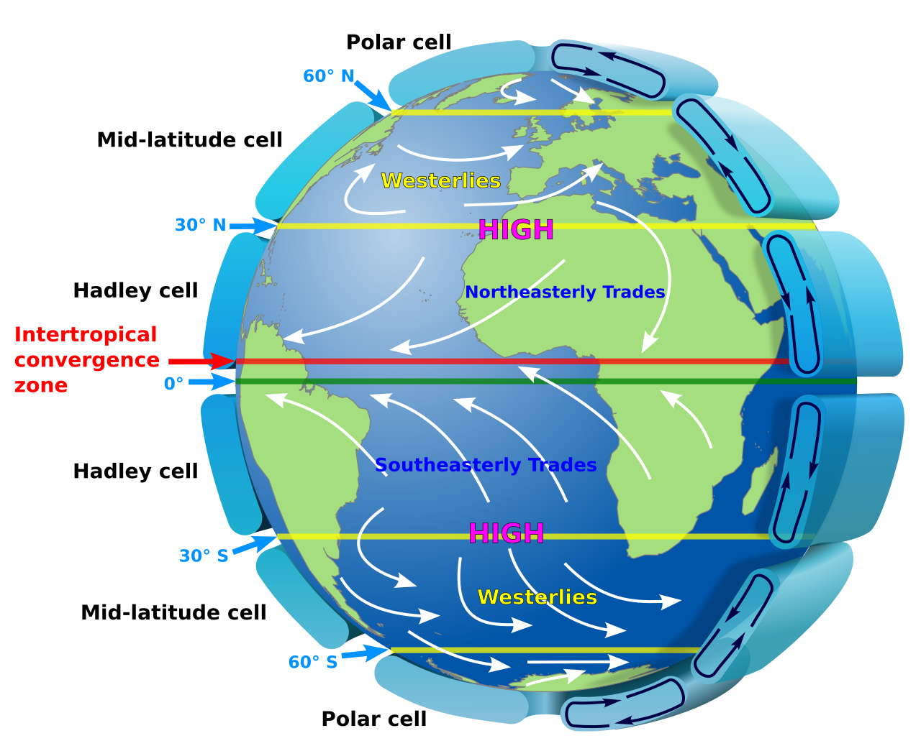
Notes:
Spinning of the earth + energy imbalance causes prevailing winds to transfer energy and water
Image: https://en.wikipedia.org/wiki/Prevailing_winds#/media/File:Earth_Global_Circulation_-_en.svg

Slide 14
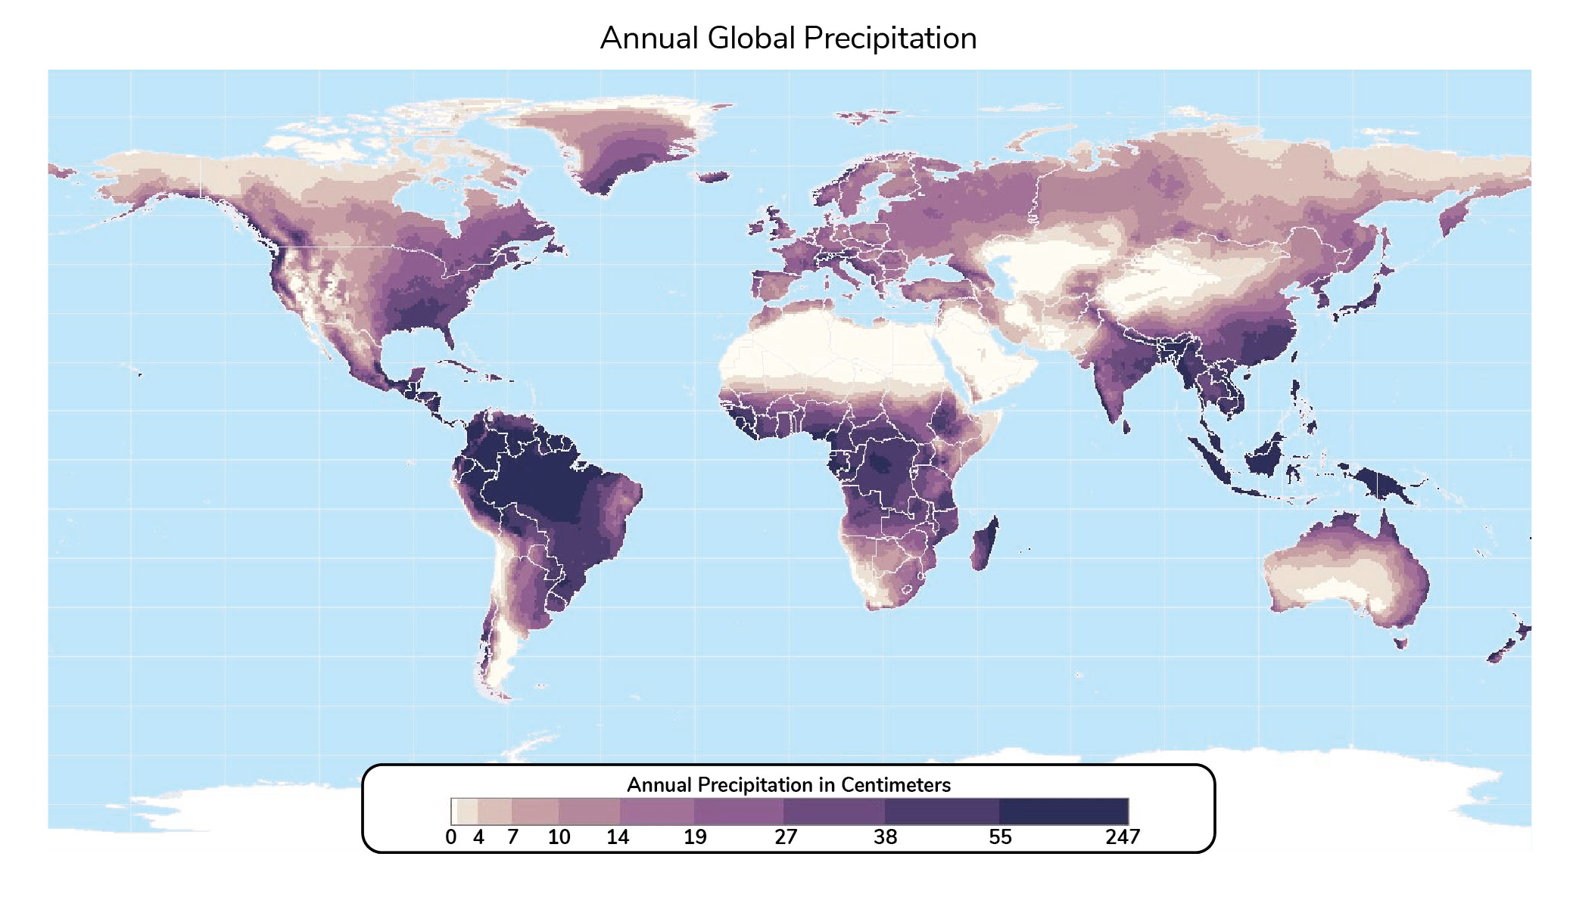
Notes:
https://sage-public-files.s3.amazonaws.com/atlas/annual-total-precipitation/atl_anntotprecip.jpg

Slide 15
This type of generalized conceptual model squashes finer detail
Any type of model has a trade off between detail and legibility

Slide 16
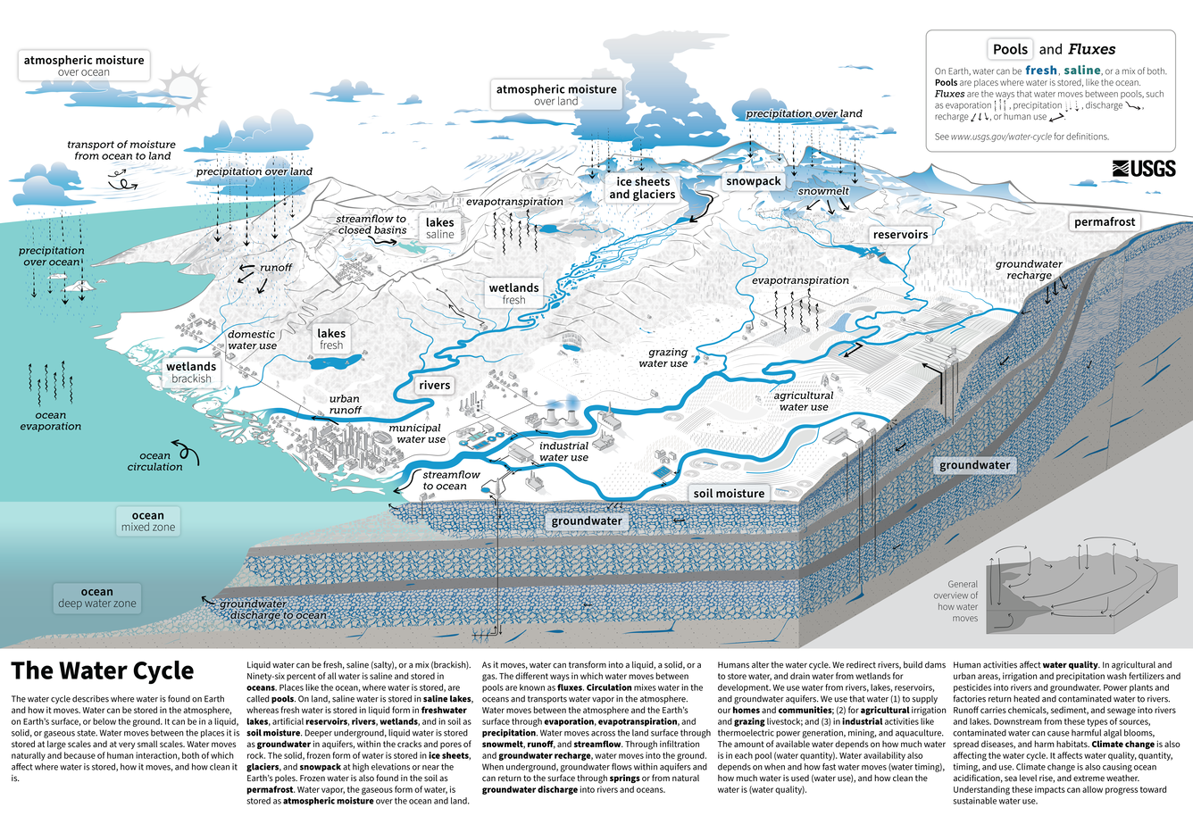
Notes:
https://www.usgs.gov/special-topics/water-science-school/science/water-cycle-diagrams

Slide 17
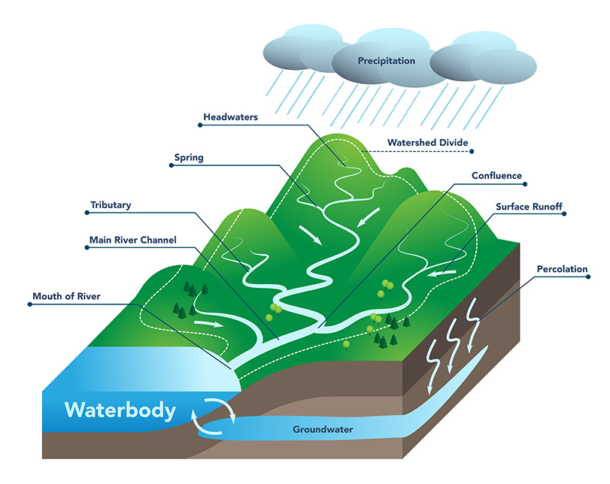
Watershed water balance
P = ET + Q ± GW ± S
How do we measure each of the components?
Notes:
https://dnr.mo.gov/water/hows-water/state/watersheds

Slide 18
At annual or multi-year timescale, assume ΔGW and ΔS are 0
P = ET + Q
Directly measure P via rain gauges/snow survey
Directly measure Q at stream gauge
Notes:
https://dnr.mo.gov/water/hows-water/state/watersheds

Slide 19
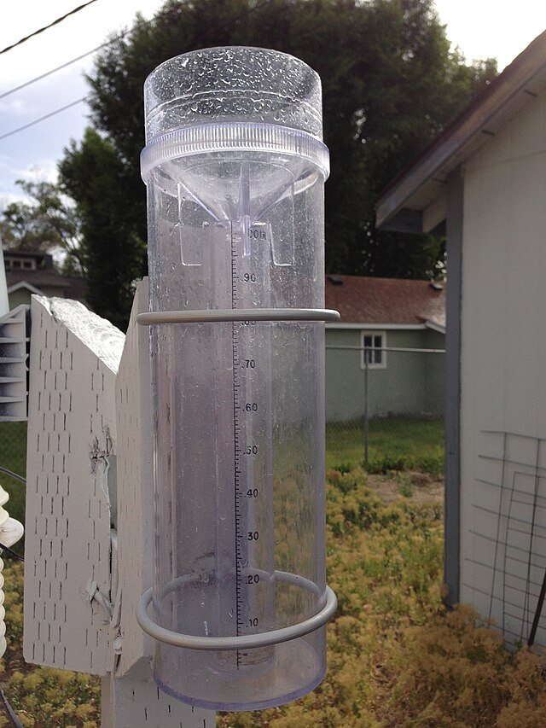
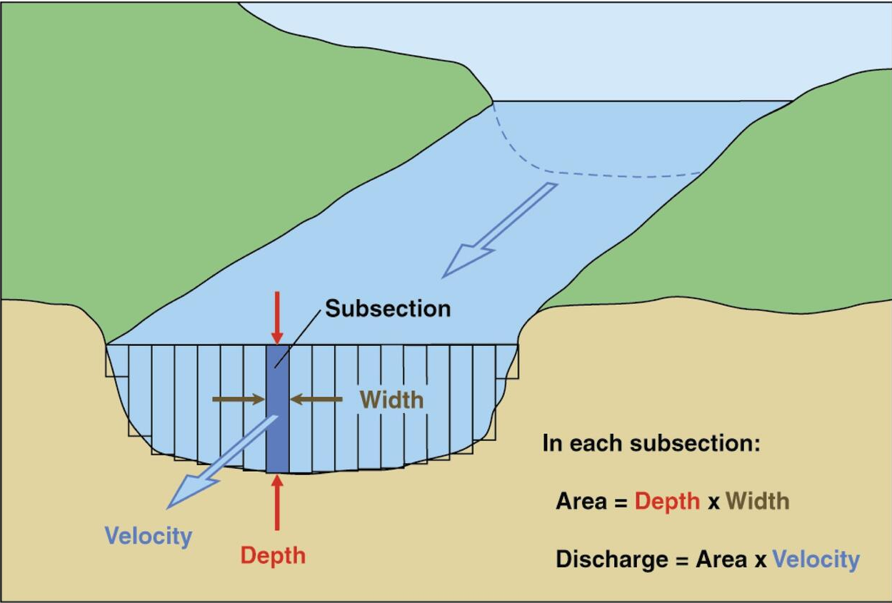
Typically measure P as a depth of precipitation
Typically measure Q as a volume
Notes:
Rain gauge: https://commons.wikimedia.org/wiki/File:2013-06-24_17_39_11_A_4-inch_plastic_rain_gauge_typical_of_those_used_by_the_CoCoRaHS_program.jpg
River cross-section: https://www.usgs.gov/media/images/diagram-channel-cross-section-subsections

