Slide 1

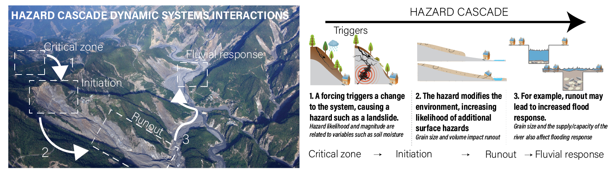
What is a hazard cascade?
Surface hazards can alter landscapes in ways that directly increase the likelihood and severity of subsequent hazards.
Modeling the downstream impacts of surface hazards requires identifying how hazards impact environmental system factors that act as variables for other hazards, including the causal hazard.
Image courtesy of CLaSH

Slide 2
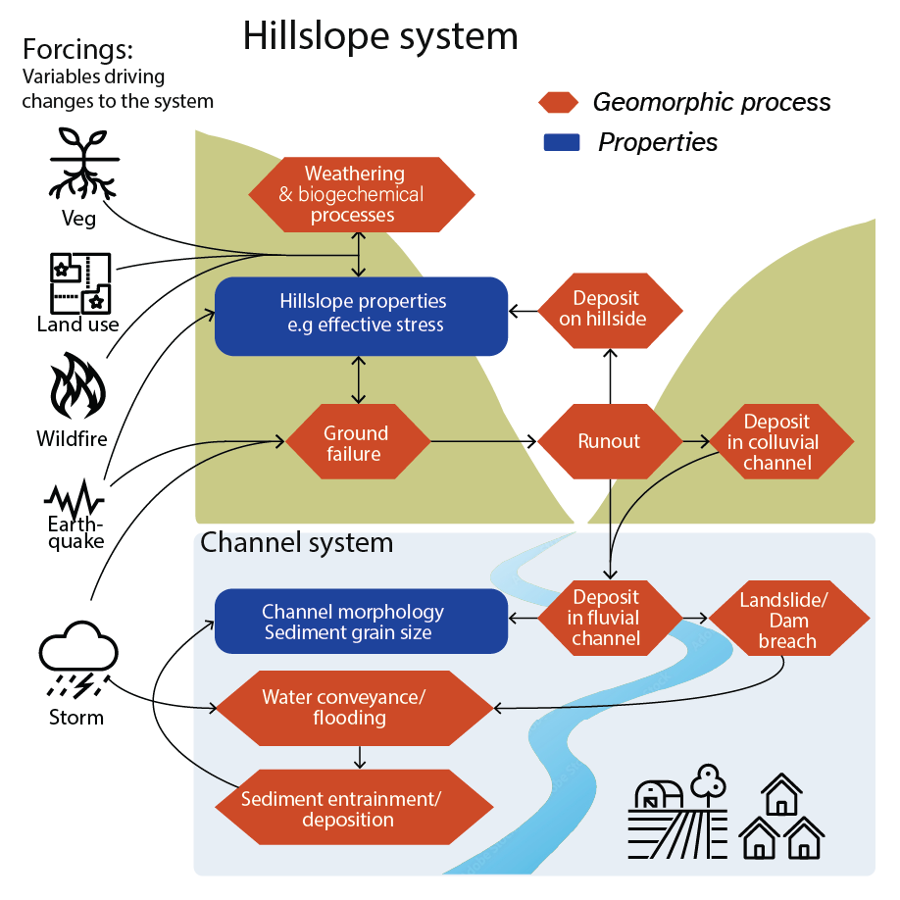
Dynamic Systems Modeling of Hazard Cascades
Models can be used to represent relationships between factors in complex, interconnected systems.
Identifying factors to include in systems models can help us identify variables that are important to predicting the evolution of the system over time.
Models help illustrate causal relationships, unveil hidden feedback loops and add clarity to interpreting complex relationships in which disparate impacts of multiple factors must be taken into account.
To be broadly applicable, most models simplify systems and demonstrate generalized relationships.
They can help students visualize relationships they observe in mathematical or computer models, e.g., understanding why increasing one variable causes a specific model response.
Image courtesy of CLaSH

Slide 3
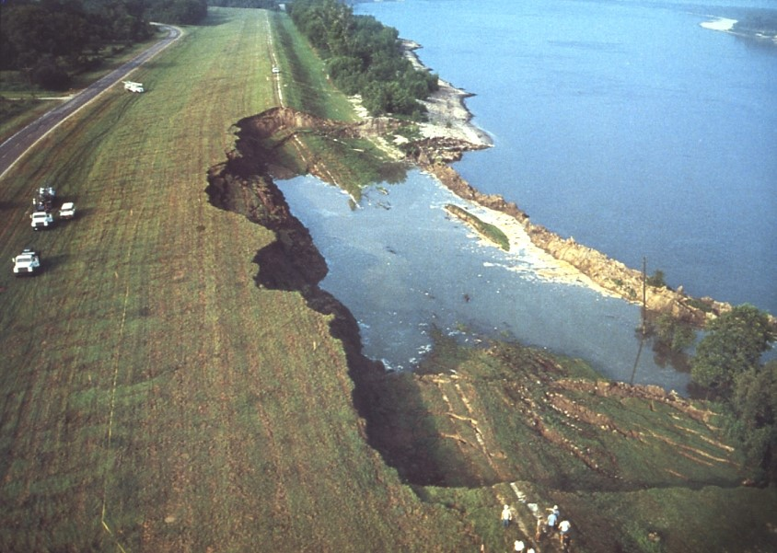
Creating systems models:
HOW and WHY
Systems models simplify complex systems by illustrating how social or scientific factors impact a system. Factors may be:
Forcings, e.g. amount of precipitation,
Properties, e.g. grain size of soil, or
Processes, e.g., mass wasting
1983 Mississippi River Levee failure. Photo source: the Missouri Science and Technology, accessed from ASDO, July 2026.
Mass wasting/ River bank failure
Increased sediment deposition in river
Both factors shown here are processes
Models show causal relationships with arrows pointing from cause to effect

Slide 4
Systems Model: Directionality
An increase in mass wasting increases sediment deposition
A decrease in mass wasting would decreases sediment deposition
Systems models can be used to illustrate directional changes using ‘+’ and ‘-’ symbols to illustrate positive and negative correlations
Positive correlation ‘+’ : the cause produces a change in the same direction as the effect
Mass wasting/ River bank failure
+
Increased sediment deposition in river
Rather than including direction within factor, label the directional arrow with a ‘+’ or ‘-’

Slide 5
Systems Model: Directionality
An increase in vegetative cover could decrease likelihood of mass wasting
A decrease in vegetative cover could increase likelihood of mass wasting
Systems models can be used to illustrate directional changes using ‘+’ and ‘-’ symbols to illustrate positive and negative correlations
Negative correlation ‘-’ : the cause produces a change in the opposite direction as the effect
Vegetative cover
-
Mass wasting/ River bank failure
+
Sediment deposition in river
Discussion question: Can cause and effect relationships move both ways?

Slide 6
Systems Model: Feedbacks
Systems models can illustrate feedbacks when factors can act as both “cause” and “effect” for each other
The “effect” may change the rate or direction of the causal factor
Occurrence of mass wasting decreases vegetation Decrease in mass wasting activity increases vegetation
Vegetative cover
-
Mass wasting/ River bank failure
Sediment deposition in river
+
-
This feedback process means that a landslide could increase the likelihood of additional landslides!
Notes:
The cause effect arrows shown in both directions between vegetative cover and river bank failure is an example of a feedback loop because changing one factor affects the other factor, which in turn will affect the initial variable changed.

Slide 7
Adding Complexity to Systems Models
Helps with visualizing indirect relationships:
e.g., increase in sediment deposition could decrease channel size, increasing likelihood of flooding and additional bank failures.
Helps identify competing processes:
e.g., increase in sediment deposition could decrease in water velocity, decreasing likelihood of additional bank failures
Which process wins out? This may depend on hydraulic properties or external forcings (e.g., precipitation/discharge)
Water velocity
+
-
Vegetative cover
-
Mass wasting/ River bank failure
Sediment deposition in river
+
-
+
Channel capacity
Flooding (water leaving channel)
-
-
Notes:
It is important to note here that we are looking at directions, but not magnitudes of change, so we are missing information we would need to accurately predict the total effect of all changes.

Slide 8
Describing potential changes using a systems model
Practice: Describe a change to this system using one of the pathways shown.
Bank failure increases sediment deposition, leading to decreased channel capacity.
Smaller channels increase flood risk, which may increase river bank failure risk.
Water velocity
+
-
Note how direction of change is related to ‘+’ and ‘-’ symbols
Vegetative cover
-
Mass wasting/ River bank failure
Sediment deposition in river
+
-
+
Channel capacity
Flooding (water leaving channel)
-
-
Notes:
For “Practice” slides, give students the opportunity to brainstorm ideas before sharing the example in the box.

Slide 9
Negative feedbacks: result of a process is to reverse to initiating factor
Initiating factor: mass wasting/bank failure
Negative feedback: Bank failure could decrease likelihood of additional bank failure if sediment deposition decreases water velocity, which decreases erosive power and likelihood of mass wasting.
Both decrease
Water velocity
+
Increase sediment decreases velocity
-
Vegetative cover
-
Mass wasting/ River bank failure
Sediment deposition in river
Both increase
One “-” in a cyclic chain indicates negative feedback.
+
-
+
Channel capacity
Flooding (water leaving channel)
-
-

Slide 10
Positive feedbacks: result of a process moves process in same direction
Initiating factor: mass wasting/bank failure
Positive feedback: Bank failure could increase likelihood of additional bank failure if sediment deposition decreases channel capacity, increasing likelihood of flooding and likelihood of mass wasting.
Water velocity
All “+” or an even number of “-” in a cyclic chain indicates positive feedback.
+
-
Vegetative cover
-
Mass wasting/ River bank failure
Sediment deposition in river
+
-
+
Channel capacity
Flooding (water leaving channel)
-
-

Slide 11
Positive feedbacks accelerate, negative feedbacks reduce impact of initiating factor
Practice: What type of feedback is shown between “mass wasting/bank failure” and “vegetative cover”?
Water velocity
+
-
Vegetative cover
-
Mass wasting/ River bank failure
Sediment deposition in river
+
-
+
Channel capacity
Flooding (water leaving channel)
-
-
Notes:
For “Practice” slides, give students the opportunity to brainstorm ideas before sharing the example in the box.
Answer: positive feedback

Slide 12
Your turn! Individual work
Go to Part 1 of the student handout. Select one of the following as the initial factor for a systems model you will create.
River channel incision
Volcanic eruption
Debris Flow
Wildfire
Coastal Flooding
Flash flooding
Then, answer the remaining questions in Part 1 to add more detail to your model and practice concepts from the lecture

Slide 13
Adding complexity: Increasing factors
Adding wildfires: another factor + feedbacks
More wildfires= less vegetation (negative)
More vegetation = less chance of wildfires (positive)
Wildfire
-
-
Water velocity
+
+
-
This makes the model better able to predict outcomes after a disruption to the system
Infiltration
Vegetative cover
-
Mass wasting/ River bank failure
Sediment deposition in river
-
+
-
+
Channel capacity
Flooding (water leaving channel)
-
-
Notes:
Answer: Negative feedback

Slide 14
Adding complexity: Adding arrows
Branches illustrate how a factor can affect (or be affected by) multiple other factors
Practice: What other arrows or factors could you add?
High intensity rainfall event
Wildfire
+
-
-
+
Water velocity
+
+
+
-
Some factors may impact more than one other factor in the system
Infiltration
Vegetative cover
-
Mass wasting/ River bank failure
Sediment deposition in river
-
+
-
+
Channel capacity
Flooding (water leaving channel)
-
-
Notes:
Two examples of factors with multiple arrows are shown (red arrows and blue arrows).

Slide 15
Adding complexity: Chains
Adding chains of 3 or more can help visualize hazard cascades
Example: Climate change increases wildfires, wildfires cause debris flows, debris flows decrease channel capacity, increasing flooding
Debris flows
High intensity rainfall event
+
Wildfire
+
-
-
+
-
-
+
+
Water velocity
+
+
-
Infiltration
Vegetative cover
-
-
Mass wasting/ River bank failure
Sediment deposition in river
+
-
-
+
Channel capacity
-
-
Flooding (water leaving channel)
-
-
Notes:
The chain shown in red started with wildfire, goes to debris flows (see resources for readings on why debris flows are connected to wildfires) and then to channel capacity and flooding

Slide 16
Adding complexity: Chains
Hazard cascades are initiated by a triggering mechanism that alters the landscape, changing the probability of a surface process that poses a hazard
Debris flows
High intensity rainfall event
+
Wildfire
+
-
-
+
Chain illustrated in red shows a hazard cascade, which could accelerate over time with the positive feedback between flooding and debris flows
-
-
+
+
Water velocity
+
+
+
-
Infiltration
Vegetative cover
-
-
Mass wasting/ River bank failure
Sediment deposition in river
+
-
-
+
+
Channel capacity
-
Flooding (water leaving channel)
-
-
-
Notes:
Flooding can increase the likelihood of Debris flows, bringing this hazard cascade, wherein one hazard increasese likelihood of another

Slide 17
Recognizing additional cascades
Cascade: Series of events leading to flooding can cause additional flooding (blue pathways)
Debris flows
High intensity rainfall event
+
Wildfire
+
-
-
+
Remember, an even number of “-” in a cyclic chain indicates a positive feedback!
-
-
+
+
Water velocity
+
+
+
-
Infiltration
Vegetative cover
-
-
Mass wasting/ River bank failure
Sediment deposition in river
+
-
-
+
+
Channel capacity
-
Flooding (water leaving channel)
-
-
-
Notes:
Flooding can increase the likelihood of Debris flows, bringing this hazard cascade, wherein one hazard increasese likelihood of another

Slide 18
Interpretation: Human interventions &
Social ramifications of cascades
Humans remove excess vegetative cover to decrease wildfire risk
Practice: What factors would these interventions change?
Debris flows
High intensity rainfall event
+
Humans dredge sediment or remove debris to increase capacity of river basins after landslides
Wildfire
+
-
-
+
-
-
+
+
Water velocity
+
+
+
-
Infiltration
Vegetative cover
-
-
Mass wasting/ River bank failure
Sediment deposition in river
+
-
-
+
+
Channel capacity
-
Flooding (water leaving channel)
-
-
-
Notes:
Provide students with time to brainstorm human factors as a group.
One example: Removing vegetation would decrease wildfire risk (the + means the change to wildfire would go in the same direction as the change to vegetative cover), but it would increase the risk of mass wasting/river bank failure (the - means the change to river bank failure would go in the opposite direction as the change to vegetative cover).

Slide 19
Your turn! As a group, create your own systems model
Choose a central factor (meteorologic, geologic, land surface hazards- see examples below)
Answer the questions in Part 2 of the Student handout
Add factors that affect and/or are affected by your central factor, using causal arrows and illustrating directionality
Consulting with other students in your group, add complexity to show indirect relationships
  Chains: sequences of factors connected by 3+ arrows in the same direction
  Branches: factors that act as causal or effect factors for more than one factor
  Feedbacks: closed chains where factors act as cause & effect in the same circuit
Wildfires
Earthquake
Volcanic eruption
Precipitation events
Drought
Flooding
Debris Flow
Notes:
Factors include Hazard sources and drivers: Environmental conditions, physical processes

Slide 20
Reflection
Fill out Part 3: reflection questions with your group
Add social and anthropogenic factors to your model: what are the human influences and implications?
Be ready to share your systems model with the class!
Notes:
Exposure/vulnerability factors: population distribution/density, built environment, economic assets, construction quality, physical, social, institutional, economic vulnerability

