Slide 1
Notes for Teaching
We are familiar with cats having the potential to be liquids (Fardin, 2014) as well as mother cats having the potential to give birth to different coloured kittens.
This allows for the use of cats to model crystallization pathways. Calico cats can model the Fo-An-Di and the Fo-An-SiO₂ systems. Tortoiseshell cats continue model the diopside-anorthite system, both binary and ternary.
Fardin (2014) https://www.drgoulu.com/wp-content/uploads/2017/09/Rheology-of-cats.pdf

Slide 2
Ternary Phase Diagrams
Goal: to apply ternary phase diagrams towards understanding crystallisation of igneous melts and melting of igneous rocks.
Specific learning outcomes:
To interpret crystallisation and melt sequences from ternary phase diagrams.
Associated textbook chapters in Introduction to Petrology (Perkins 2022):
Chapter 8.4 – Ternary Systems.
Notes:
The goal for this session is to be able to….

Slide 3
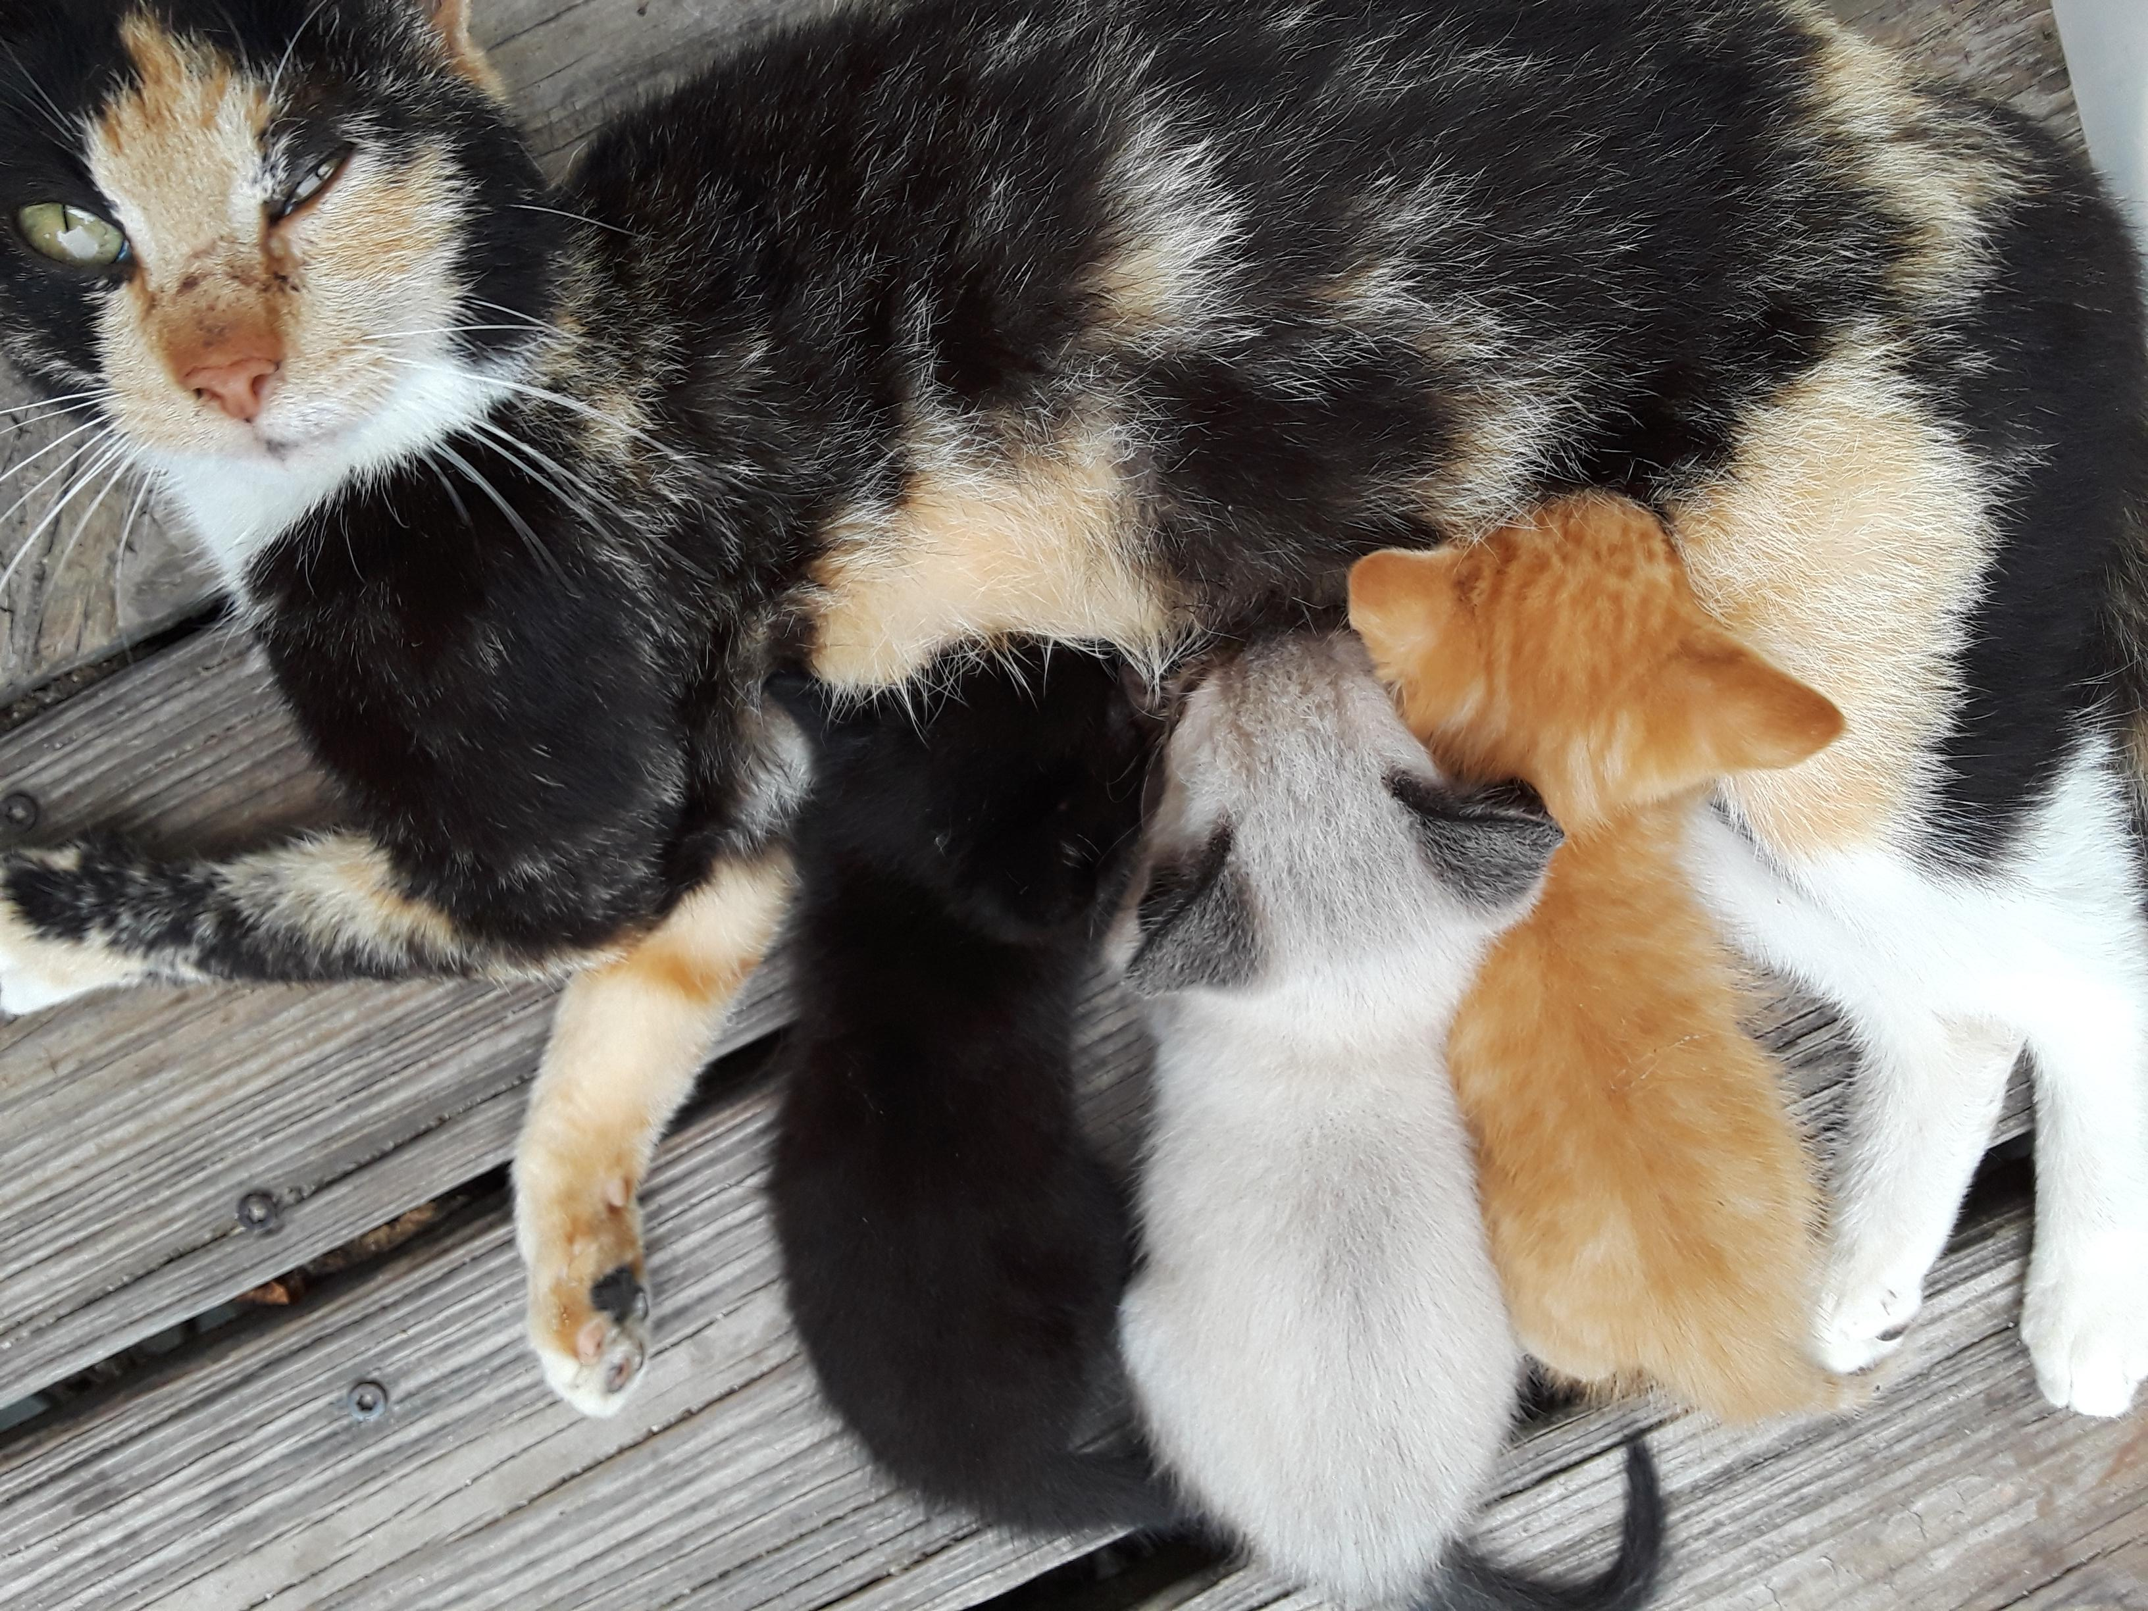
Melting and Crystallisation
Source: Brainius
A three-component melt can crystallise three (or more) separate phases.

Slide 4

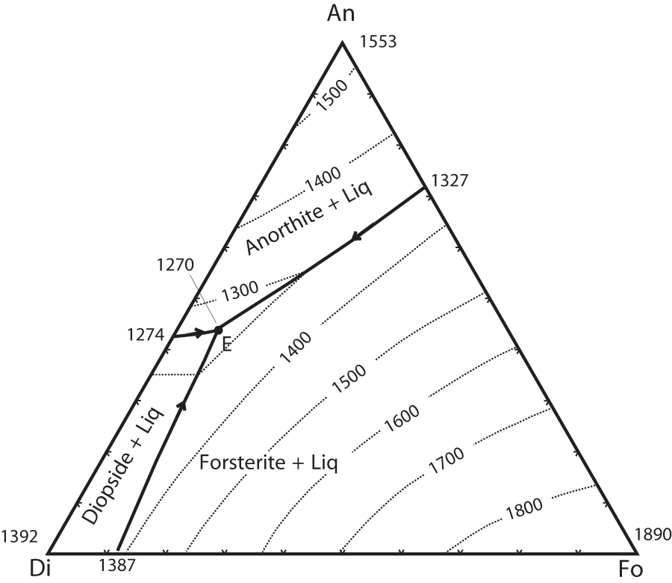



Ternary (c = 3) systems: Fo-An-Di
Equilibrium crystallisation
The melt is saturated in
  An (anorthite, Ca-plagioclase).
  Fo (forsterite, Mg-olivine).
  Di (diopside, CaMg-clinopyroxene).
Thus, a 3-component melt that can be used to depict crystallisation of ol-cpx-plag basalts.
Melt

Slide 5
Ternary (c = 3) systems: Fo-An-Di
Start cooling a melt saturated in Fo, Di and An.
Modified from Ternary Phase Diagrams. https://serc.carleton.edu/research_education/equilibria/ternary_diagrams.html

Slide 6
Ternary (c = 3) systems: Fo-An-Di
a
At 1500ºC, forsterite starts to crystallise. At this stage we have forsterite plus liquid.
Modified from Ternary Phase Diagrams. https://serc.carleton.edu/research_education/equilibria/ternary_diagrams.html

Slide 7
Ternary (c = 3) systems: Fo-An-Di
a
The cooling path is predicted from a line, from point “a” projected through the corner of the diagram where the crystallising phase is at 100% .
Modified from Ternary Phase Diagrams. https://serc.carleton.edu/research_education/equilibria/ternary_diagrams.html

Slide 8
Ternary (c = 3) systems: Fo-An-Di
b
a
When this cooling path meets the cotectic (point b), the next phase starts to crystallise. In this example, it is anorthite, as this is stable in the anorthite field and on the cotectic with forsterite.
Modified from Ternary Phase Diagrams. https://serc.carleton.edu/research_education/equilibria/ternary_diagrams.html

Slide 9
Ternary (c = 3) systems: Fo-An-Di
b
a
The cooling path then follows the cotectic, towards the ternary eutectic. This results in continued crystallisation of forsterite + anorthite.
Modified from Ternary Phase Diagrams. https://serc.carleton.edu/research_education/equilibria/ternary_diagrams.html

Slide 10
Ternary (c = 3) systems: Fo-An-Di
b
a
At the ternary eutectic, the last drop of melt is present.
Modified from Ternary Phase Diagrams. https://serc.carleton.edu/research_education/equilibria/ternary_diagrams.html

Slide 11
Ternary (c = 3) systems: Fo-An-Di
b
a
Below the ternary eutectic, i.e., below the solidus, diopside crystallises and the rock is solidified.
Modified from Ternary Phase Diagrams. https://serc.carleton.edu/research_education/equilibria/ternary_diagrams.html

Slide 12
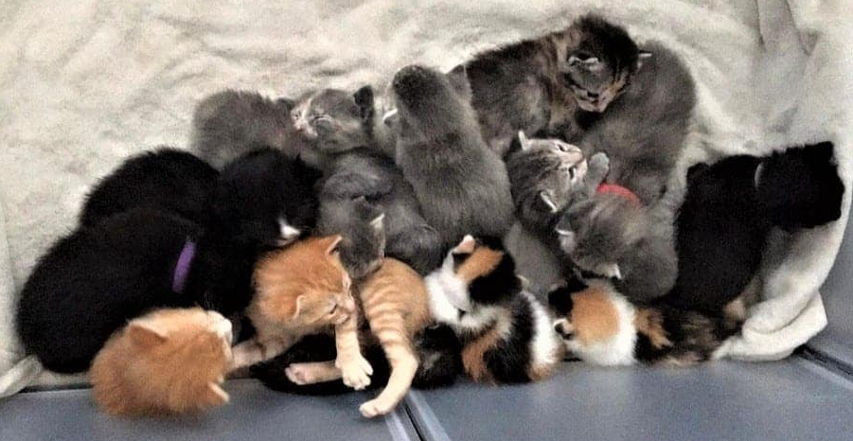
Crystallisation with an Intermediate Compound (Peritectic)
From Stray Cat Strut
Dealing with more than three phases in a 3-component diagram…

Slide 13
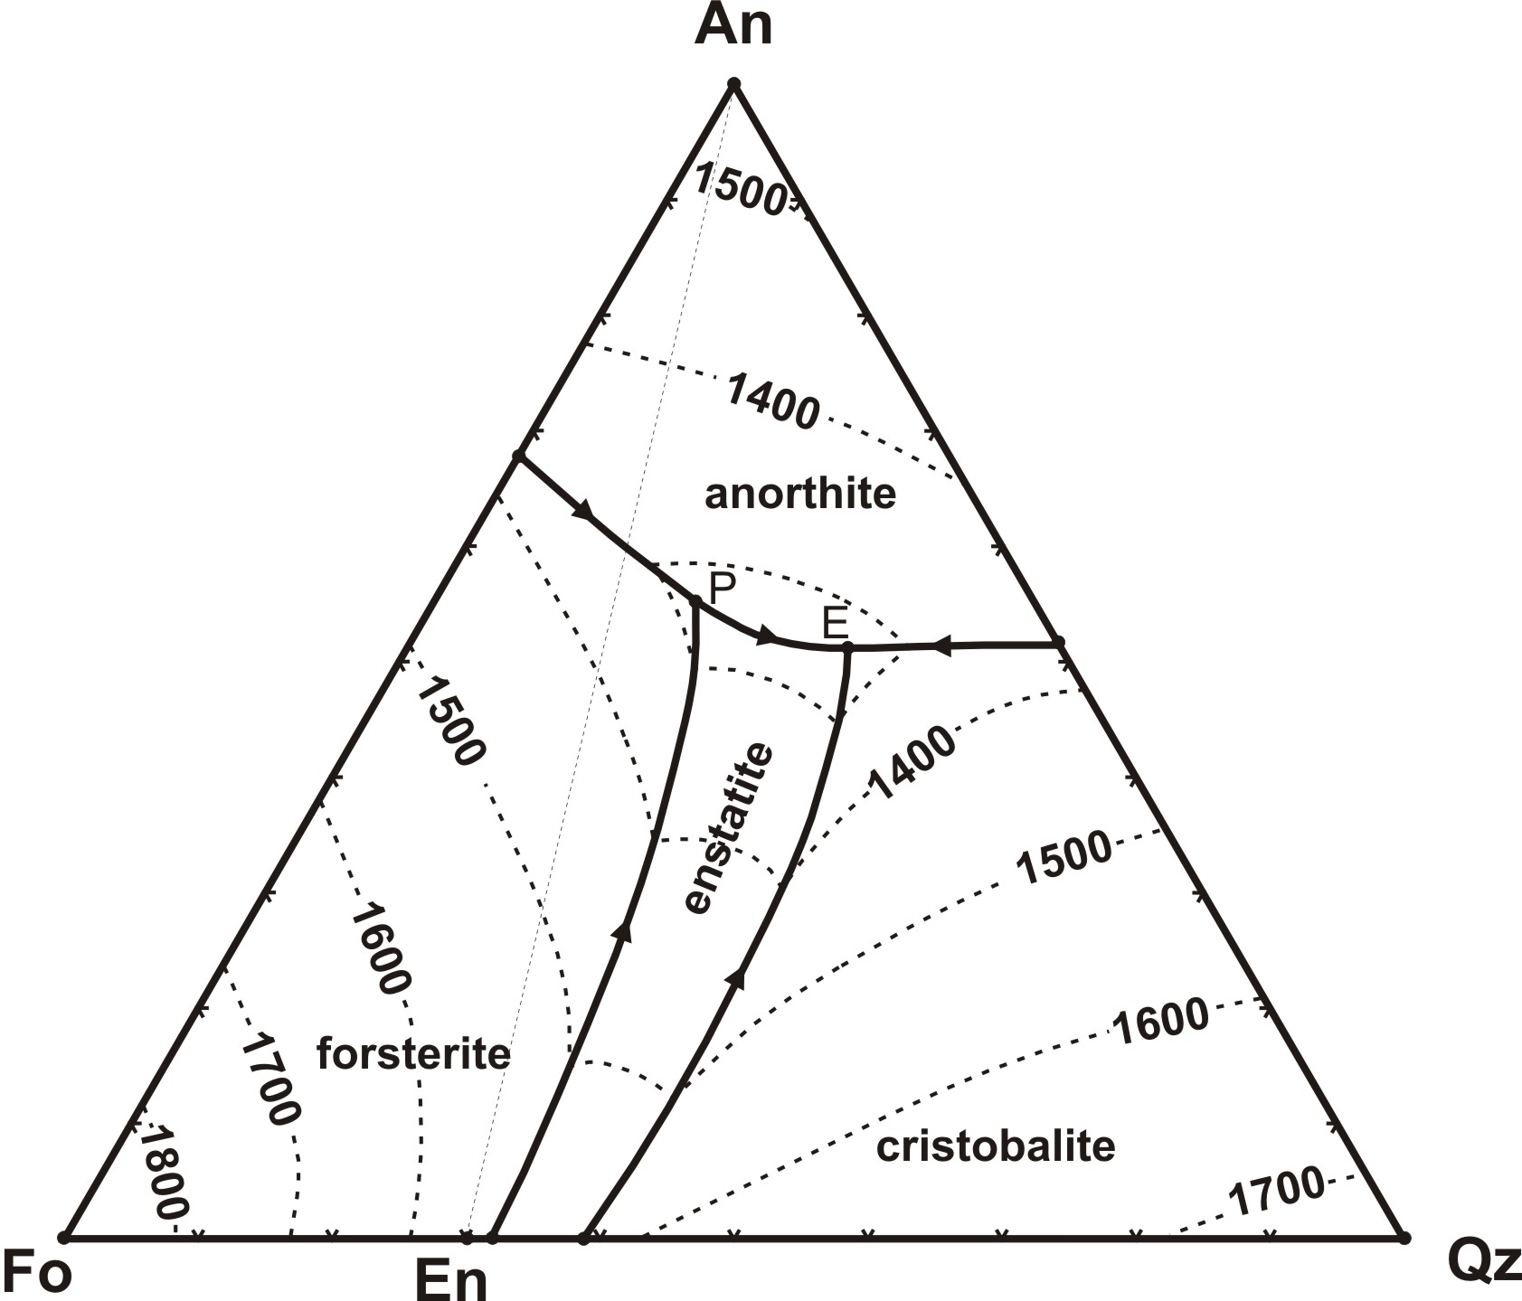



Ternary System (Fo-An-SiO₂) with an intermediate compound (Peritectic)
Peritectic
An isothermal reversible reaction in a crystallising melt or magma in which a liquid phase reacts with a solid phase to produce another solid phase on cooling.
This diagram represents a silica-saturated tholeiitic melt (another type of basalt).
Peritectic
1543ºC

Slide 14
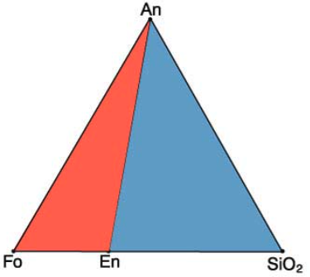
Ternary System (Fo-An-SiO₂) with an intermediate compound (Peritectic)
a₁
Peritectic
1543ºC
If the starting liquid composition is at point a₁ (Fo₅₄An₃₆Qz₁₀) i.e., in the red portion of the ternary, the liquid line of descent will end at the peritectic.
Modified from Ternary Phase Diagrams. https://serc.carleton.edu/research_education/equilibria/ternary_diagrams.html

Slide 15
Ternary System (Fo-An-SiO₂) with an intermediate compound (Peritectic)
a₁
Peritectic
1543ºC
From point a₁, the first phase to crystallise will be forsterite. The line of descent is then projected back towards the Fo corner to determine the next phase.
Modified from Ternary Phase Diagrams. https://serc.carleton.edu/research_education/equilibria/ternary_diagrams.html

Slide 16
Ternary System (Fo-An-SiO₂) with an intermediate compound (Peritectic)
a₂
a₁
Peritectic
1543ºC
At point a₂, anorthite starts to also crystallise as this is stable along the Fo-An cotectic.
Modified from Ternary Phase Diagrams. https://serc.carleton.edu/research_education/equilibria/ternary_diagrams.html

Slide 17
Ternary System (Fo-An-SiO₂) with an intermediate compound (Peritectic)
a₂
a₁
Peritectic
1543ºC
The evolution of the melt now moves down towards the peritectic at 1270ºC. The solid rock at this point has the composition Fo₃₁An₃₆En₃₃. The system is in equilibrium so has to follow Gibbs phase rule, only three phases can be stable at the same time.
Modified from Ternary Phase Diagrams. https://serc.carleton.edu/research_education/equilibria/ternary_diagrams.html

Slide 18
Ternary System (Fo-An-SiO₂) with an intermediate compound (Peritectic)
b₁
Peritectic
1543ºC
If the starting liquid composition is at point b₁(Fo₄₀An₄₀Qz₂₀) i.e., in the blue portion of the ternary, the liquid line of descent will end at the eutectic.
Modified from Ternary Phase Diagrams. https://serc.carleton.edu/research_education/equilibria/ternary_diagrams.html

Slide 19
Ternary System (Fo-An-SiO₂) with an intermediate compound (Peritectic)
b₁
b₂
Peritectic
1543ºC
At point b₂ on the Fo-En cotectic, both phases become stable with the melt.
Modified from Ternary Phase Diagrams. https://serc.carleton.edu/research_education/equilibria/ternary_diagrams.html

Slide 20
Ternary System (Fo-An-SiO₂) with an intermediate compound (Peritectic)
b₁
b₂
Peritectic
1543ºC
The melt then evolves along the cotectic, progressively crystallising more forsterite and enstatite.
Modified from Ternary Phase Diagrams. https://serc.carleton.edu/research_education/equilibria/ternary_diagrams.html

Slide 21
Ternary System (Fo-An-SiO₂) with an intermediate compound (Peritectic)
b₃
b₁
b₂
Peritectic
1543ºC
At point b₃, the peritectic is reached and the anorthosite starts to crystallise. Due to the different starting composition of the melt, it is not fully solidified at the peritectic.
Modified from Ternary Phase Diagrams. https://serc.carleton.edu/research_education/equilibria/ternary_diagrams.html

Slide 22
Ternary System (Fo-An-SiO₂) with an intermediate compound (Peritectic)
b₃
b₄
b₁
b₂
Peritectic
1543ºC
At point b₄, the melt is evolving along En-An cotectic, here Fo is not stable, so undergoes the reversible reaction (Fo + L ←→ En) and is lost while melt remains.
Modified from Ternary Phase Diagrams. https://serc.carleton.edu/research_education/equilibria/ternary_diagrams.html

Slide 23
Ternary System (Fo-An-SiO₂) with an intermediate compound (Peritectic)
b₃
b₄
b₅
b₁
b₂
Peritectic
1543ºC
At point b₅, the eutectic (ternary minimum) is reached, resulting in solidification of the rock and crystallisation of quartz (or the high-T polymorph cristobalite). The solid rock has the composition An₄₇En₅₇Qz₀₃.
Modified from Ternary Phase Diagrams. https://serc.carleton.edu/research_education/equilibria/ternary_diagrams.html

Slide 24
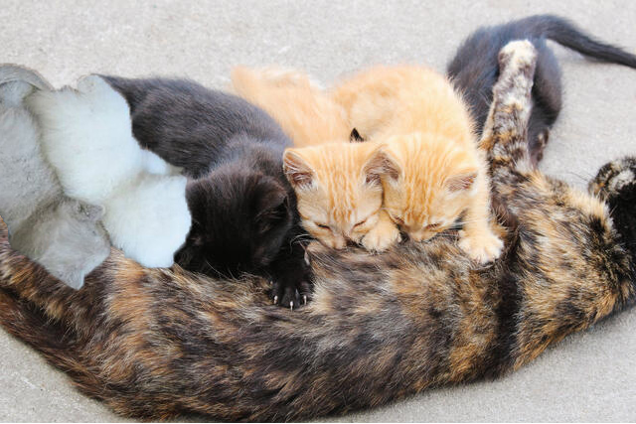
Crystallisation and Miscibility
Modified from Ana Fidalgo / kaiserj1982
A three-component melt can also deal with solid solution between represented phases.

Slide 25
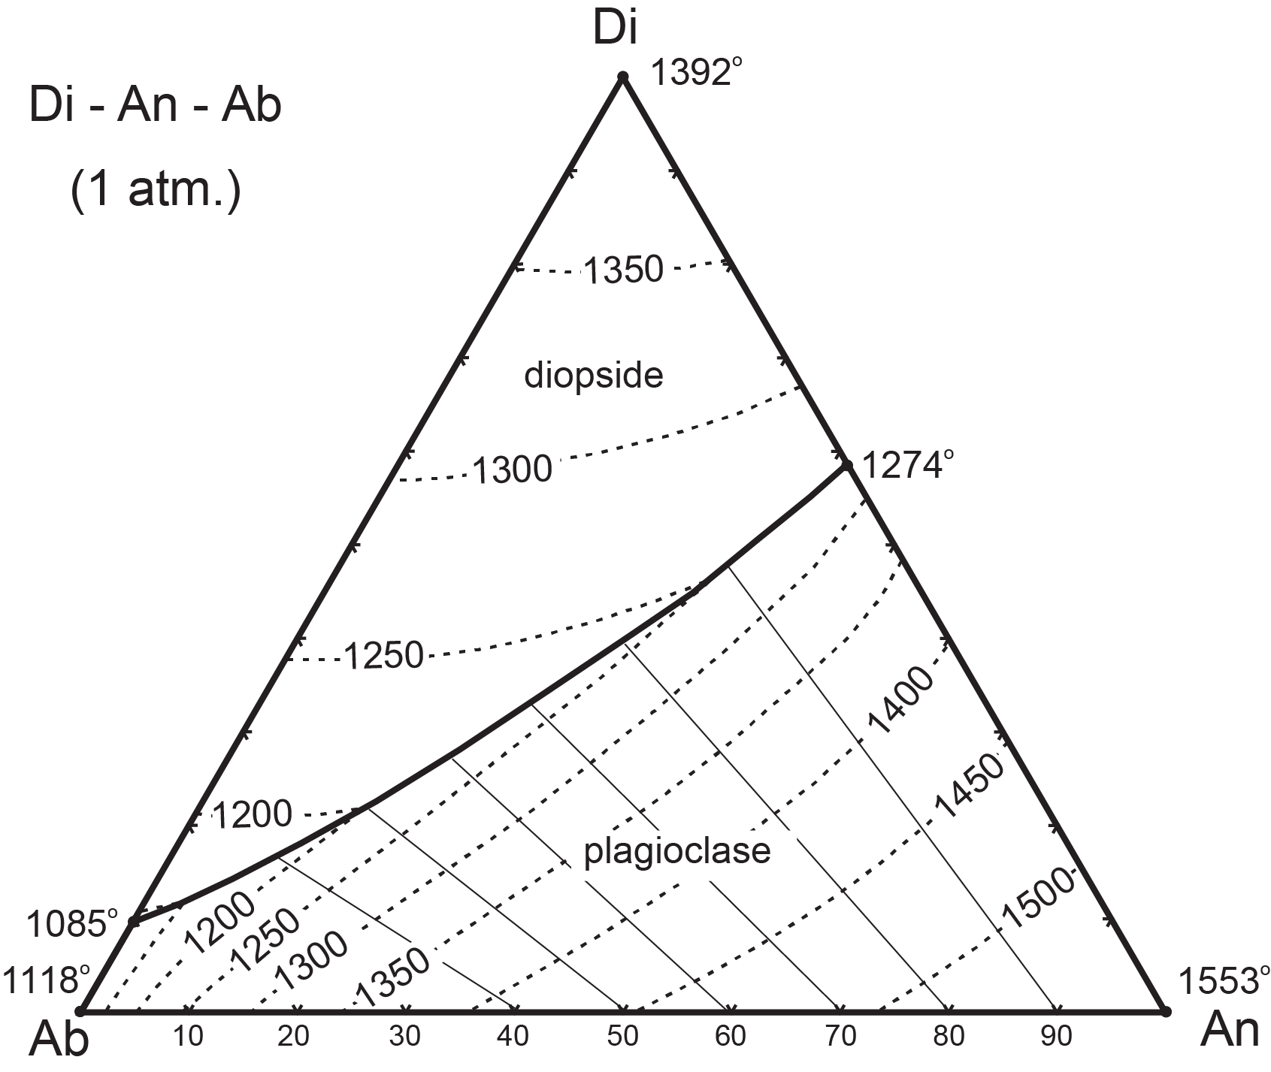


Ternary (c = 3) systems: Di-An-Ab
Equilibrium Crystallisation
Represents a melt saturated in diopside (clinopyroxene) and plagioclase, thus can be used to depict crystallisation of cpx-plag basalts.
Melt

Slide 26
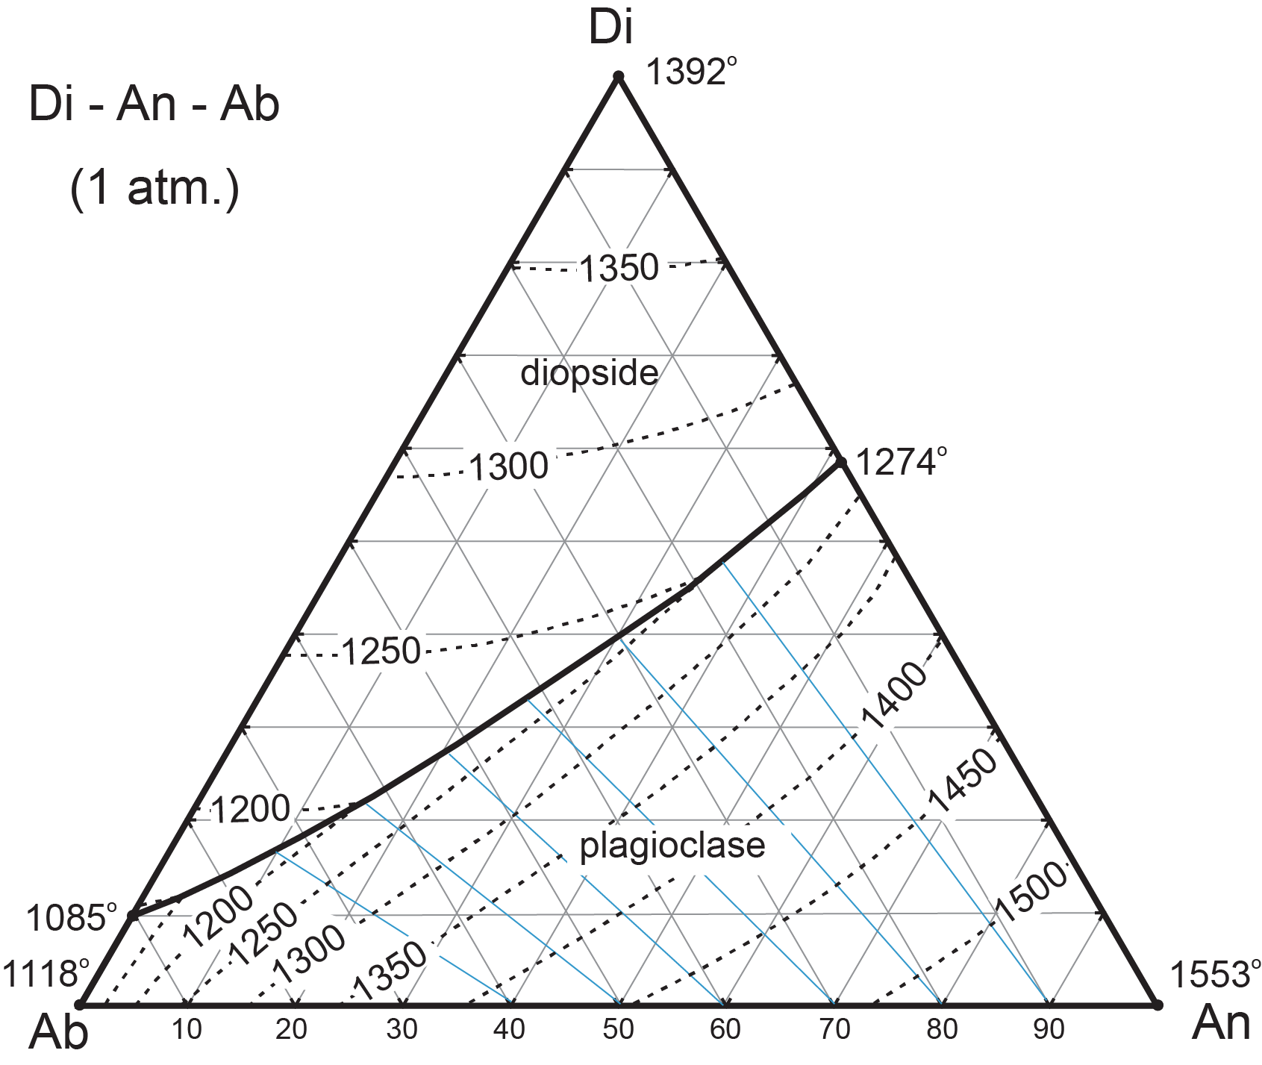
Ternary (c = 3) systems: Di-An-Ab
Modified from Ternary Phase Diagrams. https://serc.carleton.edu/research_education/equilibria/ternary_diagrams.html
1
Start cooling a melt from 1450ºC, that has a liquid composition of Di₁₅An₅₅Ab₃₀, which is determined from the position of point “1” on the ternary diagram. Note, as this composition is above the liquidus, the location of the point does not lie on an isotherm.

Slide 27
Ternary (c = 3) systems: Di-An-Ab
Modified from Ternary Phase Diagrams. https://serc.carleton.edu/research_education/equilibria/ternary_diagrams.html
1
When crystallised, this melt will be 15% diopside and 85% plagioclase.
This is calculated from Di₁₅ = 15% diopside and An₅₅Ab₃₀ = 85% plagioclase.

Slide 28

Ternary (c = 3) systems: Di-An-Ab
Modified from Ternary Phase Diagrams. https://serc.carleton.edu/research_education/equilibria/ternary_diagrams.html
2
1
At 1400ºC, (point 2) the melt starts to crystallise plagioclase, of composition ~An₈₆ as it must be higher than the melt.
The liquid composition at this stage is Di₁₇An₅₁Ab₃₂ determined by the position of the point in the ternary diagram.

Slide 29
Ternary (c = 3) systems: Di-An-Ab
Modified from Ternary Phase Diagrams. https://serc.carleton.edu/research_education/equilibria/ternary_diagrams.html
3
2
1
At 1350ºC, (point 3) the melt continue to crystallise plagioclase, with a continuously changing composition (that has to be experimentally determined). The liquid composition at this stage is Di₂₃An₄₂Ab₃₅ determined by the position of the point in the ternary diagram.

Slide 30
Ternary (c = 3) systems: Di-An-Ab
Modified from Ternary Phase Diagrams. https://serc.carleton.edu/research_education/equilibria/ternary_diagrams.html
4
At 1218ºC, (point 4) the melt continue to crystallise plagioclase, with the first diopside (on the cotectic). The liquid composition at this stage is Di₃₇An₂₈Ab₃₆, determined by the position of the point in the ternary diagram.

Slide 31

Ternary (c = 3) systems: Di-An-Ab
Modified from Ternary Phase Diagrams. https://serc.carleton.edu/research_education/equilibria/ternary_diagrams.html
5
At 1210ºC, (point 5) the rock is completely solidified, with 85% plagioclase and 15% diopside.

