Slide 1

Shoreline Stability
Geol 110L

Slide 2

Virginia’s Coastal Zone
60% of Virginia’s population lives in the coastal zone. (VA DoE)
Estuaries provide habitat for 70% of our commercial harvested fish and 80% of recreational catch. (NOAA)
Waterways are used for shipping a military.
Tidal marshes filter water entering bays and buffer upland areas from waves.
Notes:
https://www.energy.virginia.gov/geology/CoastalErosion.shtml
https://www.fisheries.noaa.gov/feature-story/5-reasons-love-estuaries#:~:text=Estuaries%20are%20often%20called%20the,live%20on%20or%20near%20one.

Slide 3
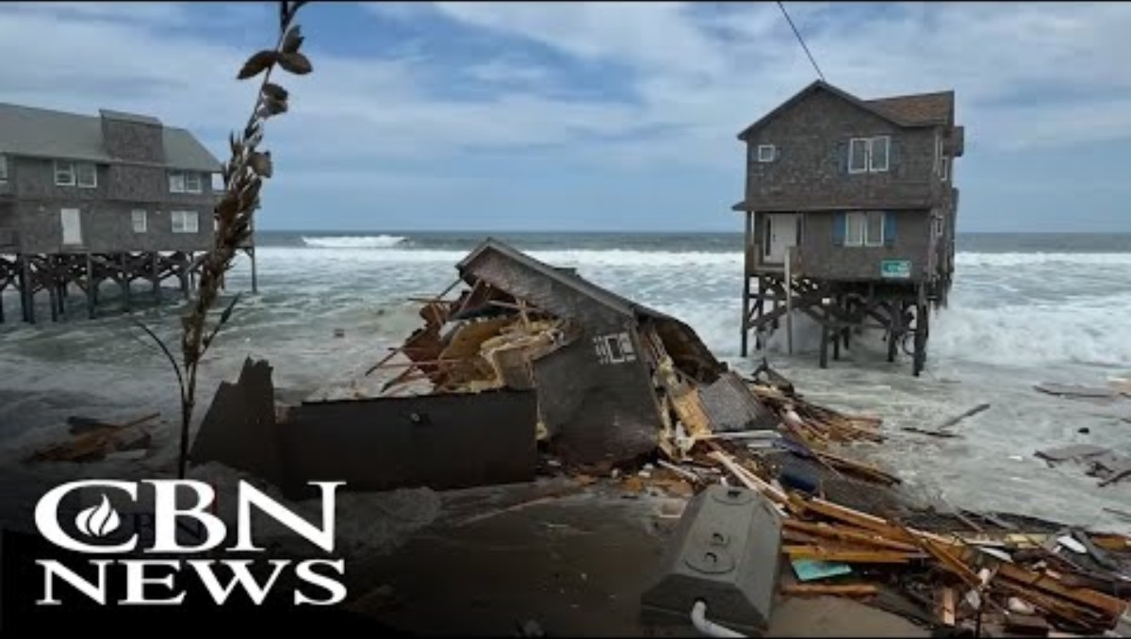
Aug 19, 2025

Slide 4
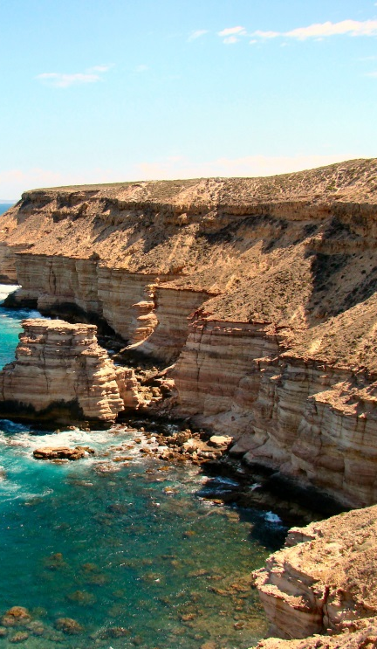
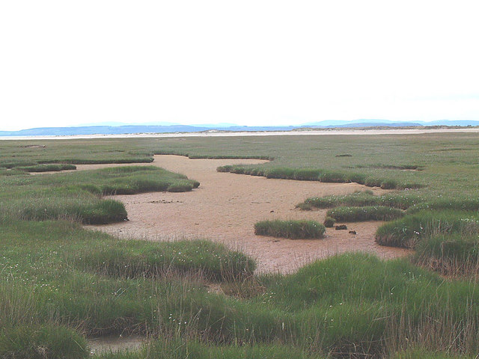
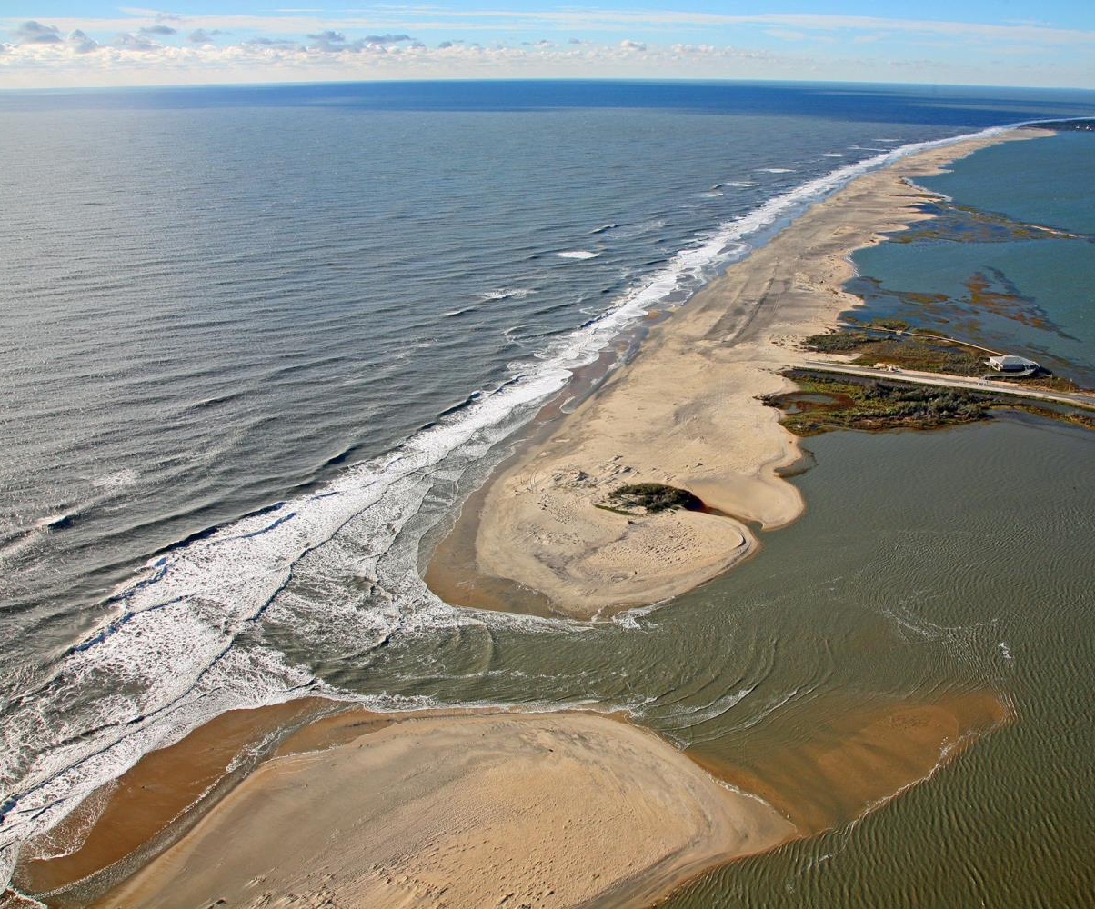
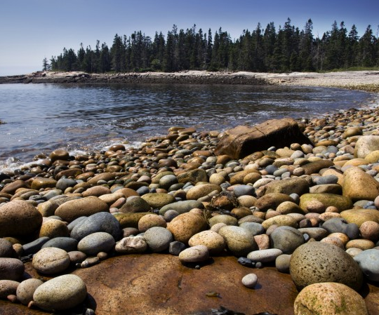
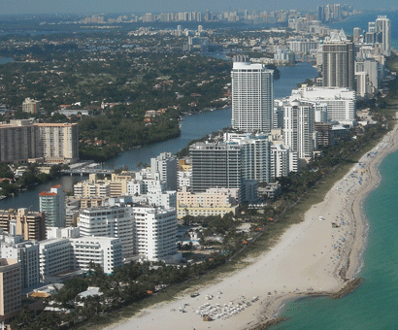
Notes:
Key Point: Shorelines are varied.

Slide 5
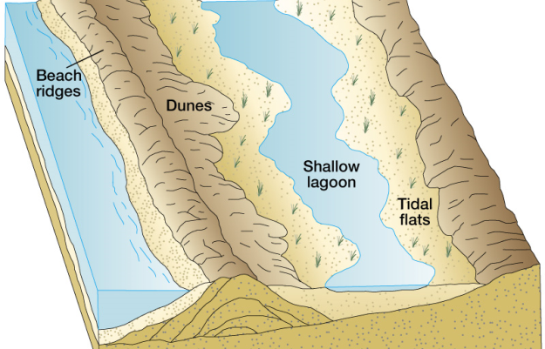
Notes:
Key Point: Explain the difference between a barrier island and non-barrier beach

Slide 6
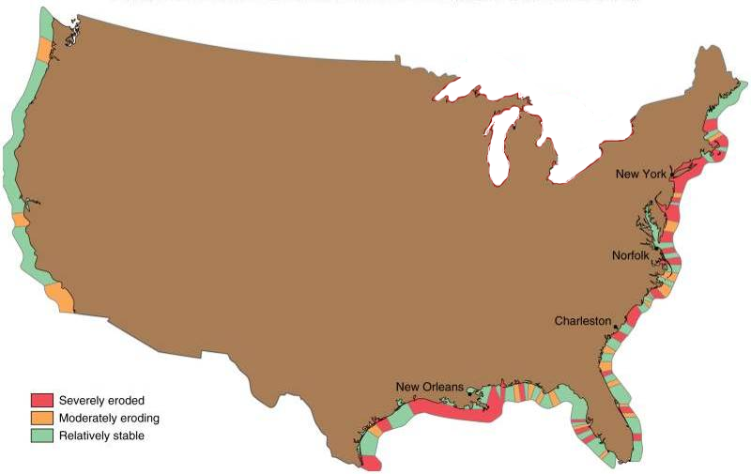
Shoreline Stability
Notes:
Ask students to develop hypothesis about why the shoreline erosion rates vary.

Slide 7
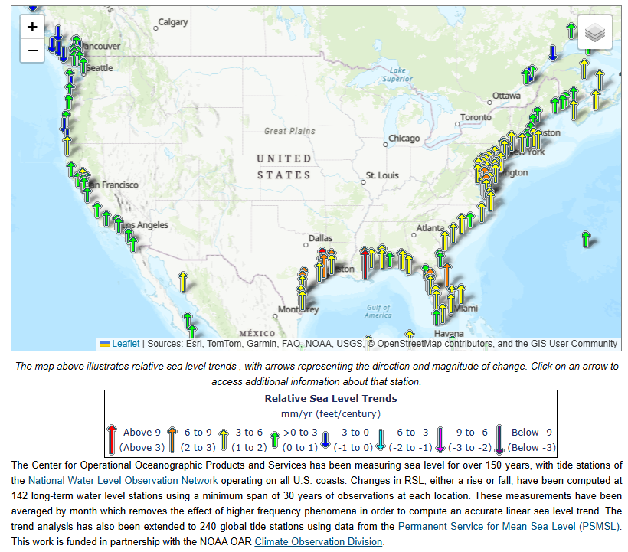
Relative Sea Level Rise
Notes:
https://tidesandcurrents.noaa.gov/sltrends/

Slide 8
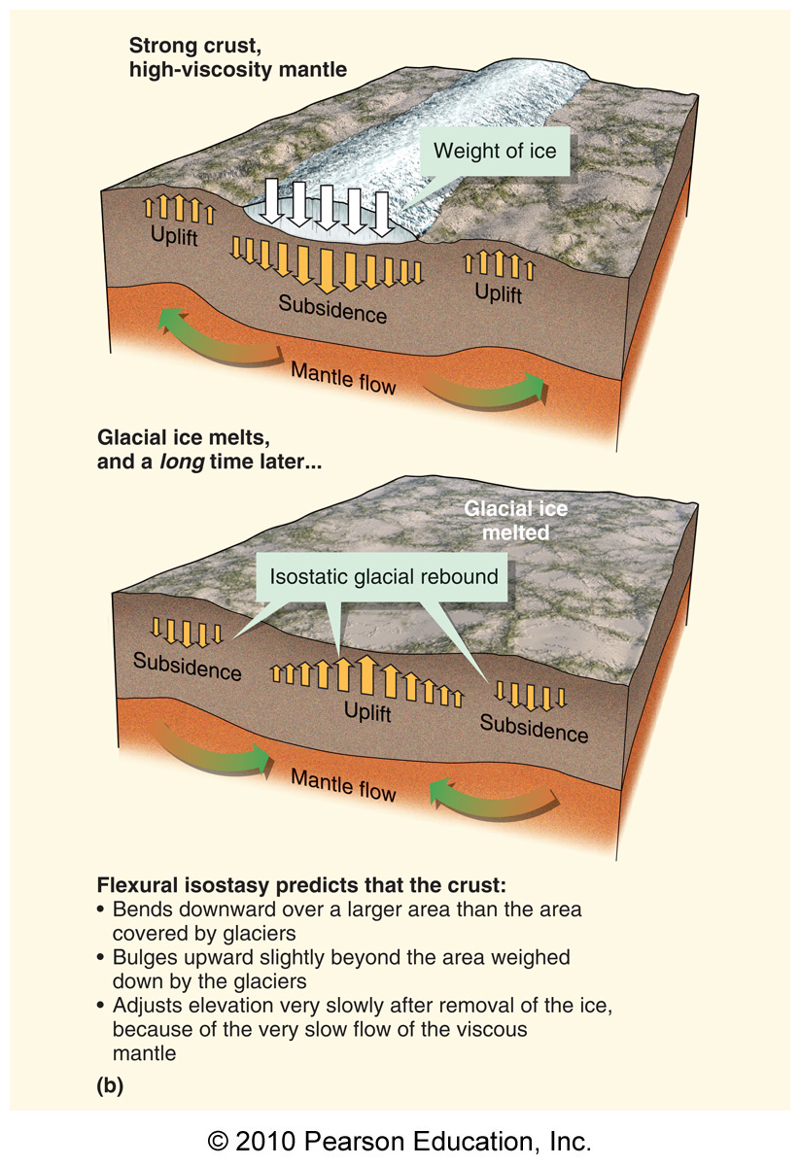
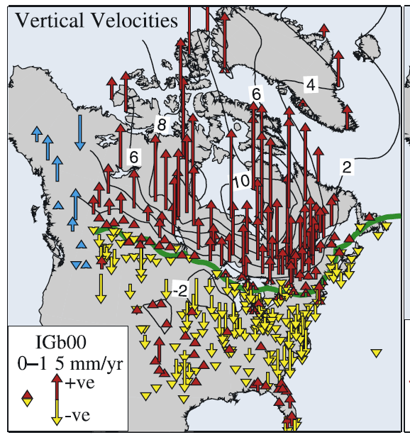

Stella et al, 2007. Observation of glacial isostatic adjustment in “stable” North America with GPS, Geophysical Research Letters,
Volume 34, Issue 2.
http://onlinelibrary.wiley.com/doi/10.1029/2006GL027081/abstract;jsessionid=DA93FD17B250792732B615F0D105C332.f01t03

Slide 9
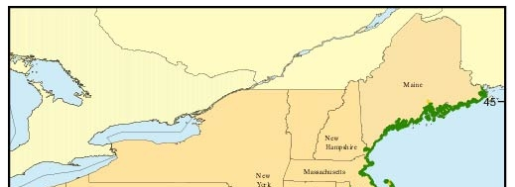
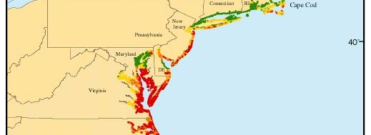
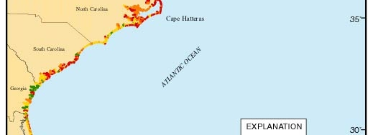
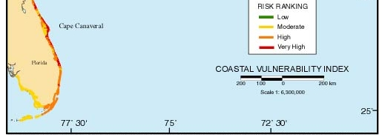
Map of Coastal Vulnerability Created by the USGS
Notes:
https://pubs.usgs.gov/of/1999/of99-593/pages/figpage/fig1.html
National Assessment of Coastal Vulnerability to Sea-Level Rise: Preliminary Results for the U.S. Atlantic Coast
U.S. Geological Survey Open-File Report 99-593
E. Robert Thieler and Erika S. Hammar-Klose Woods Hole, Massachusetts 1999

