Slide 1
Core Logging for Groundwater Investigations Using Graphical Shading Geologic Logs
Pre-lab lecture
Contributed as a Lab Activity to Teach the Earth by Jessica Meyer, University of Iowa
Development of these materials supported by ESTCP Technology Transfer grant ER23-7659

Slide 2
Core Logging for Hydrogeologic Investigations
Learning Objectives
Be able to describe why geologic data are needed for hydrogeology projects.
Become familiar with how we typically collect geologic data/information in hydrogeologic investigations.
Be able to explain some of the limitations of the standard approach to geologic data collection in hydrogeology.

Slide 3

Key Question
Why do we need geologic data for hydrogeology projects?
Notes:
The answer may seem obvious but often we focus entirely on geological controls on the permeability/hydraulic conductivity distribution in groundwater systems. However, the geology ultimately controls many important hydrogeologic properties and processes.

Slide 4
The 3-D Distribution of Geologic Materials Controls
The subsurface ‘plumbing’
  Porosity
  Permeability (pore size and structure)
  Compressibility
The distribution of reactive minerals and solid phase organic carbon
Permeability
Reactive
minerals &
organic carbon
Notes:
The geology controls the porosity (water storage) and size/structure of the pores (permeability). It also ultimately controls the compressibility of the materials which influences storage as well.
From a water quality perspective, the geology also controls, at least in some respects, the distribution or reactive mineral phases (some maybe formed post deposition related to groundwater flow but ultimately are still sourced from the solid phase geologic materials). These mineral phases may dissolve and contribute to the groundwater chemistry and/or they may react with dissolved phase constituents in the groundwater (e.g., contaminants).
The geology will also have a strong influence on the distribution of solid phase organic carbon in groundwater systems. This is important because many organic contaminants sorb to solid phase organic carbon.

Slide 5
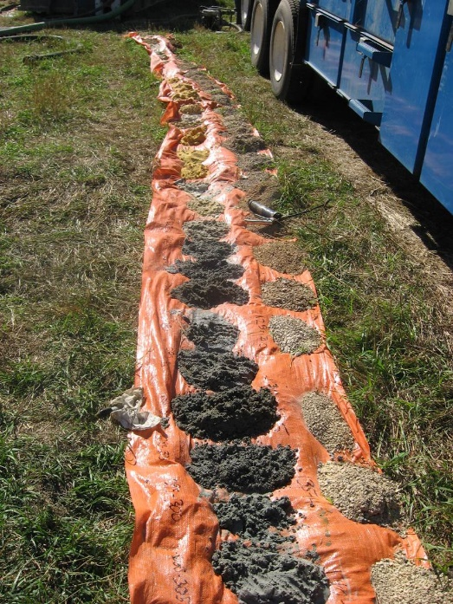
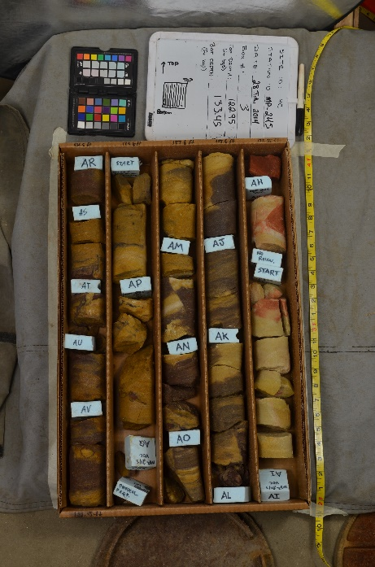
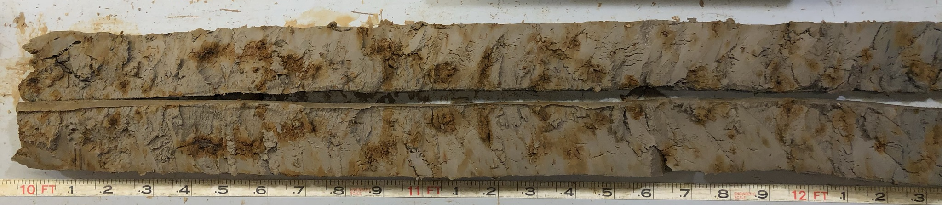
How Do We Collect Geologic Data?
Paleozoic bedrock cuttings
Afton, Minnesota
Ordovician bedrock core
Madison, Wisconsin
Drill cuttings
Cores
Inference from borehole/surface geophysics
Quaternary loess cores, Iowa City, Iowa
Notes:
The materials we are interested in are in the subsurface. So how do we get access?
We collect geologic data/information directly by making observations and measurements from drill cuttings and/or cores. We can also collect geologic data/information indirectly using direct push, borehole, and/or surface geophysical methods.
Typically we collect these data from boreholes/cores so we end up with a lot of 1-D data (data collected at different depths at a location).

Slide 6
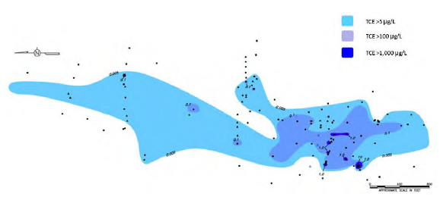
Sparse, 1-D Data is a Common Issue in Hydrogeology
The image shows a site with a trichloroethene (TCE) plume
The overall area of the site is ~ 1,700 m x 600 m
The max depth of investigation is ~ 12 m
Therefore, the total volume of investigation is ~ 12,240,000 m³
Example study site from Shultz et al., 2017
Borehole/well
Notes:
The image on the right shows the borehole/well distribution across a contaminated groundwater site.
Each of the small black circles is a borehole/well.
If you draw a rectangle around the area and consider that the maximum depth of investigation is ~ 12 m, then the volume of investigation is roughly 12,240,000 m³.
You are trying to characterize the hydrogeologic properties of that entire 12 M cubic meter volume but you only have geologic data from each of those little black circles.
Reference
Shultz, M.R., Cramer, R.S., Plank, C., Levine, H., Ehman, K.D., 2017. Best practices for environmental site management: A practical guide for applying environmental sequence stratigraphy to improve conceptual site models, 600/R-17/293, US EPA. DOI:https://cfpub.epa.gov/si/si_public_record_report.cfm?dirEntryId=341373&Lab=NRMRL.

Slide 7
Volume of a Typical Core Collected at the Site
Volume of a single core is ~ 0.06 m³
There are ~ 120 boreholes onsite so at most there were 120 cores collected.
The total subsurface volume sampled is 7.2 m³ or 0.0001% of the volume of interest
How do we fill in the blanks between the boreholes?
12 m
Diam. = 8 cm
Notes:
We are sampling a very small volume of the subsurface that we are interested in/need to characterize.
Note: core numbers are based off of a typical geoprobe core diameter of 3 inches.

Slide 8
2-D Geologic/Hydrogeologic Cross-Sections
Map View of Data Collection Locations
2-D Vertical Cross-Section Showing Grain Size Data
N
A
A’
A
?
?
?
?
Elevation
A’
Distance
clay/silt
core/cuttings data collection location
sand
gravel
Notes:
Often times we analyze/interpret our 1-D geologic data along 2-D vertical cross sections.
In order to do this, we look at the distribution of the core/cuttings locations in 2-D map view.
We are looking for data collection locations that are roughly arranged along a line like the A-A’ cross-section line showed above.
We then take the data (this example shows grain size data but it could be any data) from each of the locations that fall on or very near that line and we plot it along elevation on the z axis and distance along the line of section on the x-axis.
That plot is a 2-D vertical cross section.
Next, what we want to do is interpret how those grain size patterns we see in 1D at each location vary between the boreholes. We want to make a 2-D vertical cross-section view of the grain size distribution. What do those patterns look like?
So, how can we fill in the blanks?

Slide 9
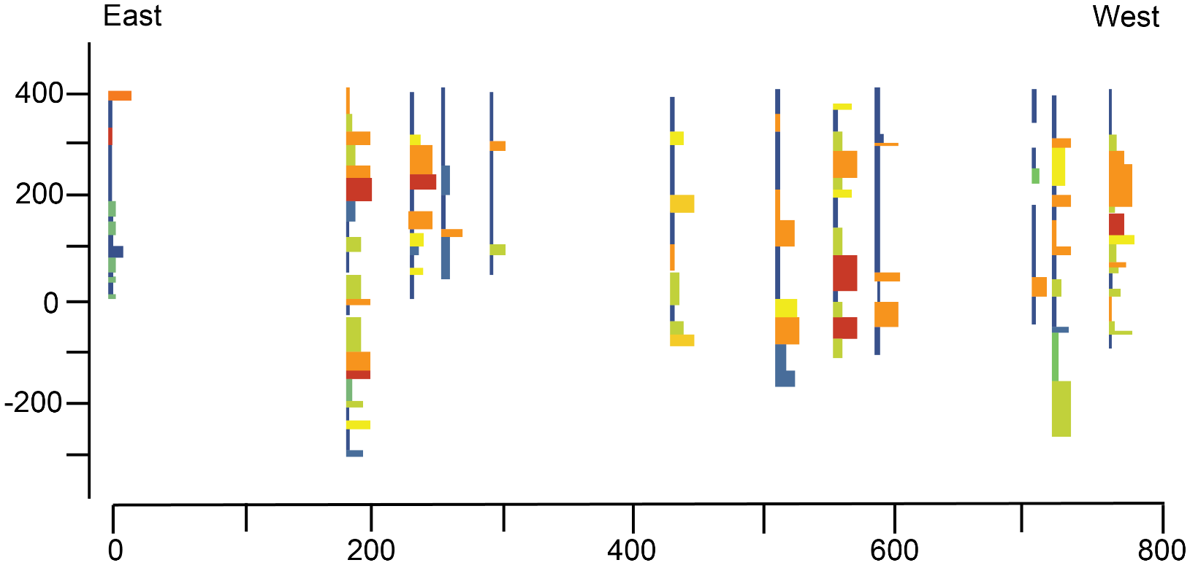
Common Approach in Hydrogeology to Interpreting the Geology Between Boreholes
Finer grained
from Shultz et al., 2017
Coarser grained
Notes:
Let’s look at an example from the TCE site. Here you see a cross section with grain size data spanning from east to west across that site. The warmer colors are coarser grain sizes and the cooler colors are finer grain sizes.
Reference
Shultz, M.R., Cramer, R.S., Plank, C., Levine, H., Ehman, K.D., 2017. Best practices for environmental site management: A practical guide for applying environmental sequence stratigraphy to improve conceptual site models, 600/R-17/293, US EPA. DOI:https://cfpub.epa.gov/si/si_public_record_report.cfm?dirEntryId=341373&Lab=NRMRL.

Slide 10
Connect Like Grain Size/Lithology at Similar Elevations
Layer of coarser grained sediments
Finer grained
from Shultz et al., 2017
Coarser grained
Notes:
The common approach in hydrogeologic investigations is to essentially connect like grain sizes/lithologies the occur at similar elevations.
So, here you can see an interpretation of a ‘layer’ of sands and gravels occurring between about 400 and 200 m of elevation extending all the way from east to west across the site.
Reference
Shultz, M.R., Cramer, R.S., Plank, C., Levine, H., Ehman, K.D., 2017. Best practices for environmental site management: A practical guide for applying environmental sequence stratigraphy to improve conceptual site models, 600/R-17/293, US EPA. DOI:https://cfpub.epa.gov/si/si_public_record_report.cfm?dirEntryId=341373&Lab=NRMRL.

Slide 11
Questions You Should Ask About this Interpretation
How do you know those sand bodies are related?
Why does the thickness of the sand unit pinch and swell?
Why does the dip of the unit vary so much across the section?
What geologic process created this coarse-grained unit?
Notes:
The big question we need to ask ourselves is does the data and geologic context for this area support this interpretation. Is it geologically realistic?

Slide 12
Depositional Processes Control Key Features of Sediment Bodies
3-D geometry
Length scales
Connectivity
Spatial distribution relative to one another
Notes:
If we understand the processes that formed the sediments, then we’ll have a basis for interpretating/predicting key features of sediment bodies like the ones you see here.
But we need more than just basic lithology or gain size data in order to understand the depositional processes that formed the sediments.

Slide 13
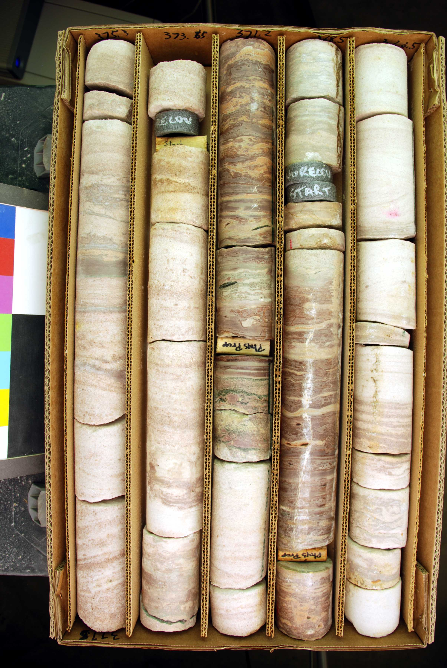
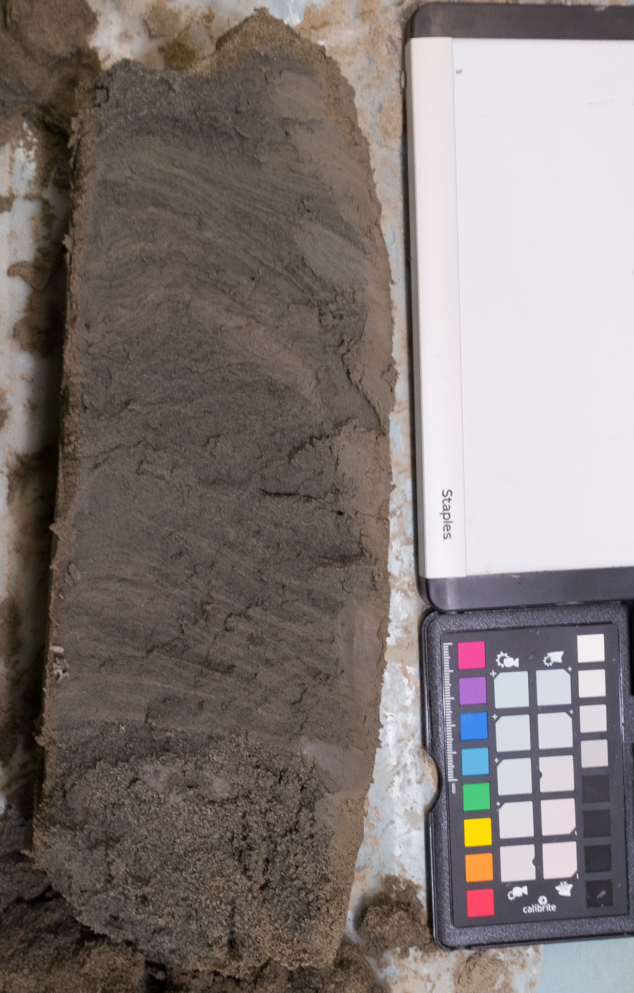
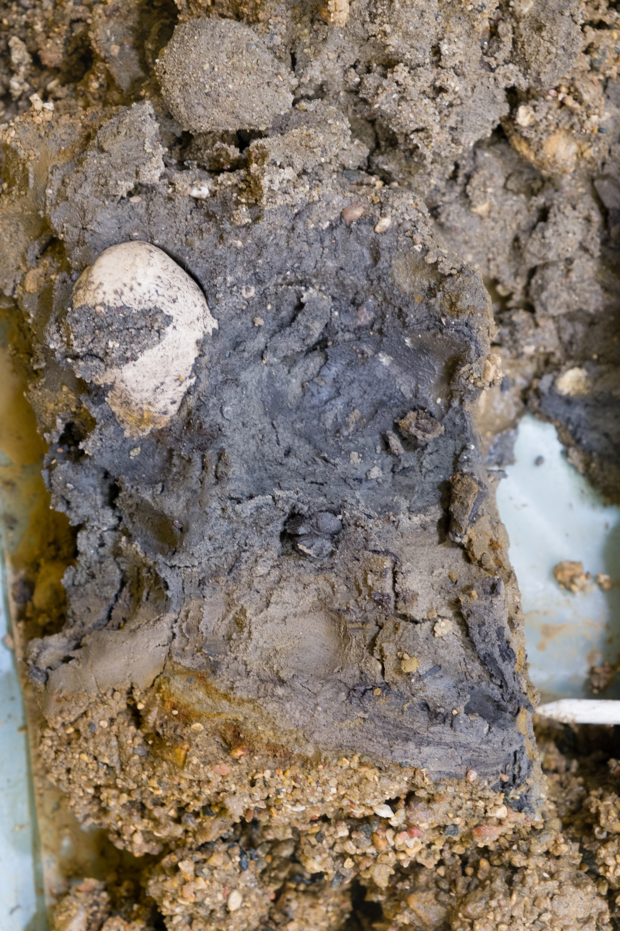
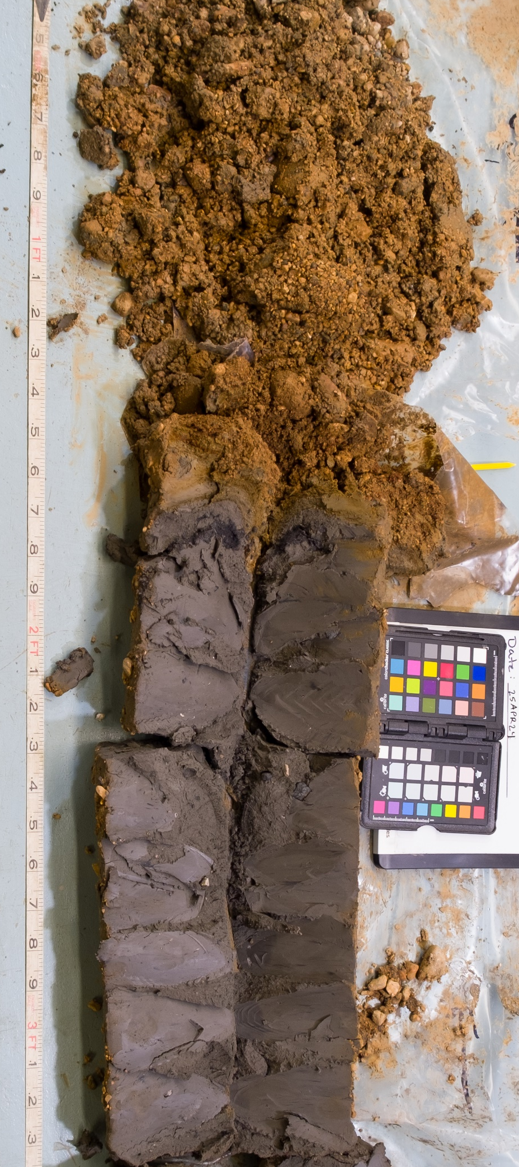
What Data Are Needed to Interpret Depositional Processes?
vertical grain size trends
sorting
sedimentary structures
contact relationships

Slide 14
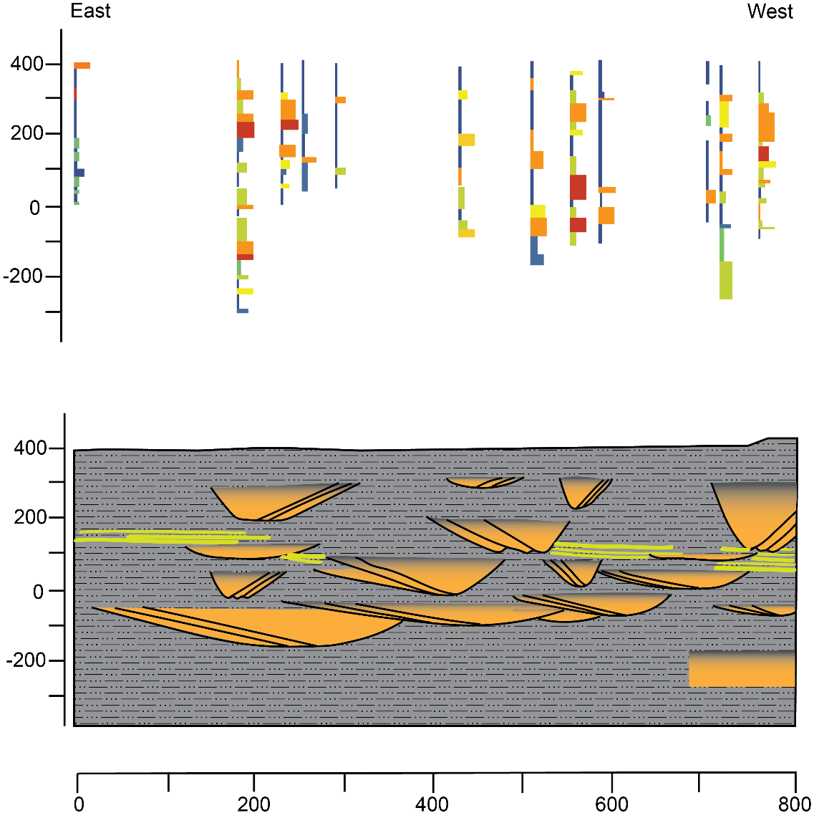
Process Based Interpretations Improve Accuracy of
Geologic Models
Layer of coarser grained sediments
from Shultz et al., 2017
Notes:
Here what we see in the bottom panel is an alternative interpretation of the same data.
You can see that the coarser grained units are not laterally extensive (i.e., they aren’t flat layers). They are actually channelized sand bodies created by a fluvial system. These channelized sand bodies are ‘embedded’ in the finer grained overbank/flood plain deposits. Groundwater flow would occur quite differently through these channelized sand bodies than it would through one continuous flat lying layer of sand.
The alternative interpretation relies on:
A broad understanding of the depositional setting for the site. This is typically based on existing geologic literature/mapping.
Site specific data that extends beyond simple grain size/lithology and includes parameters that help us interpret geologic processes occurring at the site.
Training in sedimentology/stratigraphy that helps these professionals recognize patterns that are comment in different depositional environments.
We don’t all necessarily have advanced training in sedimentology/stratigraphy but we can all collect the basic observational data needed to support these interpretations.
Reference
Shultz, M.R., Cramer, R.S., Plank, C., Levine, H., Ehman, K.D., 2017. Best practices for environmental site management: A practical guide for applying environmental sequence stratigraphy to improve conceptual site models, 600/R-17/293, US EPA. DOI:https://cfpub.epa.gov/si/si_public_record_report.cfm?dirEntryId=341373&Lab=NRMRL.

Slide 15


How Do We Collect Geologic Data?
How do we record the data?
What type of data do we collect?
Notes:
When we are thinking about geologic data collection we can think about two aspects.
How we record the data
The type of data we collect

Slide 16
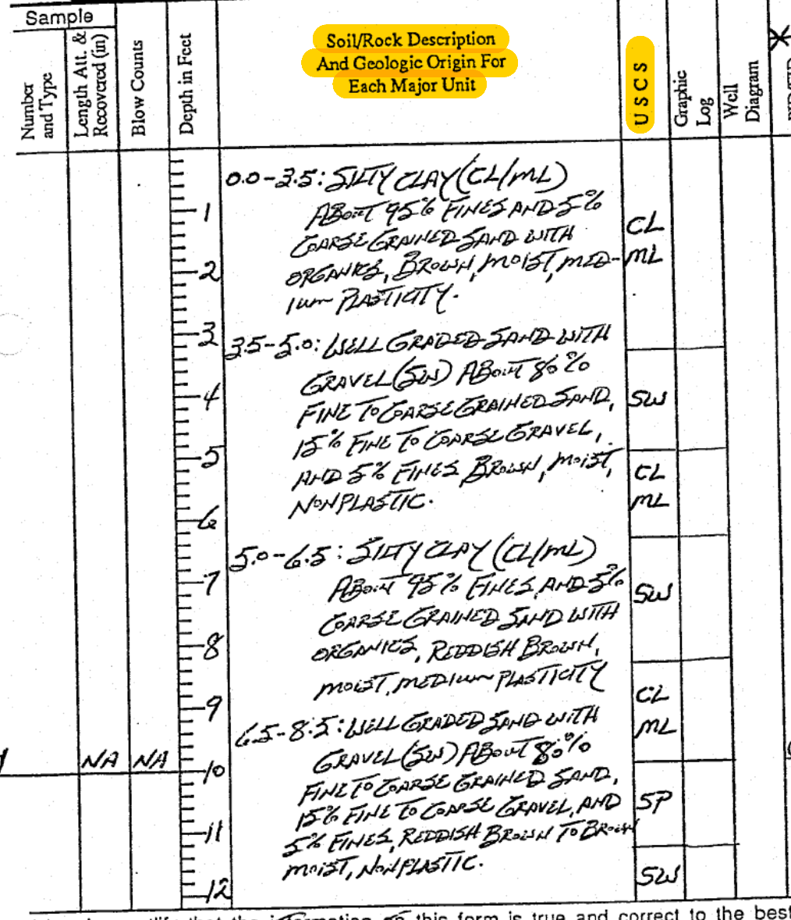
Standard Borehole Geologic Logging Form
The geologic materials are described in paragraph format along a depth scale
The only parameter specifically required by the logging sheet is the unified soil classification system (USCS) category
Notes:
This is a page from a standard borehole geologic log from a contaminated groundwater site.
You can see that the geologist has written descriptions of the geologic materials, in paragraph format, along the depth scale. These descriptions include information about the proportion of clay, silt, sand, and gravel in the sediment, the plasticity of the fine-grained materials, the color of the sediment, and the wetness of the sediment.
You’ll note that information like sorting, sedimentary structures, grain size trends, contact relationships are all missing.
The only piece of data the form explicitly requires is the USCS categorization. We will come back to that.

Slide 17
Limitations of the Standard
Borehole Geologic Logging Form
Long logging times often leading to incomplete logs
Inconsistent data capture
Loss of data for thin intervals
Text format does not facilitate real time decision making
Digitization is so inefficient it is nearly impossible
Geologic data/insight are never fully utilized
Notes:
There are a variety of issues with the format of this data collection sheet.
First, keep in mind that most geologist logging cuttings and cores for hydrogeology projects have to collect the data while the core is being drilled. That means, they are standing right next to the rig and have to keep up with the pace of drilling. For shallow investigations that might mean that the drilling crew is producing a core every 10 minutes (or even less). This is very different than many sedimentology projects where cores are collected and then taken back to a lab or warehouse to be logged.
Writing out paragraph descriptions is very time consuming. That often leads to incomplete logs.
The format of the data collection form doesn’t provide any guidance for what parameters should be described or the relevant values for those parameters. As a result, the data are often very inconsistent.
Paragraph descriptions for thin intervals or very complex intervals are hard to ‘squish’ along the depth scale. So, often times these thin intervals get lumped together with the intervals above or below.
Its very difficult to use these data once they are collected. If you want to understand how the grain size is changing with depth you have read through every single paragraph.
Imagine your supervisor at work handed you a stack of 100 of these logs. Each log has 5 pages of information. They want you to digitize all of the data in the paragraph descriptions. If you imagined that scenario you are probably feeling a bit panicked/overwhelmed right now because just by looking at the data you can see how hard it would be to digitize. The difficulty with digitizing this information mean that most often times is just gets scanned to pdf and put in the appendix of a report and is never really used.
So – the standard data collection form doesn’t really facilitate collection of the type and quality of data we need. So, we are going to learn to use a different format.

Slide 18
What Type of Data Do We Record?
Notes:
Often times hydrogeologic investigations prioritize collecting data that allows us to categorize the sediments based on the USCS system.

Slide 19

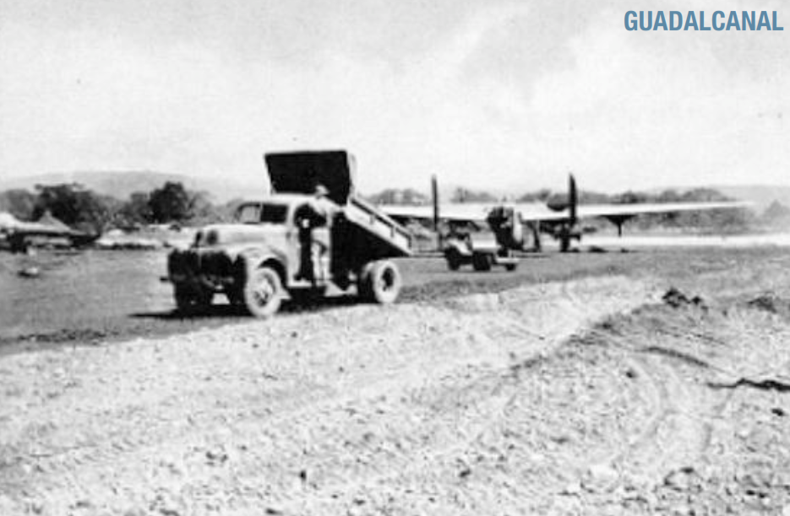
Unified Soil Classification System (USCS)
USCS categorizes unconsolidated sediments for engineering purposes
Notes:
The "Airfield Classification System" was developed in the early 1940s by Arthur Casagrande in response to the need for rapid construction of military installations and is based on soil particle size and plasticity values, or more broadly, the engineering properties of the sediments.
In 1952, after several US government agencies adopted a modified version of the system it became the USCS

Slide 20
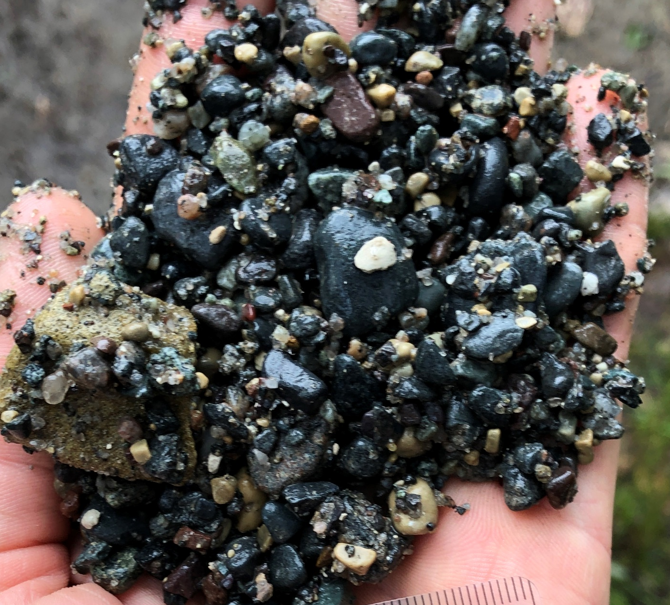
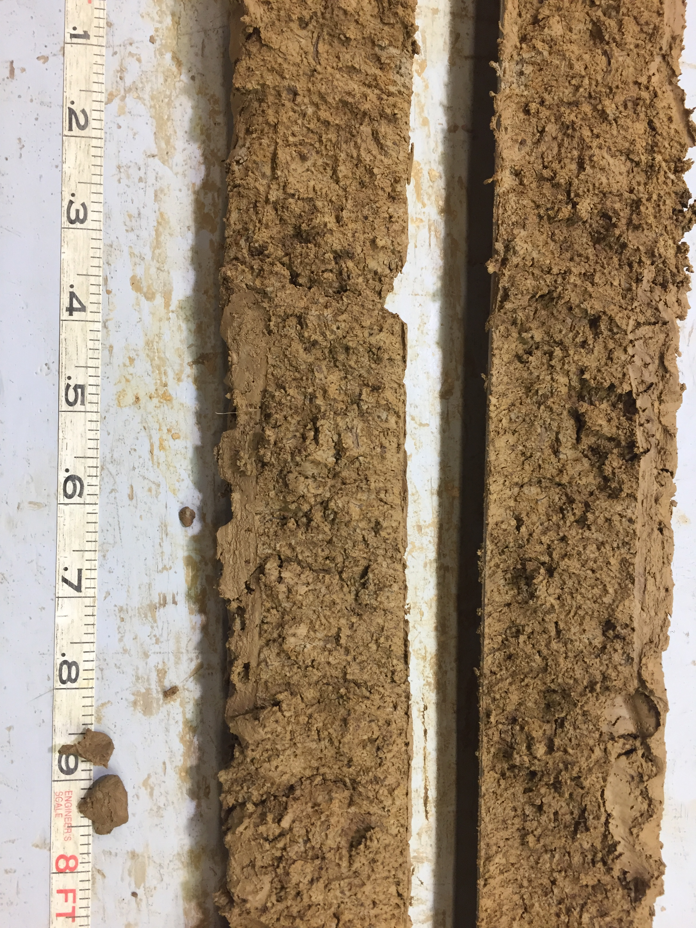
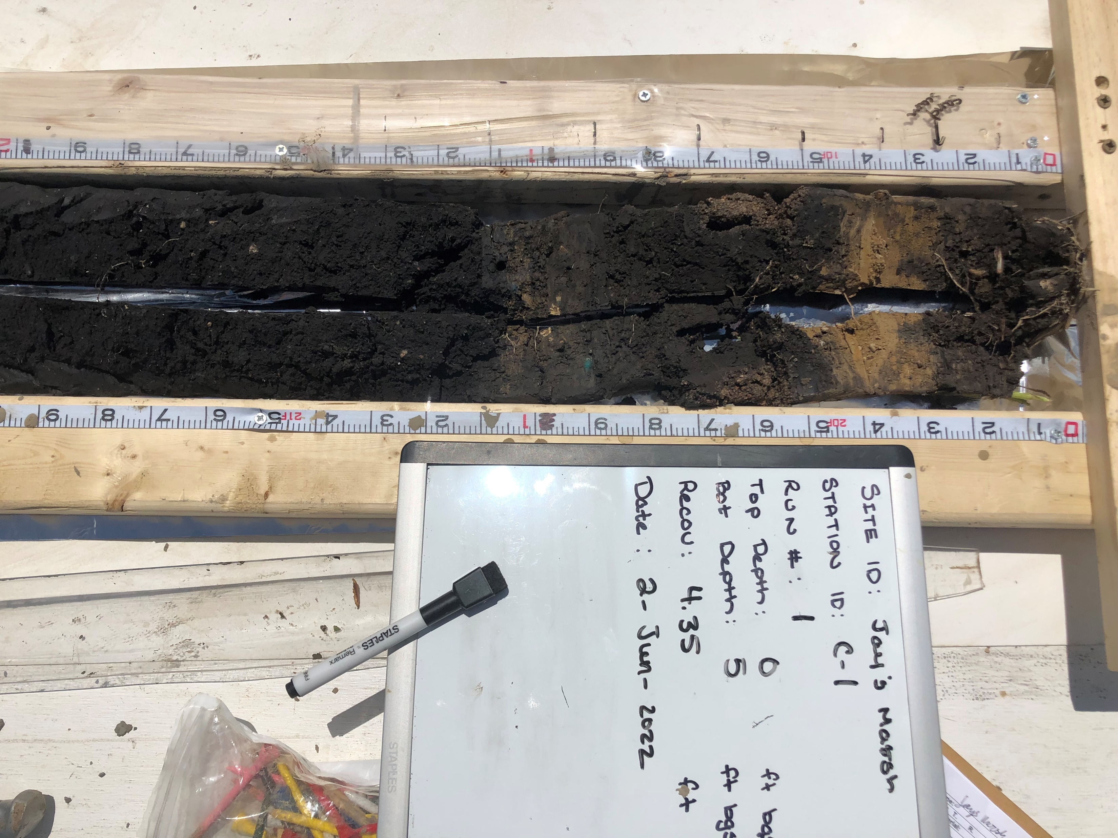
USCS Groups Sediments into
3 Broad Categories
Coarse-Grained Soils
Primarily sand and gravel
Fine-Grained Soils
Primarily silt and clay
Highly Organic Soils
Primarily organic matter
Notes:
You can take an entire class focused on USCS classification.
From a basic perspective USCS groups sediments into 3 broad groups
Coarse grained soils (sands and gravels)
Fine grained soils (silts and clays)
Highly organic soils
We’ll focus on these on the coarse and fine grained soils

Slide 21
well-graded gravels
silts (or mixtures of clay, silt, very fine sand)
low plasticity
poorly-graded gravels
Low plasticity
clays (or mixtures of clay with silt, sand, or gravel)
medium plasticity
Gravels
Coarse-Grained Soils
silty gravels
Fine-Grained Soils
silts or silty clays
low plasticity
clayey gravels
well-graded sands
Silts or fine sandy or silty sediments
medium to high plasticity
poorly-graded sands
clays
high plasticity
High plasticity
Sands
silty sands
clays or silts
medium to high plasticity
clayey sands
Notes:
Coarse grained soils are separated first into sands and gravels, then based on whether or not they include fine grained particles, and finally based on grading.
Fine grained sediments, silts and clays are categorized first based on their plasticity, and then based on whether they are inorganic or organic, and finally based on the mixture of grain sizes.

Slide 22
A Note on the term Gradation in the USCS
Well Graded Soil (geologic term = poorly sorted)
  No sizes lacking or no excess of any size range
Poorly Graded Soil (geologic term = well sorted)
  Skips grades or excess of certain size ranges
Gap Graded Soils (geologic term = bimodal)
  Soil that has an excess or deficiency of certain particle sizes or a soil that has ate least one particle size missing
Notes:
Its important to explain that the term ‘gradation’ in the USCS (or engineering in general) is essentially the opposite of sorting (the more common term in geology).

Slide 23
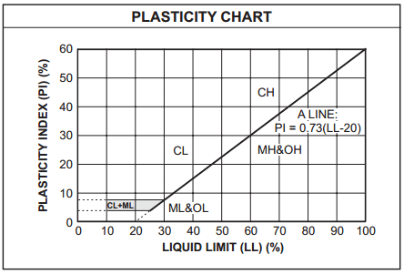
USCS Plasticity
Fine grained sediments are further described by plasticity
Plasticity is the ability of a material to undergo permanent deformation under stress without cracking. Fine-grained soils become plastic as their moisture content is increased, leading to loss in shear strength and stability.

Slide 24
well-graded gravels
silts (or mixtures of clay, silt, very fine sand)
low plasticity
poorly-graded gravels
Low plasticity
clays (or mixtures of clay with silt, sand, or gravel)
medium plasticity
Gravels
Coarse-Grained Soils
silty gravels
Fine-Grained Soils
silts or silty clays
low plasticity
clayey gravels
well-graded sands
Silts or fine sandy or silty sediments
medium to high plasticity
poorly-graded sands
clays
high plasticity
High plasticity
Sands
silty sands
clays or silts
medium to high plasticity
clayey sands
Notes:
So, we end up with 14 basic categories for non-organic rich sediments.

Slide 25
GW
ML
GP
Low plasticity
CL
Gravel
Coarse-Grained Soils
GM
Fine-Grained Soils
OL
GC
SW
MH
SP
CH
High plasticity
Sand
SM
OH
SC
Notes:
These categories get represented by 2 letter codes.
The USCS system is very good at categorizing sediments based on their ENGINEERING PROPERTIES.
But, it was not really designed or intended to capture the data needed to interpret the 2-D and 3-D distribution of geologic materials in the subsurface. Rather, the USCS system often masks grain size variability and is missing other sedimentological parameters needed to inform these interpretations.

Slide 26
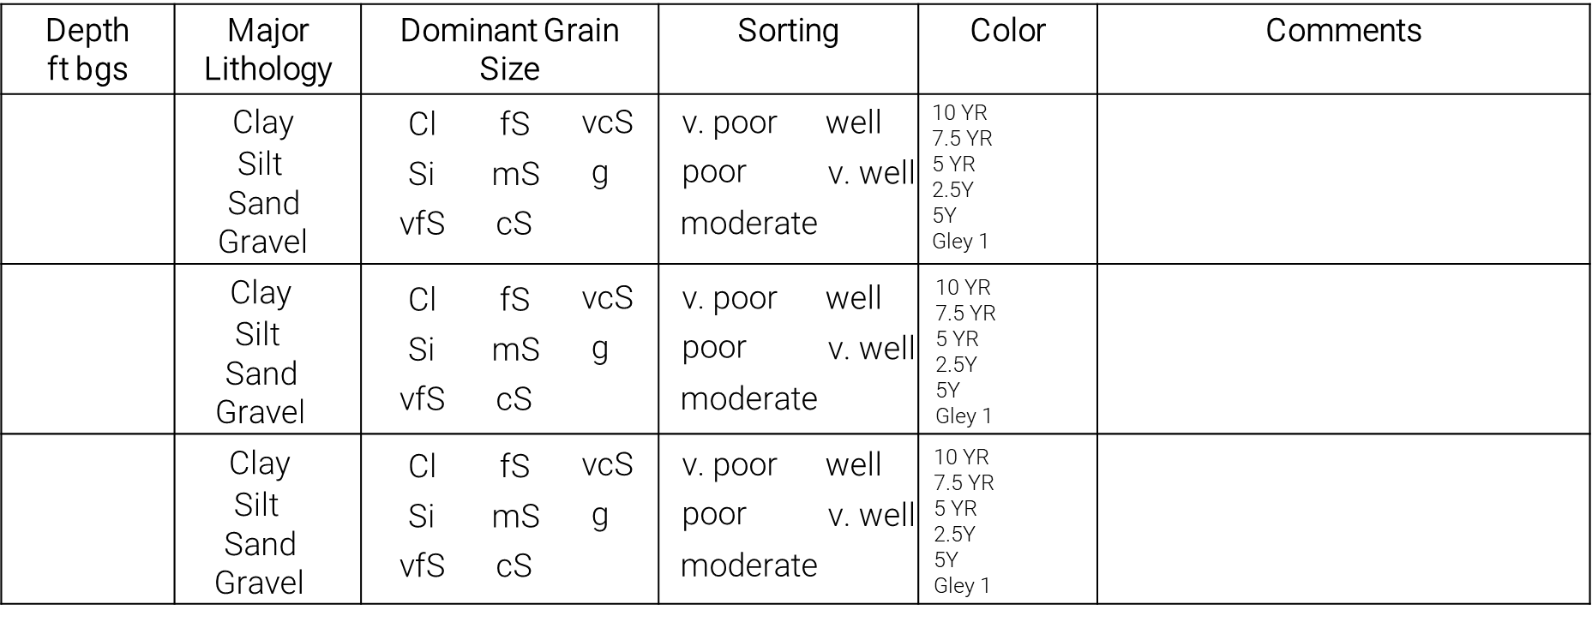
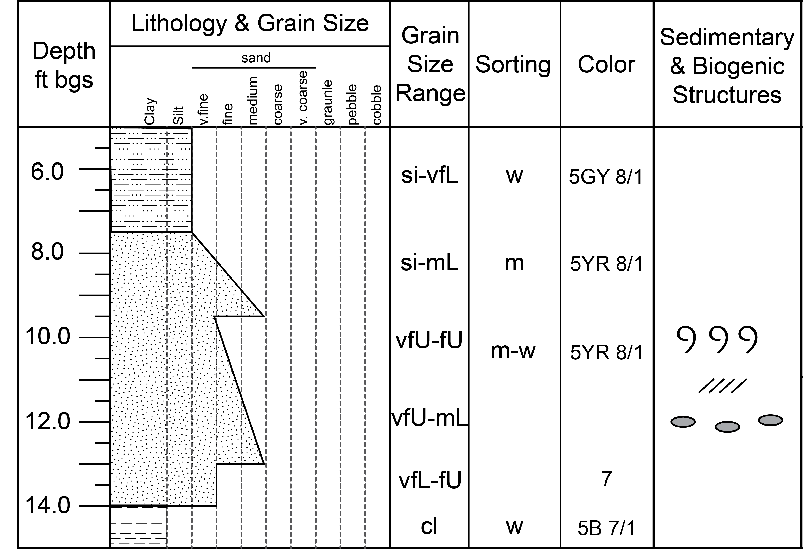
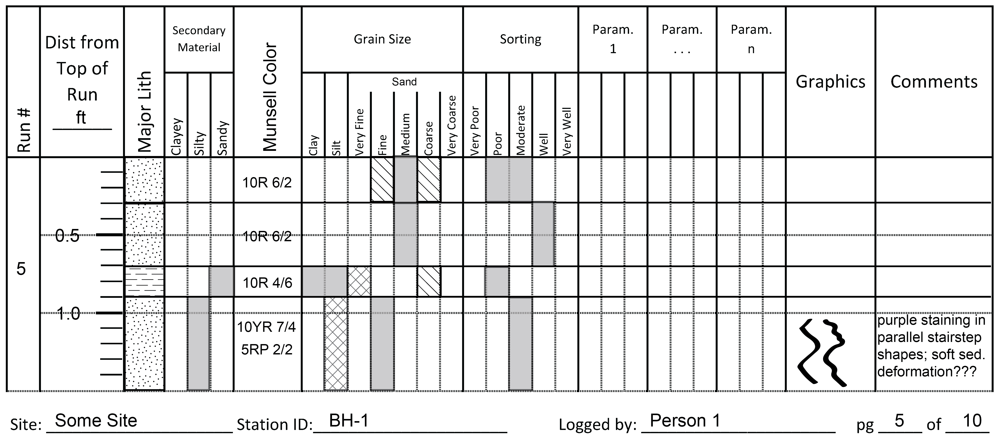
There are Alternative Geologic Logging Formats
Tabular
Graphic Log
Graphical Shading
Notes:
These alternative formats that facilitate collection of the type, quality, and resolution of geologic data needed to make accurate 2-D and 3-D interpretations. All have their own advantages and limitations.
Tabular formats just collect the geologic data/information in a table. They are very efficient, facilitate fast data collection, and help to ensure consistency. They are also easy to digitize or can be collected digitally in the field. Tabular formats also have some limitations. For example, trends in parameters with depth are not immediately apparent, you have to plot the data first. It can also be difficult to reflect which value is dominant, secondary, or trace when several values apply to an interval. Its also easy to lose your place when you are using a tabular format because the log doesn’t ‘look like’ the core and a lot of information tends to get collected in the comment field.
Graphic log formats are well established. They’ve been around since the 1960s. This is the format that is often used in sedimentological studies. They can be used to capture data at a variety of scales. They include a mix of plotting (grain size), patterns/symbols, and text to record the data. The benefits of a graphic log format include the fact that it looks like the core it represents so its easy to see where change is occurring and its also easy to keep your place as you log which enhances the accuracy of the log. You can collect a lot of information in a fairly compact format. You can use it to collect data at a variety of scales. The limitations of the graphic log include the fact that many parameters are still captured as text (harder to digitize and keep consistent), appropriate values are not provided for all parameters, it can be difficult to capture the properties for thin beds, and the mix of plotting, symbols, and text makes digitizing these logs slow.
In our lab, we are going to focus on a format called a graphical shading log that was developed specifically for use on hydrogeology projects.

Slide 27
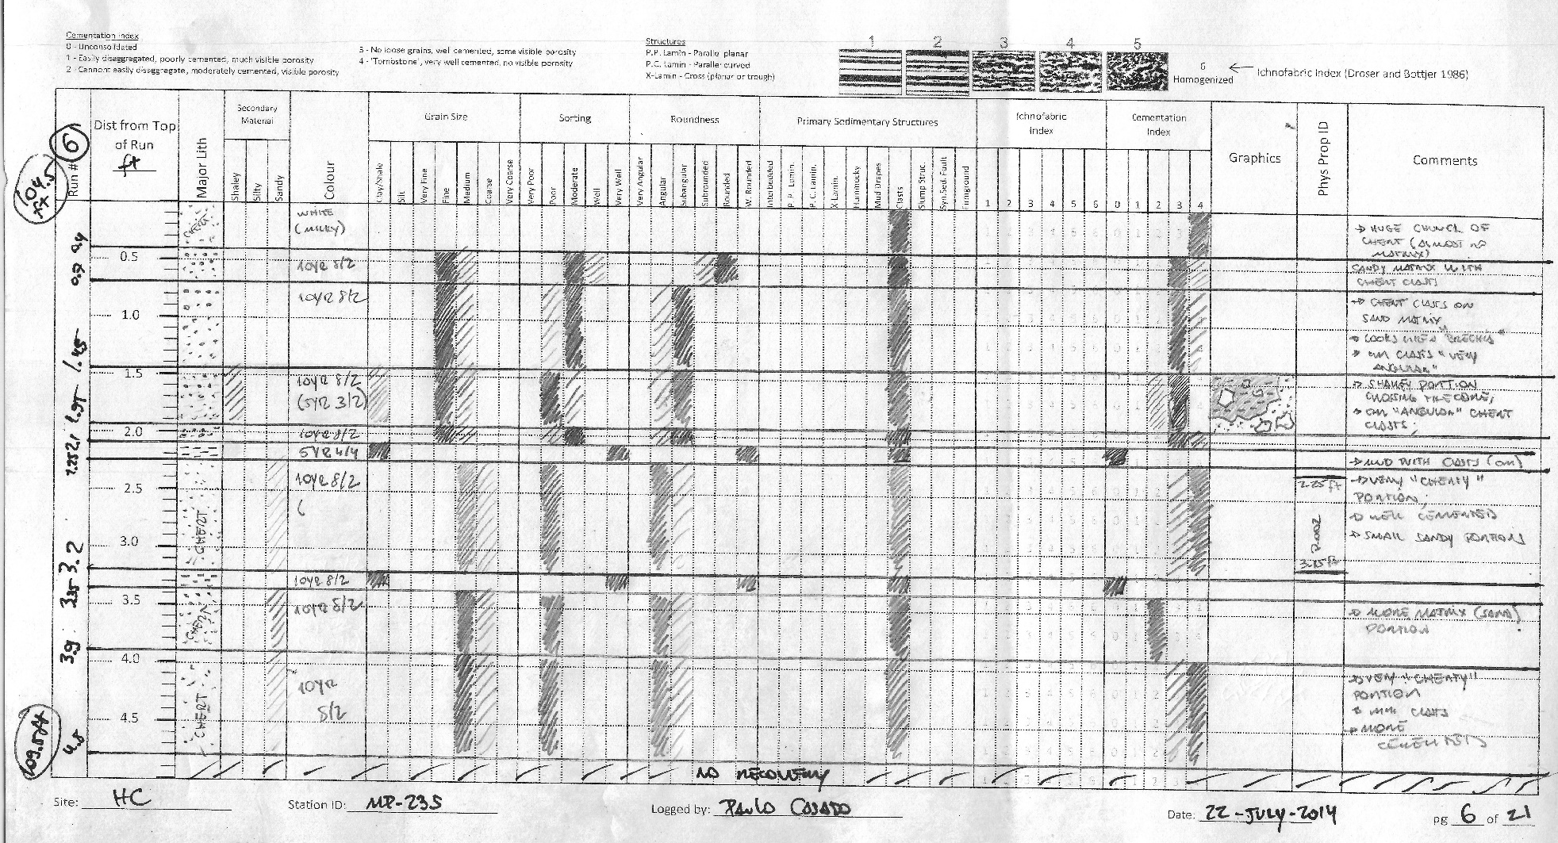
Attributes of a
Graphical Shading Log
Notes:
Data is collected to scale with a distance from the top of the run/depth scale included on the left side of the page.
All parameters to be logged are listed along the top of the page. The relevant values for each parameter are also provided. These choices change slightly depending on the depositional setting/environment responsible for the sediments you are logging. So, the logging sheets are customized for different depositional settings.
Horizontal lines drawn across the page are used to represent contacts observed in the core. Once the contacts are established the logger simply shades in the correct value for each parameter for each interval of core. Solid shading is used to represent ‘dominant’, cross-hatching is used to represent ‘secondary’ and diagonal hatching is used to represent ‘trace’. If the value spans two categories (or has equal contribution) then the logger shades in both values fully.
Thin intervals are relatively easy to capture because you are just shading in the boxes.
The format also makes it easy to see when you’ve forgotten to record a parameter because there will essentially be a ‘hole’ (i.e., blank space) in the log.

Slide 28
Benefits and Limitations of Graphical Shading Geologic Logs
Benefits
Limitations
Easily learned
Serves as a road-map for inexperienced loggers
Ensures consistent data collection
Fast and efficient
Immediately useful to decision making
More efficient to digitize
Not currently implemented in an app/digital tool
Requires some customization
Notes:
Benefits
Easily learned – no complicated symbology to learn, loggers aren’t trying to quantitatively graph parameters in the field, they are just shading in the appropriate values for each parameter
Serves as a road-map for inexperienced loggers – The log serves as a road-map by listing the parameters that are supposed to be logged as well as their relevant values.
Ensures consistent data collection – The fact that the parameters/values are consistently represented, that it's easy to see if a parameter has not been recorded (and correct the omission), and that its easy to capture data for thin intervals really ensures consistency in the data collected.
Fast and efficient – drawing contact lines and shading in boxes is very fast so that the bulk of the time available for logging the core can be spent observing, testing, and thinking about the core rather than writing paragraphs of information.
Immediately useful to decision making - Once the log is complete, you can immediately see how different parameters are varying with depth making the log useful for real time decision making.
More efficient to digitize – the consistent and graphical nature of the log facilitate digitization. There are also some programs that will essentially allow you to trace the log while capturing the values for each parameter in a tabular format in the background.

