Slide 1
U/Pb Dating Morgan Valley along the Wasatch Fault

Slide 2
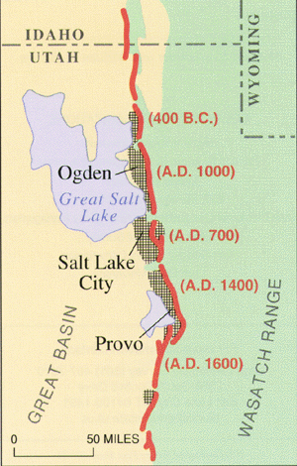
Wasatch Fault
Extension due to normal fault movement
Began ~10 million years ago
Still active today! Definite earthquake hazard

Slide 3
How quickly is this extension happening?
We get extensional basins where we had /have high mountains
As we make these basins (bowls/ low points) they get filled with sediments and can tell us the rate of extension
Recently we have done this for a basin in the Wasatch Back in Morgan Valley

Slide 4
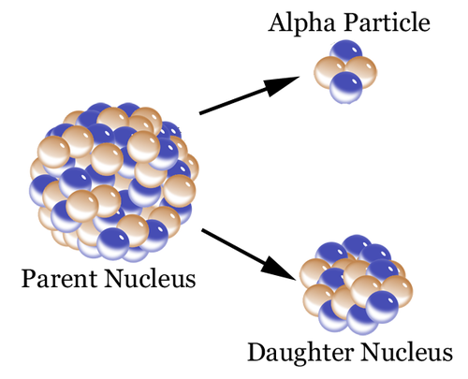
We use U/Pb ages!

Slide 5
Radiometric Dating
  Radioactive isotopes have unstable nuclear configurations.
  The decaying nucleus is called the parent, the nucleus into which it decays is called the daughter.
  Measure amount of parent/daughter and can measure amount of time that has passed

Slide 6
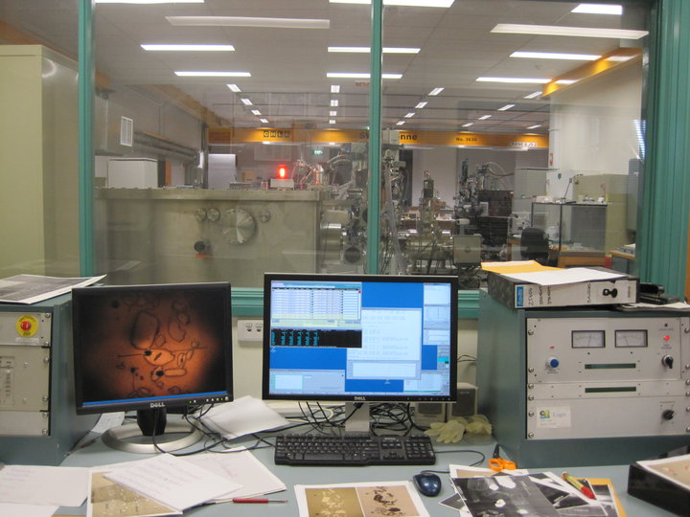
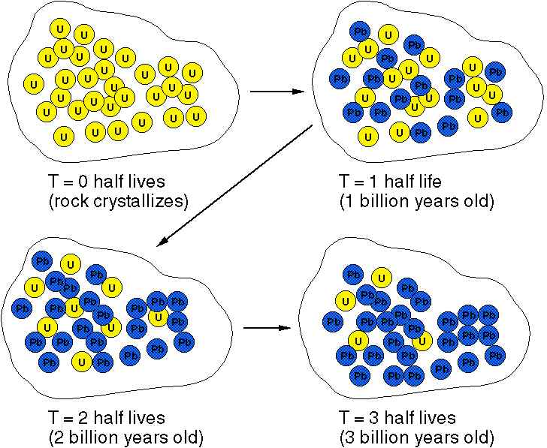
Determining Age
By measuring the parent/daughter ratio and knowing the half-life of the parent (which has been determined in the laboratory experiments) geologists can calculate the age of a sample containing the radioactive element

Slide 7
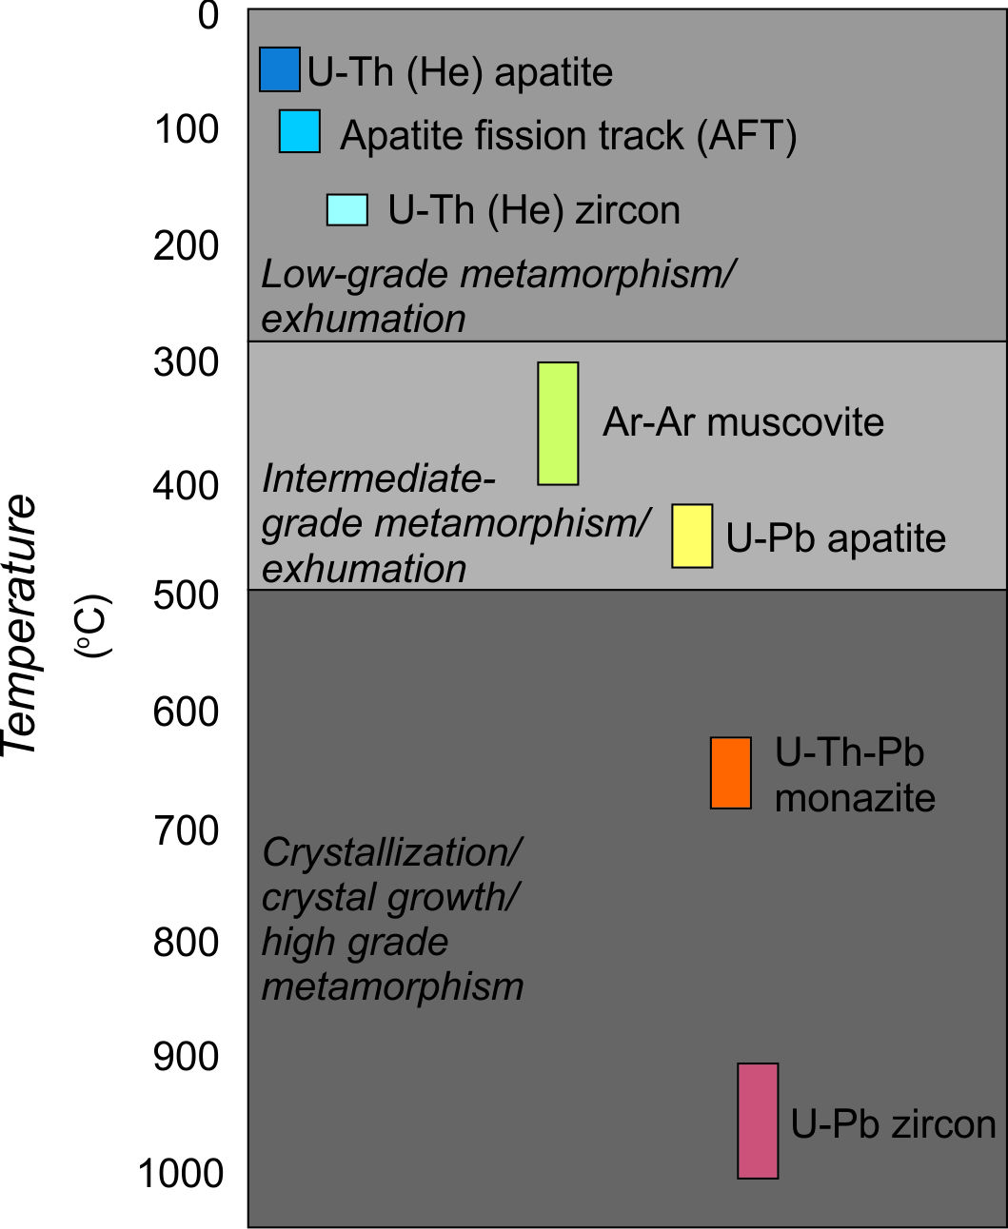
Geochronology
Geologist need to understand what they are trying to date in order to determine which isotopic system to utilize. Constraints include:
Composition of the rock and the minerals within/available
The general age of the rock you are trying to date
The temperature history of the rock - was it heated after it formed

Slide 8
What’s so special about Zircon, Zr(SiO₄)?
Common in intermediate and felsic igneous rocks
Resistant to weathering so relatively abundant in clastic sedimentary rocks
3. High closure temperature (doesn’t get reset easily, and when it does it leaves a mark so you can use that too)
4. Incorporates U but not Pb into its crystal structure.

Slide 9
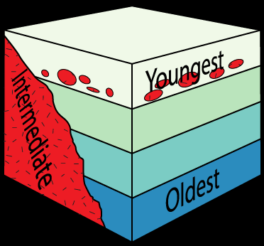
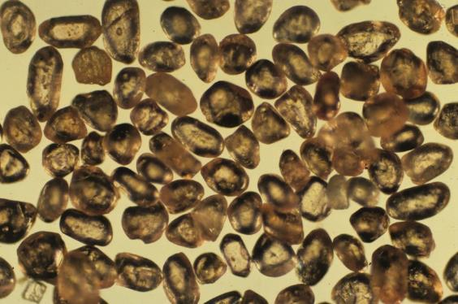
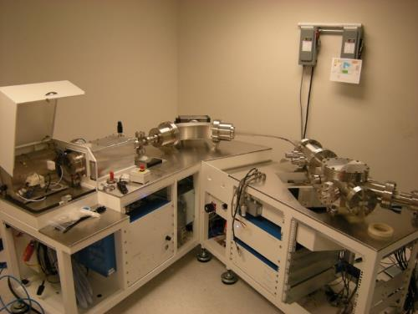
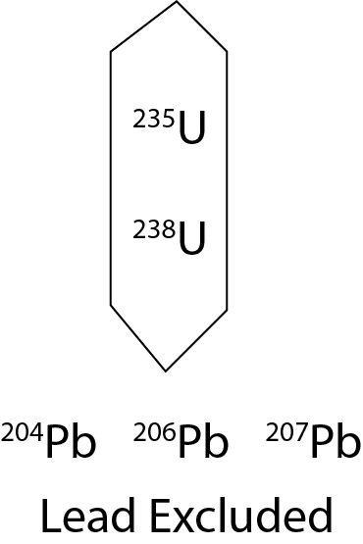
Zircon Geochronology: two U-Pb systems for the price of one (laser hole)
Law of Inclusion
Detrital Minerals (zircon or apatite)
ICP-mass spectrometer
Crystallization
Decay
Measurement
²³⁸U → ²⁰⁶Pb
²³⁸U
AGE
Half life = 4.468 x 10⁹
²⁰⁶Pb
²³⁵U → ²⁰⁷Pb
²³⁵U
AGE
Half life = 0.7038 x 10⁹
²⁰⁷Pb
Notes:
In terrestrial sedimentary rocks, we rely primarily analyzing Uranium and lead in detrital zircon crystals.
Zircon, shown here, is an accessory mineral commonly found in granites, diorites, and felsic to intermediate volcanics, and It is extremely resistant to physical and chemical weathering. Most importantly for geochronology, when zircon crystallizes, it includes large concentrations of Uranium, but excludes lead almost entirely. As a zircon ages, Uranium 238 and 235 decay into lead 206 with a half lives of 4 billion, and .7 billion years. As this happens, the lead is trapped in the crystal. To determine the age, we can measure the relative amounts of uranium and lead, and use the rate of decay to calculate the age of the crystal. Because there are two separate decay series, we can calculate two independent ages which makes this an extremely robust geochronometer.

Slide 10
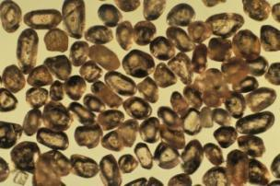
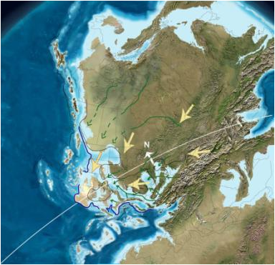
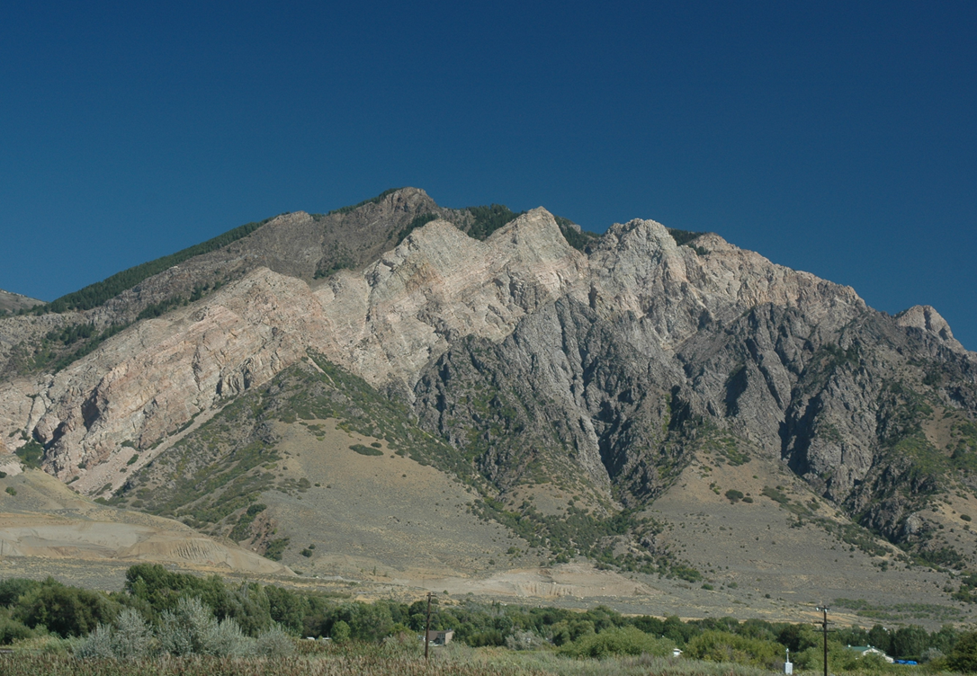
Zircon Geochronology Applications
Magmatic age
Timing of metamorphism
Provenance
Maximum depositional age (sed rocks)

Slide 11
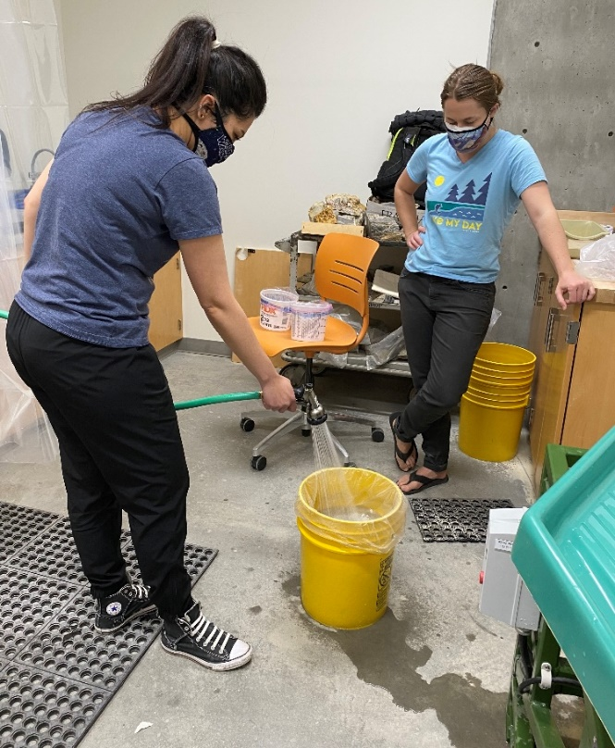
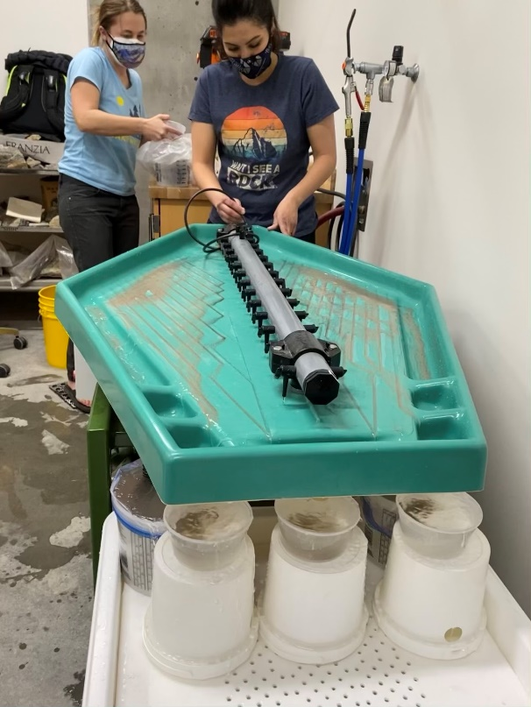
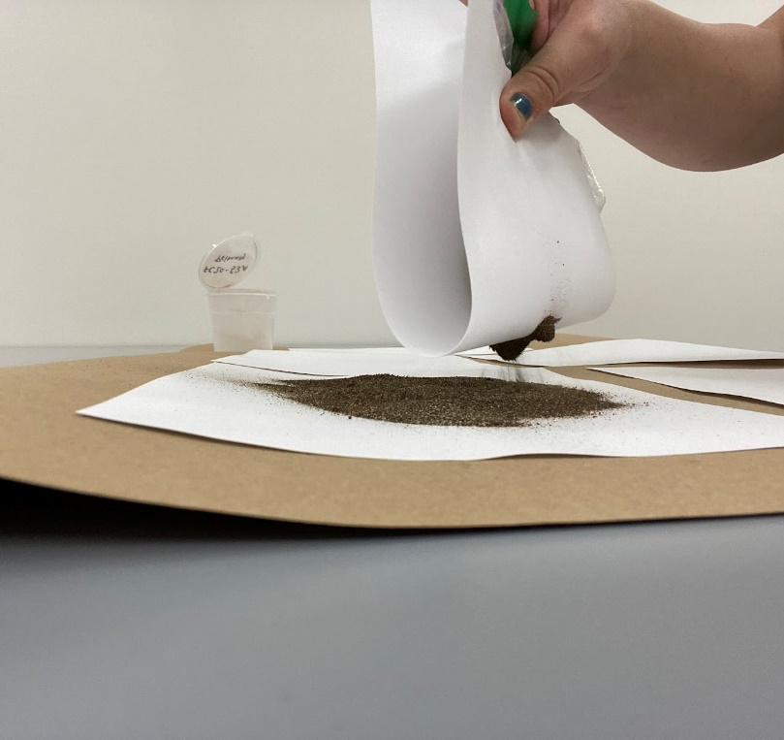
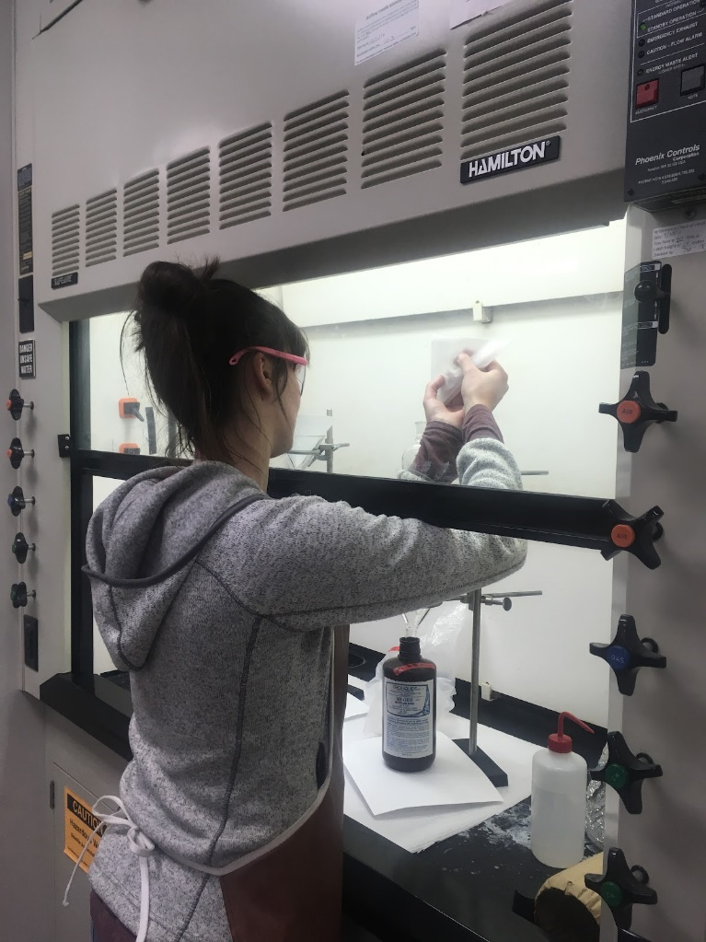
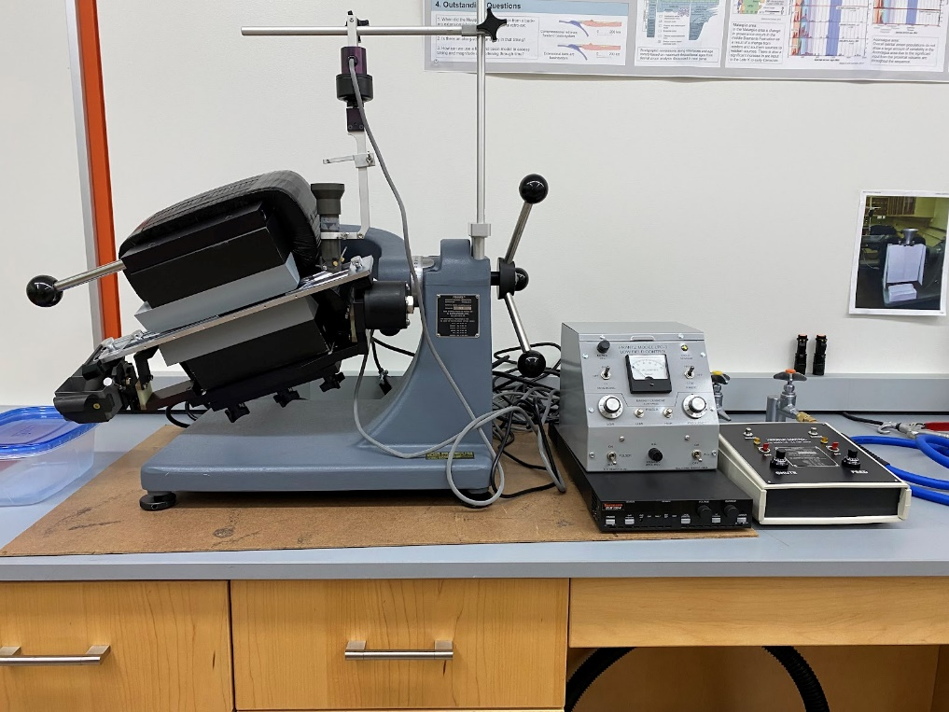
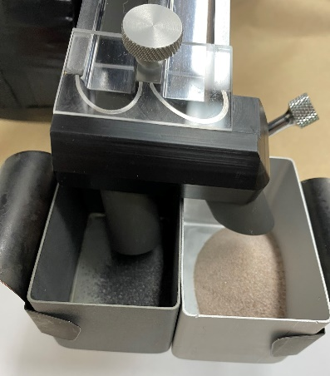
Processing the Samples and Trying Not to Bias (or contaminate) Along the Way…
We separate the zircons using its mineral properties:
Density separations (zircon is very dense)
Magnetic properties (zircon is nonmagnetic, many dense minerals are at least paramagnetic)
Going from a large sample to mounted zircon separates probably takes about ~12 hrs/sample

Slide 12
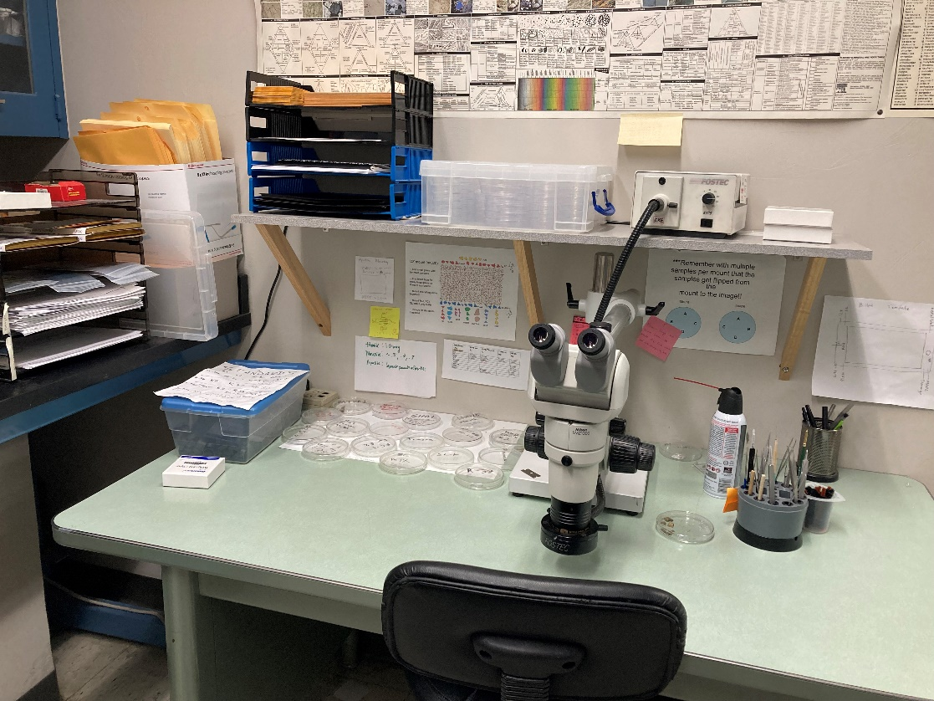
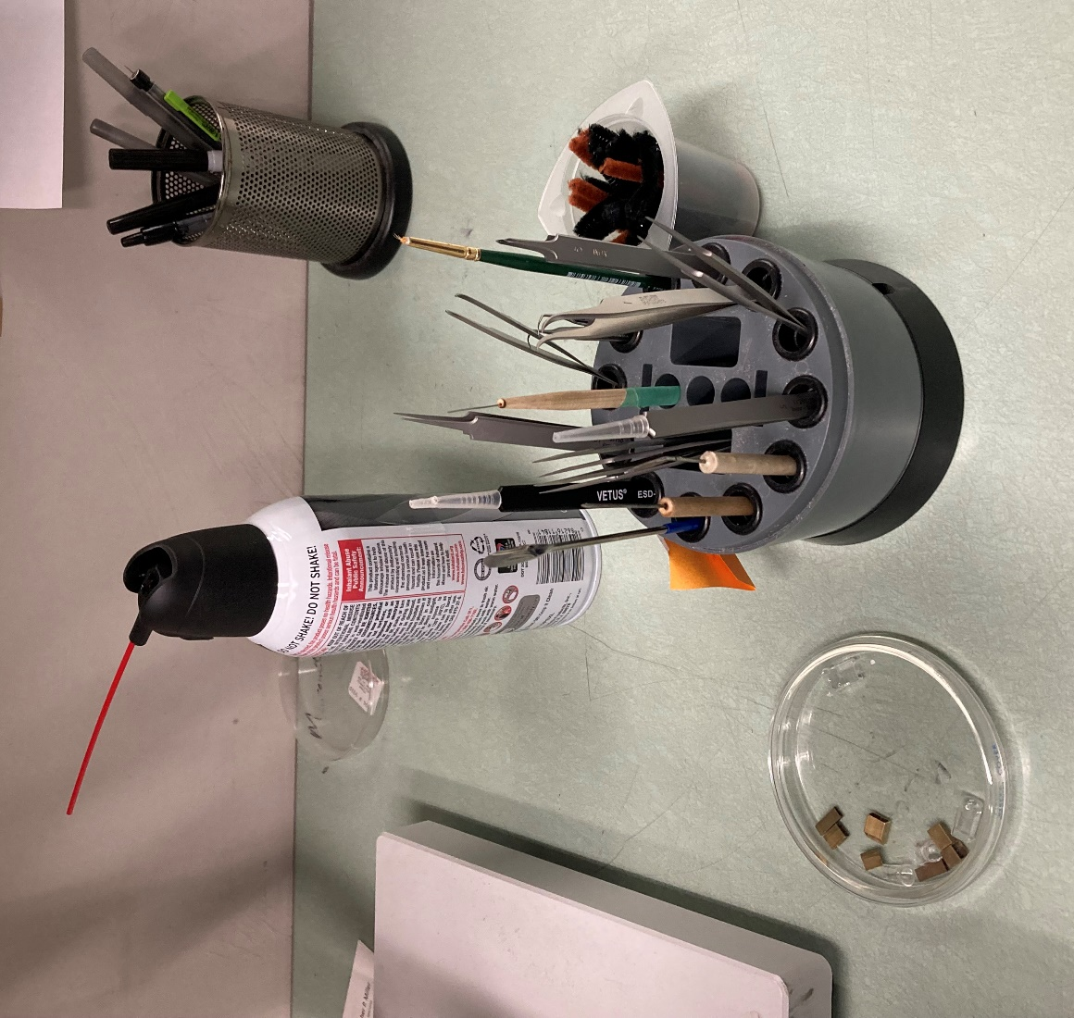
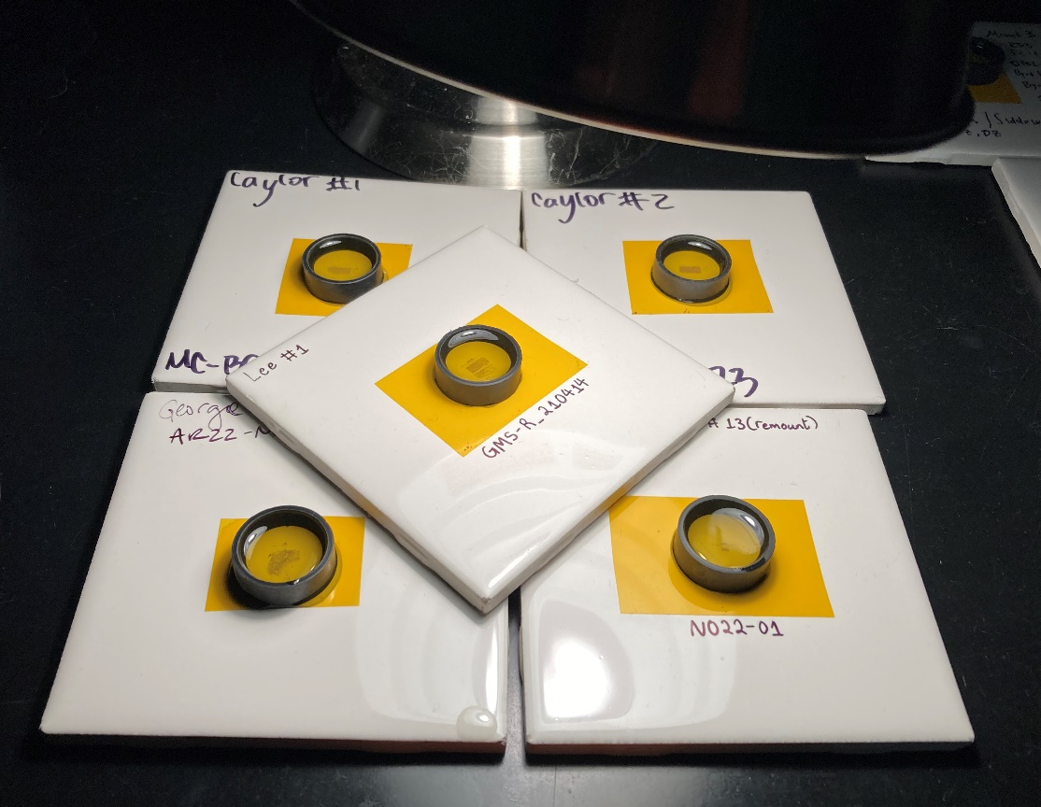
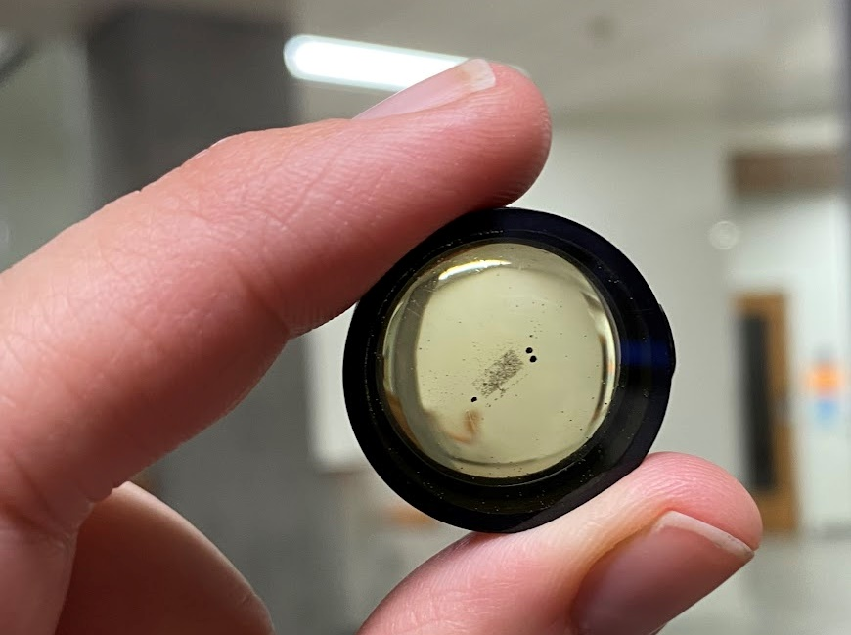
Mount Zircons in Epoxy
Zircon poured or picked under microscope Mount in epoxy
Polish to expose the grains
Image in various ways

Slide 13
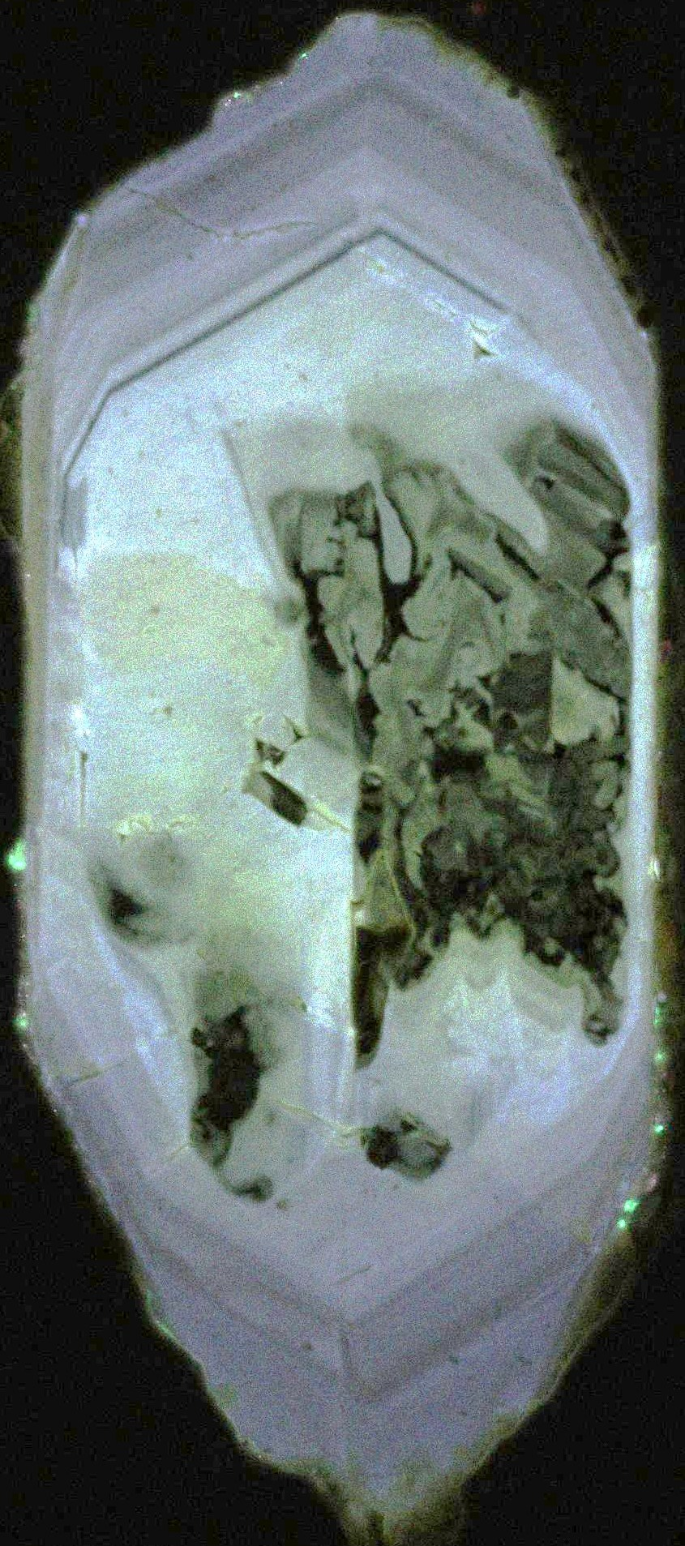
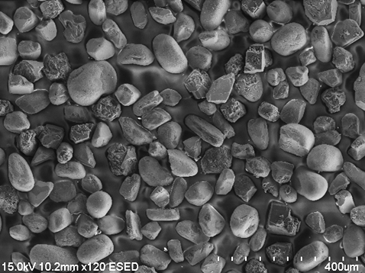
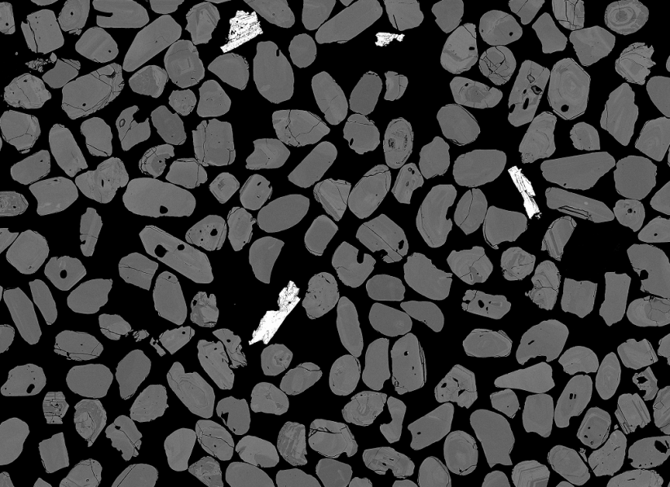
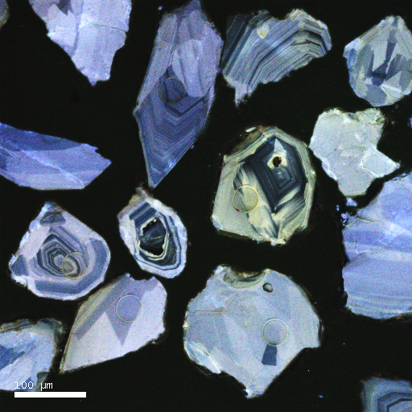
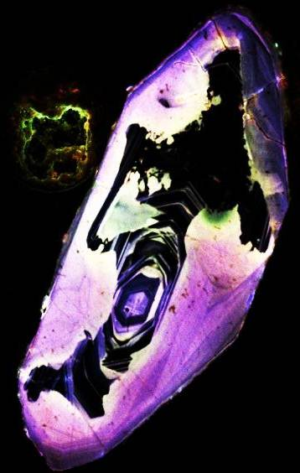
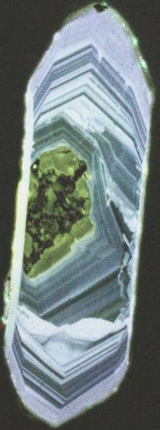
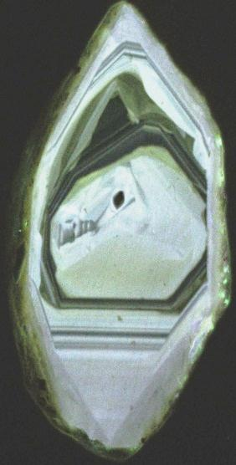
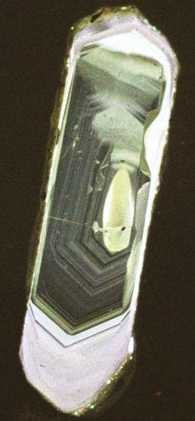
Imaging: Characterize Grains to Avoid (or Target) Complexities
SE image to characterize shape
BSE image for zonation & impurities
CL images for zonation
Notes:
what we know
and what we don’t know

Slide 14
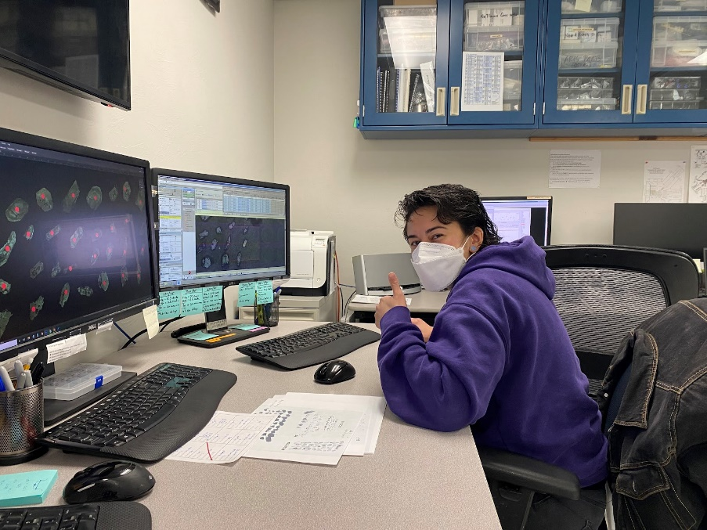
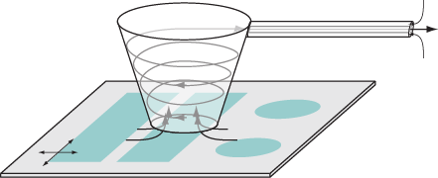
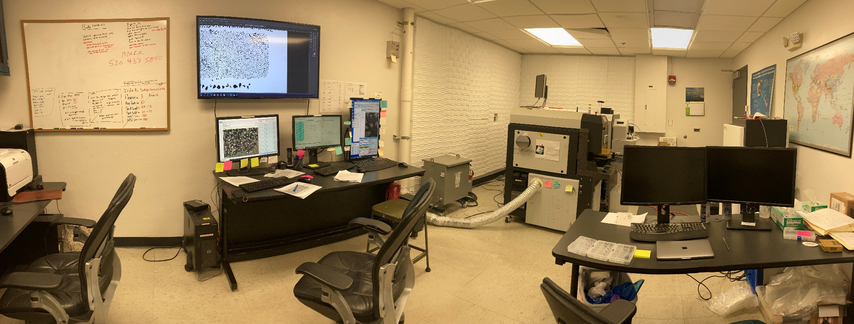
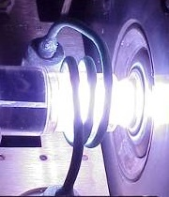
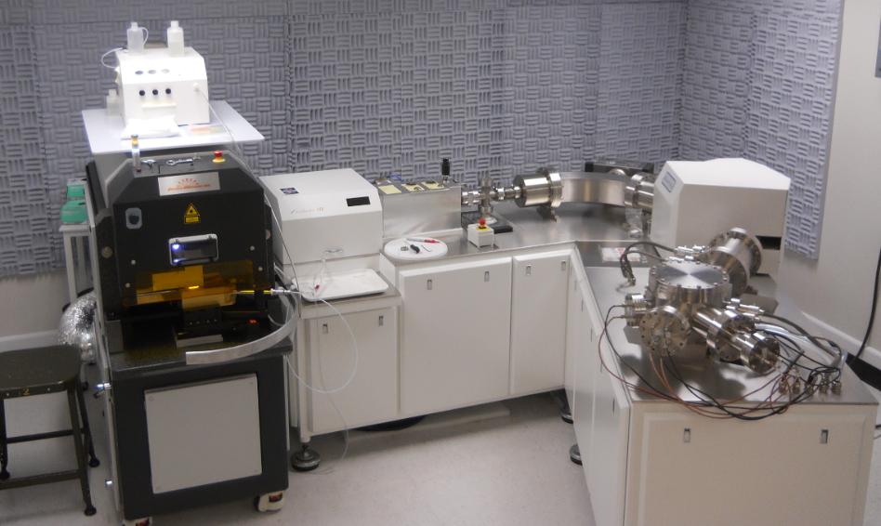
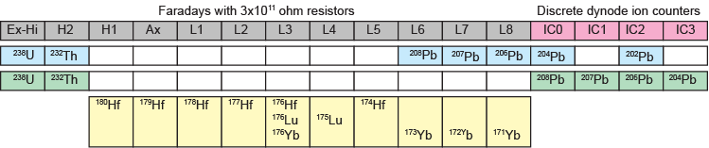
Nu Instruments HR LA ICPMS at the UA Laserchron Center
(diagram from A. Kylander-Clark)
Atoms, molecules, glass, zircon shards, etc. into plasma, charged ions enter mass spec.

Slide 15
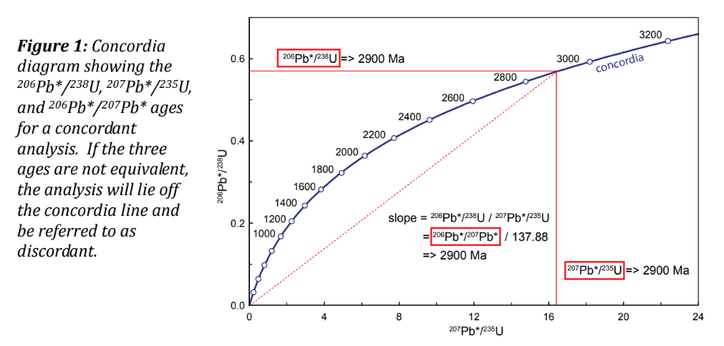
Plotting the Data: Igneous Samples
– Concordia Diagrams

Slide 16
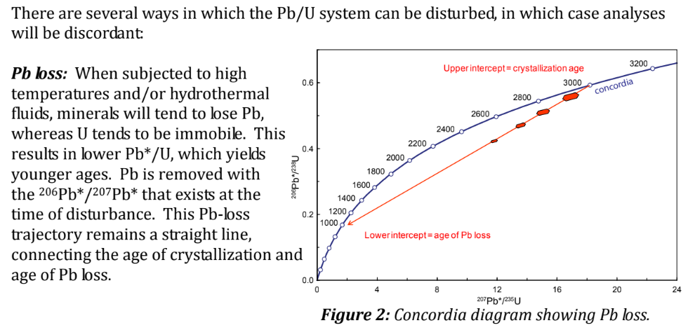
Plotting the Data: Igneous Samples – Concordia Diagrams

Slide 17
Uncovering the story from the data.
Using the data from the sample determine if the Best Age for each grain is true
Looking at the age spread of each sample, determine if the sample is volcanic or detrital
Find the youngest 3 grains and take an average for each sample

Slide 18
Finding the rate of basin and range extension
Age ?
Using the data from the two samples
Determine if the best age is true
  (75% - 110%)
Determine if the sample is volcanic or detrital
Find the single youngest grain
  Which sample is younger
Determine the rate of sedimentation/ rate of extension
Sample ?
1,500 m
Sample ?
Age ?

