Slide 1
Notes for Teaching
These materials apply the “if I fits, I sits” meme to help students envisage Goldschmidt’s rules that ionic substitution is principally controlled by ionic size and ionic charges. Cats are ideal for demonstrating “cat-ions” and solid solution.
This is demonstrated by the size difference between kittens and cats. Kittens can fit in smaller sites (i.e., tetrahedral), while adult cats can’t be cut into smaller pieces so need larger sites (i.e., interlayer).
The assumption is also made that kittens have different ionic charges to adult cats.

Slide 2
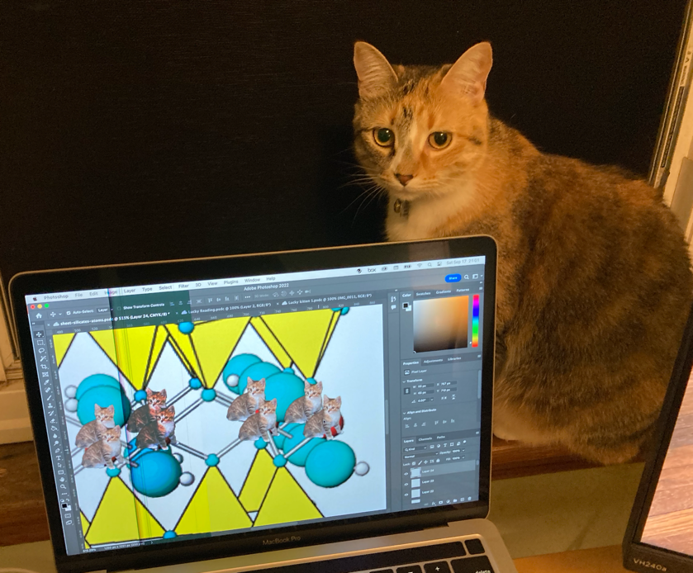
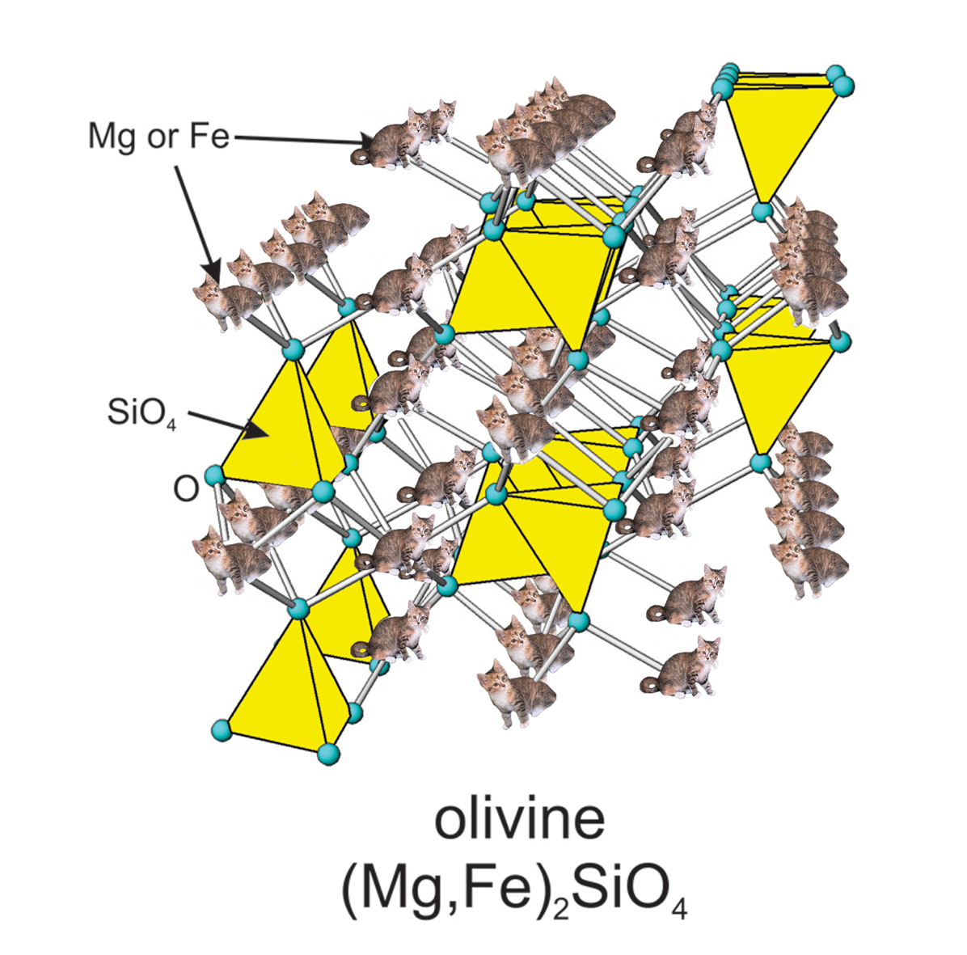
Classifying Silicate Minerals
Goal: to classify silicate minerals according to their structure and describe how this affects mineral chemistries and properties.
Specific learning outcomes:
To name the silicate mineral groups and describe how they are differentiated on the basis of crystal chemistry and structure.
To define solid solution and explain how crystal structure affects mineral chemistries.
Associated chapters in Introduction to Mineralogy (Perkins 2020):
Silicate Structures: chapter 6.4 & 13.7
Solid solution: chapter 2.5
Crystal Structures: chapter 13.6

Slide 3
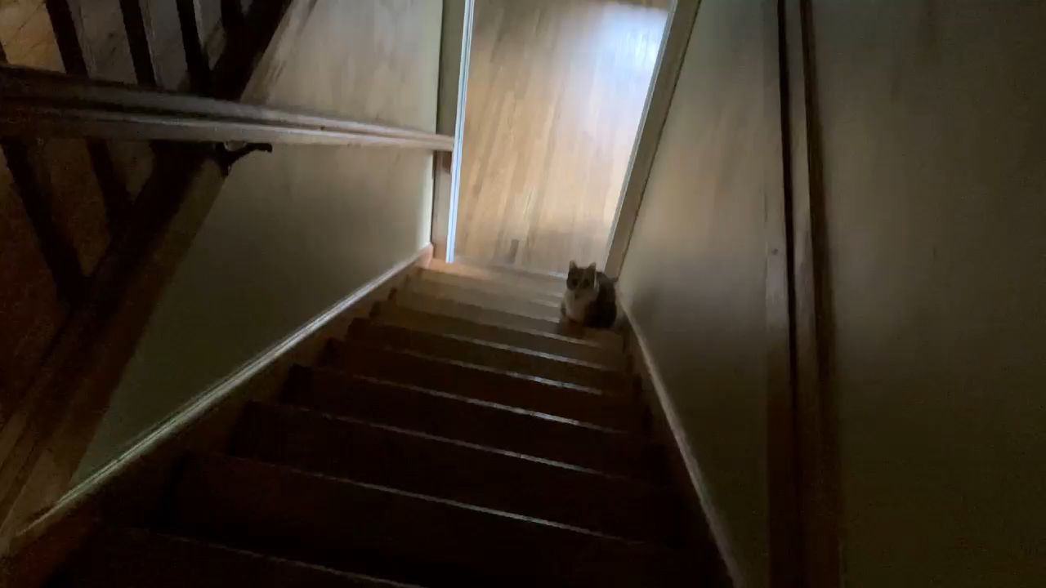
Lucky and Cat^{(ion)} Sites

Slide 4
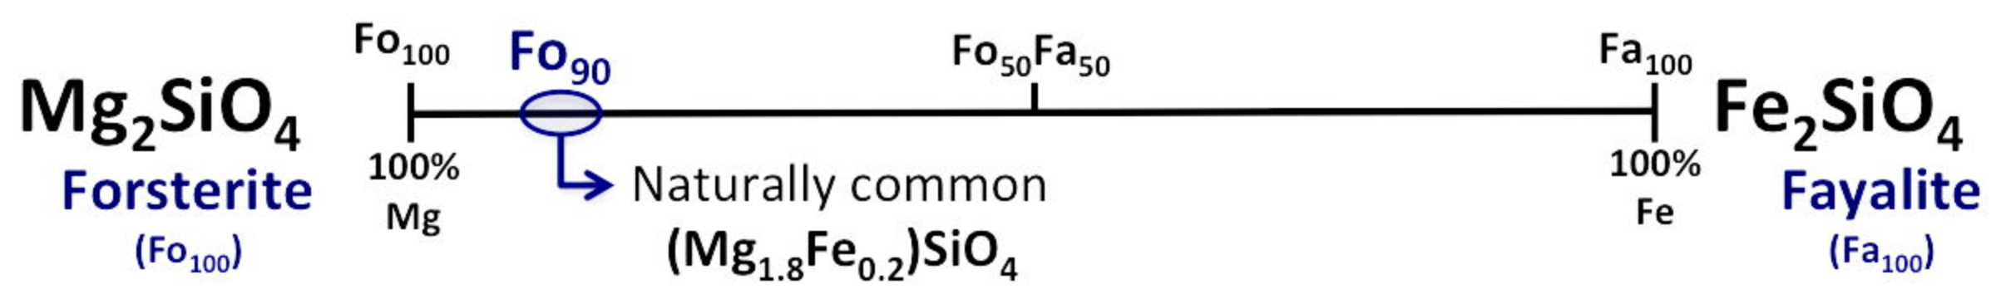
Solid Solution
Minerals with different chemical compositions, but the same crystal lattice structure.
This is how different elements can substitute into the same crystallographic site within a mineral, but the mineral retains the same crystalline geometry, and the same mineral group.
Almost every mineral group is susceptible to solid solution under the right circumstances
Solid solution in the olivine group:
Image from:: http://classes.colgate.edu/rapril/geol201/summaries/atsub.html

Slide 5
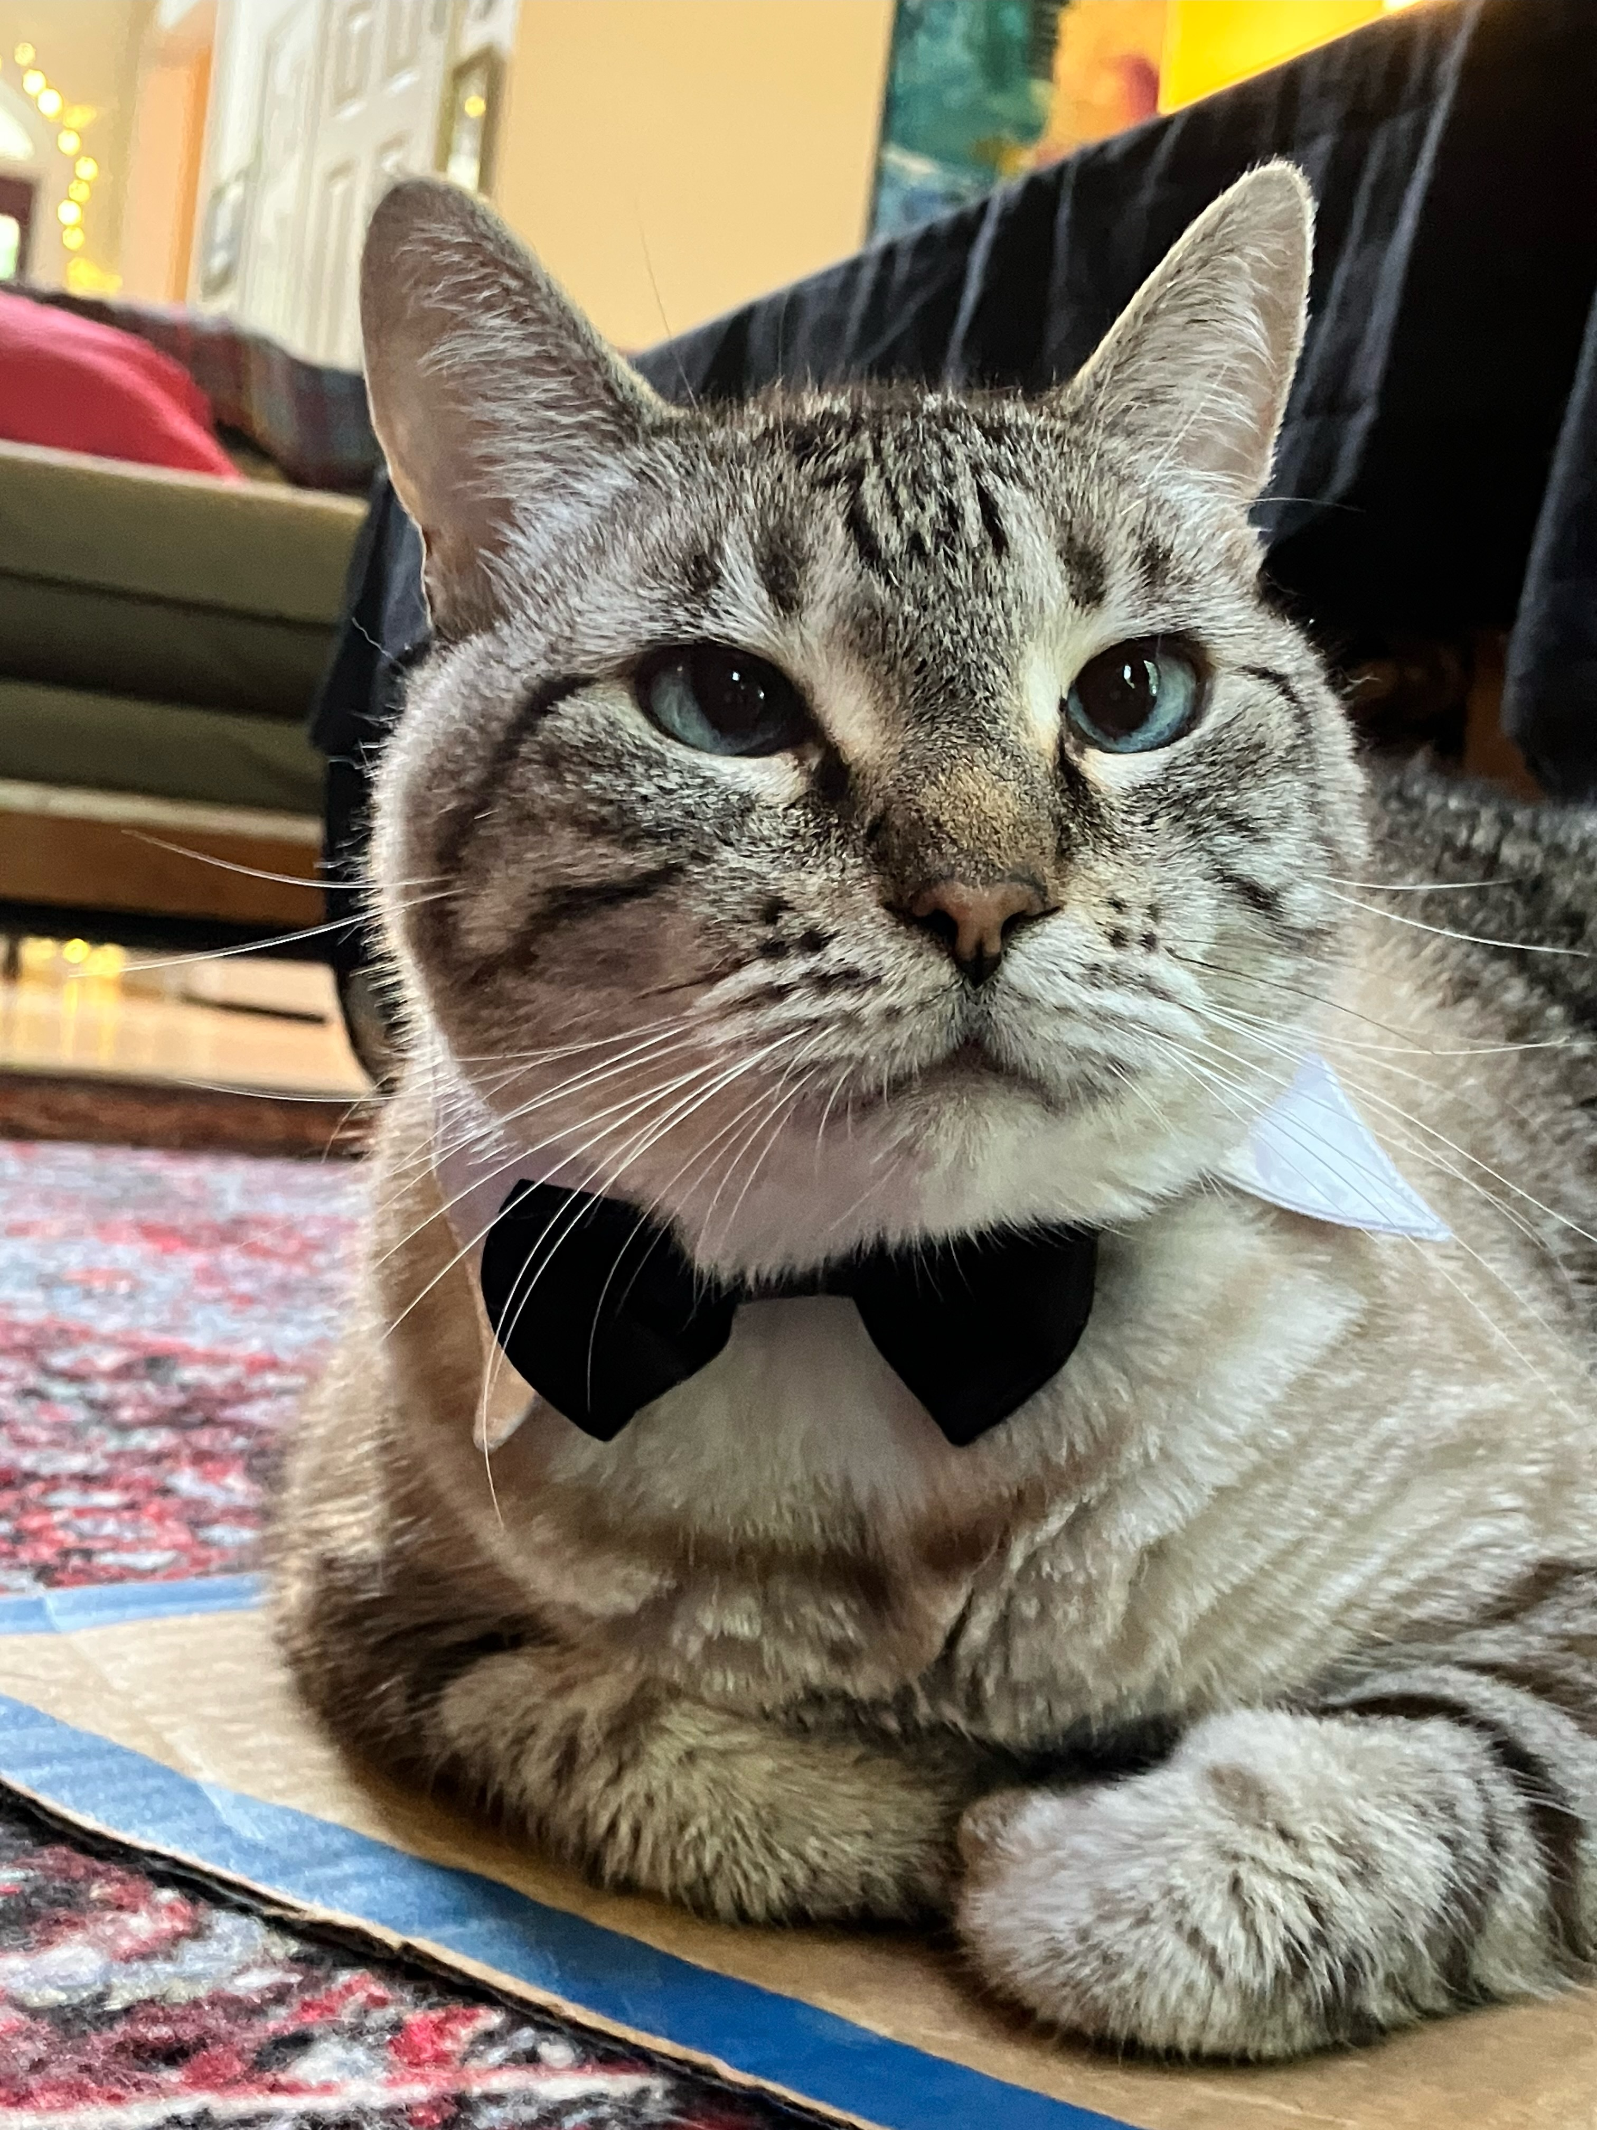
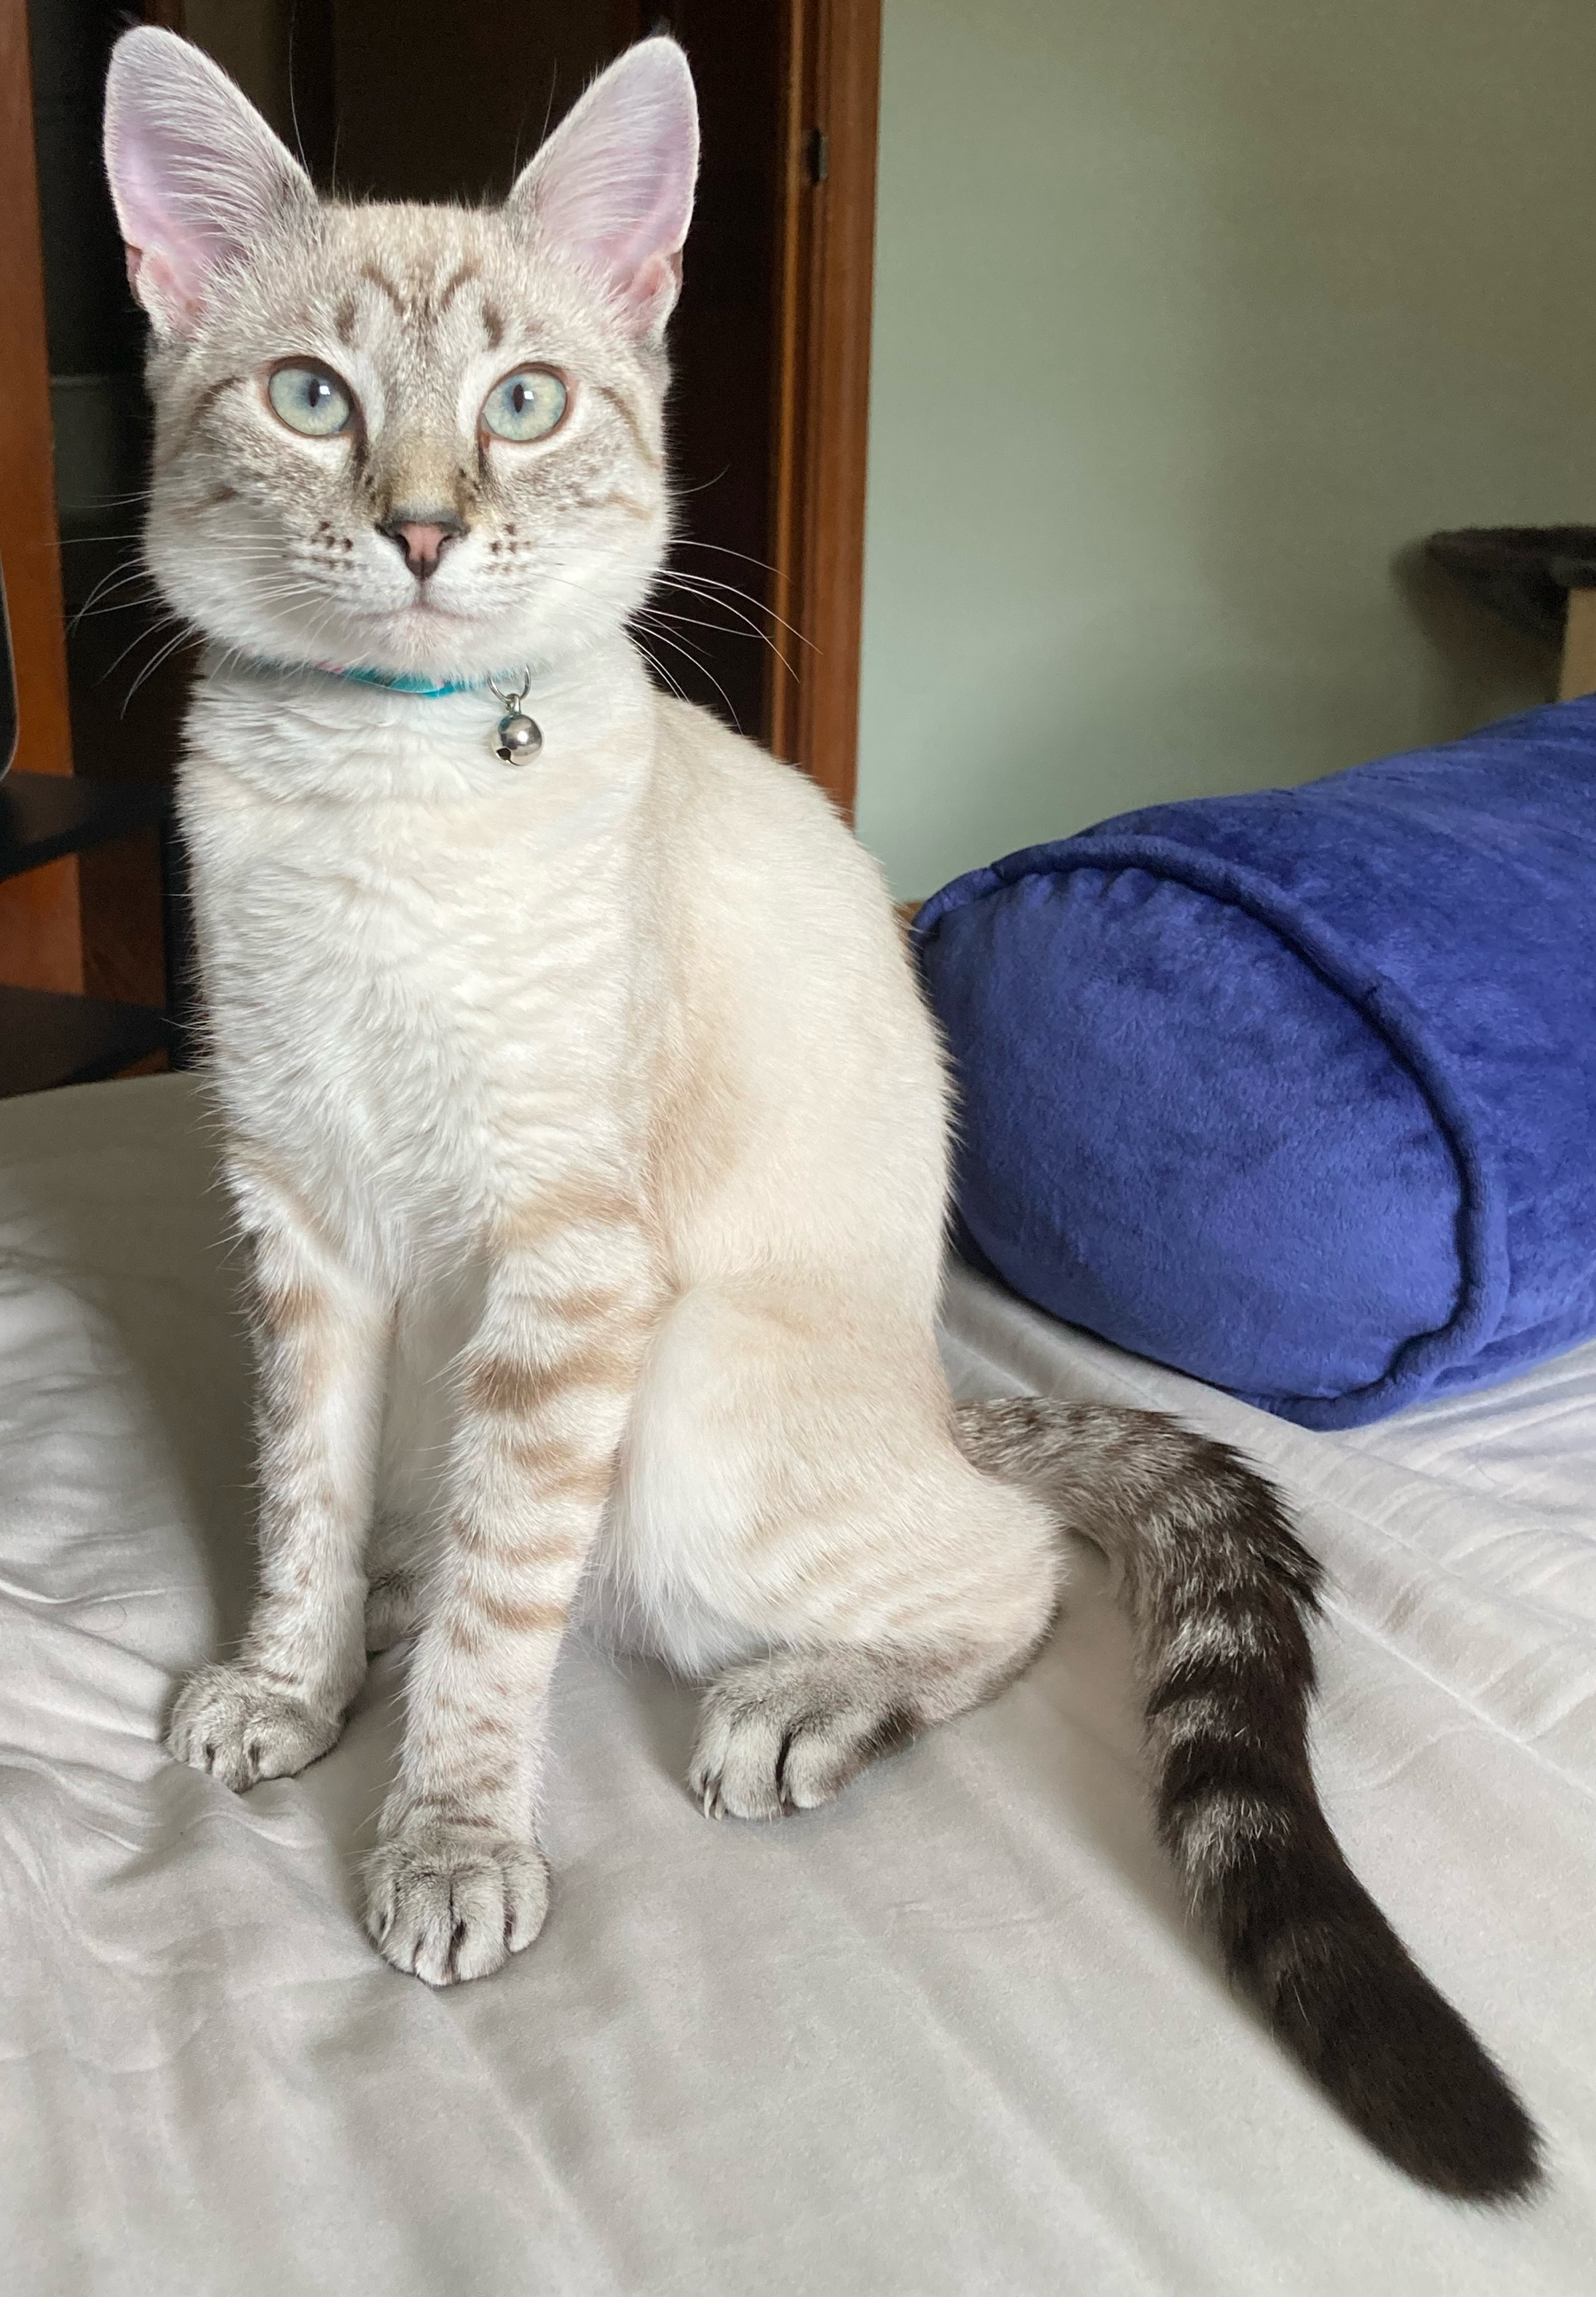
Solid Solution
Olivine Hunt
Julian Andersen
Notes:
Lynx point Siamese cats toast as they become older. This darkening of their coat colours can mimic the solid solution between forsterite (kitten) and fayalite (adult).

Slide 6
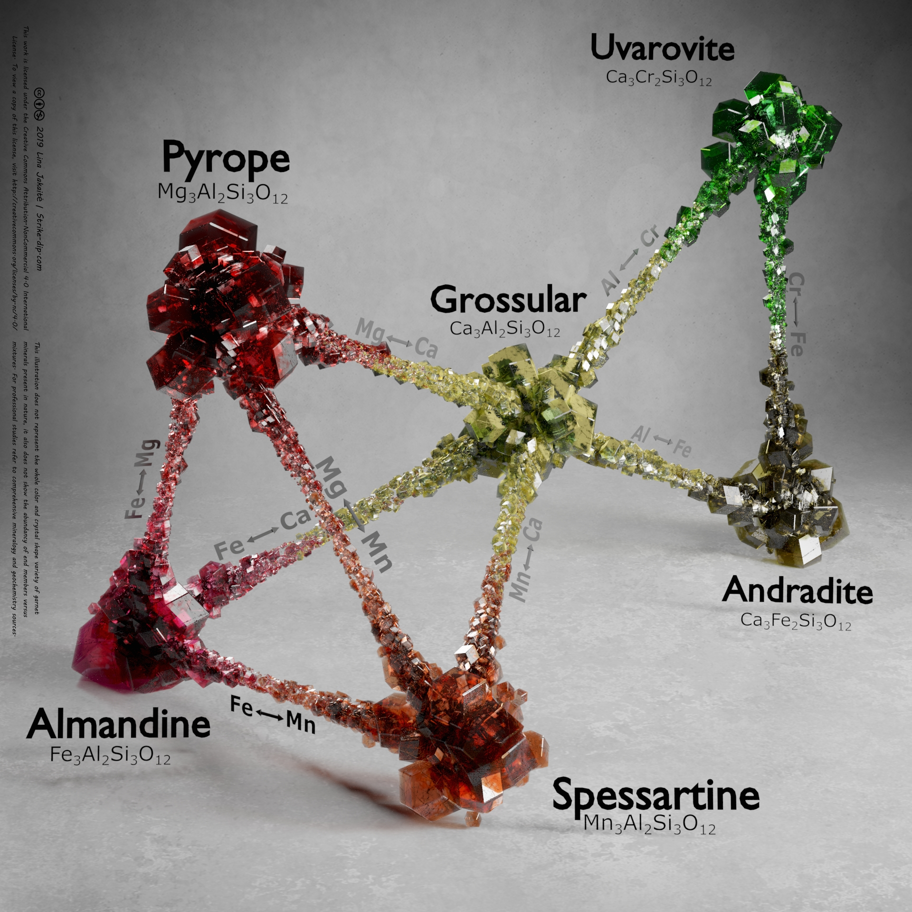
Substitution
Goldschmidt’s Rules
Substitution is controlled by:
Ionic size, i.e., radii of the ions.
The charge of the ions.
To a lesser extent on the nature of atomic bonding in a mineral’s structure.
Garnet minerals are great group of silicate minerals with general chemical formula X₃Y₂Si₃O₁₂. X stands for divalent Ca, Mg, Fe and Mn cations and Y – for trivalent Al, Fe and Cr cations. This illustration shows those relations. At the peaks there are end members shown and those end members which blend to each other are connected. Image from https://strike-dip.com/garnets/

Slide 7
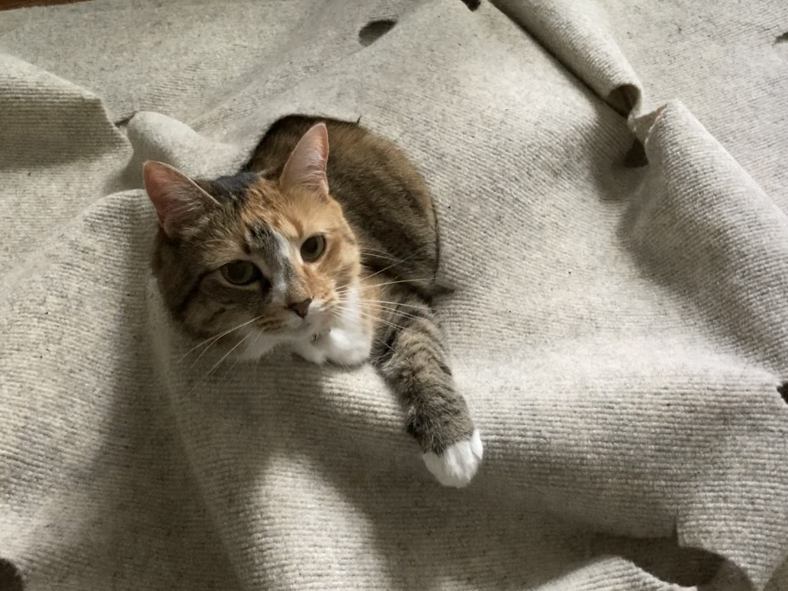
If I Fits
I Sits

Slide 8
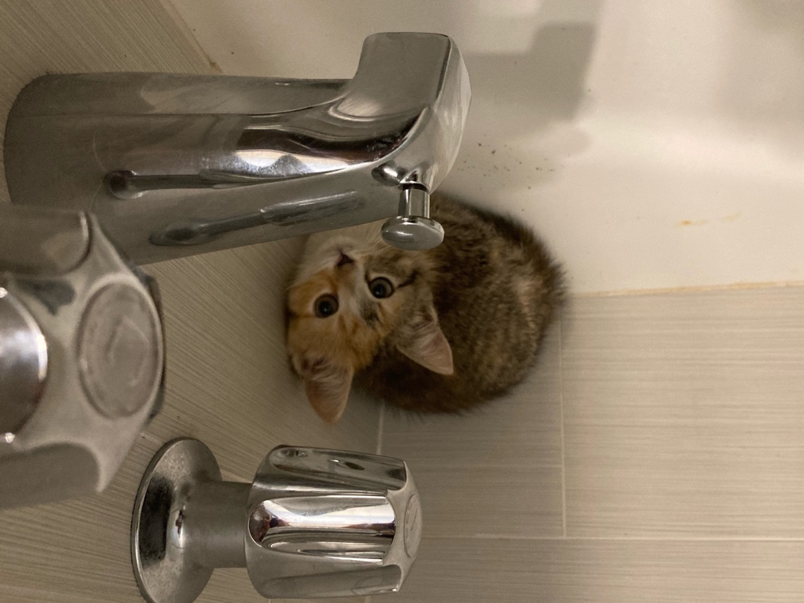
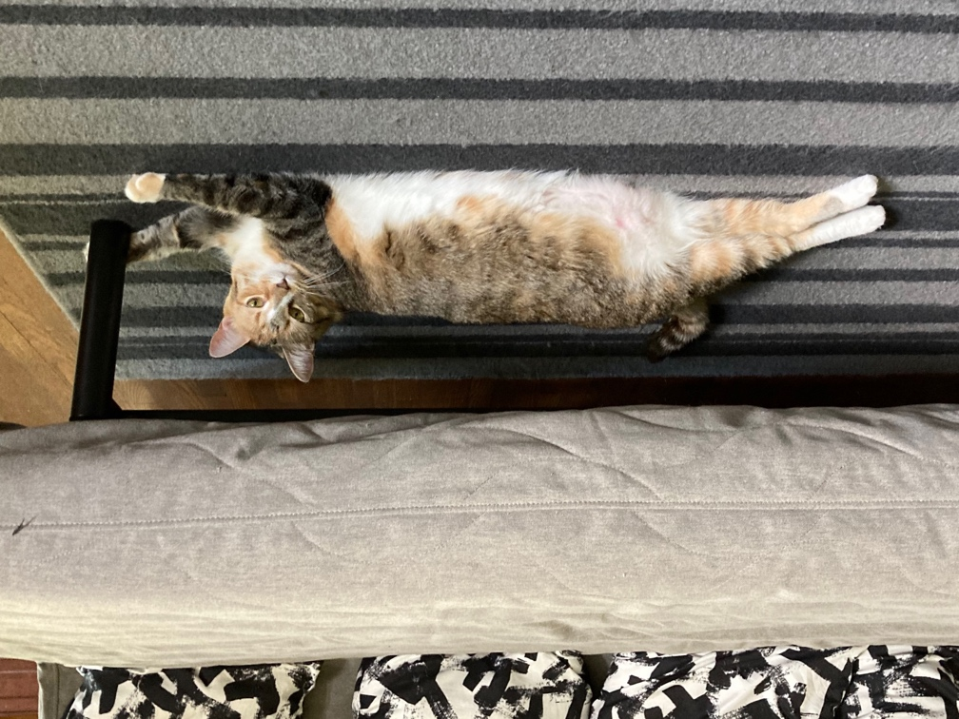
Substitution and Cat^{(ion)} Size
The nature and extent of substitutions depends partially on ionic size.
Kitten Lucky = 2 lb
Adult Lucky = 12 lbs

Slide 9
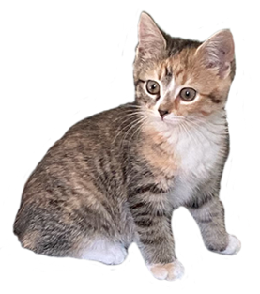
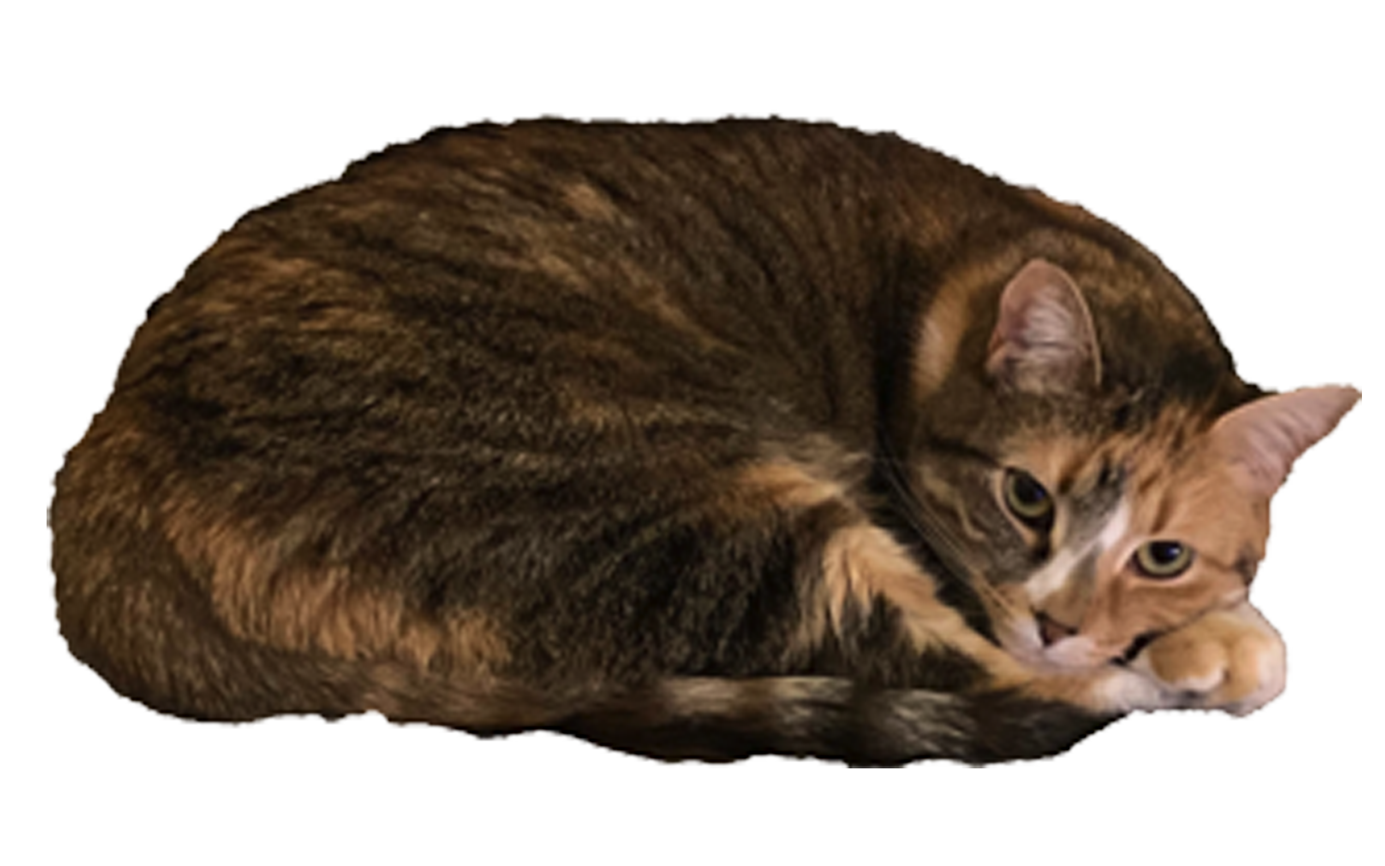
Substitution and Cat^{(ion)} Size
The nature and extent of substitutions depends partially on ionic size.
=
6 Kitten Luckys
1 Adult Lucky

Slide 10
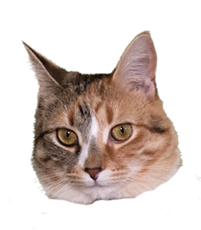
Substitution and Cat^{(ion)} Size
The nature and extent of substitutions depends partially on ionic size.
=
1 Kitten Lucky
1/6 Adult Lucky

Slide 11
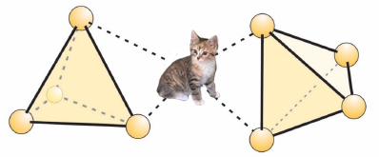
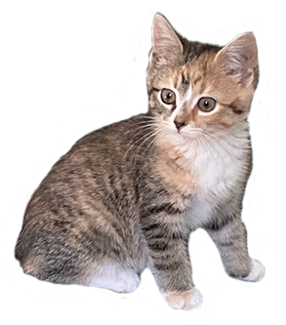
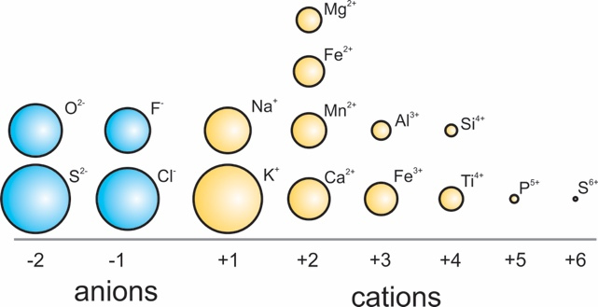
Substitution and Cat^{(ion)} Size
The nature and extent of substitutions depends partially on ionic size.
If I fits…
I sits.
Kitten Lucky fits in the nesosilicate structure through ionic bonding.
Nesosilicate
Unit composition: (SiO₄)⁴⁻
Example: olivine, (Mg,Fe)₂SiO₄
Elements of similar size and charge (e.g., Fe²⁺ and Mg²⁺) may occupy similar sites in crystal structures without causing distortion or charge imbalance.
Images modified from: Perkins (2020), Introduction to Mineralogy, chapter 13

Slide 12
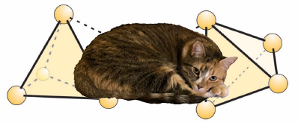
Substitution and Cat^{(ion)} Size
The nature and extent of substitutions depends partially on ionic size.
Nesosilicate
Unit composition: (SiO₄)⁴⁻
Example: olivine, (Mg,Fe)₂SiO₄
Image modified from: Perkins (2020), Introduction to Mineralogy, chapter 13

Slide 13
Substitution and Cat^{(ion)} Size
The nature and extent of substitutions depends partially on ionic size.
Don’t fit…
Don’t sit.
Adult Lucky cannot fit in the site in the nesosilicate structure.
Her “cat-ionic” size is too large for the “hole”.
Nesosilicate
Unit composition: (SiO₄)⁴⁻
Example: olivine, (Mg,Fe)₂SiO₄
Image modified from: Perkins (2020), Introduction to Mineralogy, chapter 13

Slide 14
Substitution and Ionic Charge
Thus, substitutions are not only controlled by ionic size, but also by charge, as the molecules must be balanced.
Possible Substitutions | Example Minerals
Na⁺ = K⁺ | alkali feldspar, hornblende, micas
Ca²⁺ = Mg²⁺ = Fe²⁺ = Mn²⁺ | pyroxenes, amphiboles, micas, garnet, carbonates
F– = Cl– = OH– | amphiboles, micas, apatite
Fe³⁺ = Al³⁺ | garnet, spinels
Ca²⁺Al³⁺ = Na⁺Si⁴⁺ | plagioclase, hornblende
Al³⁺Al³⁺ = (Mg,Fe)²⁺Si⁴⁺ | pyroxenes, amphiboles, micas
Si⁴⁺ = K⁺Al³⁺ | hornblende
O²⁻ = (OH)– plus other substitution(s) to keep charge balance | biotite, titanite
Table from Perkins (2020), Introduction to Mineralogy, chapter 13.

Slide 15
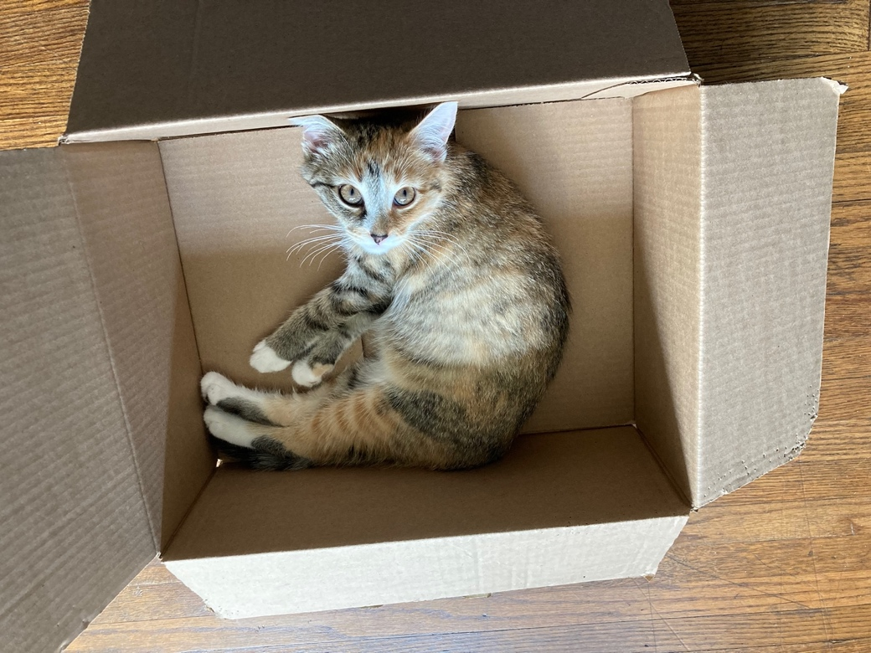
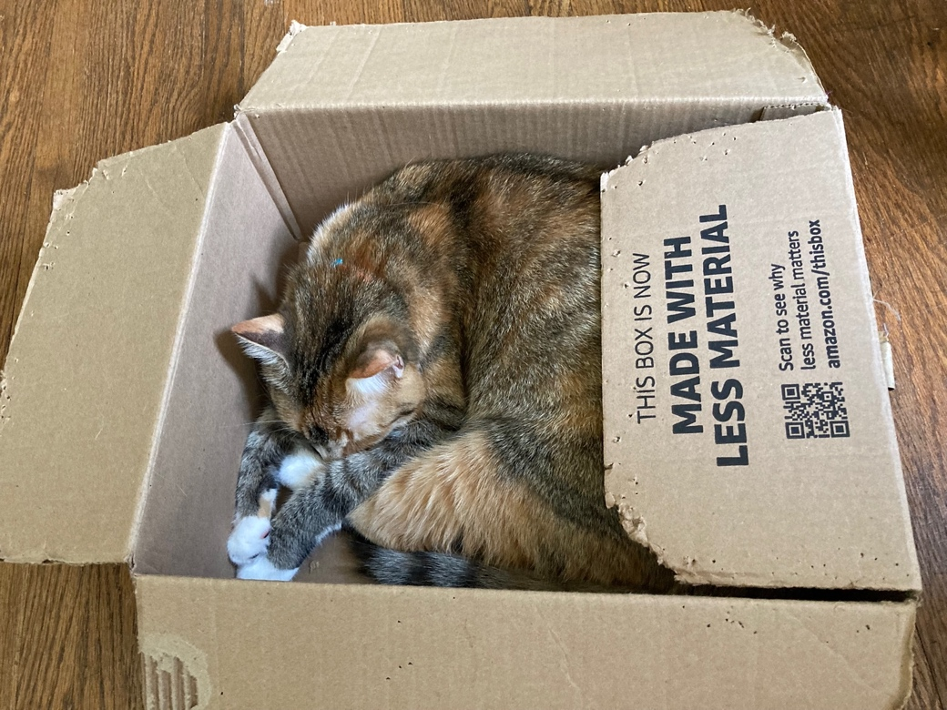
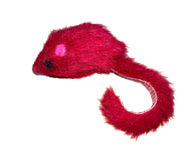
Substitution and Cat^{(ion)} Charge
The nature and extent of substitutions depends partially on ionic charge.
Kitten Lucky²⁺ + 3 Red mouse¹⁺
= 5⁺
Adult Lucky⁵⁺
= 5⁺
Notes:
Kitten Lucky must combine with toys to reach an ionic charge equivalent to adult Lucky to substitute in the space available (box). The box is identical in each photo.

Slide 16
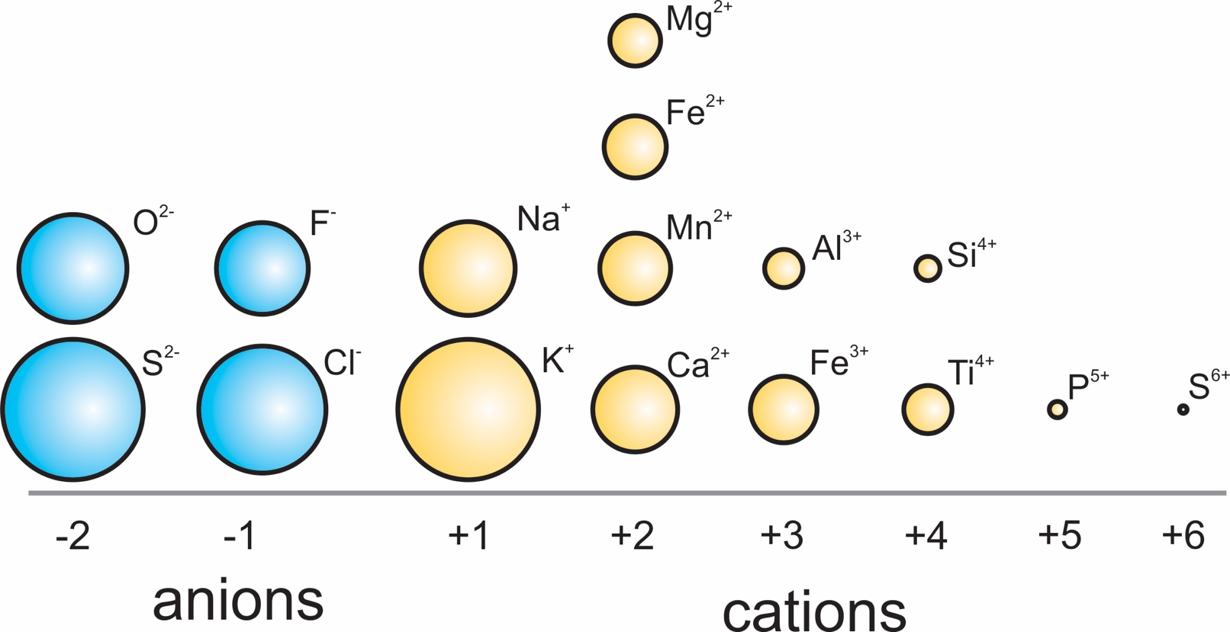
Substitution and Cat^{(ion)} Size
Kitty Lucky fits…
Kitty Lucky sits.
Nesosilicates have tetrahedral and octahedral sites.
These are NOT large enough to hold alkalis or other large cations (e.g., adult Lucky).
They can ONLY hold SMALLER cations like Fe²⁺ and Mg²⁺ (e.g., kitten Lucky).
Images modified from: Perkins (2020), Introduction to Mineralogy, chapter 13

Slide 17
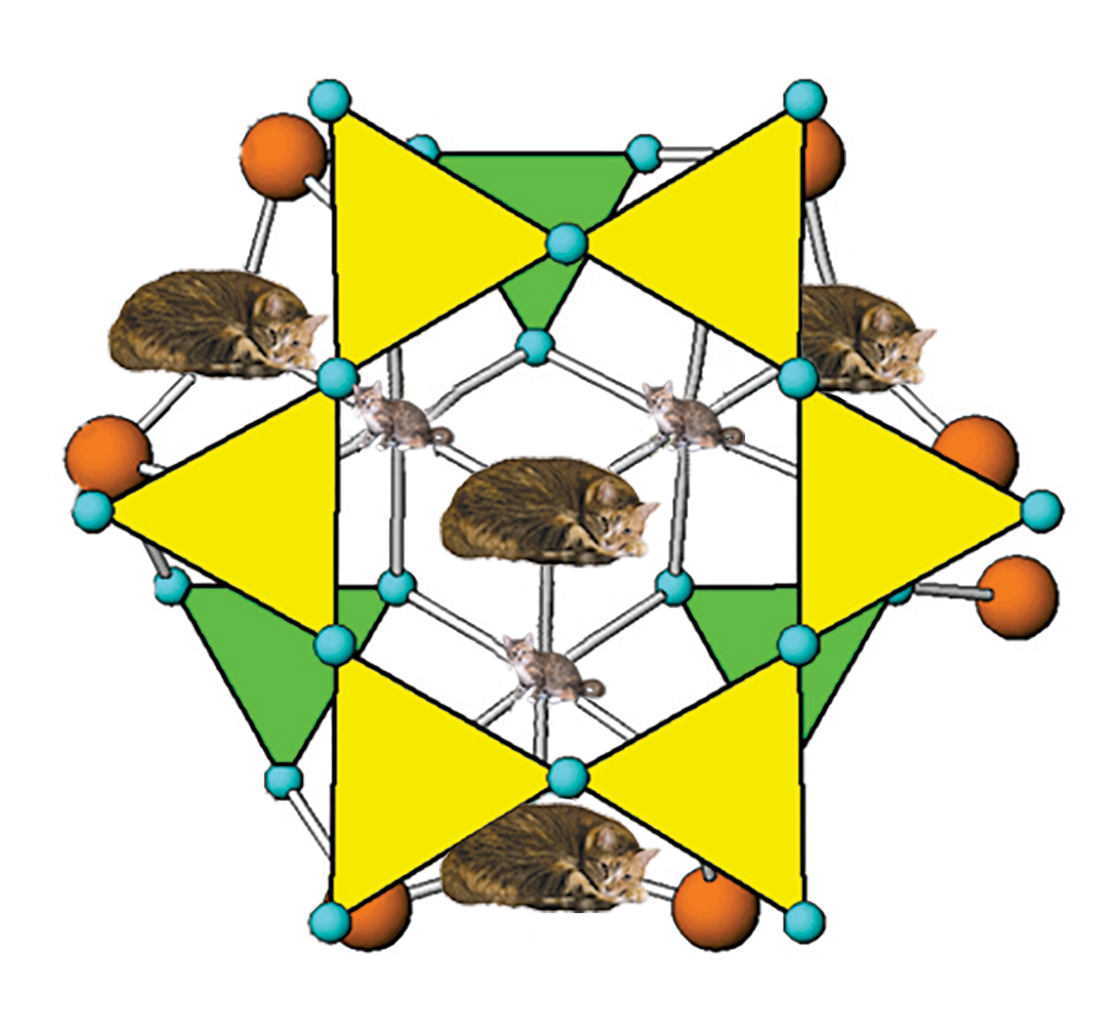
Substitution and Cat^{(ion)} Size
(OH)⁻
Ionic radius = 1.53 Å
Cyclosilicate ring structures have several different sites.
This means these structures can incorporate a wide variety of elements.
Mg²⁺
Ionic radius = 0.66 Å
Image modified from: Perkins (2020), Introduction to Mineralogy, chapter 13

Slide 18
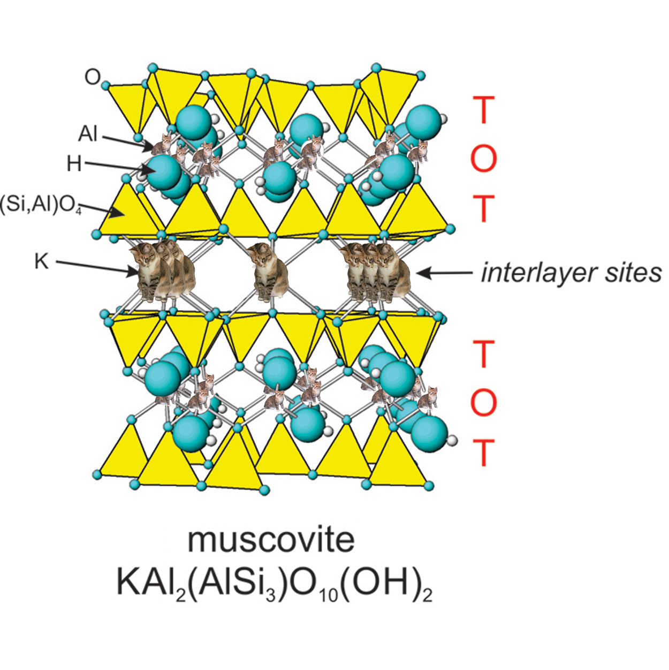
Substitution and Cat^{(ion)} Size
Lucky fits…
Lucky sits.
(in the correct site)
Phyllosilicates (sheet silicates) are planar structures with T-O-T layers
  Tetrahedral – octahedral – tetrahedral sites.
This allows for the possibility to accommodate cations of VARYING SIZES in differing sites.
Including adult Lucky in the larger interlayer sites and kitten Lucky in the smaller octahedral sites.
etrahedral
ctrahedral
etrahedral
etrahedral
ctrahedral
etrahedral
Image modified from: Perkins (2020), Introduction to Mineralogy, chapter 13

