Slide 1
Core Logging for Groundwater Investigations Using Graphical Shading Geologic Logs
Lab Lecture
Contributed as a Lab Activity to Teach the Earth by Jessica Meyer, University of Iowa
Development of these materials supported by ESTCP Technology Transfer grant ER23-7659

Slide 2
Learning Objectives
Explain how basic sedimentological parameters are evaluated in the field.
Apply the classification systems presented in lecture to describe the basic sedimentological properties of your core
Practice recording geologic observations from cores using a graphical shading geologic log.
Describe how the geologic variability you observe might influence groundwater flow.
Notes:
There are two overall objectives of the lab:
Introducing students to the approach of logging a core using a graphical shading log format (rather than writing descriptions out in paragraph form)
Give students an opportunity to practice logging core. That is, practice evaluating and assigning values for common sedimentological parameters (e.g., grain size, color, sorting, etc.).

Slide 3
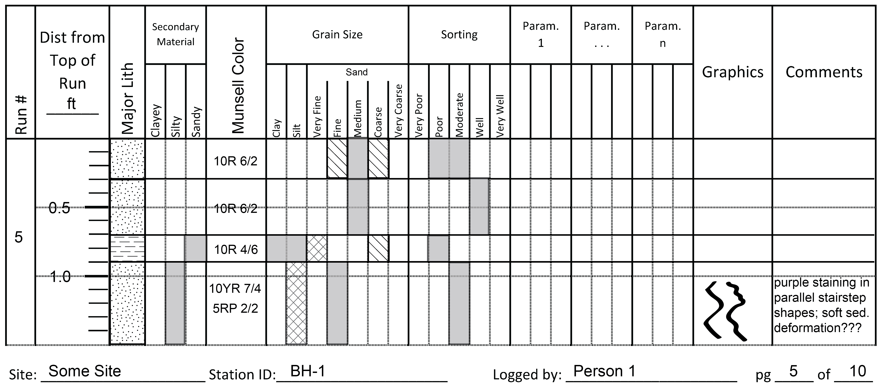
Graphical Shading Logs
Notes:
In the pre-lab lecture we discussed the concept of a graphical shading log.
These logs help to facilitate efficient (fast) collection of high quality data from cores

Slide 4
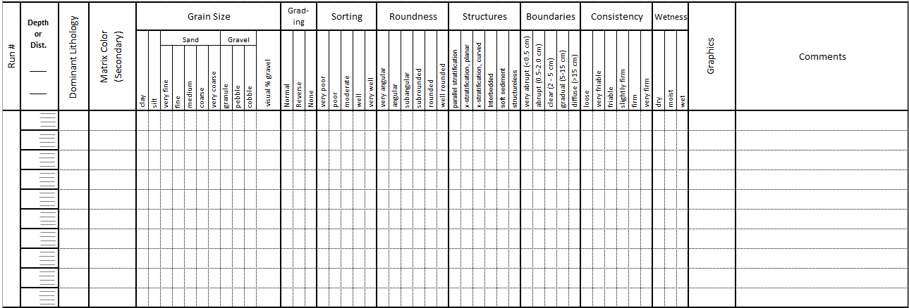
Approach to Using Graphical Shading Logs
ft
TOR
10YR
5/4
na
1.0
25%
10YR 5/4
2.0
10YR
5/4
na
23 (115-120 ft bgs)
3.0
4.0
7.5YR
7/8
na
Notes:
Remember, your logging sheet shows you all of the parameters (data types) you are supposed to log. It also lists the relevant values for each of those parameters.
Start by stepping back from the core and looking for depths where you notice change (in lithology, texture, color, etc.). Use these observations to establish boundaries in the core. Typically these are created primarily based on texture (mixture of grain sizes) or lithology to start.
Next, draw a horizontal line across the page to represent each boundary you observe.
Start with the first interval at the top of the core. Shade in the value for the appropriate grain size. Solid shading represents dominant (> 50%), cross-hatched shading represents secondary (5-50%), and diagonal shading represents minor (<5%). If for example, fine and medium grained sand are equally dominant you can shade across both categories.
Grading can be described specifically (i.e., whether the grading is normal (grain size decreases upward) or reverse (grain size increases upward) or, if you are logging in a fairly detailed way it is captured inherently in the grain size data.
Once you have the grain size completed, use a symbol to represent the dominant lithology (or primary sediment type).
Then, use the Munsell chart to evaluate the color,
Then, work your way across the log sheet shading in the values for each parameter.
For the boundary parameter, shade in the correct value right on the boundary itself.
If a parameter doesn’t apply, write N/A so you know you evaluated it (rather than just missed it)
Repeat the process for each interval.
Once all of the intervals are complete, look at your sheet and make sure you haven’t forgotten to log a parameter (there will be a ‘hole’ in your log.
You shouldn’t need to write a lot of comments. But the column is there in case you have an observation that isn’t captured by the other columns/parameters.

Slide 5
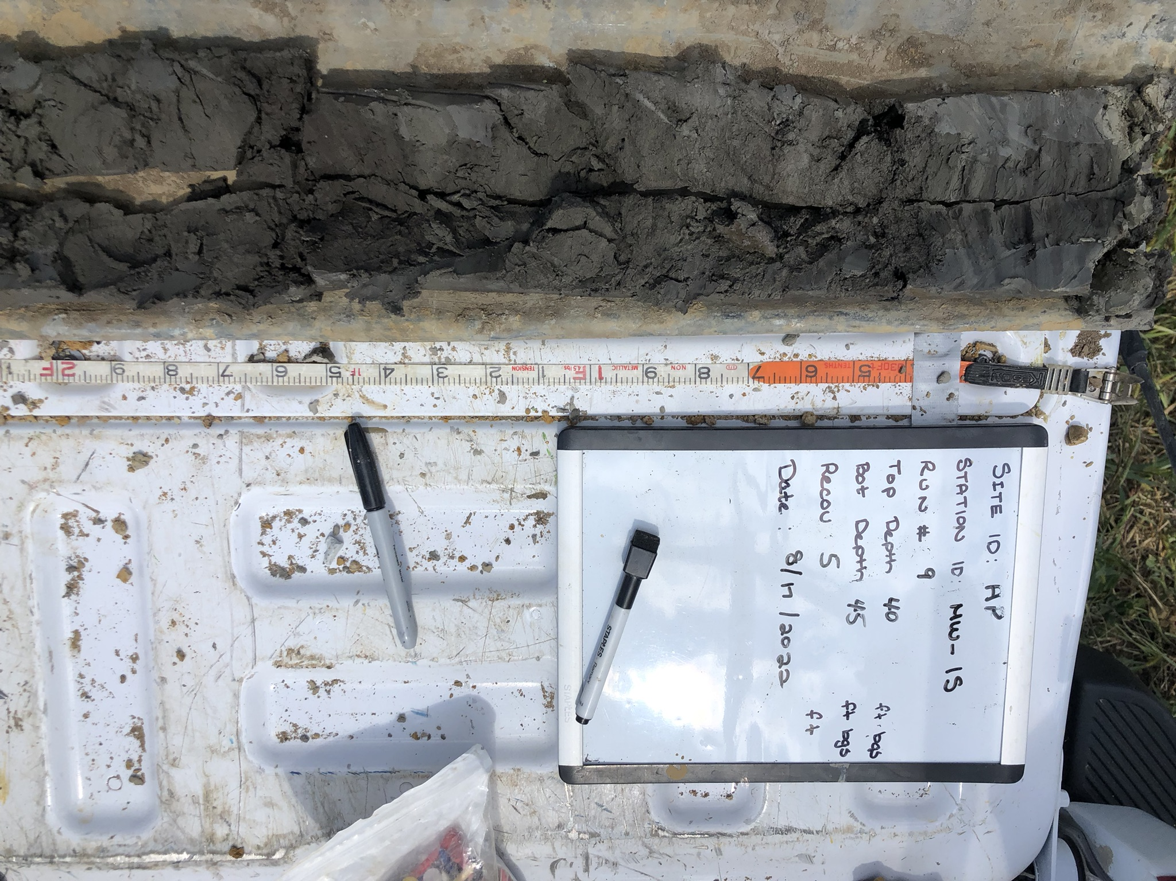
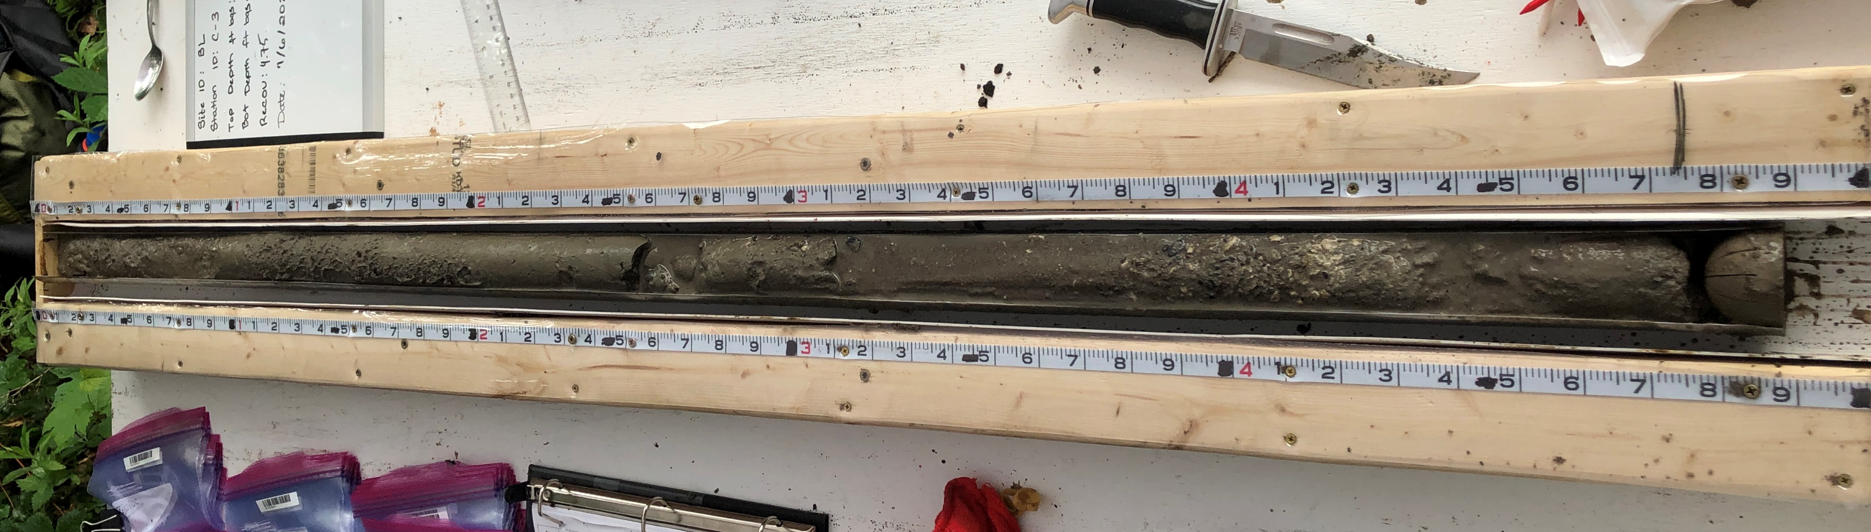
Essential Logging Equipment
A way to measure the distance/depth from the top of each core run
Core tray with tape measures permanently attached
Simple tape measured affixed to the table along the core
Notes:
Before going to the field, you need to think about the equipment and supplies you will need to be successful.
First, you need to have a way to accurately measure the distance along a core.
It can be as easy as having a measuring tape taped to the table or the tailgate (picture on left).
Of you can use a custom designed core tray with permanently affixed tape measures. The on the right is designed so the tap measures are at the same level of the core and there is a surface along side the tape measures that can be written on with wet erase markers and then ‘erased’.
Note the tape measure does NOT measure depths (in general). It will measure the distance from the top of the run. I recommend logging the run information (run number, top depth, bottom depth, recovery) on a separate sheet. Then, just logging the core based on the distance from the top of the run. Its often more accurate because you aren’t trying to calculate depths on the fly.
Also note, in the US the unit of length for drilling projects is often decimal feet.

Slide 6
A Note About Units
In field hydrogeology projects, depths/distances are commonly measured using decimal feet
Decimal Feet – 1 ft divided into 10 equal segments
Each 10th of a foot is further divided into 10 segments (hundredths of a foot)
Notes:
This is a common unit used in hydrology. Useful to be familiar with it.

Slide 7
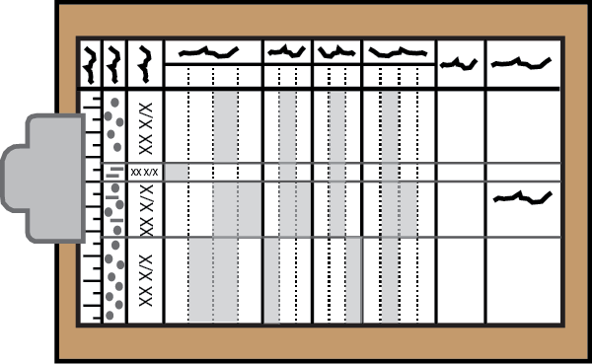
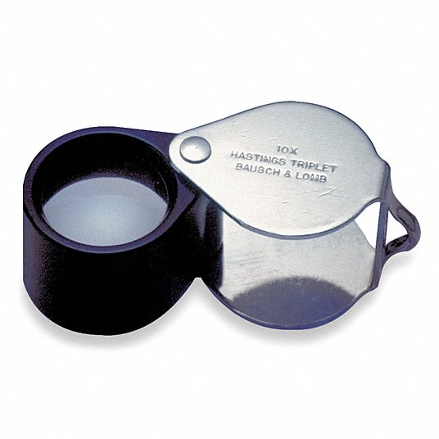


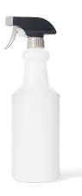
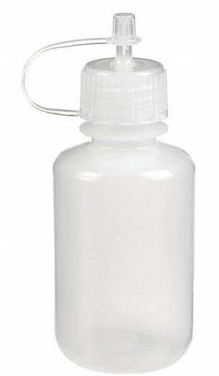
Essential Logging Equipment
Log Form
Hand Lens
Spray
Bottle
Dilute
Acid
Notes:
In addition to a tape measure and/or core tray you’ll need a variety of other equipment.
You’ll need your logging form. Its helpful to have a binder or clip board to use.
You’ll need a hand lens to assess grain size and several other parameters.
Often times structures are more distinct with the core is moist rather than dry and colors are typically assessed on moist not dry materials. So a spray bottle is useful.
You might want dilute acid (typically HCl) to test for carbonate content.

Slide 8
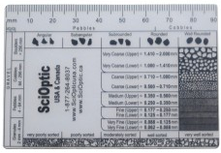
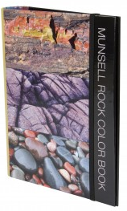
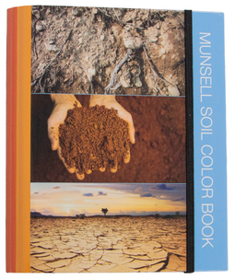
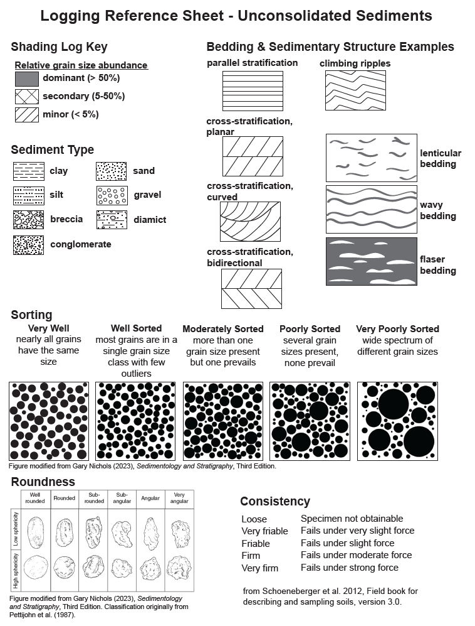
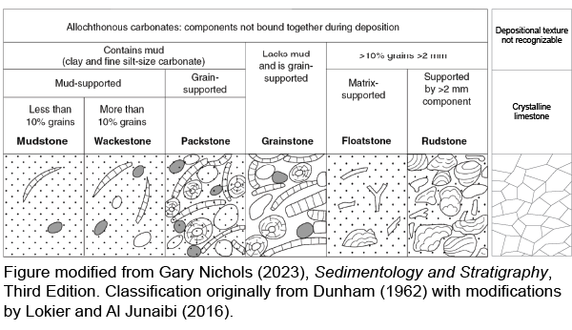
Reference Sheets to Ensure Accuracy and Consistency
Grain Size References
Munsell Color Charts
Other Visual References
Notes:
You will also need reference materials to help to ensure accuracy and consistency in your logging.

Slide 9
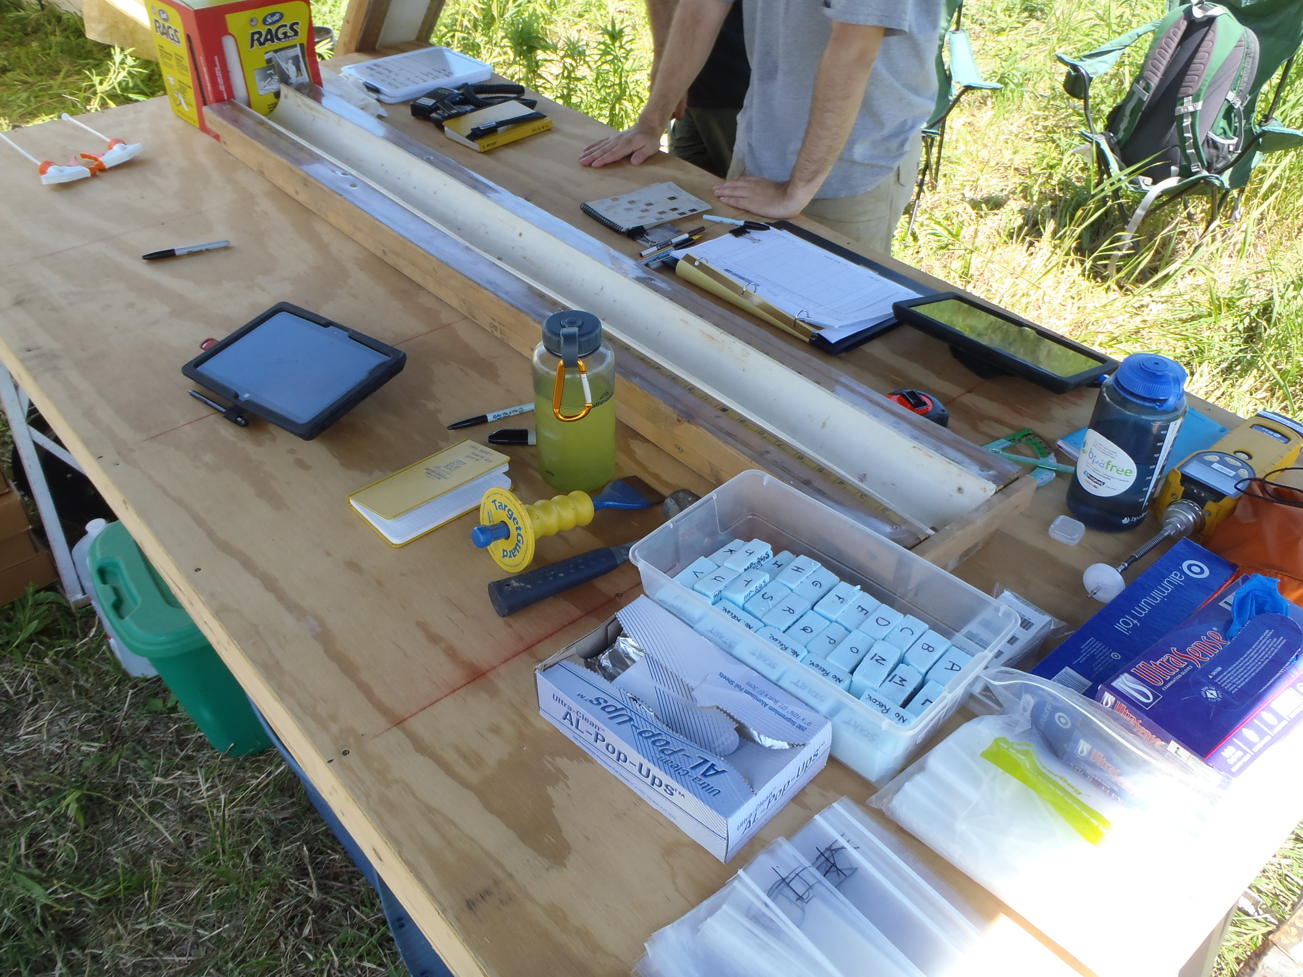

Other Useful Equipment
Unconsolidated Sediments
Bedrock
Notes:
There are many other pieces of equipment that can be useful.
For example, if you are logging unconsolidated sediments its helpful to have a soil knife and putty knife to split the core open and gently remove disturbed portions of the core. Golf tees can be really helpful for marking boundaries or other features as you log. Rags are useful for cleaning sediment off hands as you log.
In bedrock it can be helpful to have a hammer and chisel so you can create a fresh surface on the core to evaluate the parameters of interest. Its also helpful to have foam blocks (or wooden blocks) to indicate where samples have been removed. These foam blocks were made from 1” insulation foam board. It works well because its antimicrobial and easy to write on with a sharpie. Wood black sometimes promote mold. Another good option is foam pipe insulation. It can be cut to the same size as samples that are removed or sections of core that were not recovered.

Slide 10
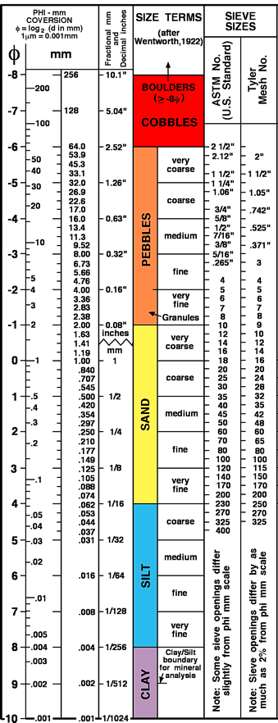
Grain Size
Grain sizes are grouped or categorized for different purposes
Sedimentological studies often use the Udden-Wentworth (1922) categorization of grain sizes
Goal is to consistently and accurately assess the proportion of clay, silt, sand, and gravel in an interval of sediment
Notes:
Characteristics of the grains (size, shape, lithology) are important for several reasons.
The size and shape of grains can provide indications of the energy of the environment the sediments were deposited it and the distance/time the sediments were transported (being moved around). Remember that understanding the depositional setting for sediments is critical to interpreting/predicting their distribution in areas where we don’t have data.
The size, shape, packing of the grains will control the characteristics of the pore space between grains. This will control important hydrogeologic properties like porosity and permeability.
Reference
Wentworth, C.K., 1922. A scale of grade and class terms for clastic sediments. The Journal of Geology, 30(5): 377-392. DOI:https://doi.org/10.1086/622910.

Slide 11
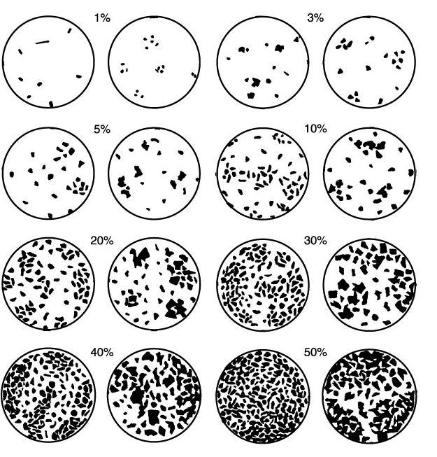
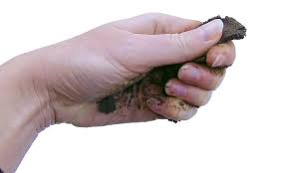
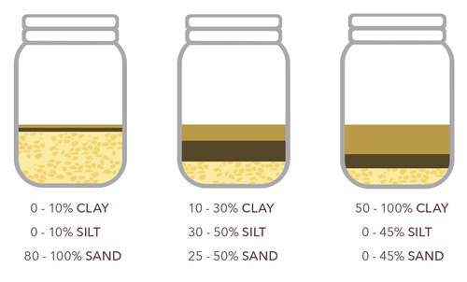
Assessing Grain Size Distributions in the Field
Visual Estimates
Manual Texturing
Settling Jars/Tubes
Notes:
If the materials are relatively coarse (sand, gravel) and relatively free of finer grained particles (clay, silt) then the proportion of grain sizes can be estimated visually.
The sample is examined with a hand lens and a grain size card for reference. References like the one shown here are used to estimate the dominant grain size (>50%), secondary, and trace grain size.
When there is a substantial proportion of clay and/or silt in the sample it’s more difficult to assess the grain size visually. Two approaches are often used in the field in these instances.
Manual texturing
Process where you evaluate the relative proportion of clay, silt, and sand in a sample primarily by feel.
Ad hoc settling jars
An alternative is to take a small sample of the materials, disaggregate it as best you can and then add it to a small jar or vial with water. Then you shake the vial vigorously until all the material is suspended. Then set the jar/vial down and let the materials settle out. The larger the particles the faster they will fall through the water (i.e., the largest particles settle out first). The smallest sand particle will fall out quickly (~44 s) and settle on the bottom followed by the silt (~7.7 hours). Clay particles will take longer to settle or may not settle out at all. The type of assessment is rooted in the principles of Stokes Law (1851). In the field, you can use this approach to get a qualitative sense for the sand distribution. But waiting for the finer grained particles to settle out is not usually an option. Quantitative settling experiments are typically conducted in the laboratory (e.g., hydrometer or pipette experiments).

Slide 12
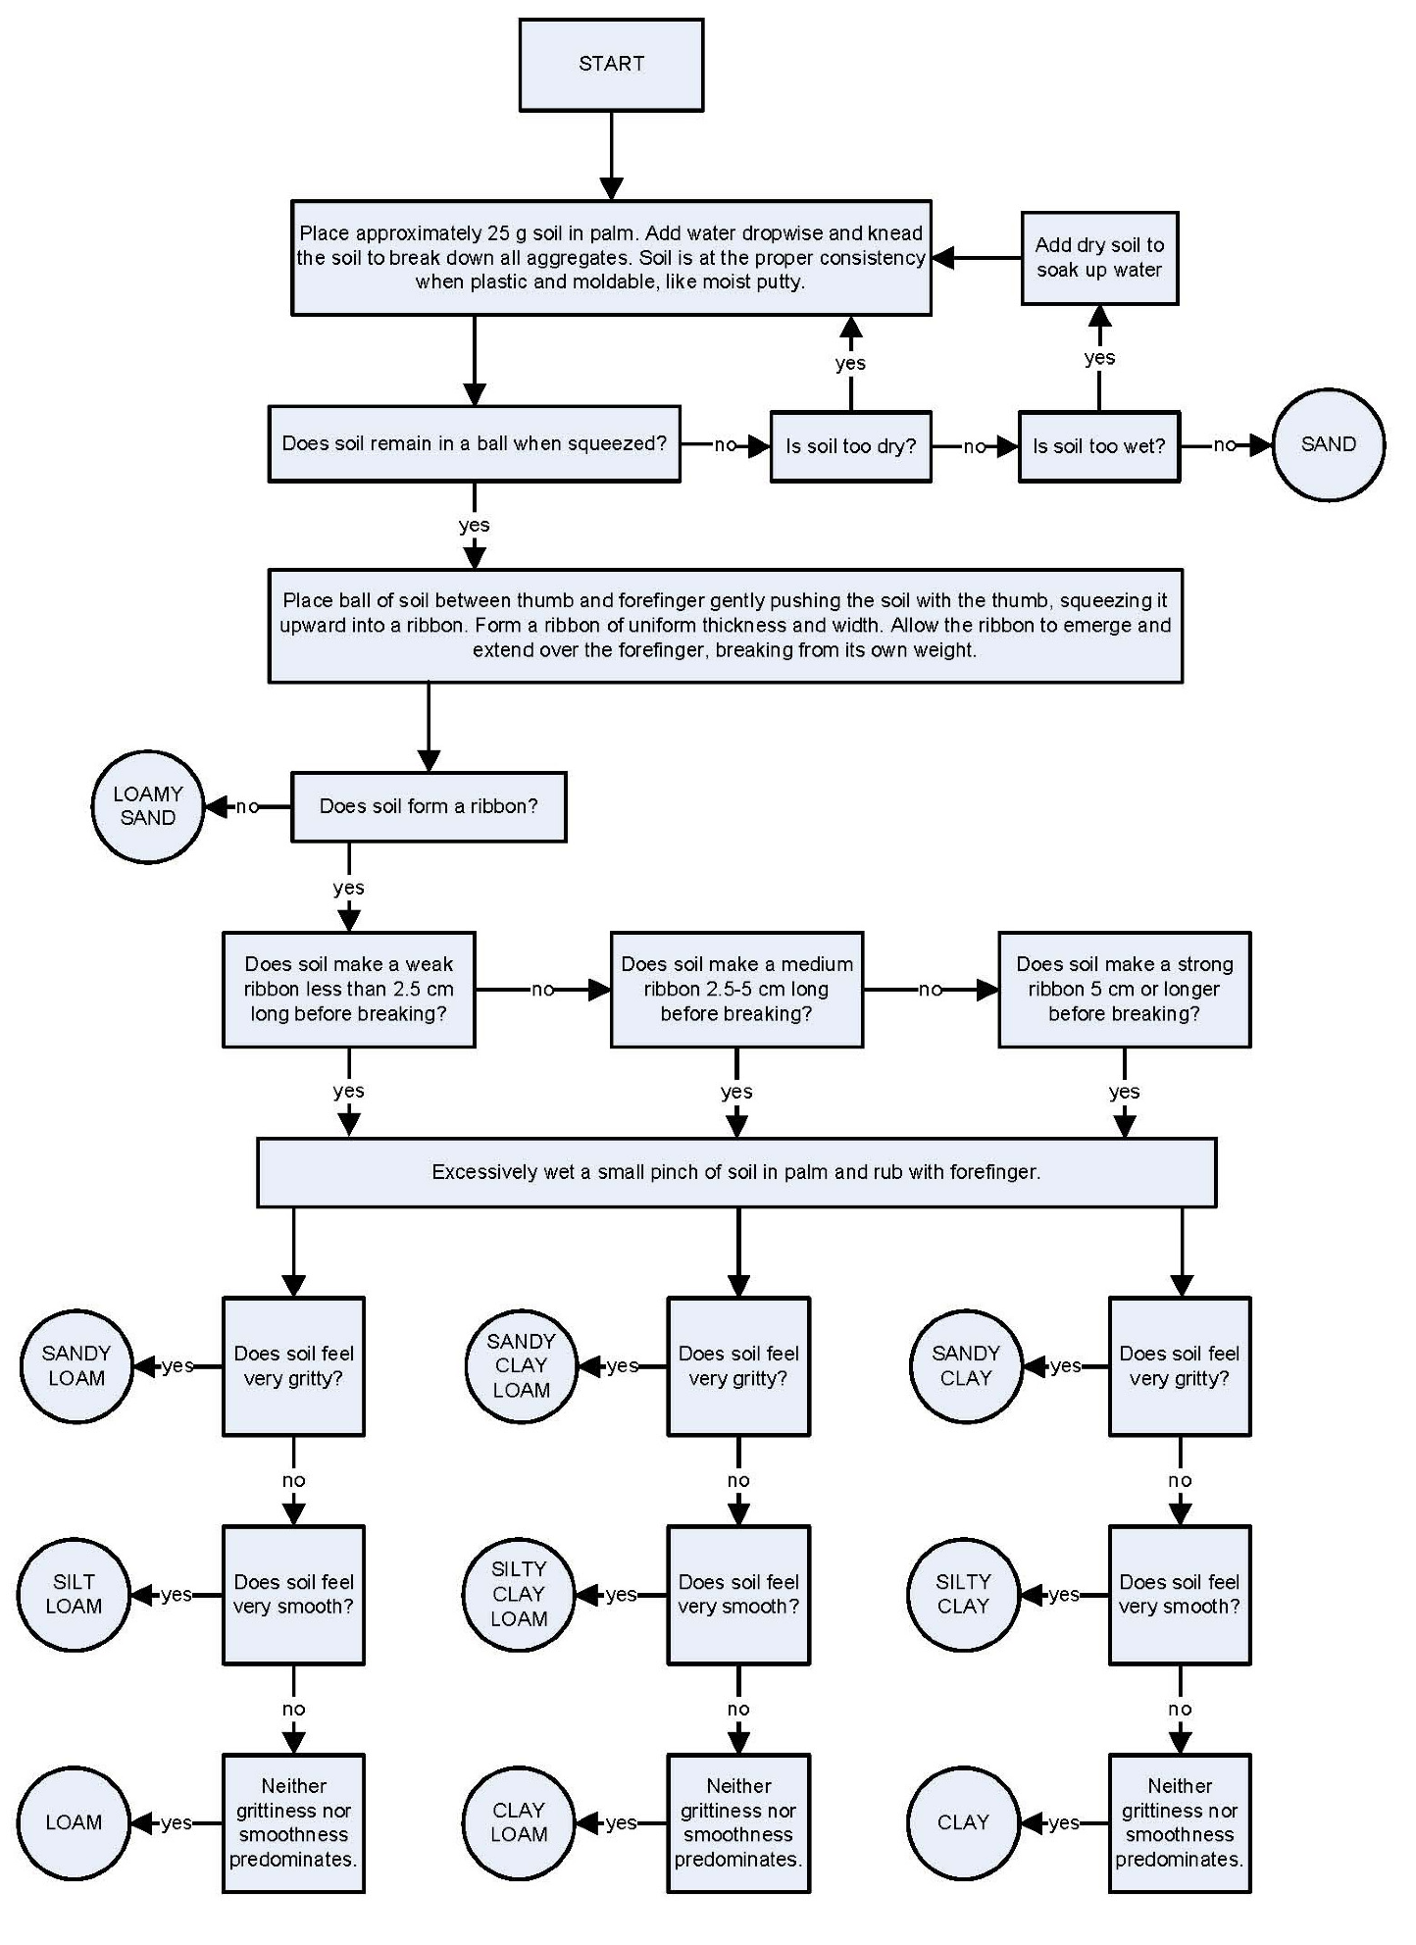
Manual Texturing
Popular method stems from soil science
Determines USDA textural classification based on how long the sediment will ‘ribbon out’
Modified from S.J. Thien. 1979. A flow diagram for teaching texture by feel analysis. Journal of Agronomic Education. 8:54-55.
Notes:
This is a popular flow chart used to describe how to do a particular style of manual texturing to categorize sediment into USDA texture classes.
A small sample of the sediment is worked in your hand to feel the texture (e.g., gritty, smooth, sticky) of the sediment and evaluate its ribbon forming properties.
Sediment that holds together well and can form a longer ribbon without breaking typically has a higher clay content. Sediment that feels/looks very smooth typically has a higher silt content. Grit that you can feel is typically sand.
This website provides a great description of manual texturing:
https://www.agry.purdue.edu/soils_judging/manual_unprotected/texture.htm

Slide 13
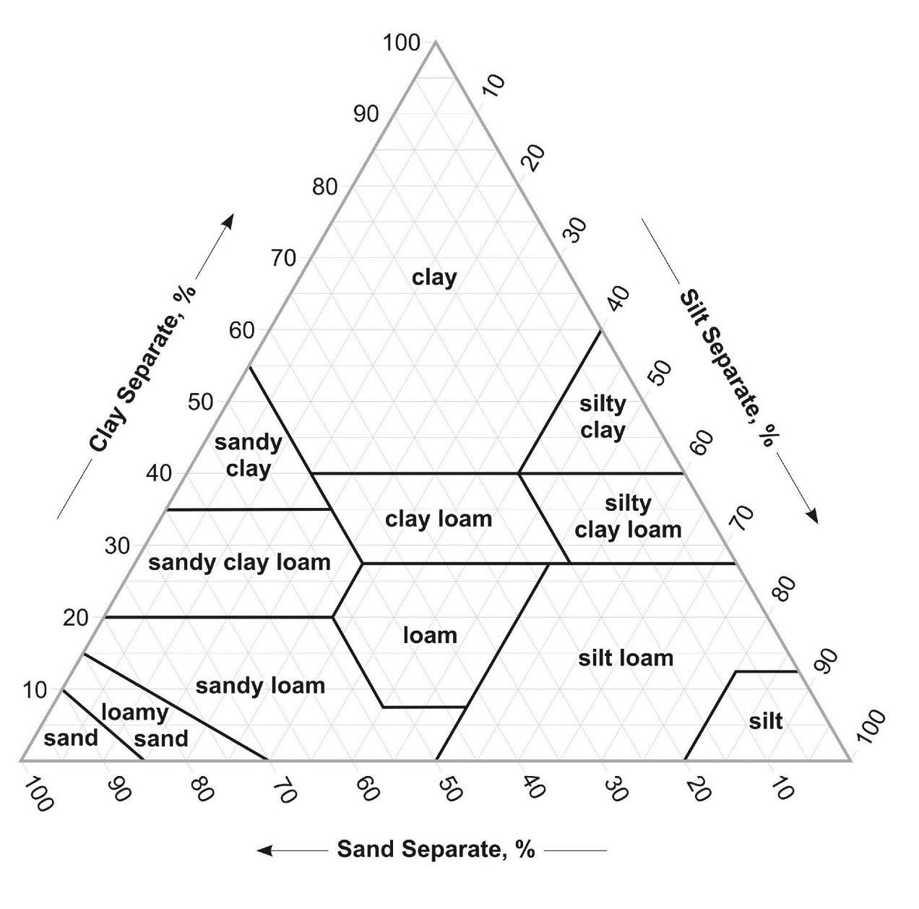
USDA Texture Classification
Groups sediments based on proportion of clay, silt, sand
Groupings are meant to emphasize water retention and transmission characteristics and tillage properties of sediment
Notes:
The manual texturing technique categorizes materials into USDA texture classifications.
These groupings are meant to emphasize the water transmission, water retention, and tillage properties of soil.
For sedimentological/stratigraphic studies it is generally preferred to classify the materials using the Udden-Wentworth scheme by quantifying the proportions of each grain size or qualitatively describing the dominant, secondary, and trace grain sizes. But manual texturing can help determine the relative proportion of clay, silt, and sand (what class or two classes are dominant, what is secondary, and what is trace) in a sample without having to then use the USDA categories as the descriptor for the sediment.

Slide 14
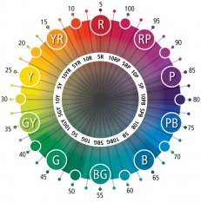
Assessing Color Using the Munsell System
Hue
Value (lightness)
Chroma
(purity or vividness)
red
White (10)
yellow-red
red-purple
yellow
purple
green-yellow
purple-blue
green
blue
blue-green
Black (0)
Notes:
You will often read sediment descriptions that use descriptive terms for color. These terms are subjective and can be difficult to compare from one sediment description to the next.
The Munsell system provides a consistent and quantitative approach to describing color.
Color is broken into 3 components:
Hue – this describes the basic color. Munsell assigned red, yellow, green, blue, and purple as the principle hues and arranged them around a circle and also defined 5 intermediate hues (e.g., yellow-red, red-purple). The circle is divided into 100 equal portions. The hues can be specified using a value between 0 and 100. However, Munsell felt the meaning was more obvious if each hue was identified by a code identifying the hue sector and then a step (on a scale of 10) within that sector. The red sector has a code of R, the yellow-red sector has a code of YR, the yellow sector has a code of Y, and so on. The hue in the middle of each sector is preceded by a ‘5’. So the middle of the red sector is 5R. The 10R sector is the last step in the red sector prior to the yellow-red sector. The zero step is not used.
Value – this describes the lightness or darkness of a color (how close to white or black) with a numeric value between 0 and 10
Chroma – this describes the saturation or vividness of a color. It is described with a numeric value that starts at 0 for neutral colors but does not have a maximum value.

Slide 15
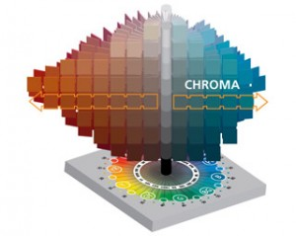
The Munsell System in 3-D
Chroma
Value
Hue
https://munsell.com/about-munsell-color/how-color-notation-works/munsell-chroma/
Notes:
Sometimes this 3-D view of the Munsell system is useful in conceptualizing how the hue, value, and chroma components come together to describe a color.

Slide 16
Munsell Color Charts for Geology and Soil Science
Notes:
Special collections of Munsell colors have been assembled into references for logging sediment/soil and rock samples.
These represent the colors most commonly observed in geologic materials.

Slide 17
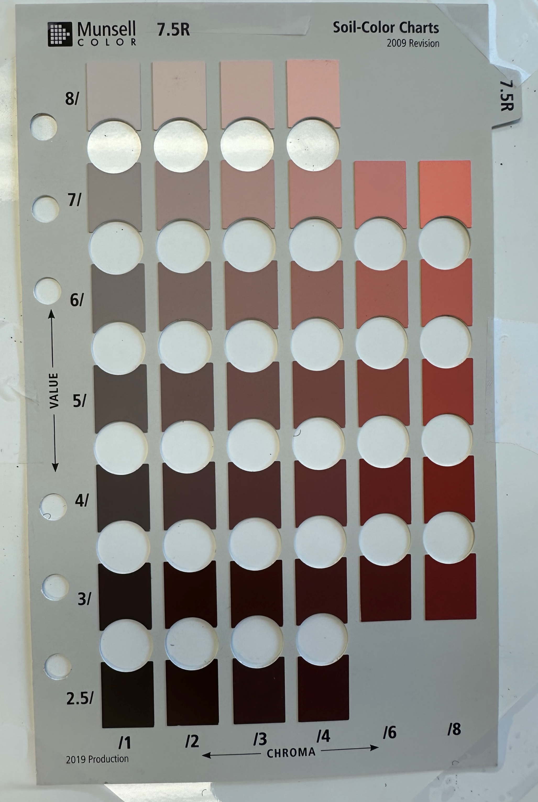
Recording Munsell Colors
7.5R 6/3
Hue
Chroma
Value
Notes:
To determine the correct value for your sediment:
Grab a representative piece to compare to the color chart.
Place the sample in your hand and arrange the chart over your hand so the sample can be observed through one of the holes
Move the chart around so you can compare the sediment to different chips
When you find the one with the closest match, record the value.
The Hue is the number of the page
The value is the number on the vertical axis
The chroma is the number on the x axis.
Be sure to examine the color under consistent lighting conditions, preferably under natural light (but not full sun).
Soils are usually ‘colored’ when moist (not wet or dry). Rocks can be colored when they are wet or dry (be consistent and make note of which condition applies).

Slide 18
Sorting
Describes the uniformity of the size of grains
Well sorted – grains are mostly similar in diameter
Poorly sorted – wide range of grain sizes

Slide 19
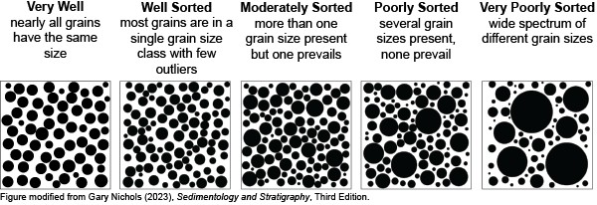
Visual Method to Assess Sorting in the Field
Compare sediment to visual references
Figure modified from Gary Nichlos (2023), Sedimentology and Stratigraphy, Third Edition
Notes:
In the field we typically use visual references to assess sorting.
Grad a representative sample of the sediment, use your hand lens to observe the grains. Compare what you see in your field of view to the descriptors and images above and apply the label that best fits your sample.
You can also apply a label that indicates the sample is ‘in between’ these classes. So, for example, well to very well or very poorly to poorly. This is accomplished with a graphical shading log by fully shading in both columns (very poorly and poorly) for the rounding parameter.

Slide 20


Laboratory Methods to Assess Sorting
Conduct particle size analyses using sieves or another method
Plot the data as a cumulative grain size distribution curve
Apply a graphical method for estimating sorting
100
95%
84%
80
60
50%
Cumulative weight percent passing
40
20
16%
5%
0
-1
2
3
4
5
$φ$ Size
Sorting = inclusive graphic
standard deviation
$$\frac{φ_{84}−φ_{16}}{4}−\frac{φ_{95}−φ_{5}}{6.6}$$
=
Folk and Ward, 1957, Journal of Sedimentary Petrology
Notes:
Sorting can also be quantified based on the results from particle size analysis.
Sorting essentially describes the spread of a grain size curve (cumulative probability density function)
There are different ways to describe the spread of this curve numerically. One of the most popular comes from a paper by Folk and Ward in 1957 and is shown in the equation on the slide.
phi < 3; extremely well sorted
0.3-0.6; very well sorted
0.6-0.9; well sorted
0.9-1.1; moderately sorted
1.1-1.5; poorly sorted
1.5-3.0; very poorly sorted
>3.0; extremely poorly sorted
phi being the log base 2 of the particle diameter
Reference
Folk, R.L. and Ward, W.C. (1957) A Study in the Significance of Grain-Size Parameters. Journal of Sedimentary Petrology, 27, 3-26.
https://doi.org/10.1306/74D70646-2B21-11D7-8648000102C1865D

Slide 21
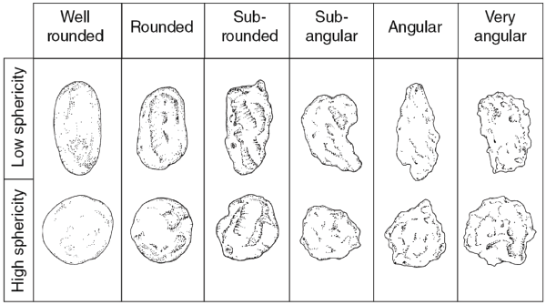
Assessing Rounding In the Field
Compare sediment to visual references to characterize rounding
Figure modified from Gary Nichols (2023), Sedimentology and Stratigraphy, Third Edition. Classification originally from Pettijohn et al. (1987).
Notes:
It can also be beneficial to describe the rounding of sand size particles (or pebbles and cobbles) because the roundness of the particle can be related to the transport distance/time.
In the field this is typically done qualitatively with a visual reference like the one above.
Examine your sediment sample with your hand lens and see which category best fits the shape of the bulk of the grains.
You can also record intermediate categories like very angular to angular if your sediments fall in between these categories. This is accomplished with a graphical shading log by shading in both columns fully (angular and very angular) for the rounding parameter.

Slide 22
Sedimentary Structures
Visible patterns/features in the sediments or sedimentary rock that reflect the environmental conditions at the time of deposition very shortly thereafter (Boggs 2001).
The major categories
Physical
Biogenic
Chemical
Notes:
Sedimentary structures provide us with clues about the processes that formed the sediments. If we understand the processes we can better predict the geometry and extent of the sediment types in areas where we don’t have data.
Physical sedimentary structures are visible features in sediments that are the result of physical interaction between the sediments and their environment.
Biogenic sedimentary structures are features formed by organisms interacting with the sediments.
Chemical sedimentary structures are features formed by chemical interactions between fluids and the sediments.
Reference
Boggs, S. 2001. Principles of Sedimentology and Stratigraphy, 3rd ed. Prentice Hall, Upper Saddle River, NJ.

Slide 23
Why Do We Care About Sedimentary Structures in Hydrogeology?
We often need to interpolate or predict what a particular sedimentary unit looks like between boreholes/wells (i.e., data points)
Shape
Thickness
Extent
Understanding the processes that formed the sediments provided important clues into these characteristics
Sedimentary structures, at a variety of scales, also contribute to anisotropy and heterogeneity in hydraulic conductivity

Slide 24
Assessing Structures
There are a wide variety of sedimentary structures
Using visual references is helpful in identifying structures
Having a broad sense of the environment where the sediments were deposited can narrow down the options (i.e., fluvial, marine, aeolian, etc.)
Notes:
There are numerous types of sedimentary structures that occur at many different scales.
Sedimentary structures are generally identified visually. For beginners, it can be helpful to have a reference sheet with common structures expected to occur in the sediments you are logging based on their general depositional setting. These include types of stratification or bedding.

Slide 25
Characterizing Boundaries
Describe how quickly the sediment transitions across a boundary
Class | Description
Very abrupt | < 0.5 cm
Abrupt | 0.5 to < 0.2 cm
Clear | 2 to < 5 cm
Gradual | 5 to < 15 cm
Diffuse | ≥ 15 cm
Schoeneberger, P.J., D.A. Wysocki, E.C. Benham, and Soil Survey Staff. 2012. Field book for describing and sampling soils, Version 3.0. Natural Resources Conservation Service, National Soil Survey Center, Lincoln, NE.
The geometry of the boundary can also be described (i.e., planar, wavy, sutured)
Notes:
Descriptions of the boundaries between units can provide information on the nature of change in depositional conditions from one sediment type to the next. A very abrupt or abrupt boundary (also referred to as sharp) generally indicates a fast transition between depositional settings or a period of non-deposition and/or erosion. Whereas a gradual or diffuse boundary might just record a gradual change in the processes depositing sediments.
The table above provides one semi-quantitative way to describe the boundaries. Sometimes the geometry of the boundary is also described.
On a graphical shading log, you shade in the relevant value right on top of the contact you are describing (see example).

Slide 26
Assessing Consistency
Consistency is often described for unconsolidated sediments. It can be thought of as the force required to break the sediment apart. For rock we often use a qualitative cementation index.
Moist Sediment | Specimen Fails Under
Loose | In tact specimen not obtainable
Very friable | Very slight force between fingers
Friable | Slight force between fingers
Firm | Moderate force between fingers
Very Firm | Strong force between fingers
Extra Firm | Moderate force between hands
Schoeneberger, P.J., D.A. Wysocki, E.C. Benham, and Soil Survey Staff. 2012. Field book for describing and sampling soils, Version 3.0. Natural Resources Conservation Service, National Soil Survey Center, Lincoln, NE.
Notes:
Often a description of the consistency of the sediment or degree of cementation/hardness for a rock is useful.
This table provides a standard reference for field evaluation of consistency for unconsolidated sediments from the NRCS field book for describing and sampling soils.

Slide 27
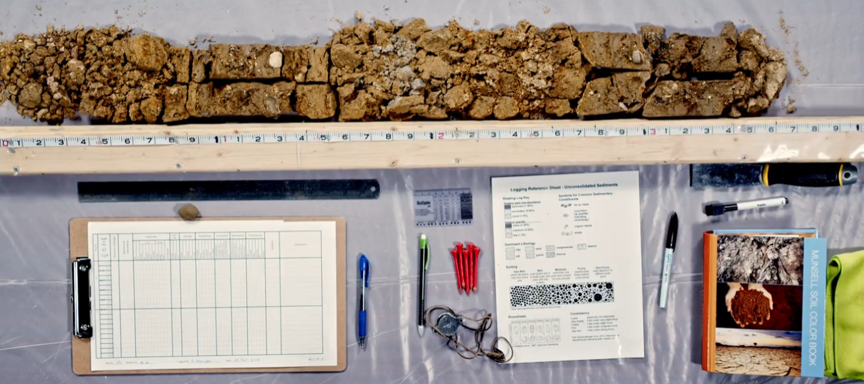
Have Fun Logging!

