Slide 1
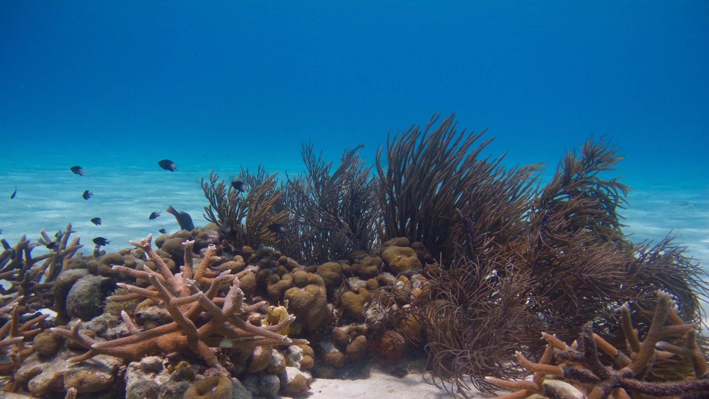
Reef Survivor Jr Game-
Modeling Reef Ecosystems
Notes:
Image licensing information: All images and diagrams in this slideshow are by Hannah Rempel, unless otherwise indicated.
Accessibility information: Alternative text is provided for images in this slideshow and slide contents are arranged so that content will be read in the appropriate order for learners with visual impairment using voice-to-text readers.
By the end of this lesson students will learn:
What is a coral reef ecosystem?
What are some of the organisms found on coral reefs?
What is a primary producer, herbivore, omnivore, and carnivore?
How are organisms in the ecosystem interdependent?

Slide 2
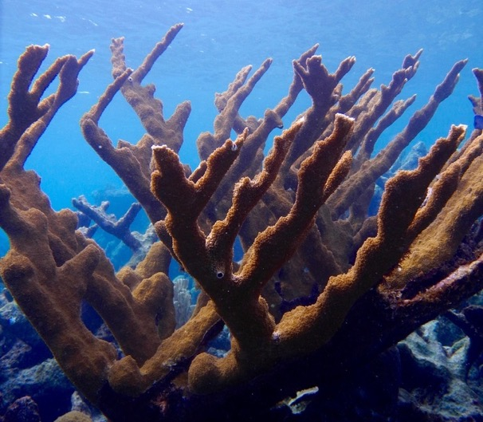
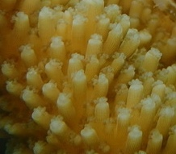
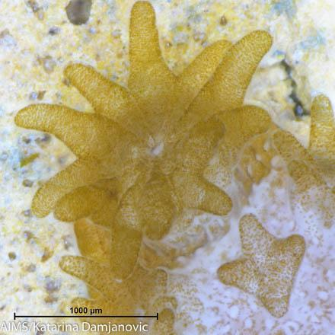



What are corals?
They may look like rocks or plants, but are actually animals!
Corals live in tropical waters and are made up of colonies of genetically identical structures called polyps (“paw-lips”).
Coral colony
Group of polyps
A single polyp
Notes:
Image 3 (“polyp close-up”) is by Katarina Damjanovic at the Australian Institute of Marine Science (AIMS), with a creative commons license. In accordance with the license and usage agreement, here is a link to the license: https://creativecommons.org/licenses/by/3.0/au/deed.en.

Slide 3
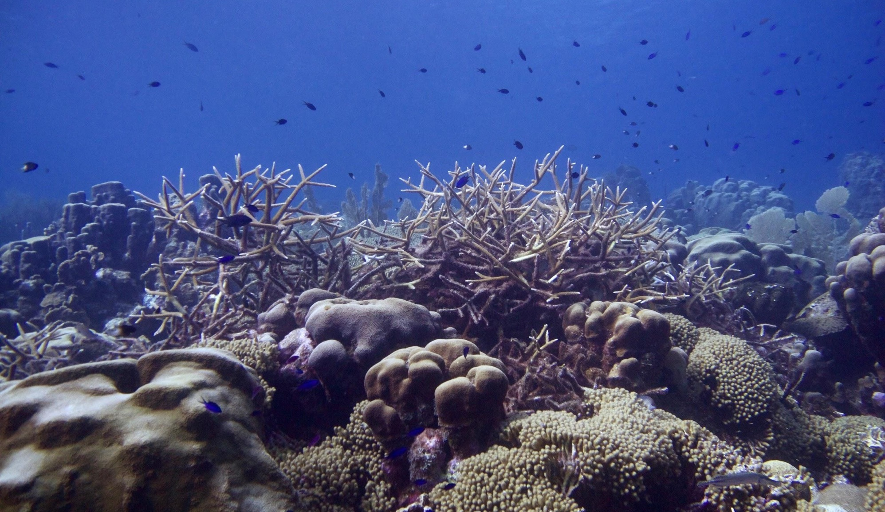
There are many coral types that make up a reef
Staghorn coral
Boulder star coral
Yellow pencil coral
Notes:
Coral reefs are formed by thousands of coral coral colonies slowly growing over hundreds of years!
This photo show a coral reef in the Caribbean with many different types of coral.
Image credit: Hannah Rempel, location: Bonaire

Slide 4
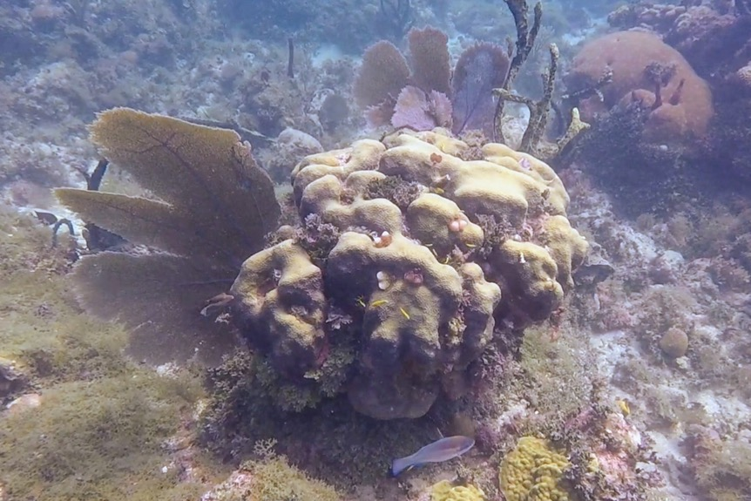
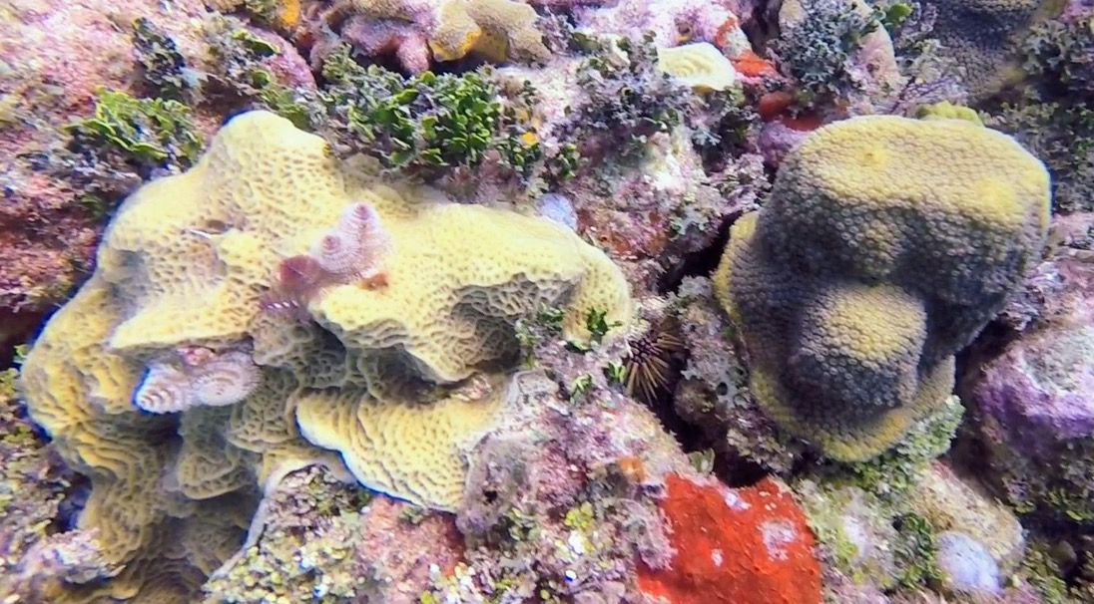
Coral and Algae share space on the ocean floor
Algae
Coral
Notes:
Photos taken by Dr. Rowan Martindale and shared for this lesson plan

Slide 5
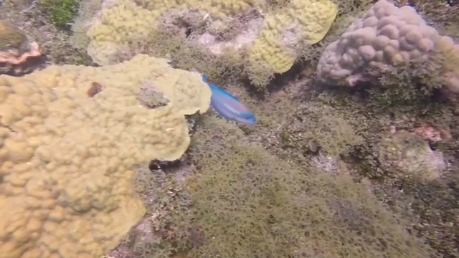
Parrotfish Eat Algae
Notes:
https://photos.app.goo.gl/GwKu55qgdtHLqZ2q8
Video filmed by Dr. Rowan Martindale and shared for this lesson plan

Slide 6
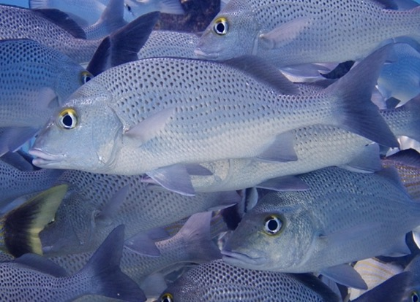
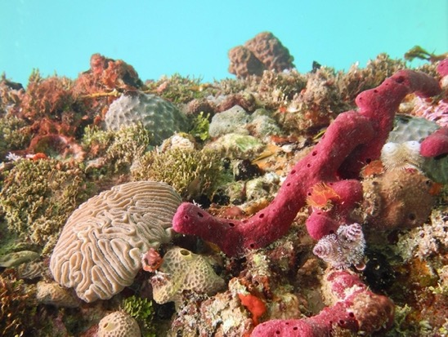
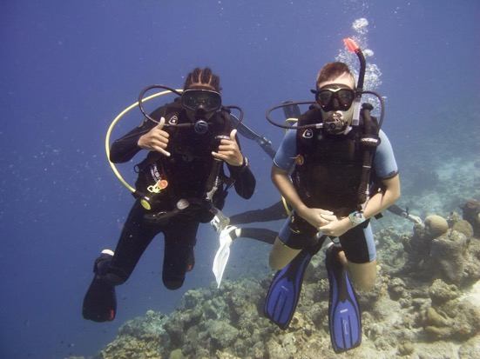
Why are corals reefs important?
Jobs like fishing and tourism
Food like fish, squid, lobster
Protection from waves and storm damage
Medicines made from reef critters!
Notes:
Ask students: Why do you think coral reefs are important?
Coral reefs are important as a job source, food source, they protect the coastline from waves and storm damage, and new medicines have been developed from reef creatures!

Slide 7
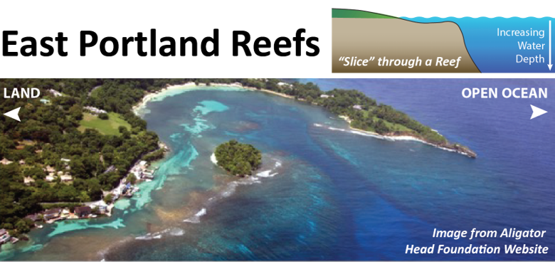
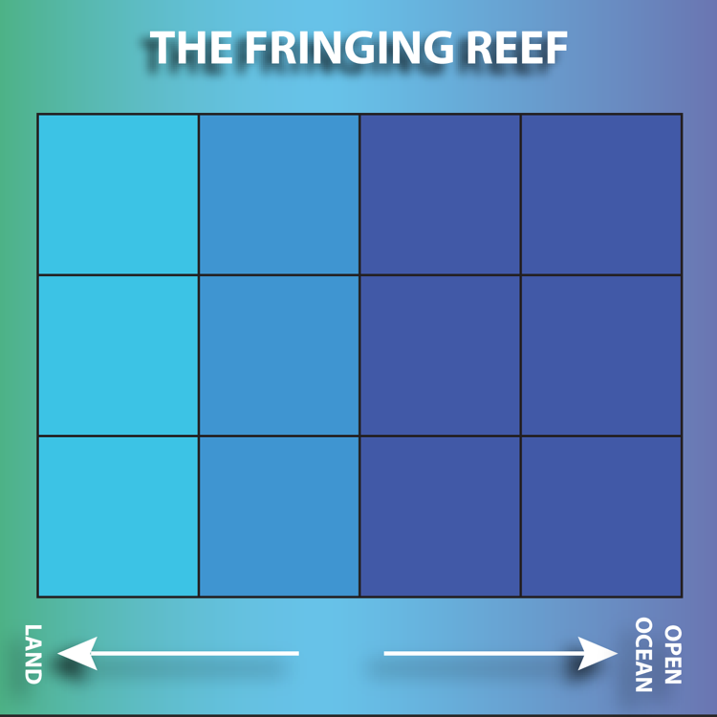
Let’s Play a Game
Game Board = Your coastline to build a reef

Slide 8
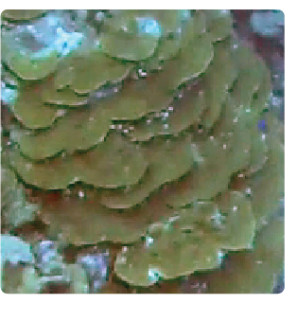
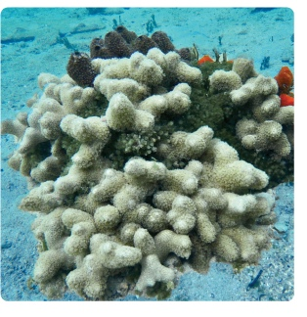
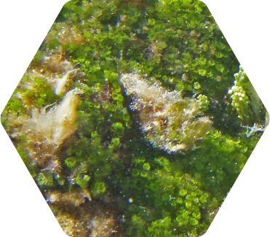
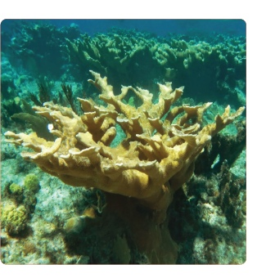
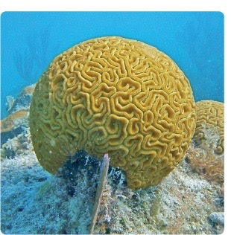
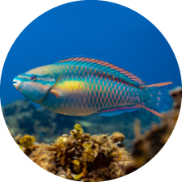
Let’s Play a Game
Different coral reef builders with different traits!
Algae compete with the corals for space
Parrotfish eat algae

Slide 9
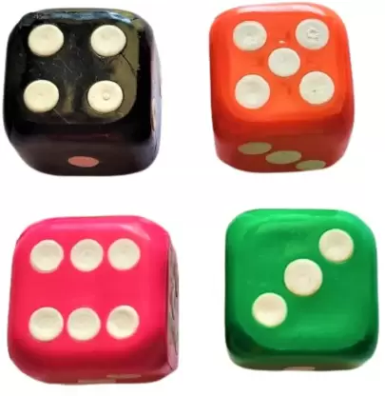




Let’s Play a Game
Corals (reef builders) get different traits!
(Roll the dice once for each coral)

Slide 10
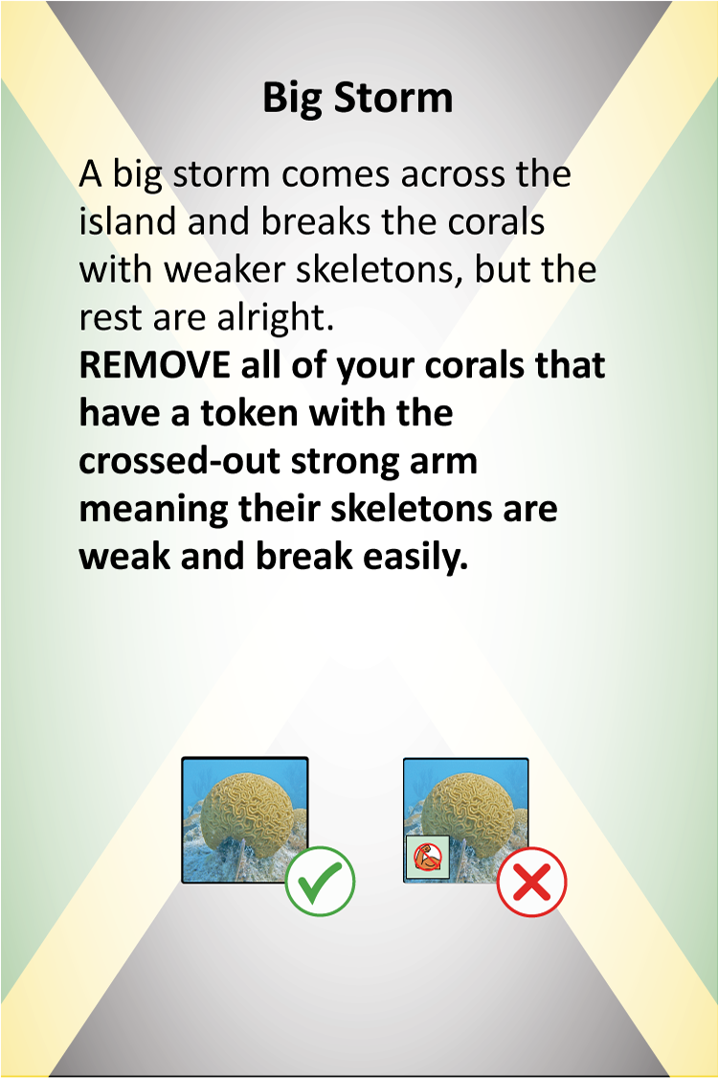

Let’s Play a Game
Survive the disaster!

Slide 11
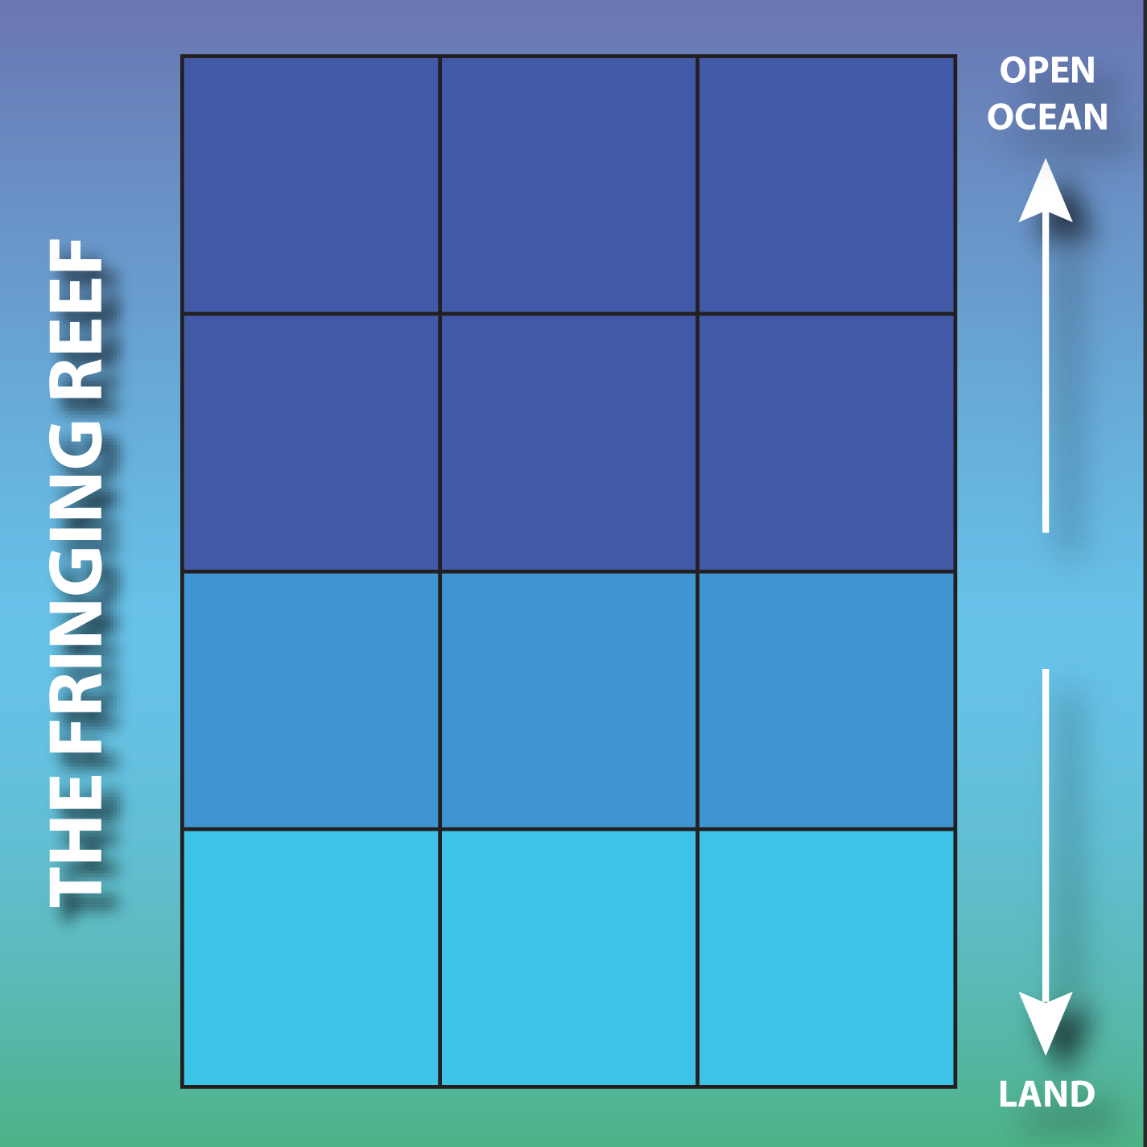
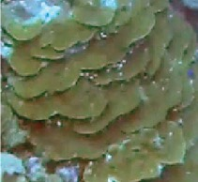

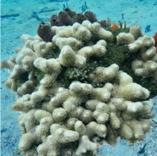
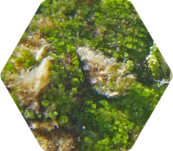
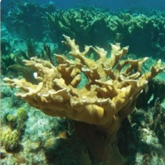
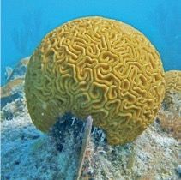
Step 1 - Build your reef
(team of 2)
Choose 4 coral tokens (reef builders) and place them on your board
Add 3 alga tokens
Add 1 parrotfish for every 2 corals

Slide 12
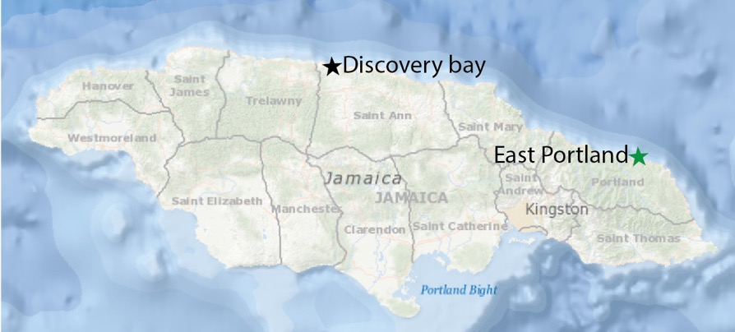
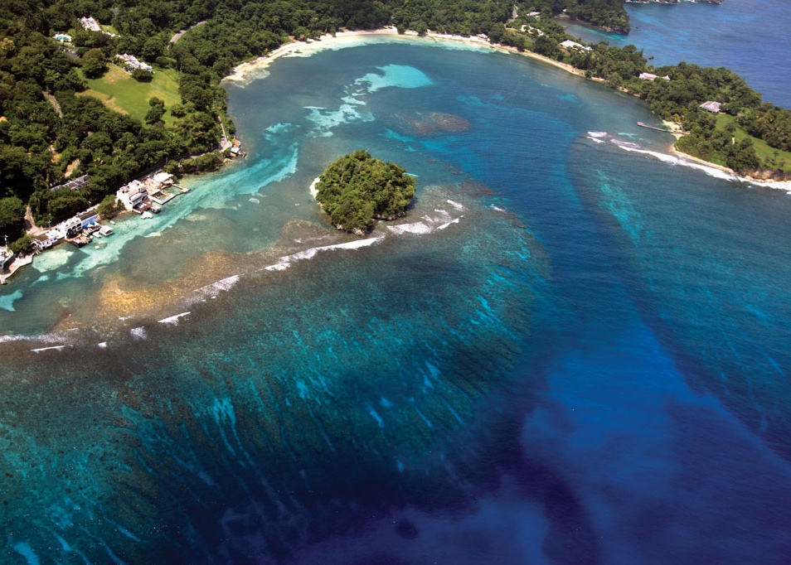
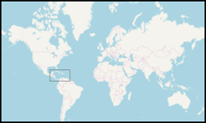
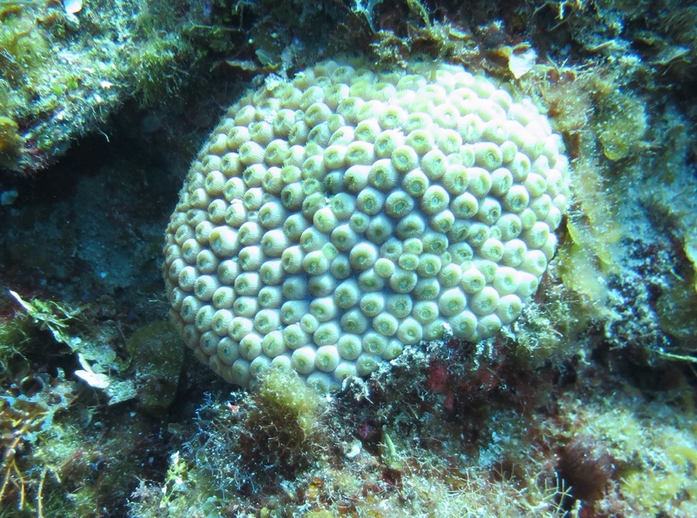
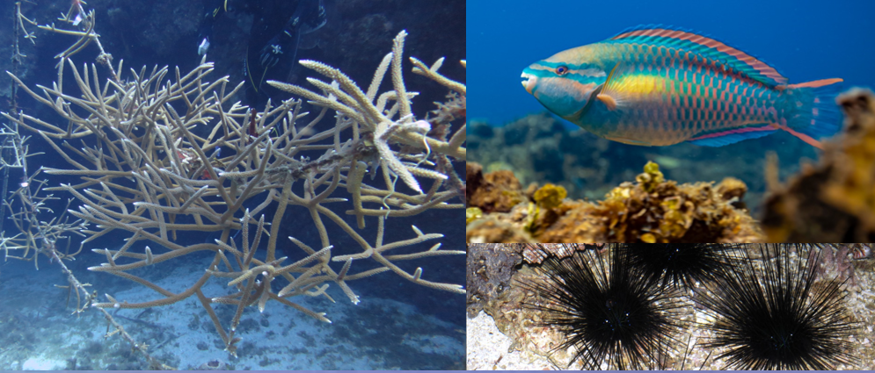
Star Coral
Let’s build some reefs!
Parrot fish
Staghorn Coral
Urchins

Slide 13
Step 2 - Lunchtime!
Assess how many parrotfish can live on your board (in the first round, we have already done this in the setup!)
Add 1 parrotfish for every 2 corals
Each parrotfish eats 1 alga (remove token)

Slide 14
Step 3 - Get new traits
Corals (reef builders) get different traits!
(Roll the dice once for each coral)

Slide 15



Step 3 - Get new traits

Slide 16
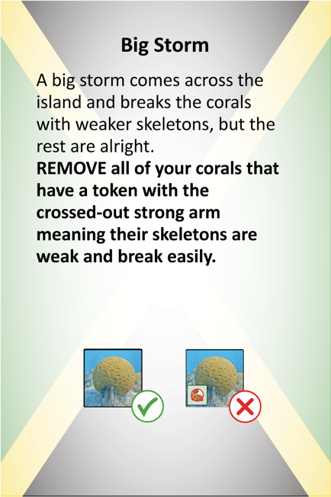
Step 4 - Survive!
Pull ONE disaster for the table from the deck.
See whose reef survives!

Slide 17
Step 5 – Scores
See who is winning!
Get 1 point for each coral and a bonus point for each kind of coral.
3 + 3

Slide 18
Step 6 - Reproduce!
Each coral makes an identical baby, place it on your board if you can or trade with someone else at the table.

Slide 19
Step 7 - Reproduce!
Each alga reproduces.
If there is no room, your algae will cover a coral (taking it out of play until the alga is eaten off).

Slide 20
Repeat steps 2-7 three more times
Step 2 - Lunchtime!
Step 3 - Get new traits
Step 4 - Survive!
Step 5 - Scores!
Step 6 - Reproduce (Corals)!
Step 7 - Reproduce (Algae)!
Ways to win:
  Healthy reef: Board covered in coral with no algae!
  Tourism Boost: Have the most diverse coral reef (the most types of coral and fish)
  Food Security: Keep 4 parrotfish on your reef
  Coastal Protection: 2 rows of corals between the land and ocean

