Slide 1

What is Climate Change?
The Roberts Environmental Center

Slide 2
Focus Questions
What is climate change?
How are humans causing climate change?
Agenda
1. Intro (5 minutes)
2. Warm Up Activity (10 minutes)
2. Discussion & Climate Change Basics (15 minutes)
3. Carbon Cycle Model (20 minutes)
5. If extra time: answer more sticky note questions
Notes:
Have a student explain the graph

Slide 3
Warm Up
What is one thing you know about climate change?
What is one thing you want to know about climate change?
What is one thing that confuses you about climate change?
Choose one question to answer, write your answer on a sticky note, and post on the board.
Notes:
Have a student explain the graph

Slide 4
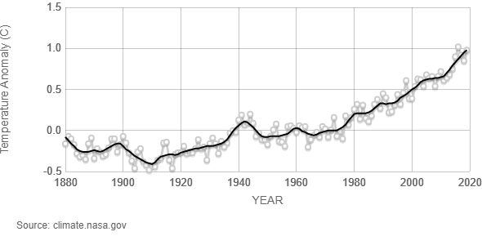
What is Global Warming?
Words: Climate Change vs. Global Warming
Notes:
Have a student explain the graph, explain temperature anomaly and what that means (1950-2000), earth is getting hotter and hotter faster

Slide 5
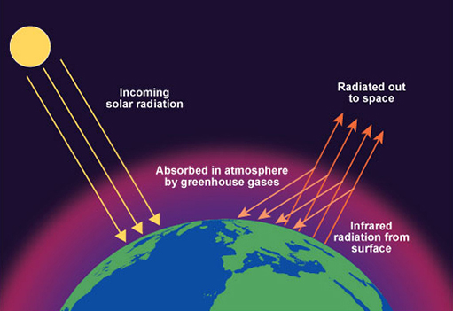
Why is the Earth Warming?
Greenhouse Gas Effect: A Heat Trapping Blanket
Energy from the sun passes through the atmosphere and is absorbed by the earth
The earth reflects infrared radiation (heat) back into space
Greenhouse gases are able to trap infrared radiation and reflect it back to earth
Without greenhouse gas, earth would be 0°F
But, humans are changing this system and putting too much carbon dioxide into the atmosphere →the Earth is getting too warm, too fast
Notes:
Have a student explain the graph

Slide 6
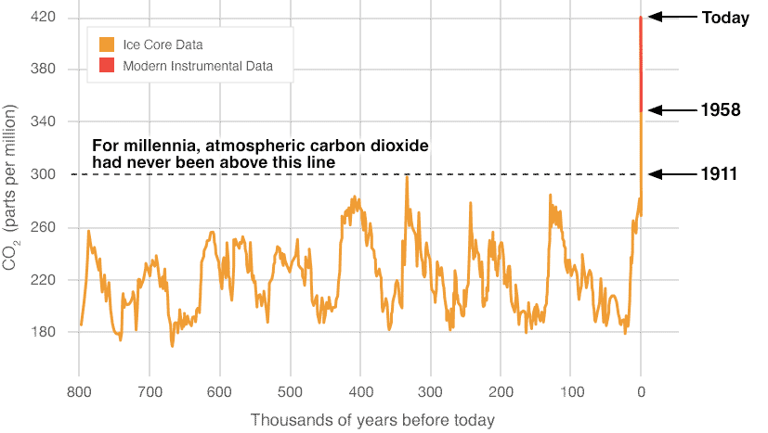
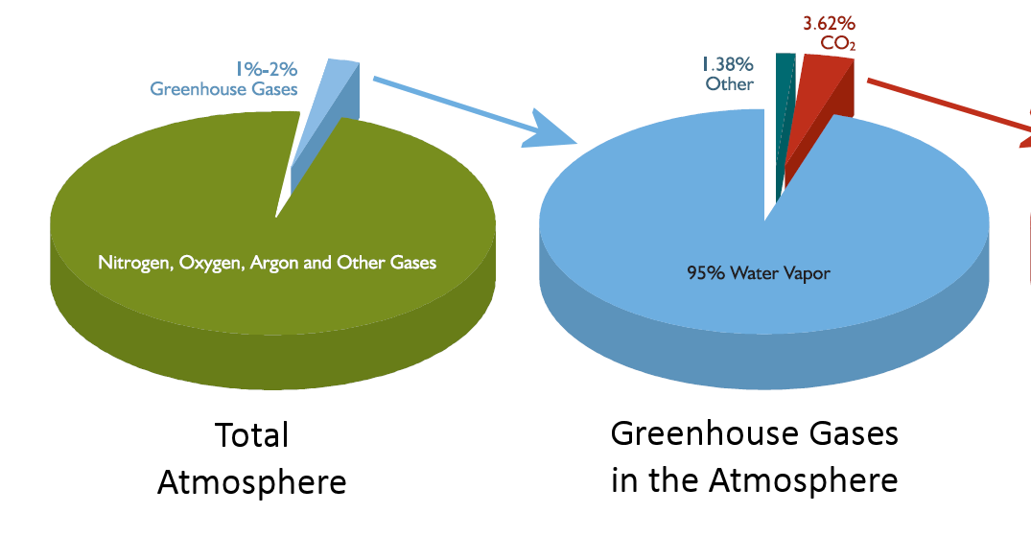
Why is the Earth Warming?
Types of Greenhouse Gases
But, humans are changing this system and putting too much carbon dioxide into the atmosphere →the Earth is getting too warm, too fast
Notes:
Have a student explain the graph

Slide 7
Activity: Carbon Cycle Roleplay
This activity will help us explore how carbon dioxide gets into the atmosphere and acts like a heat trapping blanket.
Review Terms
Carbon
Photosynthesis
Respiration
Decomposition
Weathering
Fossil Fuels
Notes:
Humans are disrupting the natural carbon cycle, moving carbon dioxide into the atmosphere much faster than natural. These actions are what is causing global warming.
Burning fossil fuels takes carbon from sediments and rocks where fossil fuels are buried and puts it into the atmosphere because when fossil fuels are burned they release carbon-containing gases.
Cutting and burning trees takes carbon from the land plants and puts it into the atmosphere because when trees are burned, the carbon that was stored in their structures is released as carbon-containing gases.

Slide 8
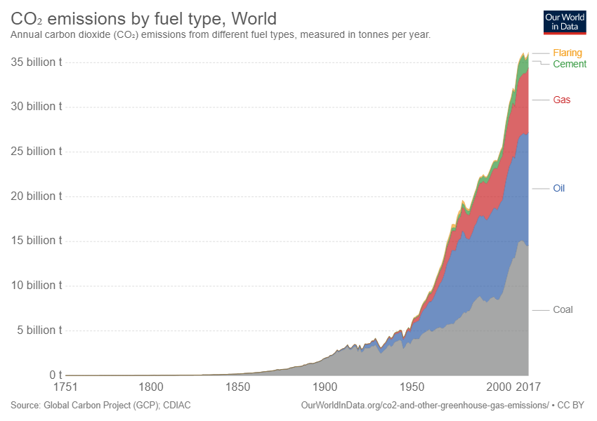
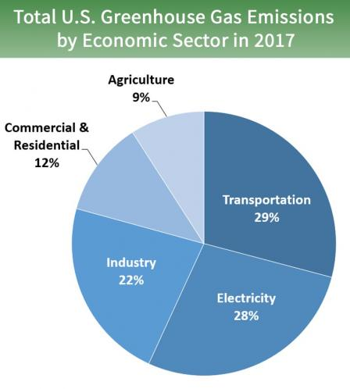
Activity: Carbon Cycle Roleplay
Final Questions:
What were the two ways humans put carbon dioxide into the atmosphere?
Did humans move faster or slower than the natural carbon cycle?
What other ways might humans impact the carbon cycle?
Notes:
Humans are disrupting the natural carbon cycle, moving carbon dioxide into the atmosphere much faster than natural. These actions are what is causing global warming.
Burning fossil fuels takes carbon from sediments and rocks where fossil fuels are buried and puts it into the atmosphere because when fossil fuels are burned they release carbon-containing gases.
Cutting and burning trees takes carbon from the land plants and puts it into the atmosphere because when trees are burned, the carbon that was stored in their structures is released as carbon-containing gases.

Slide 9

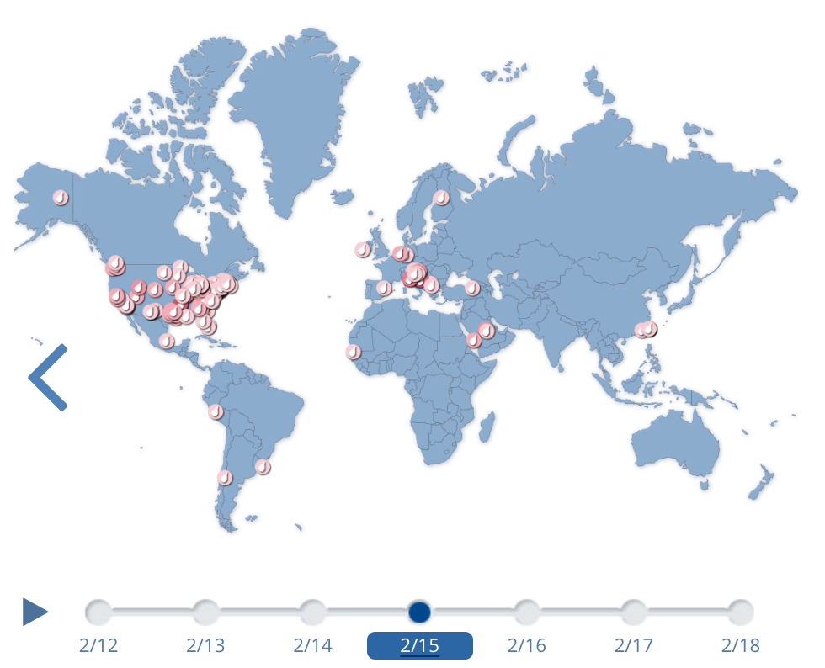
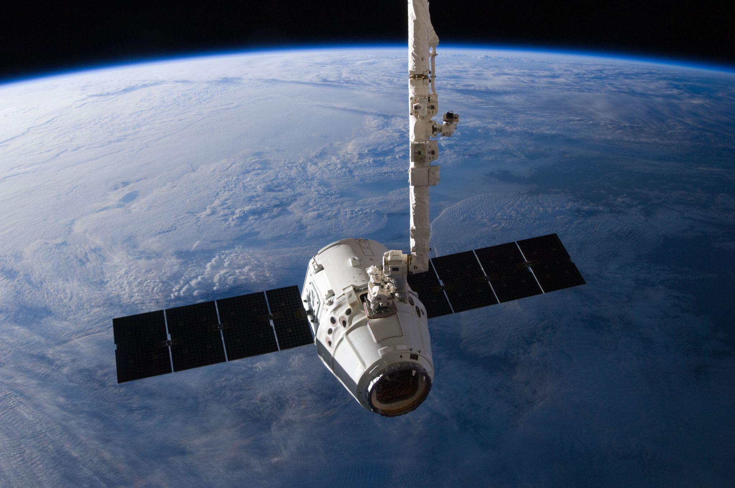
What Can You Do: Community Scientists
Your action is powerful! One way we can take action against climate change is to become community scientists. Community Scientists work together with trained scientists to collect data on climate change.
Notes:
Have a student explain the graph

Slide 10
Let’s Go Do Science!
We’re going to go collect observation about the clouds, which NASA scientists will compare with their satellite observations. Like we learned, clouds play an important role the Greenhouse Gas Effect–as the climate changes, so will clouds.
Next Lesson
Effects of Climate Change & Ocean Acidification Lab
Did we answer our focus questions? Thumbs up, down, or sideways….
What is climate change?
How are humans causing climate change?
How does carbon dioxide harm the environment?
How much time and effort does it take to turn natural things into pollutants?
Notes:
Have a student explain the graph

Slide 11
Bonus Time
Answer sticky note questions
Notes:
Have a student explain the graph

