Slide 1
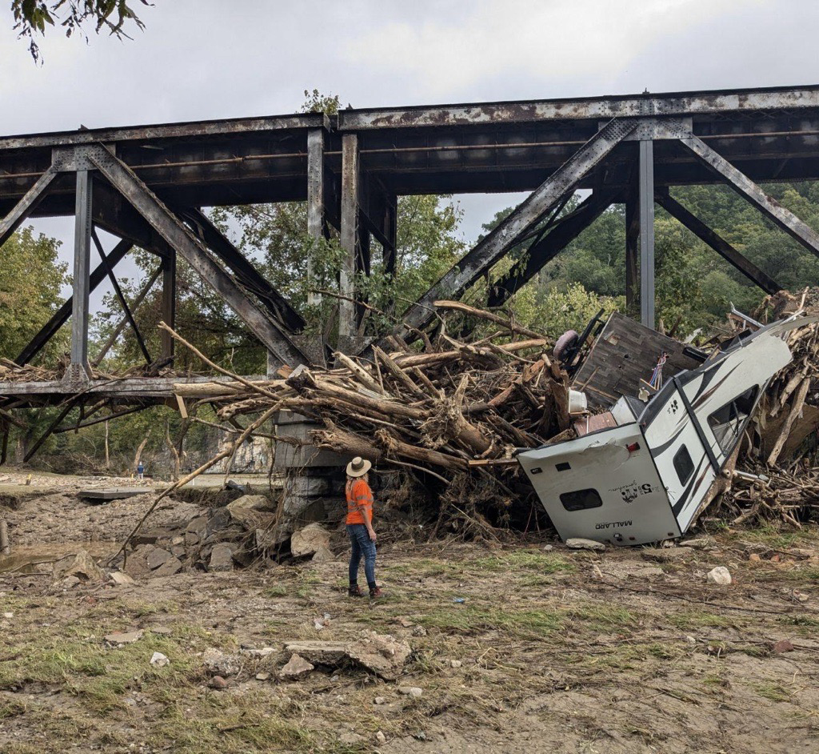
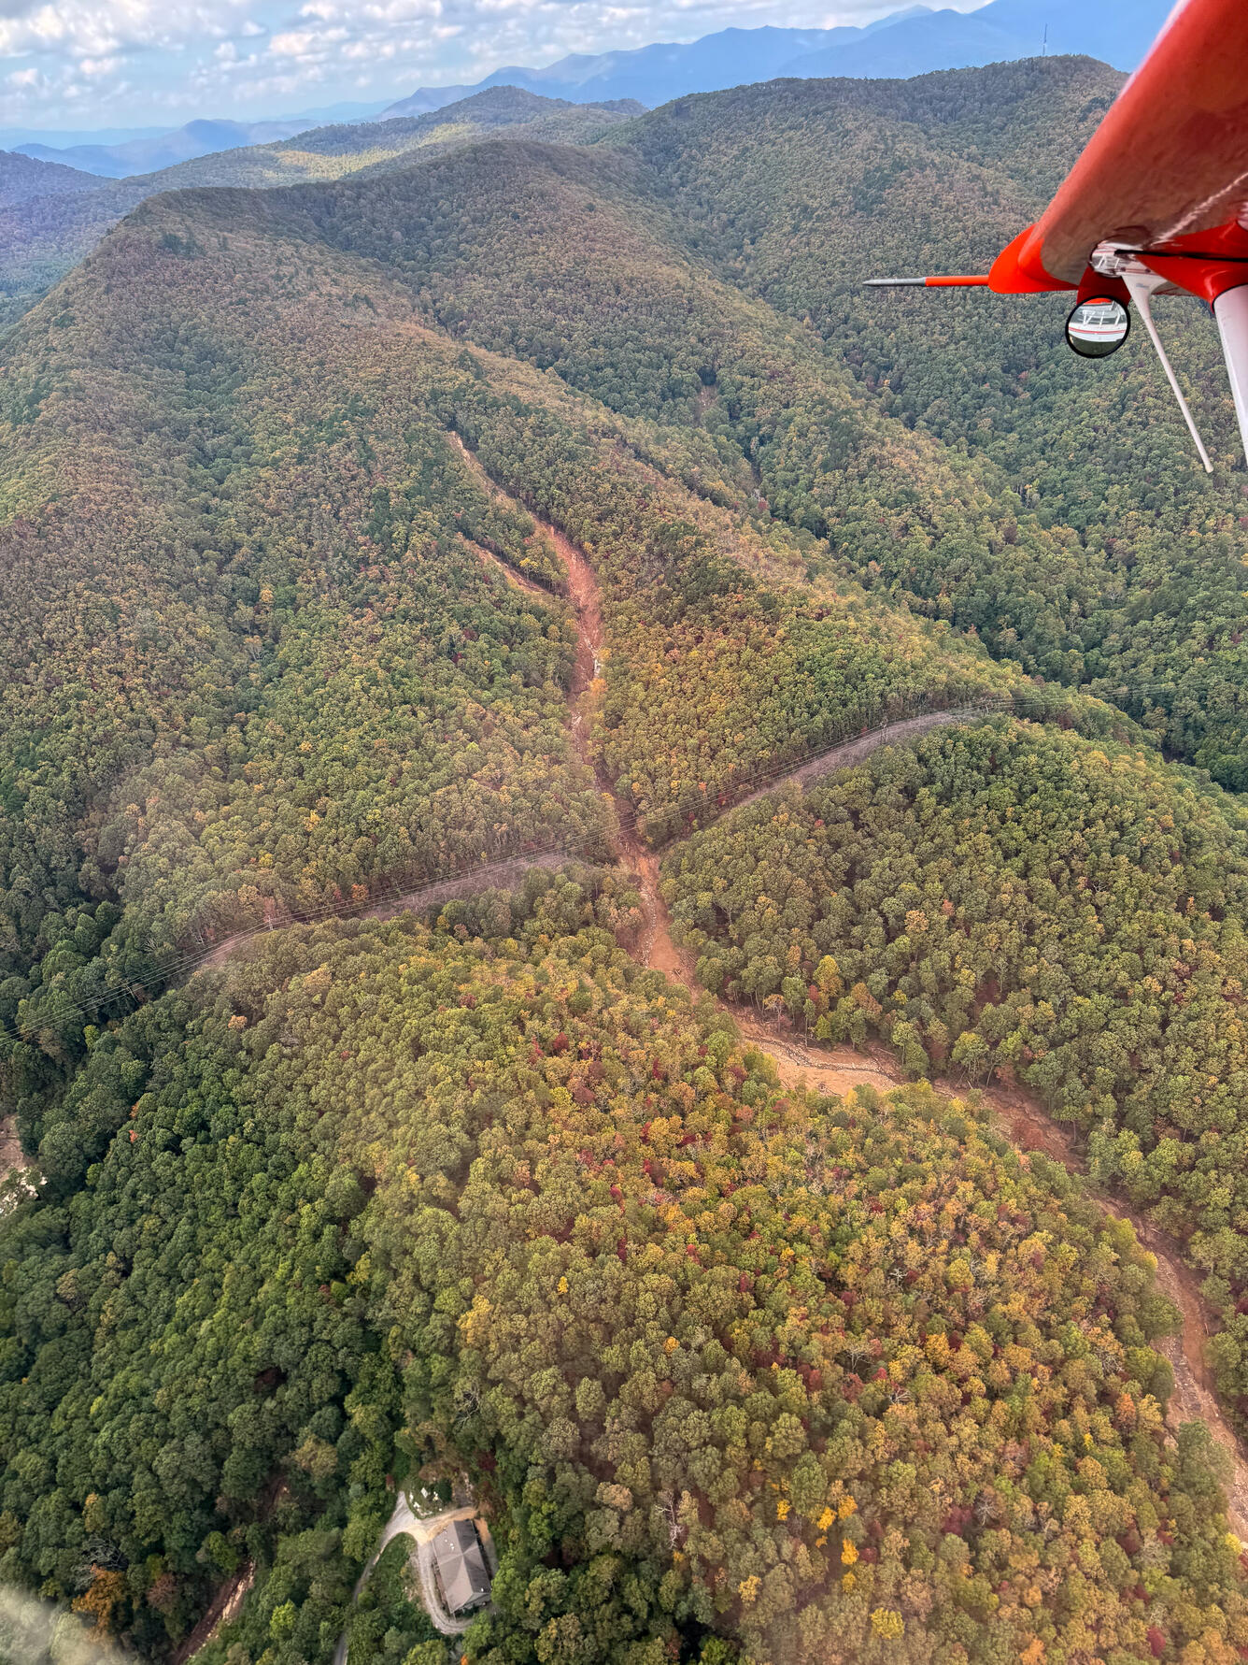
A Case Study from the Pigeon River Watershed, Western, NC
Background: Extreme Flooding in Western North Carolina: Hurricane Impacts far from the Coast
Hurricane Helene damage – Pigeon River Newport, TN (USGS Public Domain)
Hurricane Helene landslide reconnaissance flight (USGS Public Domain)
Notes:
Image notes:
Pigeon River damage: USGS Public Domain https://www.usgs.gov/media/images/aftermath-severe-flooding-pigeon-river-newport-Tennessee
Landslide overflight: USGS Public Domain https://www.usgs.gov/media/images/usgs-landslide-event-team-activated-wake-hurricane-helene

Slide 2
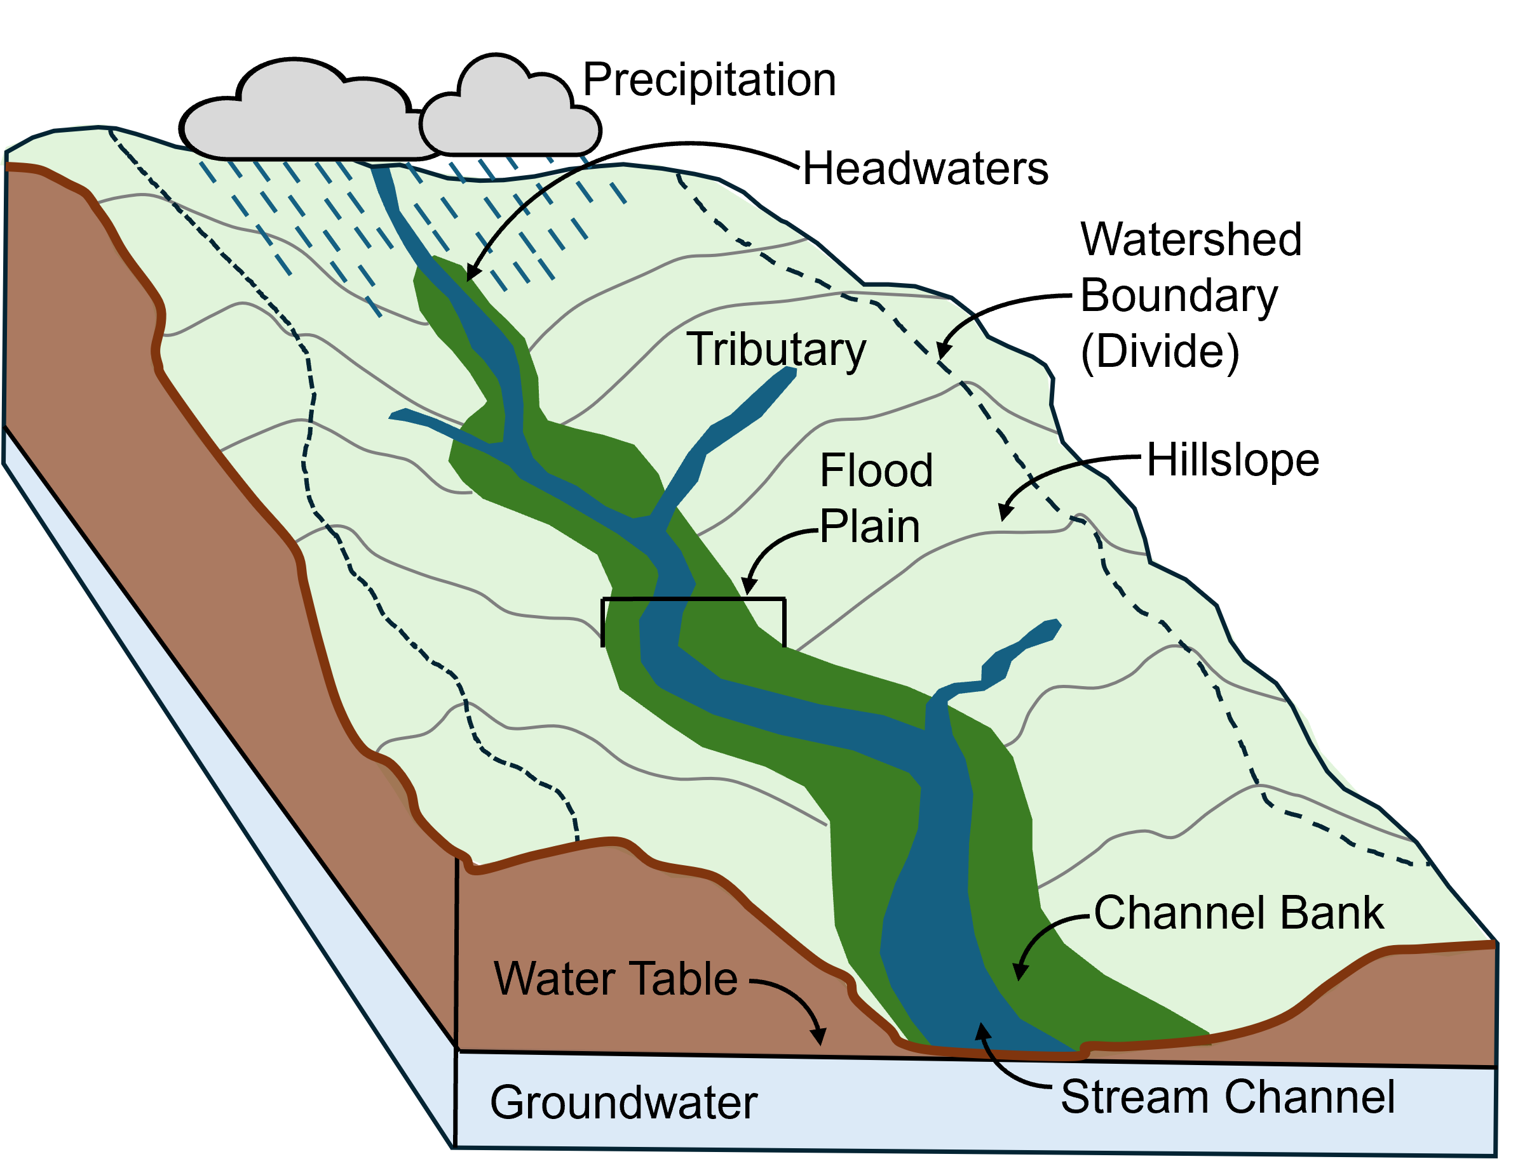
What is a watershed?
Area of land where all water drains or flows downhill to a single outlet or point along a stream
Water flows downhill due to gravity.
Watershed boundaries are defined by topography.
Figure courtesy of Will Hefner
Notes:
Instructor notes: The main points to address in this slide include: 1) Watersheds vary in size and shape from small tributaries to larger trunk (main) channels. 2) Topography defines the boundary of watersheds and where water can flow downhill. 3) Gravity is the major force driving the flow of water downhill and steeper slopes allow for faster flow over Earth’s surface and in channels.
Image notes: Watershed figure from Will Hefner (made in PowerPoint)

Slide 3
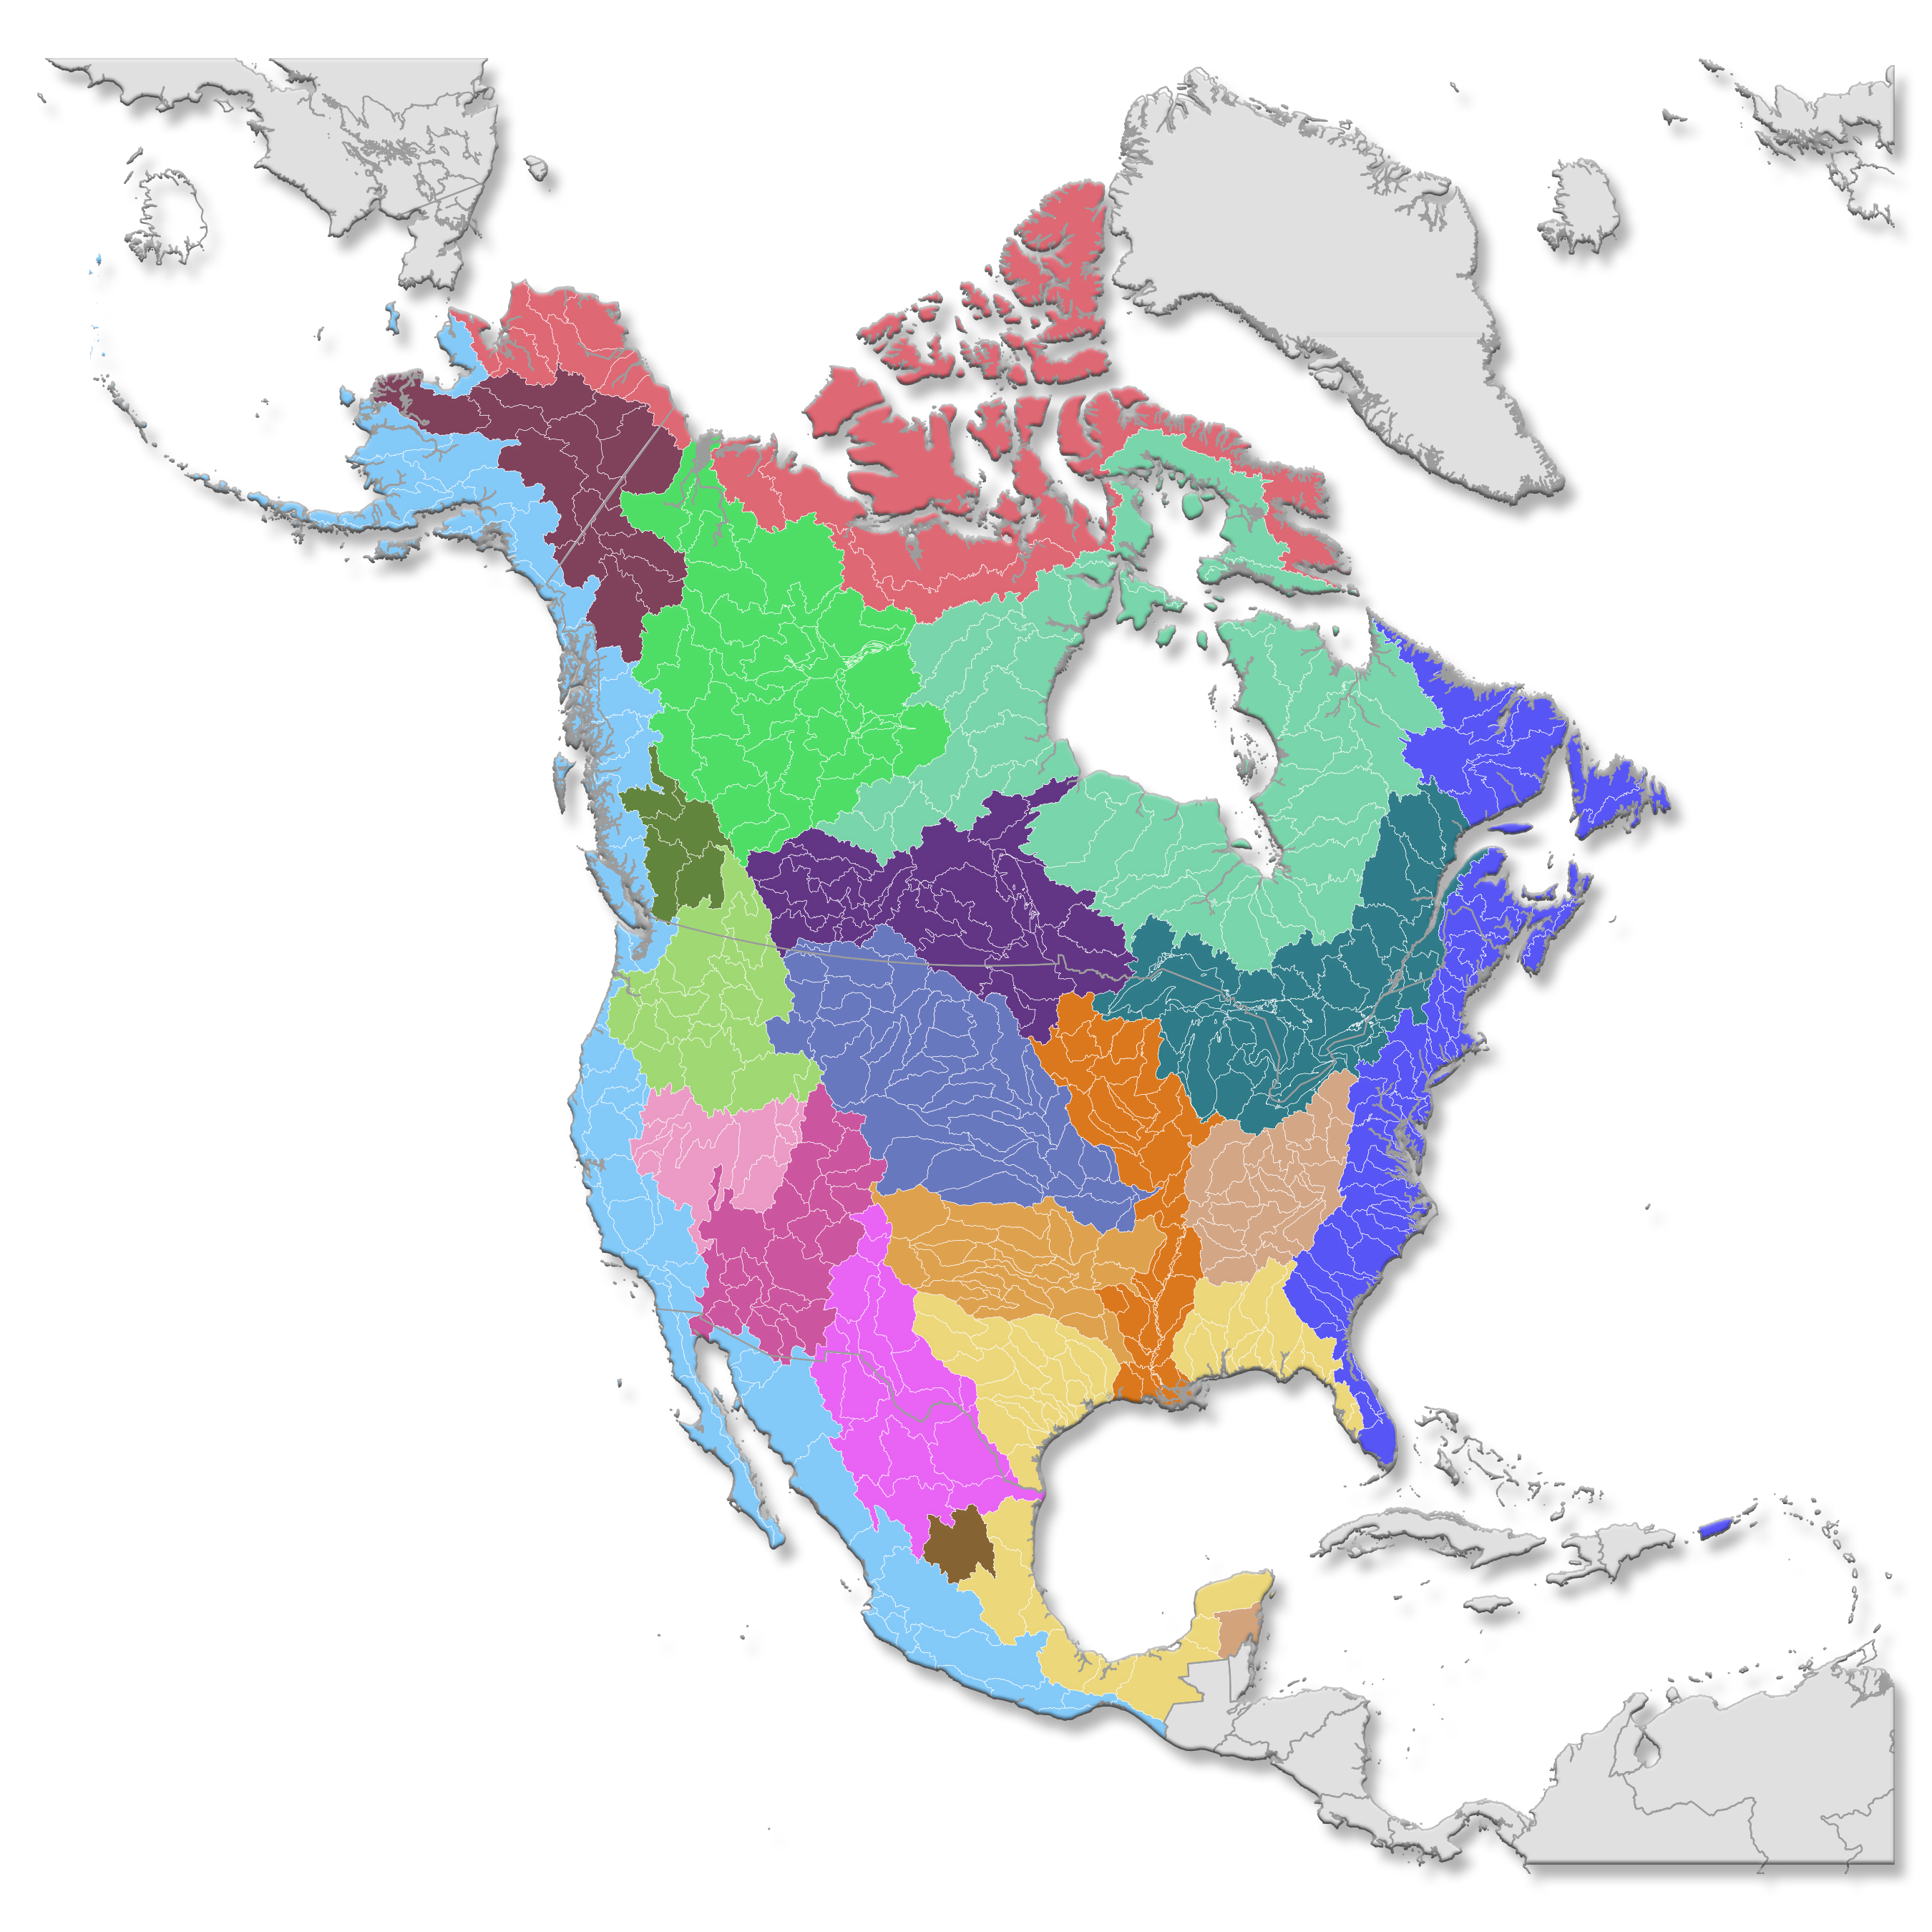
What is a watershed?
Watersheds are organized into nested drainage basins.
Small headwater basins link to form progressively larger watersheds.
Understanding watershed connectivity helps us predict where water and floods will travel.
USGS (Public Domain)
Notes:
Instructor notes: This is a good time to have students reflect on what the patterns on the map represent. See if the students can identify any patterns and locations of major drainages (the Mississippi is always a good example. The key points here are that watersheds are controlled by topography at different scales and combine to form larger and larger drainages. Understanding drainage patterns and connectivity is crucial to understanding where, when, and how much water will move downstream potentially leading to flood hazards.
Image notes: USGS Public Domain https://www.usgs.gov/media/images/watershed-map-north-america

Slide 4
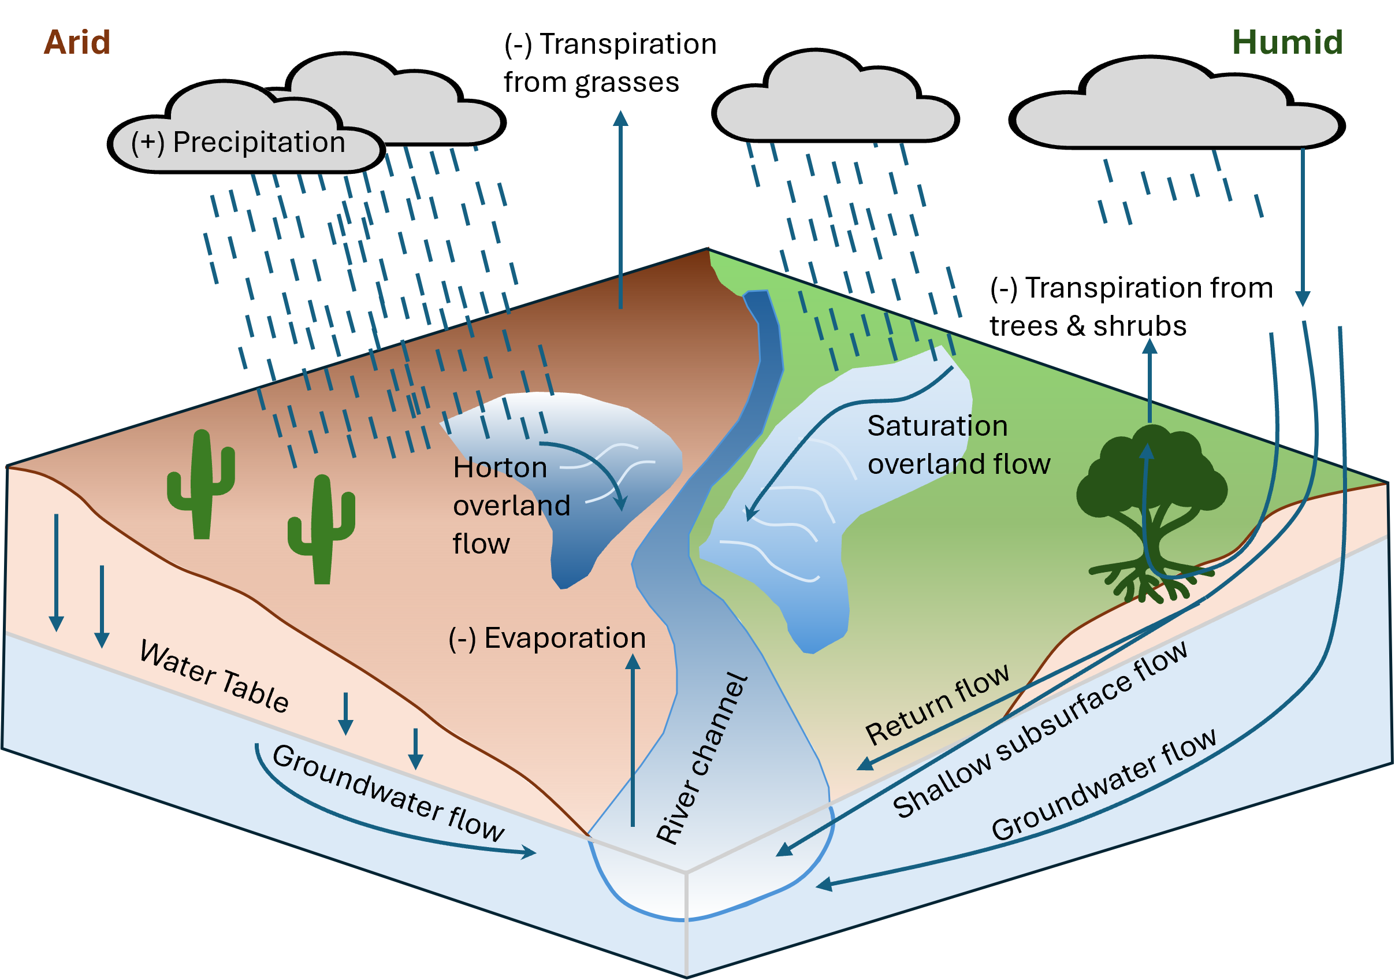
Watershed Hydrology
Water budget depends on balance of precipitation and evapotranspiration
Overland flow occurs as runoff across surface (fast)
Shallow subsurface flow can occur in humid environments (modest)
Groundwater flow occurs below water table (slow)
Infiltration of water into shallow soil is controlled by soil properties, precipitation intensity, and saturation state
Figure courtesy of Will Hefner: Modified from Figure 4.5 Bierman & Montgomery, 2020 – Key Concepts in Geomorphology
Notes:
Instructor notes: The main takeaways of this slide are the idea that we can think about water moving through a watershed as a water budget. By understanding the balance between positive inputs like precipitation and net outputs like evaporation, we can determine how much water may enter a river channel over time and space. The main points here to highlight are the different flow pathways for water routing through a watershed vary in velocity. Water that runs off as overland flow occurs rapidly where ground is impermeable or rainfall exceeds the rate of infiltration into soil (Horton overland flow) or when soil becomes entirely saturated (no more pore space for absorption) due to prolonged precipitation (saturation overland flow). Shallow subsurface flow and groundwater flow are progressively slower pathways, but in some locations can contribute significantly to river channel flow.
Image notes: Water Budget figure from Will Hefner (made in PowerPoint following Bierman & Montgomery, 2020 – Key Concepts in Geomorphology Figure 4.5)

Slide 5
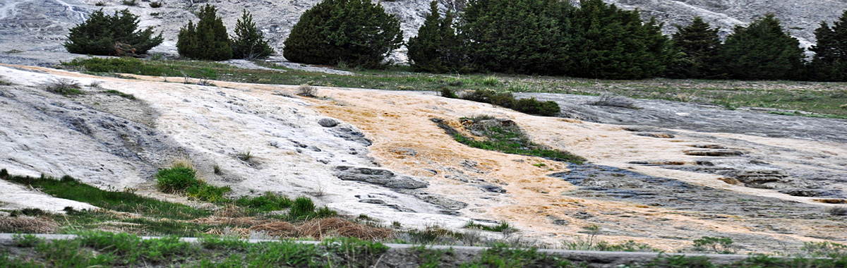
Watershed Hydrology
Overland flow occurs when rainfall intensity exceeds infiltration capacity of soils
Horton overland flow occurs when soils are exceptionally impermeable, or rainfall is very heavy. Typical in arid landscapes or developed areas.
Saturation overland flow occurs when soils become saturated after a long duration storm event
USGS (Public Domain)
Notes:
Instructor notes: The main point here is to emphasize the difference between Horton overland flow and saturation overland flow. Both lead to increased surface runoff to river channels but differ fundamentally with soil and ground properties. The image is from the USGS showing overland flow running downhill. This is a great time to reiterate the importance of gravity as a driving force for the movement of water over Earth’s surface.
Image notes: USGS Public Domain https://www.usgs.gov/media/images/most-rainfall-results-overland-runoff

Slide 6
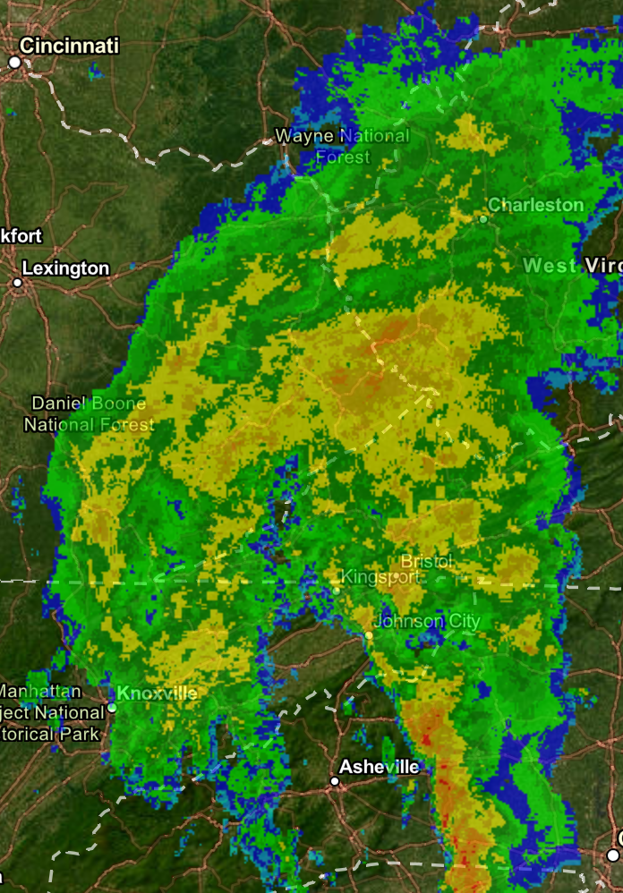
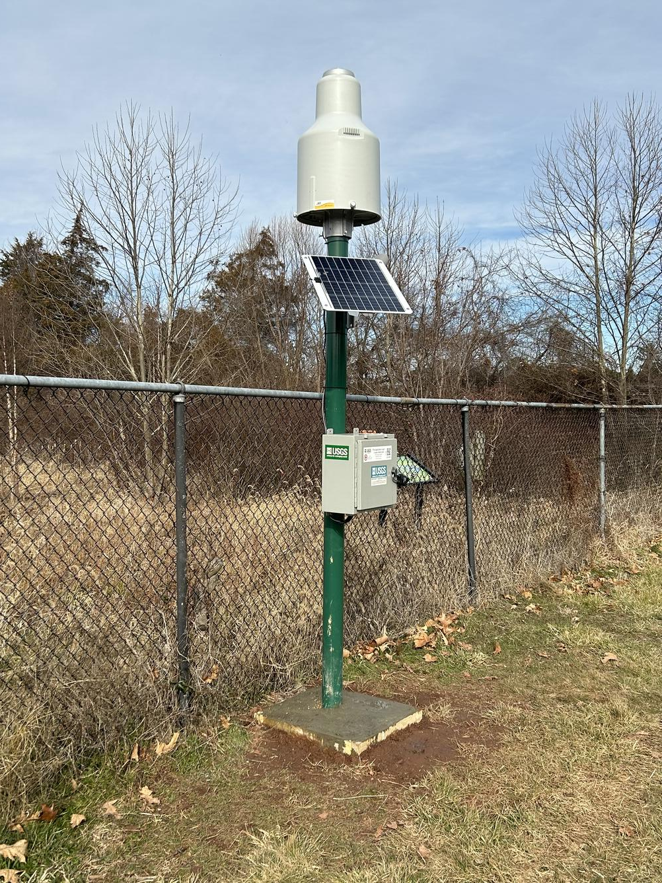
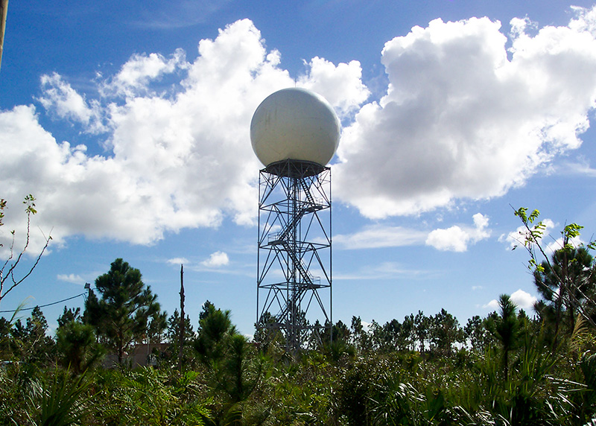
How do we measure runoff?
Measuring Precipitation
1) Rain Gages
2) Radar (NEXRAD)
NOAA National Severe Storms Laboratory (Public Domain)
USGS (Public Domain)
Tropical Storm Fred on 08/18/2021 NOAA NCEI Radar Map Viewer (Public Domain)
Measures rainfall at local sites
Wind and other local phenomena can impact measurements
Costly to maintain
Fairly long range and good coverage
Rain gages are still needed to validate radar!
Notes:
Instructor notes: This is a great time to ask students how we measure rainfall. Most are familiar with a simple rain gauge. Here we are showing a USGS weighing-type rain gauge that continuously measures the total weight of precipitation (rain, snow, hail) collected in a bucket over time to measure rainfall rates. The main point is we need the precision of local measurements from rain gauges, but they are limited in space, can have local impacts, and must be maintained (costly in remote locations). We also use Doppler radar (NEXRAD is Next-Generation Radar) to measure the location and velocity of rainfall by bouncing microwaves off of water particles. This provides great spatial coverage, but we still need rain gages to calibrate and validate measured reflectance. The radar image is of Tropical Storm Fred just after it passed through the region for our case study, the Pigeon River, Western NC.
Image notes:
USGS Public Domain rain gauge image: https://www.usgs.gov/media/images/usgs-precipitation-gage-franklin-middle-school-fairfax-county
NEXRAD Radar image: https://www.nssl.noaa.gov/tools/radar/
NEXRAD Radar map: Asheville region on 08/18/2021 the day after Fred passed through Asheville from https://www.ncei.noaa.gov/maps/radar/

Slide 7
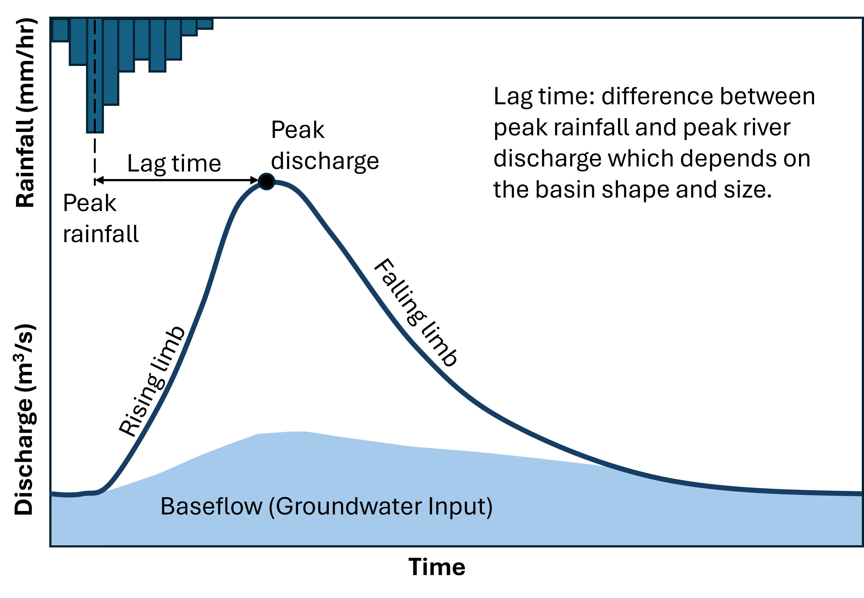
How do we measure runoff?
Example Hydrograph
Hydrograph: time series of discharge in a river at a single point in the watershed.
Discharge: volumetric flux of water (m³/s) through a section of a river channel.
Figure courtesy of Will Hefner: Modified from Figure 4.9 Bierman & Montgomery, 2020 – Key Concepts in Geomorphology
Notes:
Instructor notes: Here is a great time to ask students if measuring rainfall is enough information to understand river flooding. Remind them of the different hydrologic pathways for surface and groundwater. These pathways differ in time and space, but also, there can be storage (lakes and ponds) and net export of water (evaporation and transpiration). To directly measure the amount of runoff that enters rivers, we turn to hydrographs which measure discharge (the volume of water passing though a point in a river channel over time). On the hydrograph in the upper corner, we show rainfall intensity over time. This rainfall adds volume (mass) to the watershed that must move downhill and pass through the river network. Following peak rainfall, the rising limb of the hydrograph records this added volume over time as the river rises. Note that the peak of the flood wave occurs after a lag time between peak rainfall as water must travel overland and through the subsurface downstream. The falling limb represents the declining flood wave as water recedes over time.
Image notes: Hydrograph figure from Will Hefner (made in PowerPoint following Bierman & Montgomery, 2020 – Key Concepts in Geomorphology Figure 4.9)

Slide 8
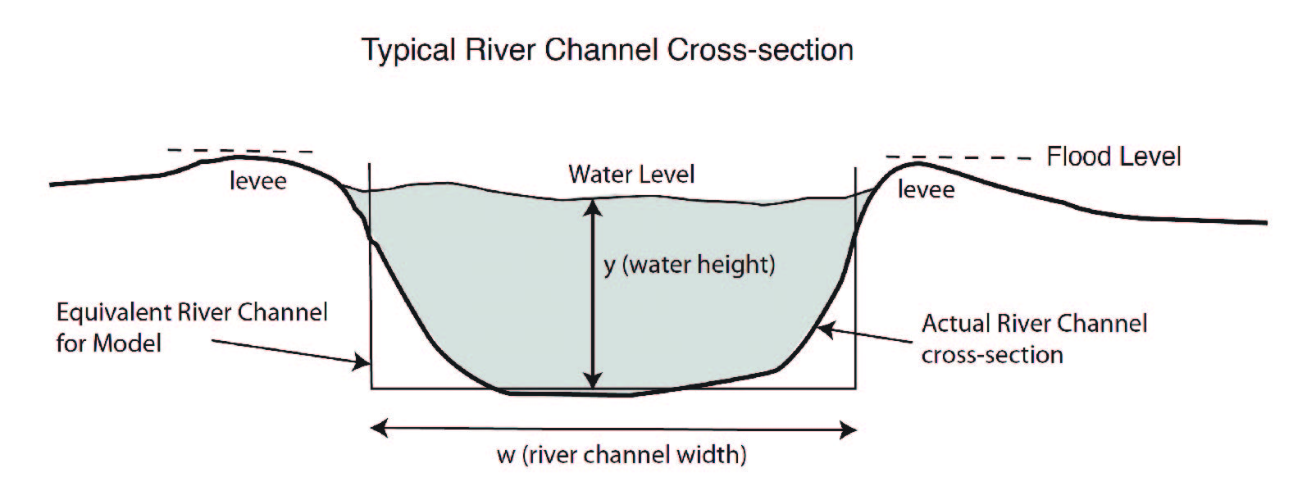



River Channel Shape: in cross-section
Wetted Perimeter (P_{w}): total length of bed (bottom of channel) and banks (sides of channel) (m)
$$P_{w}=2y+w$$
Cross-Sectional Area (A): area of channel that water flows through (m²)
$$A=y×w$$
Activity figure courtesy of Eric Kirby
Hydraulic Radius (R): the ratio of the area to the wetted perimeter (m)
For most rivers, approximating the cross-section as a rectangle is sufficient.
$$R=A/P_{w}$$
Notes:
Instructor notes: The shape of river channels dictates how increasing discharge from added rainfall relates to flood height in and outside of the river channel. At a given point along a stream channel, the cross-section (or slice of the channel) is characterized by the channel width (distance from bank to bank) and the depth of the channel. For most rivers, the parabolic shape of the channel cross-section can be approximated as a rectangle. The wetted perimeter and cross-sectional area together describe the relative extent of the channel bottom and banks that “feel” the flow of water moving through the channel. This is called the hydraulic radius, a measure of the size of the channel (or conduit in other terms) that water must flow through.
Image notes: Figure from Eric Kirby.

Slide 9
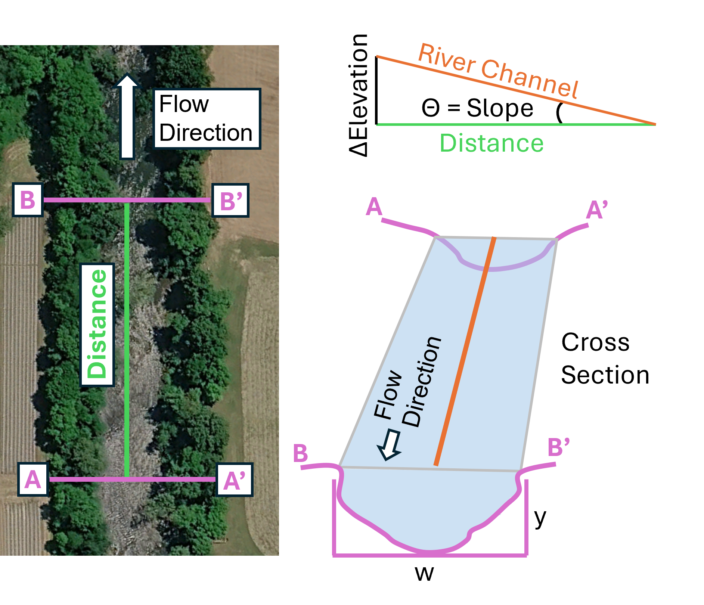


What controls flow velocity in a channel?
Conservation of Mass
Discharge (Q): volume flux of water (m³/s)
$$Q=vA$$
Velocity (v): average flow rate through cross-section (m/s)
Cross-Sectional Area (A): area of channel that water flows through (m²)
$$A=y×w$$
Figure courtesy of Will Hefner
For most rivers, approximating the cross-section as a rectangle is sufficient.
Notes:
Instructor notes: Now that we have introduced the concept of how channel shape dictates how much water can pass through a given location, it is time to introduce the concept of conservation of mass. I usually explain this in simple terms to students using the example of entry to a sporting event. The ticketing entrance acts like the river channel cross-section where the gate is a fixed width. Image the line is backed up just minutes before tipoff/kickoff. The only option to move everyone through in time is to either speed up how fast the line is moving (the velocity of water in the channel) and/or open the gate wider or stack people on each other’s shoulders (changing the width or depth of the channel). In other terms, all water in the channel must flow downhill through the cross-section, so the possibilities are faster flows or deeper flows for a given channel width.
Image notes: I made this figure using Google Earth imagery of the Pigeon River and PowerPoint following the example from https://www.boisestate.edu/drycreek/educational-resources/estimating-flood-peak-with-mannings-equation/#project-instructions.

Slide 10
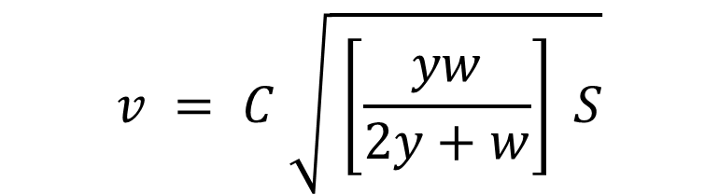
What controls flow velocity in a channel?
Flow Resistance
Chézy coefficient (m^{1/2/}/s) resistance
Viscosity of water: Hydrogen bonding creates internal friction
Obstructions and turbulence: We describe this effect with a resistance factor (roughness)
C varies with the channel roughness
Antoine de Chézy (1768) sewer system in Paris
Velocity (m/s)
Channel Slope (m/m)
$$v = C \sqrt{ \left[\frac{yw}{2y+w}\right] S}$$
Hydraulic Radius (m)
Notes:
Instructor notes: Now that the students are familiar with the concept of how the shape of the channel and speed of the flow control the volume of water passing through a channel (discharge), ask them if natural river channels are perfectly uniform. No, there are obstructions and bumps along rivers. Boulders, downed trees, and debris can slow the flow of water by adding resistance and friction in natural channels. This effect was captured by Antoine de Chézy in 1768. He was an engineer tasked with designing a sewer system to remove waste from Paris. He found that not only the shape (hydraulic radius) and steepness of channels (slope) control the flow (velocity) of sewage, but the surface of the conduit (roughness) contributes to flow rates downhill. I usually ask students to think about how placing their thumb over a hose sprays water faster because they decreased the area water can pass through. Likewise, have them think about how pouring water out of a cup speeds up the more you tip it over (how slope and gravity control flow).

Slide 11
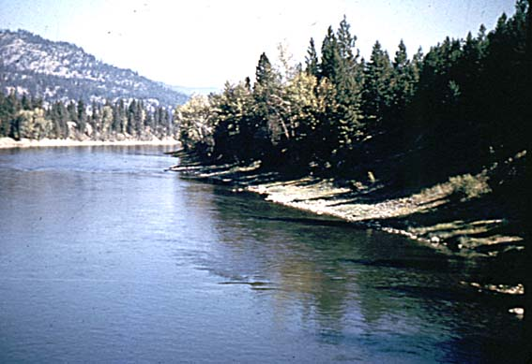
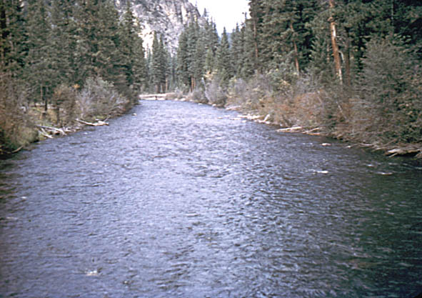
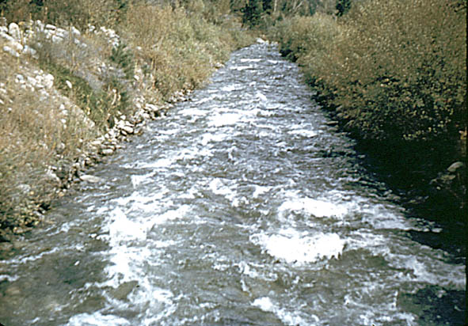
What controls flow velocity in a channel?
Smooth, engineered channels have low roughness and resistance: C values higher
Rough, natural channels have greater frictional resistance: C values lower
High C (less resistance/roughness)
Low C (more resistance/roughness)
USGS (Public Domain)
USGS (Public Domain)
USGS (Public Domain)
Clark Fork at St. Regis, MT
W. Fork Bitterroot River at Connor, MT
Rock Creek Canal at Darby, MT
Increasing channel bed resistance/roughness
Notes:
Instructor notes: Here we are showing differences between smooth channels with low resistance (higher flow means higher C values) and rougher channels (more obstructions) with greater frictional resistance (slower flows means lower C values). The main takeaway from the last three slides is that the volume of water passing through a channel (discharge) not only depends on the size of the channel (cross-sectional area) but also on the gravitational forces (slope) and frictional forces (roughness) controlling the speed of flow downhill.
Image notes: USGS Public Domain https://wwwrcamnl.wr.usgs.gov/sws/fieldmethods/Indirects/nvalues/index.htm

Slide 12
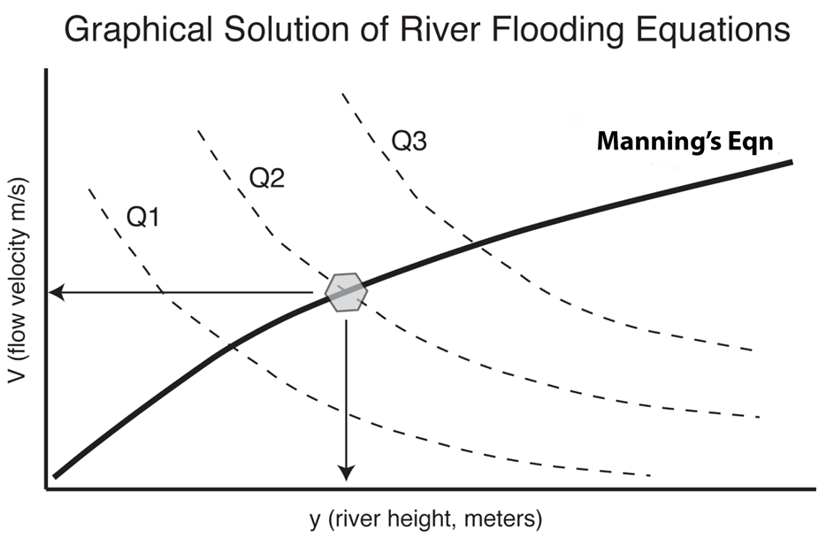


Solving for flood heights from discharge
Flow Resistance: C Chézy’s Equation
Increasing Discharge
$$v = C \sqrt{ \left[\frac{yw}{2y+w}\right] S}$$
Conservation of Mass
$$Q=vA$$
Activity figure courtesy of Eric Kirby
Or
River Stage (meters)
Notes:
Instructor notes: Here we are demonstrating how to combine conservation of mass with flow resistance to predict river heights graphically. The dashed lines represent different possible combinations of river height (x-axis) and flow velocity (y-axis) for increasing discharge conditions where Q1<Q2<Q3. These curves represent the range of possible flood heights and velocities allowing the volume (discharge) to pass through the channel. However, rivers cannot grow to infinite heights or infinite speeds due to frictional forces resisting flow. By solving for velocity using Chézy’s flow resistance equation (solid black line), we can graphically solve the intercept of this line at a given discharge (Q2) here to predict the flood height in a channel at any discharge value.
Image notes: Figure from Eric Kirby.

Slide 13
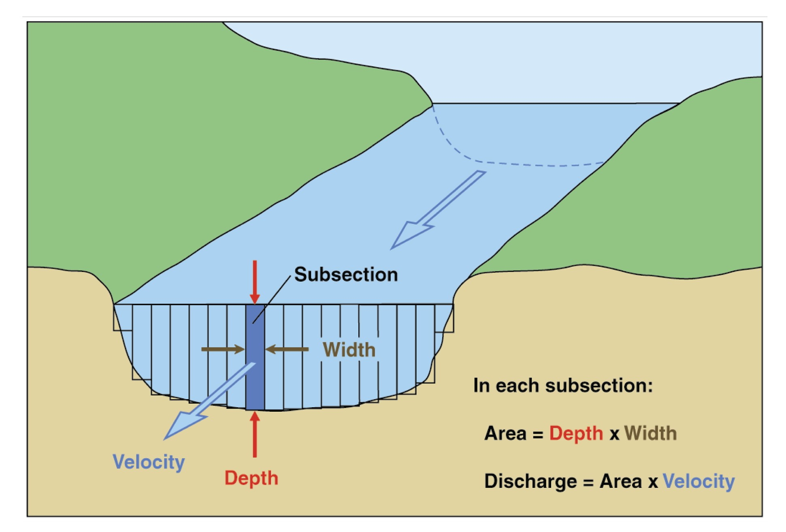
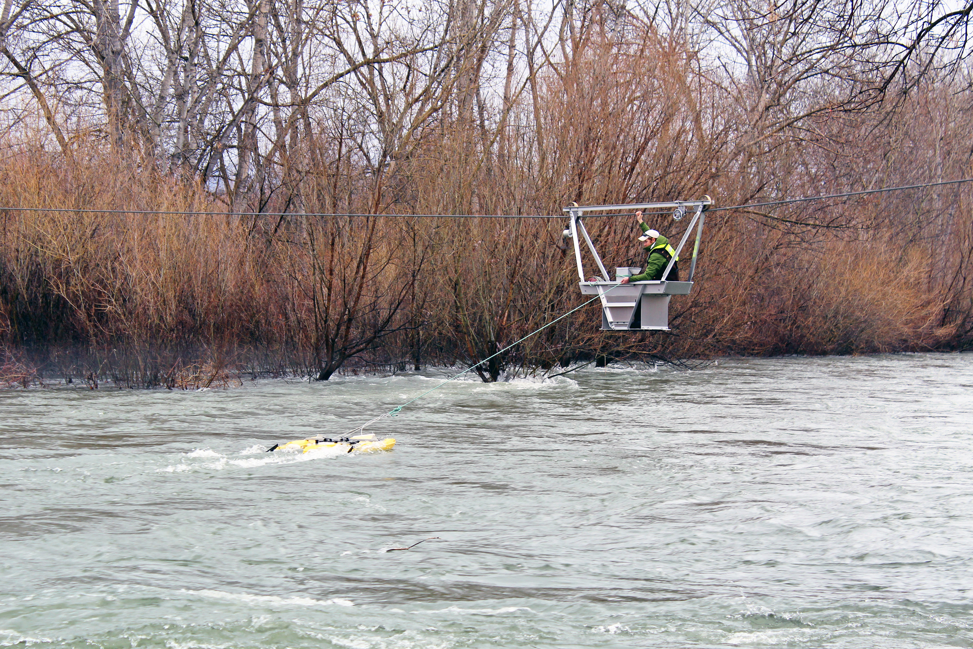
How does the USGS and other agencies measure discharge?
Cross-sections at gauge locations are divided into subsections.
In each subsection, depth and velocity are measured with instrumentation.
Acoustic Doppler Current Profiler (ADCP) in image
Measures flow through entire water column using sound waves
Total discharge is the sum of all subsection measurements.
USGS (Public Domain)
Notes:
Instructor notes: This figure shows how discharge is measured across a river cross-section by dividing the channel into smaller subsections. Hydrologists measure depth and velocity in each subsection because flow is not always uniform across the whole channel. The discharge from each subsection is then added together to estimate total streamflow. This helps students see that discharge is a calculated value based on measurements of channel shape and water velocity, not just a single reading at one point.
Image notes:
Cross-section image USGS Public Domain https://www.usgs.gov/media/images/diagram-channel-cross-section-subsections
ADCP measurements image USGS Public Domain https://www.usgs.gov/media/images/usgs-hydrologic-technician-collecting-data-adcp-a-cableway

Slide 14
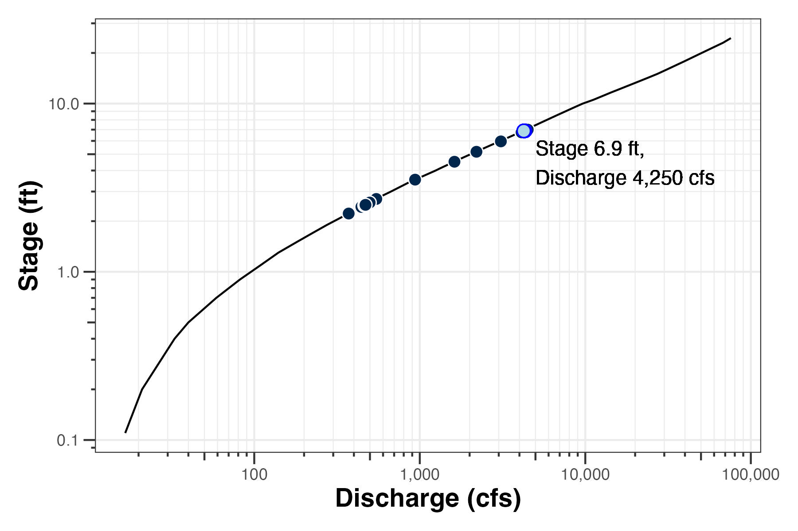
How does the USGS and other agencies solve for flood height from discharge?
Rating Curve (Stage-Discharge Relationship)
Rating Curve: Converts measurements of height (stage) to flow (discharge)
Stage: Gauge continuously records height of water surface relative to a reference point.
Direct discharge measurements taken over range of stages from low flow to flood conditions.
Curve is unique to each gauge as it depends on
Channel shape
Slope
Roughness
USGS (Public Domain)
Notes:
Instructor notes: USGS stage-discharge relations, or rating curves, convert water-level measurements into streamflow estimates for a specific river or stream gauge. The curve is built from many direct discharge measurements taken over a range of stages, from low flow to flood conditions. Because the relation depends on channel shape, slope, size, and roughness, it is unique to each gage and can change after floods alter the channel. USGS technicians regularly measure flow to keep the rating curve accurate.
Image notes: Rating Curve USGS Public Domain https://www.usgs.gov/media/images/usgs-stage-discharge-relation-example

Slide 15
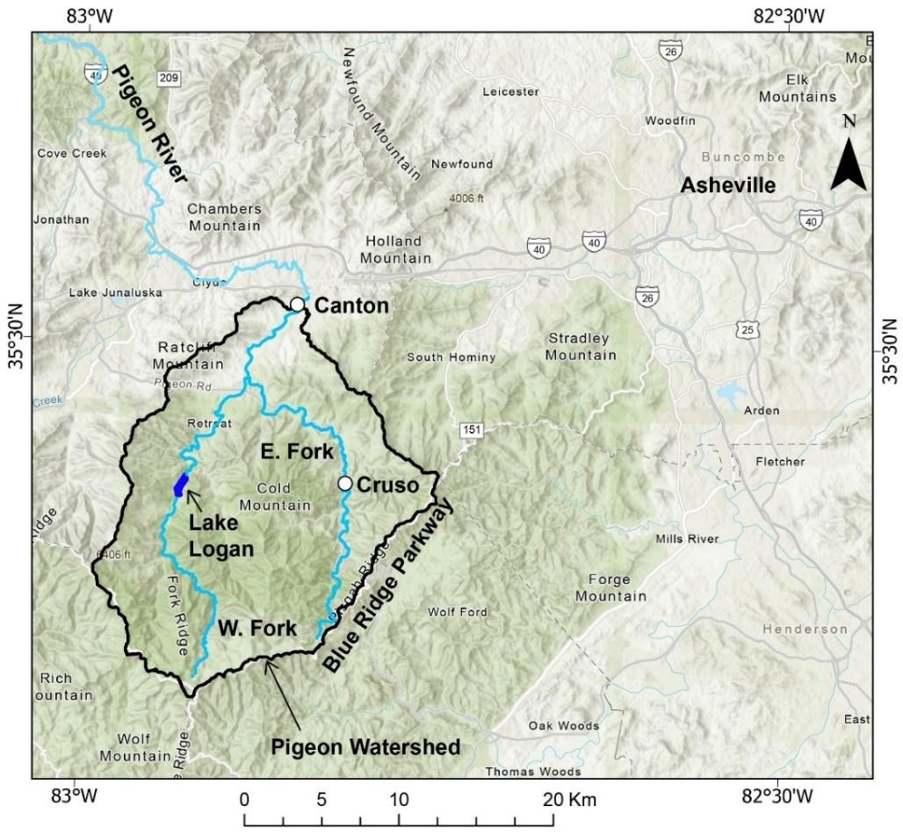
Flooding along the Pigeon River, Western, NC
Upper Pigeon River
Originates along the Blue Ridge Parkway and flows north into the French Broad River near Newport, TN
Canton has experienced major flooding in:
- The Great Flood of 1916
- The Great Flood of 1950
- Hurricane Frances and Ivan in 2004
- Tropical Storm Fred in 2021
- Hurricane Helene in 2024
Activity Figure courtesy of Will Hefner
Notes:
Instructor notes: Now that we have covered the basics of how water is routed through a watershed and what controls flood velocity and height in a river channel, we are going to investigate a case study in the Pigeon River watershed, Western, NC. The Pigeon River originates along the Blue Ridge Parkway as two branches that flow north and merge just upstream of Canton, NC. Canton, NC has experience major flooding historically and recently during Tropical Storm Fred in August 2021 and Hurricane Helene in September 2024. This mountainous watershed has steep, vegetated hillslopes and experiences frequent rainfall triggered landslides and debris flows. Likewise, repetitive flooding in Canton has forced the town to relocate their wastewater treatment plant that was located in the flood plain following devasting flooding during Hurricane Helene.
Image notes: From Will Hefner and activity

Slide 16
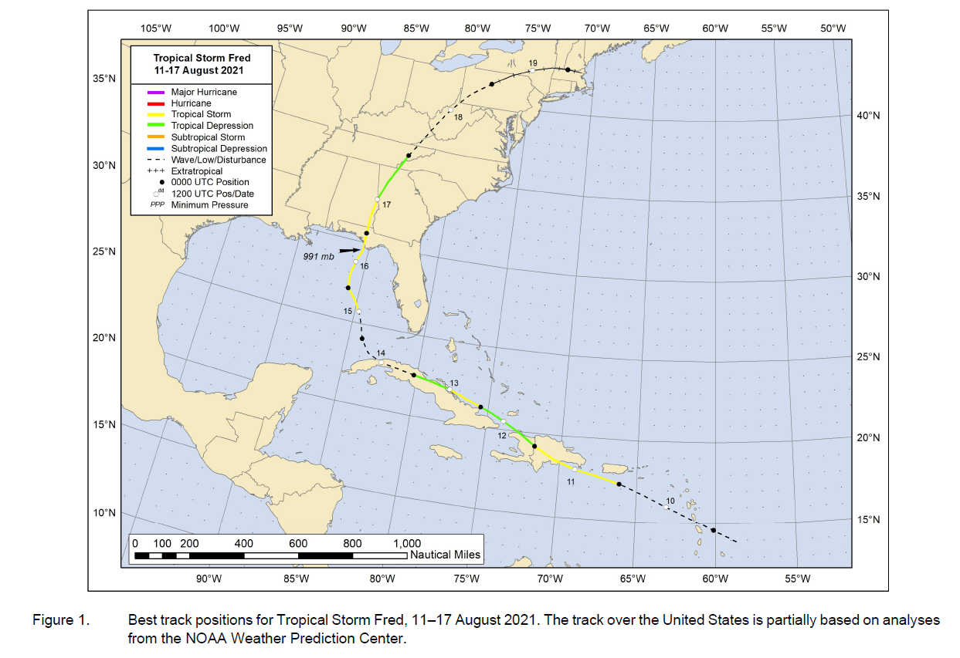
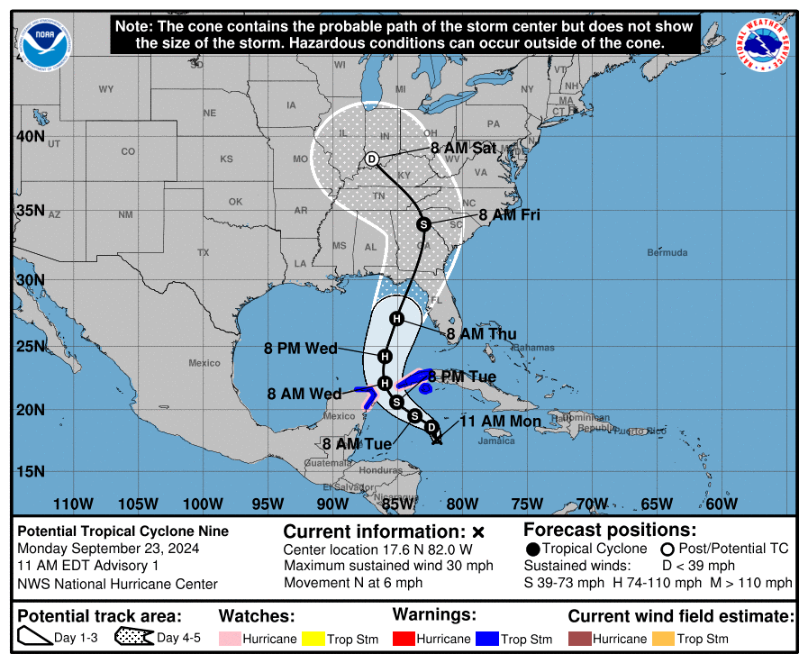
Tropical Storm Fred in 2021
Hurricane Helene in 2024
Cuba
Dominican Republic
Jamaica
Haiti
Puerto Rico
NOAA National Weather Service, Nashville Forecast Office (Public Domain)
National Hurricane Center, NOAA/National Weather Service. Tropical Cyclone Report: Tropical Storm Fred (AL062021) (Public Domain)
Notes:
Instructor notes: Tropical Storm Fred in 2021 and Hurricane Helene in 2024 followed similar tracks making landfall in the Florida panhandle before moving northwards into the Blue Ridge of GA, SC, and NC. Both events lead to intense, prolonged rainfall in the Blue Ridge of western, NC leading to regional flooding and landslides.
Image notes:
Tropical Storm Fred track from: https://www.nhc.noaa.gov/data/tcr/AL062021_Fred.pdf
Hurricane Helene track from: https://www.weather.gov/ohx/hurricanehelene

Slide 17
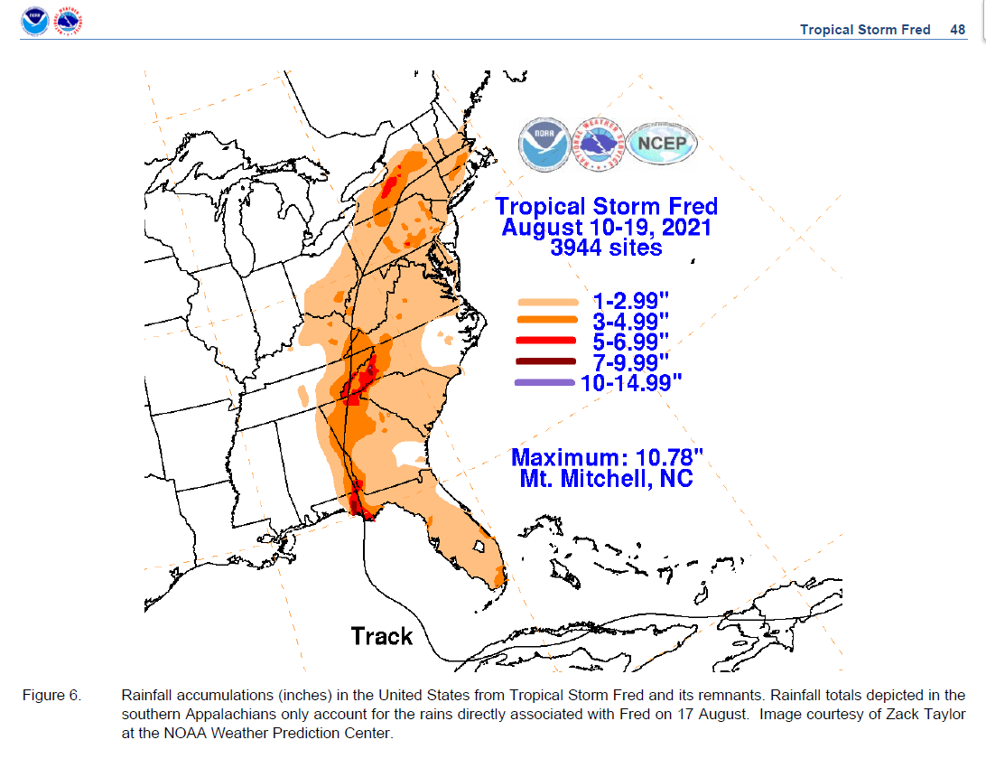
Rainfall during Tropical Storm Fred
National Hurricane Center, NOAA/National Weather Service. Tropical Cyclone Report: Tropical Storm Fred (AL062021) (Public Domain)
Notes:
Instructor notes: Tropical Storm Fred dumped up to >7 inches of rainfall in the North Carolina Blue Ridge with maximum values of ~11 inches recorded at Mt. Mitchell (the highest point east of the Mississippi River).
Image notes: Tropical Storm Fred track and rainfall from from: https://www.nhc.noaa.gov/data/tcr/AL062021_Fred.pdf

Slide 18
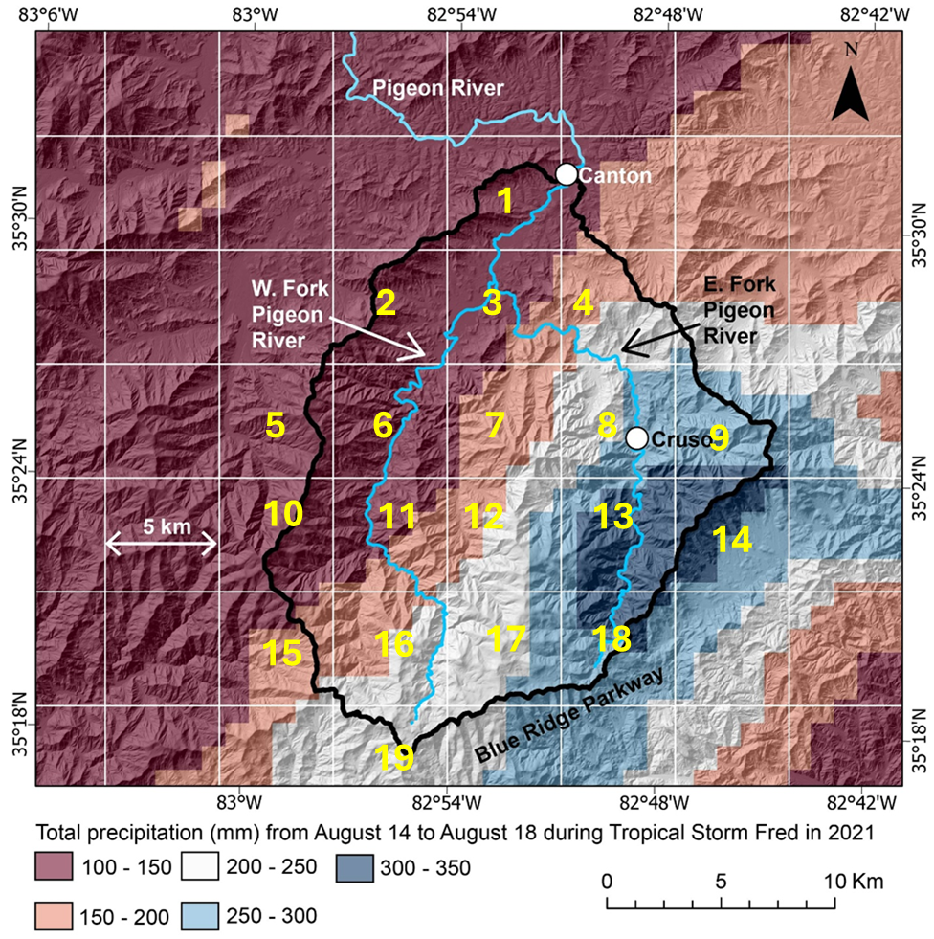
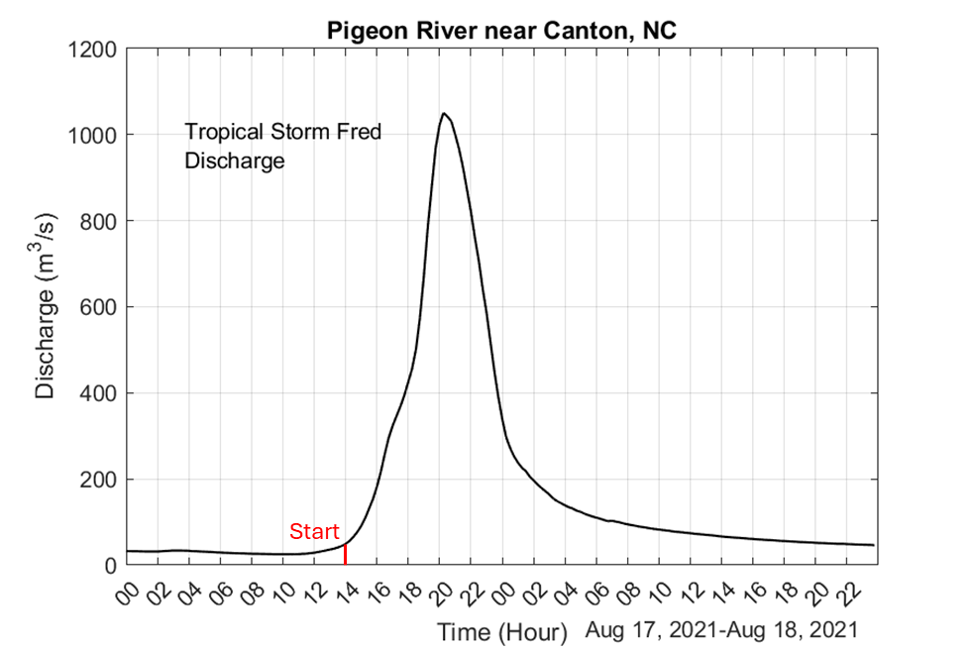
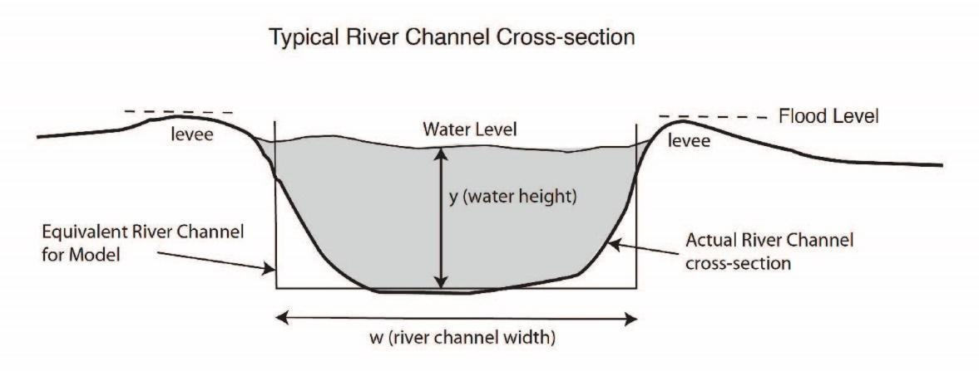
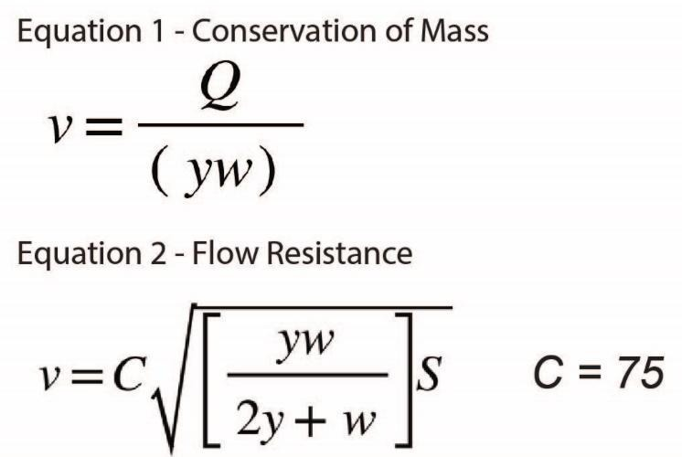
Activity: Estimating and Predicting Flood Heights after Extreme Rainfall Events
Combining:
Rainfall Data
Gauge Data
Channel Characteristics
You will predict flood heights along the Pigeon River for Tropical Storm Fred (2021) and Hurricane Helene (2024) and discuss impacts of hazard cascades for downstream communities.
All activity figures courtesy of Will Hefner & Eric Kirby
Notes:
Instructor notes: This is a chance to reiterate that we are combining different measurements of water flux from rainfall and gauges with simplified open channel flow equations to predict flood magnitudes.
Image notes: From Will Hefner and the activity

Slide 19
Simple systems model of hazard cascade for Canton, NC
High intensity rainfall event
+
Saturated soils
+
+
Landslides/
debris flows
+
Downstream impact from flooding of wastewater treatment plant in floodplain
Increased surface runoff
+
Sediment and debris enters channel
Sewage release/
contimated floodwaters
+
+
Channel Size
-
River flooding (water leaving channel)
+
Wastewater Treatment Plant floods
+
Notes:
Instructor notes: Here is a simple systems model for hazard cascades related to flood characteristics estimated and modeled during the activity. The main key here is how high intensity rainfall leads to increased runoff and the modification of channel size through the addition of hillslope debris from landslides/debris flows. This feedback leads to increased flooding outside of the river channel that impacts downstream infrastructure, particularly, the former wastewater treatment plant for Canton. Funding has allowed for the relocation of the plant due to repetitive flooding over the past decade.

Slide 20
Bonus Slides
Slides 21-24 are Google Earth images of Tropical Storm Fred impacts in 2021 along the East Fork of the Pigeon River in the town of Cruso, North Carolina.
Slides 25-27 show the full derivation of Chézy’s equation from open-channel flow equations describing the balance between gravitational driving forces, bed shear stress, flow depth, and channel slope.

Slide 21
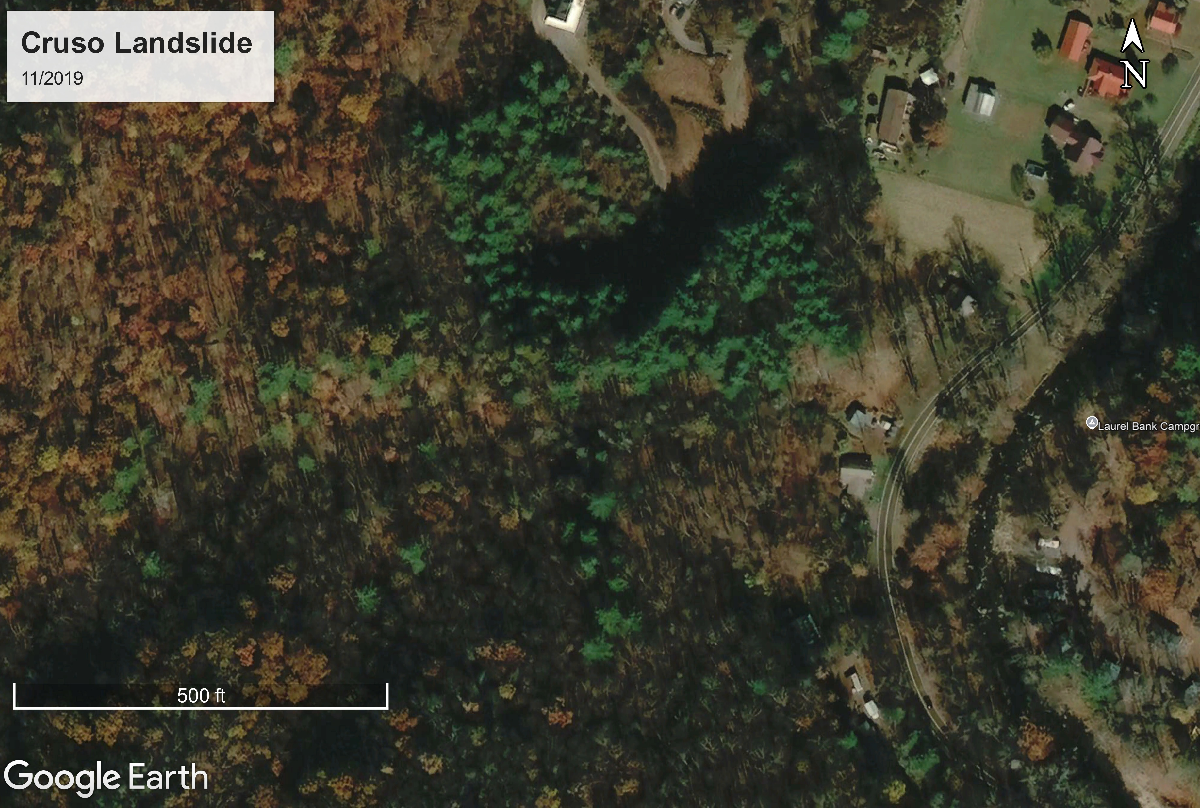
Notes:
Instructor notes: During Tropical Storm Fred, intense rainfall led to devastating floods and debris flows in the town of Cruso, NC along the East Fork of the Pigeon River upstream of Canton. Here is a before image from Google Earth. Focus on the house right at the bend in the road.
Image notes: Google Earth

Slide 22
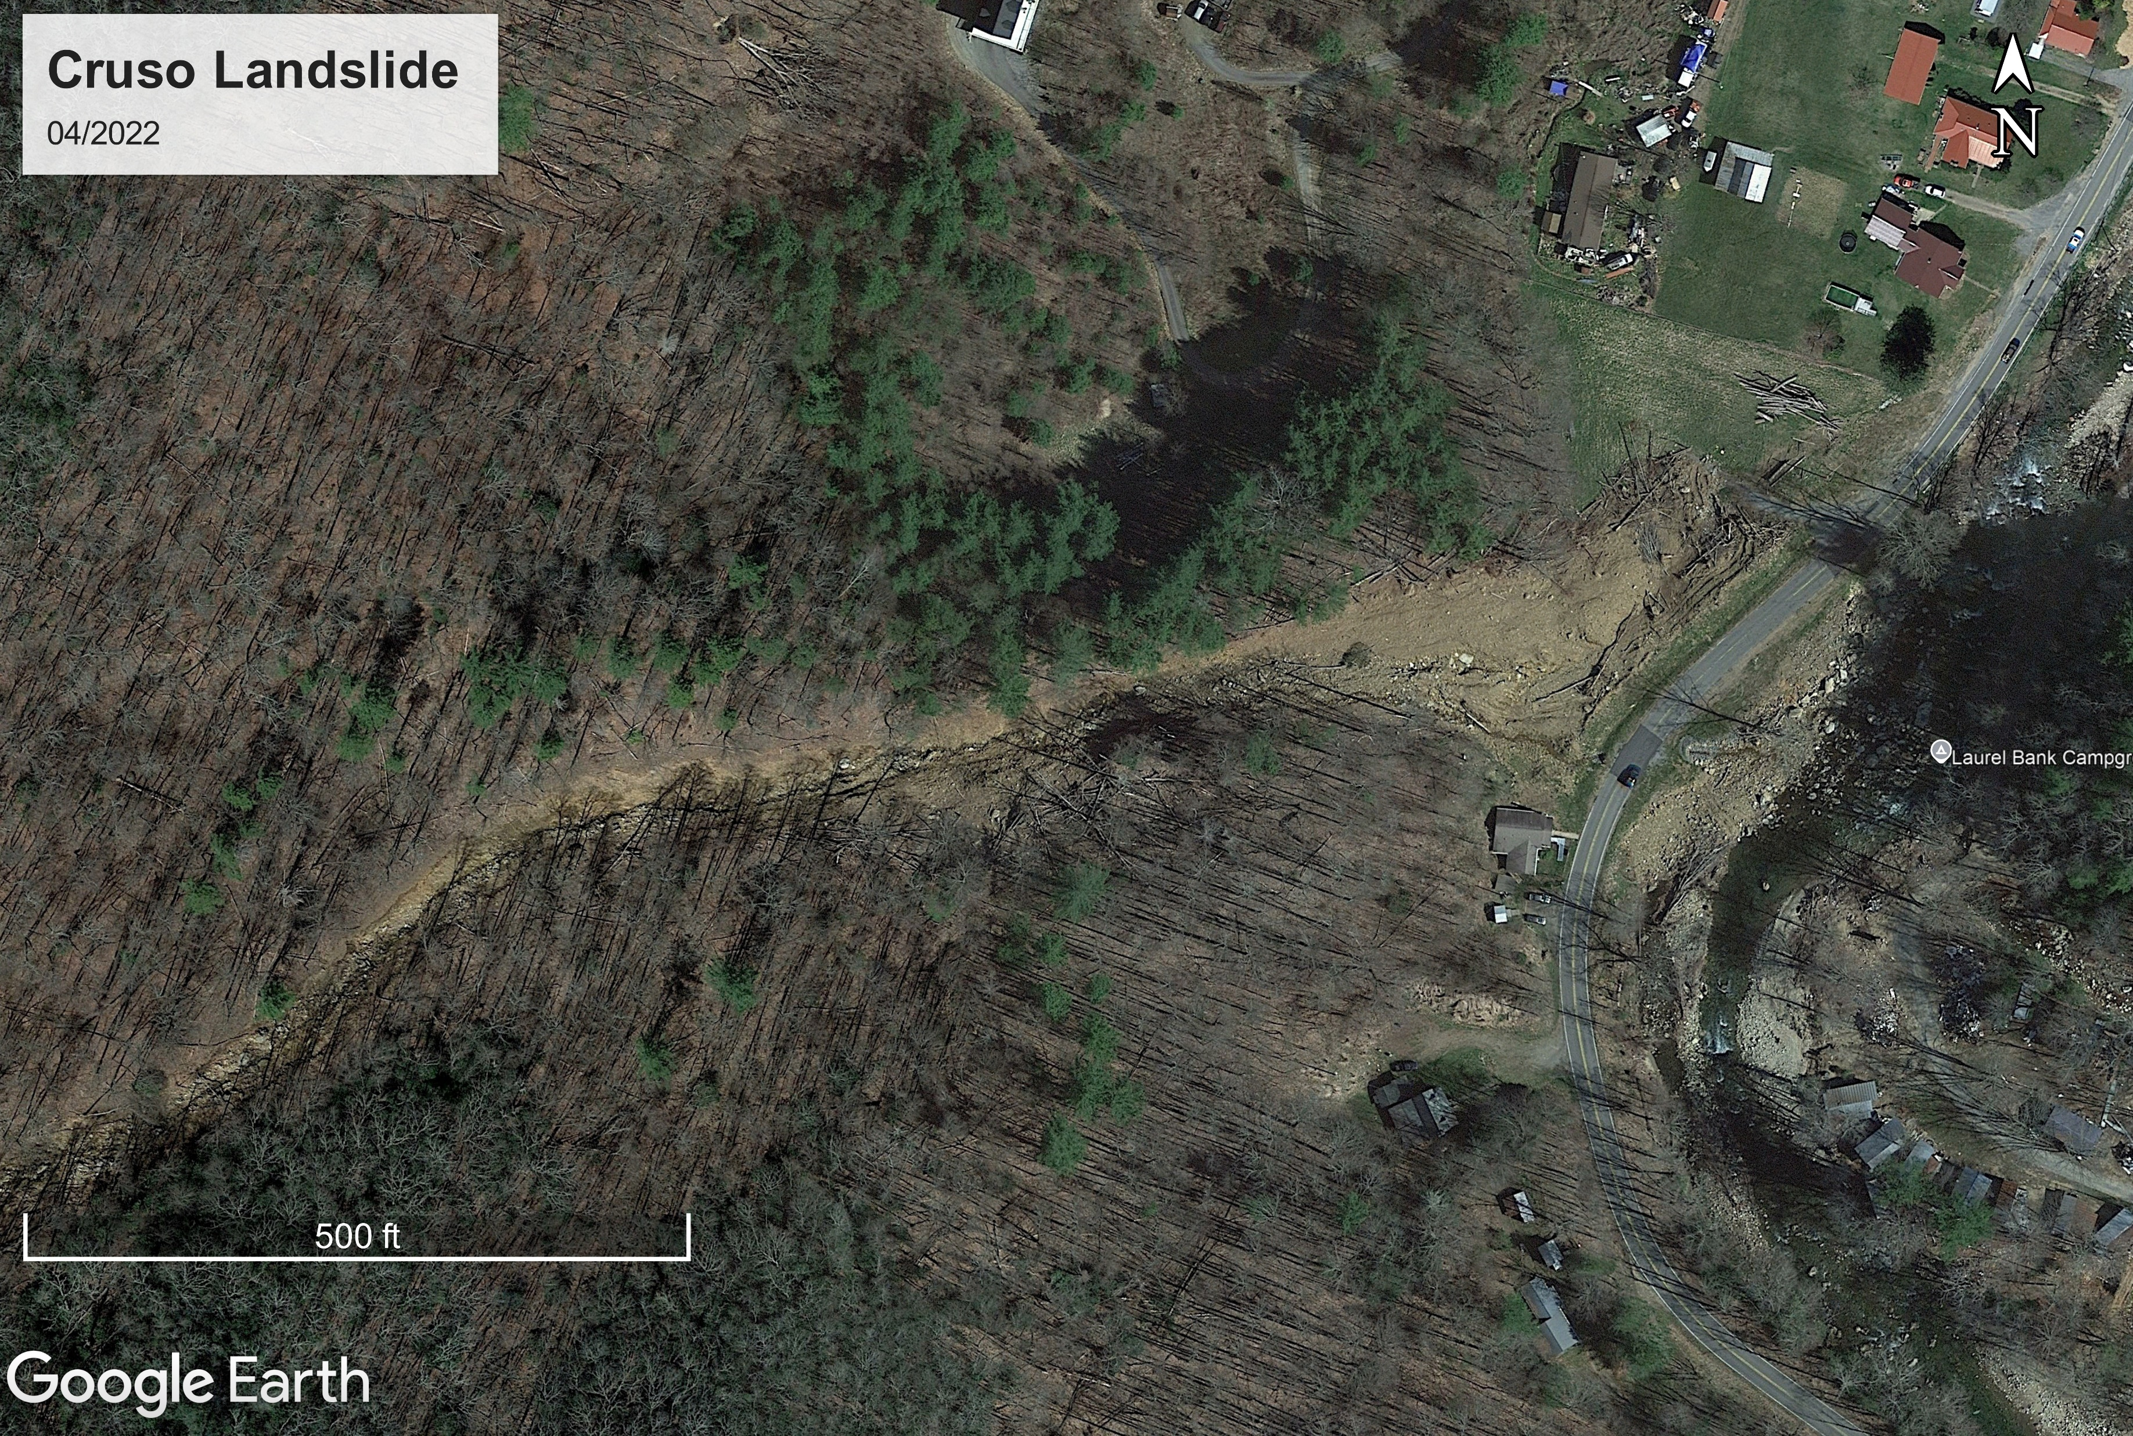
Notes:
Instructor notes: Here is the after photo from 2022 showing the debris flow. Note how much material entered the river just across the road.
Image notes: Google Earth

Slide 23
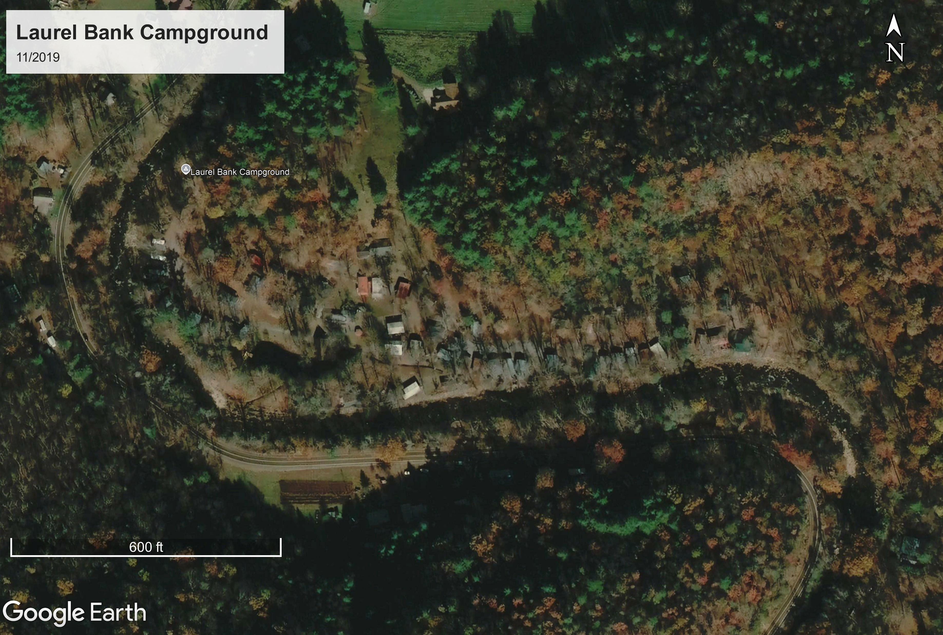
Notes:
Instructor notes: Yellow line highlights the location of the bank at the river bend in 2019 for comparison with the next slide in 2022. Also have students focus on the campground.
Image notes: Google Earth

Slide 24
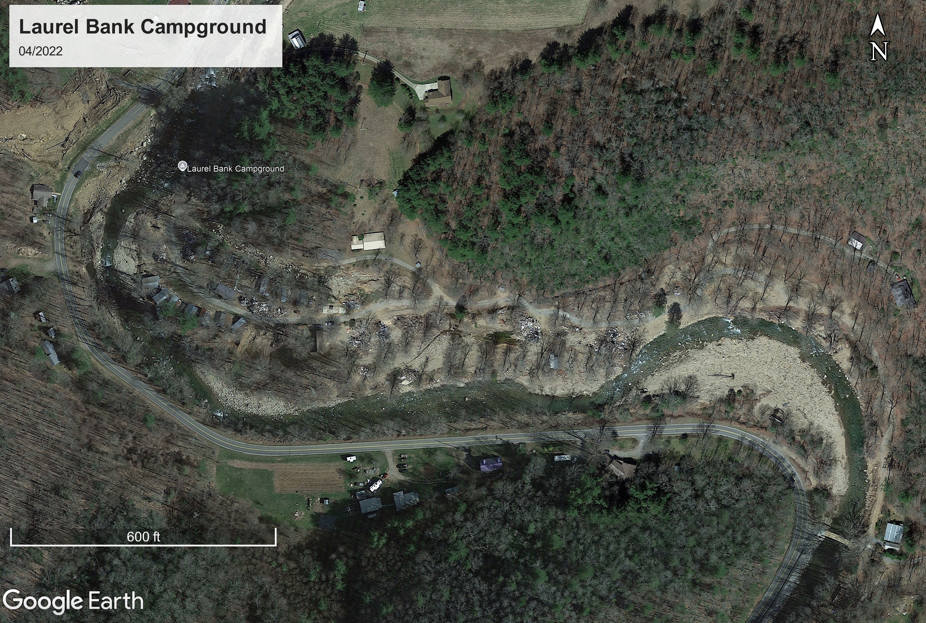
Notes:
Instructor notes: The yellow line marks the former bank location. There is almost 50 ft coarse material deposited along the bar forcing the channel to deflect and erode the far bank.
Image notes: Google Earth

Slide 25



Open-channel flow derivation
[1] Conservation of mass
Discharge: the volume of water moving through a channel per unit time
Represents water flux at a specific location [1]
where:
Q = discharge [m³/s]
v = average flow velocity [m/s]
A = cross-sectional area [m²]
Discharge
$$[1]Q=vA$$
Flow
Direction/Velocity Vector
Velocity
$$v=Q/(wy)$$
$$A=w×y$$
y
w
Notes:
Instructor notes: Emphasize that discharge is the volume of water moving though a point in the channel over time and can be expressed as the product of flow velocity and the cross-sectional area. Reiterate that using a simplified rectangular channel is appropriate for most natural river channels. Take the time to ask students what the relationship for discharge means. The main point is for a given discharge, water must move faster if the channel area is smaller, or slower if the area is greater where both possibilities allow the same volume of water per time to move through the channel.
(Steady-uniform flow)
Image notes:
Cross Section Figure from Eric Kirby.
Sloping Cross Section Figure from Will Hefner.

Slide 26




Open-channel flow derivation
Shear Stress
$$[2] τ_{0}= ρgRS_{f}$$
[2] Shear stress and flow resistance
τ₀: shear stress on the channel bed:
Flowing water exerts a shear stress on the channel bed and banks which resists flow downslope driven by gravity
where:
τ₀ = bed shear stress [N/ m²]
ρ = density of water [kg/m²]
g = gravitational acceleration [m/s²]
R = hydraulic radius [m]
Remember this is area/wetted perimeter
S_{f} = slope of the channel [m/m]
Hydraulic Radius
$$R=(wy)/(2y+w)$$
Rectangular channel approximation
g
h
ρ (water)
$$S_{f}= ∆h/∆x$$
Flow Direction
$$τ_{0}$$
Schematic of open-channel flow showing the balance between gravitational driving forces, bed shear stress, flow depth, and channel slope
Notes:
Instructor notes: The main takeaway of this slide is that flowing water downstream exerts a shear stress on the channel bed and banks, which acts as a resistance to downstream flow. This bed and bank resistance is balanced against the gravitational force driving water downstream. The slope of the channel provides the energy to move the flow, while shear stress exerts an opposing frictional force. Since water flowing across the bed and banks feel this resistance, we use the rectangular approximation of the hydraulic radius. This slide sets up the physical basis for the flow-resistance equation used later.
Image notes: Schematic from Will Hefner

Slide 27
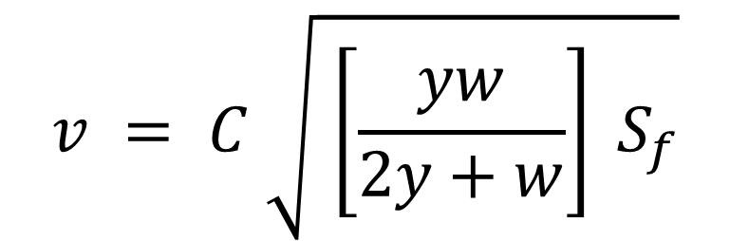

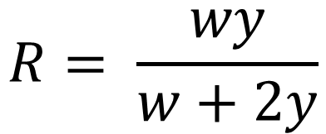
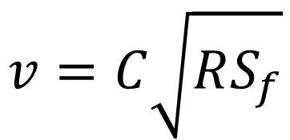
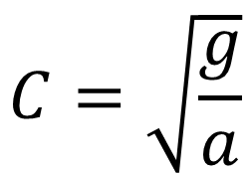
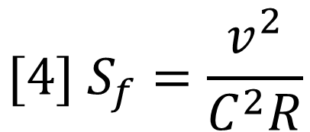
Open-channel flow derivation
Shear Stress as a drag force
$$[3] τ_{0}=aρv^{2}$$
[3] Flowing water behaves as a Newtonian fluid
Newtonian fluids have constant viscosity (at a given temperature and pressure)
Fluid flow (v) is proportional to the rate of shear applied to it
Faster flows exert higher shear stress
where:
τ₀ = bed shear stress [N/ m²]
a = dimensionless drag coefficient
ρ = density of water [kg/m²]
v = flow velocity [m/s]
Rearranging [2] and [3] yields:
$$[4] S_{f}=\frac{v^{2}}{C^{2}R}$$
$$C=\sqrt{\frac{g}{a}}$$
where:
C = Chézy coefficient [m^{1/2}/s]
Now velocity can be written as:
$$v=C\sqrt{RS_{f}}$$
$$R= \frac{wy}{w+2y}$$
and:
$$v = C \sqrt{ \left[\frac{yw}{2y+w}\right] S_{f}}$$
Flow Resistance Equation using Chézy coefficient from activity
Notes:
Instructor notes: This slide connects the force balance in the last slide to the final equation for flow resistance. Explain that water is treated as a Newtonian fluid (viscosity is constant) and its resistance to shear increases predictably as flow speed increases. This relationship (equation 3) states that faster moving water exerts greater shear stress on the channel bed. By combining this relationship with the relationship for shear stress as a function of channel slope (equation 2 last slide) leads to the form of Chézy’s flow resistance equation that we are using in the activity to predict flood heights.

