Slide 1
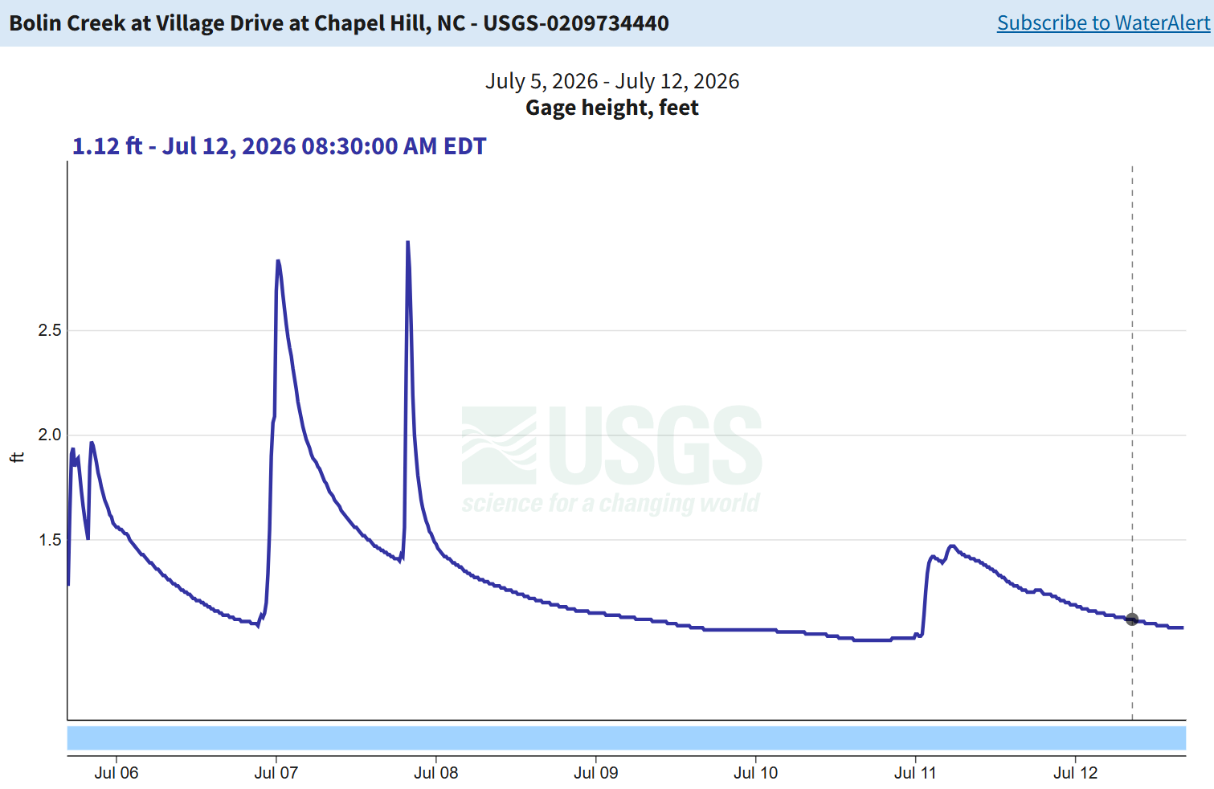
Data tutorial: How to modify the flood activity to your own region
This activity works best when it is tied to a local watershed and flood event that students are familiar with.
What data do you need?
Watershed of choice (if you can get a boundary that is great)
Rainfall or precipitation data
  More about this on upcoming slides
Stream gauge discharge or stage data
River channel width and slope data
  Google Earth imagery
  Topographic maps

Slide 2
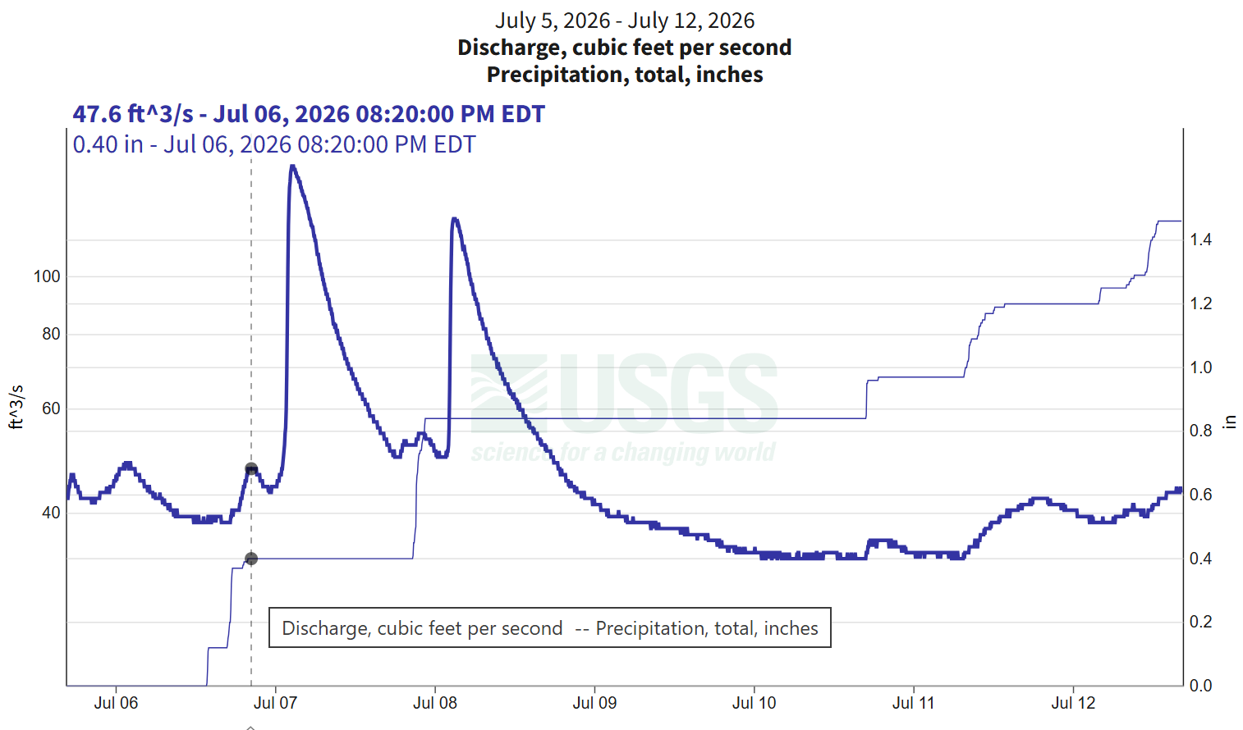
Where to find rainfall data
For the activity, we downloaded gridded rainfall data from NOAA Quantitative Precipitation Estimate (QPE) Data for our event and created maps in ArcGIS.
While this is beyond the scope of data processing for this workshop, there are several available resources to access rainfall data.
NOAA Climate Data Online (CDO): station-based historical precipitation data
NOAA NCEI Radar / NEXRAD: archived radar rainfall maps and storm totals.
NOAA precipitation/QPE datasets: gridded rainfall estimates from radar + gauges.
USGS Water Data: precipitation data at some sites, often paired with stream data.
Gauge with available discharge and precipitation totals plotted on the same graph (USGS Water Data)

Slide 3
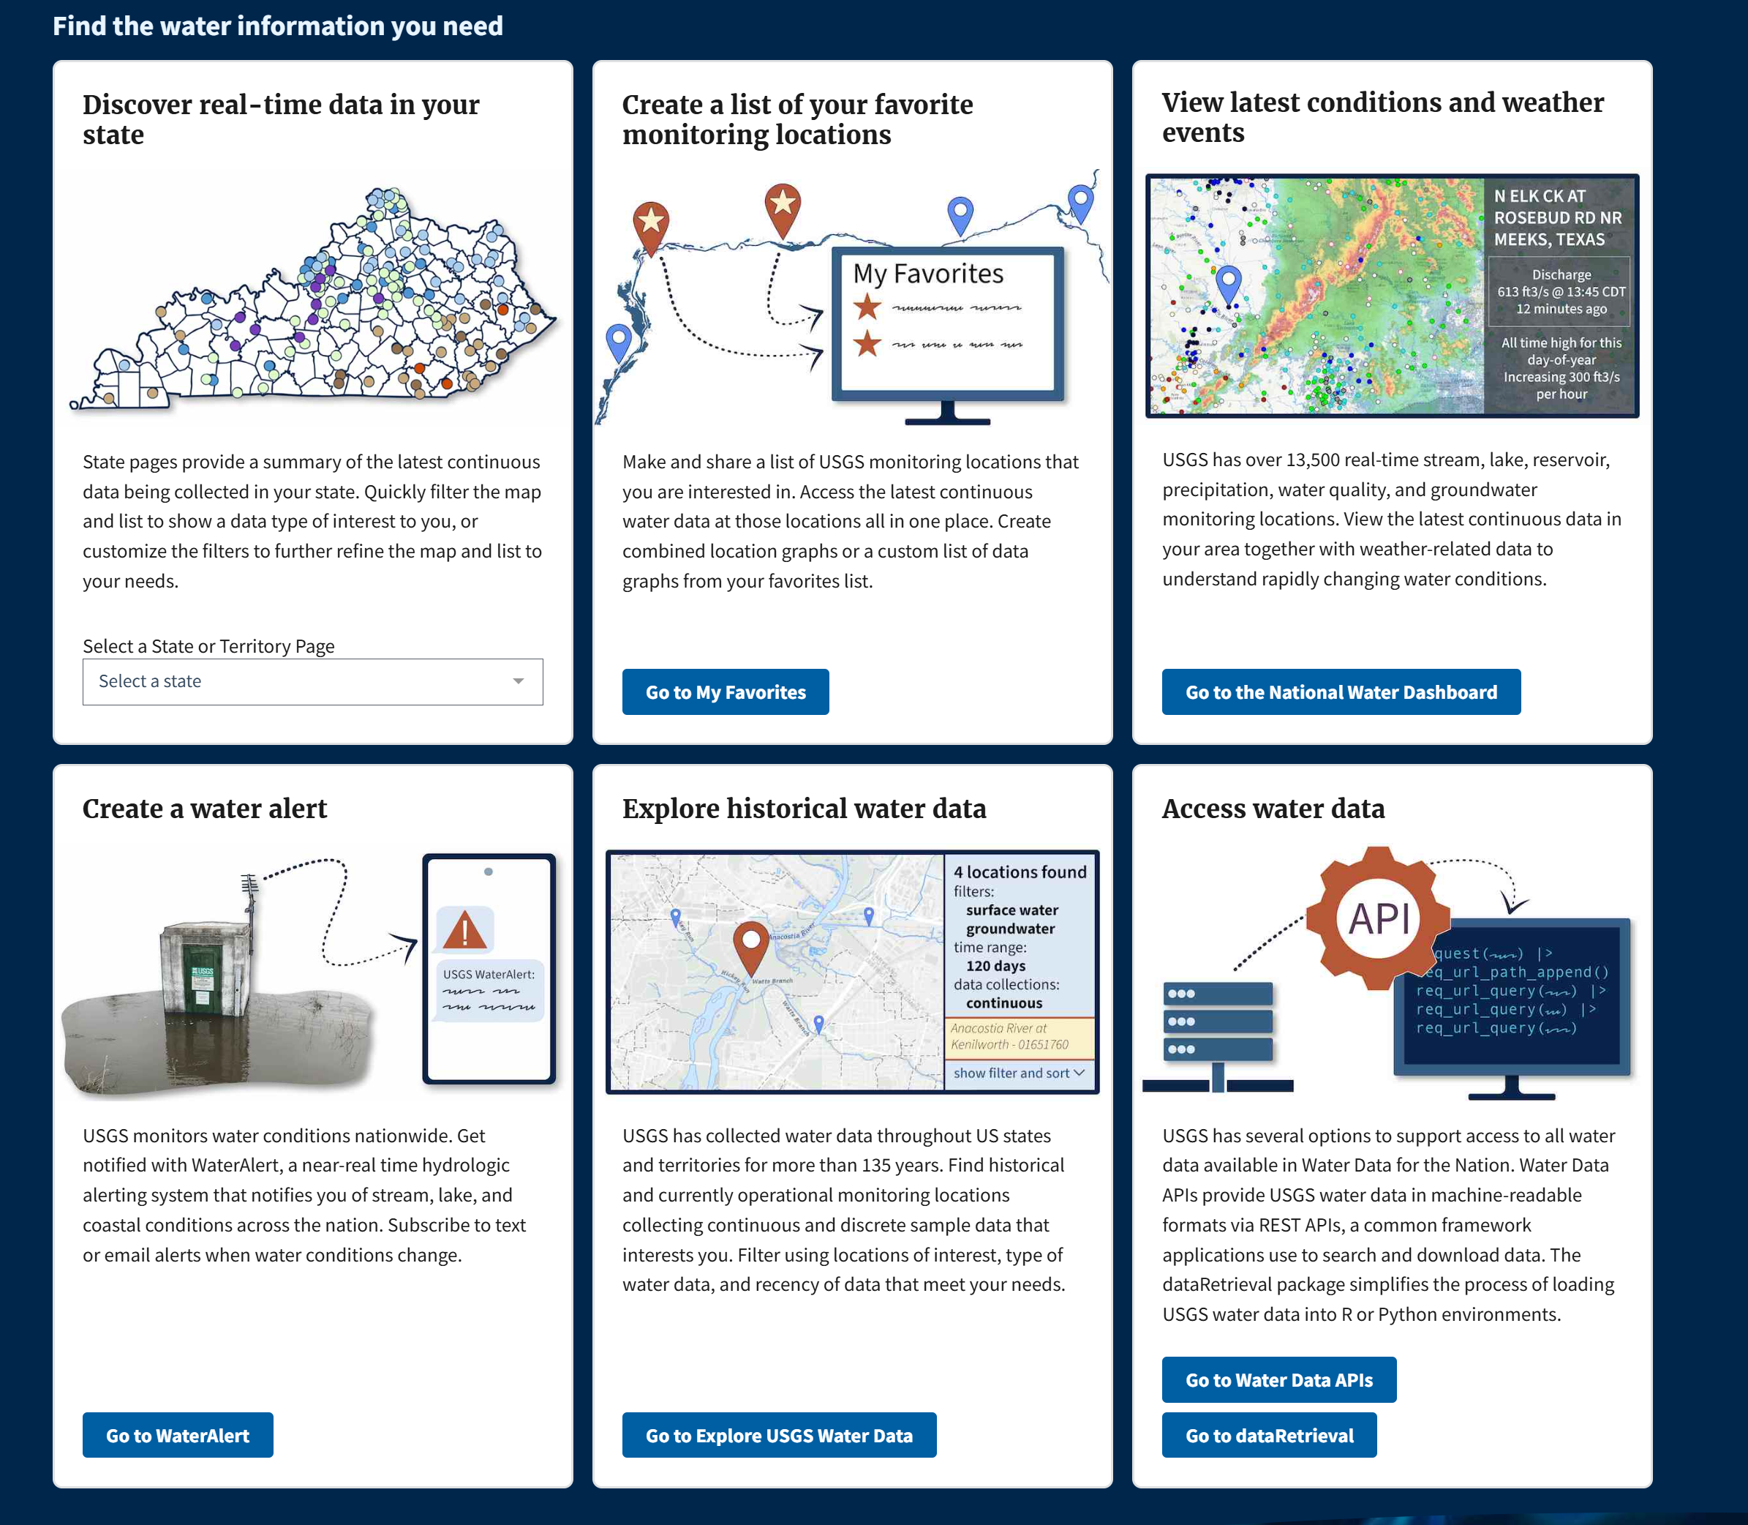
Where to find streamflow data
United States Geological Survey: (USGS) waterdata.usg.gov
Or…
Just Google a location of interest and USGS Gage
Example: Morgan Creek Chapel Hill USGS Stream Gauge

Slide 4
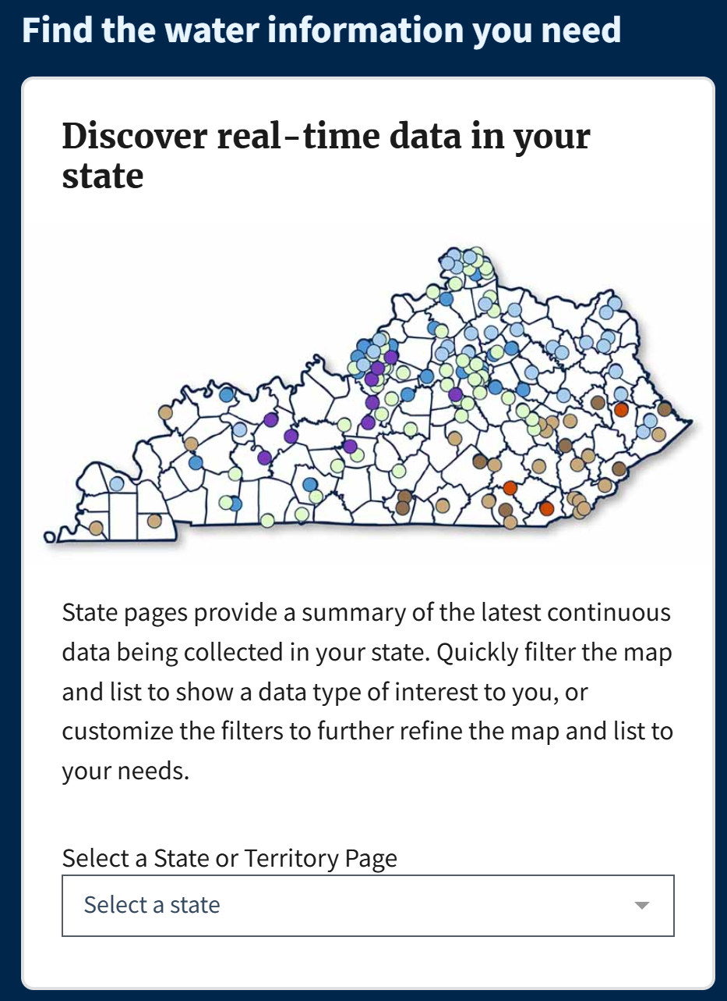
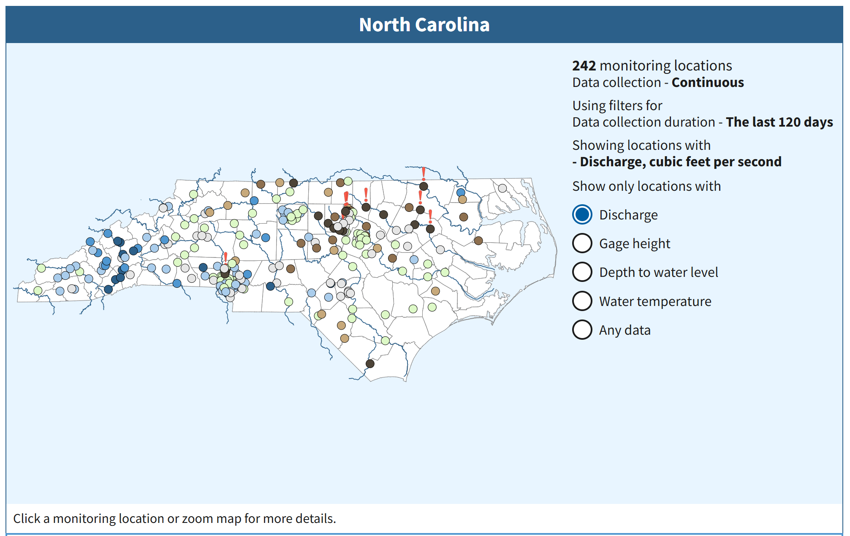
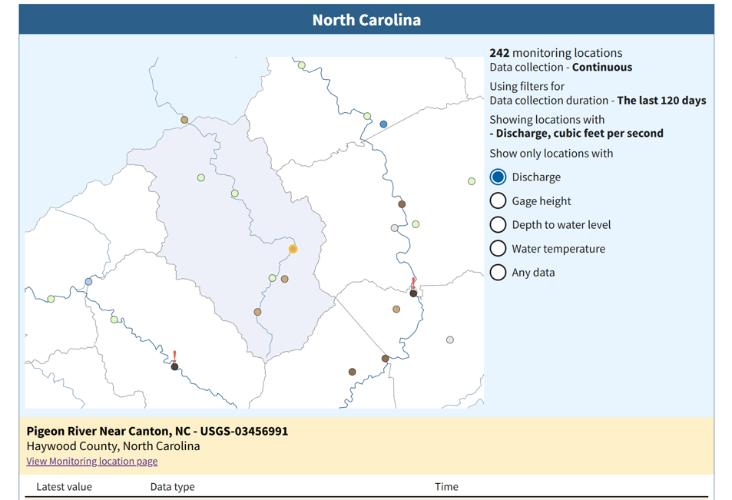
Where to find streamflow data
(2)
(1)
Select your state
Use the map to zoom in to an area of interest
Select a gauge location
Go to “View Monitoring location page”
(3)
(4)

Slide 5
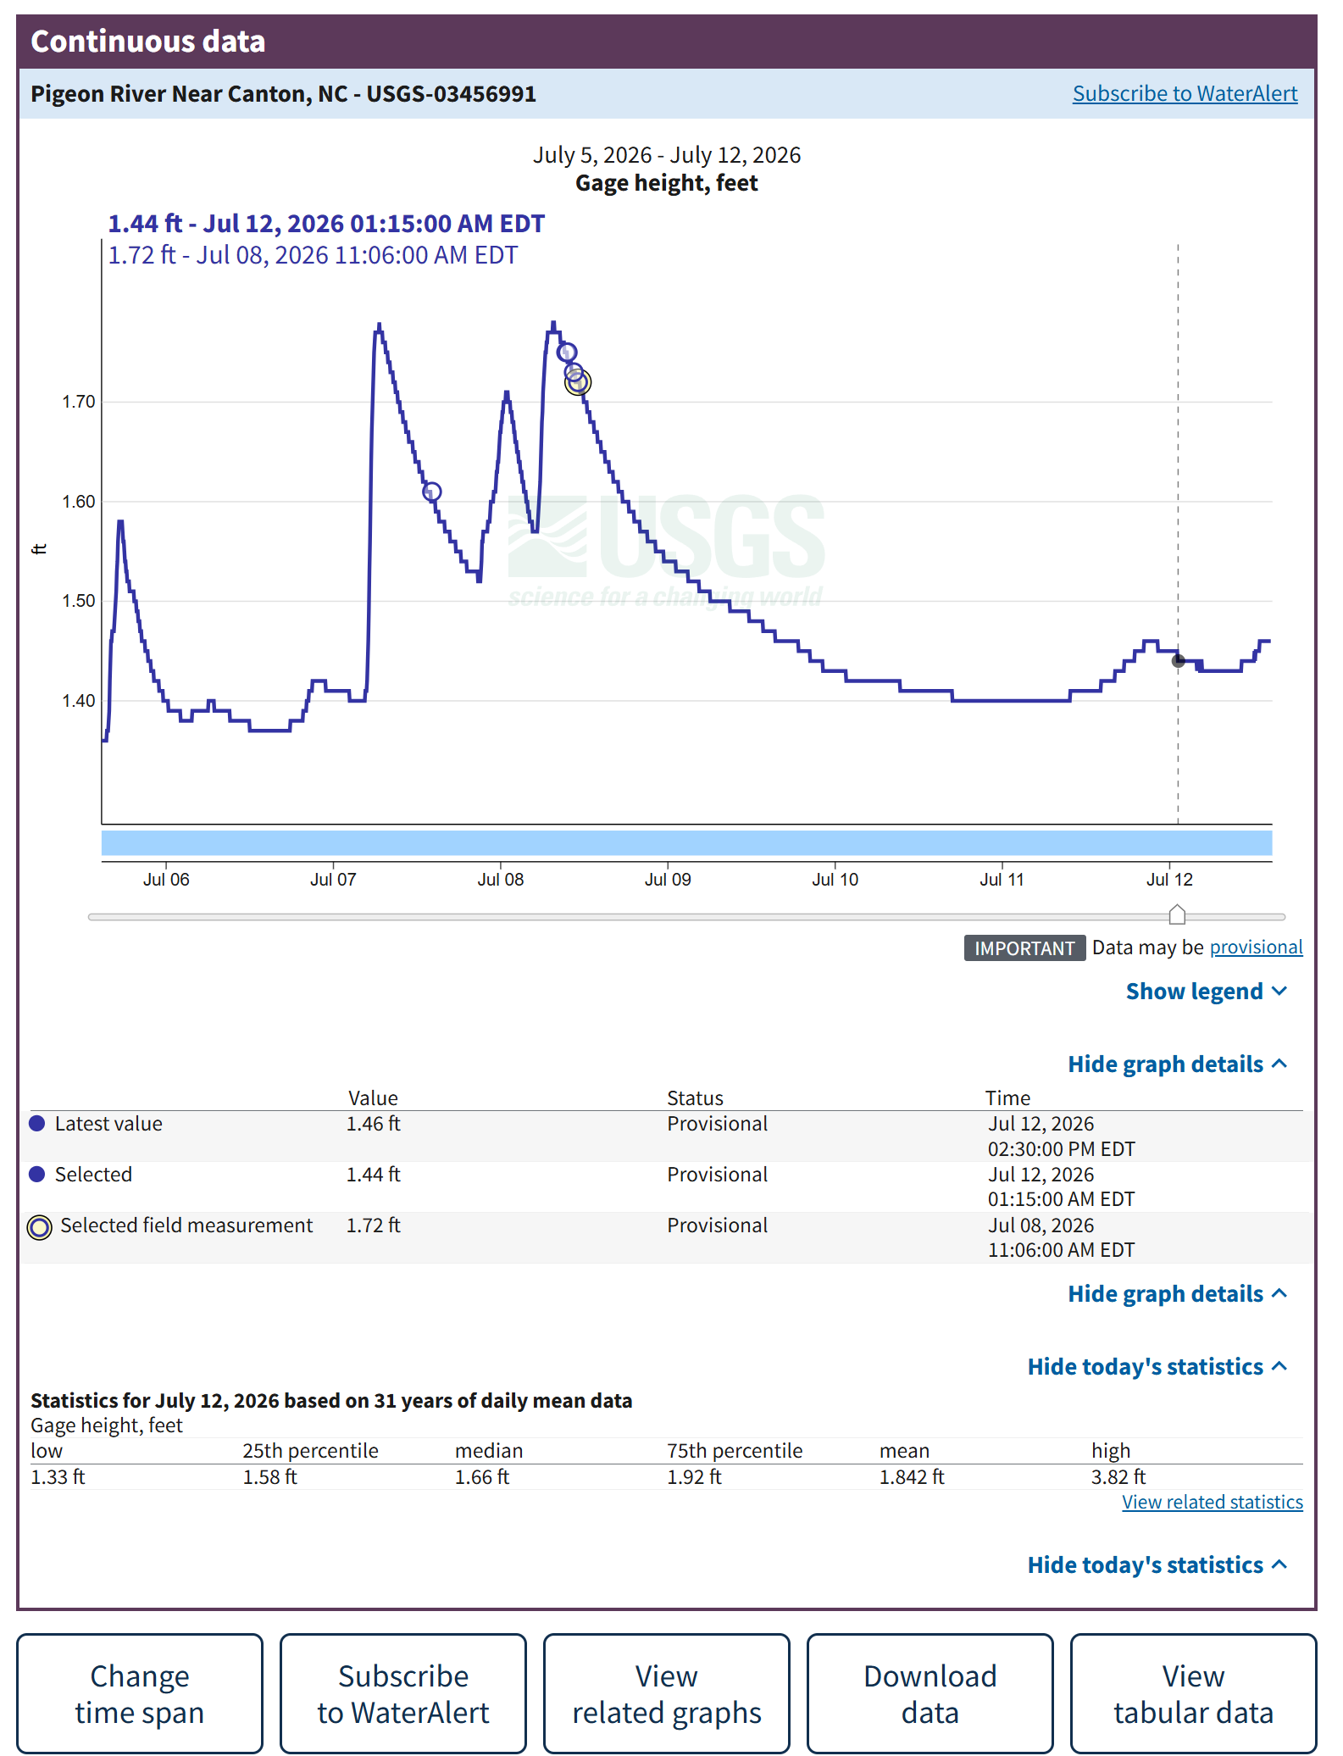
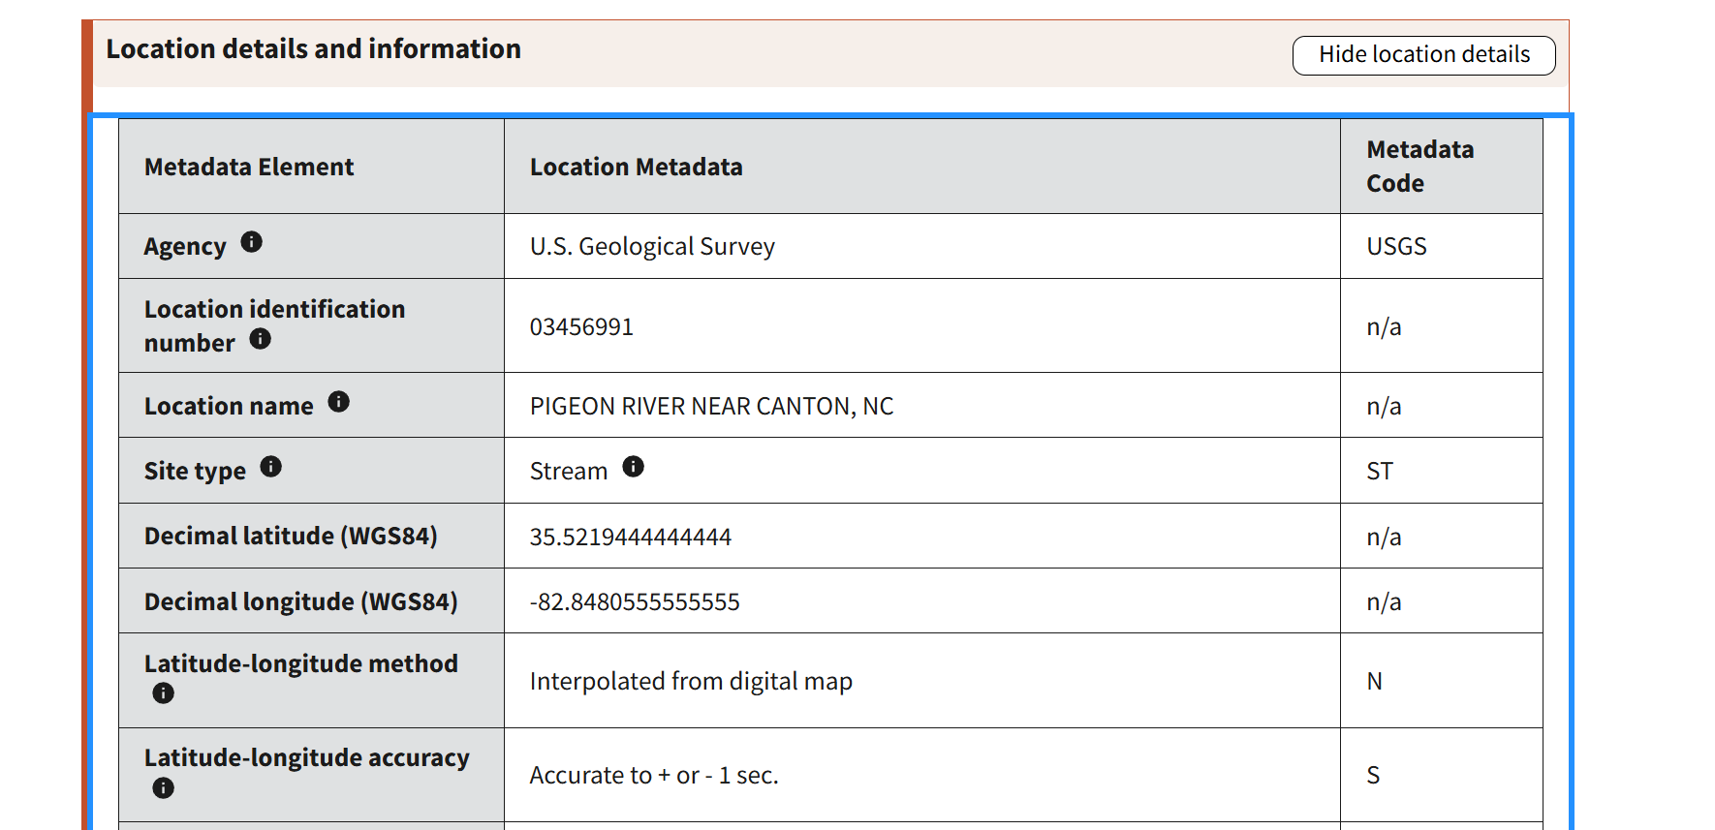
Where to find streamflow data
You have the option to either screenshot and use the hydrograph directly or change the timespan and download data directly to Excel or your plotting method of choice.
To find locations for cross-sections and topographic maps go to the “Location details and information” tab and record the gauge latitude and longitude.

Slide 6
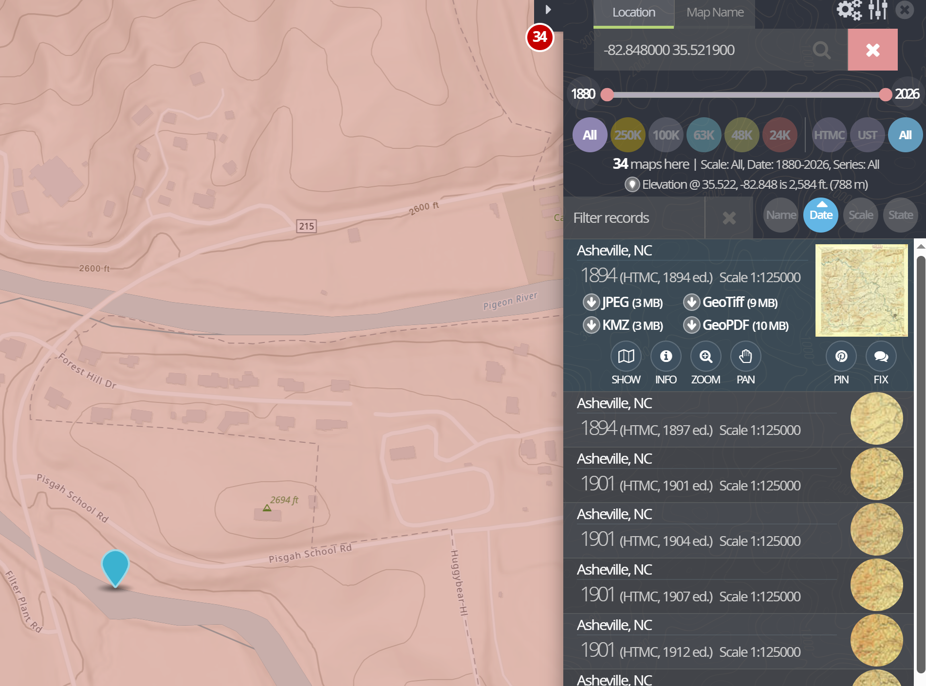
Where to find topographic maps
Go to USGS topoView: (https://ngmdb.usgs.gov/topoview/viewer/#17/35.52201/-82.84799)
Now type in the longitude and latitude of the gauge location in the search bar.
Select your map of choice from the drop down on the right.
You can download the topographic map as:
PDF or JPEG
Google Earth KMZ!

Slide 7
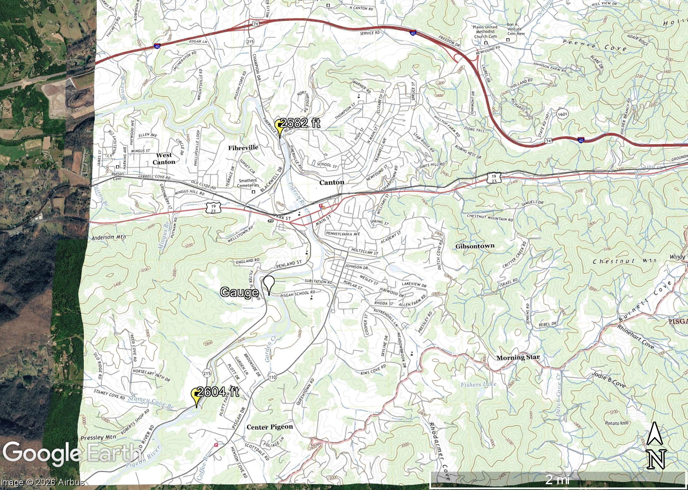
Where to find topographic maps
Bring your downloaded topographic map KMZ into Google Earth Pro.
Next create a placemark named gauge by searching for the gauge location using the latitude and longitude.
Select a start and end point by hovering your cursor along the river network upstream and downstream of the gauge to get the elevation of each point.
Make a new placemark for each elevation point with the name of the elevation value.
Go to file save -> save image.
Go to Map Options and increase the scaling % to make the scale bar larger.
Now we have an elevation basemap marking the gauge location and two points for students to measure channel slope!

Slide 8
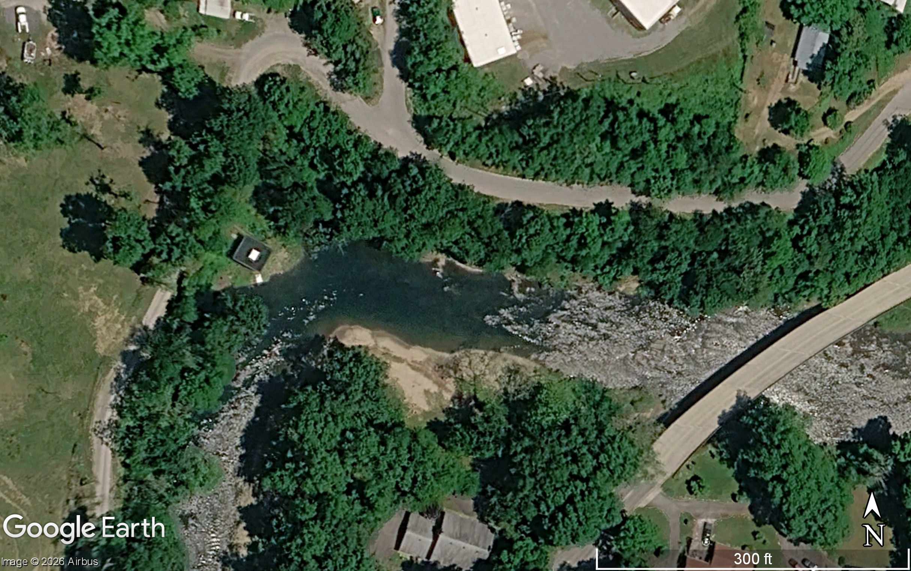
Where to get the channel cross-section
In Google Earth find a section of stream near your gauge that is fairly easy to identify the channel banks.
Create and save a new image by going to File-> Save Image
Go to Map Options and increase the scaling to make the scale bar bigger.
Once we export the image for the cross section, it is often useful to remake the scale bar in PowerPoint in different units by tracing the scale bar in the image.
150 ft
Now we have an image that students can measure the width of the cross section!

