Slide 1
Notes for Teaching
Crystallography is vital for many aspects of STEM along with everyday items. Without liquid crystal displays, we can’t view high-definition cat videos.
Lucky, the cat, illustrates important types of symmetry for mineralogy: mirror, rotation, reflection and inversion. 3-D inversion is hard to imagine, but is easier when Lucky shows it by rolling over.

Slide 2

Crystallography
Goal: to interpret mineral properties as a function of their crystal structure.
Specific learning outcomes:
To define the science of crystallography.
To name the different types of crystal systems and describe them with reference to crystallographic axes and angles, with example minerals.
Associated chapters in Introduction to Mineralogy
(Perkins 2020):
Symmetry: chapter 10.1 & parts of 10.4 & 10.5.
Notes:
The goal for this session is to be able to….

Slide 3
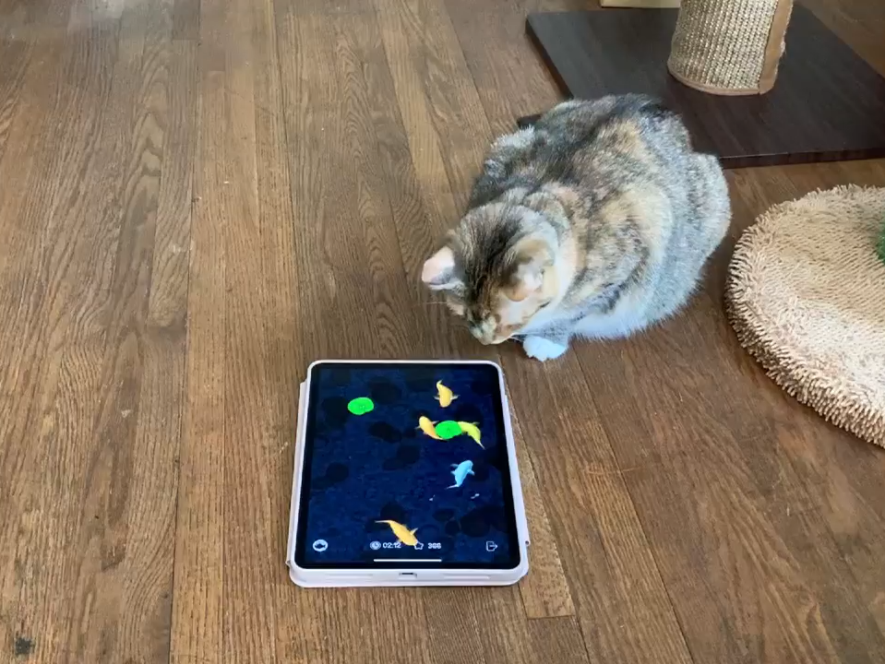
Importance of Crystallography
Notes:
Without crystallography we don’t have liquid crystal displays, which we need to view cats and cat videos.

Slide 4



Symmetry
Reflection Symmetry
The concept of symmetry describes the repetition of structural features.
Crystals possess a regular, repetitive internal structure, therefore possess symmetry.
Much of the discipline of crystallography is concerned with describing and cataloguing different types of symmetry.
Think about mirror planes
Notes:
Much of crystallography is concerned with:
Describing and cataloguing different types of symmetry.
Does the lion’s face have mirror plane symmetry?

Slide 5

Symmetry
Reflection Symmetry
Reflection symmetry:
An object on one side of a ‘mirror’ has an equivalent at an equal distance on the other side of the ‘mirror’.
The plane of the imaginary mirror is called the ‘mirror’ plane.
Think about mirror planes
Notes:
Does the leopard’s face have mirror plane symmetry?
How about Lucky’s face?
There are four major types of symmetry in minerals. Describe each.
Reflection symmetry associated with mirror planes
Symmetry with respect to an imaginary mirror plane – equivalent on the other side, with opposite handedness.

Slide 6

Symmetry
Motif: the fundamental part of a symmetric design that, when repeated, creates the whole pattern
Operation: some act that reproduces the motif to create the pattern
Element: an operation located at a particular point in space

Slide 7

Symmetry Elements (2D)
Crystals with a periodic lattice can only have axes with 1-, 2-, 3-, 4-, and 6-fold symmetry axes.
1-fold
2-fold
3-fold
4-fold
6-fold
Objects with symmetry:
a
9
d
Z
t
identity
Modified from: Winter, Symmetry I: https://www.whitman.edu/geology/winter/JDW_MinClass.htm

Slide 8

2D Symmetry - Rotation
Symmetry Elements
1. Rotation
  a. One-fold rotation
    = 360º/1 rotation
    to reproduce a motif in a symmetrical pattern
Motif
Element
Operation
Modified from: Winter, Symmetry I: https://www.whitman.edu/geology/winter/JDW_MinClass.htm

Slide 9


2D Symmetry – Reflection & Rotation
Symmetry Elements
3. Reflection (m)
    Reflection across a “mirror plane” reproduces a motif
    = symbol for a mirror
    plane
Modified from: Winter, Symmetry I: https://www.whitman.edu/geology/winter/JDW_MinClass.htm

Slide 10

2D Symmetry – Reflection & Rotation
Try combining a 2-fold rotation axis with a mirror
Modified from: Winter, Symmetry I: https://www.whitman.edu/geology/winter/JDW_MinClass.htm

Slide 11
2D Symmetry – Reflection & Rotation
Try combining a 2-fold rotation axis with a mirror
Step 1: reflect
(could do either step first)
Modified from: Winter, Symmetry I: https://www.whitman.edu/geology/winter/JDW_MinClass.htm

Slide 12
2D Symmetry – Reflection & Rotation
Try combining a 2-fold rotation axis with a mirror
Step 1: reflect
Step 2: rotate (everything)
Modified from: Winter, Symmetry I: https://www.whitman.edu/geology/winter/JDW_MinClass.htm

Slide 13
2D Symmetry – Reflection & Rotation
Try combining a 2-fold rotation axis with a mirror
Step 1: reflect
Step 2: rotate (everything)
Is that all??
Modified from: Winter, Symmetry I: https://www.whitman.edu/geology/winter/JDW_MinClass.htm

Slide 14
2D Symmetry – Reflection & Rotation
Try combining a 2-fold rotation axis with a mirror
Step 1: reflect
Step 2: rotate (everything)
No! A second mirror is required
Modified from: Winter, Symmetry I: https://www.whitman.edu/geology/winter/JDW_MinClass.htm

Slide 15



3D Symmetry - Inversion
In 3D the top becomes the bottom through inversion
Notes:
Inversion: in 3D inversion, the top becomes the bottom through inversion.

Slide 16
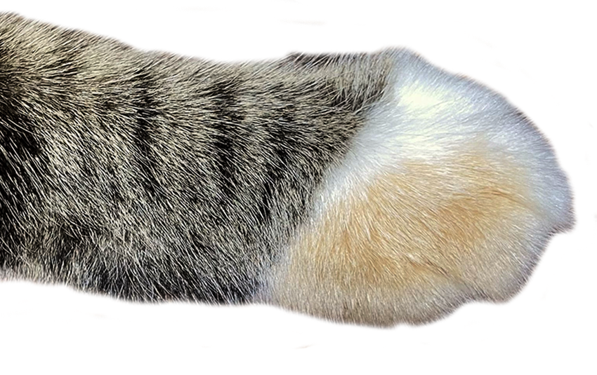
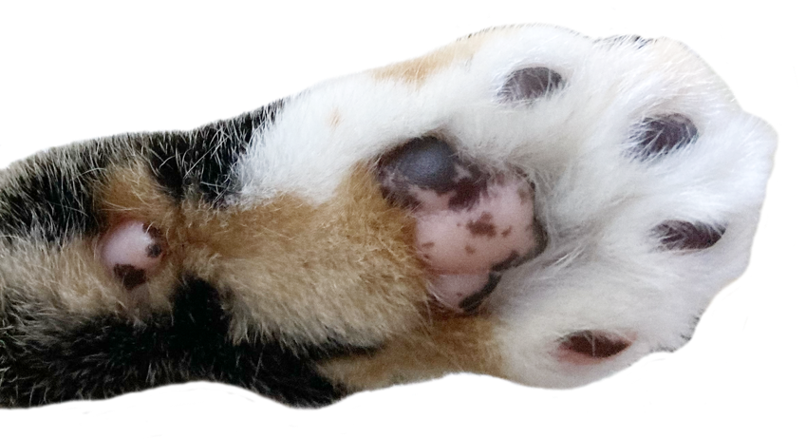
3D Symmetry - Inversion
In 3D the top becomes the bottom through inversion

