Slide 1
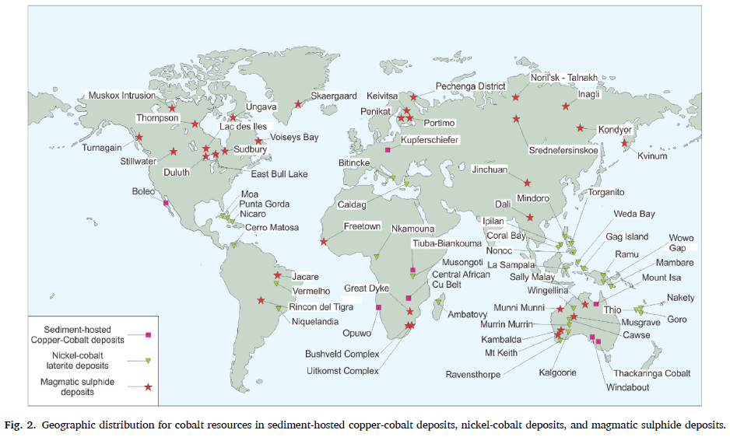
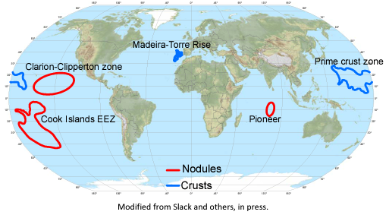
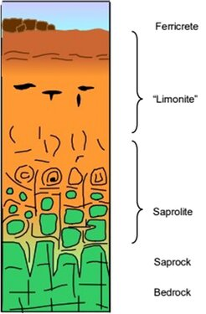
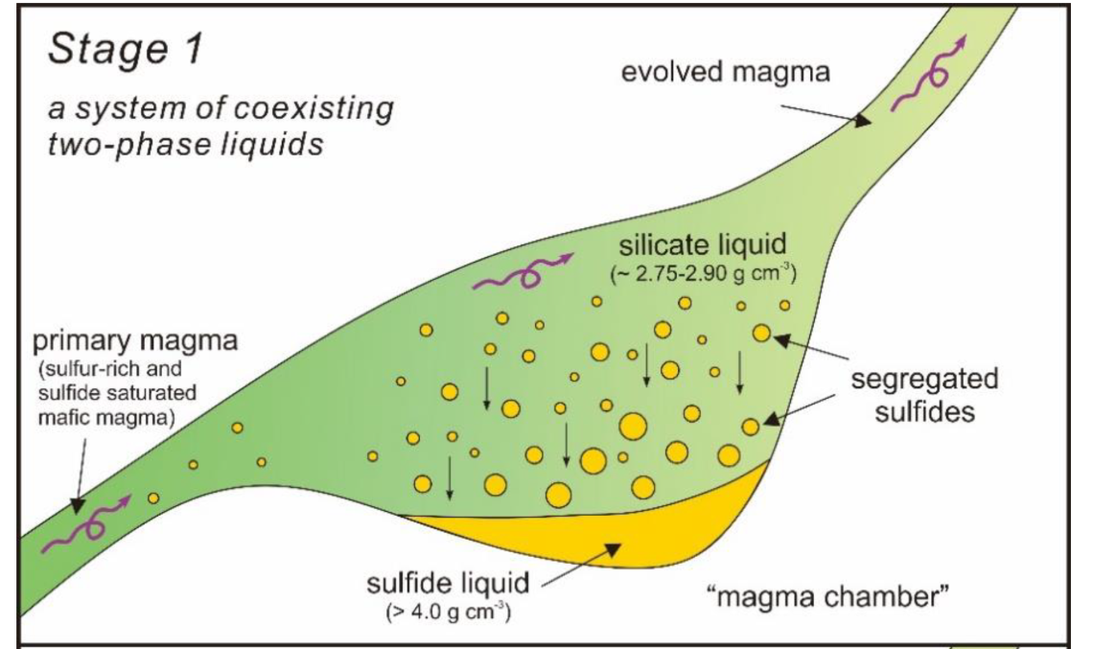
Cobalt (Co)
Figure 1. World map of cobalt deposits. Reproduced from Rachidi et al. (2021) under a CC BY 4.0 license.
Most Co is produced from sediment hosted Cu-Co deposits in the DRC.These form when hot groundwater deposits metals in sedimentary rocks.
The biggest known Co resources are at the bottom of the ocean, as polymetallic nodules or crusts on the seafloor. These are not currently being mined due to the potential environmental, legal and economic impacts.
Figure 2. World map of seafloor cobalt deposits. Source: Hitzman et al. (2017). Public Domain.
Laterites form by breakdown of ultramafic rocks to make Co-rich soil
Layer Name
Co
Sulfide deposits form in Large Igneous Provinces, which are large volumes of mafic lava erupted due to a mantle plume, focused at the boundaries of cratons (old stable continental crust)
<0.1%
Figure 3. Magmatic Sulfides. Reproduced from Wang et al. (2021) under a CC BY 4.0 license.
0.2%
Sulfide unmixes from the silicate magma, forming blebs of sulfide liquid, which can sink and concentrate Fe, Ni, Cu and Co
Figure 4. Laterites. Reproduced from Ruslan et al. (2025) under a CC BY 4.0 license.
0.1%
0.01%
Notes:
https://pubs.geoscienceworld.org/segweb/economicgeology/article/117/3/513/611699/Constraints-on-the-Genesis-of-Cobalt-Deposits-Part
https://pubs.usgs.gov/publication/ofr20171155
https://www.ifpenergiesnouvelles.com/article/cobalt-energy-transition-closer-look-supply-risks
https://www.researchgate.net/publication/355425201_Assessing_cobalt_supply_sustainability_through_production_forecasting_and_implications_for_green_energy_policies

Slide 2
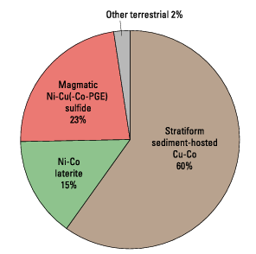
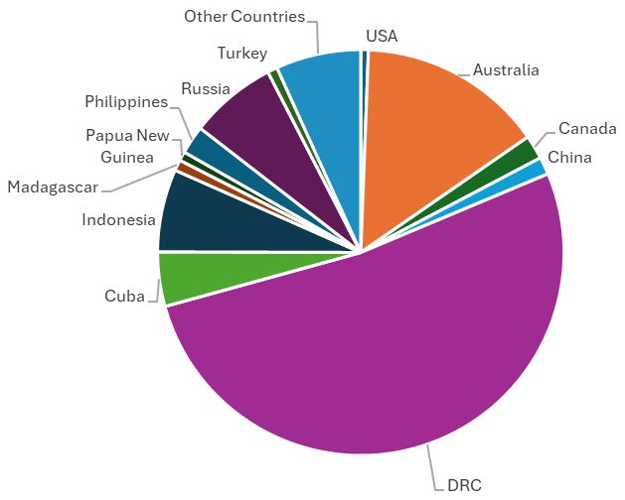
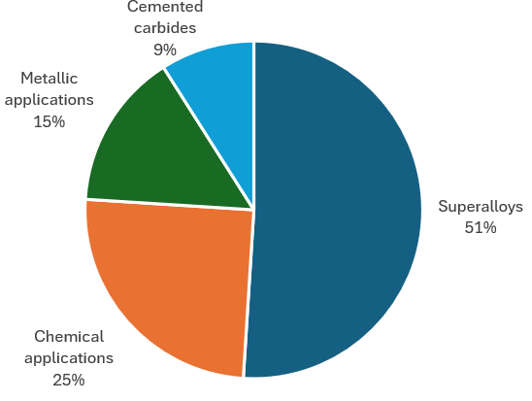
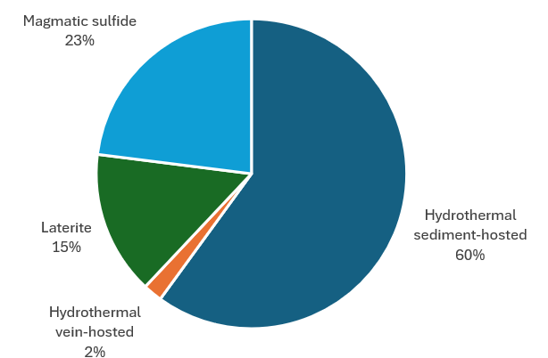
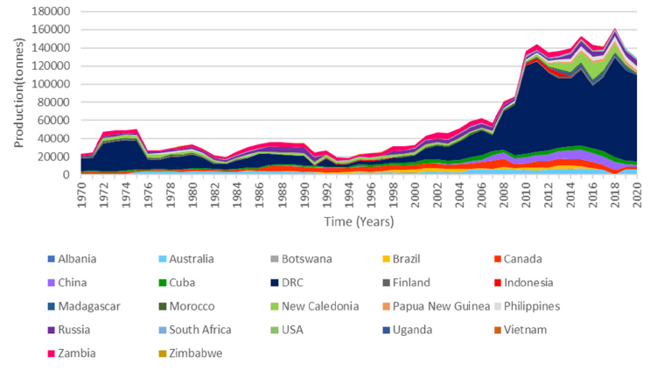
Global Co Production
Global Co Reserves (2025)
Figure 5. Global Co Production. Source: Hitzman et al. (2017). Public Domain.
Figure 6. Global Co Reserves (2025). Source: USGS Mineral Commodities Summaries (2026). Public Domain.
Global Co Uses
Global Co Resources
Figure 8. Global Co Resources by type. Data from Williams-Jones & Vasyukova (2022).
Figure 7. Global Co Resources. Source: USGS Mineral Commodities Summaries (2026). Public Domain.
Figure 9. Global Co Production over time. Reproduced from Rachidi et al. (2021) under a CC BY 4.0 license.
A “resource” is the amount of Co available, while a “reserve” is the amount that can be mined economically.

Slide 3
Cobalt Figure References
Hitzman, M. W., Bookstrom, A. A., Slack, J. F., & Zientek, M. L. (2017). Cobalt—styles of deposits and the search for primary deposits. USGS Open-File Rep. 2017-1155. US Geol. Surv., Reston, VA.
Rachidi, N. R., Nwaila, G. T., Zhang, S. E., Bourdeau, J. E., & Ghorbani, Y. (2021). Assessing cobalt supply sustainability through production forecasting and implications for green energy policies. Resources Policy, 74, 102423.
Ruslan, A. R. N., Yatini, Y., & Wicaksono, M. A. (2025). Delineation of Nickel Laterite Based on Electrical Resistivity Tomography (ERT) Method at Kolaka Regency, Southeast Sulawesi. Jambura Geoscience Review, 7(1), 48-59.
USGS Mineral Commodities Summaries (2026). Mineral commodity summaries. US Geological Survey: Reston, VA, USA, 200.
Wang, P., Niu, Y., Sun, P., Wang, X., Guo, P., Gong, H., Duan, M., Shen, F., Shi, Y., Xue, S. and Chen, Y., (2021). Iron isotope compositions of coexisting sulfide and silicate minerals in sudbury-type ores from the Jinchuan Ni-Cu sulfide deposit: a perspective on possible core-mantle iron isotope fractionation. Minerals, 11(5), 464.
Williams-Jones, A. E., & Vasyukova, O. V. (2022). Constraints on the genesis of cobalt deposits: Part I. Theoretical considerations. Economic Geology, 117(3), 513-528.

Slide 4
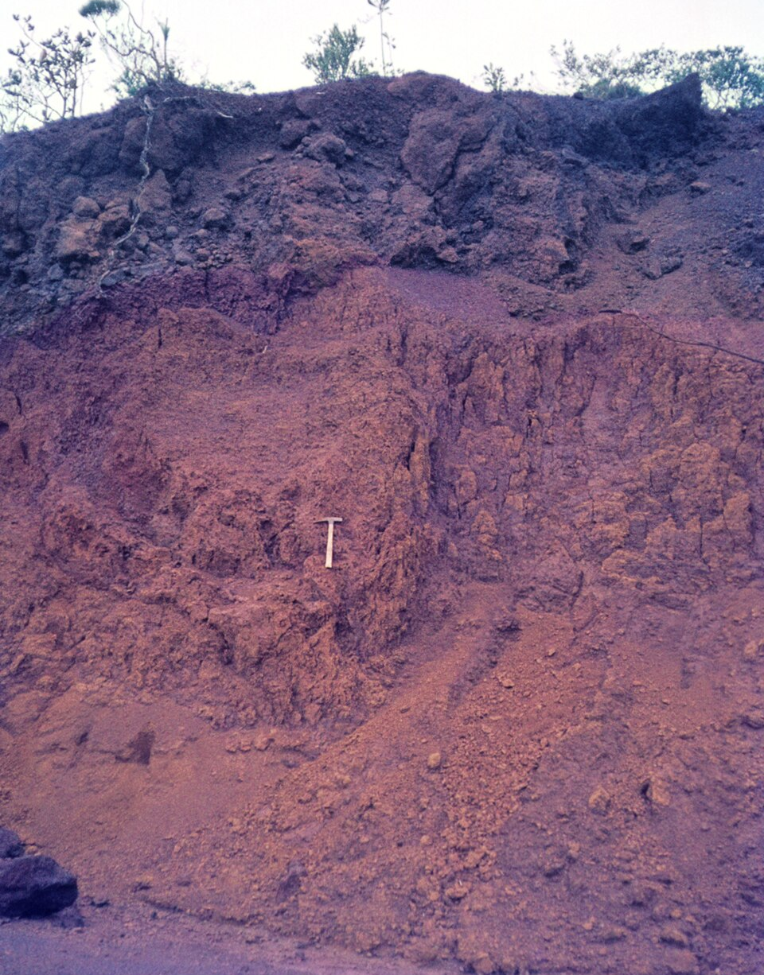
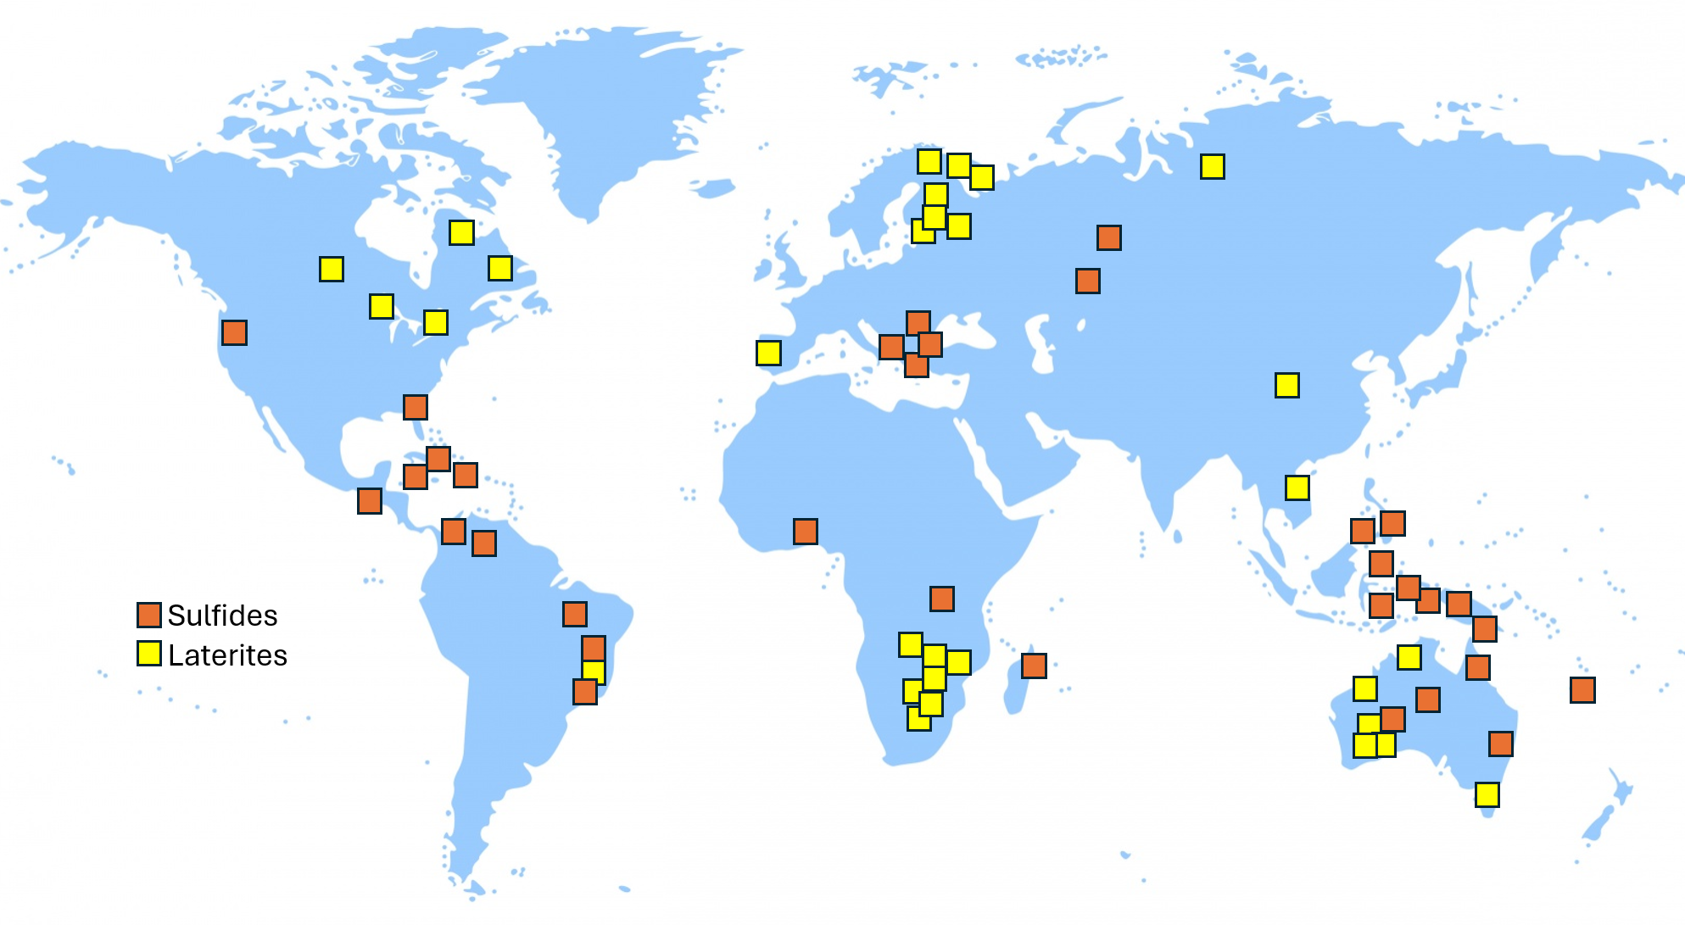
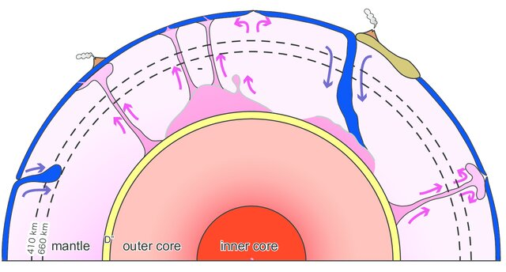
Nickel (Ni)
Figure 2. Ni laterite, New Caledonia. Reproduced from Schellmann (1969) under a CC BY-SA 3.0 license. This image is not covered by this document's CC BY-NC license.
Figure 1. Map of global Ni deposits. Locations estimated from Hoatson et al. (2006). Basemap reproduced from Arnold (2007), under a CC0 (public domain) license.
Figure 3. Tectonic Cross Section. Reproduced from Coffin et al. (2006) under a CC BY 4.0 license.
Laterites form by breakdown of ultramafic rocks to make Ni-rich soil
Ni-sulfide deposits form in Large Igneous Provinces, which are large volumes of mafic lava erupted due to a mantle plume, focused at the boundaries of cratons (old stable continental crust)
Layer Name
Ni
<0.6%
Figure 4. Magmatic Sulfides. Reproduced from Wang et al. (2021) under a CC BY 4.0 license.
1.5%
Sulfide unmixes from the silicate magma, forming blebs of sulfide liquid, which can sink and concentrate Fe, Ni, Cu and Co
3%
Figure 5. Laterites. Reproduced from Ruslan et al. (2025) under a CC BY 4.0 license.
0.3%
Wang et al. (2021)
Notes:
https://stainless-steel-world.net/an-overview-of-world-nickel-resources/
https://www.geologyforinvestors.com/nickel-laterites/#google_vignette
https://www.mdpi.com/2075-163X/11/5/464
https://volcanoes.sdsu.edu/intraplvolc_page.html
https://www.researchgate.net/publication/381324404_Availability_of_Indonesian_nickel_reserves_and_efforts_to_improve_reserves_resistance_and_its_impact_to_economic_growth/figures?lo=1

Slide 5
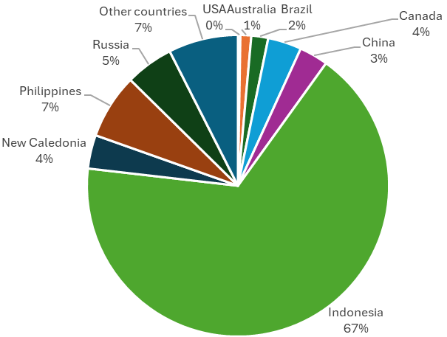
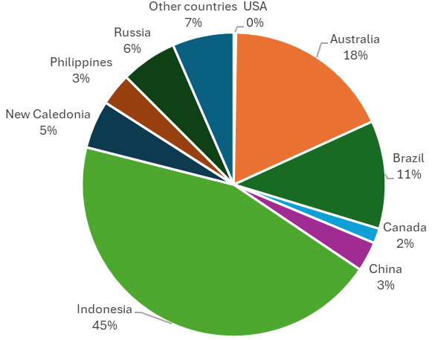
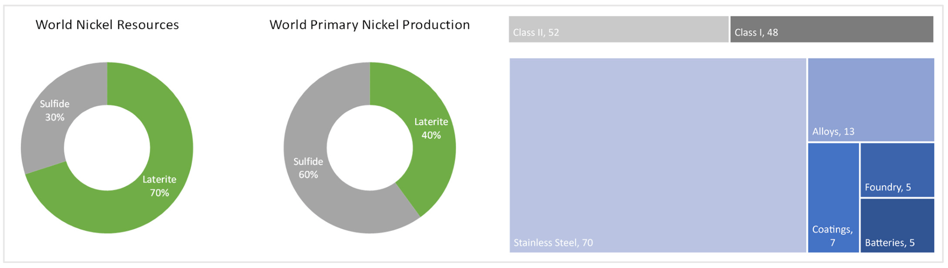
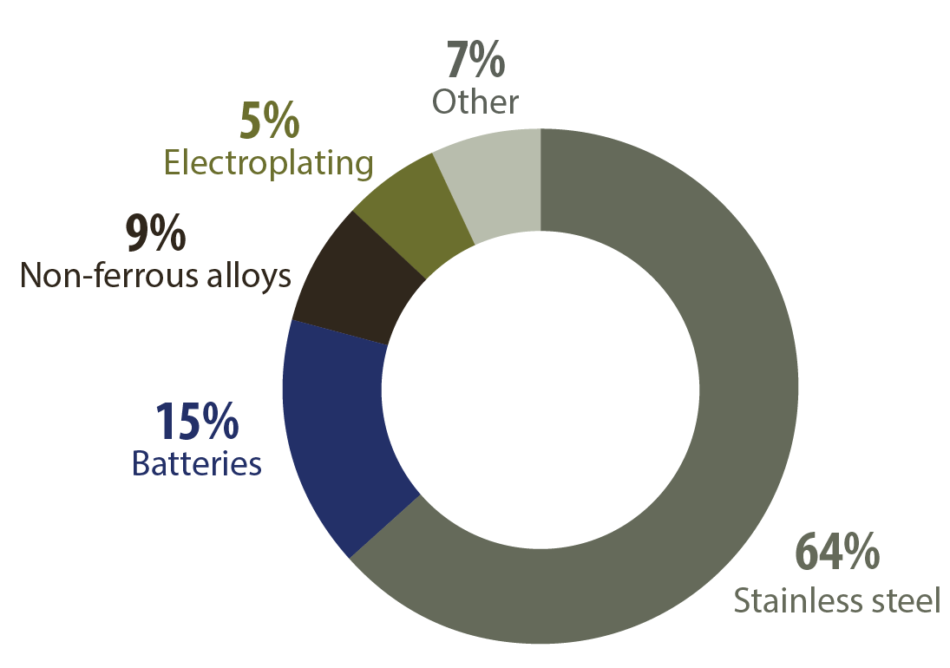
A “resource” is the amount of Ni available, while a “reserve” is the amount that can be mined economically.
Global Production (2025)
Global Reserves (2025)
Figure 7. Global Ni Production (2025). Source: USGS Mineral Commodities Summaries (2026). Public Domain.
Figure 6. Global Ni Reserves (2025). Source: USGS Mineral Commodities Summaries (2026). Public Domain.
Global Resources
Global Primary Production
Figure 8&9. Ni Resources and Production by deposit type.
Reproduced from König (2021) under a CC BY 4.0 license.
Figure 10. World Ni Uses, 2024. Source: Natural Resources Canada (2026). Non-commercial reproduction allowed.
Notes:
https://stainless-steel-world.net/an-overview-of-world-nickel-resources/
https://mine.nridigital.com/mine_apr24/top-10-nickel-producing-countries-2023
https://www.researchgate.net/publication/381324404_Availability_of_Indonesian_nickel_reserves_and_efforts_to_improve_reserves_resistance_and_its_impact_to_economic_growth/figures?lo=1
https://www.mdpi.com/2075-163X/11/11/1178

Slide 6
Nickel Figure References
Arnold, K. (2007) World Map Clipart, https://www.publicdomainpictures.net/en/view-image.php?image=465171&picture=world-map-clipartlast accessed June 2026.
Coffin, M.F., Duncan, R.A., Eldholm, O.L.A.V., Fitton, J.G., Frey, F.A., Larsen, H.C., Mahoney, J.J., Saunders, A.D., Schlich, R. and Wallace, P.J. (2006). Large igneous provinces and scientific ocean drilling: Status quo and a look ahead. Oceanography, 19(4), 150-160.
Hoatson D. M., Subhash J, & Jaques A L. (2006). Nickel sulphide deposits in Australia: Characteristics, resources, and potential. Ore geology reviews 29, 177-241.
König, U. (2021). Nickel laterites—mineralogical monitoring for grade definition and process optimization. Minerals, 11(11), 1178.
Natural Resources Canada (2026), Nickel Facts, https://natural-resources.canada.ca/minerals-mining/mining-data-statistics-analysis/minerals-metals-facts/nickel-facts, Last Accessed June 2026.
Ruslan, A. R. N., Yatini, Y., & Wicaksono, M. A. (2025). Delineation of Nickel Laterite Based on Electrical Resistivity Tomography (ERT) Method at Kolaka Regency, Southeast Sulawesi. Jambura Geoscience Review, 7(1), 48-59.
Schellmann (1969), Nickel limonite below laterite cuirass, https://commons.wikimedia.org/wiki/File:Nickel_limonite_below_laterite_cuirass._C_011.jpg, last accessed May 2026
USGS Mineral Commodities Summaries (2026). Mineral commodity summaries. US Geological Survey: Reston, VA, USA, 200.
Wang, P., Niu, Y., Sun, P., Wang, X., Guo, P., Gong, H., Duan, M., Shen, F., Shi, Y., Xue, S. and Chen, Y., (2021). Iron isotope compositions of coexisting sulfide and silicate minerals in sudbury-type ores from the Jinchuan Ni-Cu sulfide deposit: a perspective on possible core-mantle iron isotope fractionation. Minerals, 11(5), 464.

Slide 7
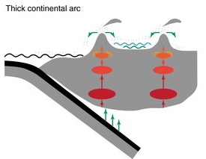
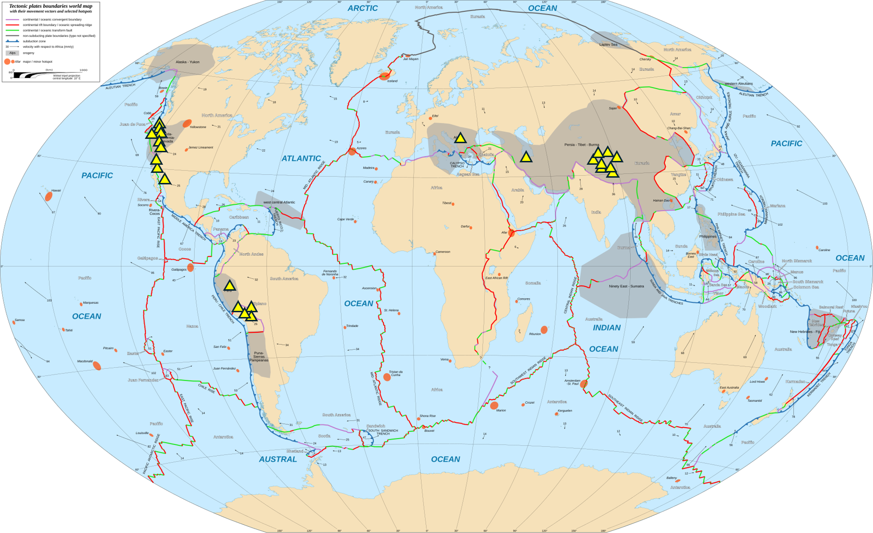
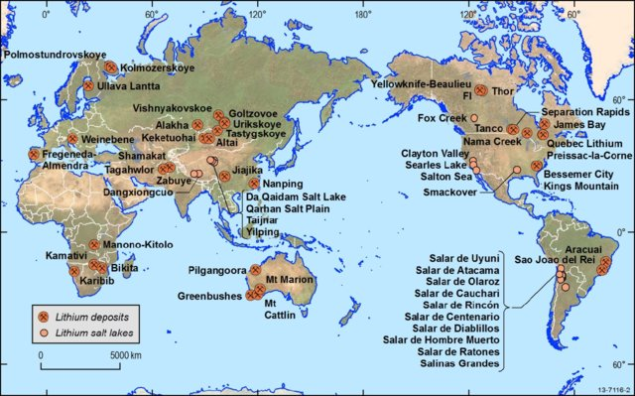
Lithium (Li)
Figure 2. Cross section of Li deposit tectonic setting. Reproduced from Chen et al. (2020) under a CC BY 4.0 license.
Figure 1. Tectonic map of global Li deposits. Locations estimated from Zheng et al. (2023). Basemap reproduced from Gaba (2018), under a CC BY-SA 3.0 license, modified with author’s written permission.
Figure 3. Map of Li deposits by type. Reproduced from Mernagh et al. (2013) under a CC BY 4.0 license.
Mernagh et al. (2013)
Notes:
https://www.researchgate.net/publication/344771761_Lithium_systematics_in_global_arc_magmas_and_the_importance_of_crustal_thickening_for_lithium_enrichment/figures?lo=1
https://www.sciencedirect.com/science/article/pii/S209651922301491X
https://www.researchgate.net/publication/291972718_A_Review_of_Australian_Salt_Lakes_and_Assessment_of_Their_Potential_for_Strategic_Resources/figures?lo=1
https://www.energypolicy.columbia.edu/publications/fact-sheet-lithium-supply-in-the-energy-transition/
https://natural-resources.canada.ca/our-natural-resources/minerals-mining/mining-data-statistics-and-analysis/minerals-metals-facts/lithium-facts/24009

Slide 8
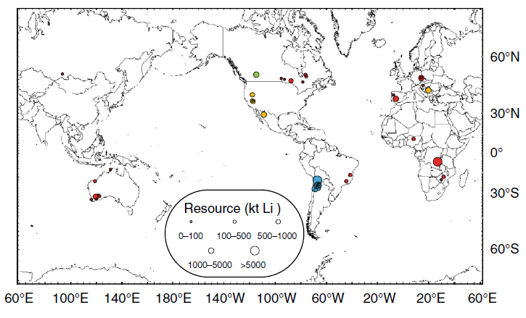
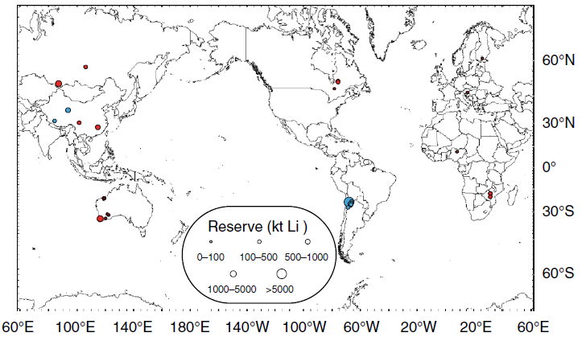
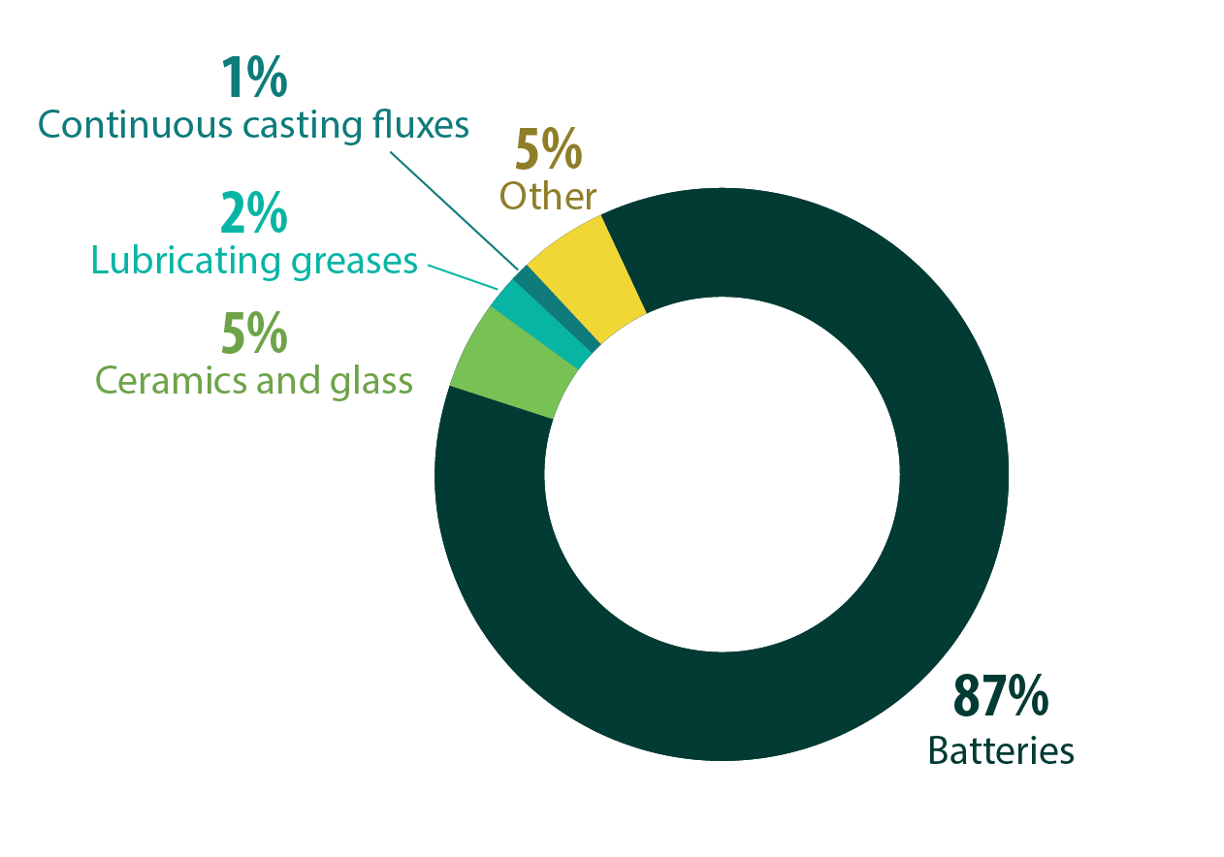
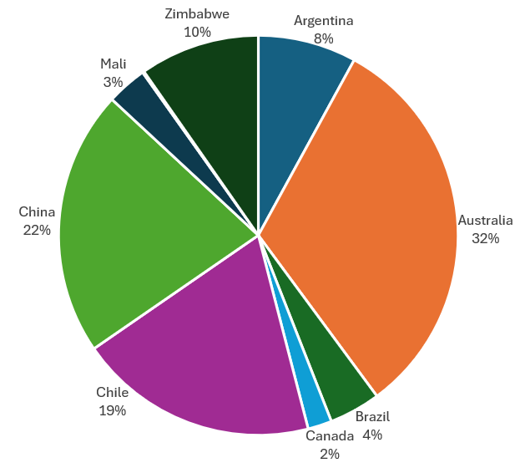
Figures 4&5 . Maps of Li resources and reserves. Reproduced from Chen et al. (2020) under a CC BY 4.0 license.
A “resource” is the amount of Li available, while a “reserve” is the amount that can be mined economically.
Uses of Li
Figure 6. Global Li Production (2025). Source: USGS Mineral Commodities Summaries (2026). Public Domain.
Figure 7. World Li Uses, 2024. Source: Natural Resources Canada (2026). Non-commercial reproduction allowed.

Slide 9
Lithium Figure References
Chen, C., Lee, C. T. A., Tang, M., Biddle, K., & Sun, W. (2020). Lithium systematics in global arc magmas and the importance of crustal thickening for lithium enrichment. Nature Communications, 11(1), 5313.
Gaba (2018) 10 degrees E centered, English, https://commons.wikimedia.org/wiki/File:Tectonic_plates_boundaries_World_map_Wt_10degE_centered-fr.svg#/media/File:Tectonic_plates_boundaries_World_map_Wt_10degE_centered-en.svg, last accessed June 2026
Mernagh, T., Bastrakov, E., Clarke, J., Caritat, P.d., English, P., Howard, F., Jaireth, S., Magee, J.W. McPherson, A., Roach, I., Schroder, I., Thomas, M., Wilford, J. (2013). A Review of Australian Salt Lakes and Assessment of Their Potential for Strategic Resources. https://www.researchgate.net/figure/World-map-showing-the-distribution-of-hard-rock-lithium-mines-dark-brown-circles-with_fig3_291972718, last accessed May 2026.
Natural Resources Canada (2026), Lithium Facts, https://natural-resources.canada.ca/minerals-mining/mining-data-statistics-analysis/minerals-metals-facts/lithium-facts, Last Accessed May 2026.
USGS Mineral Commodities Summaries (2026). Mineral commodity summaries. US Geological Survey: Reston, VA, USA, 200.
Zheng, M.P., Xing, E.Y., Zhang, X.F., Li, M.M., Che, D., Bu, L.Z., Han, J.H. and Ye, C.Y. (2023). Classification and mineralization of global lithium deposits and lithium extraction technologies for exogenetic lithium deposits. China Geology, 6(4), 547-566.

Slide 10
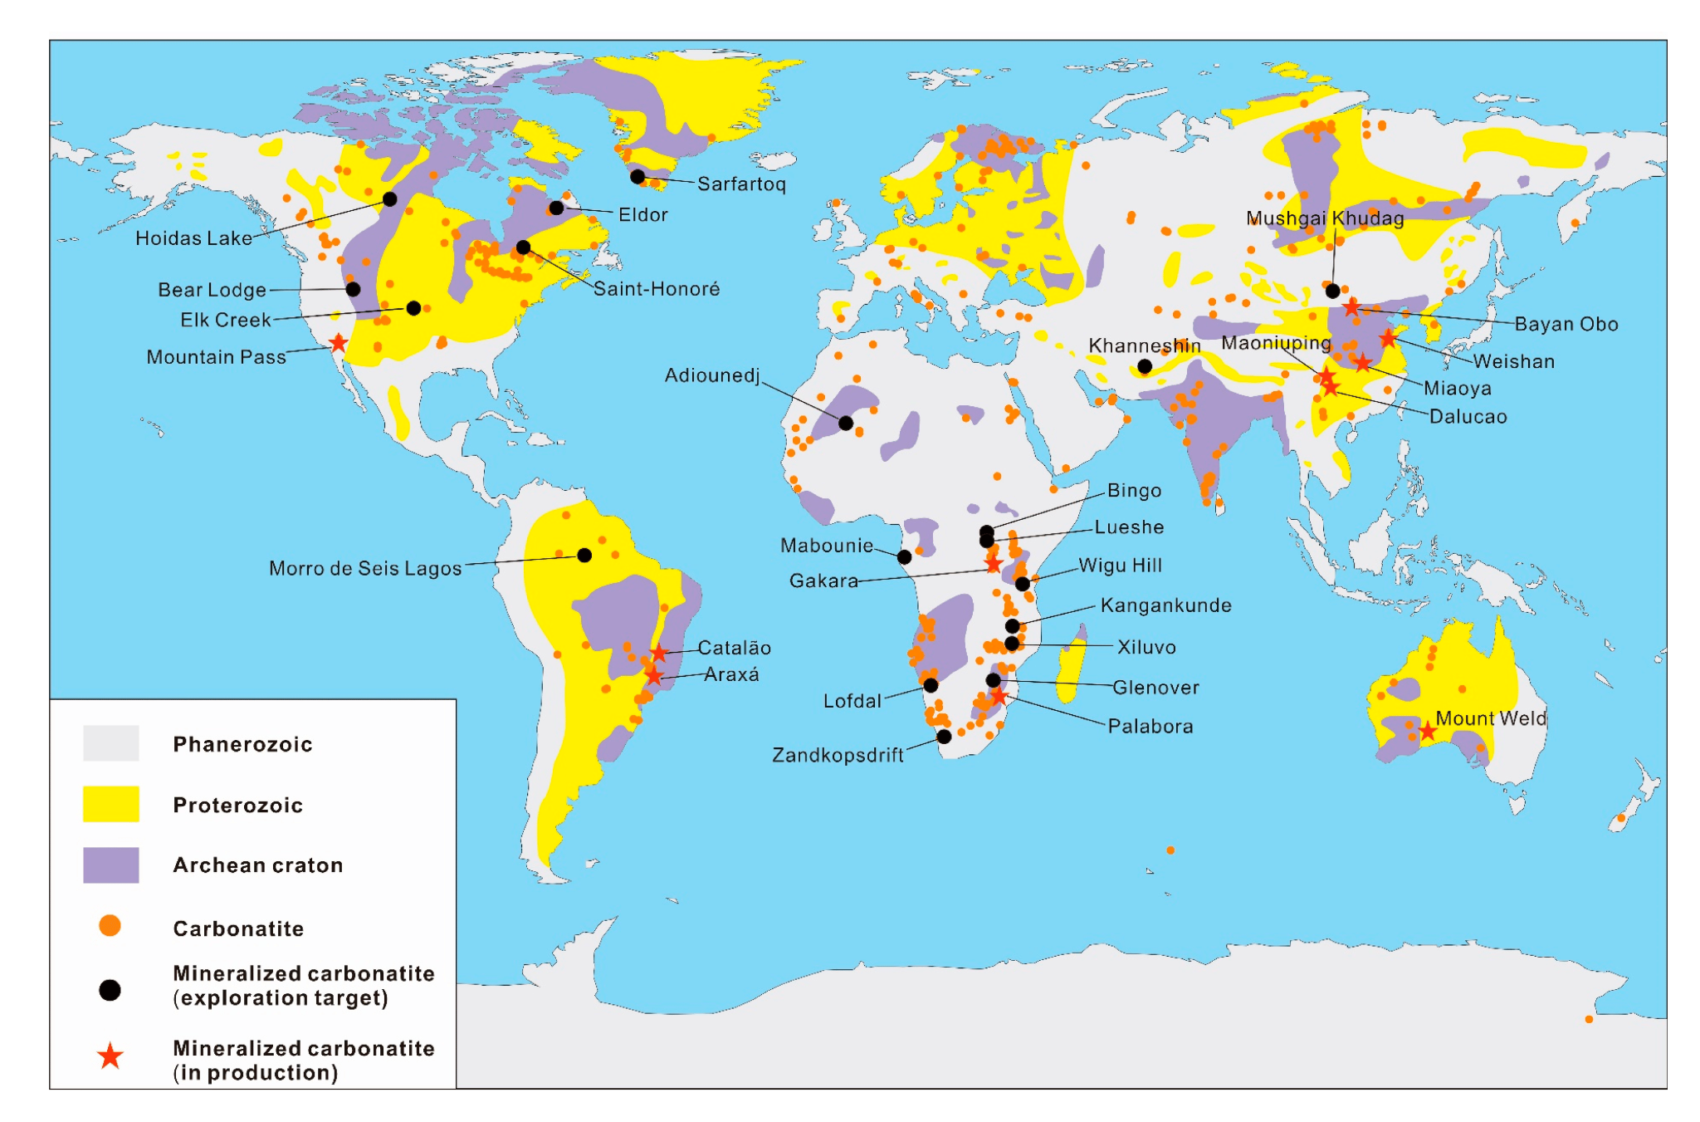
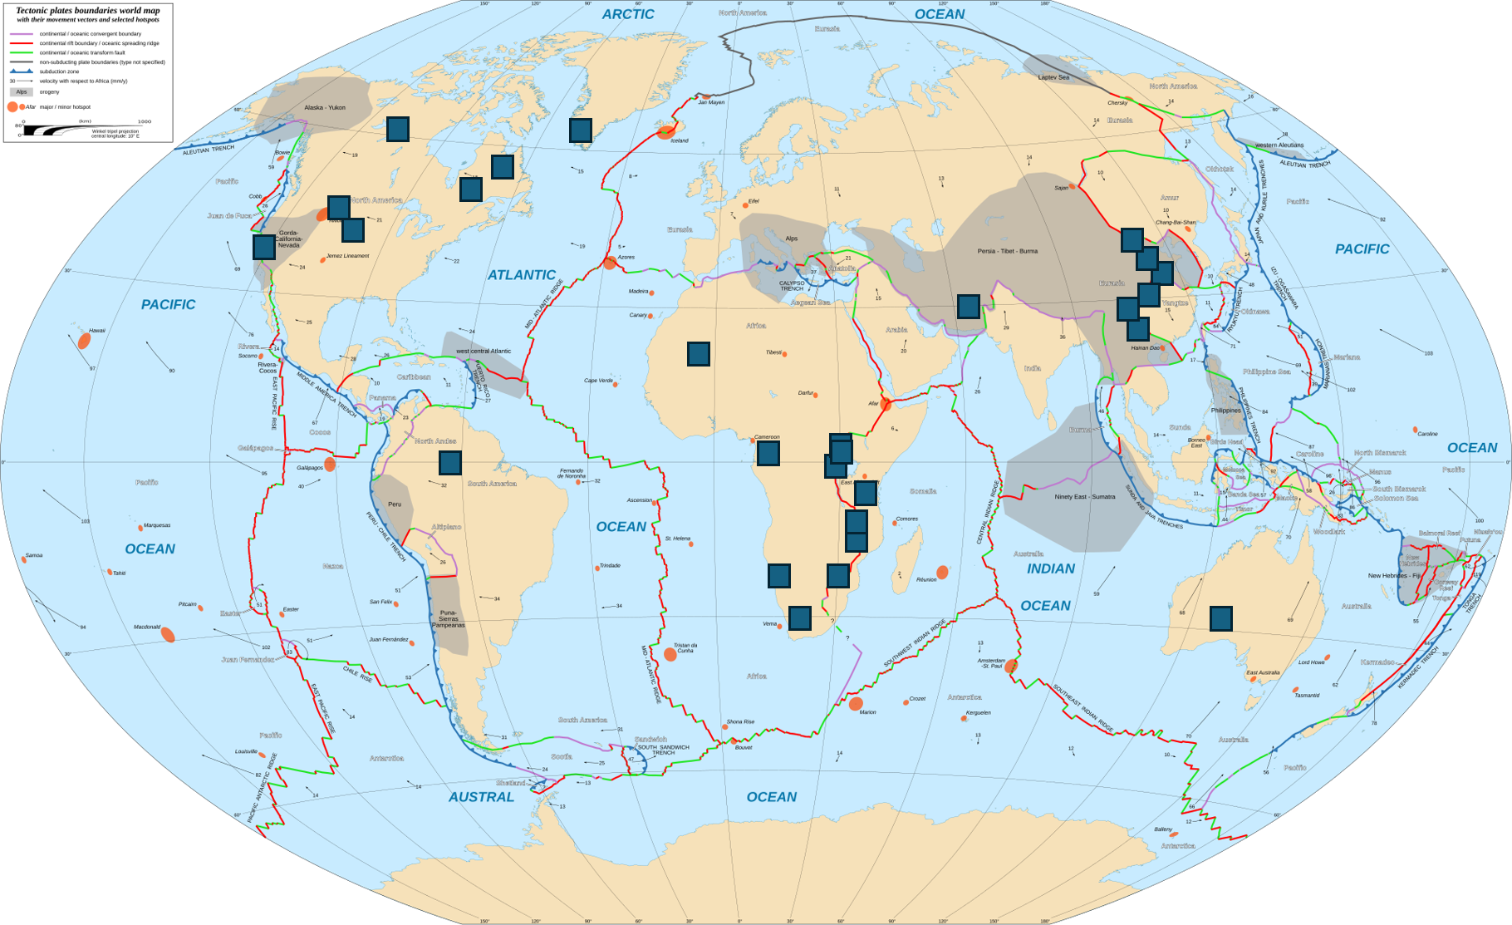
REE
Figure 1. Map of global REE carbonatite deposits.Reproduced from Wang et al. (2020), under a CC BY 4.0 license.
Phanerozoic is less than 540 million years ago
Proterozoic is 2500 to 540 million years ago
Archean is more than 2500 million years ago
Cratons are ancient, stable continental crust that formed the nucleus for each continent
Figure 2. Tectonic map of global REE carbonatite deposits. Locations estimated from Wang et al. (2020). Basemap reproduced from Gaba (2018), under a CC BY-SA 3.0 license, modified with author’s written permission.
Mineralized Carbonatites
Hotspots
Notes:
https://www.earthbyte.org/elements-carbonatites-and-global-tectonics/
https://www.amusingplanet.com/2013/05/ol-doinyo-lengai-coolest-volcano-in.html
https://www.annualreviews.org/deliver/fulltext/earth/50/1/annurev-earth-032320-104243.pdf?itemId=/content/journals/10.1146/annurev-earth-032320-104243&mimeType=application/pdf
https://www.sciencedirect.com/science/article/pii/S0169136823001439
https://www.visualcapitalist.com/rare-earth-elements-where-in-the-world-are-they/
https://www.sciencedirect.com/science/article/pii/S0169136823001439
https://onlinelibrary.wiley.com/doi/epdf/10.1111/jiec.13354
https://www.mdpi.com/2075-163X/10/11/965
https://www.researchgate.net/publication/303140029_An_outlook_on_the_rare_earth_elements_mining_industry/figures?lo=1

Slide 11
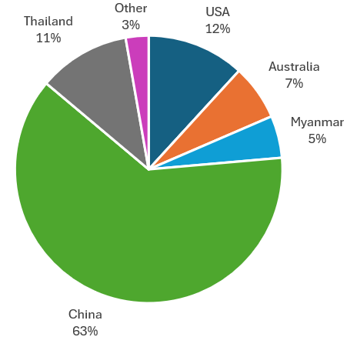
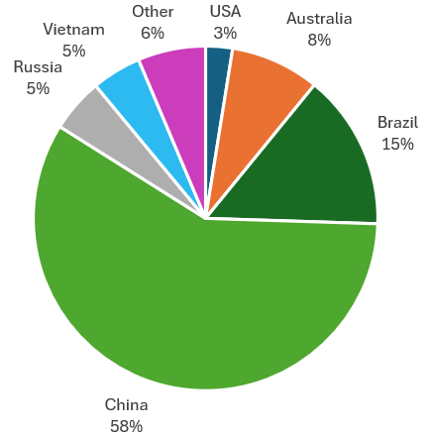
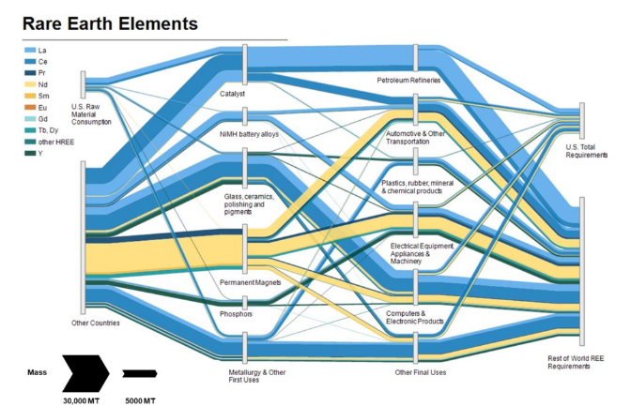
Figure 3. Global REE Production (2025). Source: USGS Mineral Commodities Summaries (2026). Public Domain.
Figure 4. Global REE Reserves (2025). Source: USGS Mineral Commodities Summaries (2026). Public Domain.
Figure 5. Supply chain for REE. Reproduced from Alonso et al. (2023) under a CC BY 4.0 license.
Alonso et al. (2023)

Slide 12
REE Figure References
Alonso, E., Pineault, D. G., Gambogi, J., & Nassar, N. T. (2023). Mapping first to final uses for rare earth elements, globally and in the United States. Journal of Industrial Ecology, 27(1), 312-322.
Gaba (2018) 10 degrees E centered, English, https://commons.wikimedia.org/wiki/File:Tectonic_plates_boundaries_World_map_Wt_10degE_centered-fr.svg#/media/File:Tectonic_plates_boundaries_World_map_Wt_10degE_centered-en.svg, last accessed June 2026
USGS Mineral Commodities Summaries (2026). Mineral commodity summaries. US Geological Survey: Reston, VA, USA, 200.
Wang, Z. Y., Fan, H. R., Zhou, L., Yang, K. F., & She, H. D. (2020). Carbonatite-related REE deposits: An overview. Minerals, 10(11), 965.

