Slide 1
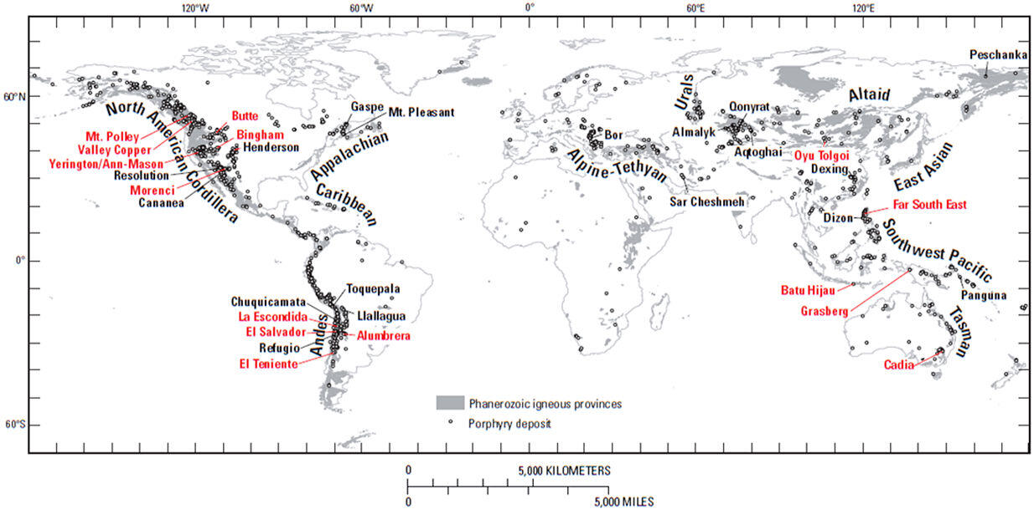
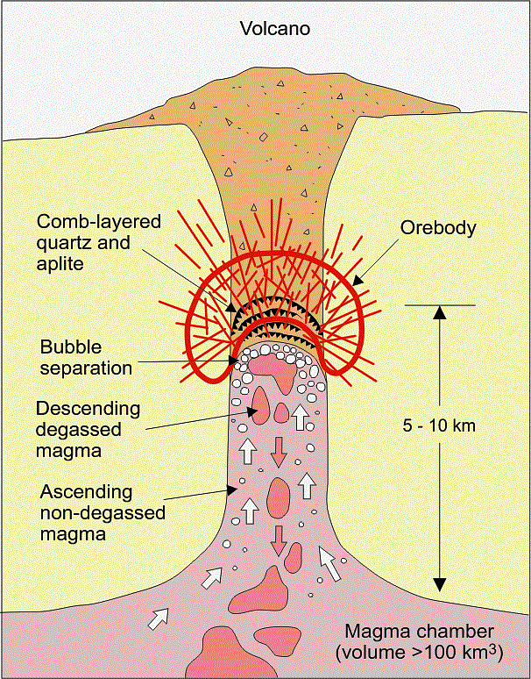
Copper (Cu)
Figure 1. World map of copper porphyry deposits. Source: John et al (2010). Public Domain.
Cu is commonly produced from porphyry deposits which form from hot water released from crystallizing magma. The hot water precipitates sulfide minerals as an orebody, which can then be mined and the Cu separated out.
Figure 2. Model of copper porphyry deposit formation. Reproduced from Earth Science Australia (2026) under a CC BY-NC-SA-3.0 license.
Notes:
https://www.nature.com/articles/s43017-021-00182-8
http://earthsci.org/mineral/mindep/phor_dep/por_dep.html
https://enerji.gov.tr/infobank-naturalresources-copper
https://insights.issgovernance.com/posts/copper-or-robber-supply-risks-and-esg-issues/
https://natural-resources.canada.ca/our-natural-resources/minerals-mining/mining-data-statistics-and-analysis/minerals-metals-facts/copper-facts/20506
https://www.moomoo.com/community/feed/the-global-copper-supply-landscape-is-a-bull-market-on-112206694252550
https://iopscience.iop.org/article/10.1088/1757-899X/427/1/012002/pdf

Slide 2
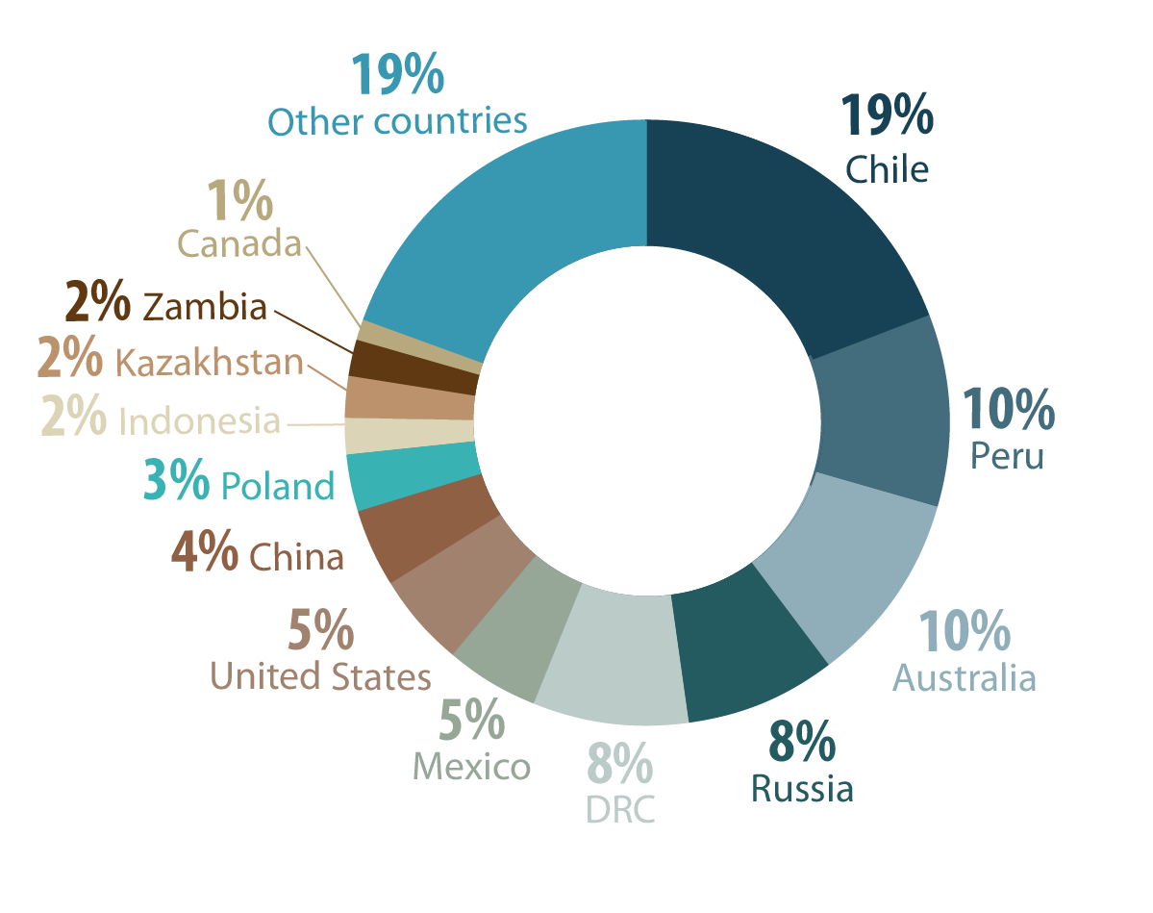
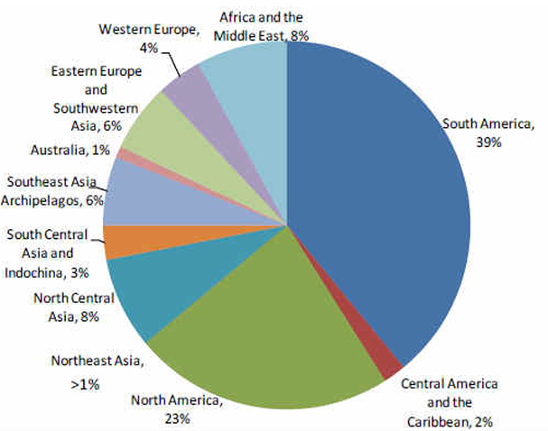

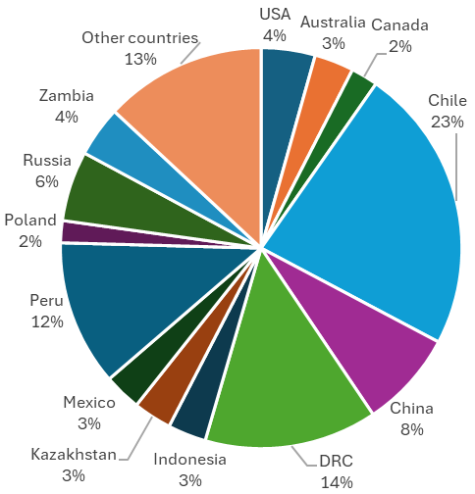
World Cu reserves, 2024
World Cu resources, 2018
Figure 3. World Cu reserves, 2024. Source: Natural Resources Canada (2026). Non-commercial reproduction allowed.
Figure 4. World Cu resources. Data from: USGS (2026). Public Domain.
World Cu uses, 2021
Figure 5. World Cu uses, 2021. Source: Natural Resources Canada (2024). Non-commercial reproduction allowed.
World Cu Production, 2025
A “resource” is the amount of Cu available, while a “reserve” is the amount that can be mined economically.
“Production” refers to the amount of Cu that is mined and refined ready for use in industry.
Figure 6. World Cu resources. Data from: USGS (2026). Public Domain.

Slide 3
Copper Figure References
Earth Science Australia (2026), Porphyry Deposits, https://earthsci.org/mineral/mindep/phor_dep/por_dep.html#TOP. Last Accessed May 2026
John, D.A., Ayuso, R.A., Barton, M.D., Blakely, R.J., Bodnar, R.J., Dilles, J.H., Gray, Floyd, Graybeal, F.T., Mars, J.C., McPhee, D.K., Seal, R.R., Taylor, R.D., and Vikre, P.G., 2010, Porphyry copper deposit model, chap. B of Mineral deposit models for resource assessment: U.S. Geological Survey Scientific Investigations Report 2010–5070–B, 169 p.
Natural Resources Canada (2026), Copper Facts, https://natural-resources.canada.ca/minerals-mining/mining-data-statistics-analysis/minerals-metals-facts/copper-facts, Last Accessed May 2026.
Natural Resources Canada (2024), Copper Facts, https://www.nrcan.gc.ca/our-natural-resources/minerals-mining/minerals-metals-facts/copper-facts/20506, Last Accessed August 2024
USGS Mineral Commodities Summaries (2026). Mineral commodity summaries. US Geological Survey: Reston, VA, USA, 200.

