Slide 1
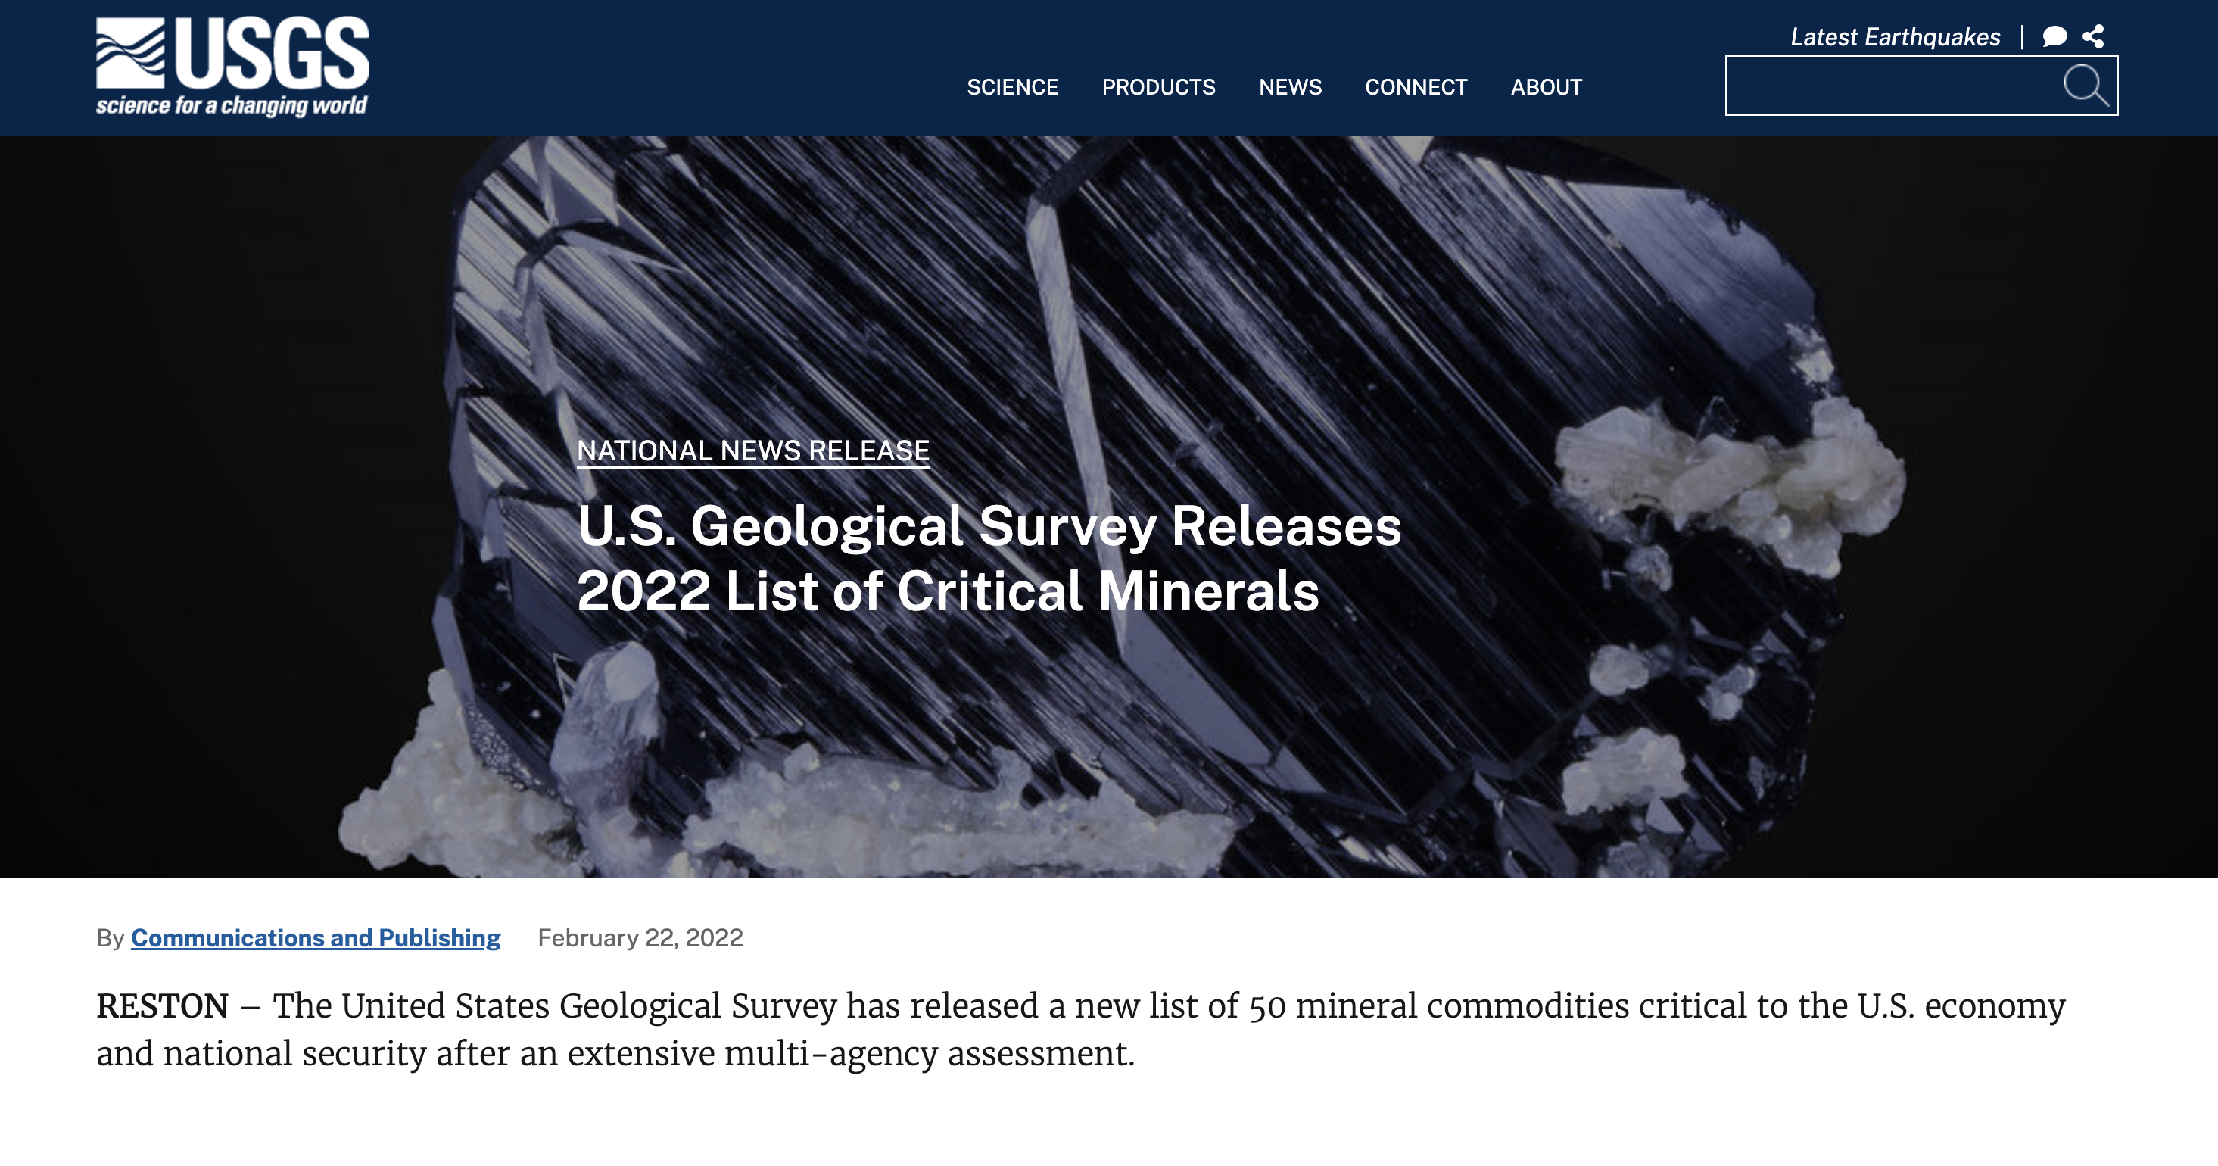

Slide 2
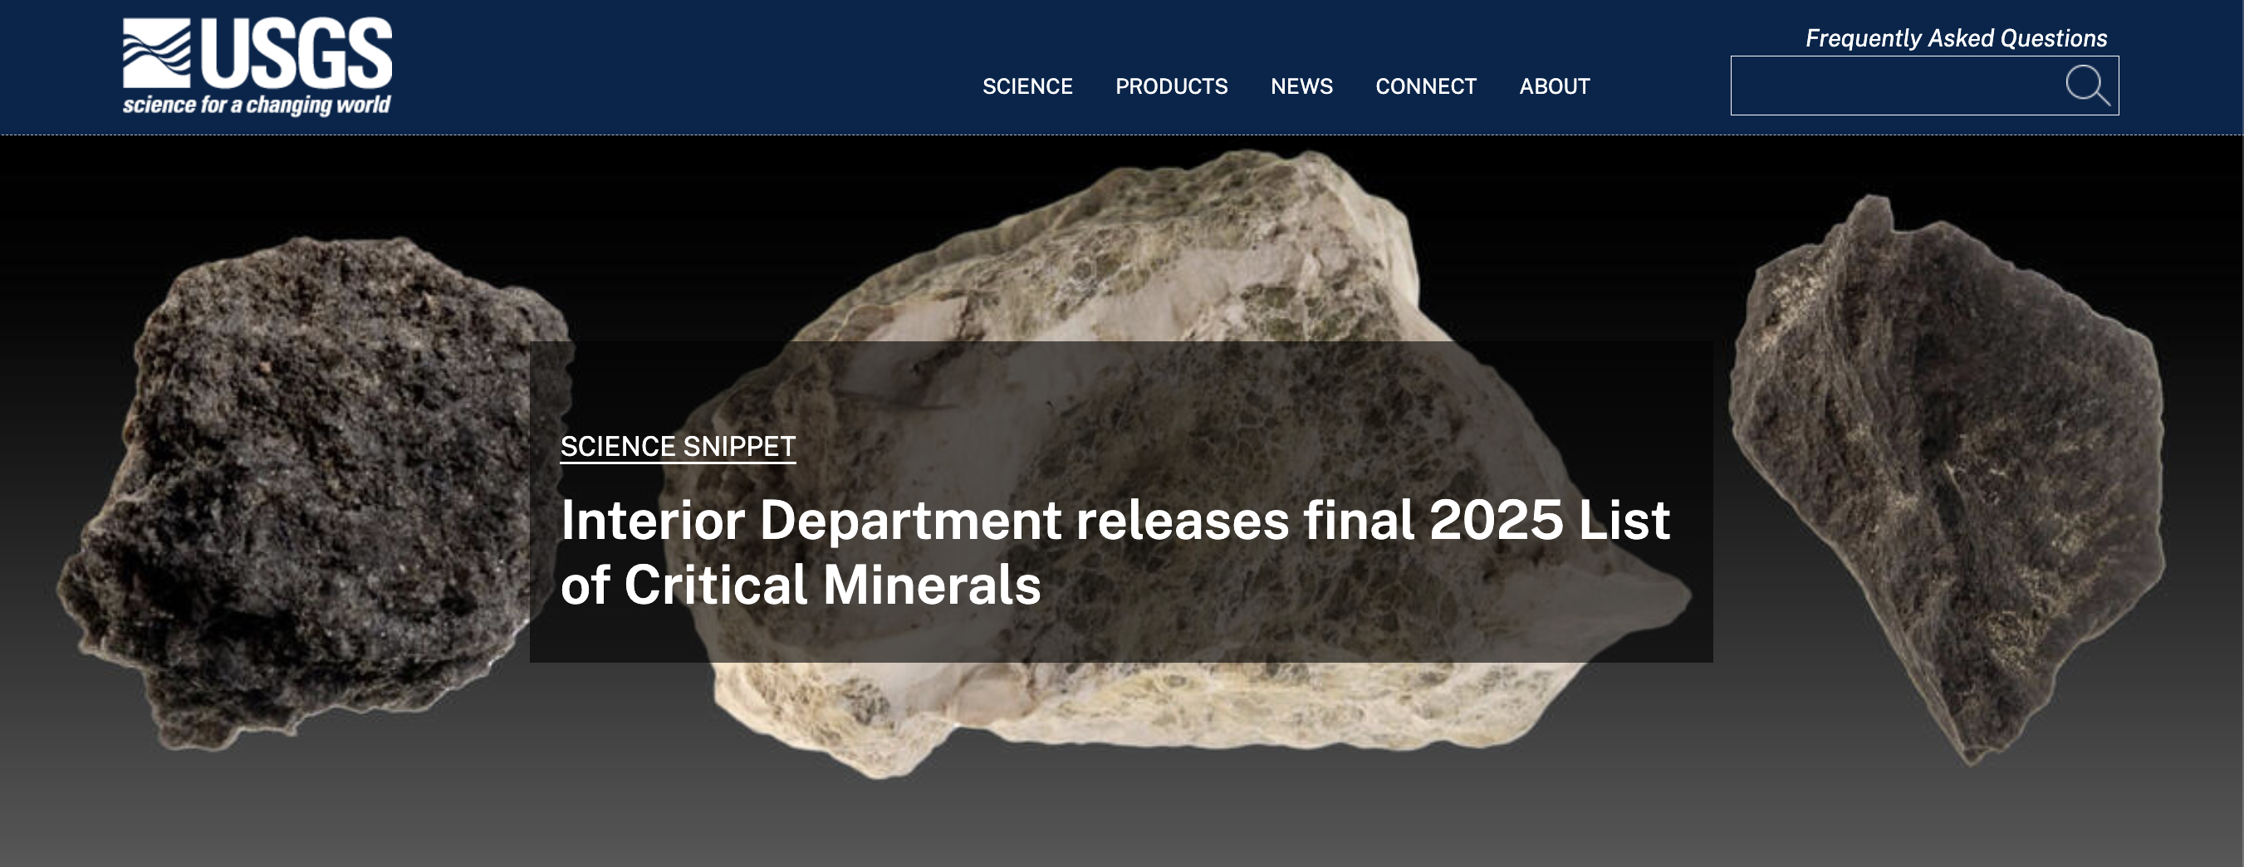

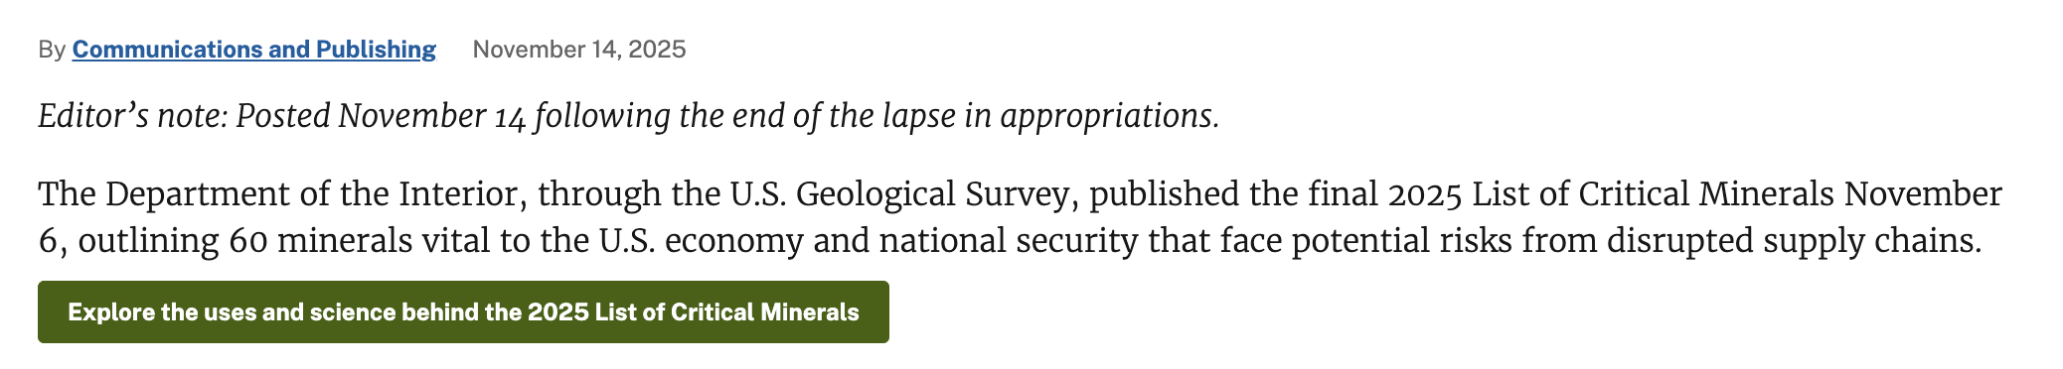
UPDATED
to 60 in 2025!

Slide 3
The Energy Act of 2020 defines a critical mineral as a “non-fuel mineral or mineral material essential to the economic or national security of the U.S. and which has a supply chain vulnerable to disruption”
Critical minerals are also characterized as “serving an essential function in the manufacturing of a product, the absence of which would have significant consequences for the economy or national security”
Significant role in the U.S. and global economy, national security…
but also in renewable energy development and infrastructure!

Slide 4
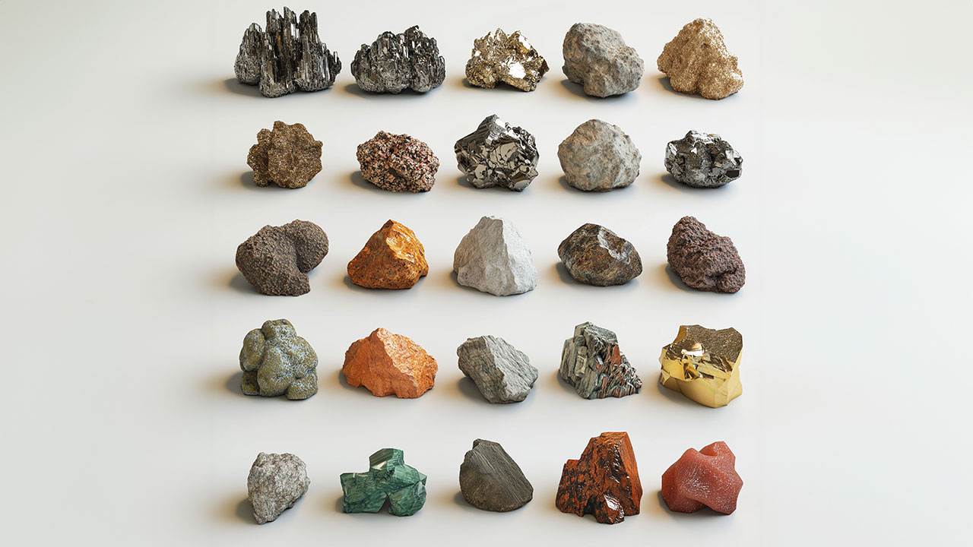
Welcome to the F2026 Critical Minerals Summit!
You have been assigned a critical element/mineral, as defined by the 2025 USGS Report following the Energy Act of 2020. You are now an essential expert in this element!
To better understand the landscape of mineral resources, their importance,
and Big Picture issues associated with them, we will assemble in groups (based on element type)
And work through the 5 stations scattered throughout the room (~4-5 minutes per station)
We will gather back as a group and discuss key observations and themes
Learning objectives:
(1) explore the societal significance of mineral resources in their geological, human, and geographic/geopolitical context
(2) apply to concepts of major, minor, and trace elements, and place them in the context of mineral resources
(3) practice looking up the scientific information you will be researching for your mineral project

Slide 5
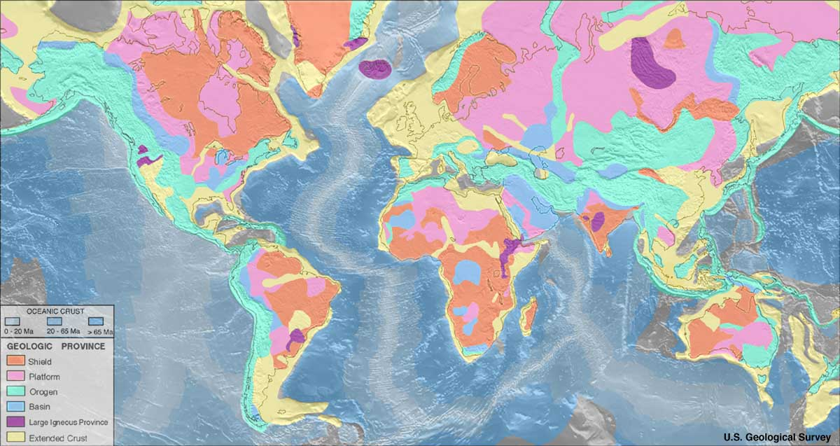
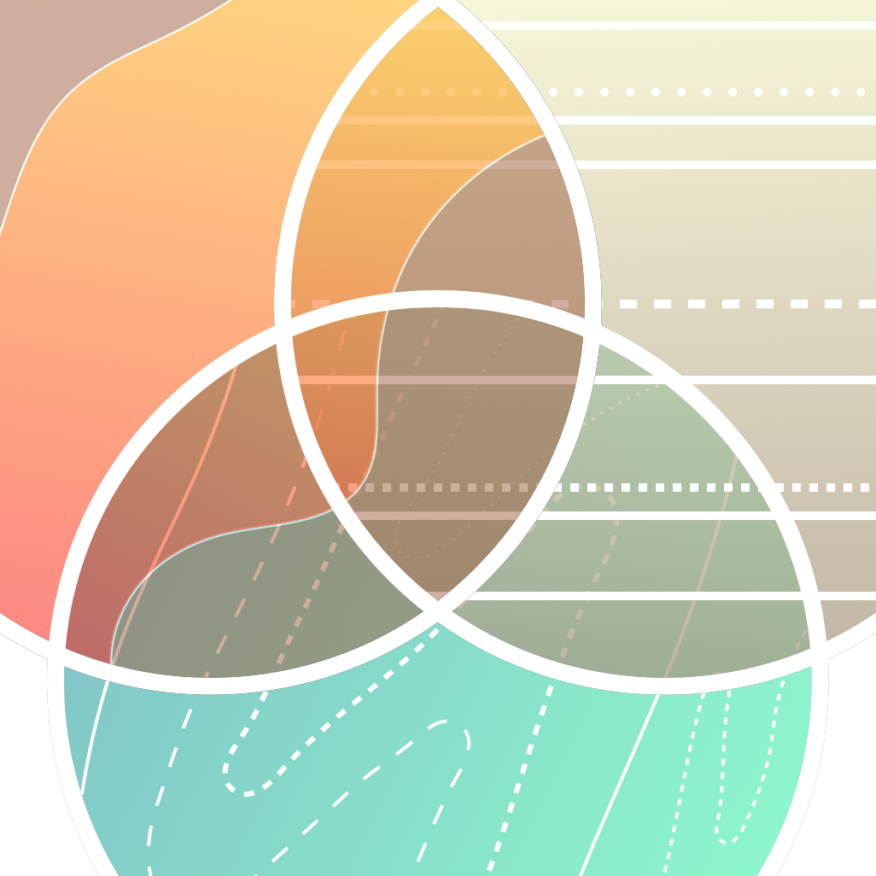
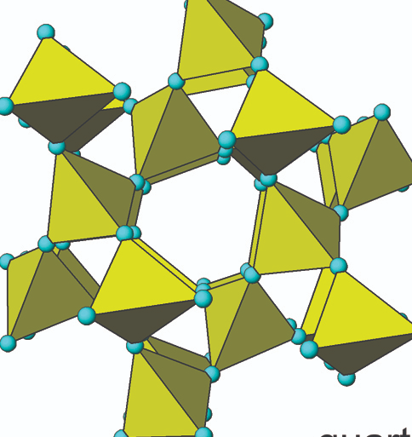

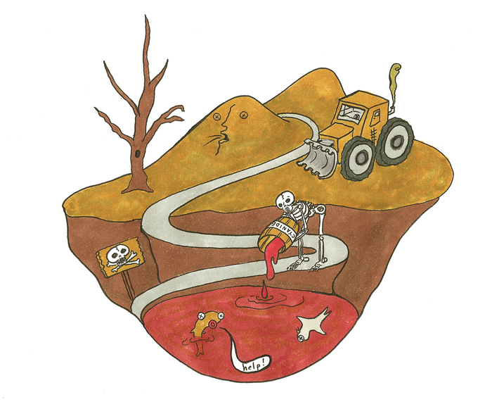

Pre-activity Research Assignment
1. Geological/
Geographical
Distribution
‘Where?’
2. Geological
Formation Processes
‘How?’
3. Mineralogy
(Chemical Formula)
‘What?’
4. Uses
‘Who benefits?’
5. Impacts
‘Who pays a price?’

Slide 6
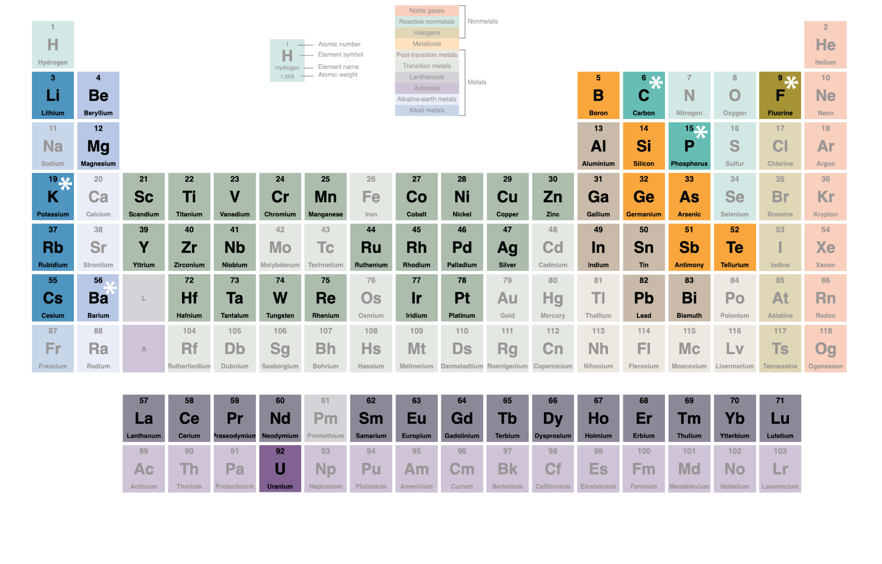
Critical Minerals (Elements)
Graphite, Metallurgical Coal (C)
Fluorspar (F)
Phosphate (P)
Potash (K)
Barite (Ba)

Slide 7
Assemble into Focus Teams
CMS 2024 Expert Teams:
Find other element in your group and assemble into teams of four (4) as show on the right
Transition Metals
Ti, Cr, Ni, Zn
Y, Pd, Nb, Zr
Hf, Ta, Ir, Pt
Alkaline Earth /
Alkali metals
Cs, Li, Rb, Be
I–
II–
III–
Metalloids
Ge, As, Sb, Te
Rare Earth
Elements
(Lanthanides):
La, Nd, Ce, Sm
Tb, Eu, Yb, Lu
Post-transition
Metals
Ga, In, Sn, Bi
I–
II–

Slide 8
1
Where in the World is your element/critical mineral
most abundant and/or mined?

Slide 9
2
Metamorphic rocks/processes
In what kind of rock/
setting does your
element/critical
mineral
form?
Sedimentary
rocks/processes
Igneous
rocks/processes

Slide 10
3
My critical Mineral/Element is…
Typically a Minor/Trace Element in minerals
(provide an example mineral and its formula)
My critical Mineral/Element is…
A Major Element in at least one mineral
(provide an example mineral and its formula)

Slide 11
4
Societal/Cultural/Economic Uses of your element/mineral
(provide 1-2 examples and indicate which element is associated with these particular uses)

Slide 12
5
Some of the Human/Health Hazards & impacts of mining and processing my element are…
(provide 1-2 examples and indicate which element is associated with these particular impacts)
Some of the Environmental/ ecological impacts of mining and processing my element are…
(provide 1-2 examples and indicate which element is associated with these particular impacts)

Slide 13
(See hidden slides for sample results slides)

Slide 14
Some Example Results Slides
from GEOL321 Fall 2024 course at William & Mary
(C. Hamelin)

Slide 15
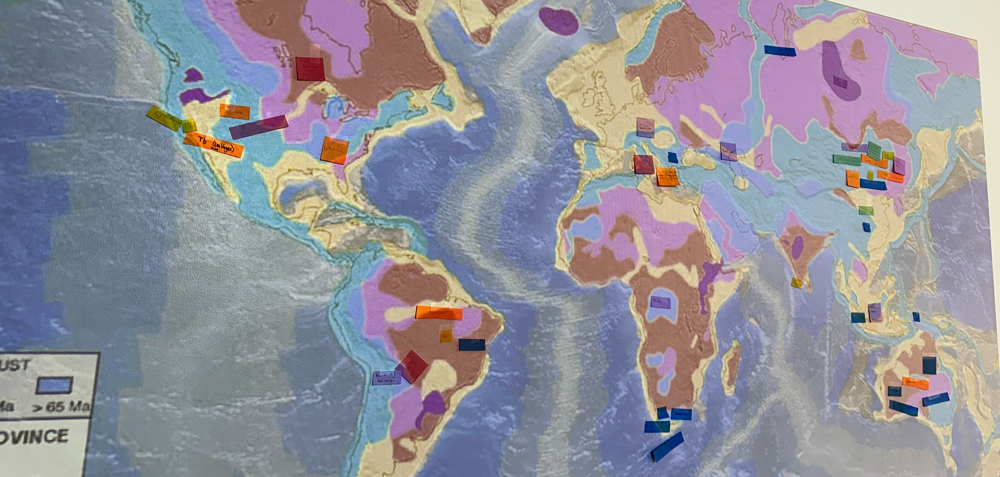
1
Where in the World is your element/critical mineral
most abundant and/or mined?

Slide 16
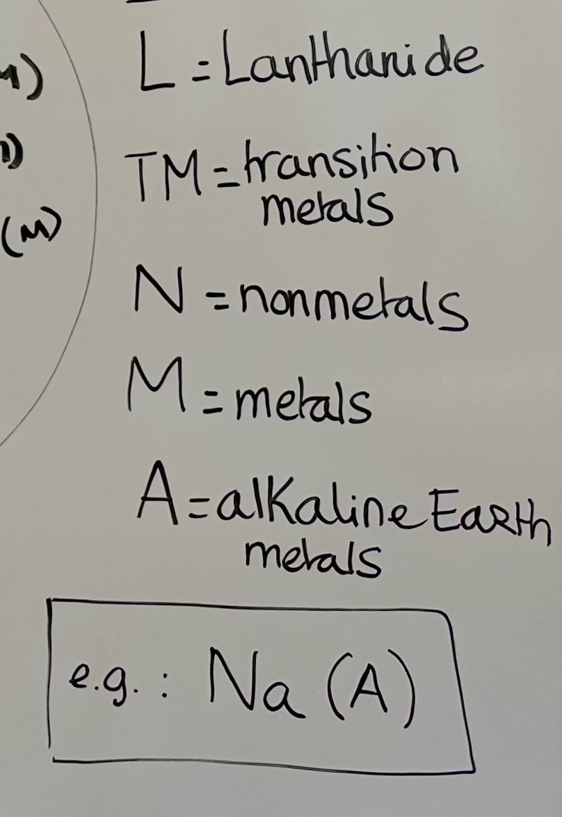
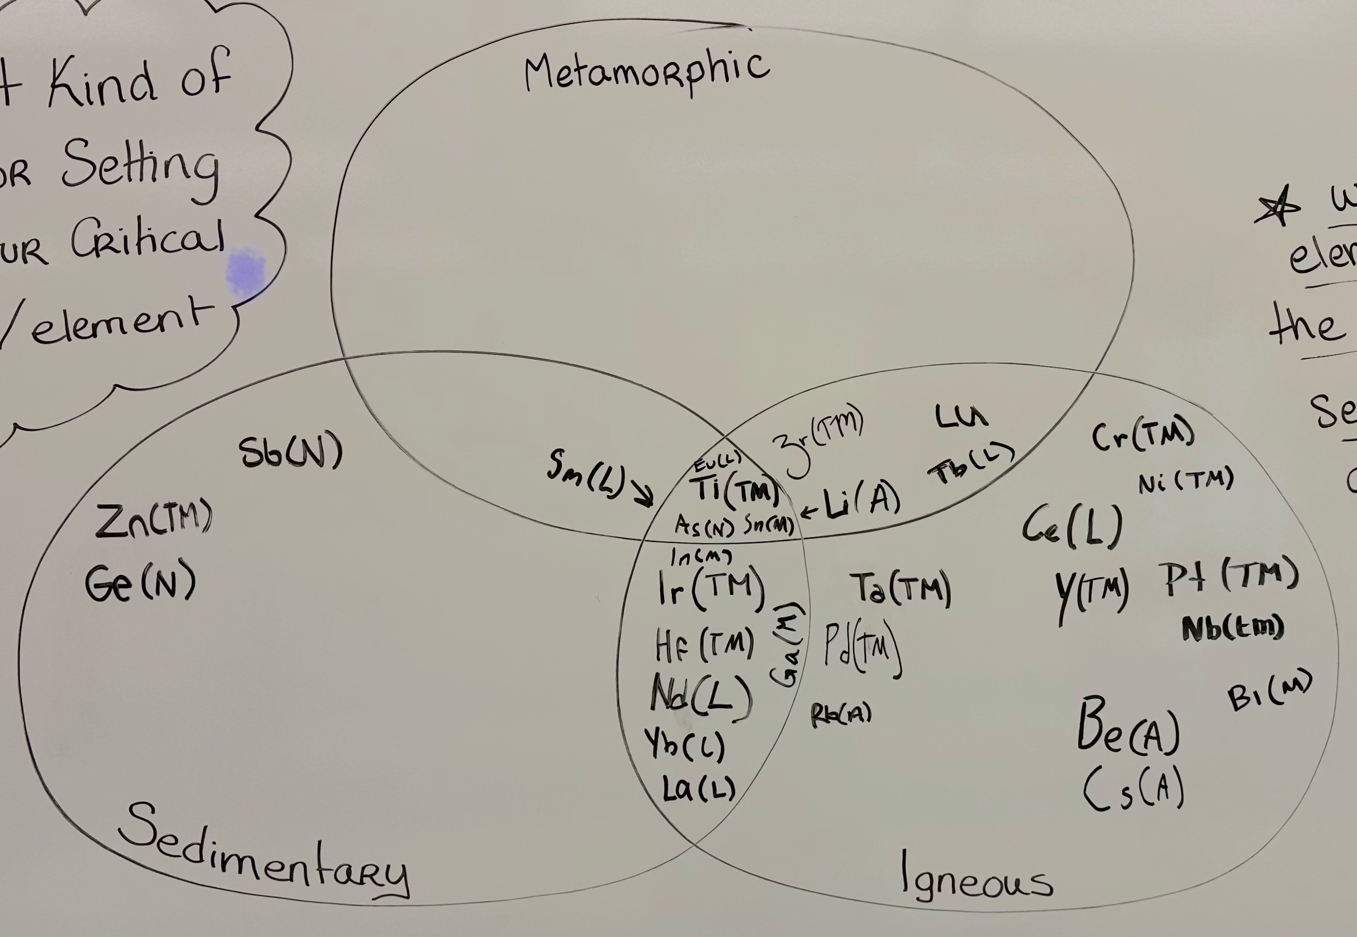
2
Metamorphic
In what kind of rock/
setting does your
element/critical
mineral
form?
Sedimentary
Igneous

Slide 17
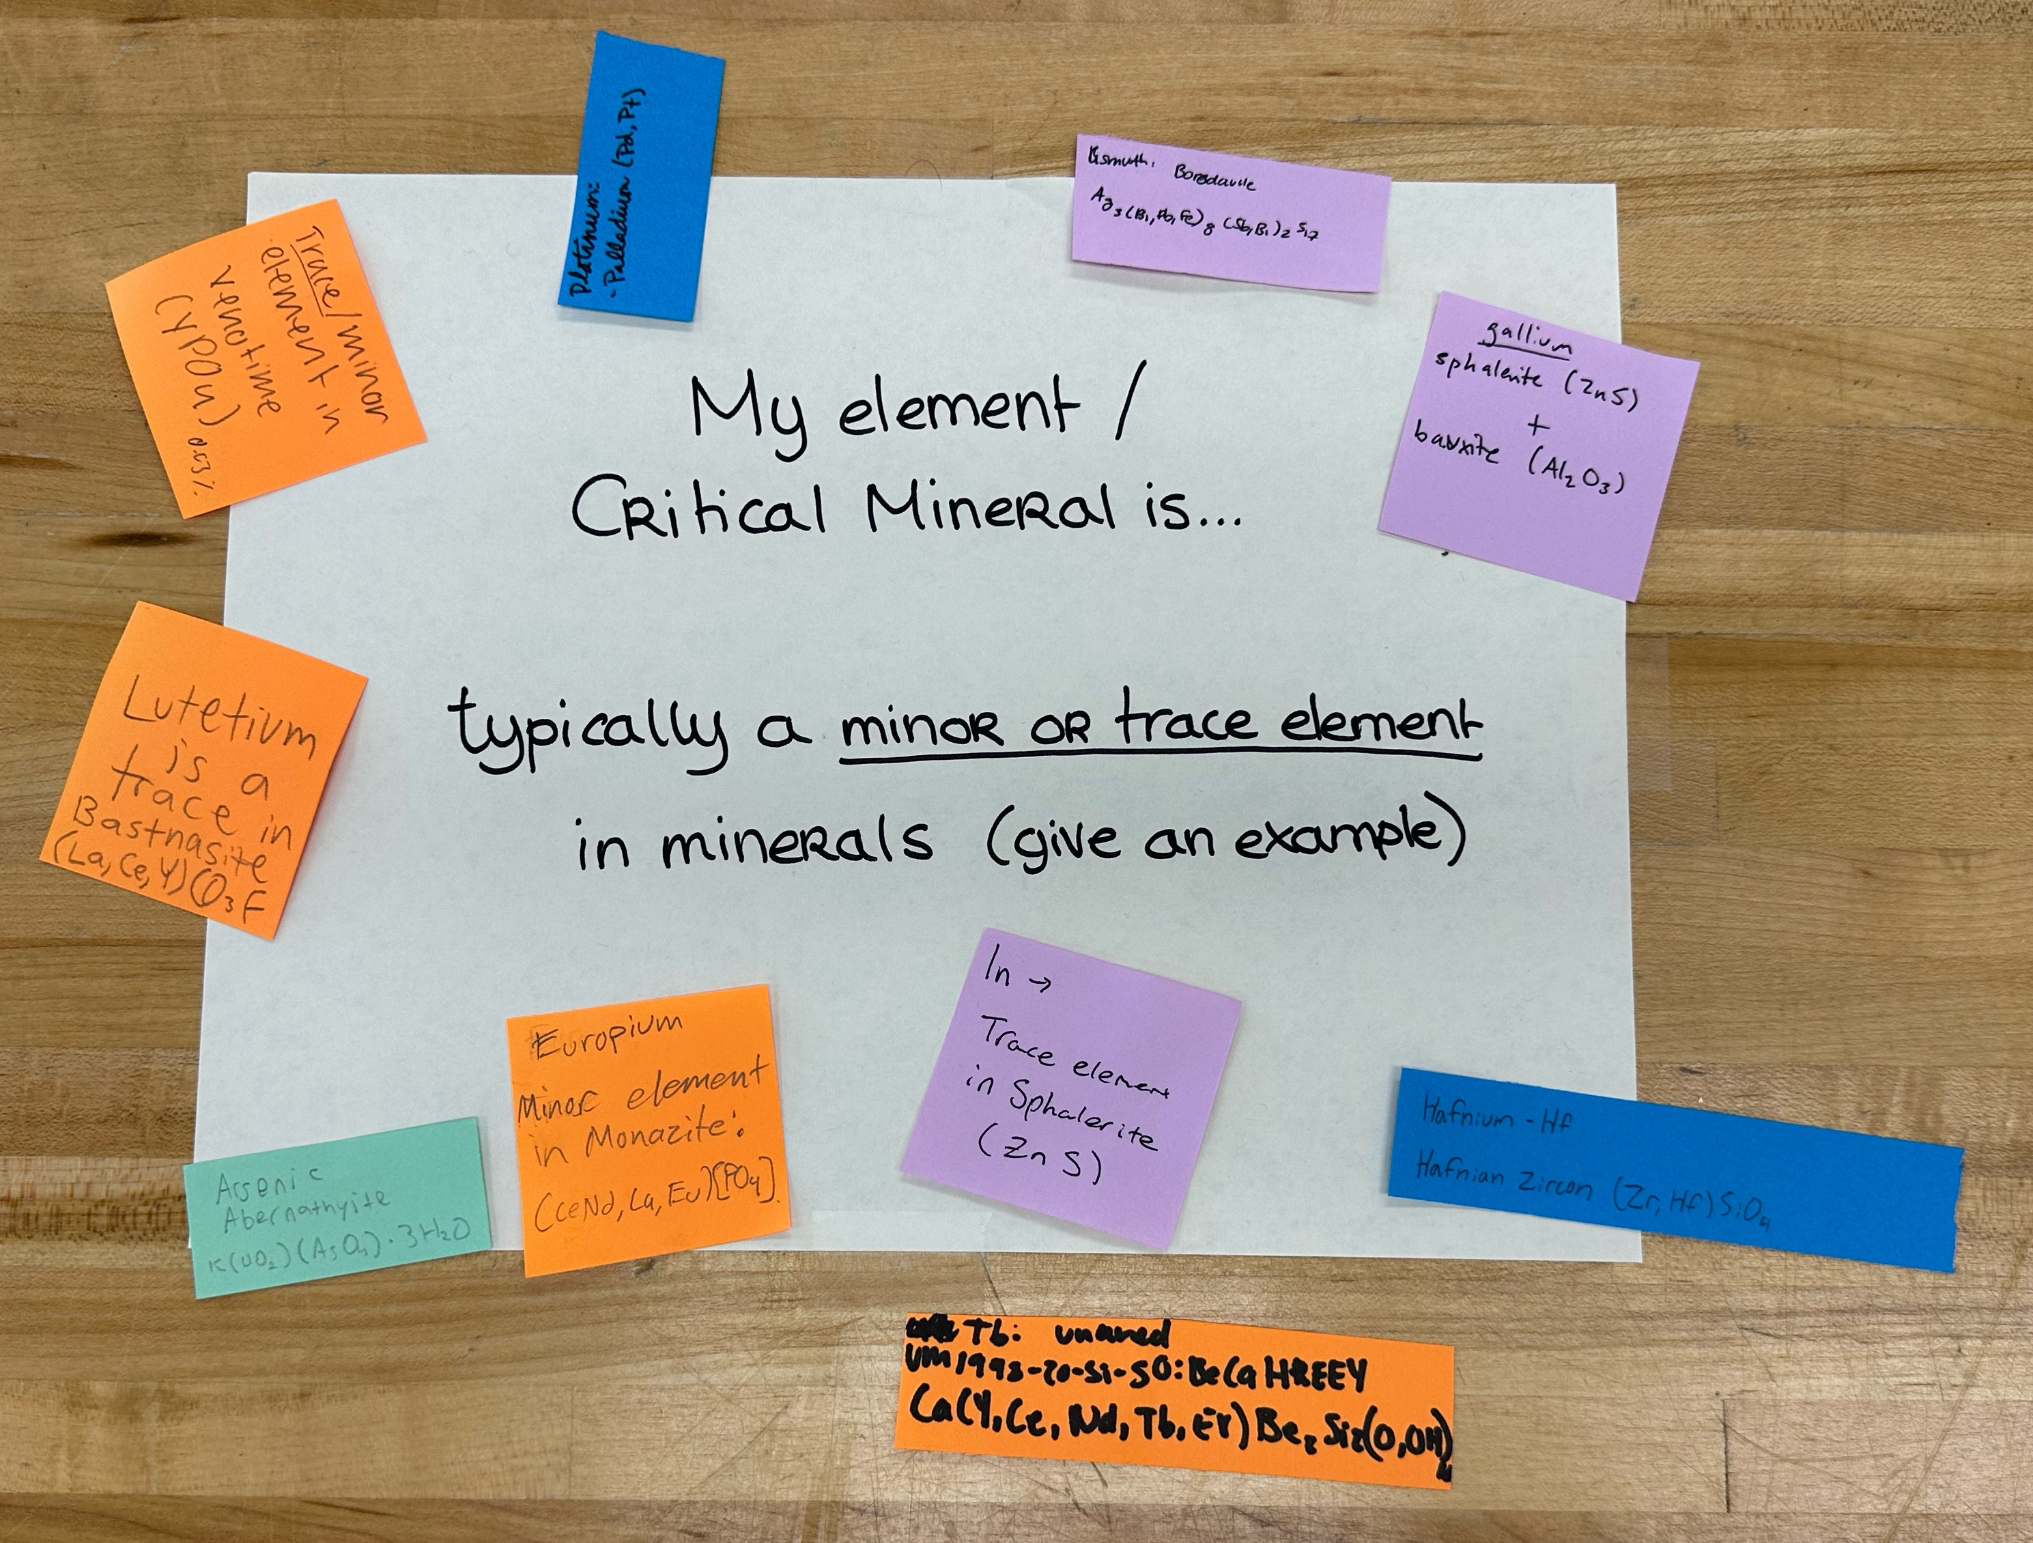
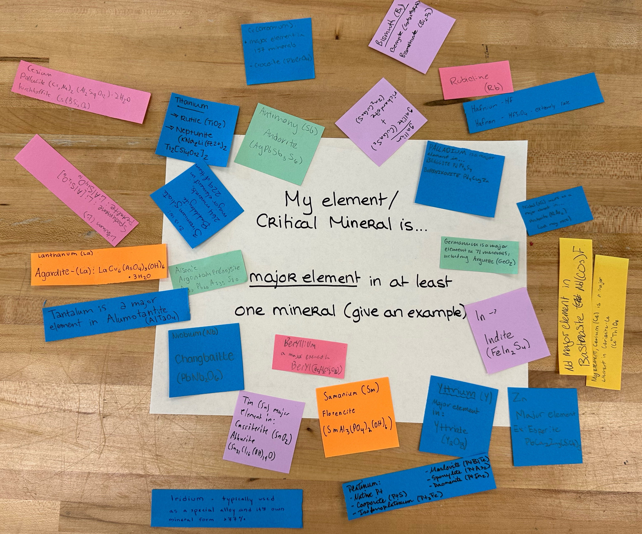
3
Major element in
at least one mineral
Minor/Trace element
in minerals

Slide 18
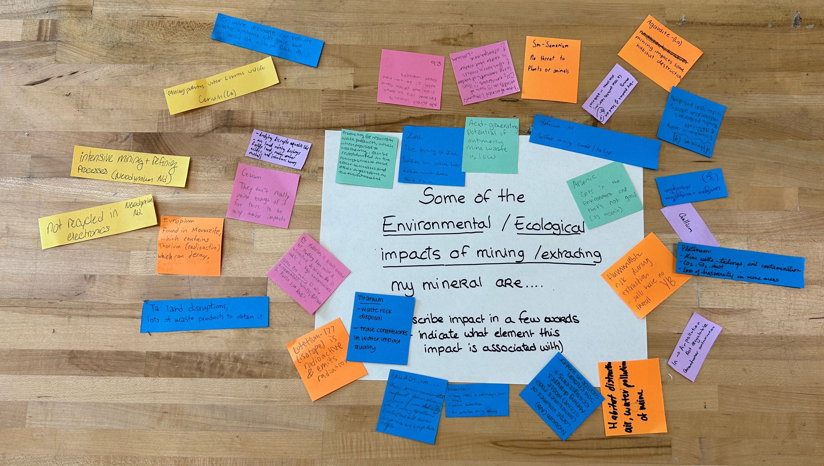
Environmental/
ecological Impacts of Mining?

Slide 19
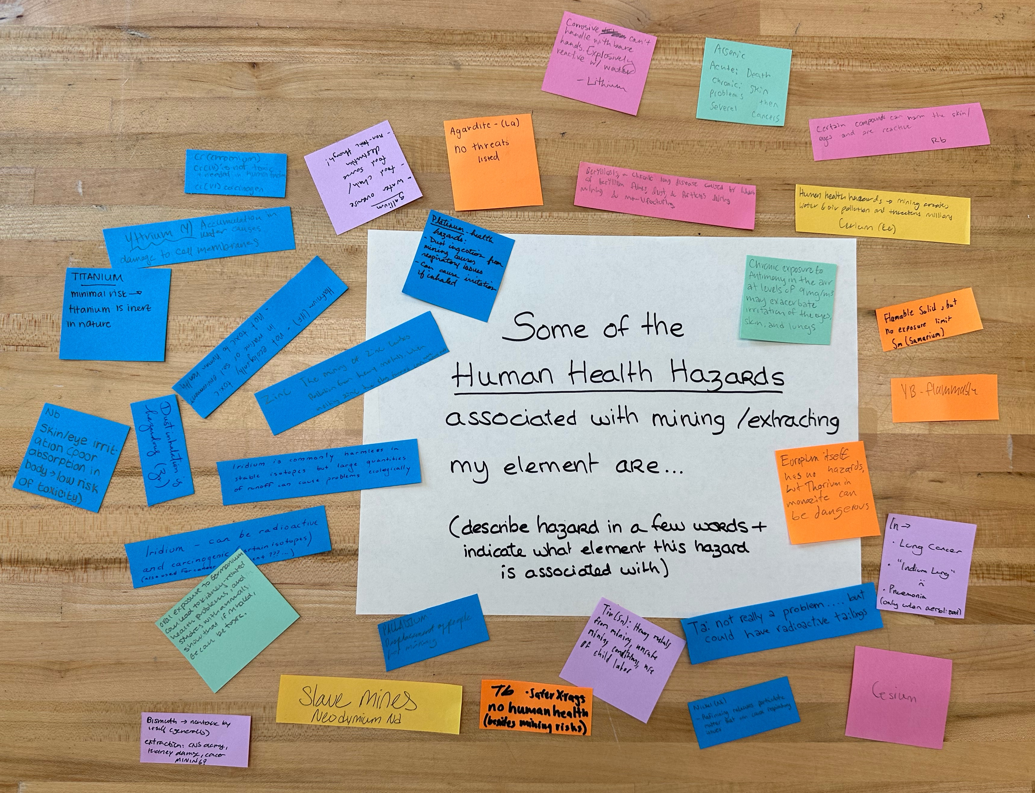
Human health
hazards
associated with
mining?

Slide 20
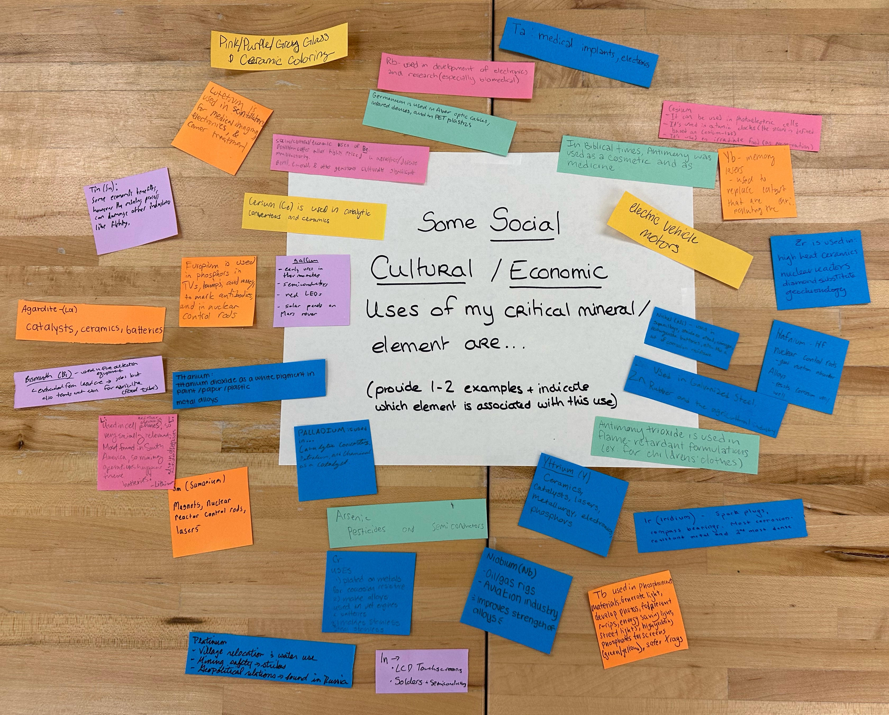
Societal/Cultural/Economic Uses of your element/mineral?

