Slide 1
Print out slides so the prompts are on the back and the photos are on the front.

Slide 2


Slide 3
You are the Trees
Option #1: Photosynthesis
You are giving carbon dioxide gas to the Atmosphere. When you die or perform respiration, you release carbon dioxide into the air.
Option #2: Burial
You are giving carbon to the Rocks & Sediments. When you die, your remains will be buried under other plants where you become part of the sediment. After many years, you will become Coal, a fossil fuel that humans burn for energy.
Option #3: Predation
You are giving carbon to the Land Animals. The animals will eat you and store your carbon in their bodies until they die.

Slide 4
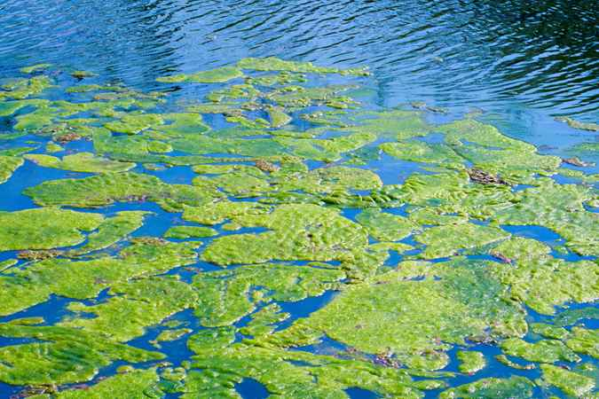

Slide 5
You are the Algae
Option #1: Respiration & Decomposition
You are giving carbon dioxide gas to the Ocean. When you die or perform respiration, you release carbon dioxide into the water.
Option #2: Burial
You are giving carbon to the Rocks & Sediments. When you die, you will sink to the bottom of the ocean floor, where you become part of the sediment. After many years, you will become Oil, a fossil fuel that humans burn for energy.
Option #3: Predation
You are giving carbon to the Marine Snails. The snails will eat you and store your carbon in their bodies until they die.

Slide 6
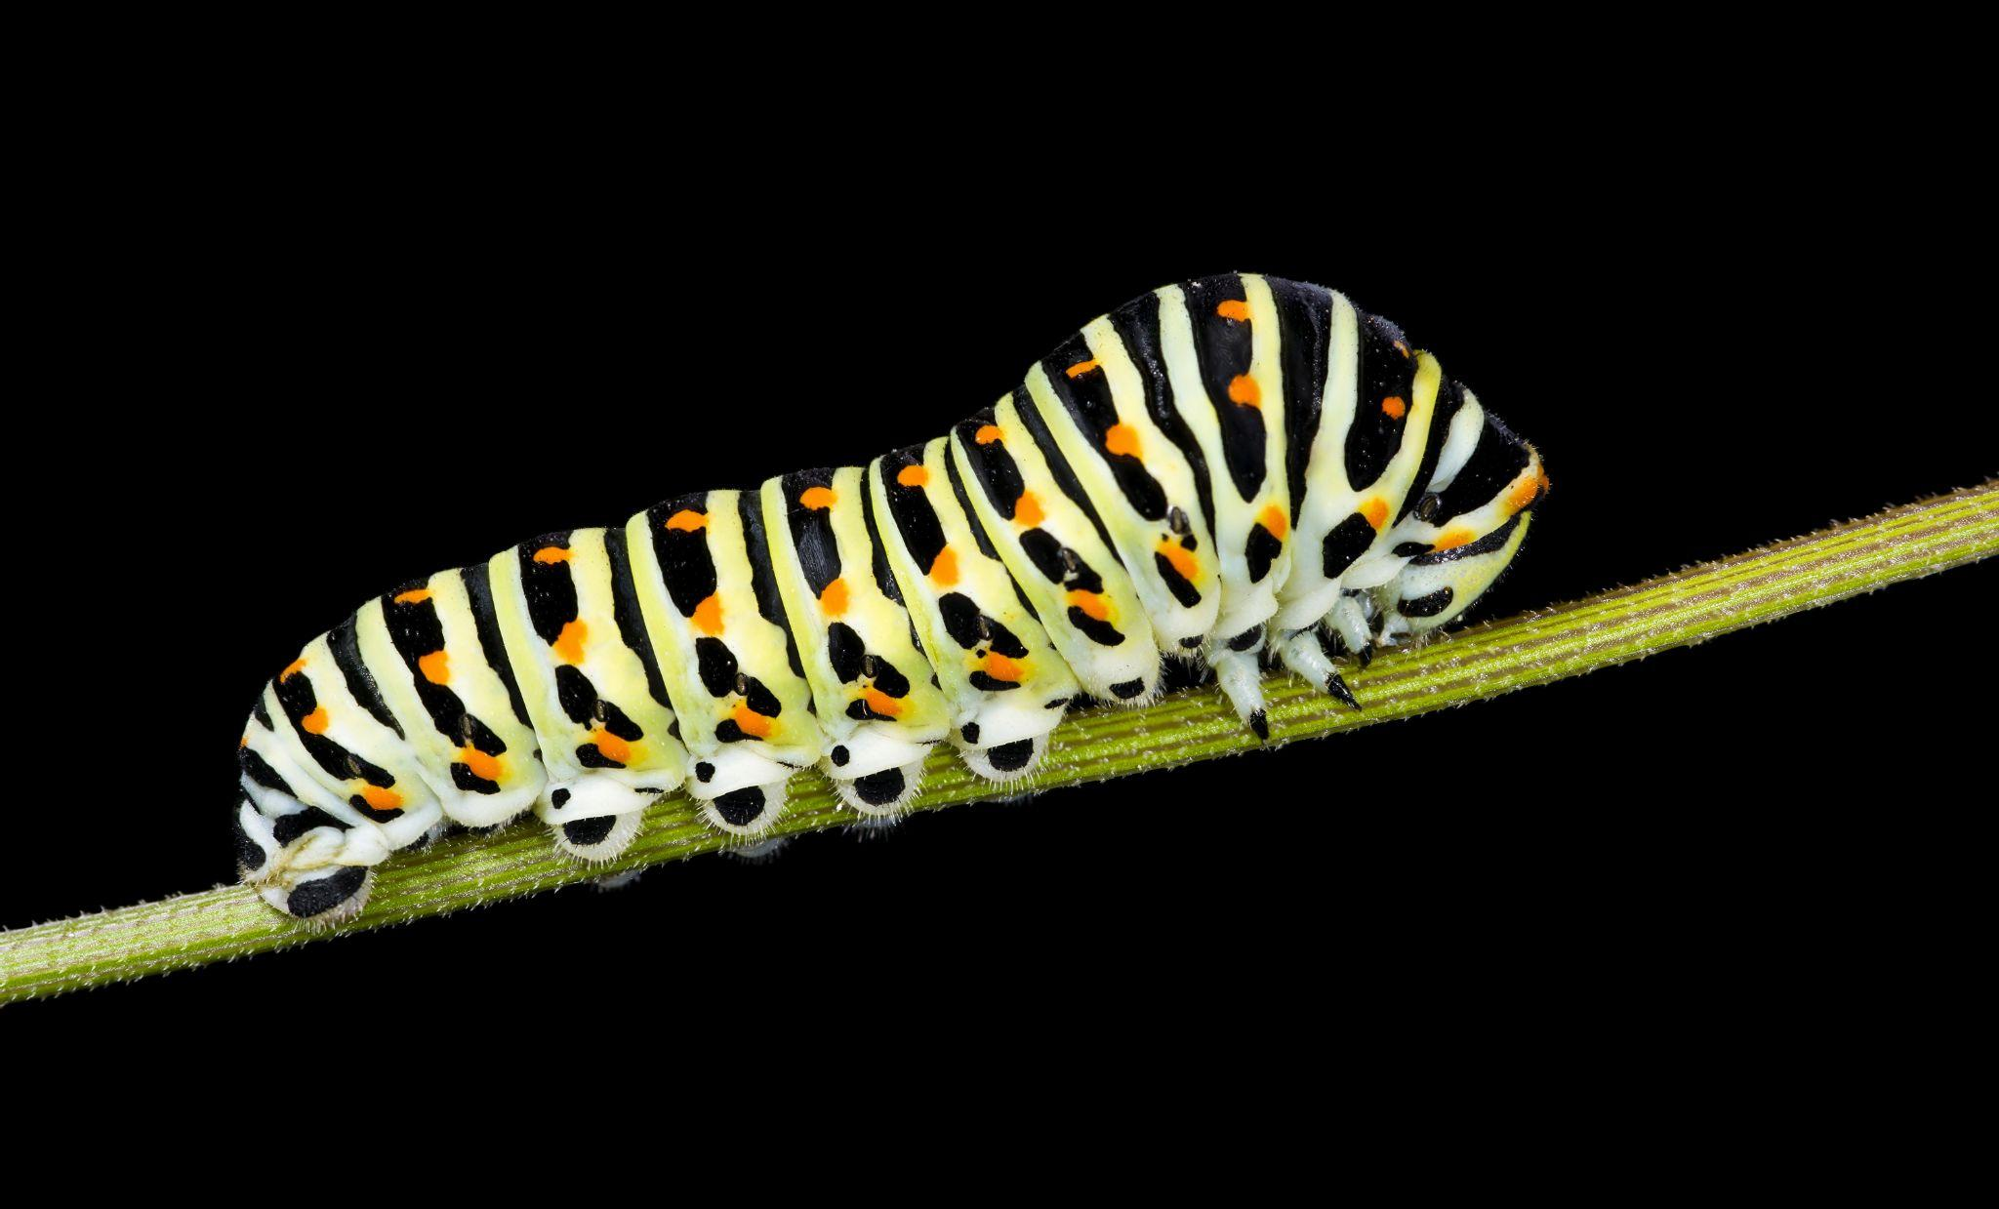

Slide 7
You are the Land Animals
Option #1: Respiration & Decomposition
You are giving carbon dioxide gas to the Atmosphere. You breathe carbon dioxide out and break down into carbon when you die.
Option #2: Burial
You are giving carbon to the Rocks & Sediments. When you die, your body is buried under other organic matter. If it’s buried for long enough, it will become Coal, a fossil fuel that humans burn for energy.

Slide 8
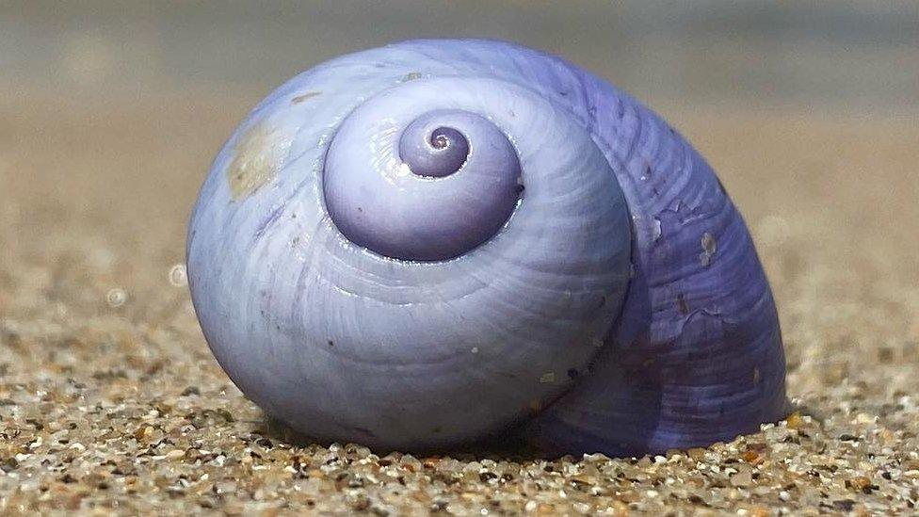

Slide 9
You are the Marine Snails
Option #1: Respiration & Decomposition
You are giving carbon to the Ocean. When you respire or die, your body will release carbon into the water.
Option #2: Burial
You are giving carbon to the Sediments & Rocks. When you die, you will sink to the bottom of the ocean floor, where you become part of the sediment. After many years, you will become Oil, a fossil fuel that humans burn for energy.

Slide 10
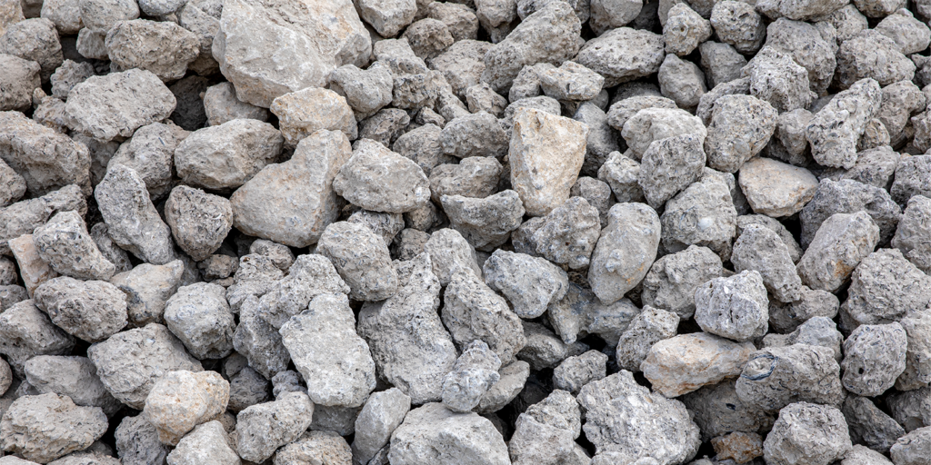

Slide 11
You are the Rocks & Sediments
Option #1: Weathering
You are giving carbon dioxide gas to the Ocean. When water weathers rock, it dissolves carbon and deposits it into bodies of water.
Option #2: Volcano
You are giving carbon dioxide gas to the Atmosphere. When volcanoes erupt, they put some of the carbon stored in rocks back into the atmosphere

Slide 12


Slide 13
You are the Atmosphere
Option #1: Exchange
You are giving carbon dioxide gas to the Ocean. The ocean will dissolve the gas and store it.
Option #2: Photosynthesis
You are giving carbon dioxide gas to the Trees to use for photosynthesis. They will use it to make energy.

Slide 14


Slide 15
You are the Ocean
Option #1: Photosynthesis
You are giving carbon dioxide gas to the Algae. The algae will use the carbon to generate energy.
Option #2: Shell Building
You are giving carbon to the Marine Snails to use in their shells. They will store carbon in their shells for their entire lives.
Option #3: Exchange
You are giving carbon dioxide gas to the Atmosphere. The atmosphere will store the carbon dioxide gas.

