Slide 1
Notes for Teaching
We are familiar with cats having the potential to be liquids (Fardin, 2014) as well as mother cats having the potential to give birth to different coloured kittens.
This allows for the use of cats to model crystallization pathways. Grey cats can model the solid solution in plagioclase and tortoiseshell cats can model the diopside-anorthite system.
Fardin (2014) https://www.drgoulu.com/wp-content/uploads/2017/09/Rheology-of-cats.pdf

Slide 2
Igneous Melts and their Crystallisation
Goal: to explain how melts form and application of binary phase diagrams for describing crystallisation of igneous melts.
Specific learning outcomes:
To interpret crystallisation and melt sequences from binary phase diagrams.
Associated chapters in Introduction to Petrology (Perkins 2022):
Chapter 3: Magma, Melting and Crystallisation
Chapter 8: Phase Equilibria and Phase Diagrams (sections 8.1 to 8.3)

Slide 3
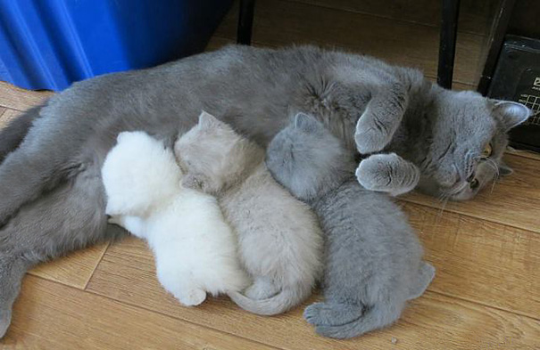
Melting and Crystallisation
Source: kaiserj1982
The products of a melt, i.e., the crystals, do not have to be the same composition as the parent melt – this is the process of differentiation of magmas.

Slide 4

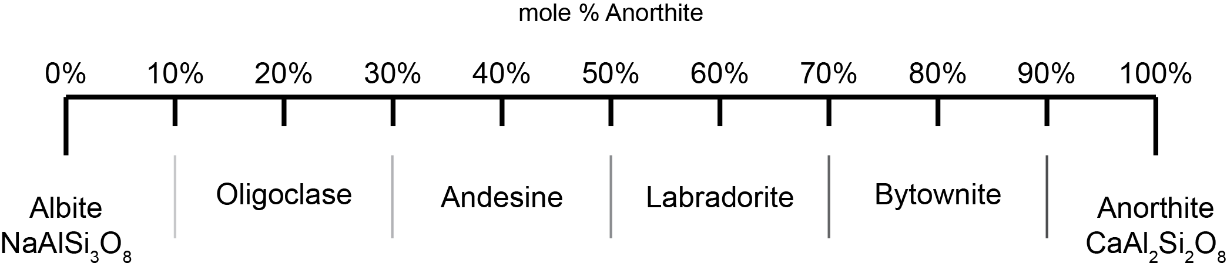






Binary Systems – Plagioclase
Liquid Plagioclase
Crystalline Plagioclase
Plagioclase has complete solid solution between albite and anorthite.

Slide 5
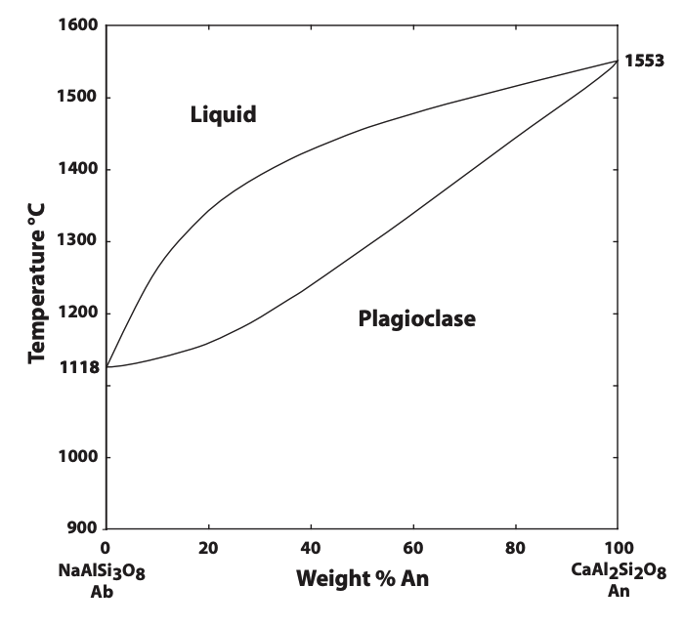




Phase Diagrams – Binary Systems
Liquid “plagioclase” is stable
Liquidus
Above this curve the material is completely molten (liquid)
Crystals and melt are stable
(two phase field)
Crystalline plagioclase is stable
Solidus
Below this curve the material is completely solid (crystalline)
System showing complete miscibility (complete solid solution) in both liquid and solid phases, e.g., plagioclase can have any composition between albite and anorthite, shown by the horizontal axis.

Slide 6
Phase Diagrams – Binary Systems
A
A melt of composition A (An₄₀) starts to cool.
Modified from Binary Phase Diagrams. https://serc.carleton.edu/research_education/equilibria/binary_diagrams.html

Slide 7
Phase Diagrams – Binary Systems
A
B
C
Ab₆₀An₄₀
Ab₂₂An₇₈
At point B, both melt and crystals are stable, thus the melt starts to crystallise plagioclase, of composition An₇₈, determined from the horizontal intersection (point C) with the solidus.
Modified from Binary Phase Diagrams. https://serc.carleton.edu/research_education/equilibria/binary_diagrams.html

Slide 8

Phase Diagrams – Binary Systems
A
B
F
D
E
Ab₈₅An₁₅
Ab₄₅An₅₅
At point D, both melt and crystals are stable, but the equilibrium compositions of both melt and crystals are continuously changing. Compositions are determined for crystals from the horizontal intersection (point E) with the solidus and for melt with the horizontal intersection (point F) with the liquidus.
Modified from Binary Phase Diagrams. https://serc.carleton.edu/research_education/equilibria/binary_diagrams.html

Slide 9
Phase Diagrams – Binary Systems
A
B
D
G
At point G, the melt has cooled below the solidus, so is completely solidified. The composition is now the same starting composition as the initial melt (An₄₀).
Modified from Binary Phase Diagrams. https://serc.carleton.edu/research_education/equilibria/binary_diagrams.html

Slide 10
Phase Diagrams – Binary Systems
A
B
D
G
H
At point H, due to the melt has cooling below the solidus, there are no further changes. The composition is still the same starting composition as the initial melt (An₄₀).
Modified from Binary Phase Diagrams. https://serc.carleton.edu/research_education/equilibria/binary_diagrams.html

Slide 11
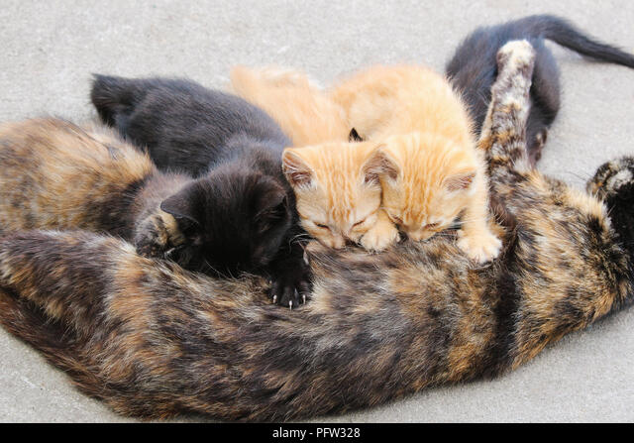
Melting and Crystallisation
Source: Ana Fidalgo / Alamy Stock Photo
This diopside-anorthite system is a simple model of melting and crystallisation of basalt.

Slide 12
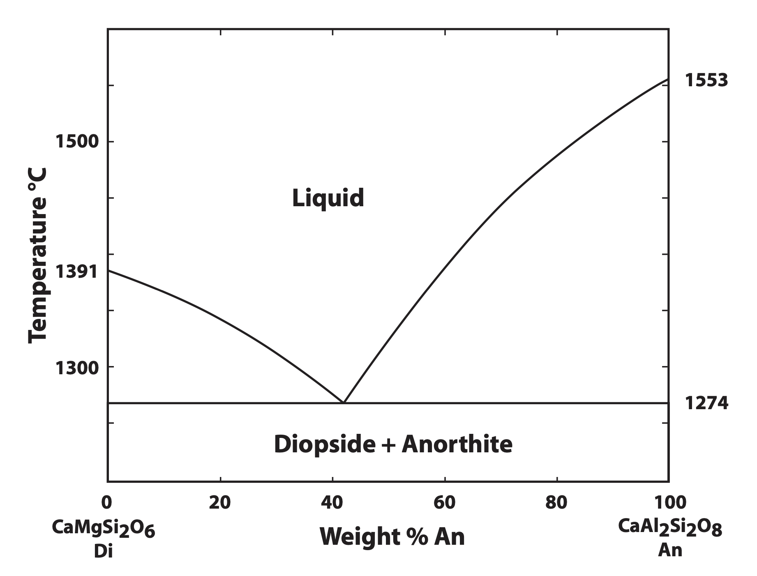


Binary Systems: Diopside-Anorthite
Liquidus
Above this curve the material is completely molten (liquid)
Melt
Liquid of any composition between CaMgSi₂O₆ and CaAl₂Si₂O₈
Eutectic
Solidus
Below this curve the material is completely solid (crystalline)

Slide 13
Binary Systems: Diopside-Anorthite
A
Start cooling liquid of composition A (An₁₈ – Di₈₂) from 1500ºC.
Modified from Binary Phase Diagrams. https://serc.carleton.edu/research_education/equilibria/binary_diagrams.html

Slide 14
Binary Systems: Diopside-Anorthite
A
C
B
Cool the melt to point B (1360ºC) and the first products of crystallisation are Diopside (as this is stable on the liquidus in this part of the phase diagram). The melt composition is still An₁₈ – Di₈₂ the crystal composition is pure diopside (read horizontally to Di-axis at point C).
Modified from Binary Phase Diagrams. https://serc.carleton.edu/research_education/equilibria/binary_diagrams.html

Slide 15
Binary Systems: Diopside-Anorthite
A
B
E
D
With further cooling, the melt composition moves along the liquidus (as diopside is removed), at point D (1310ºC), the liquid composition is An₃₀ – Di₇₀ (read vertically down to the % An axis) the crystal composition is pure diopside (read horizontally to T axis at point E, where Di = 100%).
Modified from Binary Phase Diagrams. https://serc.carleton.edu/research_education/equilibria/binary_diagrams.html

Slide 16
Binary Systems: Diopside-Anorthite
A
B
D
Eutectic
With further cooling, the melt composition moves along the liquidus to the Eutectic (1274ºC), the last drop of liquid composition is An₄₂ – Di₅₈ (read vertically down to the % An axis). At this point the melt nearly fully crystallised and both pure diopside and pure anorthite are stable.
Modified from Binary Phase Diagrams. https://serc.carleton.edu/research_education/equilibria/binary_diagrams.html

Slide 17
Binary Systems: Diopside-Anorthite
A
B
D
Eutectic
F
With further cooling, the melt is fully solidified (crystallised) with the rock composed of 82% diopside and 18% anorthite (original melt composition).
Modified from Binary Phase Diagrams. https://serc.carleton.edu/research_education/equilibria/binary_diagrams.html

