Slide 1

NextGen-WA
(NSF-IUSE 2016-2020)
The Next Generation of STEM Teacher Preparation in Washington State
Ed Geary, Dan Hanley, and Roxane Ronca (WWU), Jenny Dechaine (CWU), Julie Antilla (SPU), Kathryn Baldwin (EWU), Tamara Nelson (WSU-Vancouver), Ann Wright-Mockler (PNNL), Jose Rios (UW-Tacoma), Ellen Ebert (OSPI), Jacob Clark Blickenstaff (WA-LASER)
Notes:
Thank you All for joining us and Welcome to our first Webinar on the Next Generation of STEM Teacher Preparation in Washington State and Thanks to Monica, John, and other SERC personnel for helping us to set this up.
Before diving into the project, I wanted to introduce myself and my colleagues…Ed (WWU-Org Change) Julie (SPU- PCK)…., Jenny (CWU-Eng) , Kathy (EWU-EfS), Tamara (WSUV-EfS), Jose (UWT-Diversity) Ann (PNNL-CS), Jacob (WA-LASER---Collaborations), Roxane (project director) and Dan (Evaluator), and Ellen (OSPI and our link to P-12 NGSS and CCSS efforts)
Some of the information presented today will be familiar to many of you, while for others this is your first introduction to the Next Generation of STEM TP in Washington State
This Webinar will be recorded and posted on Google Drive so that anyone who is not able to participate today can review it at any time.
Transition to slide 2 = Webinar Overview

Slide 2
Webinar Agenda
Brief History of NextGen-WA project
Synopsis of our Proposal to NSF
Proposed Plan of Action
Project Evaluation
January 14th Workshop at Seattle University
Questions
Notes:
Thank SERC and InTeGrate for $50K grant to help us bring together STEM educators/TP faculty from across the state to help lay the foundation for this work.
GOAL for this Webinar…. to develop a shared understanding of the NextGen-WA project… Who we are, What we hope to Accomplish over the next 4 years and How we plan to carry out this work.
Questions are invited throughout the Webinar via the Chat function and we will have a few places we pause to answer some of the questions

Slide 3
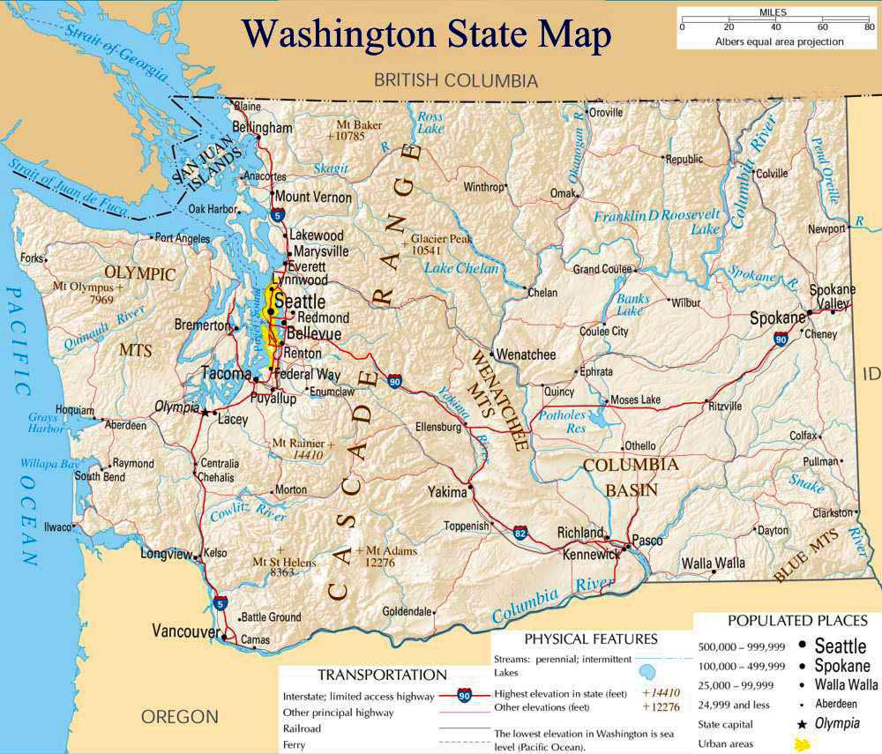
Who We Are
12 x Four-Year Colleges & Universities--producing >90% of STEM teacher graduates in Washington State
Two-Year College STEM Faculty
Western Governors University
K-12 Educators---Teachers, Principals, District Administrators
Businesses---Google, Code.org
Govt. Orgs---OSPI, PESB, ESDs, PNNL
NGO’s—MESA, Pacific Science Center, Washington LASER, WA-STEM, WA-ToToS, WA-ToToM, Compass 2 Campus
Notes:
Broad Geographic Representation *Stars represent some of the primary collaborators
Notes---CWU, EWU, WWU, SPU, WSU-V, UW-Tacoma plus PNNL, WA-LASER are all part of the Collaborative proposal.
Have and want/will recruit additional Key Stakeholders from UW- Seattle, WSU-Pullman and Tri Cities, Evergreen, Seattle U., Walla Walla, Heritage, Gonzaga, Whitworth, and Northwest University
Likewise with respect to NGO representatives, Govt folks and business folks interested in STEM education.

Slide 4
How did we get here?
Drivers of Change
  NGSS and CCSS Math and LA
  STEM Workforce Needs
  Computer Science Education Legislation
Conducted---NGSS STEM Teacher Preparation Course(s) Gap Analysis
Held Multi-Institutional Workshops---January, May, and October, 2015
Developed a shared vision of STEM teachers (elementary, middle, and high school) in 2030
Notes:
Washington is an NGSS and CCSS adoption state…. Which means that all of our Science and Math Teacher Prep programs need to be realigned/updated to reflect these new state standards. One of the underlying premises of NextGen-WA is that we can Update our programs more effectively and quickly by collaborating with one another… for the benefit of all our preservice students and eventually for the benefit of all P-12 students in the State.
Based on this Vision we identified several aspects of STEM Teacher Preparation that we all wanted to improve and align with the NGSS
WA-STEM workforce needs support this work with thousands of STEM jobs (mostly in Computer Science and Engineering) going unfilled
… and more specifically recent legislation has mandated the teaching of more CompSci in High schools (K-12). As you may/may not be aware a state taskforce has been working on a new Computer Science (K-12) endorsement. However it will be up to us to figure out how to make this endorsement work at our institutions for pre-service teachers and for inservice teachers wishing to seek this endorsement
GAP Analysis… in 2015 Gus Nollmeyer from EWU helped us put together and conduct a NGSS course gap analysis of our STEM TP courses/curricula.
This survey told us that our programs all are generally well aligned with NGSS DCI’s and Scientific Practices, but missing Engineering practices, and mixed with respect to the Cross-cutting themes. The WSSLS also include Computer Science… which is also missing from our STEM TP programs
At the three one-day workshops we developed a vision for the World of 2030, the Students of 2030, and The STEM teachers of 2030 (Elementary, Middle, and High), leading us to think about the STEM TP programs of 2030… and how are current programs will need to evolve to produce the STEM teachers of 2030 who can in turn engage and prepare the next generation of scientists, mathematicians, engineers and computer scientists… as well as the next generation of STEM literate citizens.

Slide 5
As a result of our 2015 planning we..
Identified three Capacity Building Components and six STEM Teacher Preparation critical component areas
Formed Working Groups in each of the Six Critical Component areas
Developed a Collaborative Proposal to NSF-IUSE to improve STEM Teacher Preparation across the state over the next four years
Received $3 million in funding (collectively) in Summer 2016 to support our work over the next four years
Notes:
We couldn’t have done this without all of your (and other folks) collective input, ideas, and support)
Identified 9 areas related to STEM Teacher Preparation to address/improve
Capacity Building Components: Organizational Change, Diversity, and Collaboration Building… are items that lay the foundation for all of our work.
TP Improvement Areas: **(a) Clinical Practice- Induction, (b) Pedagogical Content Knowledge, (c) Computer Science in STEM TP, (d) Engineering in STEM TP, (e) Education for Sustainability, and (f) Math and STEM Teacher Preparation
++Partners in the Proposal include:
CWU, EWU, WWU, SPU, and WSU-Vancouver, plus UW-Tacoma, PNNL, WA-LASER…
With Ellen Ebert acting as our Management Team Liaison with OSPI.

Slide 6
The NextGen-WA Proposal
Goals
Collective Impact Framework
Plan of Action
Management and Communications
Evaluation and Research
Notes:
GOALS… Anticipated Outcomes and Benefits
COLLECTIVE IMPACT FRAMEWORK… Kania, Kramer, and Hanleybrown (2011)
PLAN OF ACTION… Working Groups and Implementation Teams
MANAGEMENT AND COMMUNICATIONS… Management Team, Advisory Board, Implementation Council
EVALUATION… External and Internal
RESEARCH
EVALUATION

Slide 7
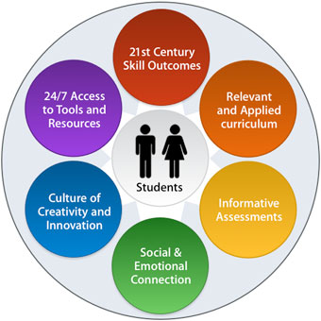
Goals
Improve STEM teacher preparation programs in the state (impacting greater than 90% of Washington’s future STEM teacher graduates)
Increase recruitment of qualified and diverse STEM students into teaching
Create an adaptive, research-based model for improving STEM teacher preparation through collaboration.

Slide 8
Anticipated Outcomes and Benefits
State Level
  Adaptive Model for ongoing Program Improvement through collaboration
Regional Level
  Stronger Collaborations between IHE’s, K-12, NGOs, businesses and Govt.
Institutional Level
  Stronger Collaborations between Colleges and widespread support for improvement of STEM Teacher Preparation
Program Level
  NGSS and CCSS aligned STEM Teacher Preparation Programs, Courses, and Curricula (including Computer Science, Engineering and EfS)
Individual Level
  Faculty --- understand, use, and model evidenced based teaching-learning practices
  Diverse Preservice Students… better prepared to support 21st Century Learning for all students
Notes:
Note--- we will also be conducting research on the extent to which collaborating to improve STEM Teacher Preparation within our institutions and across the state…. Leads to “success”
i.e. trying to determine “What Success Looks Like” at each of these levels

Slide 9
Collective Impact Framework
Common Vision: One size does not fit all, but shared vision and goals are more likely to be realized
Shared Measurement: Results are measured consistently, with shared accountability
Mutually Reinforcing Activities: Activities of each group inform others’ plans
Continuous Communication: Builds and maintains trust, collaboration, and motivation
Backbone Support: Takes on the role of overall coordination and management
Reference: Kania, J, and M. Kramer, 2011 and Hanleybrown, F., J. Kania, and M. Kramer, 2012---Stanford Innovation Review
Notes:
Large-scale social change requires broad cross-sector coordination, yet too many organizations are working in isolation from one another (i.e. every IHE, every STEM TP program, every K-12 school)
Collective Impact is a framework to tackle deeply entrenched and complex social problems. It is an innovative and structured approach to making collaboration work across government, business, philanthropy, non-profit organisations and citizens to achieve significant and lasting social change.
http://collectiveimpactforum.org/what-collective-impact
It Starts with a Common Agenda… i.e. coming together to collectively define the problem and create a shared visions to solve it (e.g. 2015 workshops and the NSF proposal)
It Establishes shared measurement…. That means agreeing to track progress in the same way, which allows for continuous improvement (see the Evaluation plan and baseline data collection efforts)
It Fosters mutually reinforcing activities--- that means coordinating collective efforts to maximize the end result (i.e. individual Working Group Efforts each contributing part of the solution… coordinated by the management team
It Encourages continuous communications--- that means building trust and relationships among all participants (within and across Working Groups and Implementation Teams) and with external partners (OSPI, PESB, etc.)
And it has a Strong Backbone----that means having a team dedicated to orchestrating the work of the group (the Management Team, plus the Statewide Implementation Council)
If you would like to learn more about Collective Impact Framework… please see the link to

Slide 10
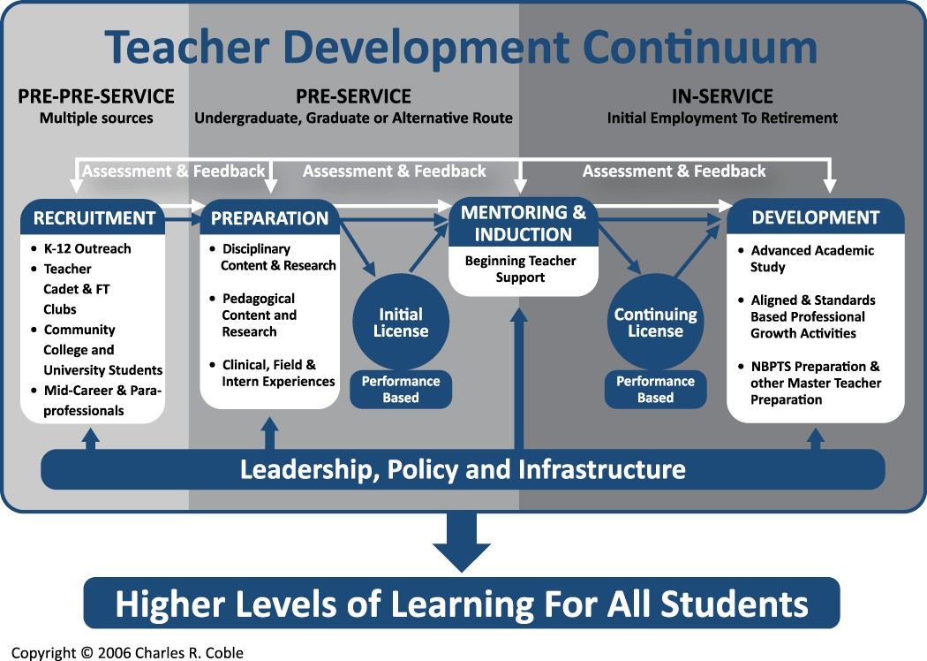
So What Are We Trying To Change?
Notes:
Our Focus is on the Pre-service component of this Continuum but we will be collaborating with groups/individuals working on the Pre-Pre-Service and In-Service components so that our efforts are synergistic and complementary.

Slide 11

Questions
Notes:
Final Note…. This is very much a work in progress, we are figuring out things collaboratively as we go. We want your input and perspective to help come up with innovative, powerful, effective solutions and models.

Slide 12

Plan of Action
Notes:
So How will we actually accomplish our goals?

Slide 13
Capacity Building Working Groups
  Understanding and supporting productive Organizational Change
  Increasing the Diversity of the STEM teaching workforce
  Collaboration-building within and across institutions and disciplines
Notes:
---Address areas that are foundational to the success of all components of this project, specifically by helping to build leaders’ capacity to overcome common barriers to change. Capacity Building Working Groups develop and present resources to the Critical Component Working Groups and the Implementation Teams

Slide 14
Critical Component Working Groups
  Clinical Practice and Induction
  Computer Science Integration [into teacher education]
  Engineering Integration [into teacher education]
  Pedagogical Content Knowledge
  Education for Sustainability
  Math and STEM (new)
https://drive.google.com/open?id=0B3l0w95zALoORlhnT3NSdmduclk
Notes:
Describe Working Groups in general…. The R&D arm of our project… containing/building the expertise we need across the state in each of these six critical component areas.
Composition…. 12-20 people/group (flexible to meet the needs of the group)… Want diverse representation
Elementary-Secondary, Math and Science, Higher Ed and K-12, NGS, Govt, Business… AND
Geographically distributed
TIE THIS BACK TO THE COLLECTIVE IMPACT MODEL… AND SCOTT PAGE’S WORK ON DIVERSITY AND COMPLEXITY… I.E. THAT DIVERSE TEAMS ARE MORE LIKELY TO COME UP WITH INNOVATIVE, POWERFUL, EFFECTIVE SOLUTIONS THAN LIKE MINDED/PEOPLED TEAMS
MATH AND STEM… this is a new group identified as being needed during the proposal development process.
Describe roles and expectations of “Core WG members” and “Review-Liaison members… AND that people filling these roles may change over time… i.e. you may start out as Core WG member in Y!, but not have enough time in Y2 so switch to a R-L role or vice versa.
Working Group Composition
ONE_PAGE Summaries about each Working Group are available online AND you will learn more about the work of each group AND develop plans for your Group…at the January 14th workshop
NOTE… much of the Work of each working groups will take place virtually… but in January you will have a chance to meet face to face with other members of your group.
TRANSITION TO--
Kathy Baldwin, co-lead on the EfS group will give you an example of the type of thinking and work that each WG will partake of.
TRANSFER control of audio/slides to Kathy

Slide 15
Timeline and Commitments for Working Groups
Core group (4-6 people) members commit to and are compensated for a few days up to 2 weeks’ time/year.
Expert Review-Liaison members (10-15) are supported with travel funds to attend NextGen meetings and Professional Development workshops.
All Implementation Team and Working Group members attend Annual Meetings
Individual Working Groups develop and provide Professional Development in years 2-4
Implementation Teams develop plans and strategies throughout the period
Notes:
Timeline and Commitments include two main levels of Working Group participation:
Core group (4-6 people) members commit to and are compensated for 1 to 2 weeks’ time/year.
Expert Review-Liaison members are supported with travel funds to attend NextGen meetings and Professional Development workshops.
All Implementation Teams and Working Groups attend Annual Meetings
Professional Development provided by individual Working Groups in years 2 to 4
Working Groups and Implementation Teams develop plans and strategies throughout the period

Slide 16
Guiding Questions and Key Components of Education for Sustainability (EfS) Working Group
What does EfS involve/include?
How do we incorporate EfS into teacher preparation?
How do our programs conceptualize EfS as a social justice /equity practice?
How do we incorporate EfS as an integrative theme?
How do we develop EfS programs that support inclusive and diverse recruitment, retention, and future placement of teachers?
Notes:
The Next Gen consortium met 3 times over the last year. First the Working Groups were determined, and that was followed by each working group creating guiding questions and key components.

Slide 17
How to Incorporate EfS into Teacher Education?
Top down – Environmental and Sustainability Education (ESE) Add-On Endorsement
  Currently 6 teacher prep programs in WA offer the endorsement
Bottom up – Integrate EfS across curriculum
  Based on state competencies for teacher preparation and the Washington State Environmental and Sustainability Education Standards

Slide 18
EfS Working Group Next Steps
Explore additional existing EfS resources
Analyze examples and models of EfS
Pilot EfS curriculum and models among working group members
Plan and present professional development about EfS for regional teams of STEM Educators
Evaluate and improve EfS professional development

Slide 19
Questions
Notes:
Final Note…. This is very much a work in progress, we are figuring out things collaboratively as we go. We NEED your input and perspective to help come up with innovative, powerful, effective solutions and models.
Thank you again for your time today. We look forward to working with you on the Working group of your choice and seeing many of you at the January 14, 2017 workshop at Seattle University. Don’t hesitate to invite colleagues you think would be interested in participating in/learning more about this effort to contact us, and join a Working Group

Slide 20
Plan of Action: 2016-2017
Project Overview (Today’s Webinar)
January 14, 2017—1 day Workshop at SPU
Year 1--- Build Capacity for Change
Year 1--- Research and Development
  Working Groups--- Find/develop models and resources for 6 Critical Component Areas of STEM Teacher Preparation
Form Implementation Teams
  To Pilot test and implement in Years 2-4
Develop common metrics and collect baseline data
Notes:
Lead into Evaluation and hand off to Dan

Slide 21
Structure of the WA NextGen STEM TP Project
Capacity-Building Working Groups:
•Organizational Change issues • Diversity Issues • Collaboration Building
Capacity Working Groups consist of 12 to 20 cross-institutions partners working collaboratively, and their results inform all aspects of the project
Implementation Groups:
Management Team
External Advisory Board
State Implementation Council
Regional Implementation Teams
STEM TP critical component Working Groups:
•Clinical Practice and Induction •Strengthening PCK • Integrating Computer Science into TP • Integrating Engineering in TP •Integrating Education for Sustainability into TP
•Math and STEM integration
Critical Component WG’s consist of 12 to 20 cross-institutional partners working collaboratively
Arrows indicate regular feedback, support, communication and assessment,
as well as research and evaluation processes

Slide 22
Project Communications via---
Zoom Meetings
Google Drive and Google Docs
Email
Phone
Webinars, and
Face-to-Face (Annual Meetings)
Notes:
Each Working Group leader now has a Zoom account and will be contacting you about your first “virtual” Zoom meeting in December to get to know each other, create some Norms for how you want to work, begin discussing your STEM TP area boundaries and goals for Year 1 and through Year 4…. Using the Template we have created to help support your discussions and work.
Have Roxane provide a short tutorial/intro to Google Drive and Docs

Slide 23

NextGen STEM Teacher Preparation Project Evaluation
Internal Evaluator: Dan Hanley, WWU
External Evaluators: Eric Banilower & Peggy Trygstad, Horizon Research Inc.
Notes:
DH and EB introduce themselves

Slide 24
Goals and Year 4 Benchmarks
Improve STEM teacher preparation programs in the state
  Partnering HEIs have incorporated one or more of the models shared by the working groups into their STEM teacher prep programs.
Increase the recruitment of qualified and diverse STEM students into teaching
  Partnering HEIs have clearly articulated and disseminated strategies and incentives to recruit underserved student populations into their institutions and STEM teaching programs.
Create an adaptive, research-based model for improving STEM teacher preparation through collaboration
  Increased quantity and quality of collaborations across partnering HEIs, and an understanding of the factors that support or inhibit high-quality collaborations.

Slide 25

Internal Evaluation
Document the iterative design process
Assist working groups in pilot-testing their innovations
Notes:
DH briefly talks about the Internal Evaluation
Documenting the iterative design process, such as the roles of key participants and organizations in the Management Team, Regional Teams, and Working Groups, including the key decisions and major design iterations.
Helping the working groups pilot-test their innovations

Slide 26

External Evaluation
Collaborative efforts and impacts of the nine Working Groups
Quality and impacts of the Summer Workshops
Institutional Profiles
Notes:
EB
The external evaluation will focus on impacts in the three Capacity Building areas of: 1) organizational change, 2) increasing the diversity of the STEM teaching workforce, and 3) collaboration building within and across institutions and disciplines, as well as the impacts in five areas of STEM Teacher Preparation: (A) clinical practice and induction, (B) computer science education, (C) pedagogical content knowledge, (D) education for sustainability, and (E) engineering education. As an example, in Year One, HRI will conduct interviews with key stakeholders (Working Group, Regional Team, and Leadership Team members) to monitor the extent and quality of collaboration within and across these groups. HRI will provide feedback on project plans for the initial Capacity Building Workshop; observe a portion of the workshop; develop, administer, and analyze a post-workshop survey; and conduct follow-up interviews with a subset of workshop attendees. HRI will also conduct interviews with individuals from a sample of participating institutions in order to gather baseline, and follow-up data (e.g. Institutional Profiles) about STEM teacher preparation at these institutions. In addition, HRI will attend (either in person or virtually) project advisory board and leadership meetings as appropriate, provide an annual evaluation report, and provide ongoing formative feedback.

Slide 27
Muddiest Point
Please write down your “muddiest point” about NextGen-WA
Notes:
… i.e. what aspect of this project is still confusing or unclear to you?
Send us your Muddiest points via the Chat function
If you haven’t had all of your questions answered, please let us know.

Slide 28
Questions
Notes:
Final Note…. This is very much a work in progress, we are figuring out things collaboratively as we go. We want your input and perspective to help come up with innovative, powerful, effective solutions and models.

