Slide 1
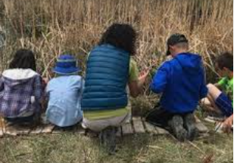
Phenomenal Outdoor Engineering K-5
Tami Moffatt &
Michelle Morrison
Notes:
NOTE: Want a different image on this slide? Select the picture and delete it. Now click the Pictures icon in the placeholder to insert your own image.

Slide 2

Welcome!
Find a place to sit.
Take a walk around the room and look at each of the charts posted on the walls. Answer the questions posed on each chart and/or add your comments using a marker.
Notes:
Time: 10-15 minutes
Notes: Be sure to prepare one chart with directions to download the Seek App by Inaturalist. They will be using this during the outdoor experience.

Slide 3

Stand up and find 2 people who are not at your table--
Introduce yourself.
Share your current position in education.
Something fun you are hoping to do or have done this summer.
Be ready to introduce people in your group.
Notes:
Time: 5-10 minutes
Notes: Follow directions on the slide

Slide 4
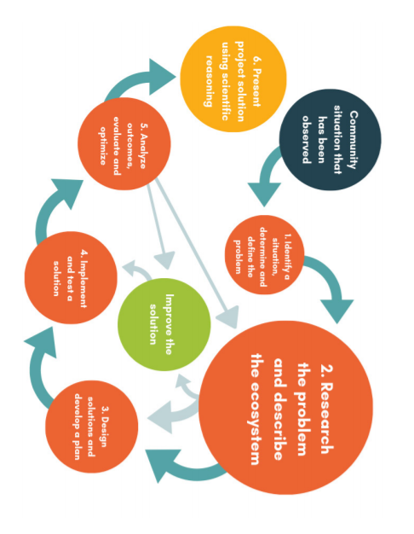

Engineering Design Process Outdoors
Notes:
Time: 10 minutes (slides 4-7)
Notes: Page 13 from the Field Design Engineering Design from PEI. Refer to the SEPs on page 13. Discuss the problem as a challenge solved through a series of steps used to design a solution. Engineering Design uses a problem to frame the purpose or reason for the project students engage in.

Slide 5
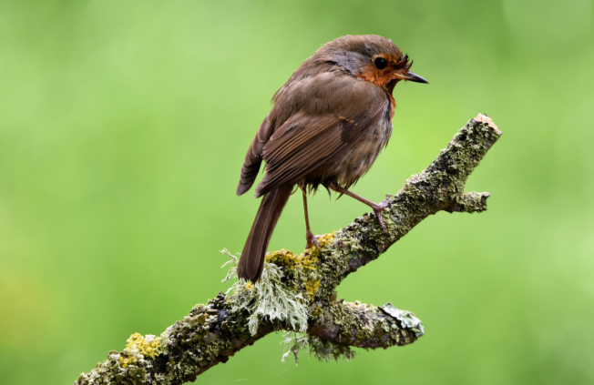
K-2
Often in K-2 classrooms, teachers support students by choosing the topic or problem in order to do "Shared Inquiry or Engineering". In this situation, the teacher would have chosen an engineering task for students to design solutions for and the teacher would work more closely in co-designing potential solutions with students as a scaffold to their finding success with prototypes.
Notes:
Notes: Pages 16-17 in PEI Guide, teachers often choose an engineering task for K-2 students to design solutions for and the teacher works more closely in co-designing potential solutions. In this case, the teacher presents the problem to the class and has already pre-planned the investigation. As time allows, consider summarizing the case study from Mrs. Cannon's 2nd Grade Classroom, pp16-17.

Slide 6
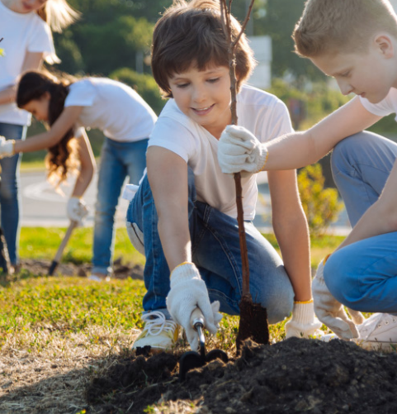
3-5
In grades 3-5 students are ready to shift into more independently chosen problems, analyzing research and balancing multiple factors when deciding on possible solutions without teacher direction. The teacher will still aim student learning toward appropriate performance expectations, however, would give more freedom to students as they hypothesize solutions and work to evaluate whether they solve the problem or not.
Notes:
Notes: As time allows consider summarizing Ms. Ramirez's 5th Grade classroom vignette, p 18.

Slide 7
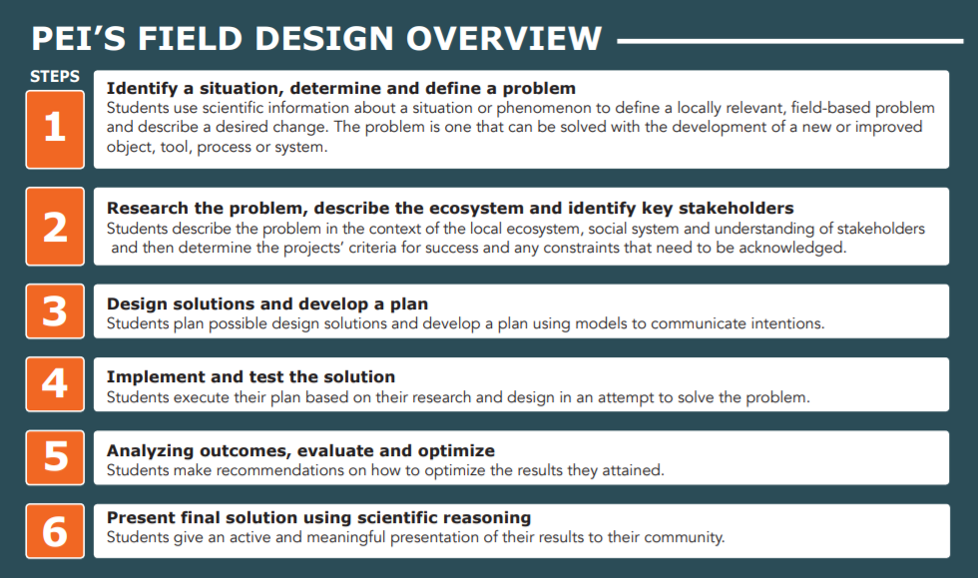
Notes:
Notes: This is an overview of the Outdoor Engineering Design Process. We will take time to engage in most the steps. Consider that with K-2 students the problem or phenomenon would be pre-selected by the teacher and in grades 3-5, the problem or phenomenon would be identified by students.

Slide 8

Step 1: Identify a situation, determine and define a problem
We will be going outside to observe PLU's outdoor space using the O.W.L. graphic organizer.
Find a partner to work with.
Modeling a process that would happen over time with students.
Meet at ____ at _____ time to discuss observations, wonderings, and anything you have learned.
Notes:
Time: 15 minutes
Notes: When working with students, this process of continually making observations, asking questions and reflecting on new gained knowledge is important for learners. Students revisit the field site with their original O.W.L chart to update previous observations and wonderings by recording their new thinking. We are condensing this process. The O.W. L chart becomes a visual model demonstrating students' growth and changes in thinking over time.
Be sure to establish a meeting time and area boundaries.

Slide 9
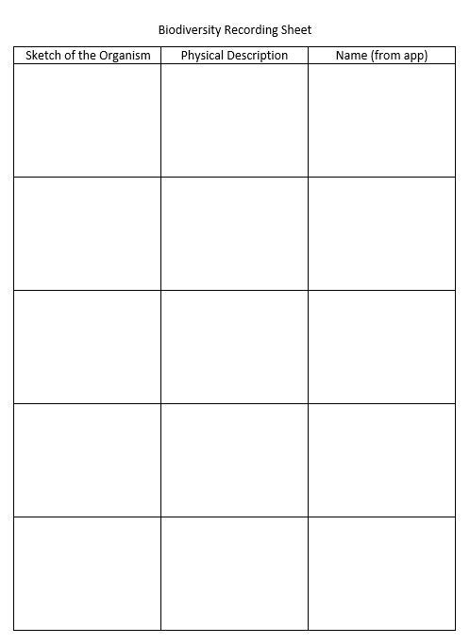

Biodiversity
Notes:
Time: 10 minutes
Notes: Introduce the Seek App by INaturalist. Tell participants that scientists and engineers often use technology tools to help them learn more about whatever they are studying. We will be looking at the biodiversity of this are using the Seek App and recording what we find on the recording sheet. Model using the App by having everyone take a picture of the same thing and recording it on their sheet. Let participants know the time and place they should meet back to discuss what they discovered using the Seek App and ways that students might use this tool.

Slide 10
Impact Walk
With your partner, use your O.W.L. sheet again and this time focus on identifying human impact problems that we could investigate.
Meet back inside the classroom at ______.
Notes:
Time: 10-15 minutes
Notes: Use the O.W.L. graphic organizer again with their partner and this time focus on identifying human impact problems that we could investigate. Remind participants about the time and place to meet inside.

Slide 11

What human impacts and problems did you see?
Notes:
Time: 15 minutes for slides 11 and 12
Notes: Share out problems that the group observed and identify one problem/phenomenon to investigate. After students have engaged in this process multiple times, you may consider having students investigate more than one problem.

Slide 12
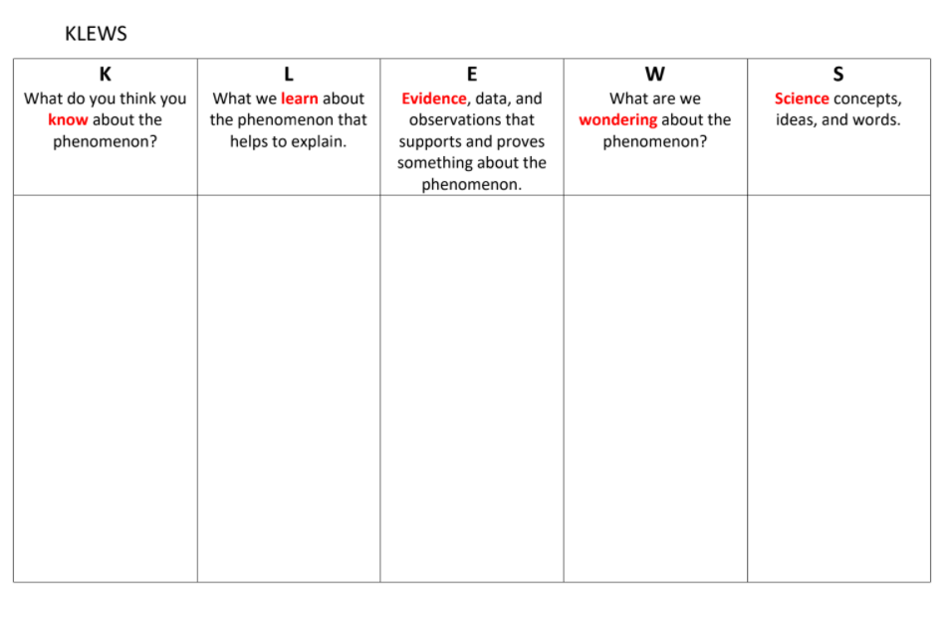
KLEWS Chart
Notes:
Notes: Once a problem/phenomenon (puzzling event that can be observed and cause one to wonder and ask questions) has been identified, explore the K—what do participants know about the problem/phenomenon, W—what do participants wonder about the problem/phenomenon. Be sure to add onto the KLEWS chart as the process continues.

Slide 13
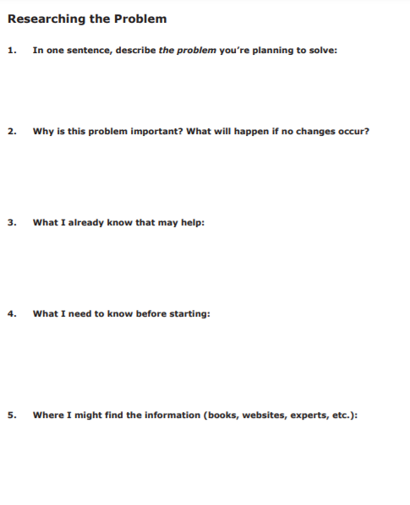
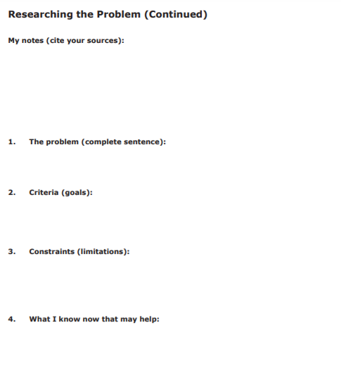
Step 2: Researching the problem, describe the ecosystem and identify key stakeholders.
Notes:
Time: 10 minutes
Notes: With your partner consider a problem that you identified outside and answer as many questions as you can on pages 58-59.

Slide 14
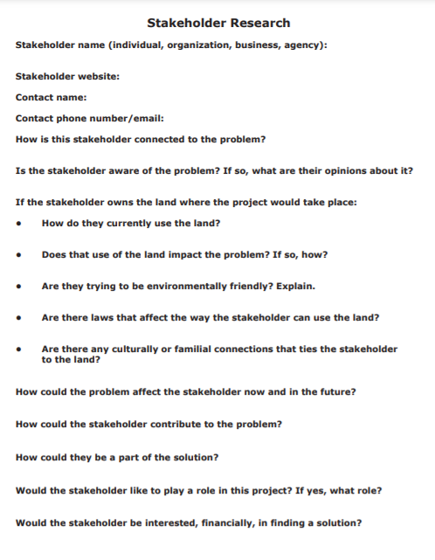
Who Cares?
Notes:
Time: 5 minutes
Notes: The idea of a stakeholder may be new to students adjust this as you think appropriate for your students. In the case of the problem you and your partner identified, who are the stakeholders, who might care about this problem/phenomenon?

Slide 15

Step 3: Design solutions and develop a plan
With your partner create a list of possible solutions. Write down all possible solutions you learned about during your research as well as your own ideas.
Notes:
Time: 10 minutes (slides 15-16)
Notes: Follow notes on slide.

Slide 16
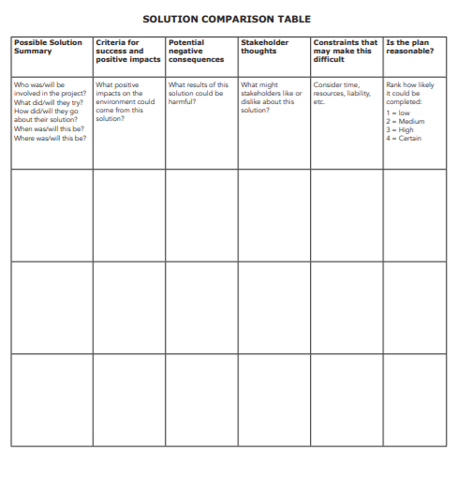
Compare Solutions
Notes:
Time: 10 minutes
Notes: As a group post 1-2 of the solutions that partners developed and go through the process of identifying best solutions. Doing this as a group with students helps them consider all of the factors involved in creating a solution. This is p 62 in the Field Design packet.

Slide 17
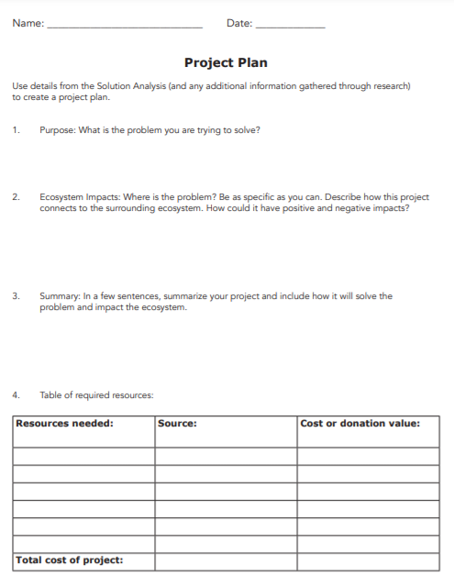
Step 4: Implement and test the solution
Review pages 63-65, then on chart paper, draw a model of your plan and be prepared to explain why you think your plan will work.
Notes:
Time: 20 minutes
Notes: Allow time for sharing using a talk protocol.

Slide 18
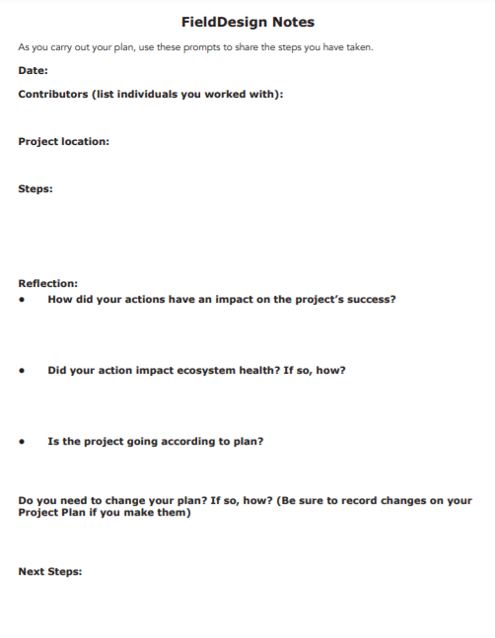
Reflection & Next Steps
Consider ways that this, or an adaptation of this reflection, and next steps may be helpful to your students.
Notes:
Time: 10 minutes
Notes: What would you do to adapt this for your students? How would students benefit from reflection?

Slide 19
Step 5: Analyzing outcomes, evaluate and optimize
Step 6: Present final solution using scientific reasoning
Notes:
Time: 5 minutes
Notes: Have participants look at pp 67-68. Because we didn't actually test our designs we cannot do these two steps.

Slide 20
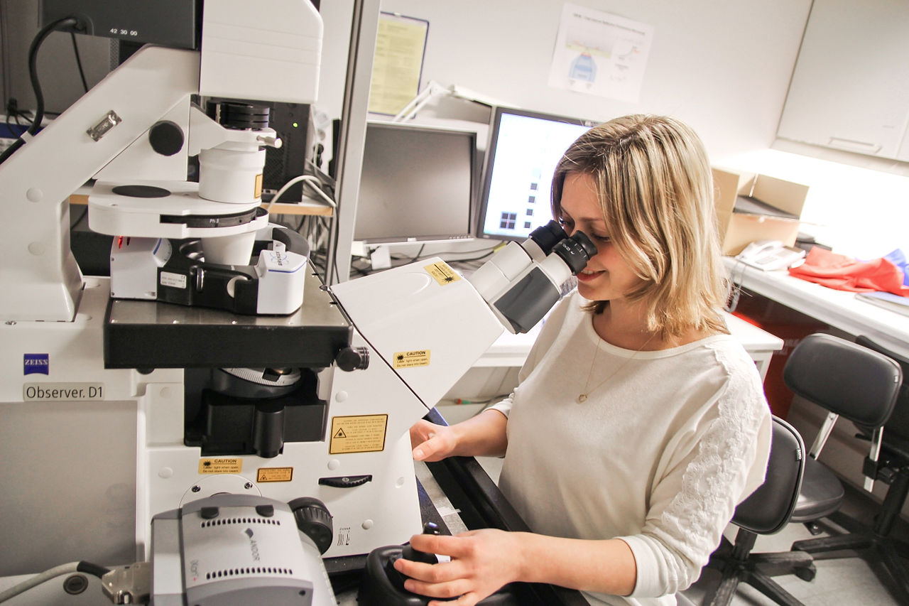

Seeing Myself As an Engineer or Scientist
This Photo by Unknown author is licensed under CC BY-SA.
This Photo by Unknown author is licensed under CC BY-SA.
Notes:
Time: 10 minutes (slides 20-21)
Notes: Brainstorm careers on sticky notes and place on a chart labeled, Seeing Myself as an Engineer or Scientist.

Slide 21

Career Cards
Notes:
Note: The Career Cards are linked into this document.

Slide 22
How has our thinking changed?
Revisit the posters and add any ways your thinking has changed. Use a different color marker than you used at the beginning of our session.
Notes:
Time: 5 minutes

Slide 23

Wrap-up
Choose one of these questions to share with the group--
What are you going to do with what you have learned during this session in your classroom?
What equitable practices did you learn about and/or engage in today?
How did these equitable practices help you make sense of the science or engineering?
What more would you like to learn about science or engineering instruction?
Notes:
Time: 5 minutes
Notes: Standing in a circle choose one of the reflection questions to share in one sentence or less and whip around the circle.

