Slide 1
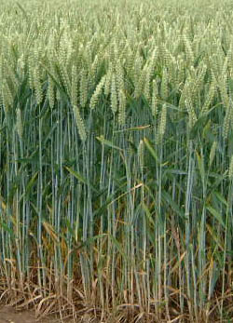
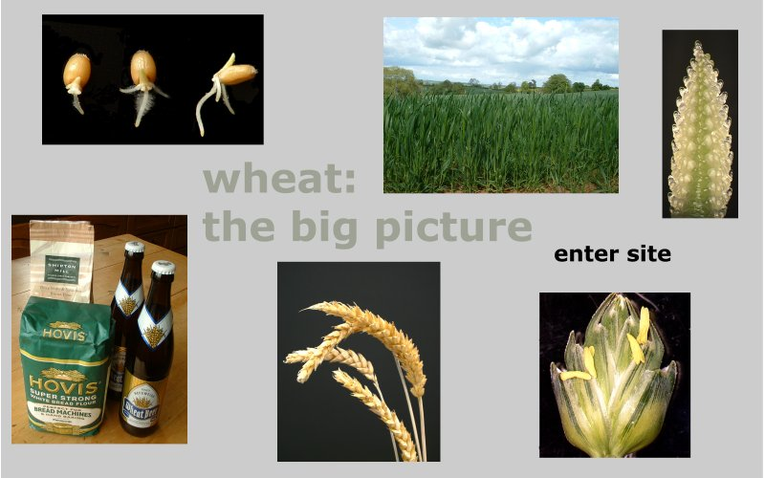

Powers of 2: Many Grains of Wheat
SSAC2007:QA139.LC1.1
Should the King be insulted by the young man’s request?
Core Quantitative Concept
Estimation (Followed by Verification)
A young man saves the life of a King’s daughter. Feeling grateful, the King offers the young man a reward up to half of his kingdom. The young man’s request upsets the King.
Supporting Quantitative Skills
The Laws of Exponents
Exponential Growth
Unit Conversions
Scientific Notation
Prepared for SSAC by
*Lawrence Couvillon – SOUTHERN UNIVERSITY*
© The Washington Center for Improving the Quality of Undergraduate Education. All rights reserved. *2008*

Slide 2
Overview of Module
This module on powers of 2 has several important dimensions. Estimation skills for doubling are minimally effective for most people because the first few “doublings” do not seem to give dramatic change. No doubt this partially explains why the King got angry when the young man made his request. Another dimension is that doubling involves the function, f(x) = 2^{x} , which models many real life situations. Finally, opportunities for unit conversion activities in nonstandard settings are provided throughout the module, when you are asked to calculate the volume of the many grains of wheat.
Slides 3-4 States the problem.
Slides 5-6 Uses the laws of exponents to connect the powers of 2 with powers of 10.
Slide 7 Uses a visual display to explain error of approximation.
Slide 8 Creates the mental picture of what the young man was requesting.
Slide 9 Measures the young man’s request in metric capacity units.
Slide 10 Creates a spreadsheet to measure the young man’s request with the number of truck loads of wheat.
Slide 11 States the Wise Men’s reaction and their report to the King.
Slide 12 Gives the End of Module Assignment.

Slide 3
Problem
A young man saves the life of a King’s daughter. Feeling grateful, the King offers the young man a reward up to half of his kingdom. The young man requests two grains of wheat on the first day, and that each subsequent day, the amount of the wheat be doubled. The reward will be the wheat at the end of forty days.
The King is insulted that his generosity was trivialized, so he orders the young man to receive forty lashes. The young man pleads with the King that the King’s Wise Men study his request carefully. The King reluctantly directs his Wise Men to study the request.
Can the Wise Men convince the King to pardon the young man? The Wise Men go to the royal granary and began the process of doubling.
In this module we anticipate what the Wise Men will find, using some insights from modern mathematics and the power of spreadsheets.

Slide 4
Part 1 Estimation and Verification
The issue addressed by this module is: How much space does it take to contain 2⁴⁰ grains of wheat. This is an estimation problem. We do not need to know the volume exactly. It is sufficient to know whether it is reasonable in terms of the amount of wheat the King could deliver. We will make use of an extraordinarily convenient relation between powers of 2 and powers of 10. If you know this relationship, you can write down without calculating the order of magnitude (power of 10) of 2⁴⁰. The relationship is that 2 raised to a particular power is almost equal to a well-known power of 10 (you use the word every day). The purpose of the next few spreadsheets is two-fold: (1) to determine the relationship (which power of 2 corresponds to what well-known power of 10?), and (2) to verify that the approximation given by the relationship is a good one.
Since grains of wheat are small, and their numbers are huge, we need to aid our intuition through the use of some intermediate common objects to serve as units of measure.

Slide 5
Watching 2^{n} grow
In this slide we observe the growth of 2^{n}. Develop a spreadsheet to show the value of 2^{n} for all values of n between 1 and 40.
Look carefully at the values of 2^{n}. For which value of n is 2^{n} approximately a natural number power of 10? (That is, 2^{n} ≈ 10^{m} for which values of n and m?)
Recreate this spreadsheet
= Cell with a number in it
= Cell with a formula in it

Slide 6
Connecting 2^{n} with 10^{m}
Expand your spreadsheet by adding columns for 10^{0.3n} , and 10^{0.301n}.
How do the values in the new columns compare to each other and to 2^{n}?
10 to exactly what power equals 2?
End Note 1
We shall assume that 2¹⁰ ≈ 10³. Use the Laws of Exponents to “solve” for 2. Hence, 2 equals what approximately? How do you know?
Need help remembering the Laws of Exponents?
End Note 2

Slide 7
Calculating the Error of Approximating 2^{n} with 10^{0.3n}
In a new spreadsheet, adapt your spreadsheet of Slide 6 to calculate the percent difference of 2^{n} from 10^{0.3n}.
You may notice that the numbers in Column G have one decimal place whereas numbers in Column F have three. Why? Notice too that they have the same number of significant figures.
You can see from the spreadsheet that
2¹⁰ is approximately 10³ (a thousand)
2²⁰ is approximately 10⁶ (a million)
2³⁰ is approximately 10⁹ (a billion)
2⁴⁰ is approximately 10¹² (a trillion)
Convince yourself that once you know the first, that the others follow from the Laws of Exponents. (End Note 2).
7

Slide 8
Part 2 Visualizing the Magnitude of the Request
What is the magnitude of 2⁴⁰ grains of wheat? What volume does it take to contain that many grains?
The percentage error arising from our approximation is acceptable for determining whether the young man’s request is “reasonable.”
Because the metric system relates well to base 10, we will use two units for capacity common to the metric system: liters and cubic meters. A liter occupies the volume of a cube 100 mm on a side. A cubic meter contains 1000 liters (it is a kiloliter). Verify these assertions.
What volume does it take to contain a trillion grains of wheat?

Slide 9
Converting in Metric Capacity Units
In a new spreadsheet, modify your spreadsheet of Slide 7 to convert 2^{n} grains from numbers of grains to liters and cubic meters. We will estimate that a grain of wheat (complete with husk) is 2 mm × 3 mm × 8 mm. We will use 50 mm³ as an estimate of the volume of one grain of wheat. Therefore, verify that there are 2×10⁴ grains of wheat in each liter, and 2×10⁷ grains of wheat in each cubic meter.
It is convenient to convert numbers of grains first to cubic millimeters and then convert cubic millimeters to liters and cubic meters. How many cubic millimeters are in a liter?
2⁴⁰ grains = 1000⁴ grains = 10¹² grains = 50E+12 mm³ = 50E+6 L = 50,000 m³.
For formulas in Column D refer to Slide 7. Then, it is up to you to figure out the formulas in Columns E, F and G. Remember, you can check your formulas by comparing your spreadsheet numbers to the ones here.
Use scientific notation when the magnitude exceeds 10³, and use no more than three significant digits.

Slide 10
Converting to Truckloads of Wheat
Expand your spreadsheet by adding a new column for truckloads of wheat. Assume that an empty 18-wheeler has a capacity of 40 cubic meters.
How many trucks would it take to deliver the young man’s request?
Again, it is up to you to use the conversion from cu m to truckloads to figure out the formulas in Column H.
We’re assuming of course that the tiny rectangular “bricks” of rice fit together perfectly with no spaces in between, so the number of truckloads is an underestimate. But it should be good enough to see the problem that the wise men will encounter.
10

Slide 11
The Wise Men
Now back to the Wise Men. Tired and upset, they report to the King that the royal granary does not have enough wheat to reward the young man.
Startled, but determined to fulfill his promise, the King asked the young man if he has a different request. The young man asks for the daughter’s hand in marriage. With the daughter’s assent, the King agrees. He is happy to welcome into his family someone who is so clever.

Slide 12
End of Module Assignment
A sheet of paper is approximately 1/250 inches (500 sheets have a thickness of 2 inches). Fold the paper 5 times. Estimate or measure the thickness after 5 folds. After doing this, estimate (don’t compute) the thickness of 50 folds (cuts).
2. Use the room where you are now. Estimate the volume in cubic meters. Replace the 18-Wheelers with the room in which you reside.
3. Replace grains of wheat with pennies. How much would the King owe the young man in dollars.
4. Develop spreadsheets to compare the following sequences. 2^{n}, 10^{n}, n!, n². and n^{n}. Computer Scientists frequently do this to describe complexity of algorithms.
5. Redo the calculations involving the grains of wheat assuming the porosity is 0.35. Include the change in the number of trucks needed. The porosity of a truckload of rice is the fraction of the truckload that is occupied by the spaces between the rice grains. Technically, it is defined as the ratio of volume of voids to the total bulk volume.
6. Sometimes, patterns are best seen if the data are limited to those needed to spot the pattern. Develop a spreadsheet which shows only those rows for involving integer powers of ten, including 10⁰ = 1. (Hint, begin the value of n with n = 0, and use rows n = 10, 20, 30, and 40).
7. We each have 2 parents, 4 grand parents, 8 great-grand parents, etc. if we go back 20 generations, how many direct ancestors do we have?
12

Slide 13
End Note 1
Enter 2 in your calculator. Take the logarithm (base 10) of the number. Then press the 10^{x} key. What do you get? What is log(2)?
Note: The use of the word "exact" depends on whether one is a theoretical or practical mathematician. Mathematicians view the symbol log(2) as the exact value. Anything read from a calculator is only an approximation, depending on how far one wants to go in the series expansion of the appropriate log function. Calculators which use more significant digits than the one you use will give a different "exact" value. It is possible that log(2) is an irrational number, in which case no one will ever know its exact decimal expansion. All values read from a calculator are rational numbers.
Return to Slide 6

Slide 14
End Note 2
x^{n} = (x)(x)…(x) (n factors of x)
x^{-n} = 1/x^{n} (if x ≠ 0)
x^{1/n} = n√x
xª × x^{b} = xª+^{b}
xª × yª = (xy)ª
xª/x^{b} = xª× x^{-b} = x^{a-b}
xª/yª = (x/y)ª
(xª)^{b} = x^{ab}
x⁰ = 1 (if x ≠ 0)
x ^{a/b} = b√xª = (b√x)ª
From: http://oakroadsystems.com/math/expolaws.htm
The prefixes, kilo, mega, giga and tera refer to thousand, million, billion and trillion, respectively. Therefore, in the language of computer storage,
kilobyte refers to 2¹⁰ bytes
megabyte refers to 2²⁰ bytes
gigabyte refers to 2³⁰ bytes
terabyte refers to 2⁴⁰ bytes
Return to Slide 6
Return to Slide 7

