Slide 1
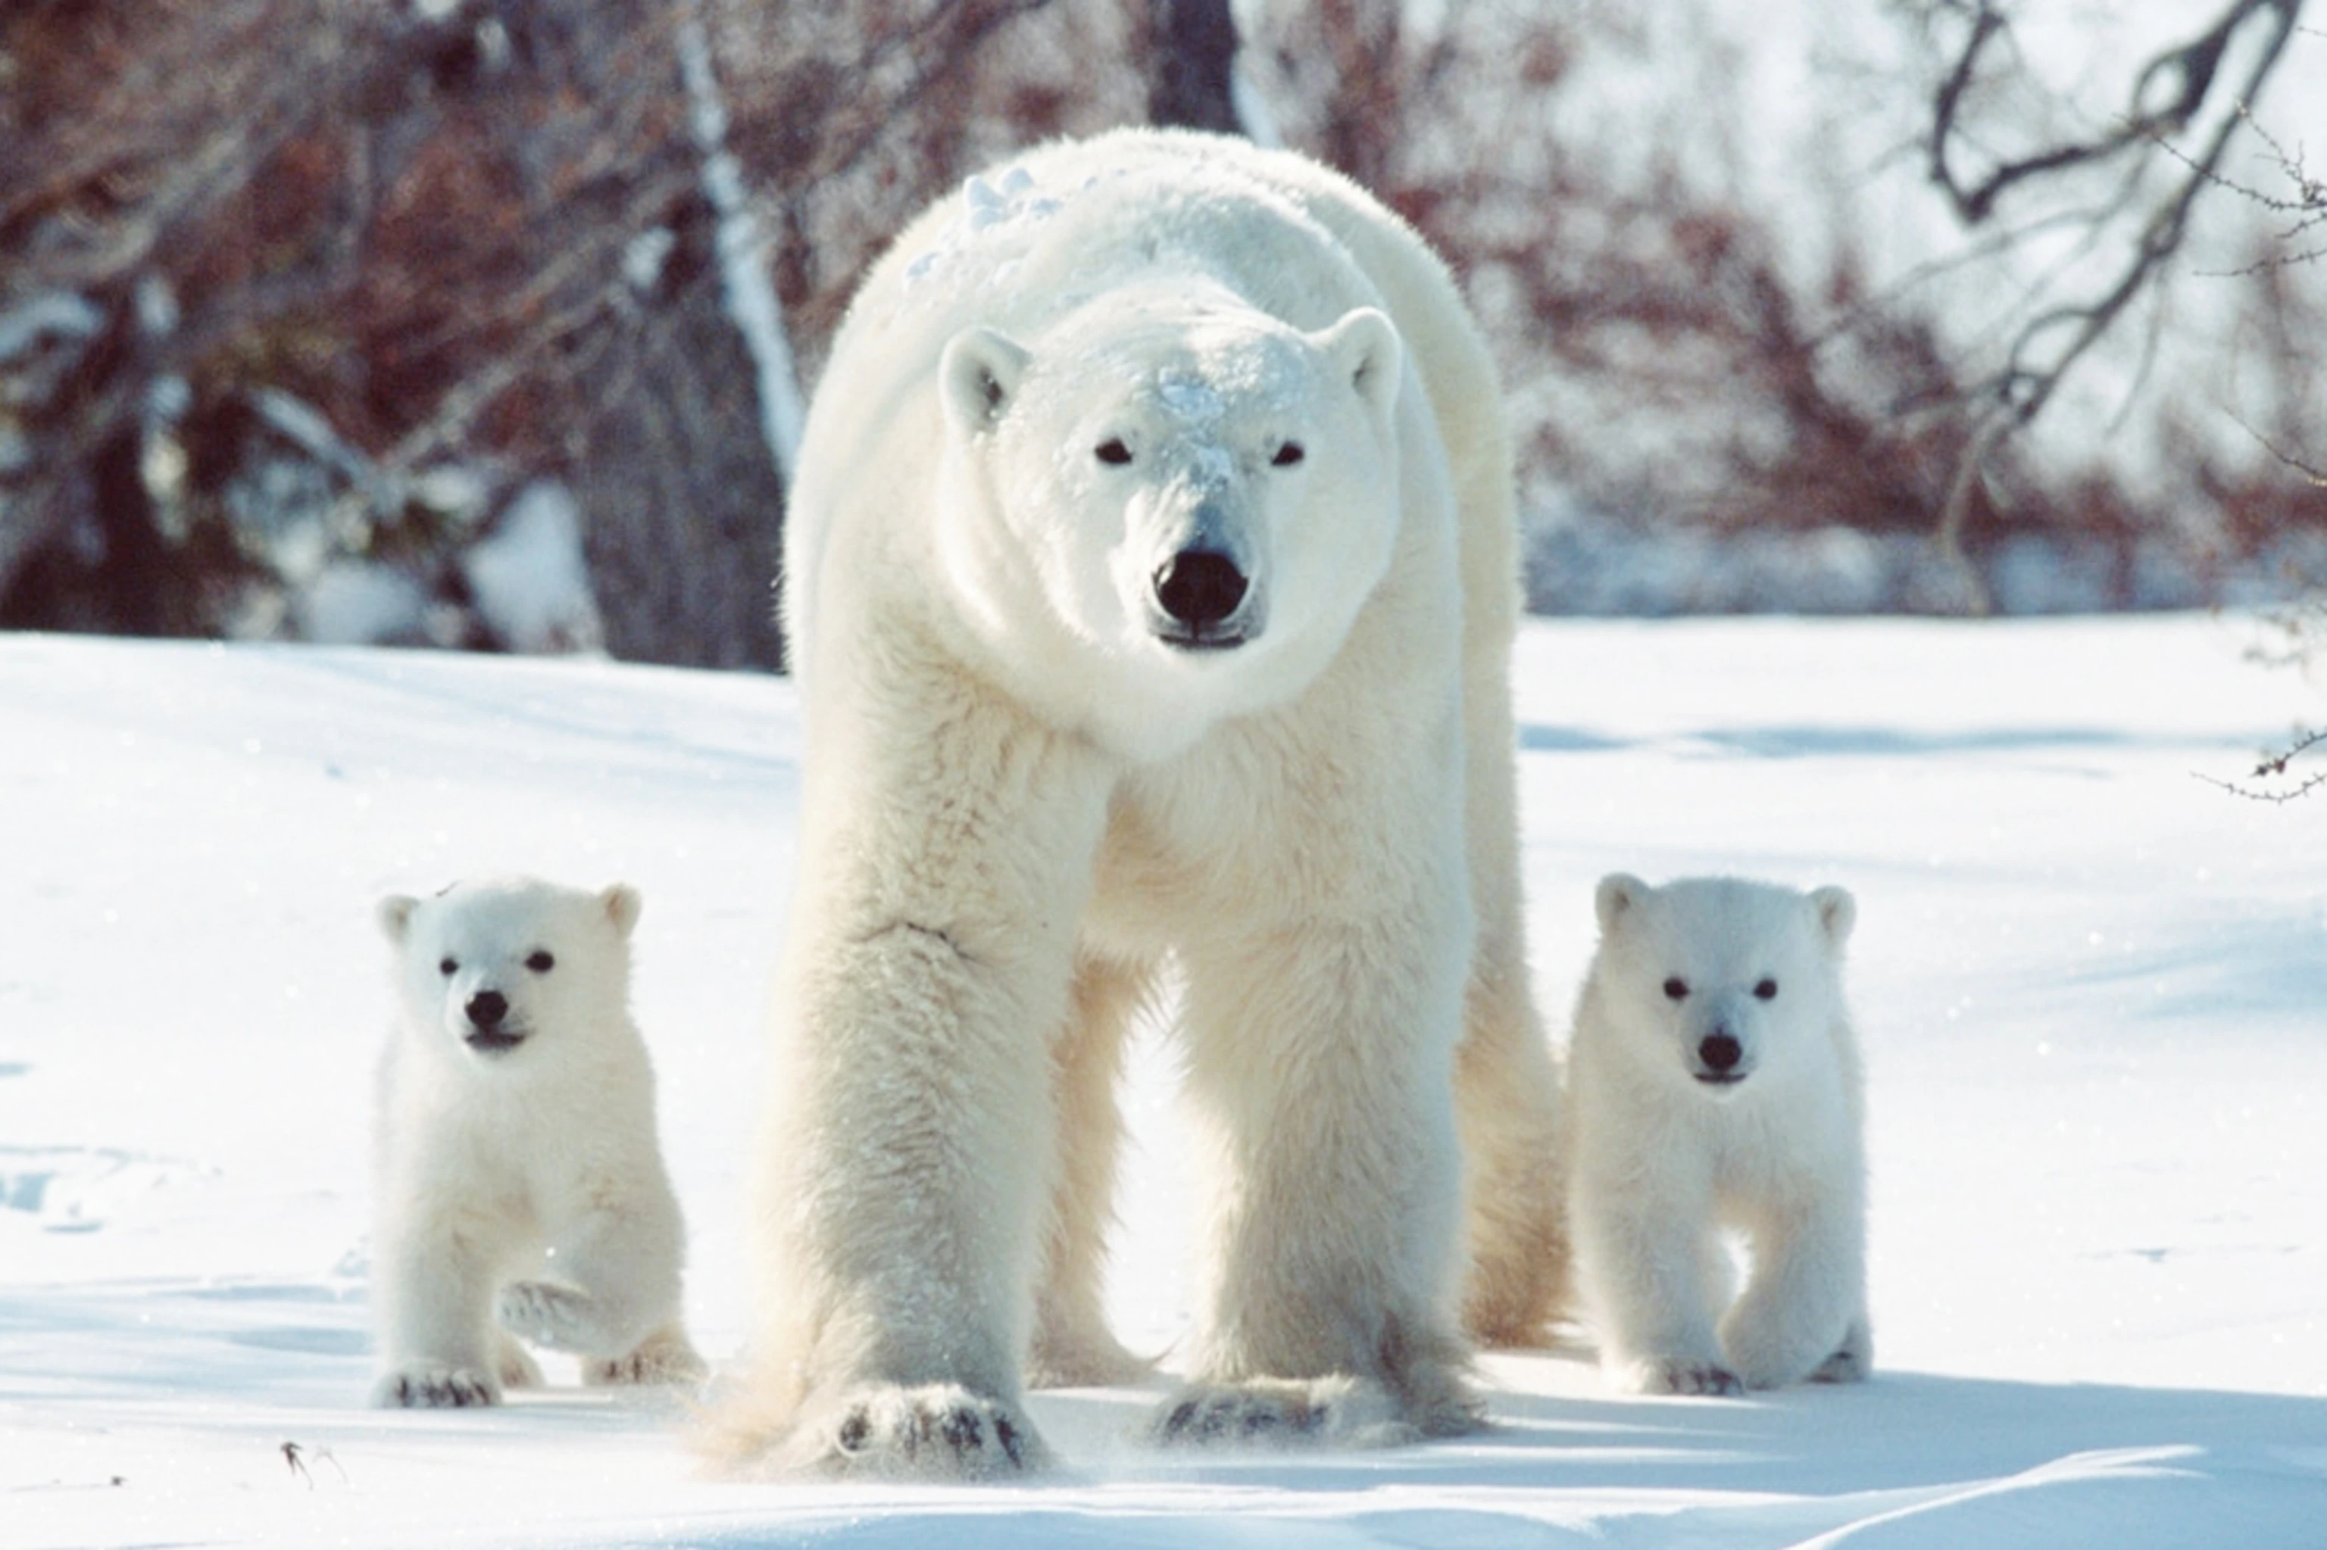
Notes:
poster child for climate change
bears are big, imposing, impressive predators
what makes them vulnerable?

Slide 2
What is vulnerability?
The degree to which a species, population, or ecosystem is likely to be harmed when exposed to a stressor
Determined by:
exposure
sensitivity
adaptive capacity

Slide 3
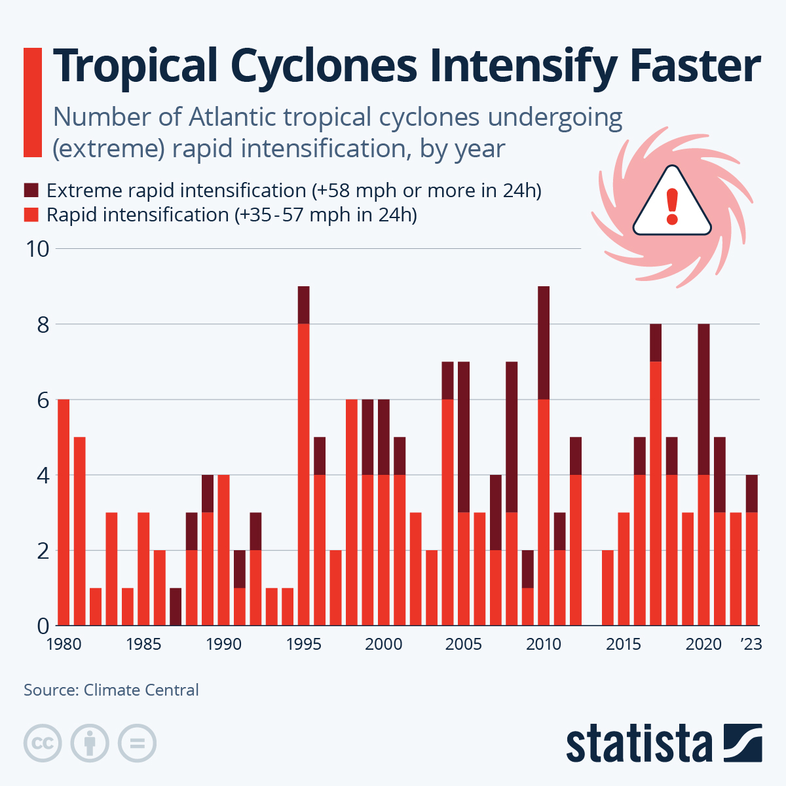
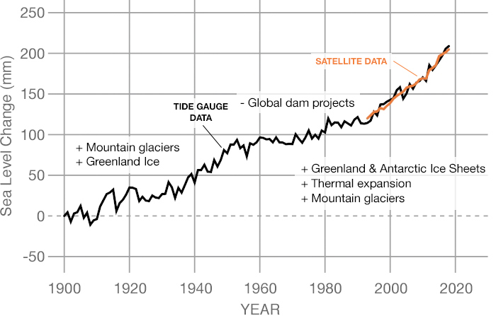
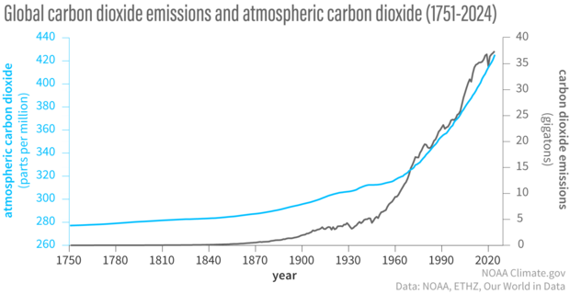
Notes:
Temperature extremes (heatwaves, marine heatwaves)
Altered precipitation (droughts, floods, snowpack loss)
Ocean changes (acidification, hypoxia, warming)
Extreme events (storms, wildfires, glacial melt)

Slide 4
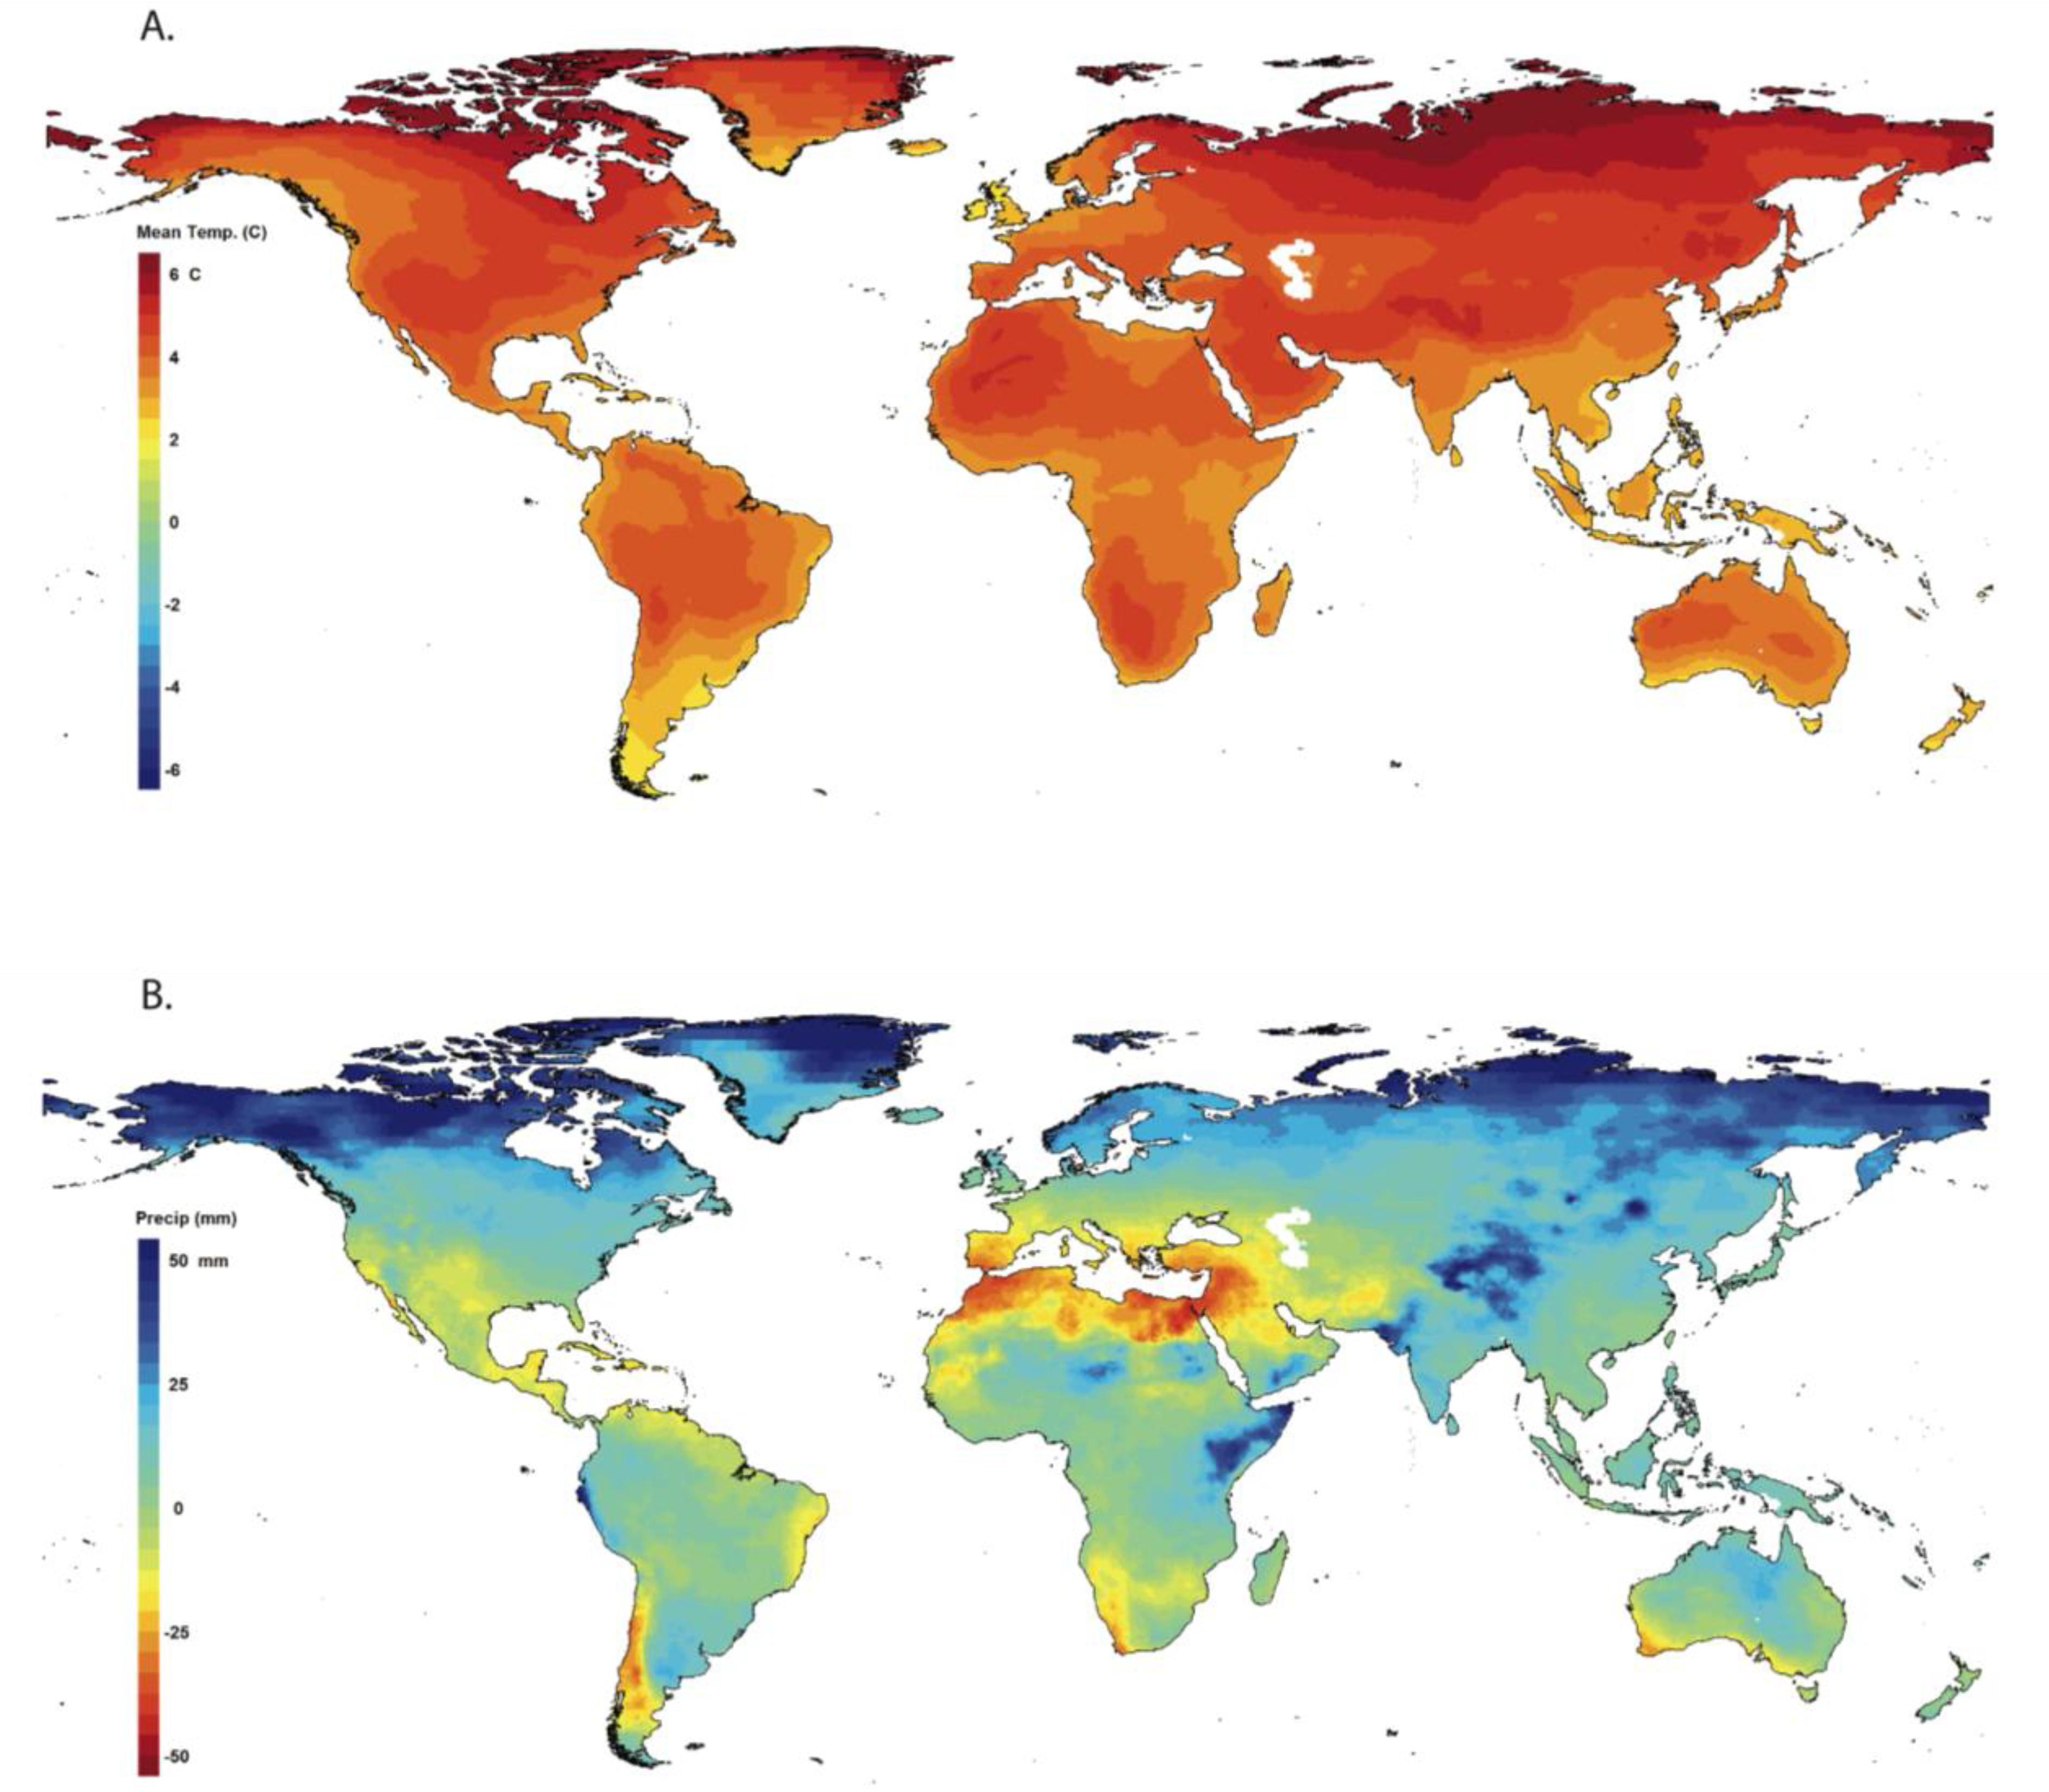
Notes:
Figure 1. Projected changes in (A) mean annual temperature, and (B) total annual precipitation. All changes are for an averaged period from 2070 to 2099 relative to an averaged period from 1961 to 1990. Mapped values are the medians of projections from 16 general circulation models run for the SRES A2 emissions scenario. All 16 climate projections were created for the World Climate Research Programme’s (WCRP’s) Coupled Model Intercomparison Project phase 3 (CMIP3) multi-model dataset and used for analyses reported in the IPCC Fourth Assessment Report. The climate projections were downscaled to a 0.5-degree resolution as described in Maurer et al. [223]. The maps were created with the ClimateWizard climate data analysis tool [224].
https://www.mdpi.com/1424-2818/2/2/281

Slide 5
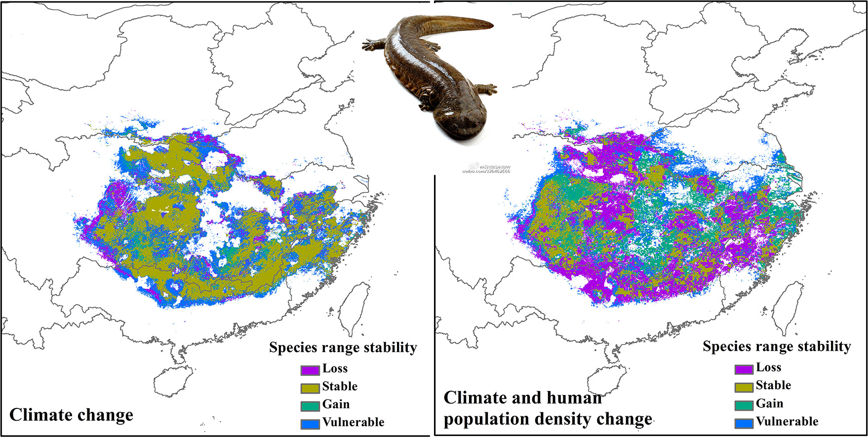
Zhang et al., 2020
Notes:
https://ars.els-cdn.com/content/image/1-s2.0-S0048969720330606-ga1_lrg.jpg

Slide 6
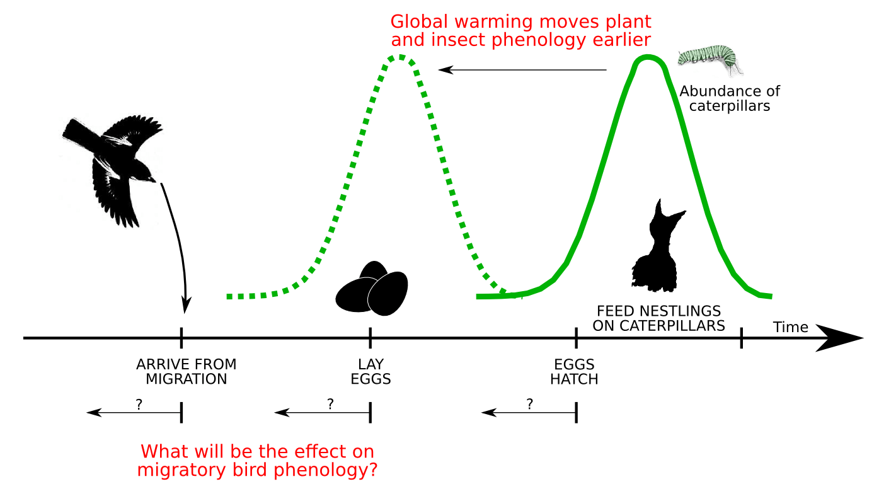
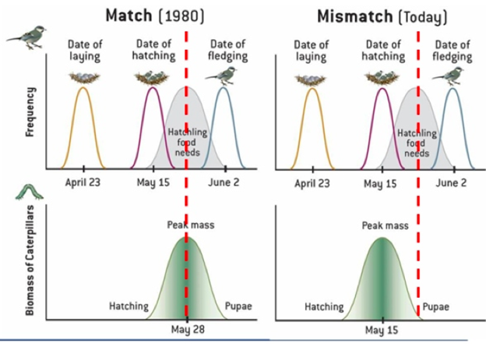
Notes:
phenology (change of behavioral biological events based on climate)

Slide 7
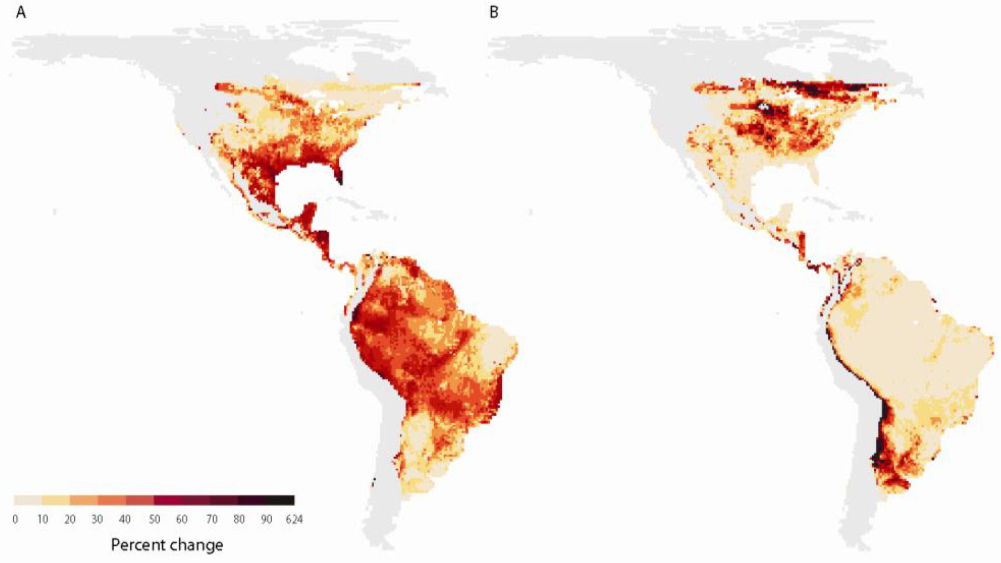
Amphibian Losses
Amphibian Gains
Notes:
Figure 2. Predictions of (A) losses and (B) gains in amphibian species as a result of potential climate-driven shifts in species distributions. Predictions were based on 10 different climate projections for a mid-high (A2) greenhouse-gas emission scenario. Eighty percent (8 of 10) of the climate-change projections resulted in greater percent losses (A) and gains (B) in species richness than the values in these maps. The light grey areas indicate where small sample sizes precluded reliable estimates of change. These data and analyses are described in full in Lawler et al. [17].

Slide 8
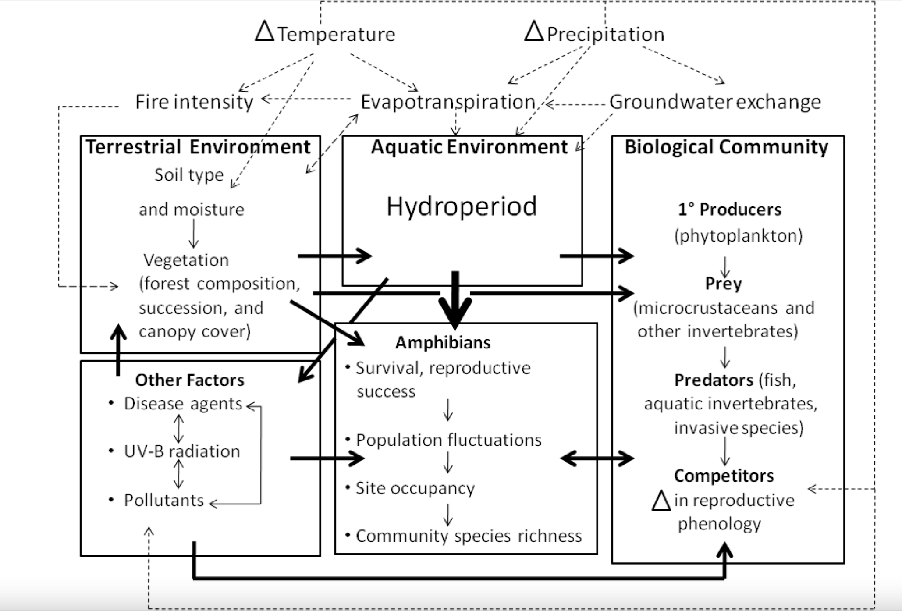
Notes:
Connection to vulnerability: these stressors amplify existing pressures, making species and ecosystems more susceptible.
Figure 3. Conceptual model of pathways through which changes in temperature and precipitation may impact amphibian populations, using a generalized freshwater ecosystem as an example. Changes in temperature and precipitation affect amphibians via the effects of climate on terrestrial and aquatic habitats, the biological community in which amphibians are embedded and other factors such as disease agents, UV-B radiation and pollution. Factors that influence the availability of water, such as the hydroperiod of aquatic habitats, are likely the most important constraints on the reproductive success and persistence of amphibians (indicated by heavier arrow). Dashed arrows indicate interactions among meteorological variables, and their effects on biological communities and the environments in which they occur. Heavy solid arrows indicate relationships among compartments; light solid arrows indicate relationships within compartments.
https://www.mdpi.com/1424-2818/2/2/281

Slide 9
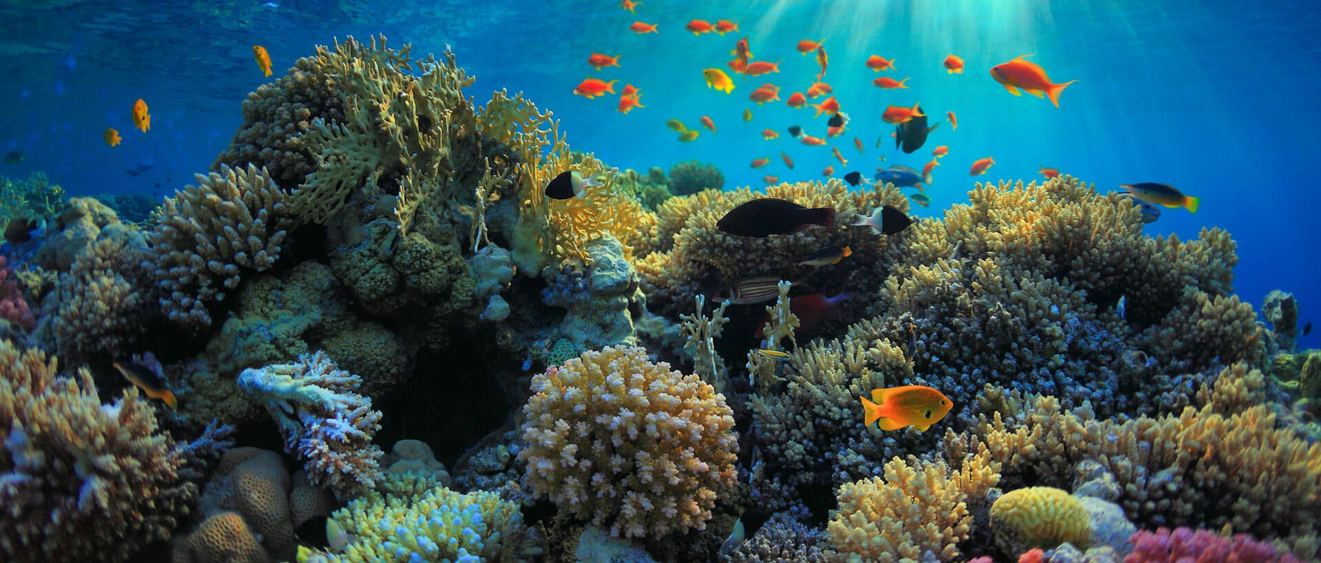
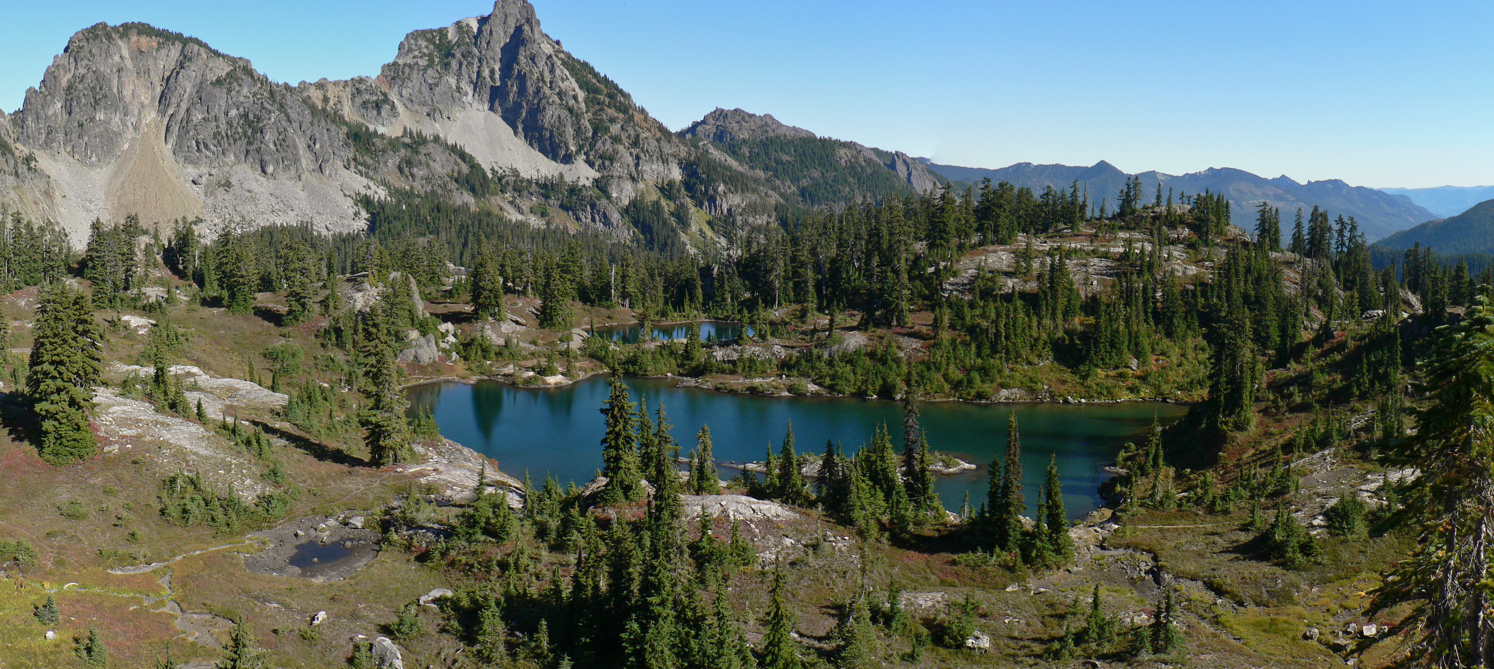
Assessing Organism and Ecosystem Vulnerability
Notes:
Framing: If we want to understand extinction and adaptation in the past, we first need to practice recognizing what vulnerability looks like today. We’ll use the same uniformitarian principle we use in geology: present is the key to the past

Slide 10
Key Dimensions of Vulnerability
Physiological/Functional Limits
Temperature tolerance
Oxygen limits
Dietary constraints
Habitat & Resource Dependence
Specialized vs. generalist habitat use
Availability of prey/food plants
Dependence on migratory stopovers or breeding grounds
Movement & Adaptation Potential
Mobility or dispersal ability
Reproductive rate
Genetic diversity/adaptive capacity

Slide 11
What Evidence Indicates Vulnerability?
Range contractions or shifts
Population crashes or skewed demographics
Morphological changes
Community reorganization
Novel ecosystems

Slide 12
How to think about vulnerability like a geoscientist:
These same principles apply when we look at fossil evidence of stress and collapse.
Use Uniformitarianism: Is this organism’s response to climate change today likely to have been its ancestor’s response in the past?
Identify stressors: What specific stressors are affecting this organism today? Were those stressors present during past crises?
Think About Time: What did the organism’s population look like before, during, and after past crises? How do those changes compare to today?
Consider Resilience: What features do today’s successful organisms share? How/why do they confer resilience?
Notes:
Close with: “Keep the idea of vulnerability in mind. Next, we’ll see what happens after crisis — how ecosystems rebuild.”

