Slide 1
How to restore the estuary you just destroyed
A not-so-straightforward guide

Slide 2
After 10,000 years of human impact, where does your taxon stand now? How did it get here?

Slide 3
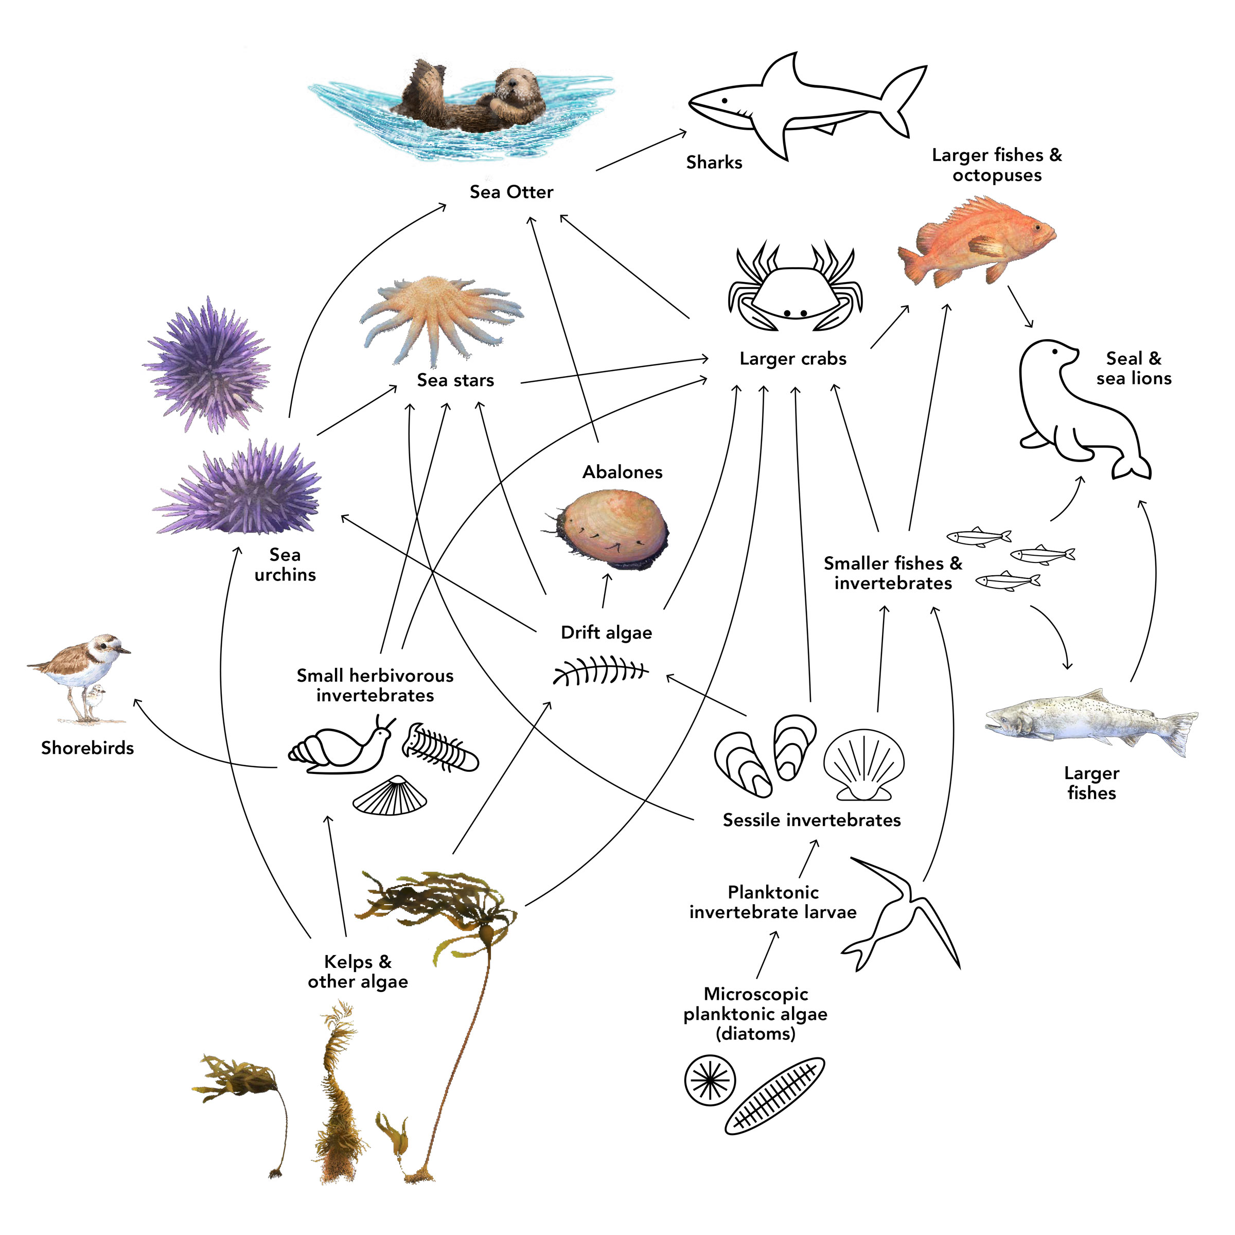
Trophic Cascades
The ripple effect of population change through successive trophic levels as a result of rapid increase or decrease in a subset of the population (often a single species)
Notes:
keystone species
bottom up or top down? examples of the opposite?

Slide 4
What does ecological restoration look like for your taxon/guild?
return to pre-impact abundances?
achieving functional recovery?
maintaining resilience?
stability without intervention?
restoration of particular ecosystem services?
other (explain)?

Slide 5
Design a realistic restoration or management plan for your taxon in the Chesapeake Bay. Include:
goal/target condition
mechanisms/actions (e.g. policy, habitat restoration, harvest limits, water quality)
metrics of success (biotic and abiotic indicators)
predicted trade-offs (who/what benefits or loses)
description of the role CPB played in setting restoration targets
(record on post-it and be prepared to share)
Notes:
look at other groups’ post-its for information on other taxa

Slide 6
Reflection Questions
What determines whether ecosystems can recover after centuries of human impact?
What does the fossil record reveal about recovery potential that modern motioring cannot?
How can conservation paleobiology inform future restoration, not just describe the past?

