Slide 1
Q1: What are some things that you think of when we mention the word “water”?
Notes:
Before we even introduce the title or the framework, we want to start with a very simple question: what comes to mind when you hear the word “water”?
There is no single right answer here. People may think about drinking water, rivers, drought, swimming, farming, flooding, wildlife, infrastructure, culture, or daily life. That range is exactly the point.
We ask this question first because we want to capture people’s initial thoughts without shaping their answers too early. Once we introduce terms like water security or systems thinking, people may start answering in ways they think are expected. Starting here helps us see the variety of perspectives people already bring into the room.
As we collect responses, notice how broad they are. Some answers may focus on water as a natural resource, some on human needs, and some on infrastructure or hazards. This helps show, right from the beginning, that water means different things to different people, and that those differences matter when we think about water challenges.
Good options for collecting and displaying answers include:
Mentimeter
other live polling or word cloud tools
a shared online document or jamboard-style platform
a whiteboard or flip chart for in-person groups
Note: we intentionally started with this question before the title slide to not introduce language that could influence answers

Slide 2


How Water Connects Everything
Understanding Water Security Through Three Worldviews
2026
Sandia National Laboratories is a multimission laboratory managed and operated by National Technology and Engineering Solutions of Sandia, LLC., a wholly owned subsidiary of Honeywell International, Inc., for the U.S. Department of Energy’s National Nuclear Security Administration under contract DE-NA0003525. SAND2026-25756PE
Notes:
Welcome, everyone. Today we’ll explore how water connects to the environment, infrastructure, and communities around us. The goal of this session is to introduce water security in a way that is accessible and interactive, especially for people who may be new to water topics. Our intention is to help participants see that water challenges are rarely just about the water itself—they are also shaped by technology, people, institutions, and decision-making.
By the end of the session, we hope you’ll have a broader way to think about water problems, recognize different perspectives, and start seeing why more complete solutions need to consider the whole system.

Slide 3
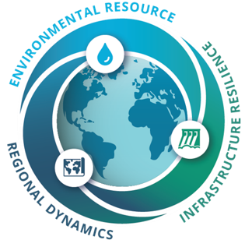
Learning Objectives
After reviewing the course content and associated activities, participants will be able to:
Define key concepts related to water security, including water availability, built infrastructure, and social considerations
Apply the WXS framework to real-world water security examples and a cooperative water security game
Recognize system interconnections through the three worldviews of the WXS framework

Slide 4
Outline
Background
WXS: Three worldviews framework
  Environmental resource
  Infrastructure resilience
  Regional dynamics
Interactive learning activity
  Water scarcity
  Data center growth
  Economic development
Concluding thoughts

Slide 5
Background

Slide 6
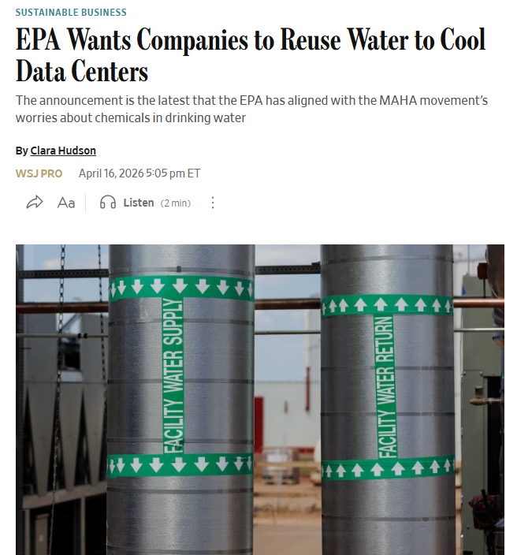
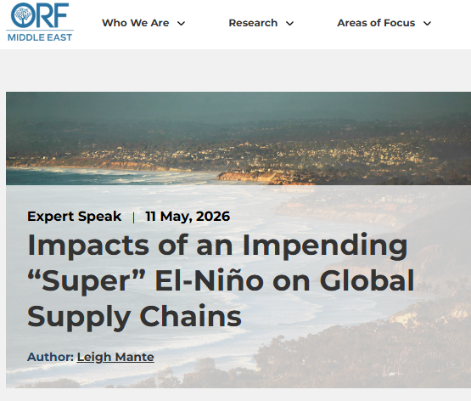
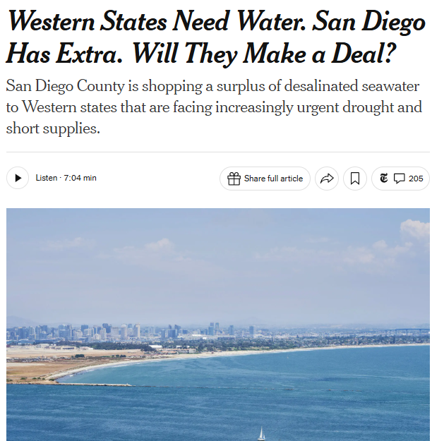
Water is Everywhere: Recent Headlines
Hudson, 2026
Mante, 2026
Dance, 2026
Notes:
Water shows up in many different kinds of news stories, often in ways we may not expect. These headlines are meant to show that water security is not just about drought. It can also relate to technology, supply chains, governance, infrastructure, trade, and other connected systems.
As you look at these examples, think about what they have in common. Even though the topics are different, they all show that water is connected to broader environmental, social, and infrastructure issues.
Facilitators can swap in headlines that are more relevant to their audience, region, or current events.
Note: If you’re not familiar with El Niño, it’s a recurring climate pattern that can change weather and water conditions across regions.

Slide 7
What is Water Security?
“The capacity of a population to safeguard sustainable access to adequate quantities of acceptable quality water for sustaining livelihoods, human well-being, and socio-economic development, for ensuring protection against water-borne pollution and water-related disasters, and for preserving ecosystems in a climate of peace and political stability.”
Working definition, United Nations, 2013
Water Security
Availability
Access
Quality
Stability
Notes:
The United Nations defines water security as [read or summarize the definition on the slide]. There is a lot packed into that definition, so it helps to pause and break it down.
At a basic level, water security means that people need water to live, work, and support their communities. That water also has to be usable and safe, not just physically present. There needs to be enough of it, of good enough quality, and people need access to it in a way that is reliable over time, which is where ideas like availability, access, quality, and stability come in.
Point out the four qualities on the slide:
availability
access
quality
stability

Slide 8
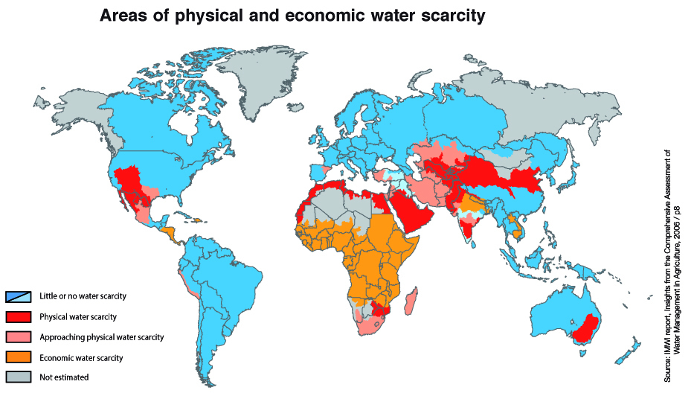
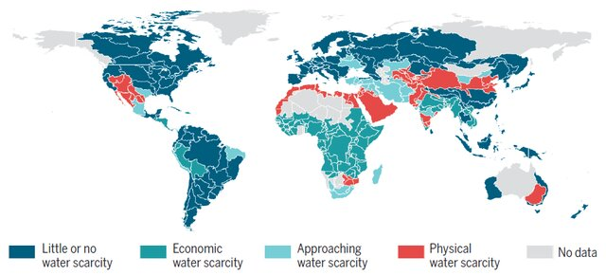
What is Water Scarcity?
Water scarcity occurs when the water available for a given use is less than the amount needed or demanded
There are multiple types of water scarcity (e.g., physical scarcity, economic scarcity) and many places experience more than one type at the same time
Because scarcity affects people, infrastructure, ecosystems, and decision-making, understanding scarcity is a key part of understanding water security
Larabi et. al., 2017
Notes:
A major reason people talk about water security is because of water scarcity. Water scarcity occurs when the water available for a given use is less than the amount needed or demanded. In other words, there is not enough water, or not enough usable water, to meet all needs.
There are also different types of scarcity. Physical scarcity means there is not enough water available in the environment. Economic scarcity means water may exist, but people may not have the infrastructure, resources, or institutions needed to access it. Many places experience more than one type at the same time.
This is why scarcity is such an important part of water security. When there is not enough water, it can affect people, communities, infrastructure, ecosystems, and the choices decision-makers have to make. So while water security is broader than scarcity, understanding scarcity is one of the key ways we understand why water security matters.

Slide 9
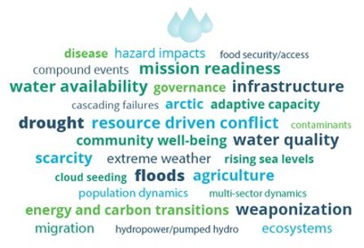
WXS: Water Intersections with Security Framework
A major challenge is understanding all the different factors that shape water security
Water Intersections with Security (WXS) framework helps us think about water security through a systems lens
The framework uses worldviews to create practical boundaries for discussion and implementation
It also helps people from different fields and backgrounds explore possible solutions about water security using a shared approach
UN Definition of Water Security:
“The capacity of a population to safeguard sustainable access to adequate quantities of acceptable quality water for sustaining livelihoods, human well-being, and socio-economic development, for ensuring protection against water-borne pollution and water-related disasters, and for preserving ecosystems in a climate of peace and political stability."
Word cloud responses to the prompt, “What comes to mind when we say water?”
Notes:
Water security is inherently multifaceted because water touches so many systems at once. It connects environmental processes, social and community needs, infrastructure, economics, governance, and politics. That is part of what makes water security both important and difficult to talk about clearly.
The UN definition is a strong starting point because it captures that breadth. But in practice, once we begin discussing water security, the conversation can quickly expand into many overlapping topics, sectors, and perspectives. The word cloud on this slide helps show that broad and sometimes unstructured problem space.
The WXS framework helps organize that complexity into three worldviews: Environmental Resource, Built Infrastructure or infrastructure resilience, and Regional Dynamics. These worldviews create practical boundaries for discussion and implementation without pretending that the categories are completely separate. They also help people from different disciplines and backgrounds communicate more clearly about water security. That is part of what makes WXS especially useful for teaching and learning materials focused on systems understanding.

Slide 10
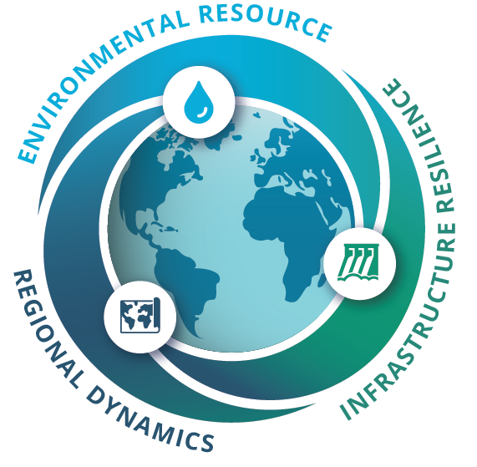
WXS: Three Worldviews
What aspects of the natural system are relevant (precipitation patterns, changing ice floes, animal migration, …)?
How are social dynamics influencing system states (supply chains, tensions between users, adaptation behaviors, …)?
How are the current and planned systems able to meet needs or withstand changing system states (drinking water, energy production, manufacturing, …)?
The key idea is that each worldview highlights something important, but none tells the whole story on its own. Together, they help us think more completely about water security.
Notes:
To understand the WXS framework, it helps to first define what we mean by a worldview. A worldview is a particular philosophy of life or conception of the world. In this context, you can think of it as a way of looking at a problem—what you pay attention to first, what questions you ask, and what you see as most important.
The three WXS worldviews help us look at water security from different angles. One worldview asks about the social dynamics shaping the system, such as supply chains, tensions between users, or how communities adapt. Another focuses on the natural system, asking what environmental conditions matter, such as precipitation, changing snow or ice, ecosystems, or migration patterns. A third asks how our built systems are functioning—whether current or planned infrastructure can meet needs and withstand changing conditions, for example for drinking water, energy production, or manufacturing.
The key idea is that each worldview highlights something important, but none tells the whole story on its own. Together, they help us think more completely about water security.

Slide 11
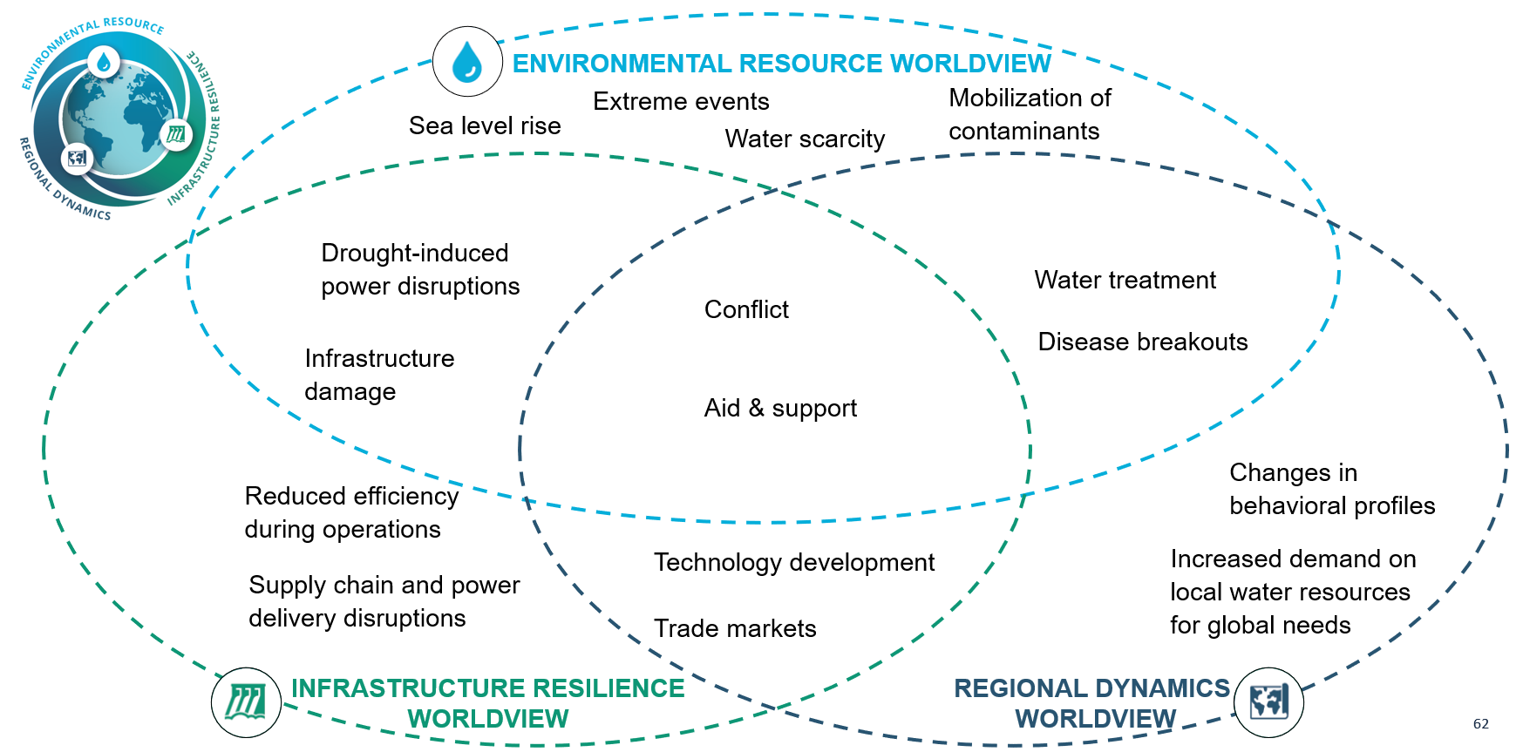
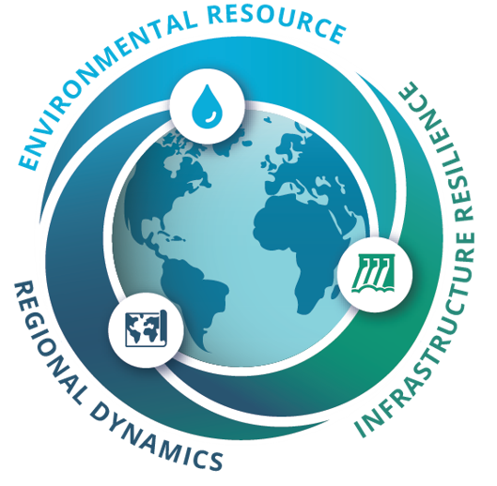
WXS: Example Components
Worldview | Water-Related Priorities
Environmental Resource | Understanding touchpoints to water availability, the surrounding environment, weather, and surface and groundwater hydrology
Infrastructure Resilience | Provisioning of water for drinking, sanitation, and hygiene to supporting critical infrastructure (e.g., energy, food, manufacturing)
Regional Dynamics | Influencing tensions between physical resources and associated broader social capabilities and adaptive capacity
Notes:
This slide gives a more concrete view of what each worldview focuses on. The Environmental Resource worldview is concerned with the water itself and the natural systems around it, including water availability, weather, and surface and groundwater hydrology.
The Infrastructure Resilience worldview focuses on the systems that help provide and use water, from drinking water, sanitation, and hygiene to the infrastructure that supports sectors like energy, food, and manufacturing. The Regional Dynamics worldview looks at the social side of water security, including tensions around resources, community capabilities, and the ability to adapt to changing conditions.
The Venn diagram is a helpful reminder that these are not isolated categories. Many real-world issues sit in the overlaps. For example, conflict, aid, or system disruptions can involve the water resource, infrastructure, and social dynamics all at once. That overlap is exactly why the framework is useful.

Slide 12
Environmental Resource

Slide 13
Environmental Resource
Q2: What words come to mind when you think about water in the environment?
Notes:
Before we get deeper into this first worldview, let’s pause for another quick question: what words come to mind when you think about water in the environment?
This question is meant to narrow our focus a bit from the opening water question. Now we are thinking specifically about water as part of the natural system—for example, rivers, rainfall, snowpack, groundwater, ecosystems, drought, flooding, or water quality.

Slide 14
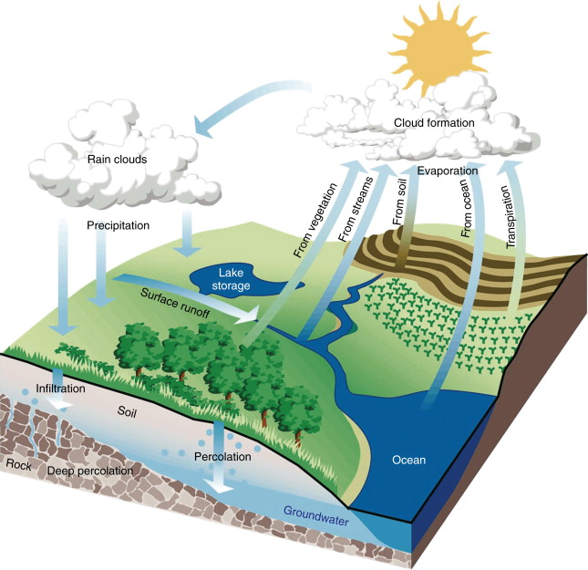
Hydrologic Cycle
Fresh water is a renewable but limited environmental resource
Its availability depends on how it moves through the hydrologic cycle (connects the atmosphere, land, rivers, soils, and aquifers)
Water quantity and quality are shaped by natural processes and human activity
Surface water and groundwater connections matter for long-term supply
Understanding the whole cycle is key to managing water sustainably, including timing, location, and amount
Wilzbach & Cummins, 2008
Notes:
Fresh water is a renewable but limited environmental resource. We mainly say this about fresh water, because even though Earth has a lot of water, not all of it is in a form that people can easily use. Much of the planet’s water is salt water, and even fresh water may be frozen, difficult to access, or not available where and when it is needed.
Fresh water availability depends on how water moves through the hydrologic cycle, which connects the atmosphere, land, rivers, soils, and aquifers. Water is constantly moving, being stored, and changing form across this system. That movement helps determine not only how much water is available, but also when it is available and where it is located.
Water quantity and quality are shaped by both natural processes and human activity. It is also important to remember that surface water and groundwater are connected, and those connections matter for long-term supply. Understanding the whole cycle helps us think more sustainably about water management, especially questions of timing, location, amount, and long-term reliability.
Note: the U.S. Geological Survey has an updated water cycle figure that contains more atmospheric-land-ocean interactions if more detail is desired https://water.usgs.gov/edu/activity-watercyclebegin.html

Slide 15
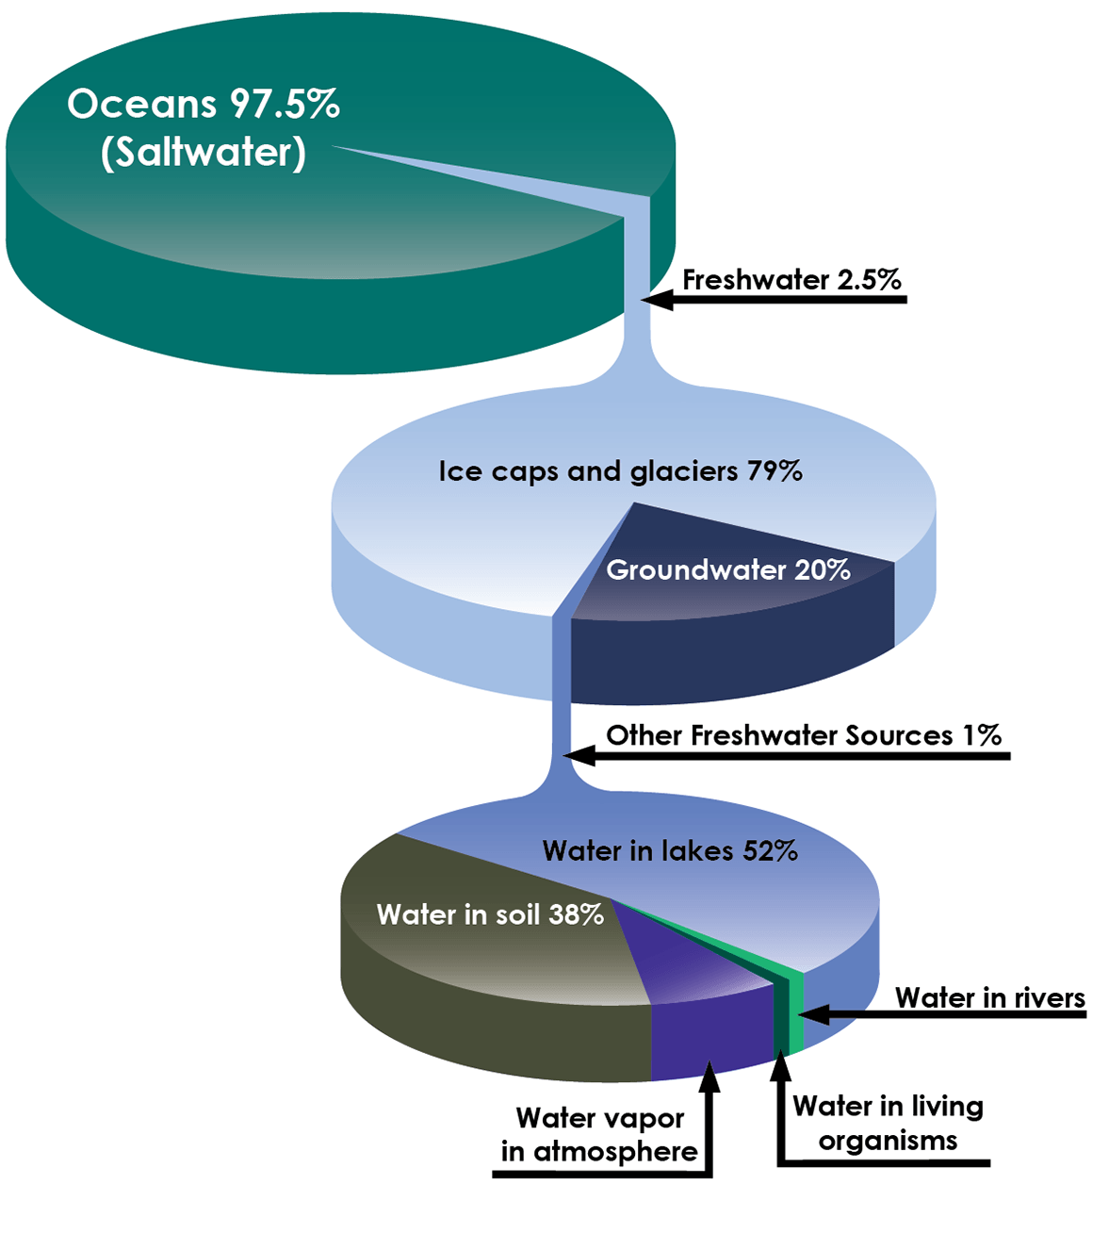
Water Supply
Water supply refers to the water available for human and environmental use
Water supply can come from surface water, groundwater, snowpack, reservoirs, and reclaimed water
The amount of available water changes over time and across locations
Water supply is affected by climate, drought, infrastructure, water quality, and demand
Not all water is equally accessible, usable, or reliable, which is a key part of water security
For example, in New Mexico, water supply is especially limited because of the state’s arid climate, variable river flows, and heavy reliance on both snowpack and groundwater
Seawater and Freshwater Distribution on Earth
PBS
Notes:
Water supply refers to the water available for human and environmental use. That supply can come from a number of sources, including surface water, groundwater, snowpack, reservoirs, and reclaimed water.
One important thing to understand is that water supply is not fixed. The amount of available water changes over time and across locations. It can be affected by climate, drought, infrastructure, water quality, and demand. So when we talk about water supply, we are not just asking how much water exists in total—we are also asking whether that water is available, usable, and reliable when it is needed.
This is a key part of water security: not all water is equally accessible, usable, or dependable. For example, in New Mexico, water supply is especially limited because of the state’s arid climate, variable river flows, and heavy reliance on both snowpack and groundwater. That makes timing, storage, and long-term planning especially important.

Slide 16
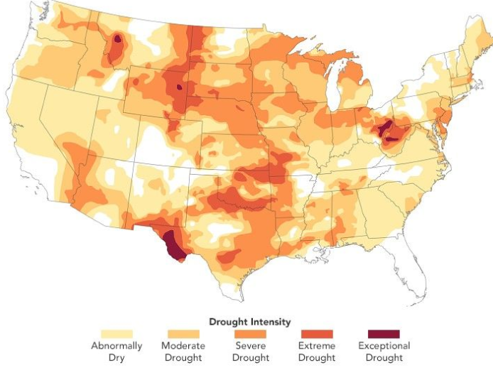
Changing Weather Patterns
Weather patterns affect when, where, and how much water is available
  Changes in temperature and precipitation can alter the timing and amount of runoff
  Warmer temperatures can reduce snowpack, increase evaporation, and dry soils faster
Extreme weather events—both acute and chronic—can stress water systems (e.g., floods, heat, drought, hurricanes)
These changes can make water supply less predictable. For example, when surface water becomes less reliable, communities often rely more on groundwater, which can contribute to long-term depletion.
In October 2024, unusually dry and drought conditions affected more than 78% of the U.S. population—the highest level in the 25-year history of the U.S. Drought Monitor.
NASA, 2024

Slide 17
Built Infrastructure

Slide 18
Built Infrastructure
Q3: What words come to mind when you think about the systems needed to move, store, or treat water?
Notes:
Now we’re shifting from water as part of the natural environment to water as part of the built systems people depend on every day. So here’s our next question: what words come to mind when you think about the systems needed to move, store, or treat water?
You might think of things like pipes, pumps, dams, reservoirs, treatment plants, canals, storage tanks, wells, or wastewater systems. The point here is to start noticing that water does not simply appear where we need it. It depends on infrastructure that collects it, stores it, moves it, treats it, and delivers it.

Slide 19
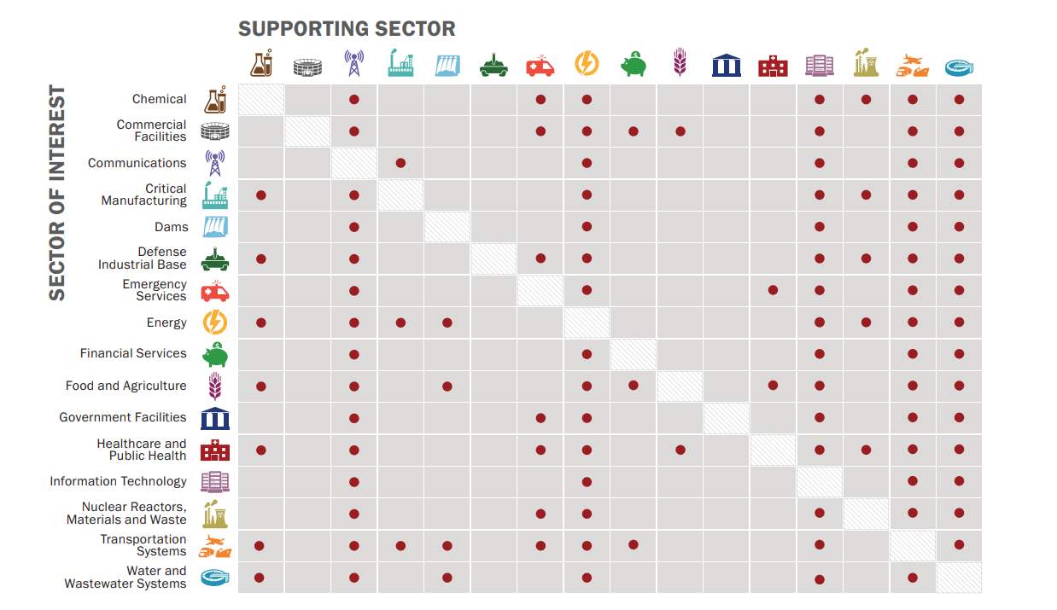
Water & Critical Infrastructure
Water systems are part of a larger network of critical infrastructure
Critical infrastructure includes the systems and services that communities rely on every day
These systems are connected, so a disruption in one area can affect many others
Water supports every critical infrastructure
Water also depends on other infrastructure
Understanding these connections helps us see why water security is also an infrastructure issue
DHS CISA, 2021
Notes:
Water systems are part of a much larger network of critical infrastructure. Critical infrastructure includes the systems and services that communities rely on every day to function, such as energy, transportation, communications, food, and healthcare.
These systems are highly connected, which means a disruption in one area can affect many others. Water is a particularly important example because water and wastewater systems support every other critical infrastructure sector in some way. At the same time, water systems also depend on other infrastructure, such as energy, communications, transportation, and chemical supply chains.
The figure on the right shows the 16 critical infrastructure sectors identified by the Department of Homeland Security. It is organized as a matrix, with one sector on each axis. Each red dot represents a connection between sectors. One thing to notice is that the water and wastewater systems sector is connected to all the others, which helps show why water security is also an infrastructure issue, not just an environmental one.

Slide 20
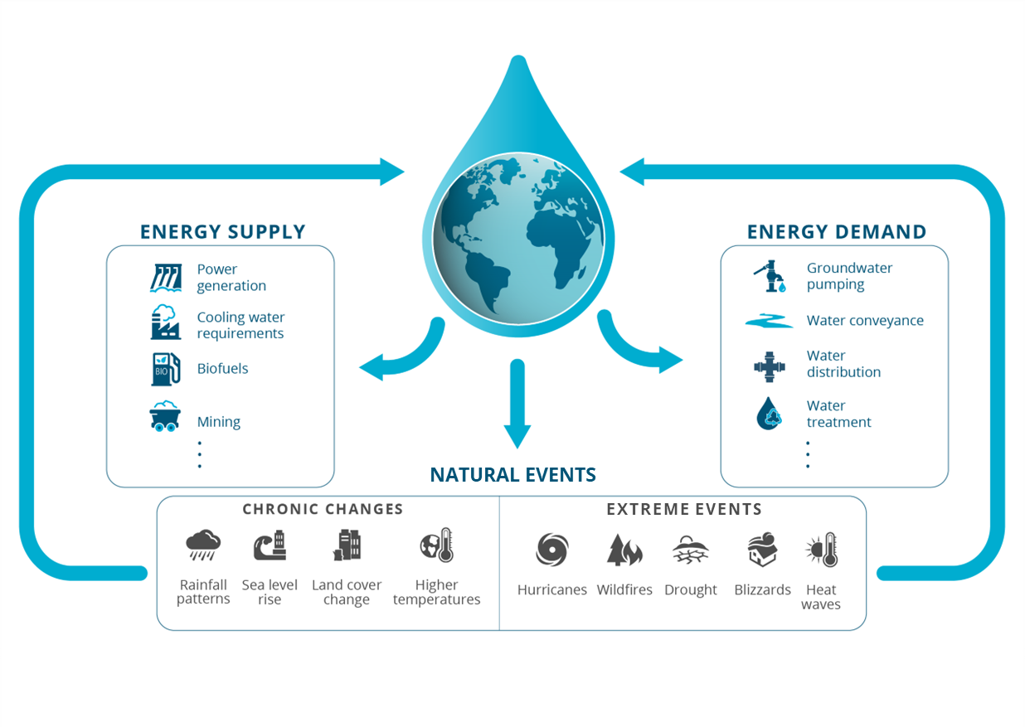
Energy-Water Nexus
Water and energy are deeply interconnected
Water systems rely on energy for collection, pumping, distribution, and treatment
Energy systems rely on water for power generation, cooling, and some fuel production
These interdependencies are influenced by local resource conditions, infrastructure, governance, and market dynamics

Slide 21
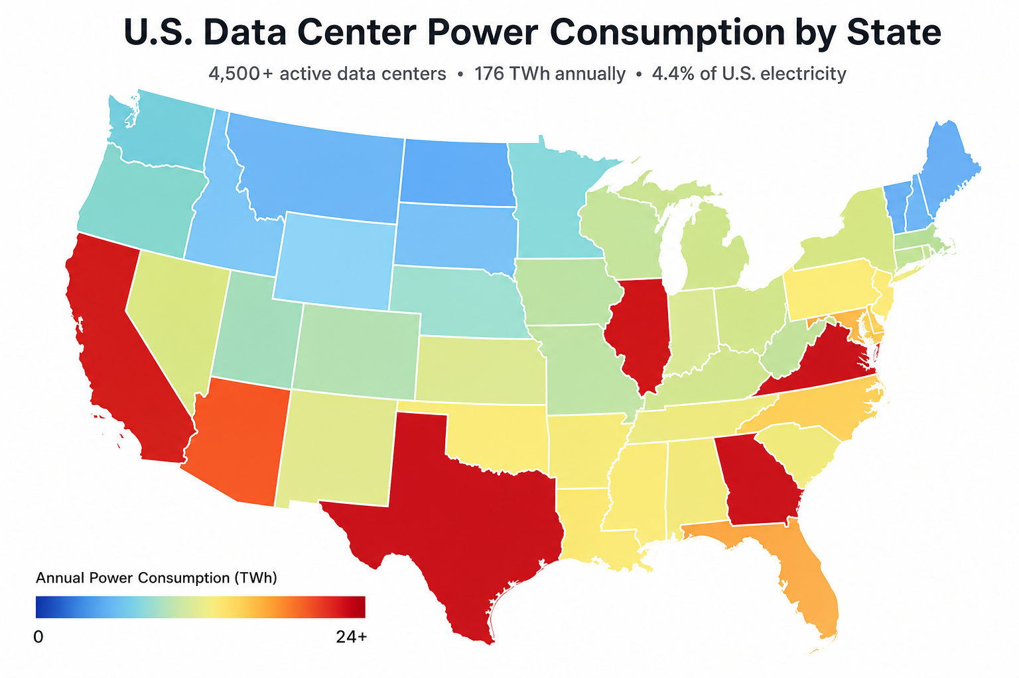
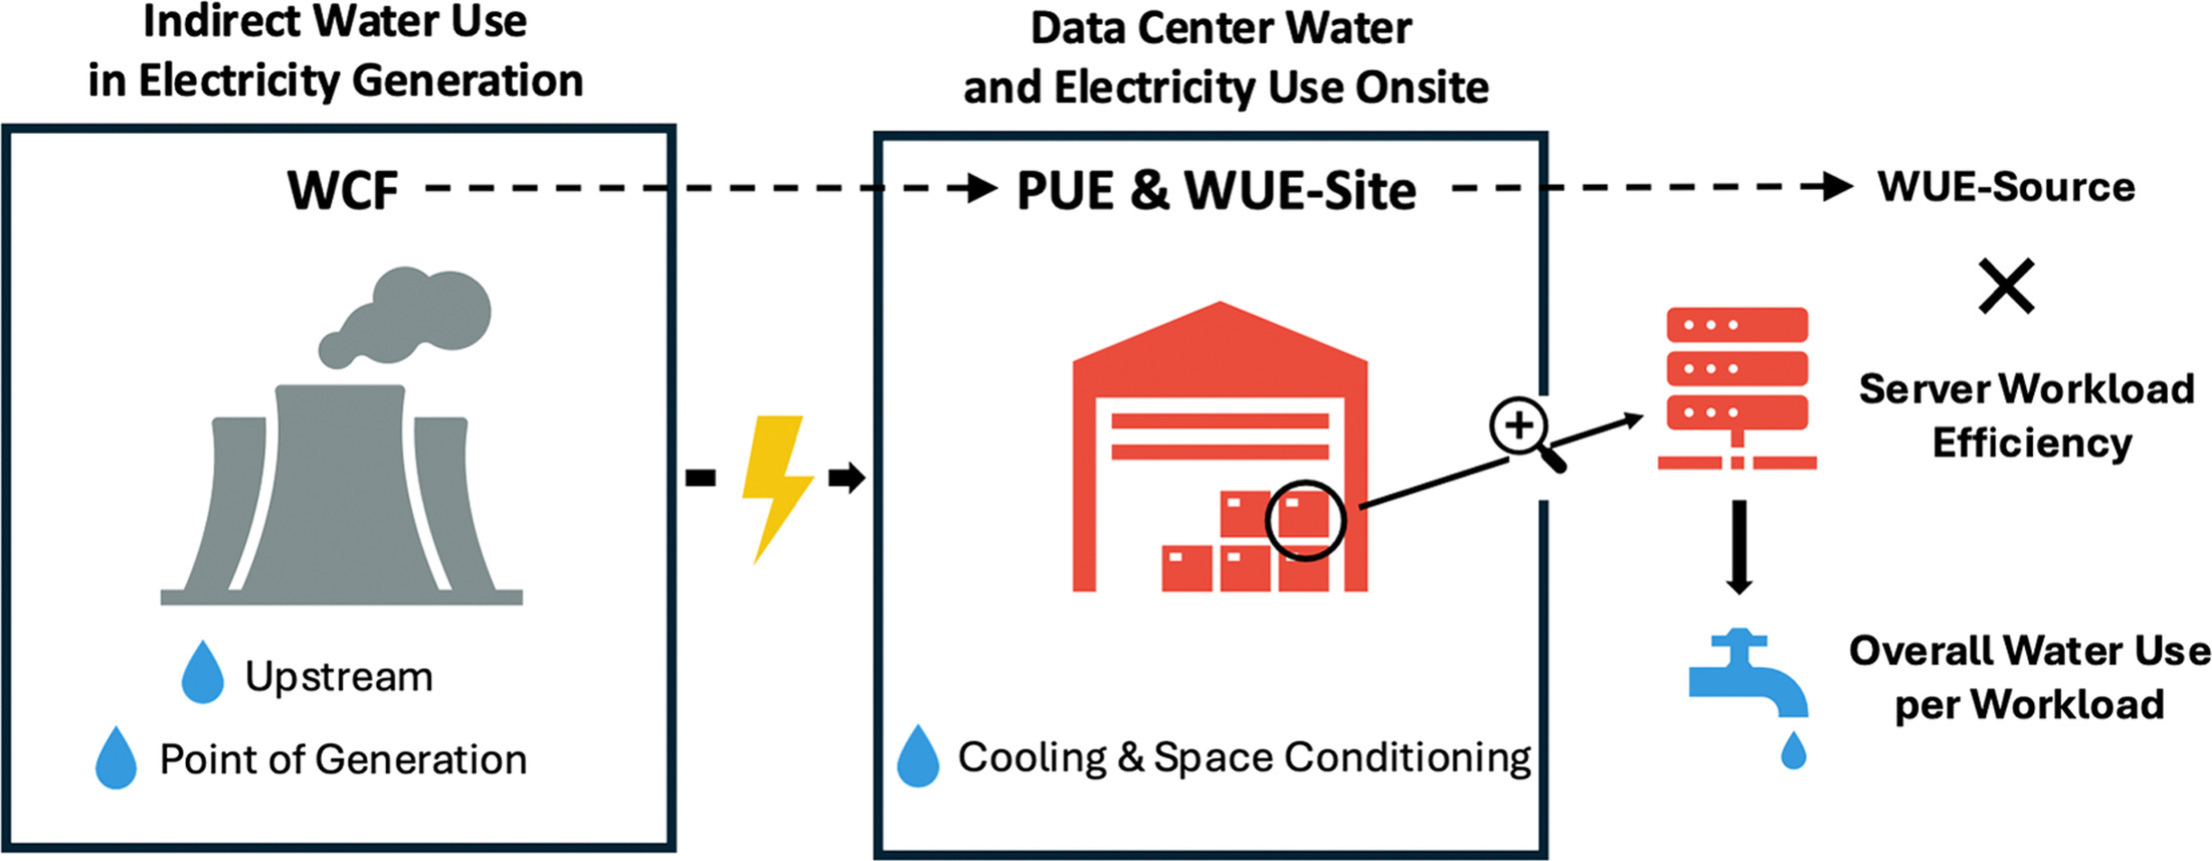
Example: Data Centers
Data centers are part of modern critical infrastructure and support many digital services people use every day
They rely on large amounts of electricity to power servers, storage, and cooling equipment
Water may be used directly for cooling and maintaining facility operations
Water is also used indirectly through the energy systems that supply electricity to data centers
Because of these direct and indirect demands, data centers highlight the interconnected nature of water, energy, and built infrastructure
Electric Choice, 2026
Lei et al., 2025
Notes:
Data centers are a useful example of modern critical infrastructure because they support many of the digital services people use every day, often without us thinking much about them. They store, process, and manage information, and they rely on large amounts of electricity to power servers, storage, and cooling equipment.
They also connect directly to water. Water may be used directly for cooling and maintaining facility operations. Water is also used indirectly because the electricity that powers data centers often depends on water somewhere in the energy system.
That is what makes data centers a helpful example for this section: they show how water, energy, and built infrastructure are closely connected. We will come back to data centers later in a discussion activity, where we’ll use the WXS framework to think through some of these connections more fully.

Slide 22
Regional Dynamics

Slide 23
Regional Dynamics
Q4: What words come to mind when you think about how water affects people and communities?
Notes:
Now we’re shifting to the third worldview: Regional Dynamics, or the human side of water security. So here’s our next question: what words come to mind when you think about how water affects people and communities?
People may think of things like health, farming, conflict, access, cost, culture, jobs, fairness, governance, or community well-being. That range is important because water does not affect everyone in the same way, and different groups may experience the same water issue very differently.

Slide 24
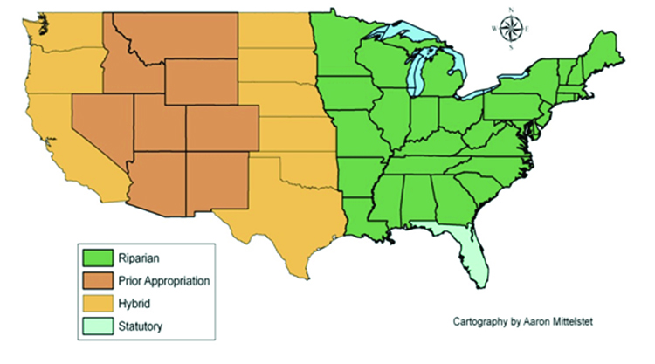
Regional Dynamics
People, communities, institutions, and governments all influence how water is used and managed across sectors and scales
Numerous scales are of interest, including:
  International
  National
  Regional
  Local
Nature of interactions are driven by various factors, including:
  Existing contracts/agreements
  Built infrastructure
  Social capacity and resources
  Market and economic development priorities
  Nature of extreme weather risk
In the United States, legal systems for water rights are managed by the states
Smolen et al., 2017
Notes:
This slide introduces the broader idea behind Regional Dynamics. Water is shaped not only by the resource itself or by infrastructure, but also by people, communities, institutions, and governments. These actors influence how water is used and managed across different sectors and at different scales.
Those scales can include the international, national, regional, and local levels. For example, a water issue may involve local utilities or communities, but it may also be shaped by state laws, federal policy, or interstate and international agreements.
The way these interactions play out depends on many factors. These can include existing contracts or agreements, the built infrastructure already in place, social capacity and available resources, market and economic development priorities, and the nature of extreme weather risk. In other words, regional dynamics help explain why the same physical water challenge may look very different in different places.

Slide 25
Water Rights
Water rights help determine who can use water, when they can use it, and for what purpose
Different regions use different systems for allocating water
Riparian Doctrine
Common in the eastern United States, England, and Wales
Community-based
Some water rights systems are tied to the needs of a community
Prior Appropriation Doctrine
Common in the western United States and Chile
Based on the idea: “First in time, first in right”
People who claimed water earlier usually have priority during shortages
Reflects conditions of water scarcity
Water rights can sometimes be reduced or lost if they are not used
Water use is tied to land next to a water source
Landowners can make reasonable use of the water, as long as it does not unfairly harm others downstream
Reflects regions with more abundant water
For example, water rights in Pueblo New Mexico and Kitchenuhmaykoosib Inninuwug First Nation in Ontario Canada are both connected to long-standing community use and can expand with the needs of the community
These systems may reflect different values and relationships with water than state-based allocation systems
Notes:
Water rights help determine who can use water, when they can use it, and for what purpose. Different regions use different systems for allocating water, which means water rights can look very different depending on where you are.
One of the most important in the western United States is the Prior Appropriation Doctrine. This system is based on the idea “first in time, first in right,” which means people who claimed water earlier usually have priority during shortages. This is where the idea of senior and junior water rights comes in: senior rights are older and usually receive water first, while junior rights are more vulnerable when supplies are low. Prior appropriation reflects conditions of water scarcity, and in some cases rights can be reduced or even lost if they are not used.
A different approach is the Riparian Doctrine, which is more common in the eastern United States, England, and Wales. In this system, water use is tied to land next to a water source. Landowners can make reasonable use of the water as long as they do not unfairly harm others downstream. This system developed in regions where water was generally seen as more abundant.
There are also community-based or culturally grounded water rights systems. For example, Pueblo water rights in New Mexico are connected to long-standing community use and may expand with the needs of the community. These systems can reflect different values and relationships with water than state-based allocation systems.
It is also important to note that surface water and groundwater are not always managed in the same way. In some places, surface water rights are more clearly defined, monitored, or administered than groundwater rights. Groundwater can be harder to measure, track, and regulate, even though it is closely connected to surface water in many systems.
That difference matters because it can shape who has access to water, how shortages are managed, and how well the overall system is understood.

Slide 26
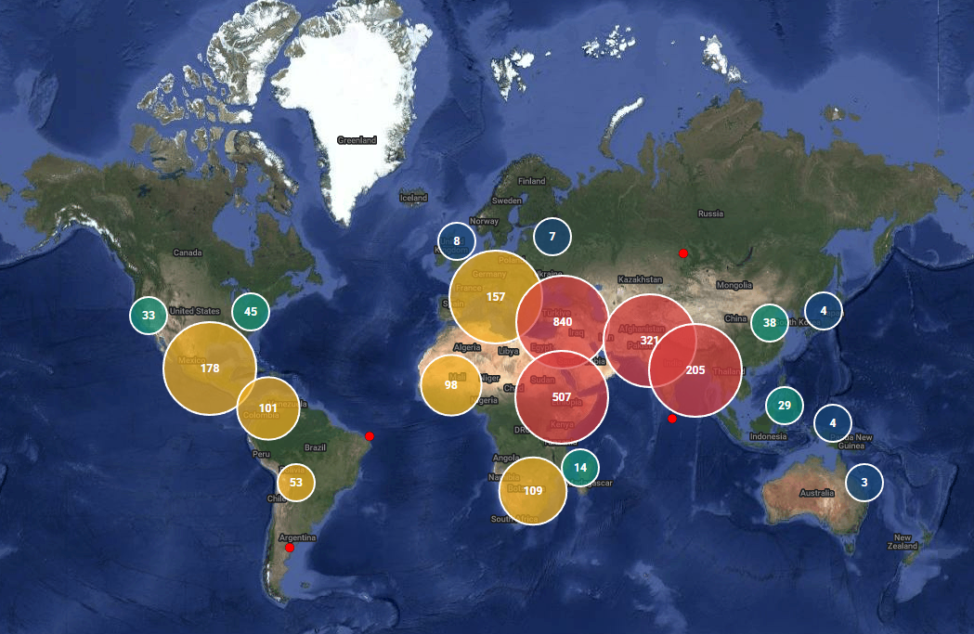
Water Conflicts
Water can play many different roles in conflict and insecurity
As of 2026, over 2,758 water-related conflicts have been catalogued in current databases
  Water may be intentionally or incidentally impacted during conflict
  Water scarcity or access may be part of the root cause of dispute or violence
  Water can also serve as a tool or weapon within conflict
In some cases, long-term water stress can also contribute to migration and displacement
Water conflicts, 3000 BC – 2026 AD
Pacific Institute, 2026
Notes:
Water can play many different roles in conflict and insecurity. It may be part of what people are fighting over, part of what gets damaged during conflict, or part of the larger conditions that increase instability. As of 2026, more than 2,758 water-related conflicts had been catalogued in current databases, which shows just how often water appears in disputes and insecurity.
Water may be intentionally or incidentally impacted during conflict. For example, infrastructure such as dams, pipelines, treatment plants, or irrigation systems may be damaged. Water scarcity or unequal access can also contribute to tensions or violence, especially when people, sectors, or communities are competing over a limited supply.
Water can also serve as a tool or weapon within conflict. That might mean cutting off water access, contaminating water, controlling infrastructure, or using access to water as leverage over another group. Even outside of formal warfare, water can be used strategically in disputes—for example, when upstream control, diversions, or access restrictions put pressure on downstream communities. Long-term water stress can also contribute to migration or displacement when people can no longer support livelihoods, agriculture, or daily life.

Slide 27
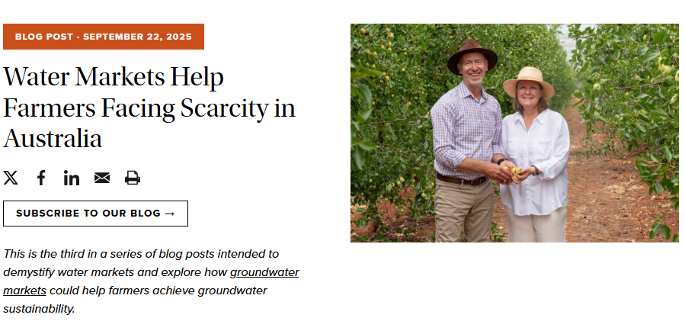
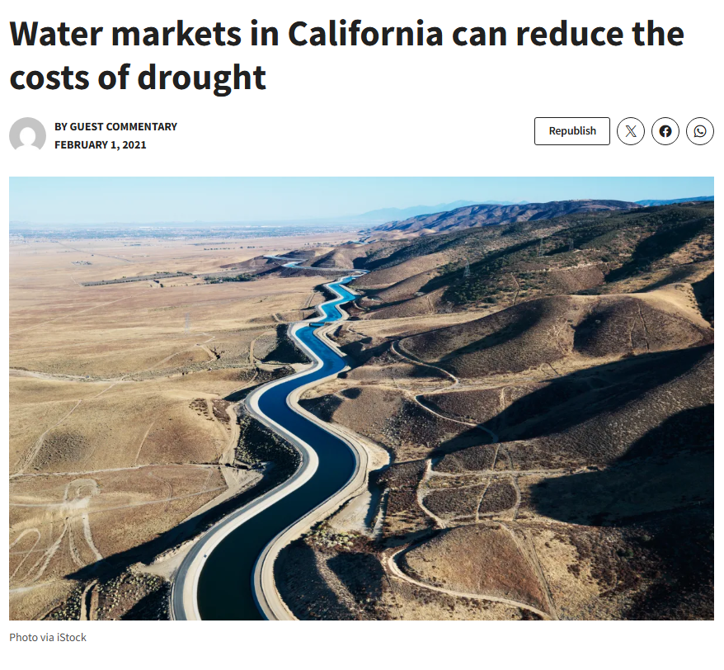
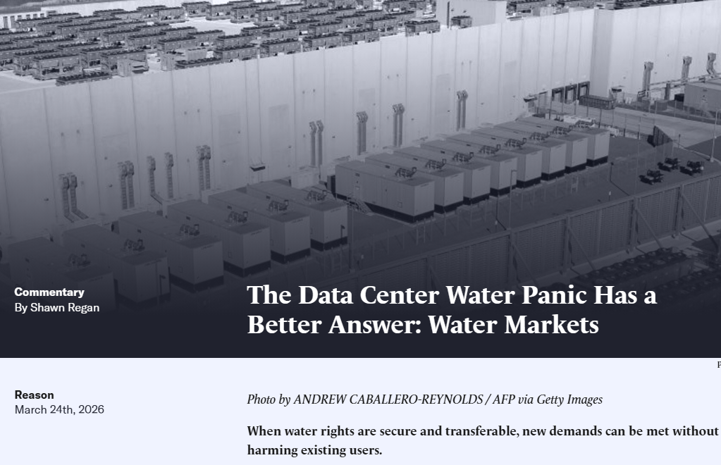
Water Markets
Water markets allow water rights to be bought, sold, or leased
Water market transactions can be temporary or permanent and can range from informal local agreements to more formal state- or regionally managed systems
They can help move water to where it is most needed or most valued
But they can also raise concerns about equity, affordability, and impacts on communities or ecosystems
PPIC, 2025
Cal Matters, 2021
Regan, 2026
Notes:
Water markets are one way that people and institutions manage limited water supplies. They allow water rights to be bought, sold, or leased between users. These transactions can be temporary or permanent, and they can range from informal local agreements to more formal systems managed at the state or regional level.
One reason water markets exist is that they can help move water to where it is most needed or most valued. For example, during drought, a temporary lease might allow water to shift from one use to another in response to changing conditions.
At the same time, water markets can raise important concerns. These include questions about equity, affordability, and impacts on communities or ecosystems. If water moves away from one area or use, that can affect local livelihoods, environmental flows, or who is able to afford access. So water markets are a good example of how economic tools can provide flexibility, but also create tradeoffs.

Slide 28
WXS: Water Security
“The capacity of a population to safeguard sustainable access to adequate quantities of acceptable quality water for sustaining livelihoods, human well-being, and socio-economic development, for ensuring protection against water-borne pollution and water-related disasters, and for preserving ecosystems in a climate of peace and political stability.”
Working definition, United Nations, 201
Environmental Resource
Infrastructure Resilience
Regional Dynamics
Notes:
Now that we’ve walked through the three WXS worldviews, let’s return to the United Nations definition of water security. Earlier, this definition may have felt broad or a little overwhelming. Now we can use the WXS framework to unpack it and see that many of its parts align with the different worldviews we just discussed.
As you look at the highlighted definition, notice that some phrases connect to one worldview, some connect to two, and some connect to all three. That is an important point. The goal is not to force every part of the definition into a single category, but to show how connected these ideas really are. For example, a phrase about water quality may relate to the resource itself, the infrastructure needed to treat or protect it, and the people and communities affected by it.

Slide 29
Interactive Learning Activity

Slide 30
WXS Framework Application: Identify Issues and Solutions
For any given problem, the WXS framework helps us to:
Identify the relevant perspectives and worldviews
Recognize tradeoffs, tensions, and unintended consequences,
01
02
Understand how those perspectives interact across the system
Develop more comprehensive, all-encompassing solutions
03
04
Notes:
Now we’re moving from understanding the WXS framework to applying it. For any given water problem, the framework helps us identify the relevant perspectives and worldviews involved. That means asking: what part of the system are we focusing on, and what other dimensions might also matter?
It also helps us understand how those perspectives interact across the system. In many cases, what looks like a simple issue in one area can create effects somewhere else. WXS helps us recognize those connections, along with tradeoffs, tensions, and possible unintended consequences.
Lastly, this is what makes the framework useful for thinking about solutions. Rather than focusing on only one part of a problem, WXS encourages us to develop more complete responses that consider the water resource, the infrastructure, and the people and institutions involved.

Slide 31
WXS Framework Application: New Mexico Issues
Choose one issue and identify how it touches all three WXS dimensions:
Reflect on:
What is the environment/water resource challenge?
What infrastructure is affected or needed?
What people, institutions, or communities are involved or impacted?
What tradeoffs or solutions do you see?
Water Scarcity
Data Center Growth
Economic Development
Notes:
Now we’re going to practice applying the WXS framework to a few example issues relevant to New Mexico: water scarcity, data center growth, and economic development.
For this activity, the goal is not to come up with one perfect answer. Instead, it is to use the framework to think more broadly about each issue. As you discuss, use these questions to guide your thinking:
1. What is the environment or water resource challenge?
2. What infrastructure is affected or needed?
3. What people, institutions, or communities are involved or impacted?
4. And what tradeoffs or solutions do you see?
The point of this exercise is to show that water challenges are rarely only about hydrology, only about infrastructure, or only about people and policy. The WXS framework helps us see how those dimensions interact.
Take about 10 minutes, or whatever amount of time your facilitator gives you, to talk through one of these issues before we move into the examples. After that, the next several slides will walk through each issue using these same questions and show articles and stories from New Mexico. These examples are meant to make the discussion more concrete, but they can be swapped out for any region or really any water-related issue.
Even if some examples do not explicitly mention water at first (e.g., drought-tolerant trees or a data center building its own energy system) you are encouraged to think a little more broadly and creatively. Ask yourself how water might still be connected through the environment, infrastructure, energy use, community impacts, or long-term resource demands.

Slide 32
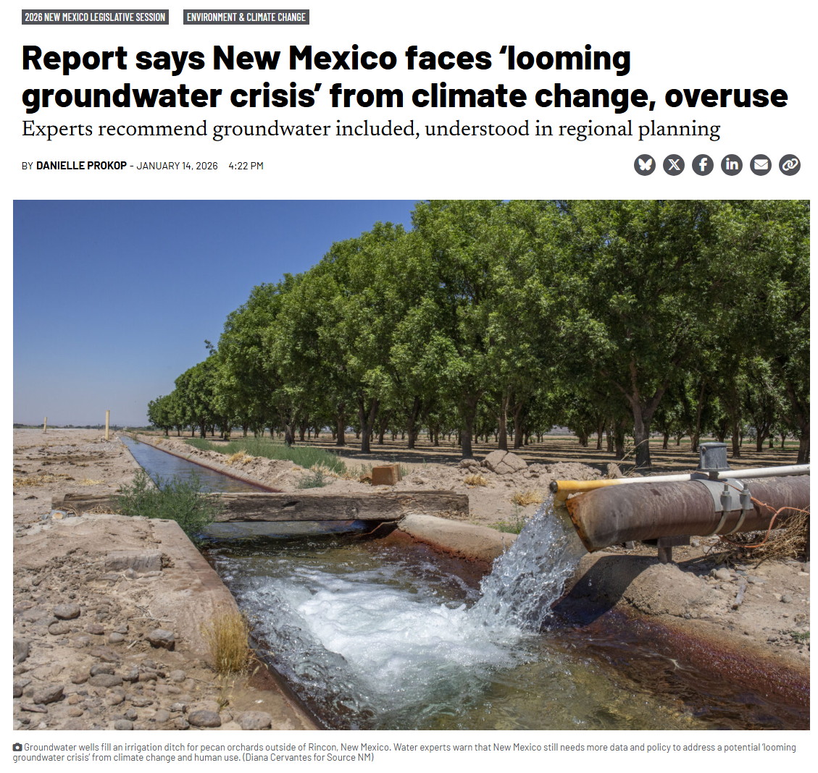
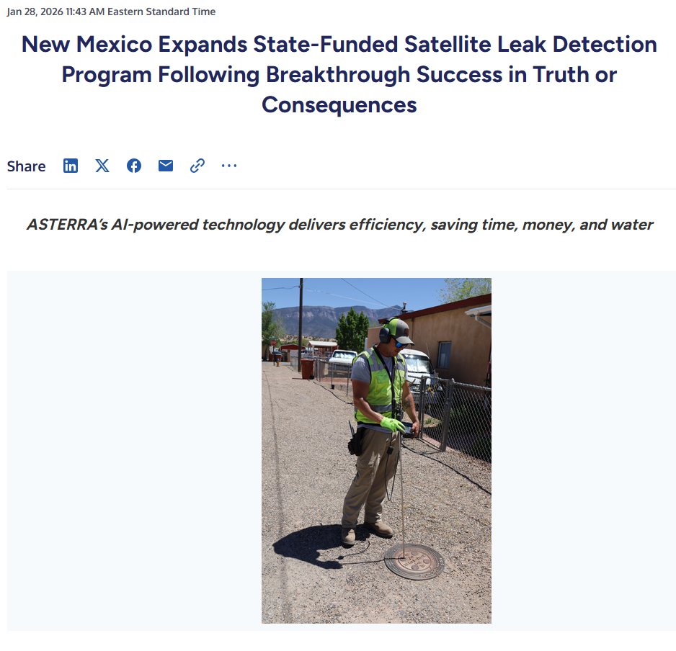
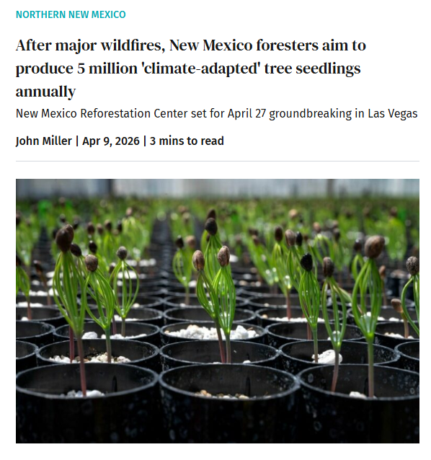
WXS Example: Water Scarcity
Prokop, 2026
Asterra, 2026
Miller, 2026
Regional examples to support discussion — not an exhaustive list

Slide 33
WXS Example: Water Scarcity
Environmental Resource
Built Infrastructure
Lower snowpack in the Upper Rio Grande can reduce runoff and shift peak flows earlier in the year
Extended drought and warming temperatures can reduce streamflow, dry soils, and increase evaporation from reservoirs and fields
When surface water deliveries are reduced, many users turn more heavily to groundwater, increasing stress on aquifers
Reservoir operations (e.g., Elephant Butte and Caballo) can be affected by changing inflows and storage conditions
Irrigation systems, acequias, municipal wells, and treatment systems may all face added pressure during shortage
Communities may look to reuse systems, aquifer storage, leak reduction, or updated delivery infrastructure to improve reliability
Regional Dynamics
Tradeoffs / Solutions
Farmers, cities, tribes, acequia communities, utilities, etc., and downstream users may all be affected
State agencies, interstate agreements, and local governance systems can also shape how scarcity is managed
Communities with fewer financial or technical resources may face greater difficulty adapting to shortages
Increased groundwater pumping can help in the short term, but may reduce long-term aquifer sustainability
Conservation and reuse can stretch supply, but they require investment, planning, and public acceptance
Decisions about how to allocate scarce water may create tension among agricultural production, municipal growth, ecosystem health, and legal requirements
Regional examples to support discussion — not an exhaustive list

Slide 34
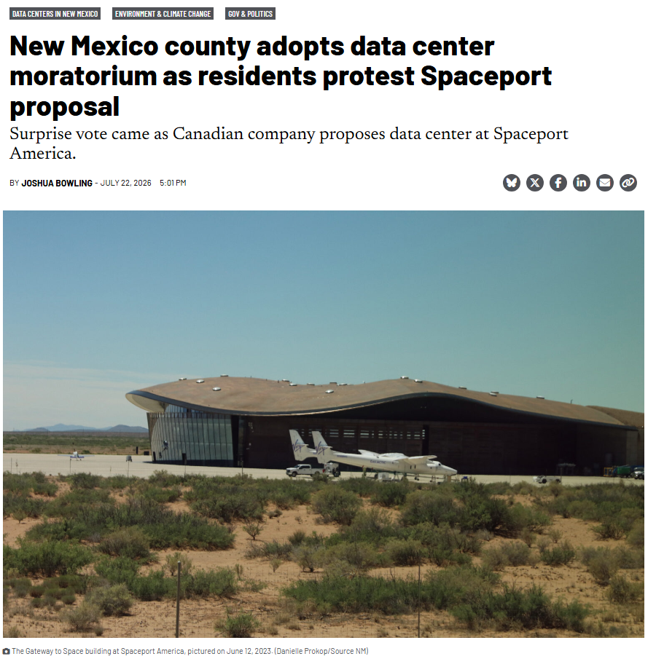
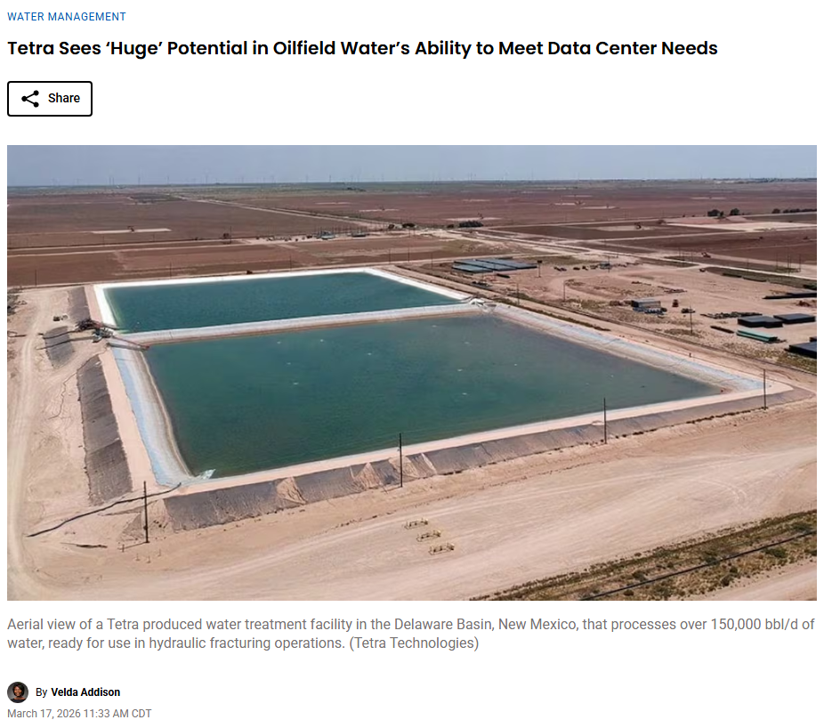
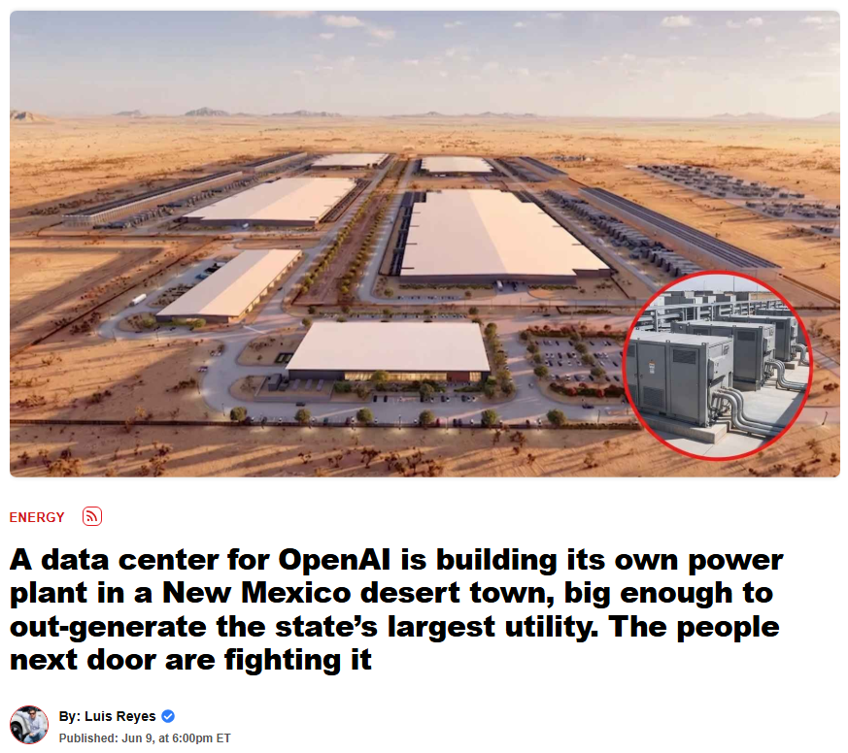
WXS Example: Data Center Growth
Bowling, 2026
Addison, 2026
Reyes, 2026
Regional examples to support discussion — not an exhaustive list

Slide 35
WXS Example: Data Center Growth
Environmental Resource
Built Infrastructure
Data centers can increase local water demand through cooling, especially in arid regions where water is already limited
Fouling of treatment membranes can occur
Their electricity use also creates indirect water demand if the power supply depends on water-intensive generation
In New Mexico, the key question is often whether new demand fits with already stressed supplies
New facilities may require reliable power, cooling systems, water service, and wastewater capacity
Existing utility systems may need upgrades to support large, continuous loads
Some proposed solutions may include water-efficient cooling technologies or use of reclaimed water rather than potable supply
Regional Dynamics
Tradeoffs / Solutions
Local governments, utilities, developers, economic development groups, and nearby communities may all be involved
Residents may ask whether the water and energy use is justified by the local economic benefits
Regulators and planners may need to consider cumulative impacts if multiple projects are proposed in the same region
Data centers may bring jobs, tax revenue, and economic expansion, but they can also increase pressure on water and power systems
Using reclaimed water or more efficient cooling can reduce some impacts, but may require additional infrastructure or cost
What kinds of growth are compatible with long-term water constraints?
Regional examples to support discussion — not an exhaustive list

Slide 36
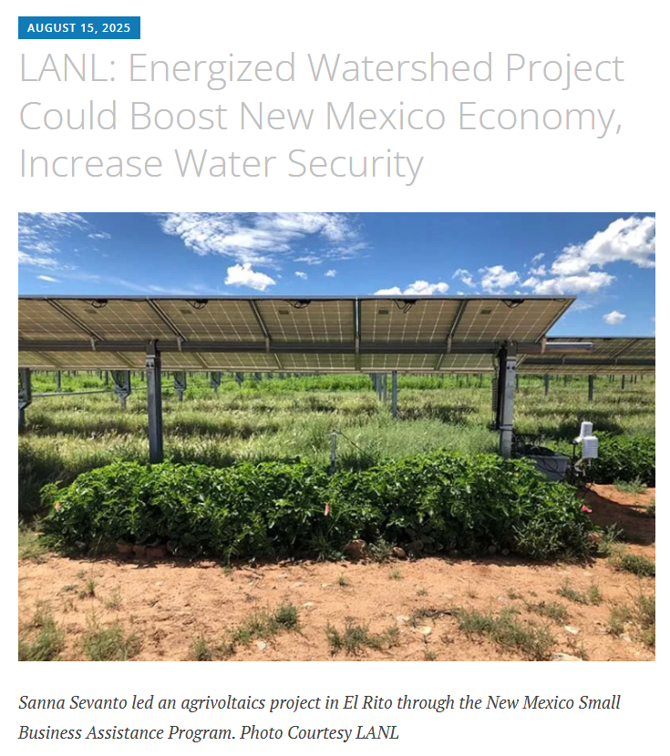
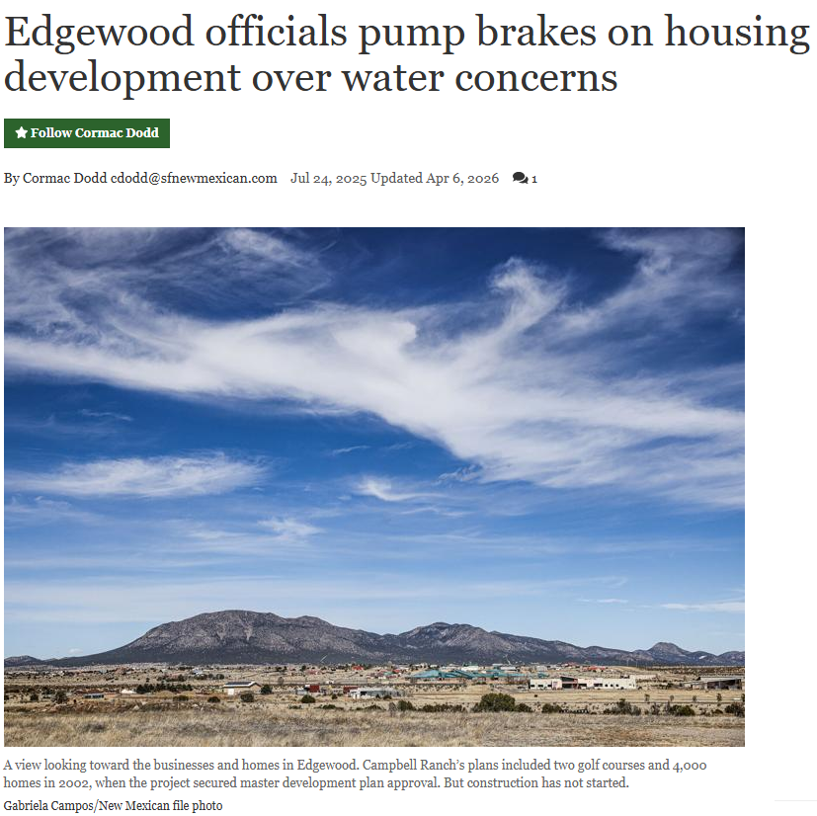
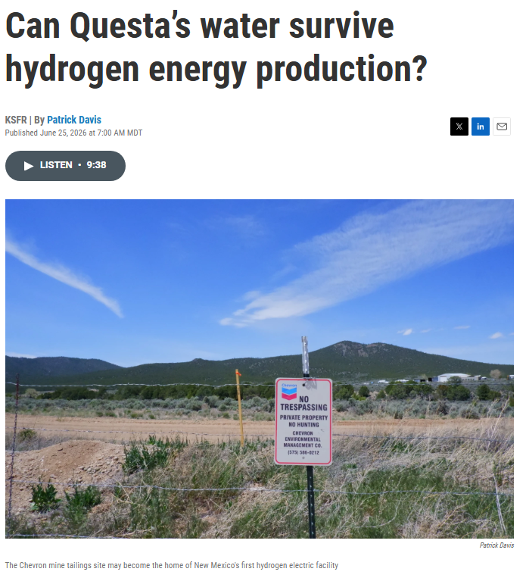
WXS Example: Economic Development
Los Alamos Reporter, 2025
Dodd, 2026
Davis, 2026
Regional examples to support discussion — not an exhaustive list

Slide 37
WXS Example: Economic Development
Environmental Resource
Built Infrastructure
In the Rio Grande Basin, development decisions are shaped by drought, variable river flows, and long-term supply uncertainty
Growth in one area may increase pressure on resources already needed for agriculture, ecosystems, or existing communities
Economic development may require expanded drinking water treatment, wastewater systems, stormwater management, and energy infrastructure
New housing, industrial sites, and commercial growth can strain systems that were built for smaller populations or different land use patterns
Long-term planning may need to consider not only new infrastructure, but also maintenance of existing systems
Regional Dynamics
Tradeoffs / Solutions
City/local governments, utilities, tribal governments, businesses, developers, and residents all have a stake in growth decisions
Some communities may prioritize jobs and tax base, while others may emphasize affordability, environmental protection, or cultural water uses
The effects of development are not always shared equally, especially where water access, cost, or infrastructure quality already vary
Economic development can support jobs and services, but it may also increase demand on limited resources
Better land use planning, water-efficient design, reuse, and early coordination between planners and utilities can help reduce conflicts
Can desired growth match water realities and infrastructure capacity?
Regional examples to support discussion — not an exhaustive list

Slide 38
WXS: Three Worldviews
What aspects of the natural system are relevant (precipitation patterns, changing ice floes, animal migration, …)?
How are social dynamics influencing system states (supply chains, tensions between users, adaptation behaviors, …)?
How are the current and planned systems able to meet needs or withstand changing system states (drinking water, energy production, manufacturing, …)?
The key idea is that each worldview highlights something important, but none tells the whole story on its own. Together, they help us think more completely about water security.
Notes:
Before we close, let’s come back to the main WXS figure. At the beginning, this framework may have looked like a simple set of categories. But after working through the examples, we can now see it more as a way to organize complex water issues and understand how different parts of the system connect

Slide 39
Understanding Water Security Through Three Worldviews
Water security requires more explicit consideration of environmental resources, built infrastructure, and regional dynamics given water’s role in shaping natural processes, human systems, and critical functions across sectors and scales.
Three Worldviews to Advance Understanding
Benefits of a Systems Approach
Connects resources, infrastructure, and community dynamics across scales
Use multiple perspectives to build a more complete understanding of current system conditions
Support more thoughtful solutions by recognizing connections, tradeoffs, and unintended consequences
Why Collaboration Matters
Because water supports many critical functions and depends on other systems, water challenges can create ripple effects across sectors
As a result, understanding and addressing water problems often requires people from different disciplines and backgrounds to work together beyond a single issue or perspective
Notes:
community priorities R&D, workforce development, equity, and community priorities

Slide 40
Thank you for your time!
Any questions can be sent to tgunda@sandia.gov

