Slide 1


Watershed Works:
Every Drop Counts
Facilitating System Understanding of Water Intersections with Security
Overview
Sandia National Laboratories is a multimission laboratory managed and operated by National Technology and Engineering Solutions of Sandia, LLC., a wholly owned subsidiary of Honeywell International, Inc., for the U.S. Department of Energy’s National Nuclear Security Administration under contract DE-NA0003525.

Slide 2
Can you balance watershed health with regional development?
In this game, we are part of a shared watershed
You will:
Use water to build and maintain developments
Earn points from functioning developments
Negotiate with other players under scarcity
Decide when to store water, use groundwater, or let water flow downstream
Protect watershed health while pursuing your own goals
The game applies the Water Intersections with Security (WXS) framework with these three worldviews:
Environmental Resource: water availability, weather, groundwater, watershed health
Built Infrastructure: developments, storage, dams, wells, data centers
Regional Dynamics: prior appropriation, trade, cooperation, conflict

Slide 3
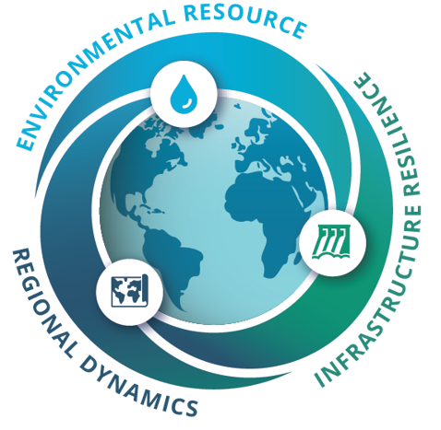
How the game connects to water security
Water security is about more than having enough water for drinking.
During the game, think about:
Availability: How much water enters the watershed?
Access: Who gets water first, and who has to adapt?
Stability: Can the watershed support everyone’s decisions over time?
Quality: Not directly modeled in the base game, but important in real water systems.

Slide 4
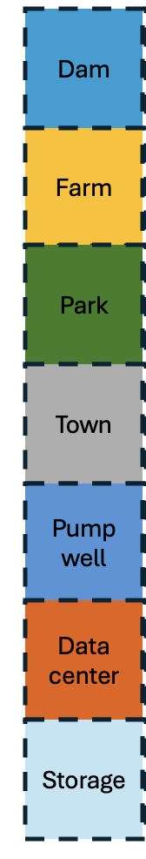
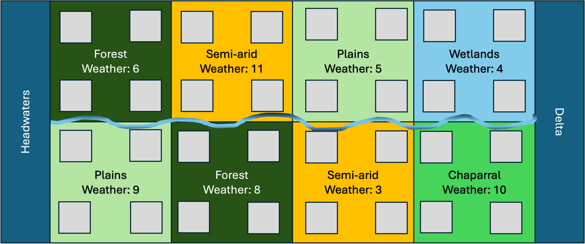
Game Setup
Set the development tokens, the water tokens, and build tokens in separate piles
Shuffle and stack event cards
Each player rolls a die: Highest number goes first
Turn order also determines who gets water first (prior appropriation)
Earlier players get first access to headwater water each round
Example tokens:
Player tokens
Player 1
Player 3
Player 2
Player 4
Development tokens
Water tokens
Water
Water
Board layout & example event card:
GOOD SNOWPACK
Headwaters generate +2 extra water tokens this round.
Upstream weather conditions shape water availability for the whole watershed.
Build tokens
Build
Build

Slide 5
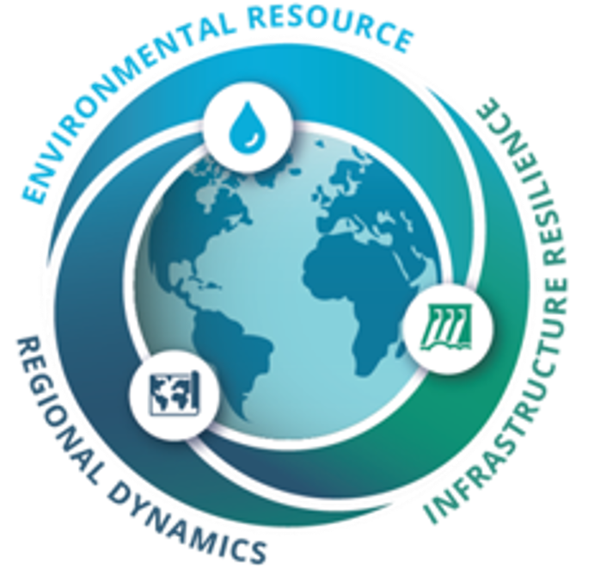
The Board: Tiles and building
Each tile has four spots to build on. Players may place developments on any open spot within a tile they control.
Each player can only build one development per turn!
WXS connection: Environmental conditions shape when and where water is available.

Slide 6
The Board: Ecosystems
Ecosystems are more or less likely to experience rain based on the number on their tile (the weather roll number):
  Tiles have different weather roll numbers
  Statistically speaking, numbers closer to 7 are more likely to receive additional water
  This means some ecosystems receive extra water more often than others
Event cards may affect specific ecosystem tiles differently; for example, a wildfire event may cause forest tiles to burn.

Slide 7
The Board: Who controls what?
Following turn order, each player chooses one tile to control
Then, following reverse turn order, each player chooses a second tile to control
Example:
    Player 1 chooses forest, player 2 chooses forest, Player 3 chooses plains, Player 4 chooses wetlands
    Order reverses,
    Player 4 chooses plains, Player 3 chooses chaparral, Player 2 chooses semi-arid, Player 1 chooses semi-arid
Player 1
Player 2
Player 3
Player 4
Player 4
Player 2
Player 1
Player 3
WXS connection: Position in the watershed affects opportunity, vulnerability, and negotiation

Slide 8
The Round: Overview
Watershed and aquifer health start at 5
Round order:
  Headwaters generate water and players appropriate it
  Roll weather dice
  Draw event card
  Trade, negotiate, build, upkeep, store, pump, or deconstruct
  Calculate points and check watershed/aquifer level
The game ends immediately if watershed health reaches either 0 or 10. If it reaches 0, the watershed collapses and no one wins. If it reaches 10, the watershed is considered highly resilient.
  WXS connection:
  Water allocation is influenced by regional dynamics
  Spatial variability in water influenced by ecosystems
  Different events and negotiations will influence water security

Slide 9
The Round: Generate Water Tokens
Water is not distributed evenly
Each round, the headwaters produce 3 x number of players water tokens
  In turn order, players take as many tokens as they choose from what is available. This reflects prior appropriation: “first in time, first in right”.
  Note: not all tokens need to be taken. Any unstored water leftover flows out of the watershed
This creates:
  Upstream/downstream tensions
  Unequal access
  Need for cooperation
  Potential conflict under scarcity
Water
Water
Water
X number of players
WXS connection: Regional dynamics shape who gets water and how decisions are negotiated

Slide 10
The Round: Weather Rolls
Roll 2 dice to determine which tile (if any) receives water this turn
If the dice total matches a number on a tile, the controller of that tile receives 1 additional water
  Example: If the two dice rolls are 4 and 2, the total is 6. If Player 1 controls a tile numbered 6, Player 1 receives 1 additional water token this round.
Weather rolls represent variability in water availability.
In real systems, weather patterns affect runoff, drought, recharge, and long-term supply reliability
Player 1
+
Water
WXS connection: Weather variability in different ecosystems affects water availability

Slide 11
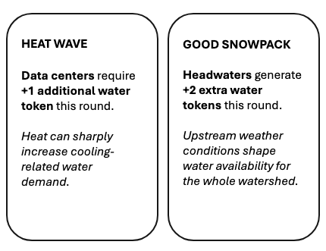
The Round: Event Cards
Event cards have a variety of advantageous and challenging effects
Some can be minor effects, and some can be major!
Event cards represent uncertainty and disruption
They may affect environmental resources, infrastructure demands, or regional decision-making
For example:

Slide 12
The Round: Building Upkeep
 | Build | Upkeep | Output | Build slots | Deconstruct | Special
Farm | 1 water token | 1 water token | 1 point | 1 slot | 2 water tokens
Town | 1 water token | 1 water token | 1 build token | 1 slot | 2 water tokens
Data Center | 1 build token + 3 water tokens | 3 water tokens | 4 points | 2 slots | 1 build token
Dam | 2 build tokens + 2 water tokens | 2 water tokens | 2 points | 2 slots | 4 build tokens + 4 water tokens | Stores up to 3 water tokens
Pump well | 1 build + 1 water | 0 water | Access to 1 aquifer water | 1 slot | 1 water tokens | Aquifer must have water
Park | 1 water token | 1 water token | 2 points | 3 slots | Cannot be Deconstructed
Storage | 1 water token | 0 water token | 0 points | 1 slot | No cost to deconstruct | Allows 1 water to be stored until needed
Each development requires water to function
Use water tokens to meet upkeep needs
If upkeep is not met:
  That development does not provide points or outputs this round
  Watershed health declines
WXS connection: Infrastructure can provide benefits, but it also creates ongoing water demand.

Slide 13
The Round: Trade, negotiation, planning, building
Players may trade:
  Water tokens
  Build tokens
  Points
  Future agreements
Suggested time limit: 2 minutes
Use this time to:
  Meet upkeeps
  Build one development or deconstruct developments
  Store water or use groundwater if you have a pump well
  Negotiate shared strategies
Negotiation examples:
“I’ll give you 1 water now for 1 build token.”
“I’ll help you this round if you pass water downstream next round.”
“I’ll store water for the group if others help me build storage.”
WXS connection: Cooperation toward shared goals is important for water security, but environmental conditions can place pressure on negotiations and decision-making

Slide 14
The Round: Calculate Points
Each player: Count points from developments whose upkeep was met
As a group:
  If any upkeep was not met, reduce watershed health by 1
  If all upkeeps were met and at least 1 unused water token flowed out of the watershed, increase watershed health by 1
  Watershed health can range from 0 to 10
A scoresheet is provided for keeping track of points
Round | Start | 1 | 2 | 3 | 4 | 5 | 6 | 7 | 8 | 9
Watershed Health | 5
Aquifer Level | 5
Player 1 | 0
Player 2 | 0
Player 3 | 0
Player 4 | 0
WXS connection: Water security depends on long-term system stability, not only individual success

Slide 15
The End of the Game & Game Debrief
The game ends when one of three conditions is met:
  Watershed health reaches 0: The watershed is degraded and no one wins
  Watershed health reaches 10: The watershed is being used in a way that supports development without overuse. The highest-scoring player(s) win
  The facilitator determines that time is up
After the game, reflect on:
  How did you use water?
  Who had access to water?
  What infrastructure choices shaped outcomes?
  Did cooperation improve watershed health?
Additional questions are available in the Facilitator Guide

