Slide 1
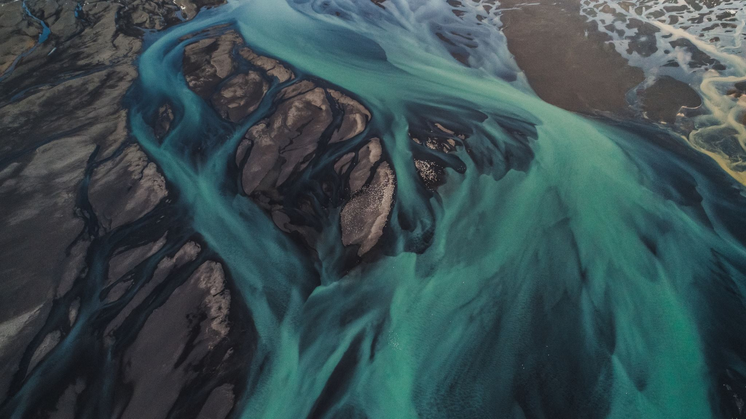
How to Destroy an Estuary
A Practical, Evidence-Based Guide

Slide 2
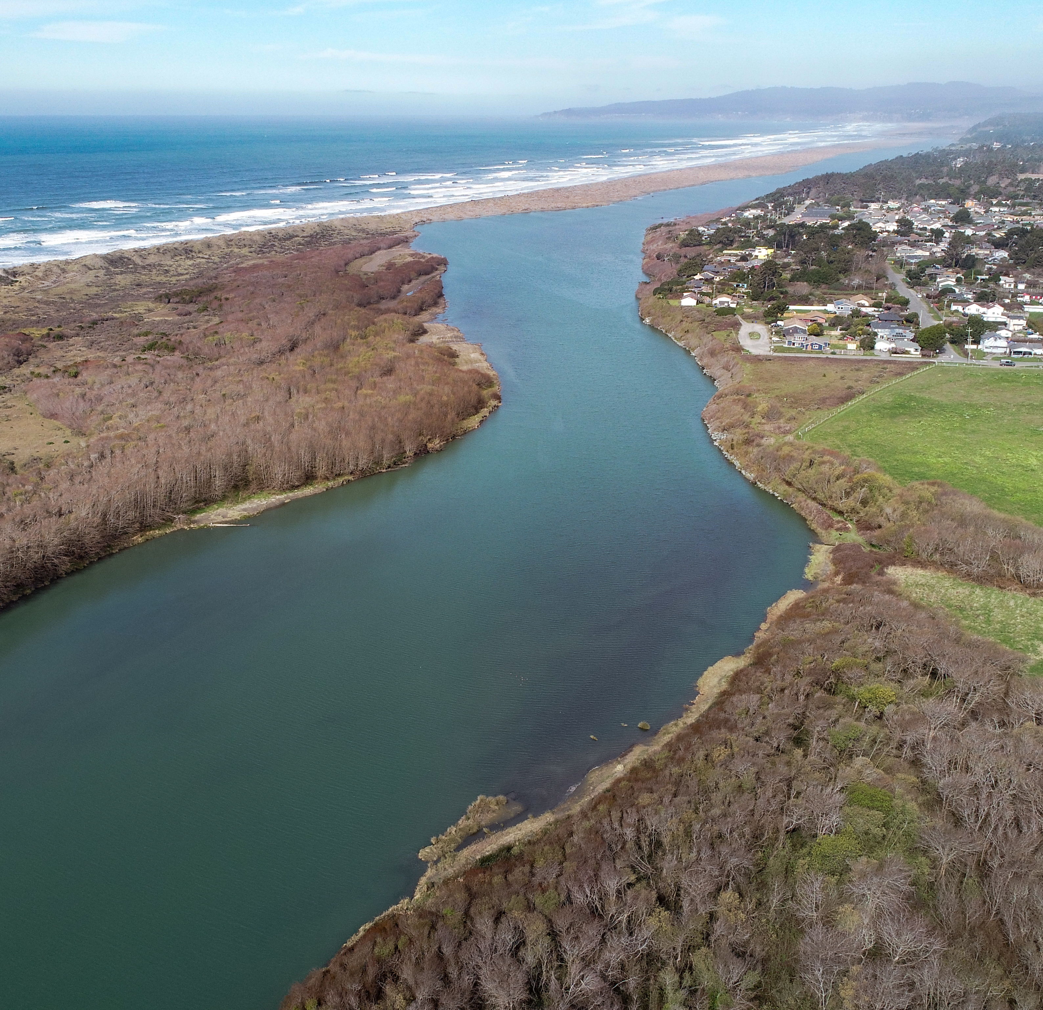
What is an Estuary?
A semi-enclosed coastal body of water where freshwater from rivers mixes with saltwater from the ocean, forming a dynamic gradient of salinity, sediment, and nutrients.
Estuaries are ecotones – boundary ecosystems
Notes:
ecotones are some of the most productive ecosystems on earth

Slide 3
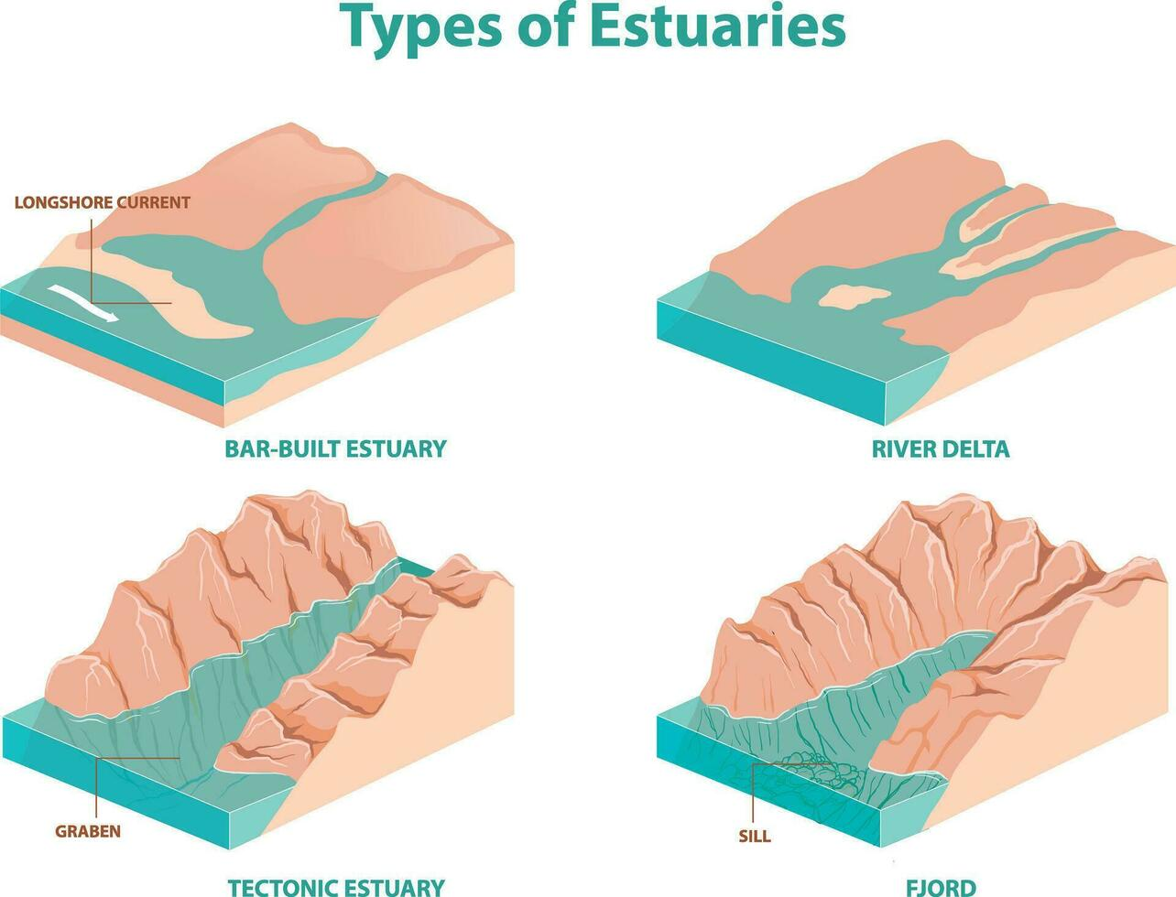
Notes:
Formation processes:
Drowned river valleys (coastal plain estuaries): e.g., Chesapeake Bay — formed ~8,000 years ago as sea level rose after the last glacial maximum, flooding the Susquehanna River valley.
Bar-built estuaries: e.g., Outer Banks lagoons.
Tectonic estuaries: e.g., San Francisco Bay (fault downwarping).
Fjords: glacially carved estuaries (e.g., in Norway, Alaska).

Slide 4
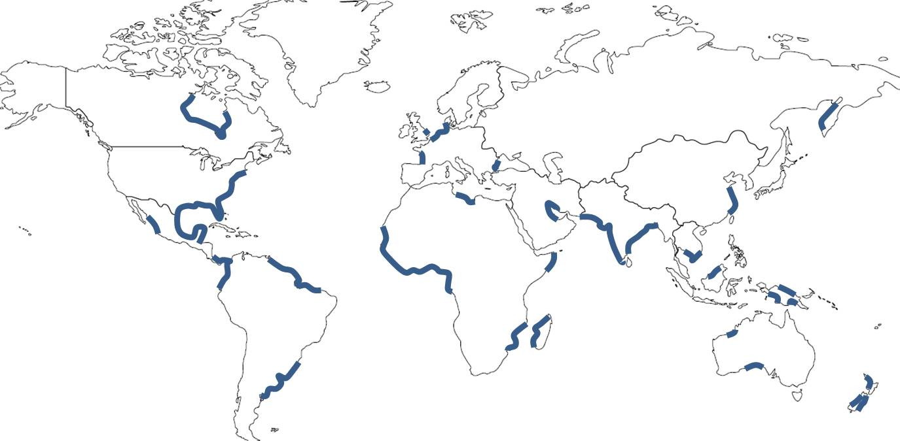
Global Distribution of Estuaries
Notes:
less common on active margins (isolated, destroyed quickly)

Slide 5
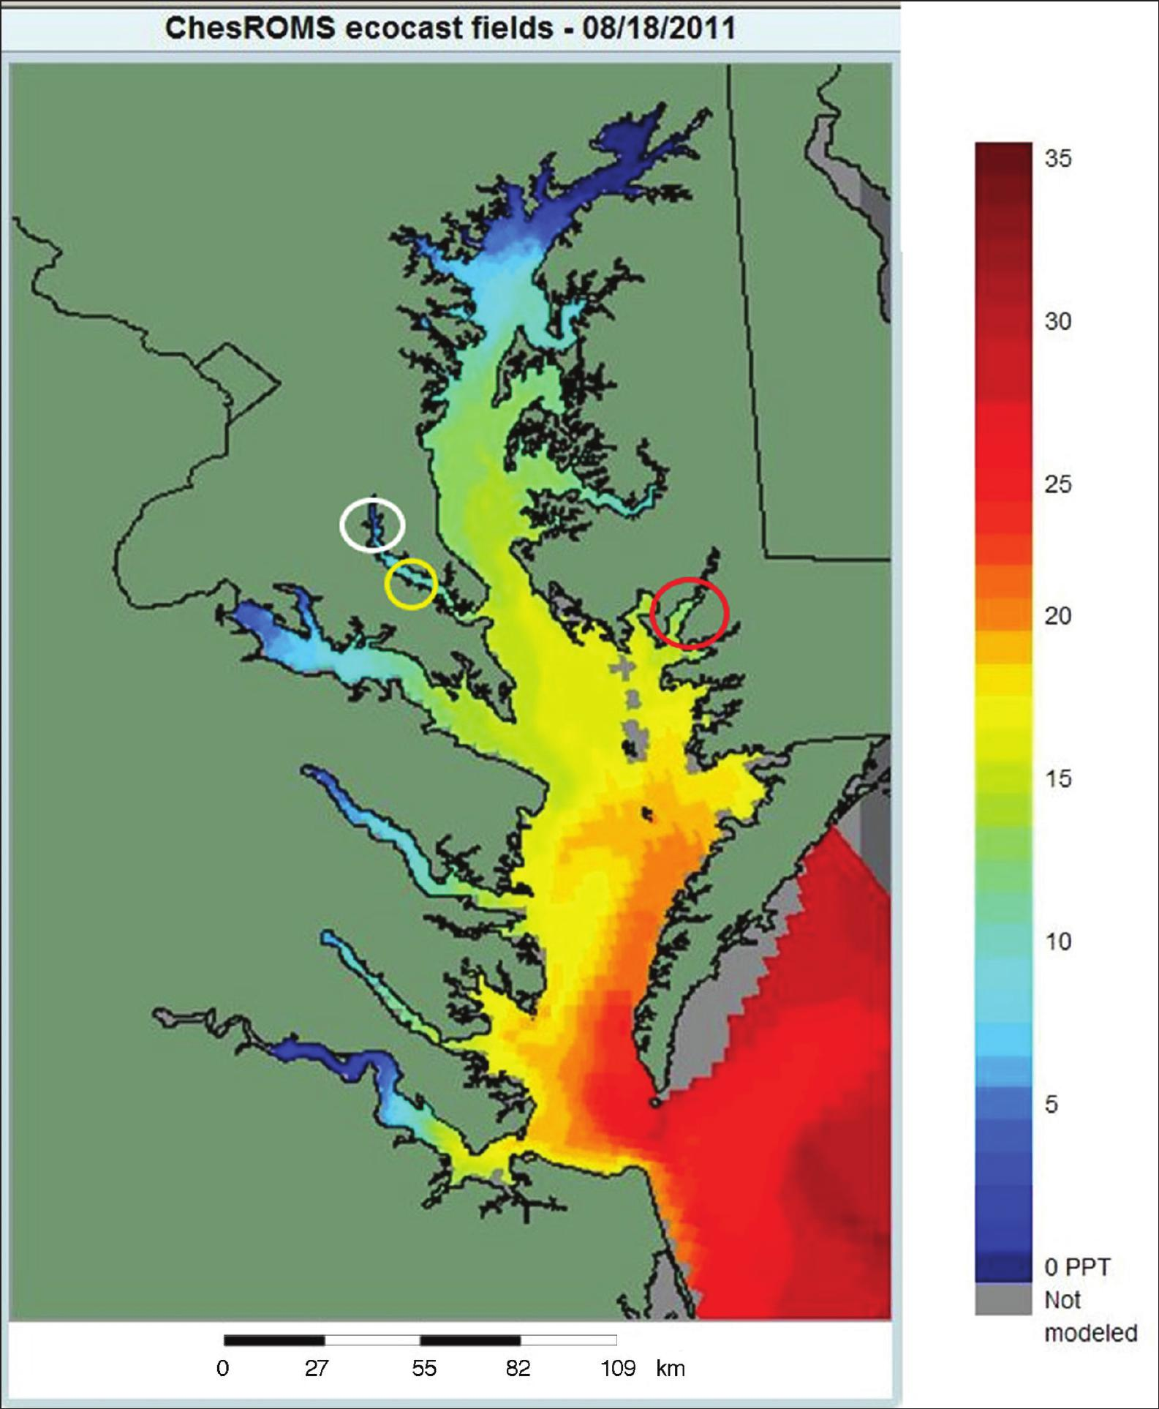
Physical and Chemical Gradients
Notes:
Estuaries are highly variable in salinity, temperature, oxygen, and turbidity — both spatially and temporally.
Key features:
Salinity gradient: river mouth (fresh) → ocean (salt).
Stratification: layering of freshwater over denser seawater (salt wedge).
Sediment and nutrient trapping: leads to high productivity.
These gradients structure habitat zones (mudflats, seagrass, saltmarsh, open channel).

Slide 6
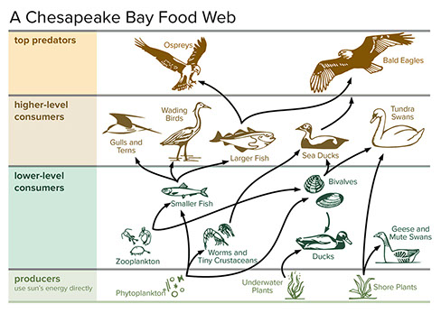
Biological Communities and Trophic Interactions
Notes:
Taxa represented:
Primary producers: phytoplankton, seagrasses (Zostera), saltmarsh plants (Spartina, Juncus).
Invertebrates: oysters, mussels, crabs, polychaetes, benthic filter feeders.
Fish: estuarine residents (killifish, gobies), transients (menhaden, striped bass).
Reptiles: terrapins, sea turtles.
Birds: shorebirds, ospreys, herons, migratory waterfowl.
Mammals: dolphins, whales seasonally, otters.
Emphasize trophic connectivity — energy transfer between benthic and pelagic systems, and between estuary and open ocean.

Slide 7
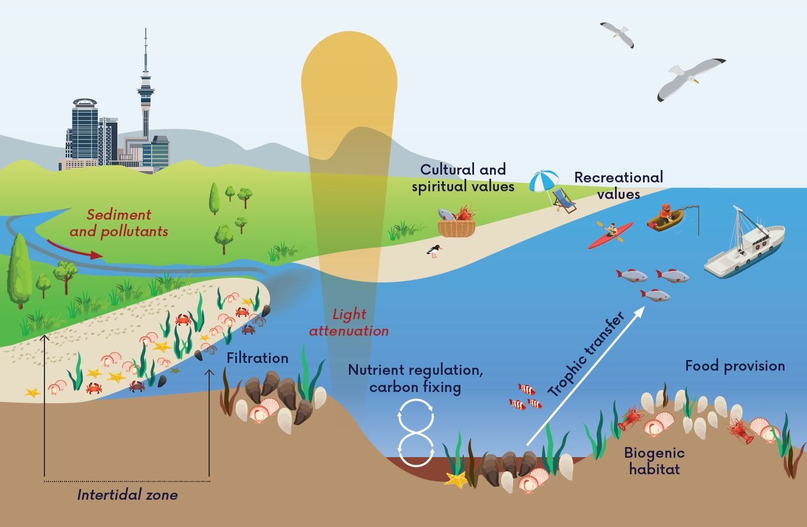
Ecosystem Services
Notes:
Ecosystem Services
High primary and secondary productivity — estuaries serve as nurseries for many marine species.
Ecosystem services:
Nutrient cycling, filtration (e.g., oysters).
Carbon storage in saltmarsh and seagrass.
Coastal protection from storm surge.
Support for fisheries and bird migration.
Tie to Chesapeake Bay: historically supported vast oyster reefs that filtered entire bay volumes in days.

Slide 8
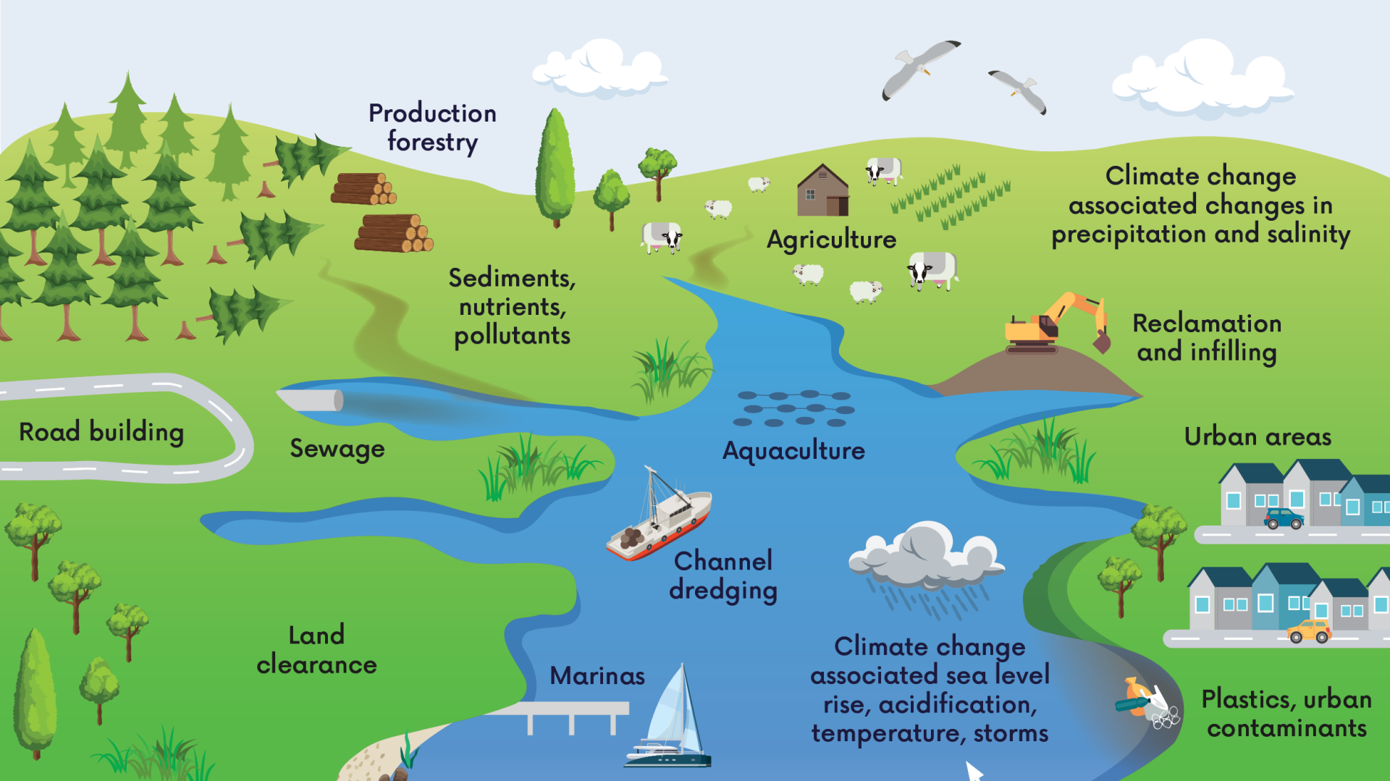
Notes:
Vulnerabilities and Human Impacts
Natural stressors: storms, variable salinity, sedimentation.
Anthropogenic threats:
Nutrient loading → eutrophication, hypoxia.
Sediment input from deforestation/agriculture.
Overfishing → trophic imbalance.
Coastal development → wetland loss.
Pollution and contaminants (e.g., heavy metals, plastics).
Climate change → sea level rise, warming, altered salinity.
Key idea: Estuaries are naturally dynamic but vulnerable to cumulative and synergistic human stressors.
Transition: We’re about to trace 10,000 years of change in the Chesapeake Bay. You’ll see how each human action reshapes not just one species, but the entire estuarine network

