Slide 1
Metacognition

Slide 2
The Learning Process
F. Bartlett, Remembering (1932)
  Demonstrated (re)constructive nature of memory
  established concept of cognitive schema
Bartlett’s studies showed how (and when) people incorporate new knowledge into a previously formed cognitive schema—more importantly for us why and when people don’t incorporate new knowledge
Fast forward ~20 years Benjamin Bloom publishes Taxonomy of Educational Objectives: The Classification of Educational Goals
  Blooms Taxonomy

Slide 3
The Learning Process
Affective
Cognitive
Psychomotor
Why learning occurs
How learning occurs
How physical development occurs
The manner in which we deal with things emotionally.
The development of knowledge and intellectual skills
Higher order
Characterization
Organization
Valuing
Responding
Receiving
(Krathwohl)
Evaluation
Synthesis
Analysis
Application
Comprehension
Knowledge
(Bloom)
Lower order

Slide 4
Encouraging Cognitive Development
Novice
Expert
Affect
Why learning occurs
Novice Learner:
No plan (or poor plan) for studying,
Uses limited methods;
Poor recognition of her learning goals;
Often disappointed with the results but doesn’t know how to change things
Expert Learner:
Sets goals; plans studying with logistical constraints in mind;
Identifies and uses strengths;
Makes adjustments as needed; Usually happy with results, or adjusts
Motivation
Interest
Emotion
Value
Self-regulation
Metacognition

Slide 5
Metacognition
Thinking about thinking
Learning about how people learn
Developing an awareness of one’s own learning process
  Monitoring and assessing one’s own learning
  Making adjustments to one’s learning process
  Managing one’s motivation and attitudes
Notes:
First step: make sure we all have a similar understanding of the term “metacognition”
Metacognition in the most general sense is “thinking about thinking”. But we use this term to encompass several different things. (5 bullets) We cannot cover strategies for all of these things today, so let me tell you what we are going to focus on and what we are going to set aside for the time being

Slide 6
Metacognition
Thinking about thinking
Appealing to the Affective Domain
Motivation- student believes they can succeed
Interest- a predisposition to engage with material (personal = triggered by personal experience or situational = triggered by novelty/competition)
Emotional connection –material address social goals or values
Value - the topic is related to their own lives and/or interests?
Self-regulation -monitoring and reflecting on one's learning strategies and their effectiveness and adjusting accordingly

Slide 7
Applying this to your classrooms
Students come in to our classes with preconceptions (their cognitive schema), not blank slates
Students must have the opportunity to develop a conceptual framework that facilitates retrieval, modifies preconceptions, and builds on deep knowledge.
A metacognitive approach helps students monitor their own learning and become better learners
Promising practices:
  Developing (and using) learning outcomes
  Engaging students in activities during class, in groups
  Organizing content in scenarios, with context—adjusting cognitive schemas
  Getting and giving feedback through formative assessment

Slide 8
Students Who Dramatically Improved
The first exam is never an indicator of your success. All others are.
            Exam 1 Exam 2
Student 1 41 81
Student 2 58 78
Student 3 62 91
Student 4 48 83

Slide 9
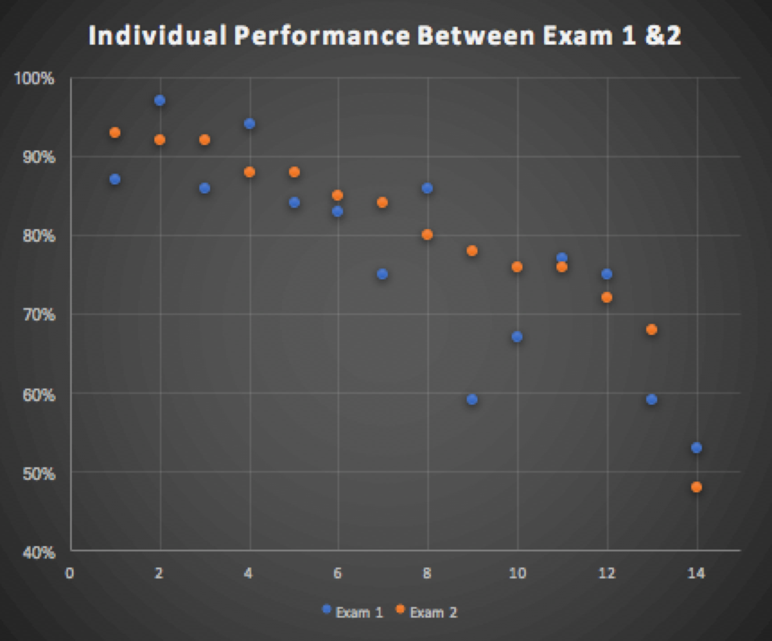
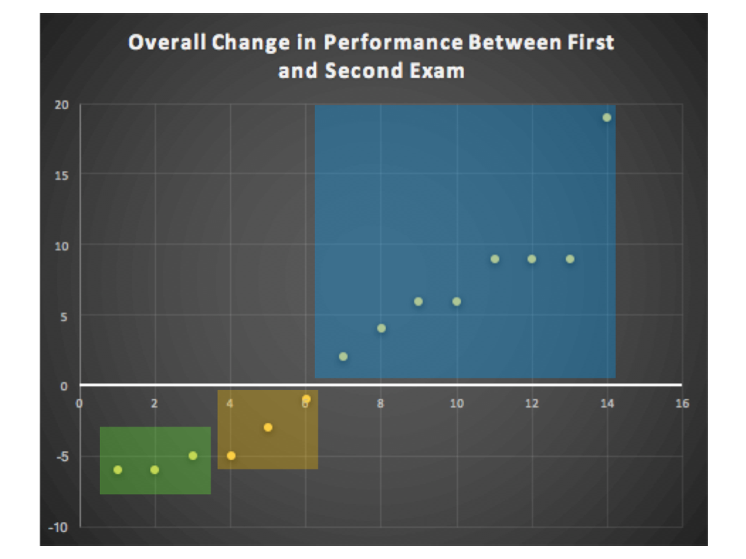

Slide 10
Let’s Reflect
What’s the difference, if any, between studying geology and learning geology?
Which mode have you been in?
A. Study mode
B. Learn mode

Slide 11
In order to ace geology (and all your other classes!)
For which task would you work harder:
A. Earn an A on the test
B. Teach the material to the class?
Why?
Stay in learn mode, not study mode
Study as if you have to teach the material, not just earn an A on the test

Slide 12
Why is this so important?
Because College is Harder Than High School
College courses move a lot faster
The material is conceptually more difficult and cumulative
The problems and questions are more involved
The tests are less straightforward and require you to apply several concepts at one time

Slide 13
Example questions from Exam 1
Consider two different igneous rocks. Both rocks crystallize at the same temperature. Rock A crystallizes intrusively rock B crystallizes extrusively.
Explain how and why Rock A and B will be similar
Explain how and why Rock A and B will differ:
In order to answer this question fully you need to:
      Understand the affects of temperature on mineral crystallization (Bowen’s reaction series).
      The affect of cooling rate on mineral crystallization.
      The differences between igneous environments

Slide 14
Using Metacognition to Become an Expert Learner

Slide 15
Metacognition
Refers to your ability to:
think about thinking
be consciously aware of yourself as a problem solver
monitor and control your mental processing (e.g. “Am I understanding this material?”)
accurately judge your level of learning

Slide 16

This pyramid depicts the different levels of thinking we use when learning. Notice how each level builds on the foundation that precedes it. It is required that we learn the lower levels before we can effectively use the skills above.
Bloom’s Taxonomy
Putting elements together to form a coherent or functional whole; reorganizing elements into a new pattern or structure through generating,
planning, or producing.
Creating
Making judgments based on criteria and standards through checking and critiquing.
Evaluating
Breaking material into constituent parts, determining how the parts relate to one another and to an overall structure .
Analyzing
Carrying out or using a procedure through executing, or implementing.
Applying
Constructing meaning from oral, written, and graphic messages through interpreting, exemplifying, classifying, summarizing, inferring, comparing, and explaining.
Understanding
Retrieving, recognizing, and recalling relevant knowledge from
long-term memory.
Remembering

Slide 17
At what level of Bloom’s did you have to operate to make A’s, B’s, or C’s in high school?
Remembering
Understanding
Applying
Analyzing
Evaluating
Creating

Slide 18
At what level of Bloom’s do you have to operate to make A’s, B’s, or C’s in college?
Remembering
Understanding
Applying
Analyzing
Evaluating
Creating

Slide 19
How do you move yourself higher on Bloom’s Taxonomy?
Use the Study Cycle!

Slide 20
The Study Cycle
Preview
Preview before class – Skim the chapter, note headings and boldface words, review summaries and chapter objectives, and come up with questions you’d like the lecture to answer for you.
The procedure is actually quite simple. First you arrange items into different groups. Of course one pile may be sufficient depending on how much there is to do. If you have to go somewhere else due to lack of facilities that is the next step; otherwise, you are pretty well set. It is important not to overdo things. That is, it is better to do too few things at once then too many. In the short run this may not seem important but complications can easily arise. A mistake can be expensive as well. At first, the whole procedure will seem complicated. Soon, however, it will become just another facet of life. It is difficult to foresee any end to the necessity for this task in the immediate future, but then, one can never tell. After the procedure is completed one arranges the materials into different groups again. Then they can be put into their appropriate places. Eventually they will be used once more and the whole cycle will then have to be repeated. However, that is a part of life.
(Bransford & Johnson, 1972)
Attend
Attend class – GO TO CLASS! Answer and ask questions and take meaningful notes.
Doing the Laundry
Review
Review after class – As soon after class as possible, read notes, fill in gaps and note any questions.
Study
Study – Repetition is the key. Ask questions such as ‘why’, ‘how’, and ‘what if’.
Intense Study Sessions* - 3-5 short study sessions per day Weekend Review – Read notes and material from the week to make connections
Assess
Assess your Learning – Periodically perform reality checks
Am I using study methods that are effective?
Do I understand the material enough to teach it to others?
*Intense Study Sessions
1 | Set a Goal | (1-2 min) | Decide what you want to accomplish in your study session
2 | Study with Focus | (30-50 min) | Interact with material- organize, concept map, summarize, process, re-read, fill-in notes, reflect, etc.
3 | Reward Yourself | (10-15 min) | Take a break– call a friend, play a short game, get a snack
4 | Review | (5 min) | Go over what you just studied

Slide 21
Effective Metacognitive Strategies
Always solve problems and answer questions without looking at an example or the solution
Memorize everything you’re told to memorize (e.g. polyatomic ions, mineral names, terms)
Always ask why, how, and what if questions
Test understanding by giving “mini lectures” on concepts
Spend time on geology every day
Use the Study Cycle with Intense Study Sessions
Aim for 100% mastery, not 60%!

Slide 22
What can you do to support students’ metacognition?
Provide opportunities for students to self-evaluate their own learning
Establish an environment that fosters learning how to learn (modeling!)
Encourage behaviors that foster learning to learn
Low effort
(activity-level):
● Think-Pair-Share
● Reflective questions
Moderate effort (activity/unit-level):
● Reflective Prompts
● Exam Wrappers
Committed effort (course level):
Learning journal

Slide 23
Creating an environment that fosters learning to learn (intrinsic)
Reward effort over ability (allow for revisions; participation instead of graded)
Encourage self-comparison over social comparison (exam wrappers)
Model and provide graphic organizers and other organizational structures
Be explicit: spend time discussing how these activities help learning

Slide 24
Encourage behaviors that foster learning to learn (intrinsic)
Encourage questioning and help-seeking
  Frequent use of think-pair-share
  Frequent use of reflective questions
Encourage goal-setting
  Exam or module wrappers
  Course journals
Be explicit: spend time discussing how these activities help learning

Slide 25
What could you do in your…
What activities have we explored that addressed metacognition and the affect component of learning?
Large lecture course?
Small -moderate sized lecture course?
Lab section or field course?

Slide 26
A few extra resources:
Addressing Student Motivation: https://serc.carleton.edu/NAGTWorkshops/affective/motivation.html
Role of Metacognition in Learning: https://serc.carleton.edu/NAGTWorkshops/metacognition/index.html
Self-Regulated Learning: https://serc.carleton.edu/sage2yc/studentsuccess/self_regulated/index.html
For students, “studying tips” video series (Samford University): https://youtu.be/RH95h36NChI (1st in series of 5)

