Slide 1

Aligning Assessments with Learning Outcomes

Slide 2
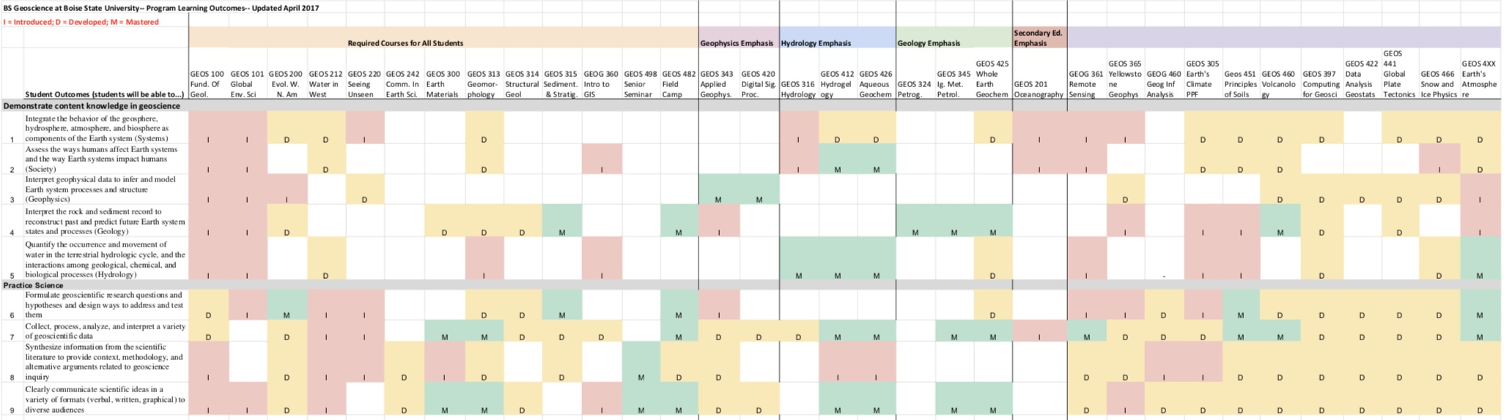
PLOs vs CLOs
Program Level Outcomes
Course Level Outcomes
Field Courses
Upon successful completion of the Liberal Arts and Sciences: Science Emphasis / A.S. Degree program, graduates will be able to:
Demonstrate knowledge of factual material essential to their discipline in science;
Apply the scientific process, including designing and conducting experiments and testing hypotheses;
Read, understand, and critically review scientific papers;
Prepare written reports in a standard scientific format;
Analyze and interpret quantitative scientific data;
Perform laboratory skills specific to their discipline in science; and
Evaluate and discuss contemporary science-related social and ethical issues, both locally and globally, using scientific knowledge and reasoning.
Students exhibit mastery in…
creating models of Earth systems
experimental design
quantitative measurement in three dimensions
hypothesis testing
deductive reasoning (a set of premises demonstrated as true lead to a logical conclusion)
inductive reasoning (particular instances lead to generalized probable conclusion)
data visualization and synthesis
assessing and handling uncertainty
Classroom (or field) Assessment Activities

Slide 3

Aligning Assessments with Learning Outcomes
Current Assessment Activities
  In-class Exams
    Multiple Choice
    Short Answer
    Essay
  Homework Assignments
  Laboratory/Field Activities/Assignments
  Papers
  Presentation
Low-stakes vs. High-stakes Assessment Activities

Slide 4
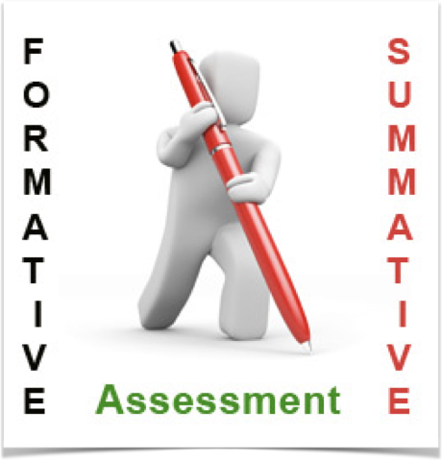
Aligning Assessments with Learning Outcomes
Low-stakes assessment activities.
  Individual activities have little, if any, impact on overall course grade.
    Practice problems, homework assignments, quizzes, laboratory and classroom activities
High-stakes assessment activities.
  Individual activities have significant impact on overall course grade.
    Exams, quizzes, laboratory activities, papers, presentations.

Slide 5
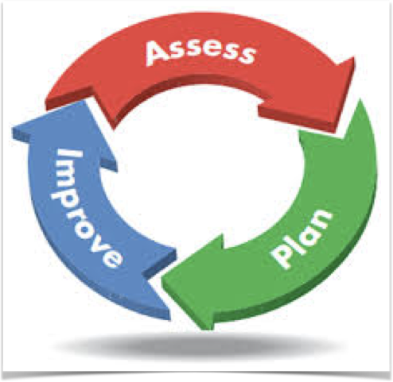
Why Assessment Matters
Program Level
  Provides data that helps guide departmental decisions/resources
Course Level
  Provides measurement of student mastery of content. Are students meeting stated learning outcomes?
Effective assessment methods
  Align with course (CLOs) and/or program level outcomes (PLOs)
  Allow us to quickly monitor/gauge student understanding of course content.
  Provide students practice responding to similar high-stakes assessments.

Slide 6
Aligning Assessments with Learning Outcomes-
Learner Outcomes By the end of this course, you will be able to… | Assessments (in class) You will demonstrate your abilities through…
Apply appropriate scientific investigative techniques to address questions about relevant Earth science concepts. | In-class activities, out-of-class assignments
Collect, analyze, and interpret quantitative and qualitative data to address questions about relevant Earth science concepts. | In-class activities, out-of-class assignments
Apply Earth science concepts and processes to personal and societal issues. | Out-of-class assignments, engineering project, final project (engineering group project on earthquake mitigation)
Articulate how your own ideas and understanding change and develop, and how the structure of the learning environment and curriculum facilitates these changes. | Reflections, reading questions
Find and utilize a variety of resources to learn and communicate about Earth science events and processes. | Out-of-class assignments, final project (poster presentation in final exam)
From Anne’s Earth Science Inquiry Syllabus

Slide 7
Aligning Assessments with Learning Outcomes-
How are students currently assessed in your course(s)?
  Do your high-stakes assessment activities align with specific CLOs (and PLOs)?
  Is there an appropriate distribution of higher and lower order questions/problems?
  What practice do students currently get responding to similar questions/problems?

Slide 8
Assessment Activities…time to work
Review the active learning method that was provided to your group. As a group discuss:
  Benefit to the students
  Preparation required of instructor using the method
  Specific ways it might be used in your courses
Re-group. In your new group take turns discussing the active learning method you discussed in your first group.

Slide 9
Low-stakes Assessment Activities
Tool: Think-pair-share
Assessment: Students are ready to move on or need more info?
  Instructor: Ask students to complete an activity
  Students: Construct an answer individually, then confer with another person and report out.
Instructor circulates during conversation and listens/responds to report out (follow up questions to reporter/whole class)
Correct response provided (Instructor explanation, student volunteer, other)
Stakes: students turn in assignment for participation/grading (or not)
Instructor learns: students prepared to move on or need more info
More at: http://www.eos.ubc.ca/research/cwsei/eossei-times/EOSSEITimes_5.03MCQ.pdf
https://serc.carleton.edu/sp/library/conceptests/index.html; https://serc.carleton.edu/introgeo/interactive/tpshare.html;

Slide 10
Low-stakes Assessment Activities
Tool: Concept Map (visual representation of concepts linked together)
Assessment: Can students link multiple concepts/topics together?
  Instructor: Introduces key concept terms to be mapped
  Students: Organize ideas, connect concepts to processes
Students work in groups or individually; Instructor circulates during conversation, asks for students to share with class (on document camera?)
Listens/responds to report out (follow up questions to reporter/whole class)
Correct response provided (Instructor explanation, student volunteer, other)
Stakes: students turn in assignment for participation/grading (or not)
Tools: concepts to be included
Instructor learns: have students processed concepts to the extent that they can convey them to others or do they need more info; may see themes of missing info
More at: https://serc.carleton.edu/NAGTWorkshops/assess/conceptmaps.html
  http://d32ogoqmya1dw8.cloudfront.net/files/NAGTWorkshops/coursedesign/tutorial/concept_sketch_1.doc
http://d32ogoqmya1dw8.cloudfront.net/files/NAGTWorkshops/assess05/activities/Johnson_ConceptSketches.pdf (with general rubric for concept sketches)
http://reynolds.asu.edu/EG_movies/EG2e_concept_sketch.m4v (short video on how to make a concept sketch)

Slide 11
Low-stakes Assessment Activities
L.O. Use geologic monitoring data and historic events of a region to evaluate the likelihood of future geologic disasters
Assessment: Can students link multiple concepts/topics together?
Tool: Concept Map (visual representation of concepts linked together)
Gravity
Social impacts
Monitoring
Deformation
Volcanoes
GPS
Gas
Tectonic
environments
types

Slide 12
Low-stakes Assessment Activities
Tool: Jigsaw Activity
Assessment: Can students use data to address a problem/scenario?
Instructor: Provides resources for “expert groups” to learn and data to interpret
Students: Work in groups on “expert” data type, then in mixed groups to interpret data
Stakes: students turn in assignment for participation/grading (or not)
Tools: concepts to be included
Instructor learns: have students processed concepts to the extent that they can convey them to others or do they need more info; may see themes of missing info
https://nagt.org/nagt/teaching_resources/vepp/examples/48383.html

Slide 13
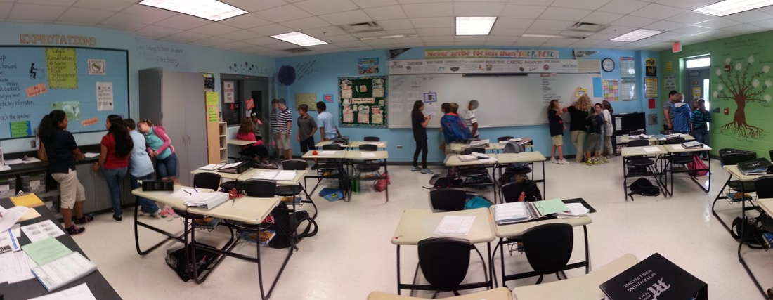
Low-stakes Assessment Activities
Tool: Gallery Walk
Assessment: Can students interpret multiple scenarios/perspectives?
  Instructor: Introduces multiple questions, asks for student responses in groups
  Students: Rotate through series of questions
Student groups assess responses from previous groups, compile best answers for final report out
Instructor circulates during conversations; Listens/responds to report out (follow up questions to reporter/whole class)
Stakes: students turn in assignment (posters) for participation/grading (or not)
Tools: data sets, questions, mechanism for circulating (e.g. poster sticky notes etc)
Instructor learns: students can assess data provided to determine hazards
More at: https://serc.carleton.edu/introgeo/gallerywalk/what.html

Slide 14
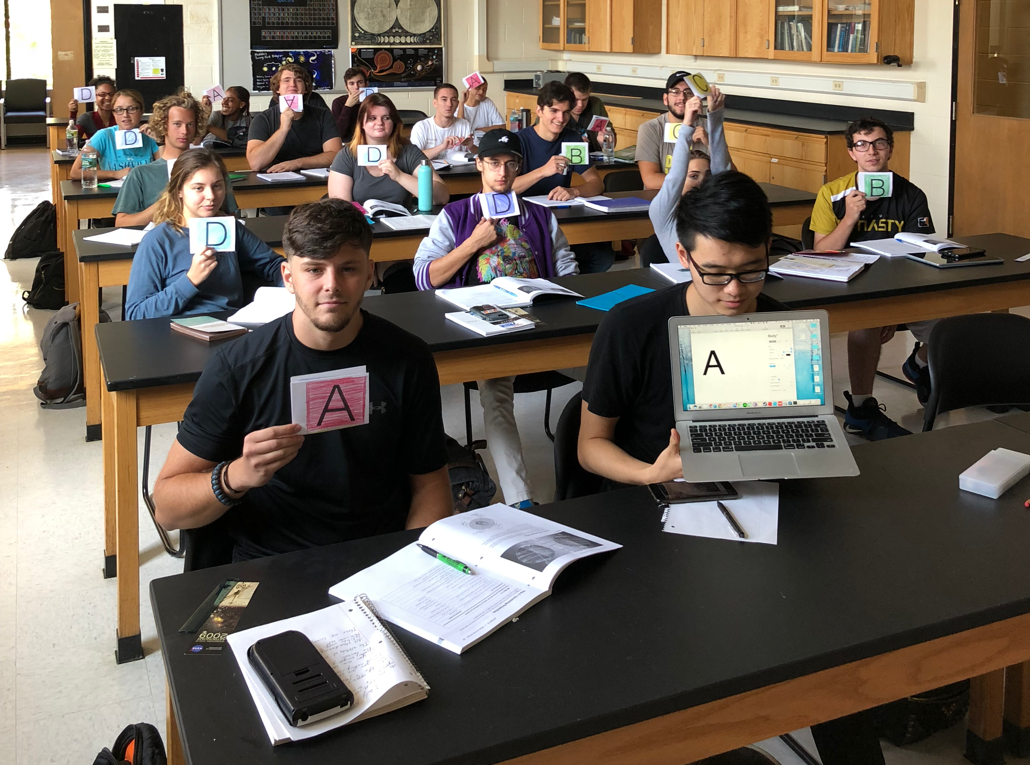
Low-stakes Assessment Activities
Tool: Interactive Multiple-choice questions (e.g. clickers,IF AT)
Assessment: Students are ready to move on or need more info?
  Instructor: Ask questions during class
  Students: indicate correct answer
Instructor shares results with class, moves on, or may provide additional info, ask students to re-vote.
Tools: Colored cards, Clickers, networked computer systems/software (student’s devices)
Instructor learns: students prepared to move on or need more info
More at: http://cwsei.ubc.ca/resources/clickers.htm; https://serc.carleton.edu/sp/library/conceptests/index.html
http://www.eos.ubc.ca/research/cwsei/eossei-times/EOSSEITimes_5.03MCQ.pdf

Slide 15

Low-stakes Assessment Activities
Tool: Minute Paper
Assessment: What did they really learn? What are their real questions?
  Instructor: asks students to explain what they’ve learned, still need help with
  Students: Write short response (anonymously or not) in 1 minute (usually at end of class)
Quick written feedback from students to explain their understanding
Stakes: students turn in for participation or anonymously
Minute Paper 9/7/17
What were the most important points for you in class today?
What was the most confusing/challenging part of today’s class?
Alt: Knowledge Survey
Quick written feedback from students to describe their confidence in understanding
e.g. What is ENSO? How is the Atlantic hurricane season effected by El Nino?
Response options: a) I can answer this question completely, b) I know about 50% of the answer c) I don’t know anything about this
More at: http://serc.carleton.edu/resources/14315.html; http://www.flaguide.org/cat/minutepapers/minutepapers1.php
http://serc.carleton.edu/NAGTWorkshops/assess/knowledgesurvey.html

Slide 16

Interactive Activities in large groups
112 students in 28 groups of 4
Low-stakes assessment—allow students
22
23
24
25
26
27
28
15
16
17
18
19
20
21
8
9
10
11
12
13
14
1
2
3
4
5
6
7
WHITE BOARD/SCREEN

