Slide 1
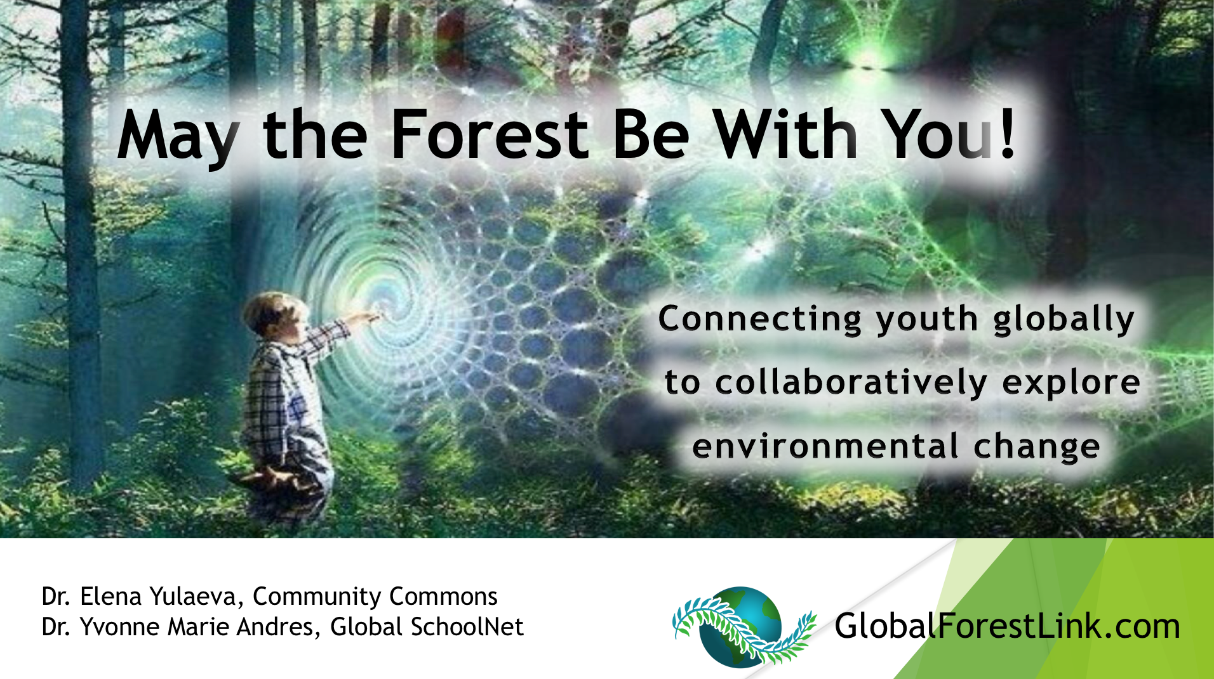
Notes:
(Yvonne) 2 mins
Introductions
Explanation of the GFL vision
GFL Goals
Engage student teams worldwide in dialogue on environmental change
Educate a new generation skilled in cutting-edge earth observation technologies
Teach young people to communicate and tell stories effectively using digital media

Slide 2
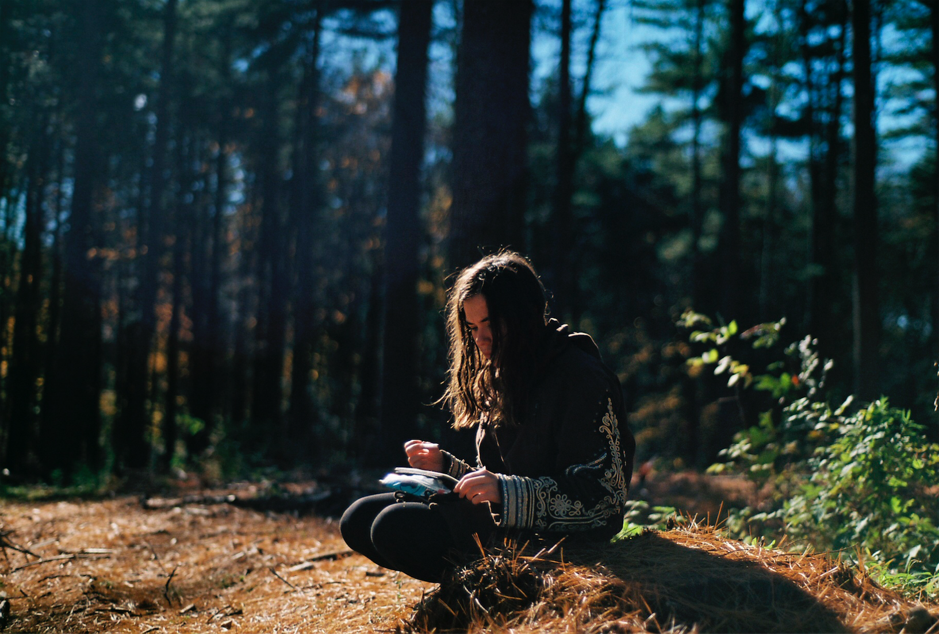
Why is it important to study forest health?
Notes:
Yvonne (1 min)
Every major city, including San Diego has an Urban Forest Forest Management Plan
65% the clean drinking water supply in the United States comes from forests
Forests are home to 80% of the world’s species
Trees improve air quality by filtering pollutants
Trees and forests impact weather and climate around the globe
A vigorous and engaged urban forestry program is critical to meeting San Diego’s commitment to climate change, carbon sequestration, stormwater reduction, and water conservation. With these goals in mind, the City has will develop a long-range urban forest management plan to guide the city’s urban forest into the future.
Urban forests contribute to San Diegans’ quality of life.
100 large, mature trees have the potential to:
Remove 7 tons of carbon dioxide.
Remove 328 pounds of other air pollutants.

Slide 3
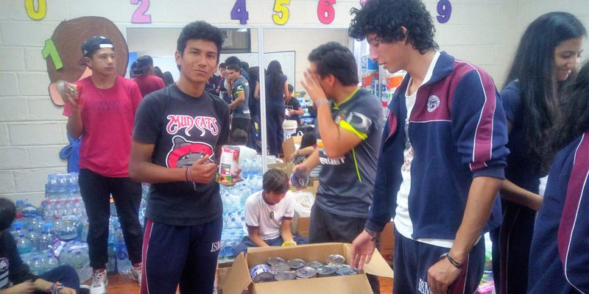
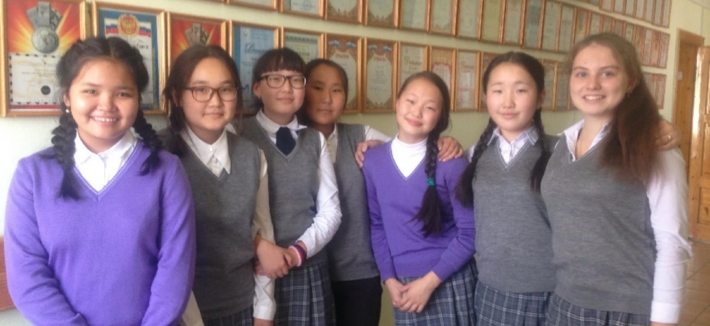
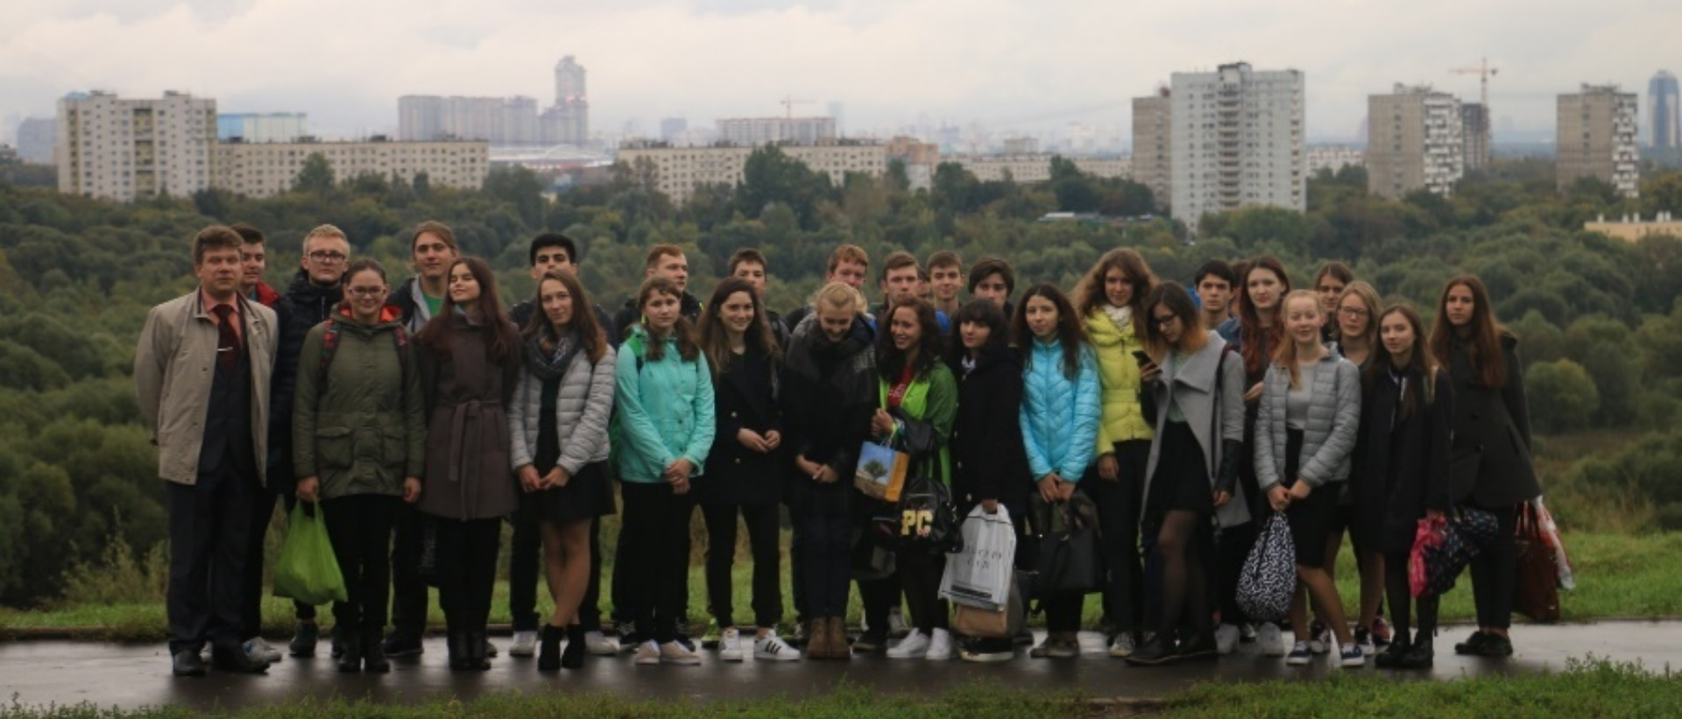
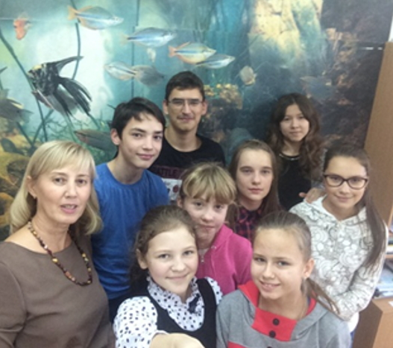
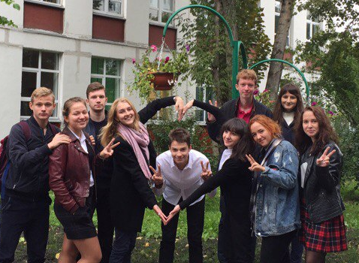
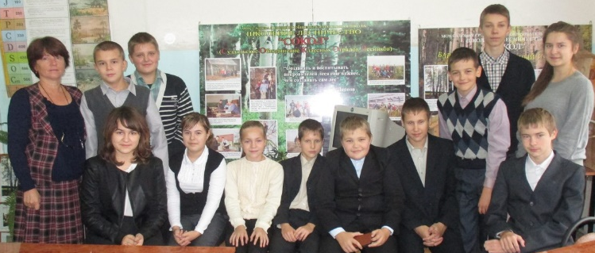
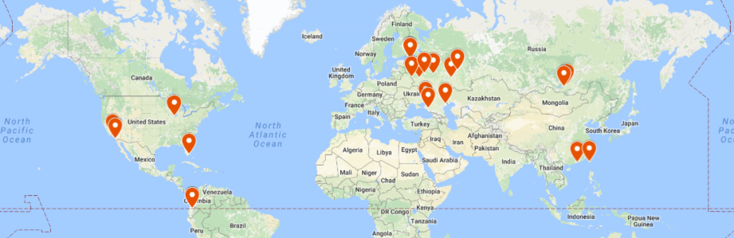
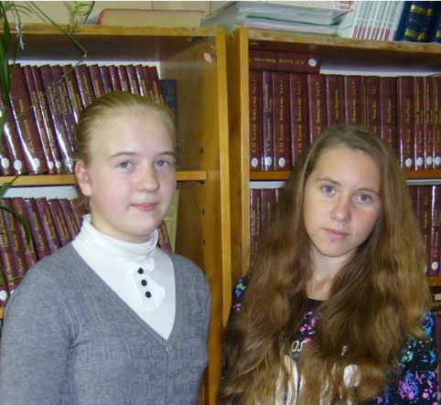
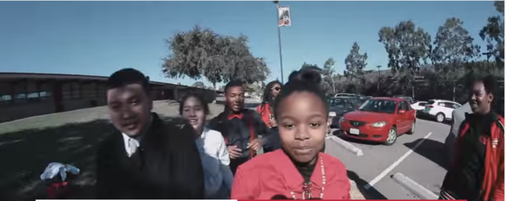
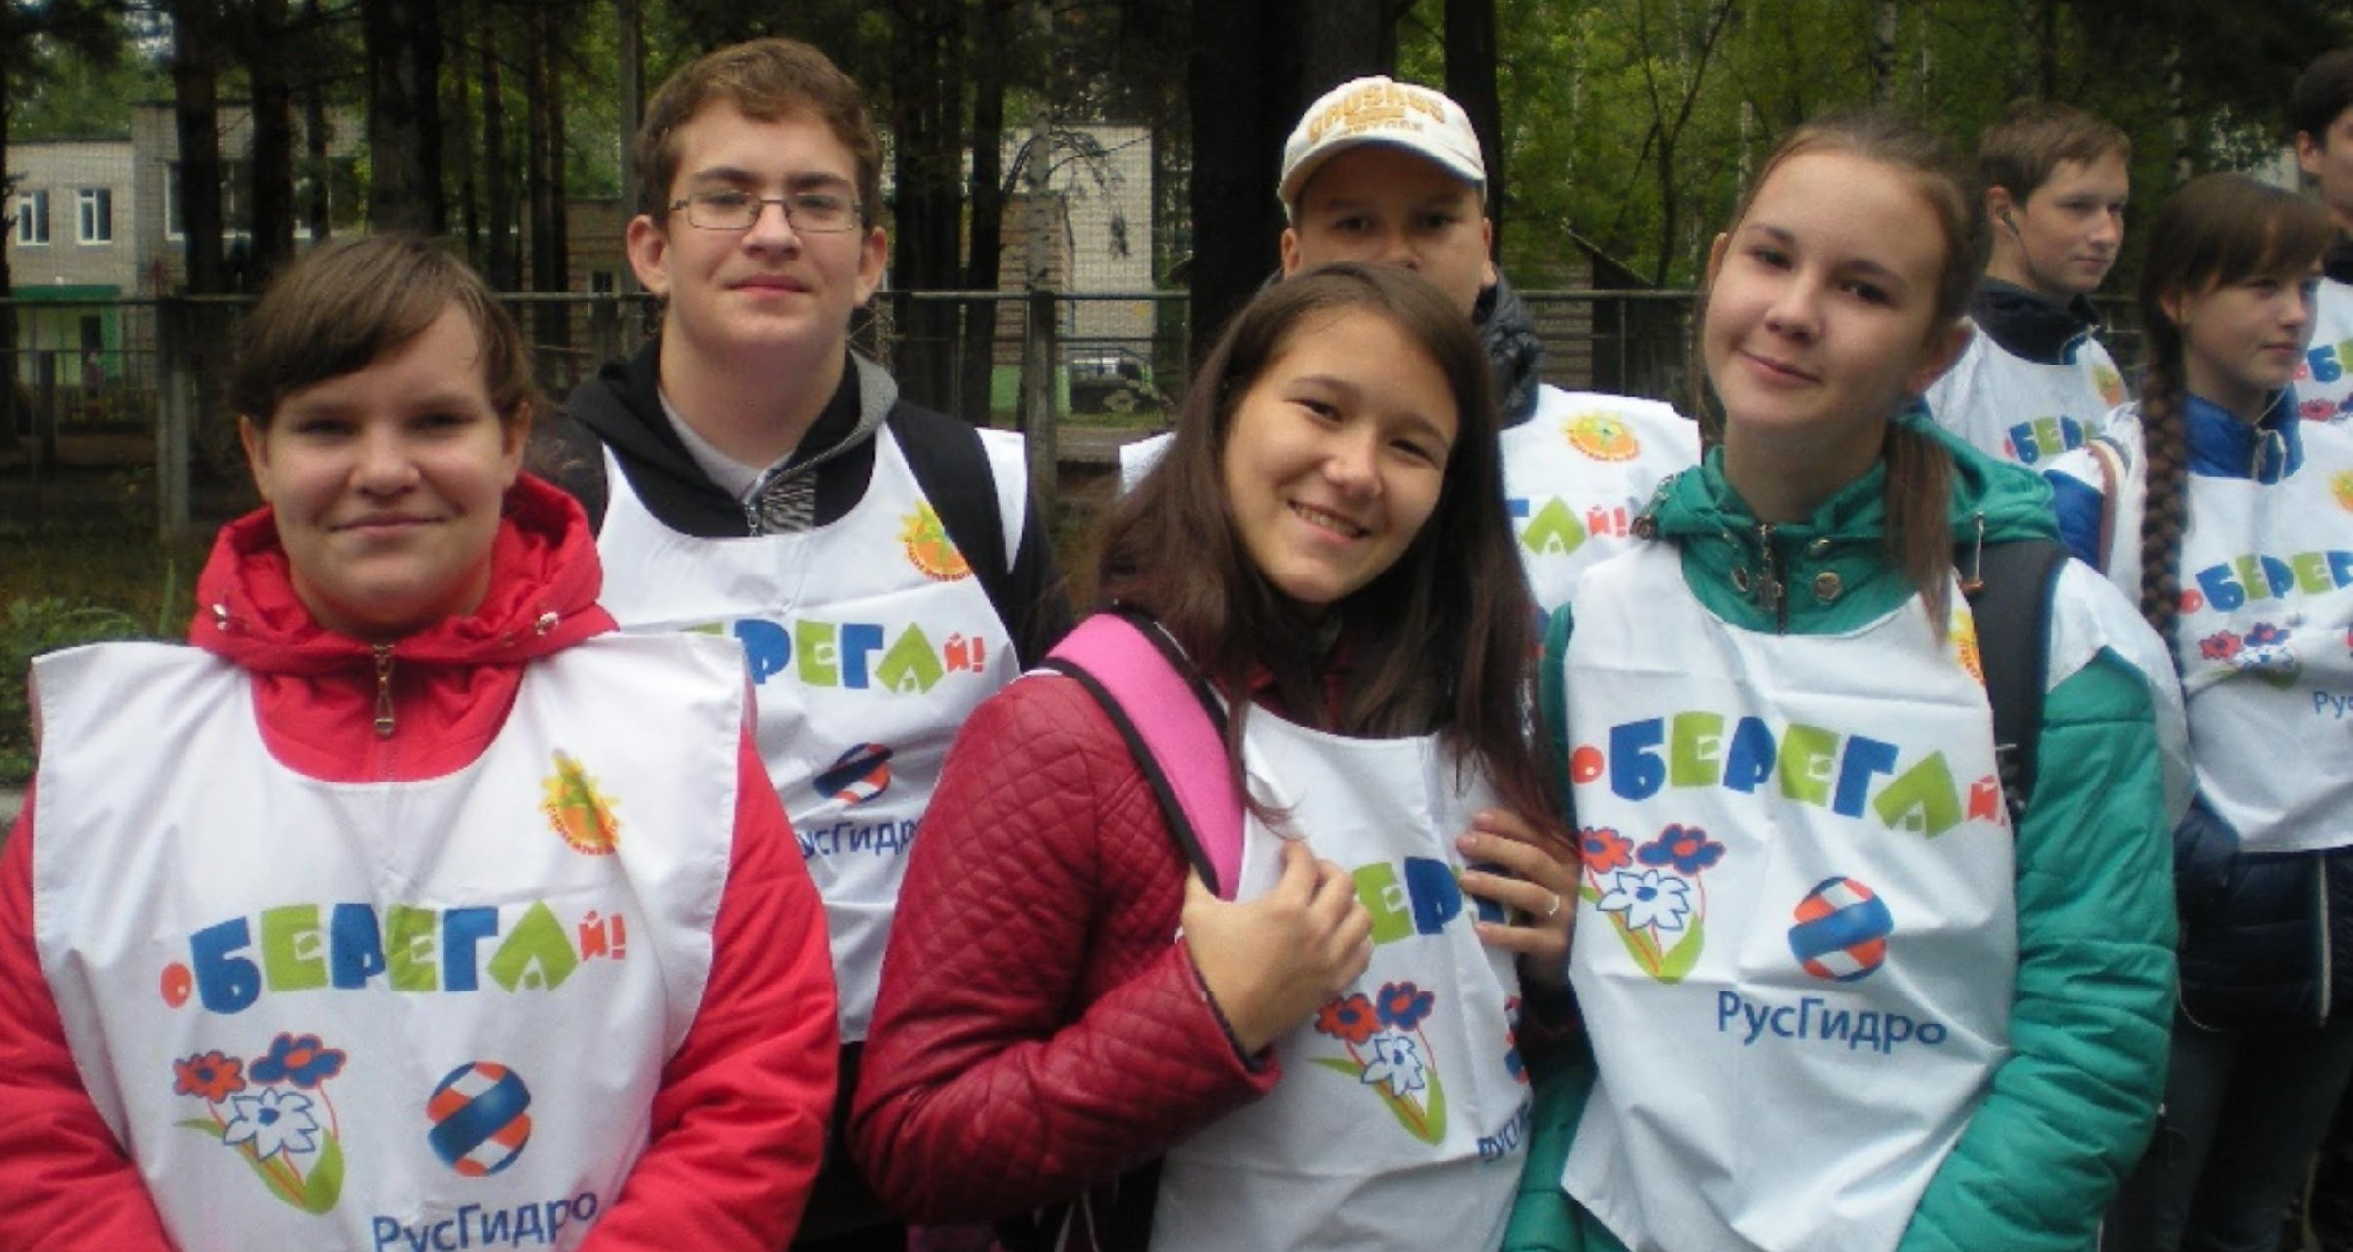
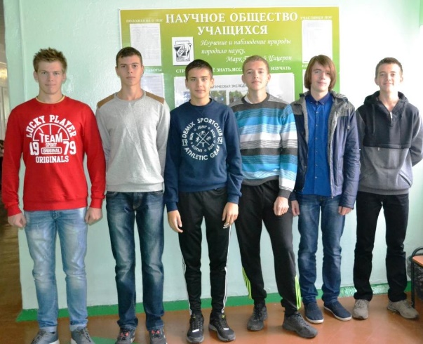
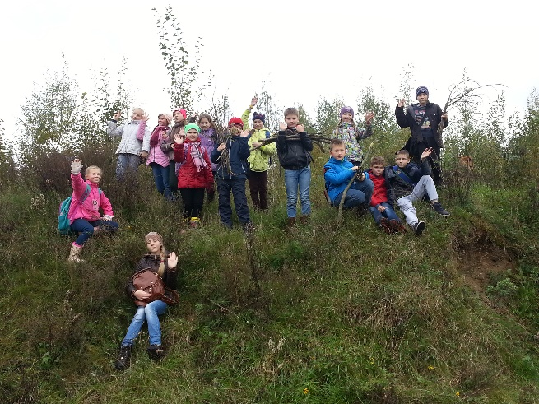
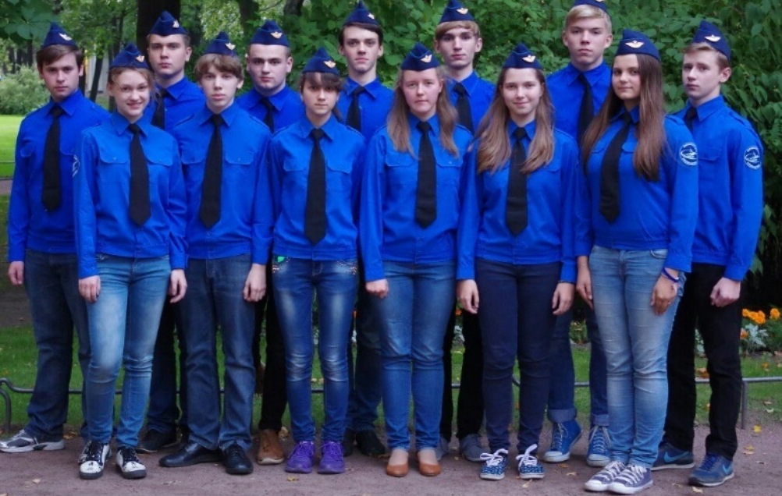
Fall 2016: Russia, US, Ecuador, Taiwan, Hong Kong
(1000+ students)
Notes:
(Elena) (2 mins)
Expansion of GFL to more locations
IMPORTANT: We are accepting registrations for Spring 2017
Fall 2016: 20 RUSSIAN, 5 US , 1 Ecuador, 1 Hong Kong, 3 Taiwan.
More than 550 students

Slide 4
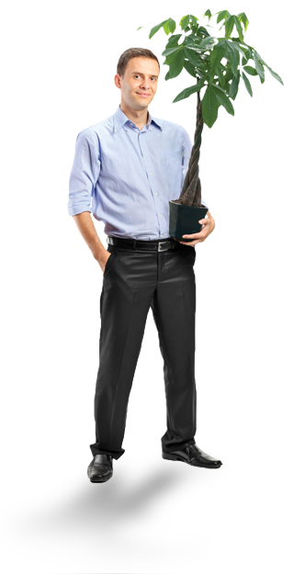
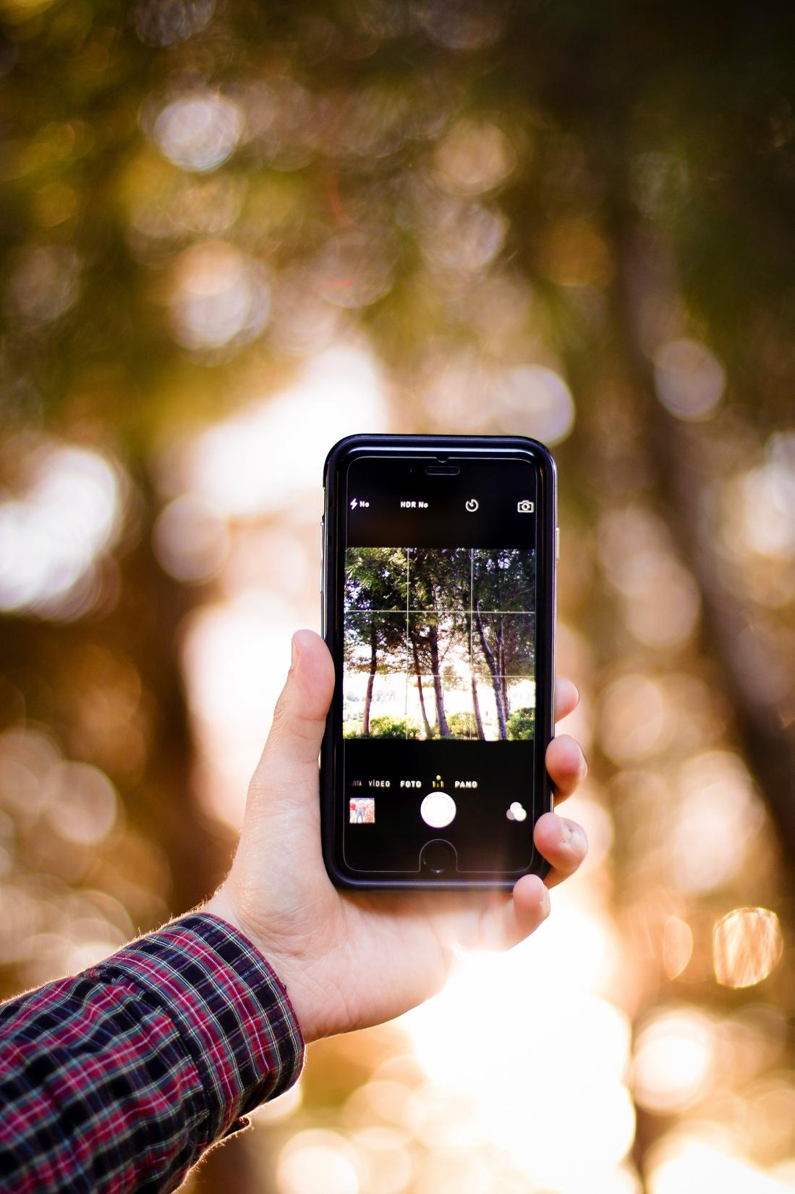

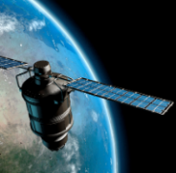


Youth learn important skills & help scientists
Data Collection
& Analysis
Learning from Experts
Science
Technology
Engineering
Arts
Math
Innovative Technologies
Global
Connections
Sharing Results via Stories
Notes:
Yvonne (1 min)

Slide 5
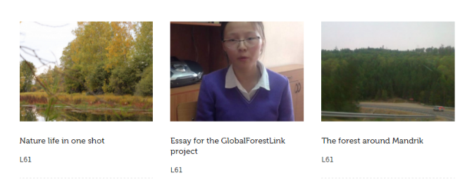
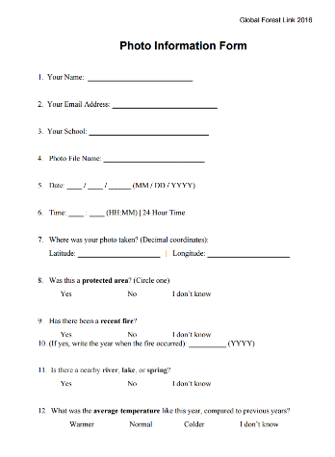
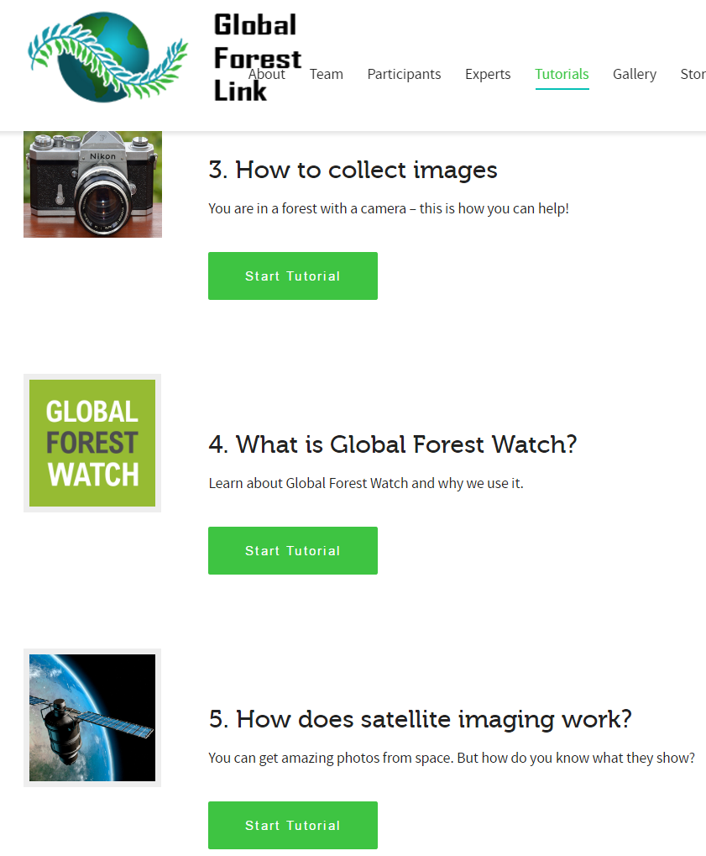
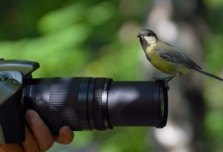
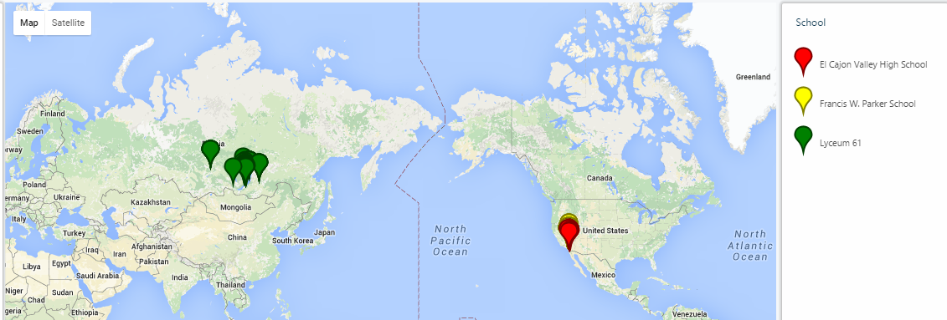
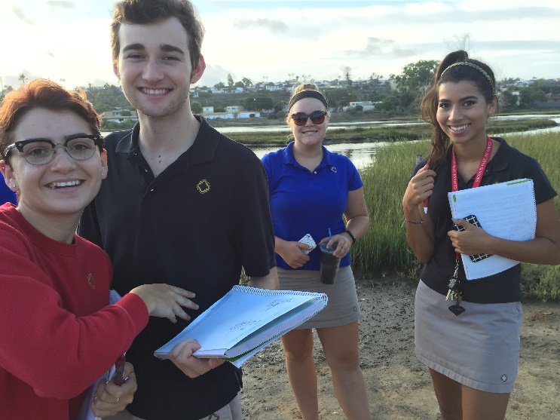

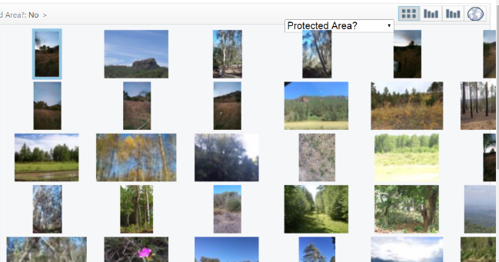
How does GFL work?
Sharing Stories
Data Collection
Training & Tutorials
Collaborative Analysis
Survey Analysis via Visual Exploration
Notes:
Elena (2 mins)
Take photos and video of local forests and parks and record data on a form for each image
Upload photos and data into the Global Forest Watch database (gallery) that is linked to satellite images
Meet with experts, analyze photos and satellite images, and discuss forest health with peers
Create and share original digital stories that explain what students have observed and learned

Slide 6
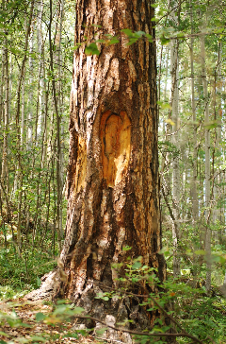
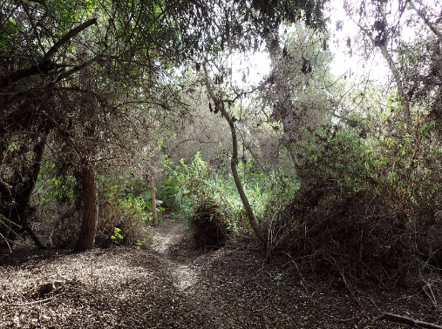
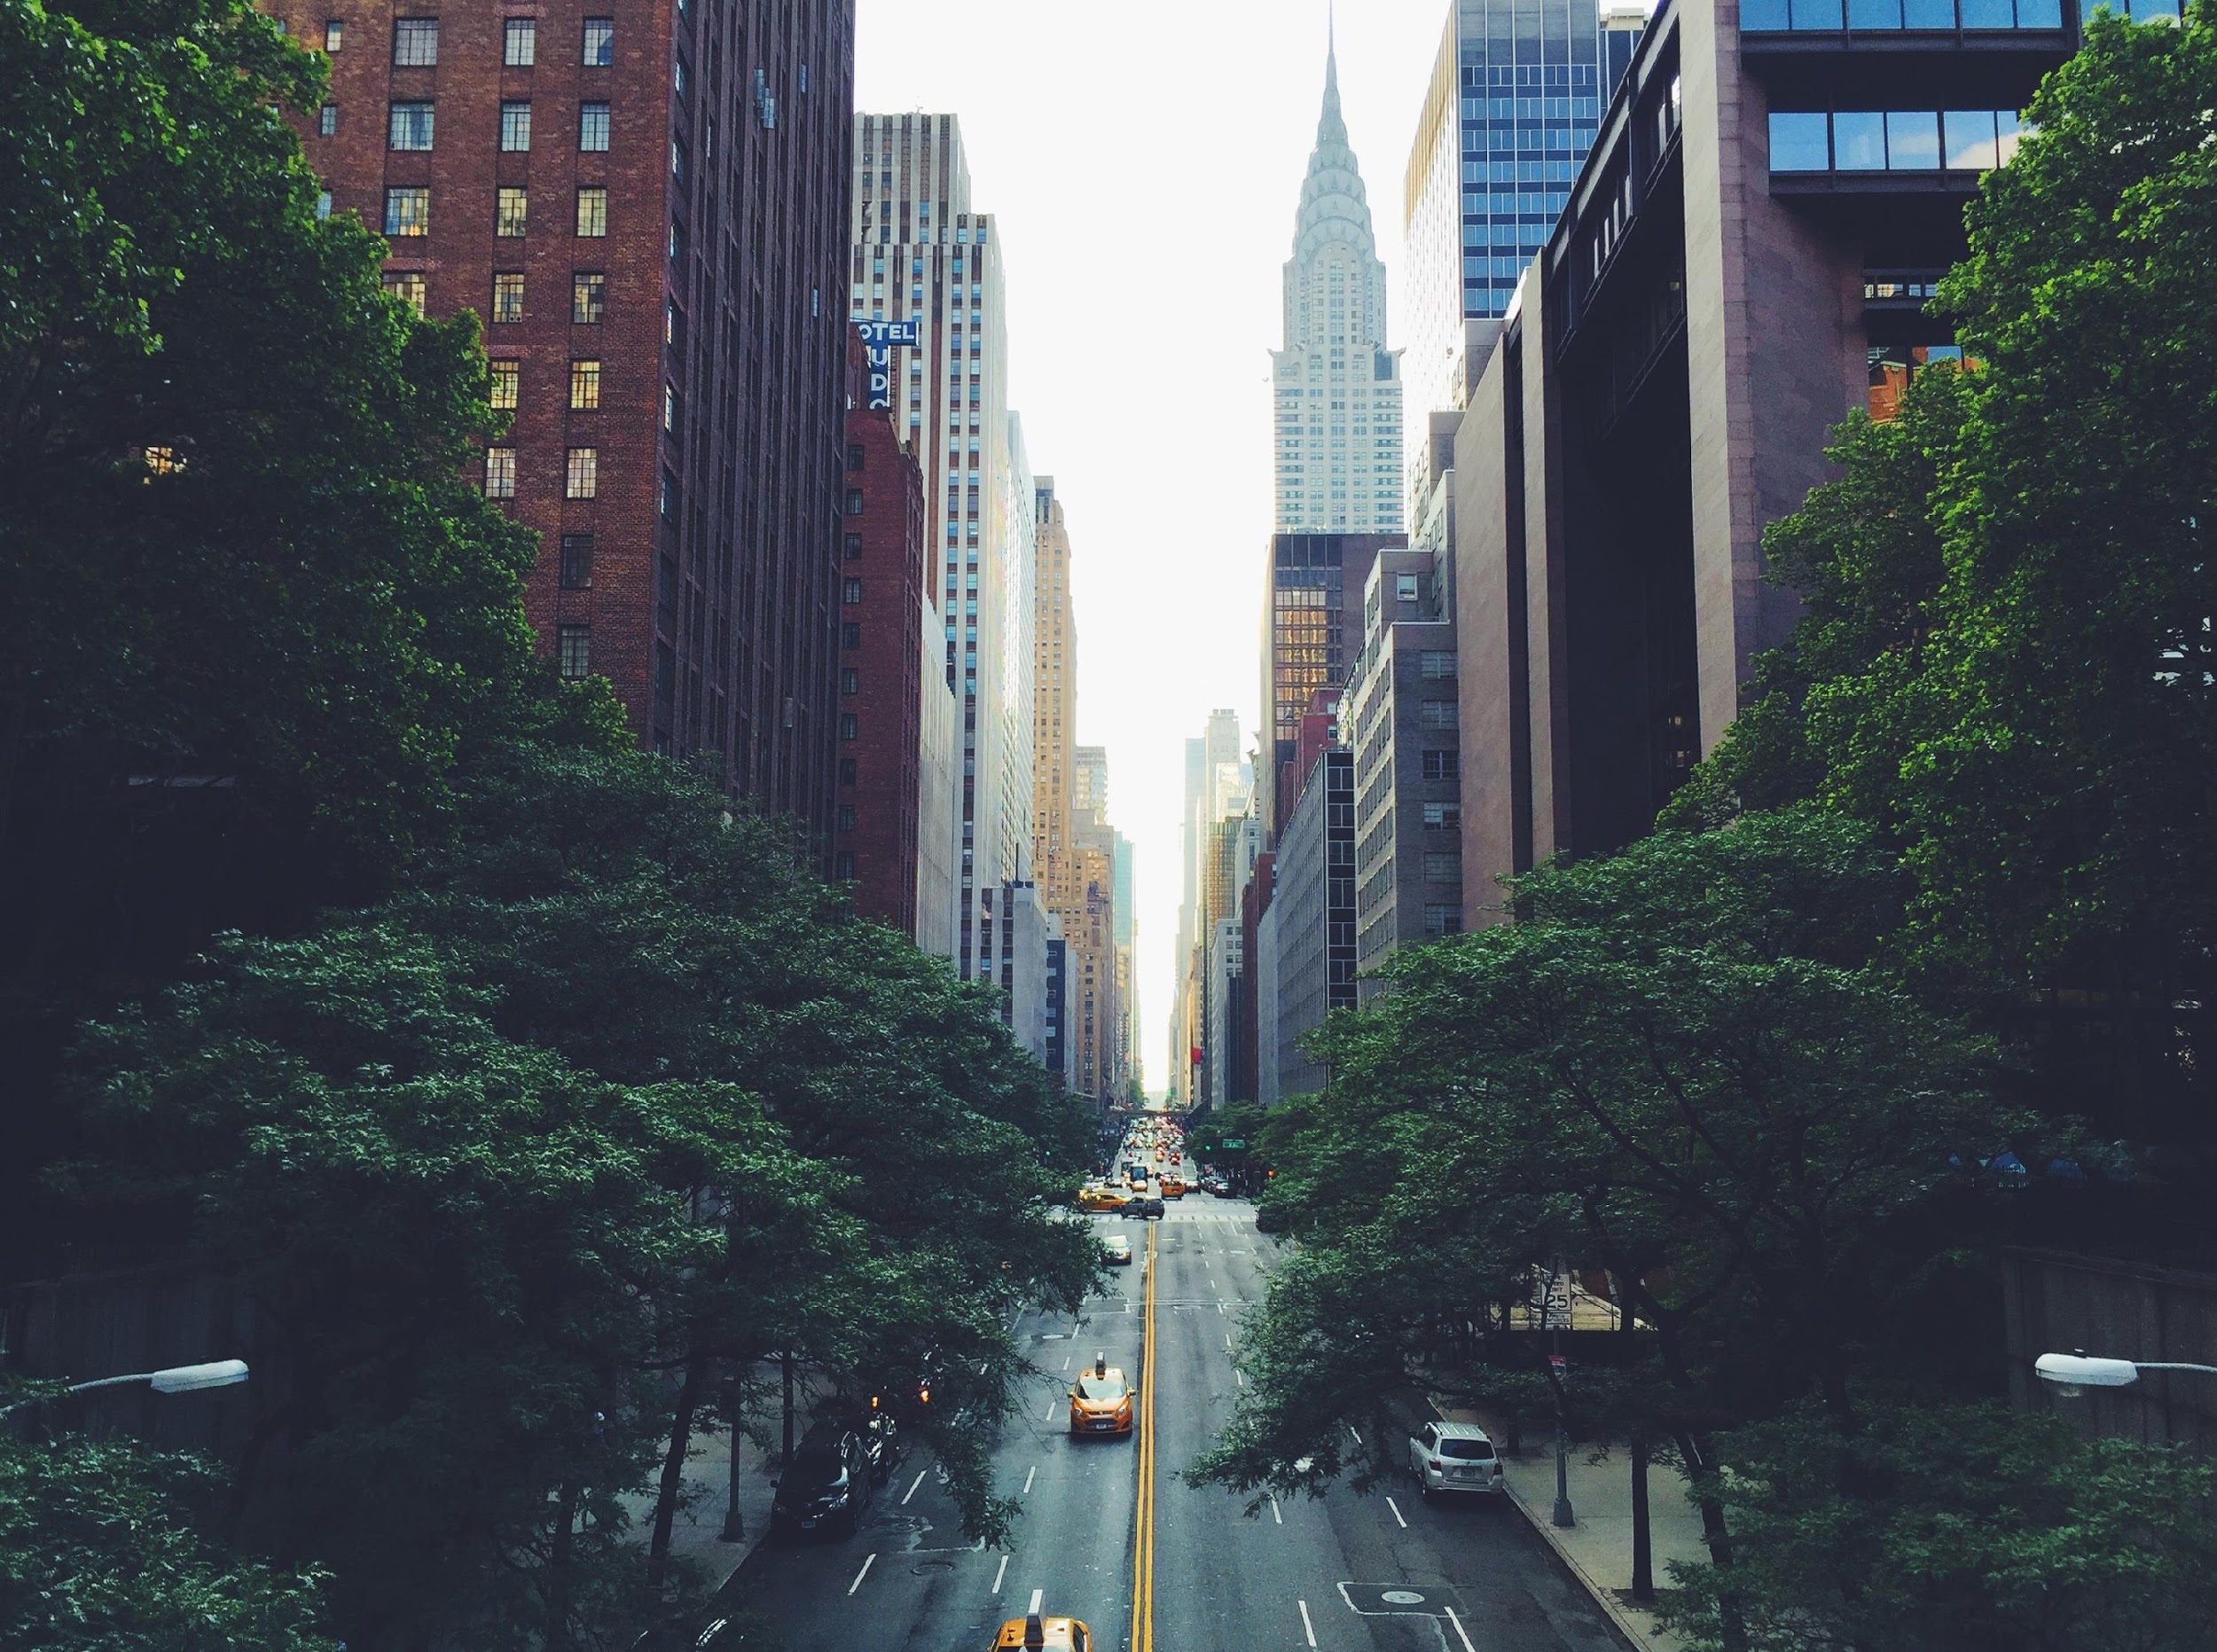
Photos & videos are uploaded to the Global Forest Link Gallery
GlobalForestLink.com/gallery
Notes:
Elena (2 mins)
Live demo

Slide 7
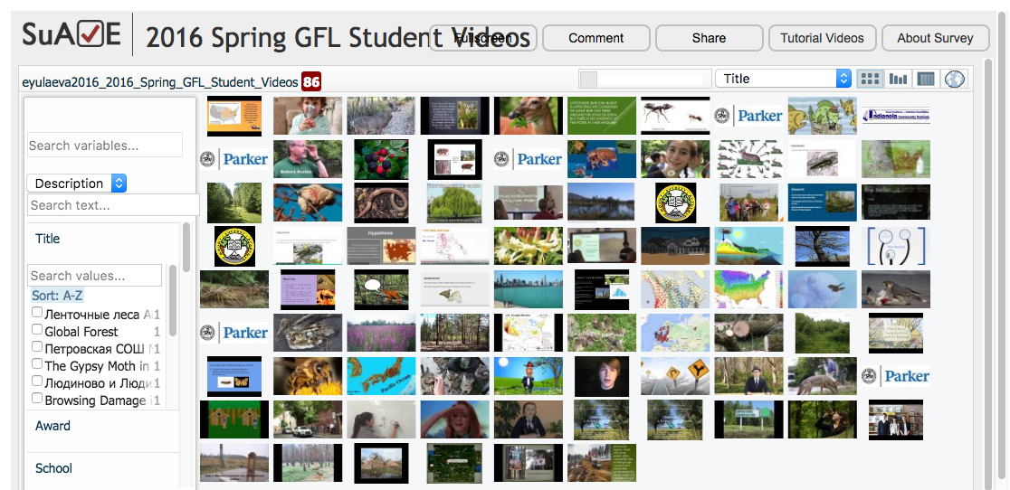
Visual Analysis of Digital Stories
Notes:
Elena (4 min)
Live demo

Slide 8
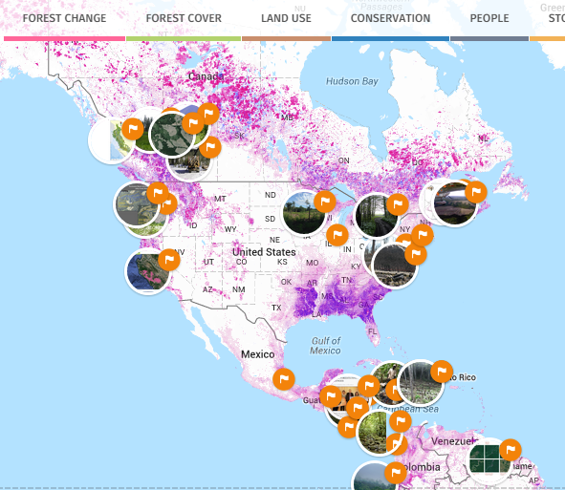
Global Forest Watch Features
GFW interactive map
Notes:
Elena (4 mins)
Photos are linked to Global Forest Watch
Live demo

Slide 9
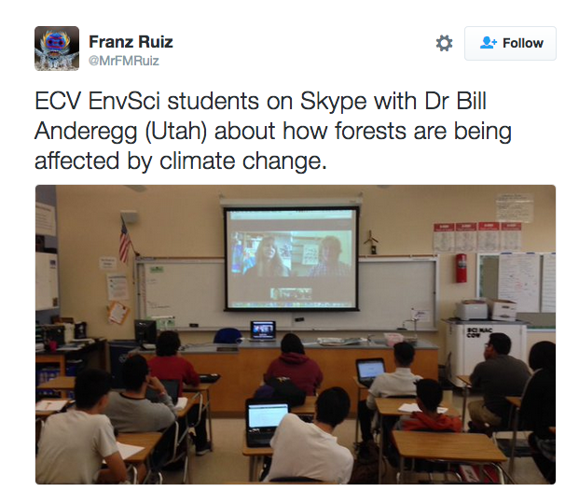
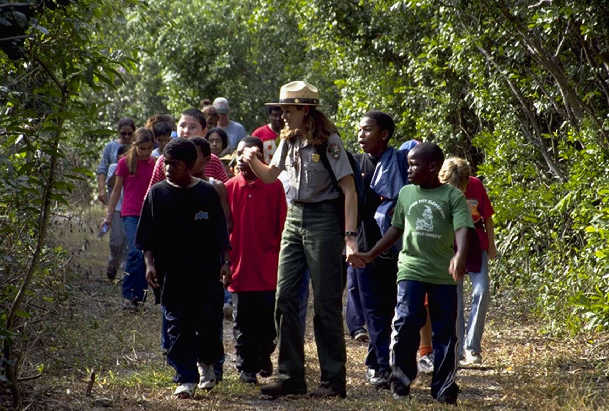
Experts are interviewed in person or via online conferencing
Notes:
Yvonne (1 min)
Blended learning offline and online
Authentic project-based learning

Slide 10
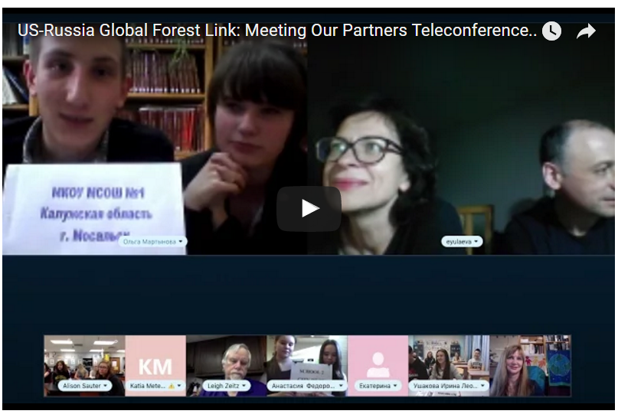
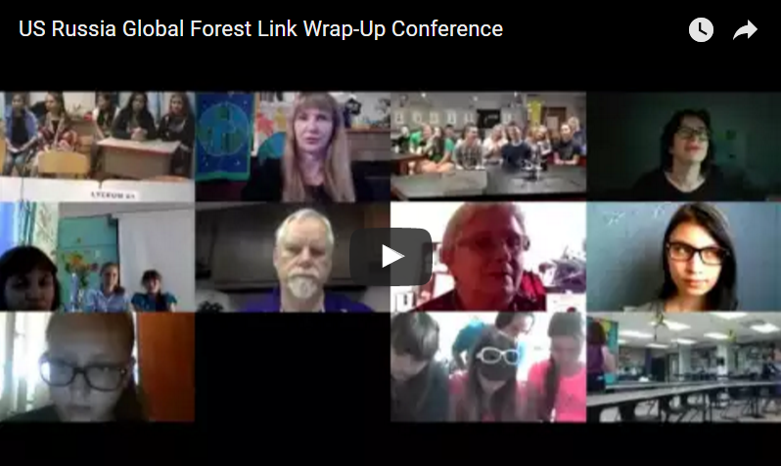
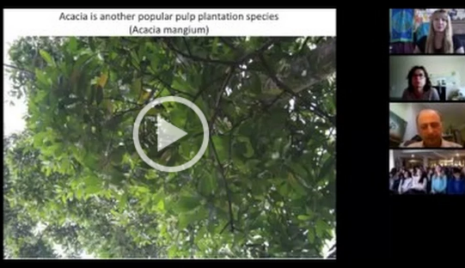
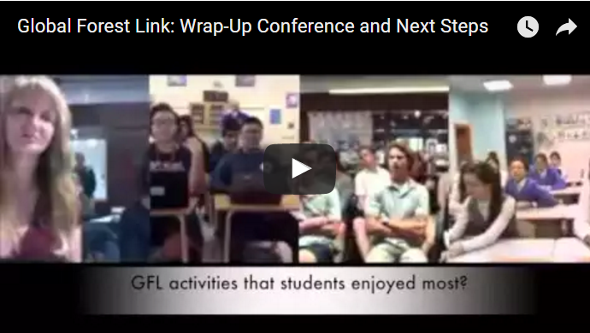
Global Forest Link: Interactive Teleconferences
Training
Cultural connections with other participants
Sharing the Results
Meet-the-Experts
Notes:
Yvonne (4 mins)
(clip of Jeremy Barrick, San Diego Urban Forest Council)
Value of the interactive teleconferences:
Training
Meeting the other participants
Meet-the-Experts
Wrapping up and sharing results
Cultural Interactions

Slide 11

Students create digital stories to explain what was learned
Includes:
Forest images & videos
Research
Interviews with experts
Satellite images
Voice Narration
Notes:
Yvonne (1 mins)
Evaluation rubric
Content, Technical, Creative

Slide 12
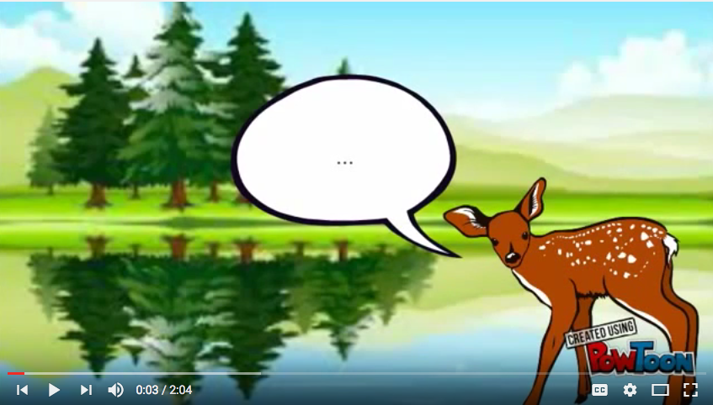
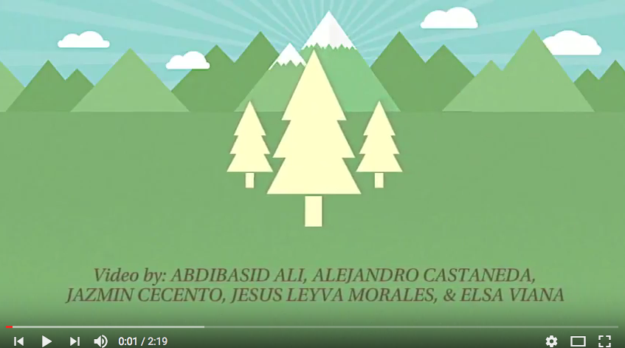
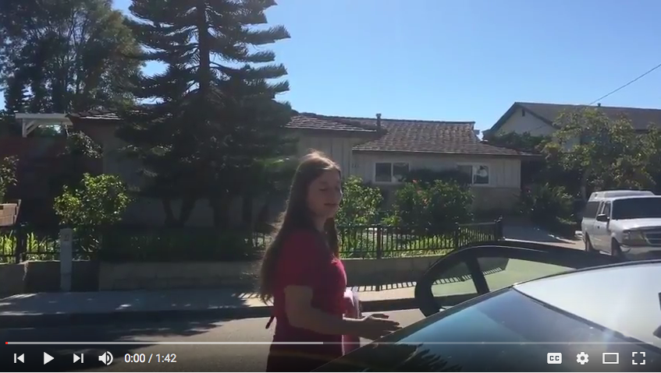
Global Forest Link: US Digital Stories
Forests are Important
Mt. Miguel High School
San Diego
Lake Ahquabi
State Park
Indianola HS, Iowa
Elfin Forest, Francis Parker School, San Diego
Notes:
(Yvonne) (5 min)
Sample digital stories from the US
2 from San Diego and 1 from Iowa
Forests are Important (Mt. Miguel High School, San Diego
https://youtu.be/JkX5LJYYmro
Lake Ahquabi State Park Forest Health (Indianola HS, Iowa)
https://youtu.be/Sz0fwE9dSBU
Elfin Forest (Francis Parker School, San Diego)
https://youtu.be/kFrJoPkItvI

Slide 13
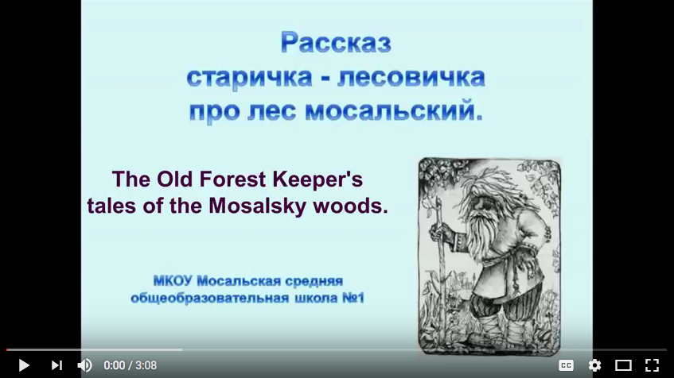
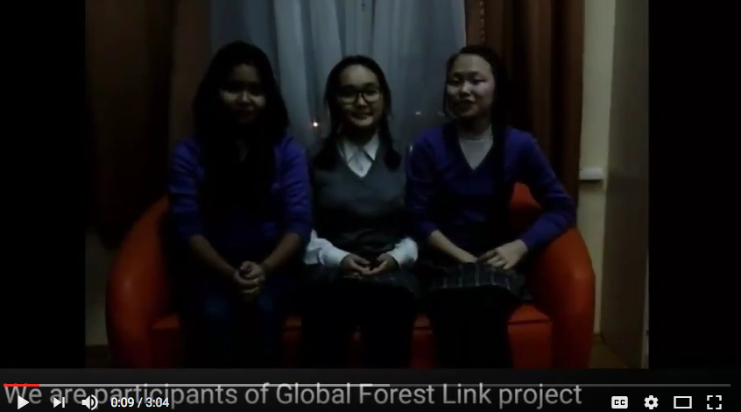
Global Forest Link: Russian Digital Stories
Old Forest Keeper
Mosalsky Woods, Russia
Forests of Buryatia
Lyceum #61, Ulan-Ude, Russia
Notes:
(Elena) (4 mins)
Sample digital stories from the Russia
Forest Keeper
https://www.youtube.com/watch?v=xCoCQlAPO_o
Forests of Buryatia (Lyceum #61, Ulan-Ude, Russia)
https://youtu.be/vbRUj_pSwyU

Slide 14
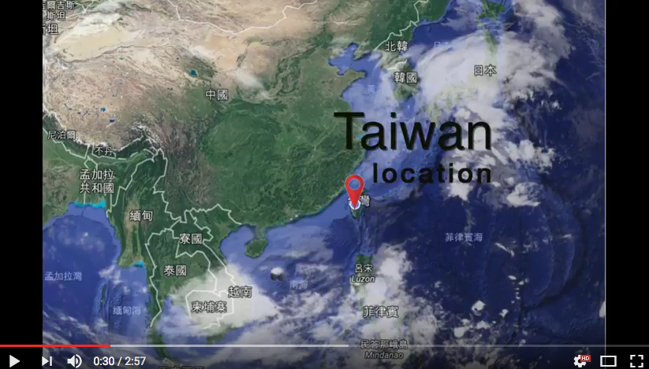
Global Forest Link: Taiwan Digital Story
Notes:
(Yvonne) 2
Sample digital story from the Taiwan
https://youtu.be/qN-smW1t3E4

Slide 15
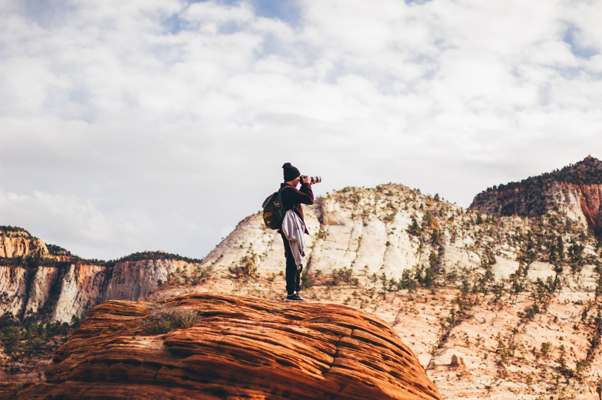



Join Us!
Facebook.com/groups/GlobalForestLink
Twitter.com/GlobalForestLink
#GlobalForestLink
Notes:
Q & A Yvonne & Elena (5 mins)
We are looking for opportunities to expand Global Forest Link

