Slide 1



National Collaborative for Research on Food, Energy, and Water Education (NC-FEW)
Kick-starting collaborations for the next steps of NC-FEW
July 2, 2025 | Virtual Workshop
This material is based upon work supported by the National Science Foundation under Grant No. 1856040 and 2242276 (ECR-EHR Core Research), National Institute of Food and Agriculture, U.S. Department of Agriculture, under award #1006539 and #2017-06281, and the Network of STEM Education Centers/APLU. Any opinions, findings, and conclusions or recommendations expressed in this material are those of the author(s) and do not necessarily reflect the views of these funding agencies.

Slide 2
Welcome and Introduction
Introduce yourself in the chat!
Your name
title
institutional affiliation
your research and practice focus

Slide 3

What is NC FEW?
Community focused on FEW Nexus education and education research

Slide 4
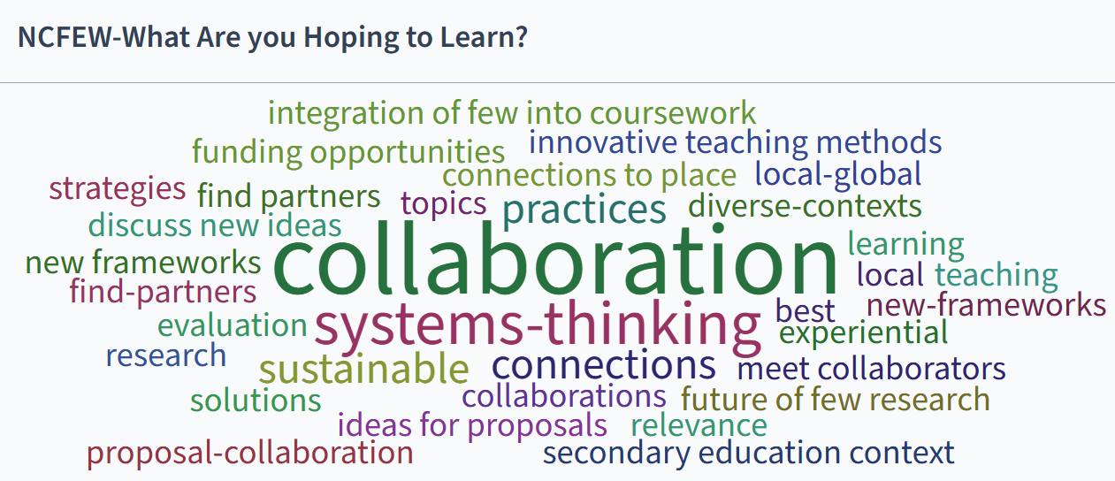
What are NC-FEW participants looking for?
Post in the chat:
what type of FEW Education Research collaboration topics are you hoping to connect with people about?

Slide 5
An Integrated Framework for Food-Energy-Water Nexus Education and Educational Research
Ontological Dimension
Social Dimensions of the FEW Nexus
Ecological Contexts within the FEW Nexus
Collective
Beliefs about Education and Education Research
Social Contexts of Formal and Informal Education Communities
Hannah Scherer, Virginia Tech
Doug Lombardi, University of Maryland College Park
Epistemological Dimension

Slide 6
Ontological dimension
Thoughts about the socio-ecological systems aspects of the nexus
Subcodes
  Scale, Complexity, and Systems (social and ecological dimensions)
  Specific systems or issues (ecological)
  Power, Inclusion, and Justice (social)
  Governance, Policy, and Decision-Making (social)
  Equity of Access and Interdependence (social)
  Critical Social Science and Ontological Reframing (social)

Slide 7
Epistemological dimension
Thoughts about FEW Nexus education
Social contexts: constraints, opportunities, affordances, and/or needs for structuring teaching and learning about the FEW-Nexus
  Student Diversity in FEW Nexus Education
  Expertise and Educator Knowledge of the FEW Nexus
  Educator Support is Needed to Implement FEW Nexus Education
  Tools for Teaching with the FEW Nexus are Desired
  Curricular Structures and Educational Contexts to Implement FEW Nexus Education
  Human and Financial Resources
  External Connections and Considerations
  Community Defining the Concept of FEW for Education

Slide 8
Epistemological dimension
Thoughts about FEW Nexus education
Collective Beliefs about Education (and Education Research): what education is for and how it should function
  Systems Thinking as a Core Educational Aim
  Civic and Societal Relevance of Education
  Experiential and Place-Based Learning
  Inclusive and Equity-Oriented Pedagogy
  Interdisciplinary Collaboration and Integration
  Student and Instructor Identity and Agency Development
  Cognitive and Social Construction of Knowledge about FEW Science and FEW Interdisciplinarity
  Relevance of FEW to Curriculum and Student Futures

Slide 9
Breakout Session
In this session, participants will engage in two breakout room discussions with fellow NC-FEW members to think collaboratively about their own next steps in FEW Nexus-related educational work.
Format:
  Choose a facilitator to watch the time
  Every person share for a few minutes about the topic and your vision for collaboration on the subject
  Decide next steps: Schedule a meeting, look for other collaborators. Identify a funding source or publication target.

Slide 10
Breakouts
Session 1 8:45 am - 9:15 am Pacific 9:45 am - 10:15 am Mountain 10:45 am - 11:15 am Central 11:45 am - 12:15 pm Eastern TOPICS: Ways of Knowing Community Engaged Research & Teaching Scaling and Sustaining (Beyond Funding period) | Session 2 9:15 am - 9:45 am Pacific 10:15 am - 10:45 am Mountain 11:15 am - 11:45 am Central 12:15 pm - 12:45 pm Eastern TOPICS: Socio-Ecological / Systems Thinking (2) Developing Student Learning Outcomes Civic Engagement

Slide 11
Which groups are looking for collaborators?

Slide 12
Breakouts
Share out!
Are you looking for other collaborators or expertise? Raise your hand to tell us more or share in the chat your call for team members.
Is there some sort of support you need that you aren’t sure how to get? Raise your hand to get called on or ask your question in the chat!
Keep in mind that our listserv will continue and this is a good place to reach out to folks. Join here: https://serc.carleton.edu/nc-few/engage.html

Slide 13
What’s Next for NC FEW
What is your vision for what’s next? How will you make it happen?

Slide 14
Final Steps for NC-FEW Grant
Summer Newsletter highlighting this virtual workshop and durable resources
Final report synthesizing lessons learned and recommendations for next steps
Listserv and website will stay active
Leadership team is available to help teams find additional collaborators, ideas for funding, etc.

Slide 15
Durable Resources from NC-FEW

Slide 16
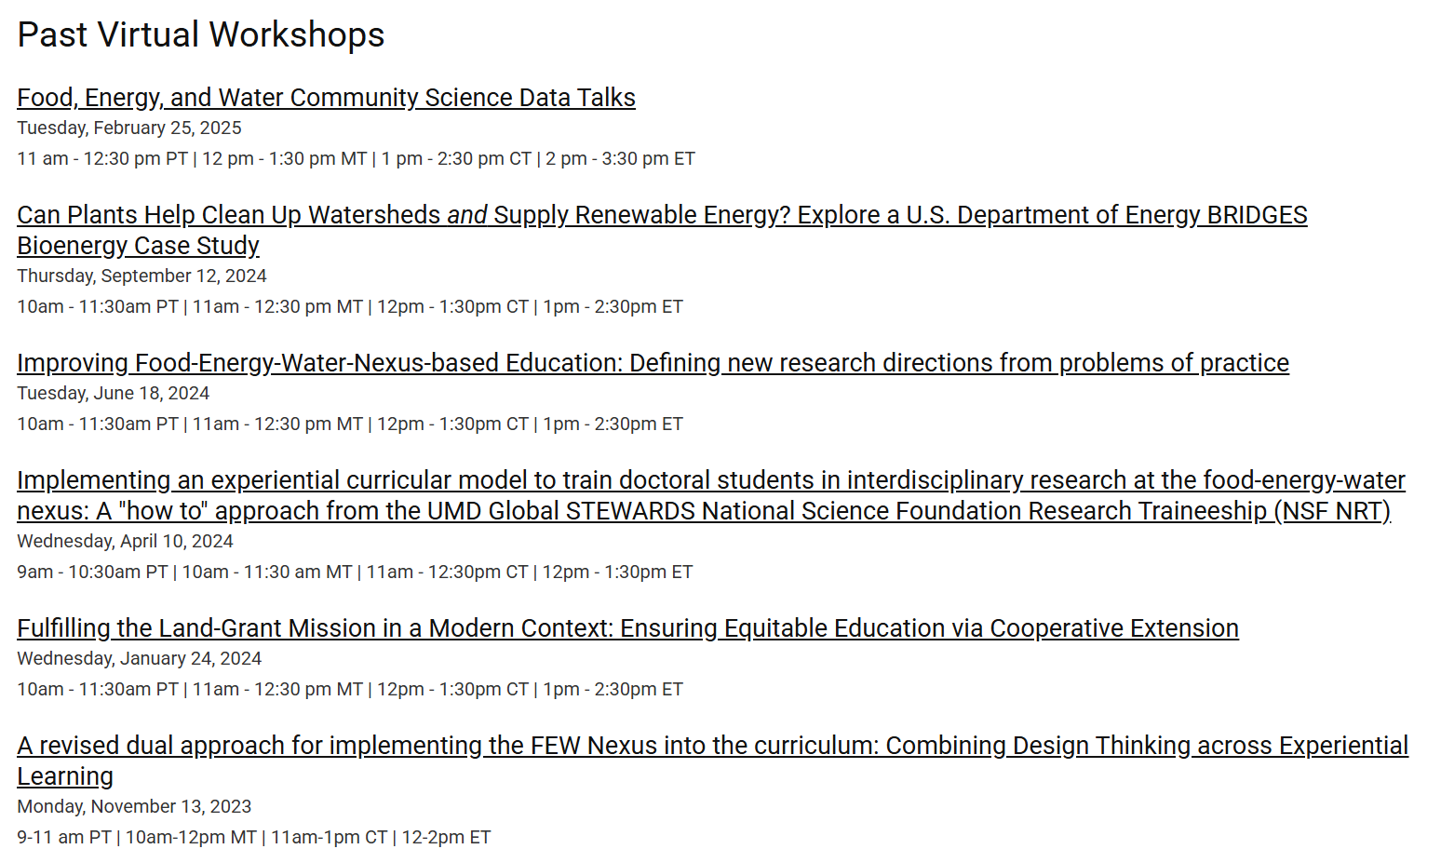
Virtual Workshop Series Recordings and Synthesis Documents

Slide 17
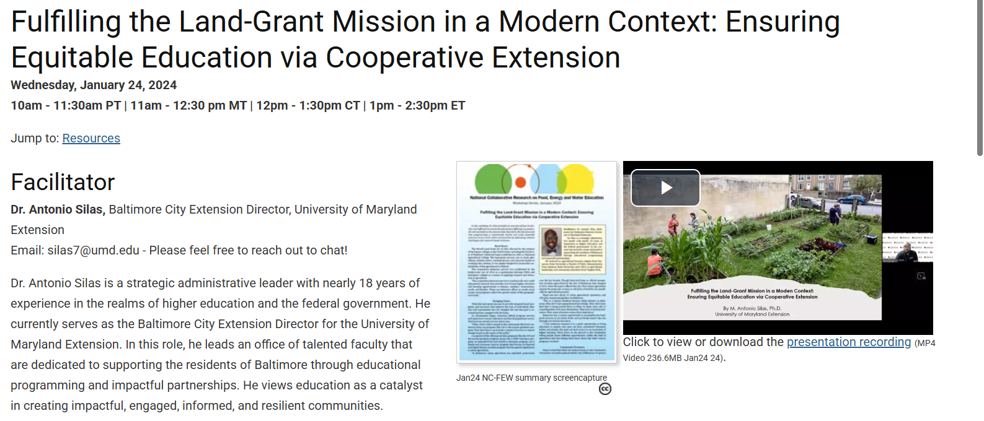
Virtual Workshop Series Recordings and Synthesis Documents

Slide 18
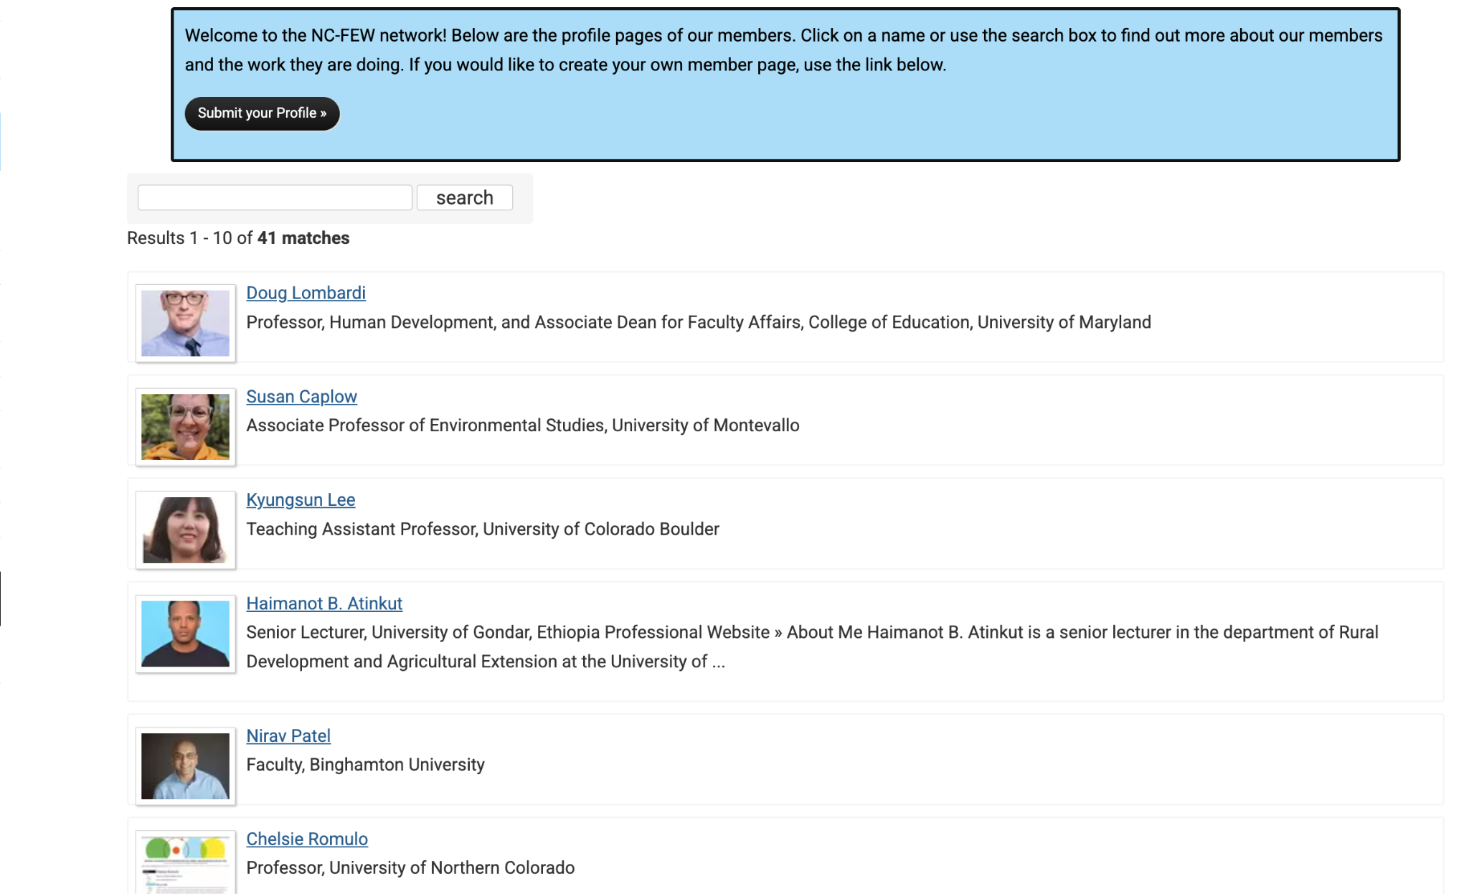
Member Profiles

Slide 19
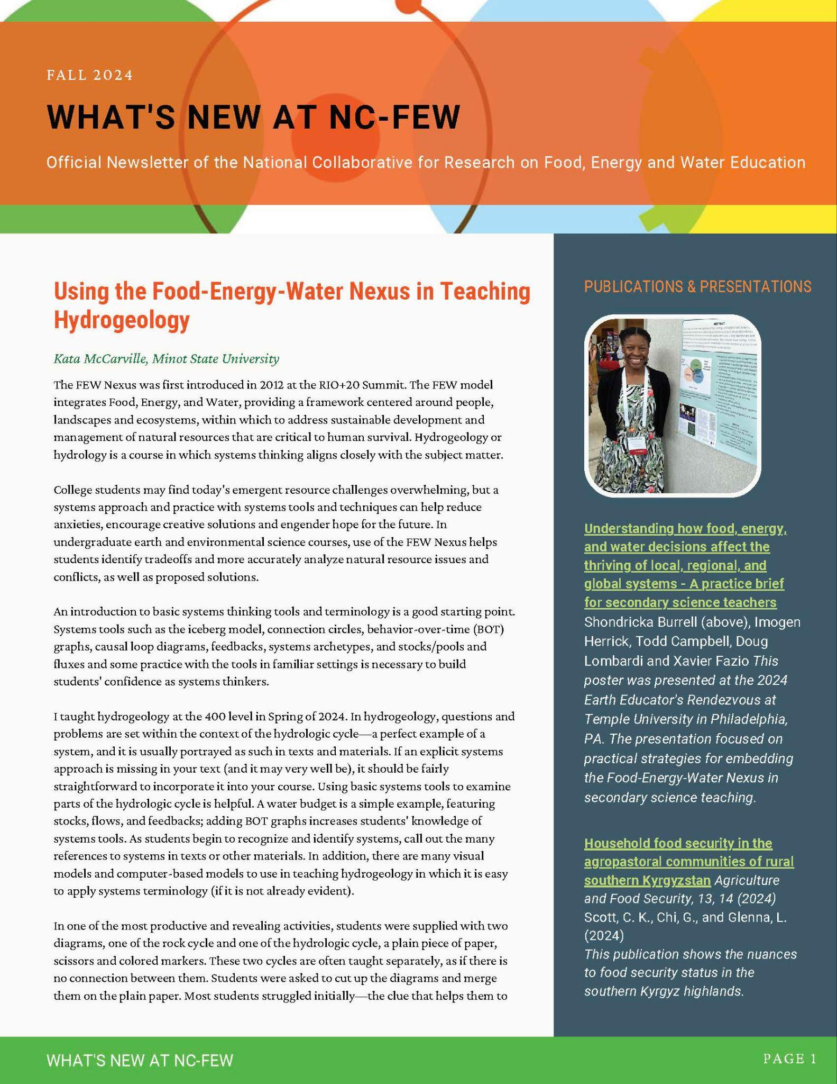

Newsletters (with feature articles)

Slide 20
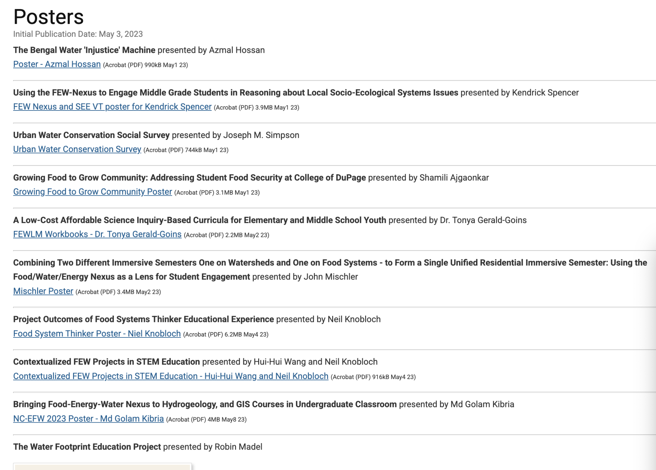
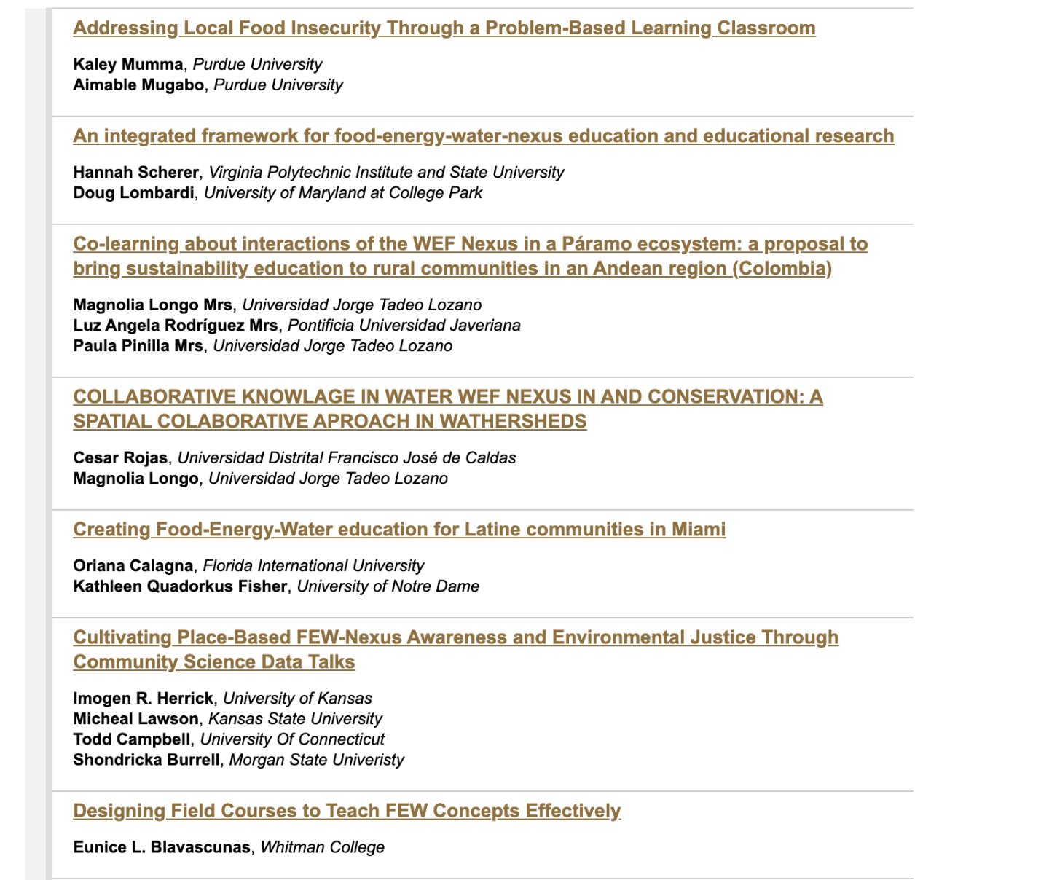
2025 Conference Proceedings
2023 Conference Posters

Slide 21
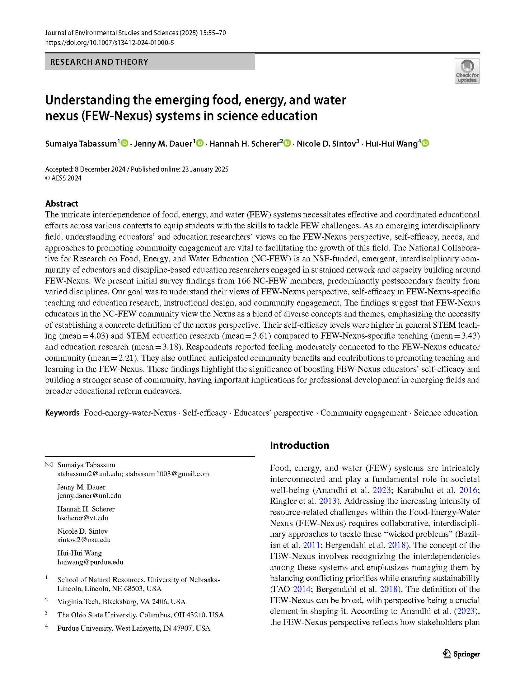
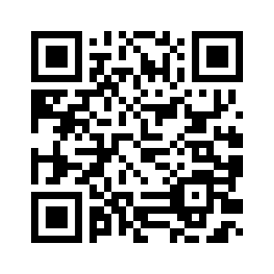
Understanding the emerging food, energy, and water nexus (FEW-Nexus) systems in science education
Tabassum, S., Dauer, J., Scherer, H. H., Sintov, N., & Wang, H.-H. (2025). Understanding the emerging food, energy, and water nexus (FEW-Nexus) systems in science education. Journal of Environmental Studies and Sciences, 15, 55-70. https://doi.org/10.1007/s13412-024-01000-5

Slide 22
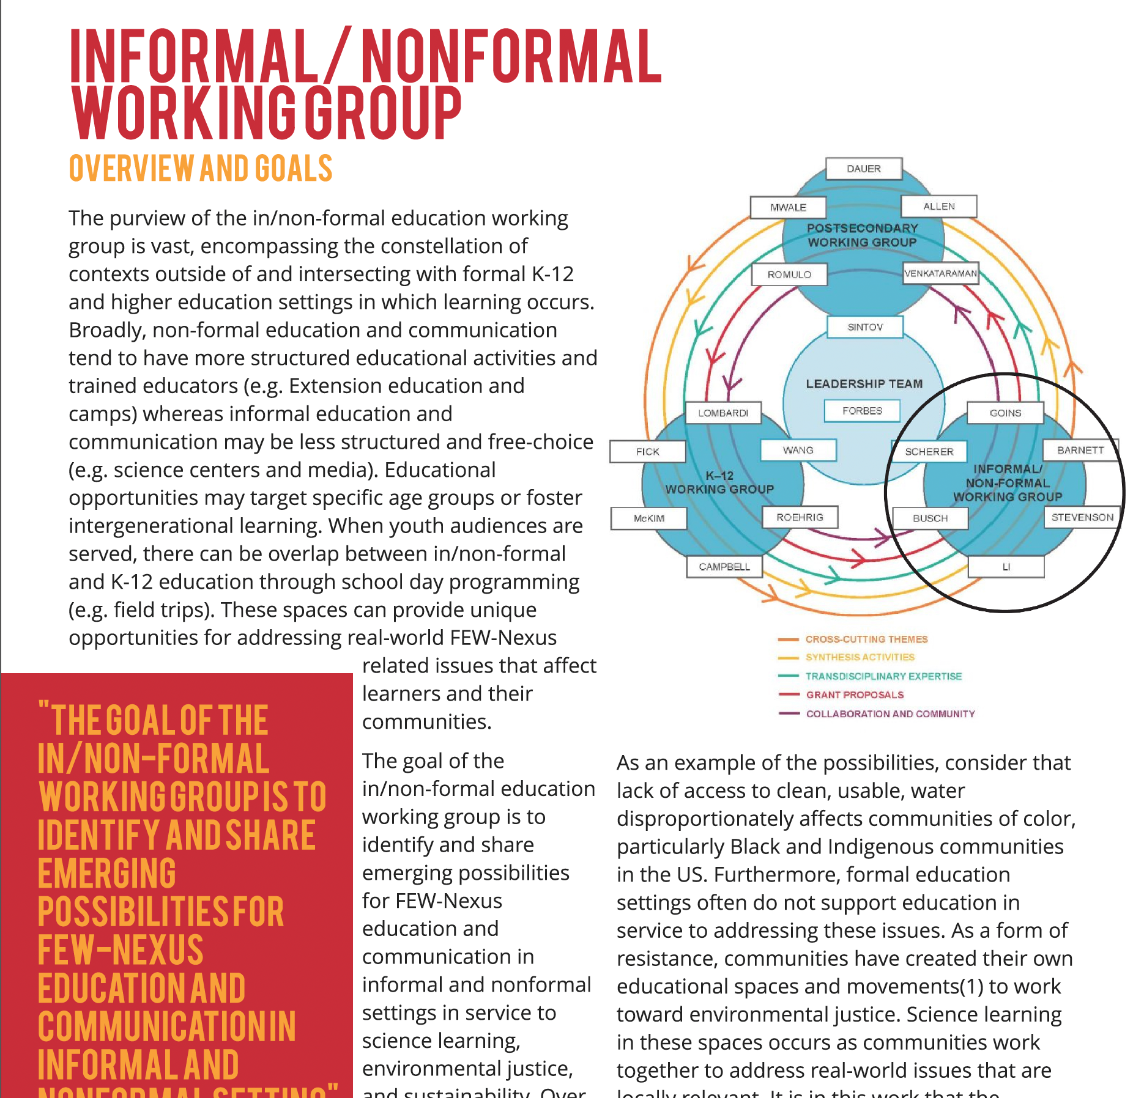
Informal/Non Formal Working Group
Broad purview, difficult to put boundary, varied educational opportunities
  Working group had multiple discussions putting a boundary and understand the applications
Conference presentation and newsletter
Working Manuscript: Defining FEW Nexus in Informal/Nonformal Education - Applications from Diverse Contexts

Slide 23
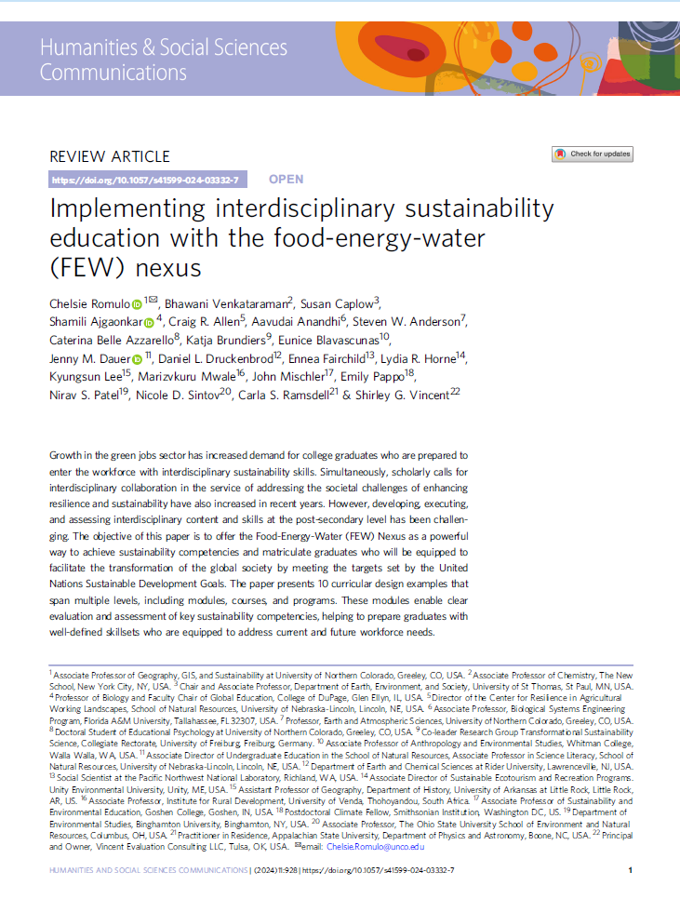
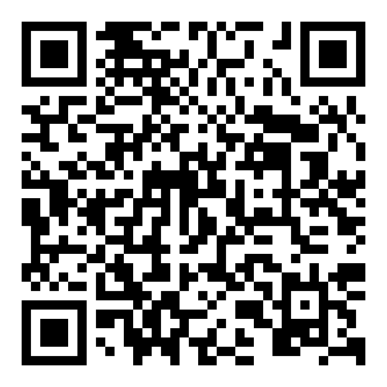
Postsecondary Working Group
Manuscript Ideas
FEW Ways of Knowing
Writing Interdisciplinary Mega Papers Together
International Case Study Collection
Managing multiple interdisciplinary environmental programs at the same institution
https://www.nature.com/articles/s41599-024-03332-7
Get this paper

Slide 24
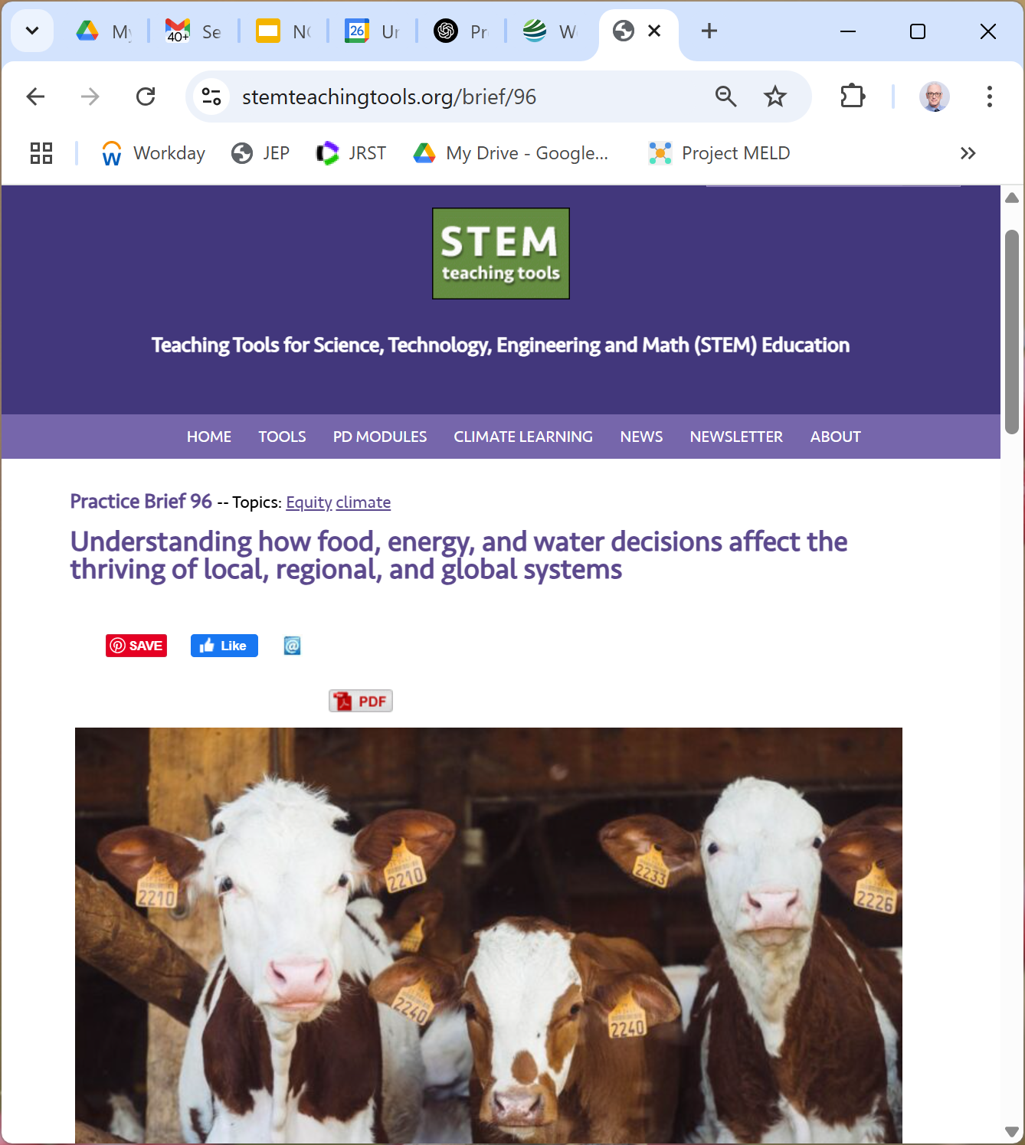
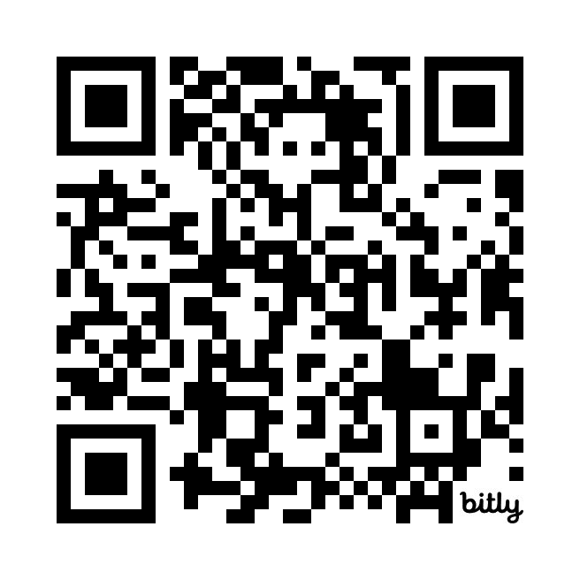
PK12 Working Group: K12 Practice Brief

Slide 25
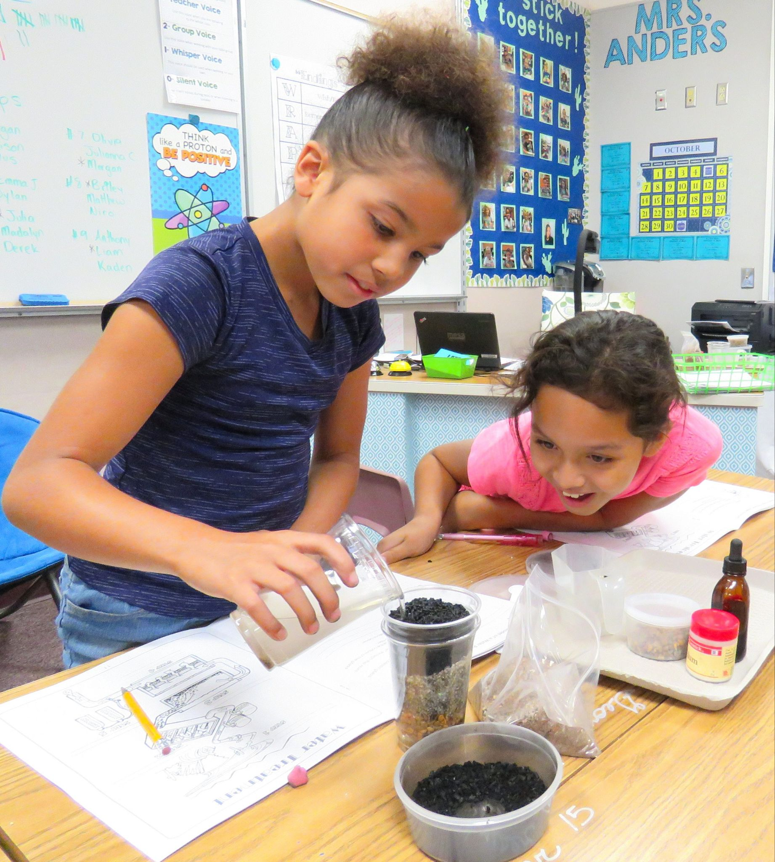
PK12 Working Group: Community Science Data Talks (CSDTs) Project
Led by Imogen Herrick (KU), Shondricka Burrell (MSU), and Todd Campbell (UConn), with the help of 6 graduate students: 2 (KU), 3 (MSU) & 1 (UConn)
Empirical research on engagement in teaching and learning about local FEW-Nexus challenges using community-centered data stories
CSDTs developed and piloted across 3 regions:
  Urban Heat Islands (MSU)
  Local Well Water (UConn)
  Land Use & Prairie Ecosystems (KU)

Slide 26
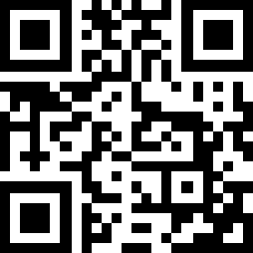
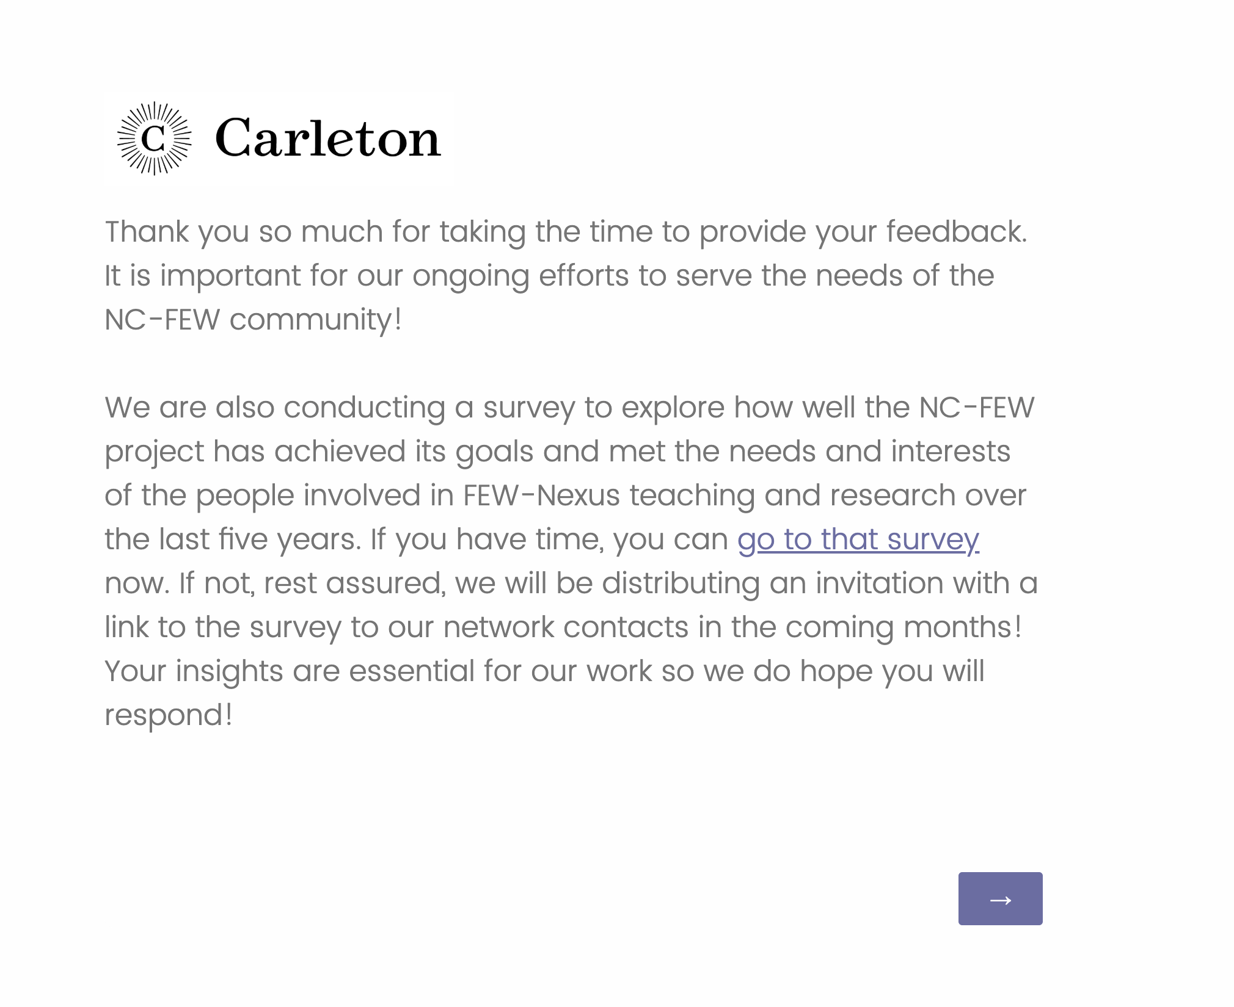
End of Project survey
https://tinyurl.com/ncfewsurvey
Notes:
https://survey.research.carleton.edu/jfe/form/SV_cHoc3INwVFKURme

